Slide 1
Data Infrastructure for Streaming Data Analytics

Slide 2



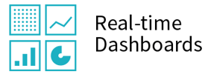




Stream Processors
Data Ingestion, Transformation
And Analytics
Real-time dashboards (BI)
Pre-written code to process streaming images. It assumed that the exactly-one semantic is applied and the image type can be obtained here.
Cloud Pub: Ingest and distribute data reliably
Number of Images
Type of Images
Number and types of images by different customer groups
Cloud Dataflow: Fast, simple, correct computations
BigQuery: Store data in data warehouse and data transformation
Streaming Data Source
a) Images uploaded by customers
b) Stream of Image data from Kafka Stream
(CustomerID reflected as NULL)
Data Storage and Archival Management
Cloud BigTable: Use of Garbage collection to remove data more than 7 days old to keep cost low

Slide 3
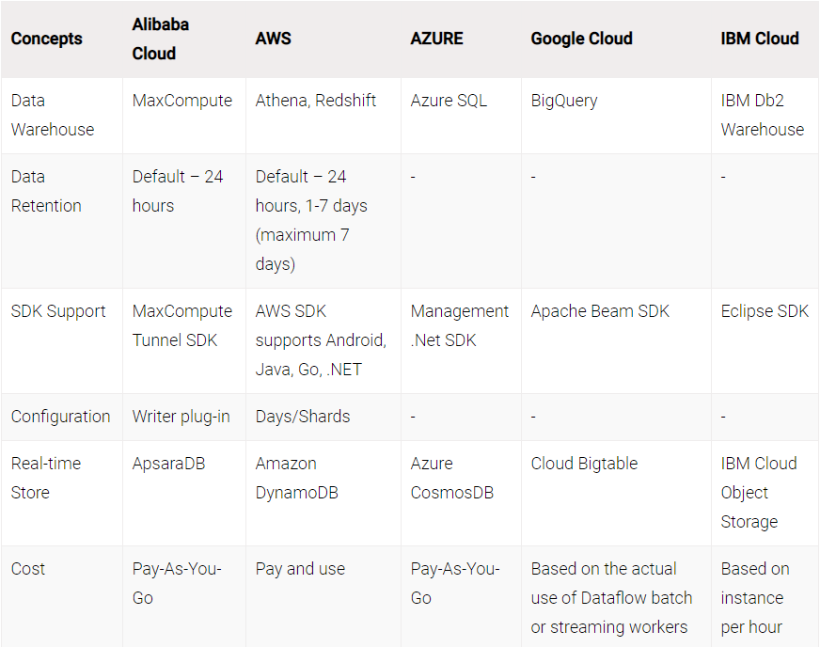
Requirements and Streaming Data Cloud Services Comparison
Able to support data from web application and Kafka Stream (based on Java and Scala)
Able to set data retention to be more than 7 days (AWS does not meet the requirement)
Source: https://wire19.com/streaming-data-services-comparison-alibaba-cloud-aws-azure-google-cloud-ibm-cloud/

Slide 4
Additional Research Required
Ability to support data from web applications and Kafka Stream (based on Java and Scala)

Slide 5
References
https://www.youtube.com/watch?v=DFtaavorJXY
https://www.upsolver.com/blog/streaming-data-architecture-key-components
https://wire19.com/streaming-data-services-comparison-alibaba-cloud-aws-azure-google-cloud-ibm-cloud/
https://analyticsindiamag.com/top-7-data-streaming-tools-for-real-time-analytics/
https://www.techradar.com/sg/best/best-cloud-analytics

