Slide 1
Real-Time Meteorological Diagnosis of the 2026 ENSO/FEP Event
Purpose
Apply the 2023/24 ocean-strong / atmosphere-weak logic to the ongoing 2026 event, and test whether the atmospheric branch is catching up.
From the 2023/24 decoupling problem: SST leads, wind and pressure recover with lag, rainfall and convection remain uneven
Current-data update
ERA5 + OISST + GPCP + OLR
Yue Dai | 22 June 2026

Slide 2
From the 2023/24 Question to a 2026 Real-Time Test
Starting point
Why 2026 matters
Peng et al. (2025) argues that the 2023/24 strong El Nino was generated primarily by ocean dynamics. The follow-up question for this project is why strong SST anomalies did not produce equally strong wind, pressure, rainfall, and teleconnection responses.
The ongoing 2026 case provides a real-time comparison: after far-eastern/eastern Pacific SST warming begins, do low-level winds, sea-level pressure, rainfall, and convection respond at the same time? ERA5 indicates that wind and pressure begin to recover in spring, while rainfall and convection remain the slowest branch.
Slide 2 | research logic
ENSO/FEP 2026 diagnostic

Slide 3
Data Chain and Abbreviations
Abbrev. | Meaning | Use in this deck
ENSO | El Nino-Southern Oscillation | Air-sea coupling background in the tropical Pacific
FEP | Far Eastern Pacific | Coastal eastern-Pacific early-warming region
SST | Sea surface temperature | OISST-based ocean-warming anomaly
u10 / u850 | Zonal wind at 10 m / 850 hPa | Positive: westerly anomaly; negative: easterly anomaly
MSLP | Mean sea-level pressure | Used for SOI-like Tahiti-Darwin pressure contrast
OLR | Outgoing longwave radiation | Negative: stronger deep convection; positive: suppressed convection
omega850 | Vertical pressure velocity at 850 hPa | Positive: downward motion; negative: upward motion
Anomaly definition
2026 anomaly = 2026 monthly or period mean minus the 1982-2022 same-month climatology. MAM means March-May; Apr-May means April-May. Full AMJ requires the June 2026 monthly mean.
Slide 3 | data note
ENSO/FEP 2026 diagnostic

Slide 4
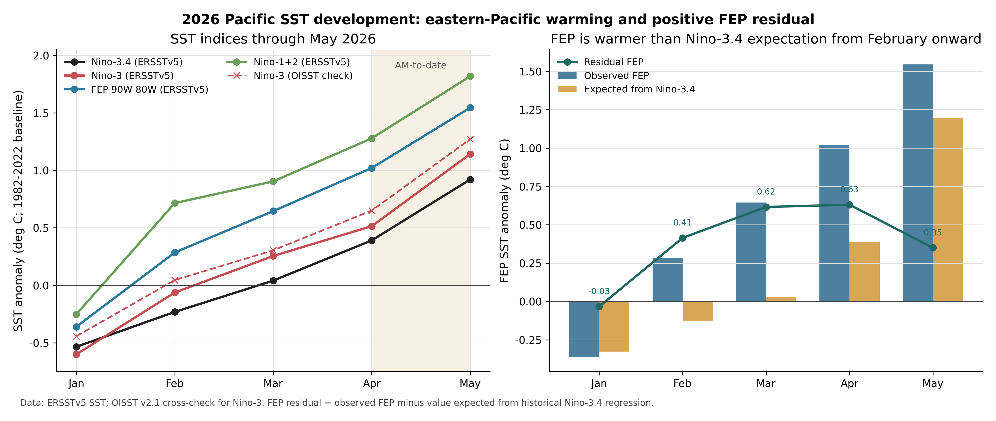
Ocean Branch: FEP and Eastern Pacific Warm First
What the figure shows
Dataset: NOAA OISST v2.1 monthly SST anomaly.
Key reading: after February 2026, FEP and Niño1+2 warming intensifies rapidly. A positive FEP residual means coastal eastern-Pacific warming is stronger than the broader tropical-Pacific background.
Role in the story: first establish that the ocean branch moved, then test whether the atmosphere responded synchronously.
Slide 4 | Figure: OISST indices and FEP residual
ENSO/FEP 2026 diagnostic

Slide 5
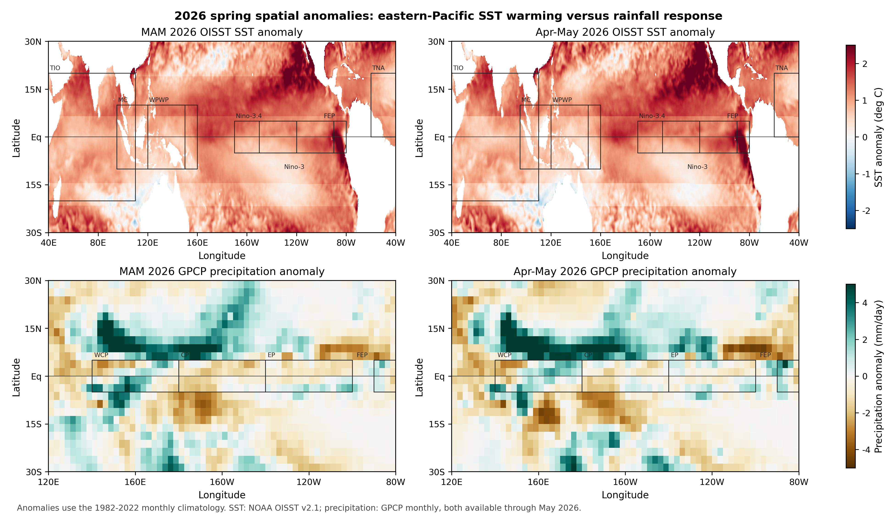
SST and Rainfall: Warming Is Clear, Equatorial Rainfall Is Not
What the figure shows
Datasets: OISST SST anomaly and GPCP monthly precipitation anomaly.
Key reading: MAM and Apr-May show clear eastern-Pacific/FEP warming, but the rainfall enhancement is displaced toward the western Pacific and north of the equator. A continuous positive equatorial central-eastern Pacific rainfall band is absent.
New contribution: transfer the 2023/24 SST-rainfall asynchrony question to a real-time 2026 case.
Slide 5 | Figure: OISST SST + GPCP rainfall
ENSO/FEP 2026 diagnostic

Slide 6
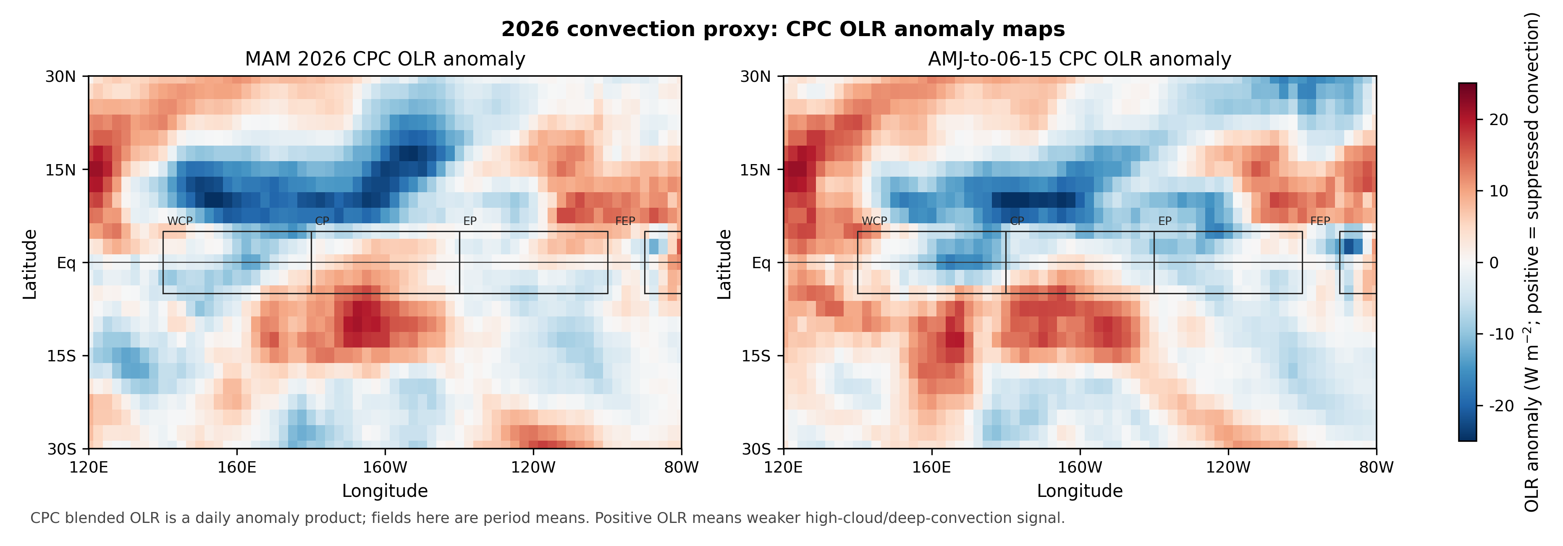
Independent Convection Check: OLR Supports Spatial Displacement
What the figure shows
Dataset: CPC Blended OLR daily anomaly averaged over selected periods.
Key reading: negative OLR means stronger deep convection; positive OLR means suppressed convection. In spring 2026, enhanced convection is displaced toward the western/northern central Pacific rather than forming a broad equatorial central-eastern Pacific signal.
Role: this gives an independent check on the rainfall conclusion.
Slide 6 | Figure: CPC Blended OLR anomaly
ENSO/FEP 2026 diagnostic

Slide 7
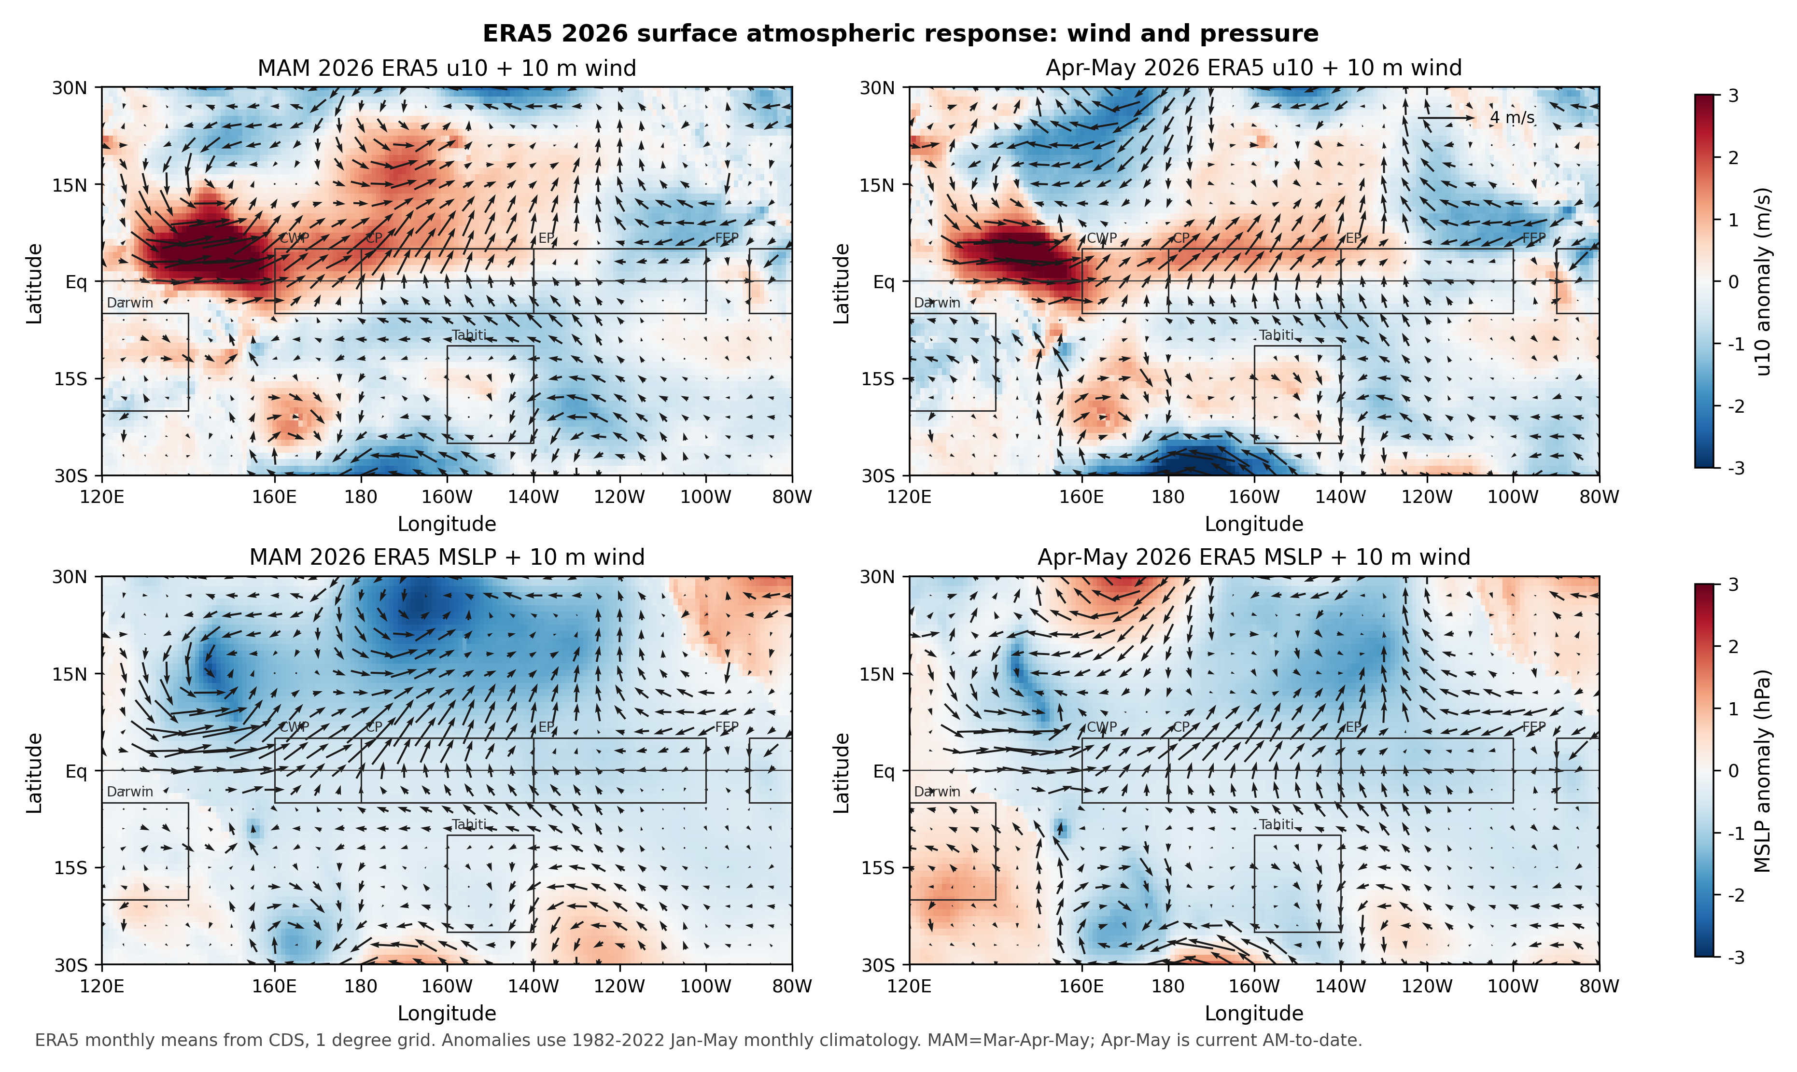
ERA5 Wind-Pressure Evidence: Spring Recovery Begins
What the figure shows
Datasets: ERA5 10 m wind anomaly and mean sea-level pressure anomaly.
Key reading: in MAM and Apr-May, westerly anomalies emerge over the central-western equatorial Pacific, and pressure lowers over the central-eastern tropical Pacific. The Tahiti-Darwin contrast becomes more El Nino-like.
Update from the older view: NCEP only covered Jan-Feb, so it showed early asynchrony. ERA5 Jan-May indicates lagged recovery rather than persistent non-response.
Slide 7 | Figure: ERA5 10 m wind and MSLP
ENSO/FEP 2026 diagnostic

Slide 8
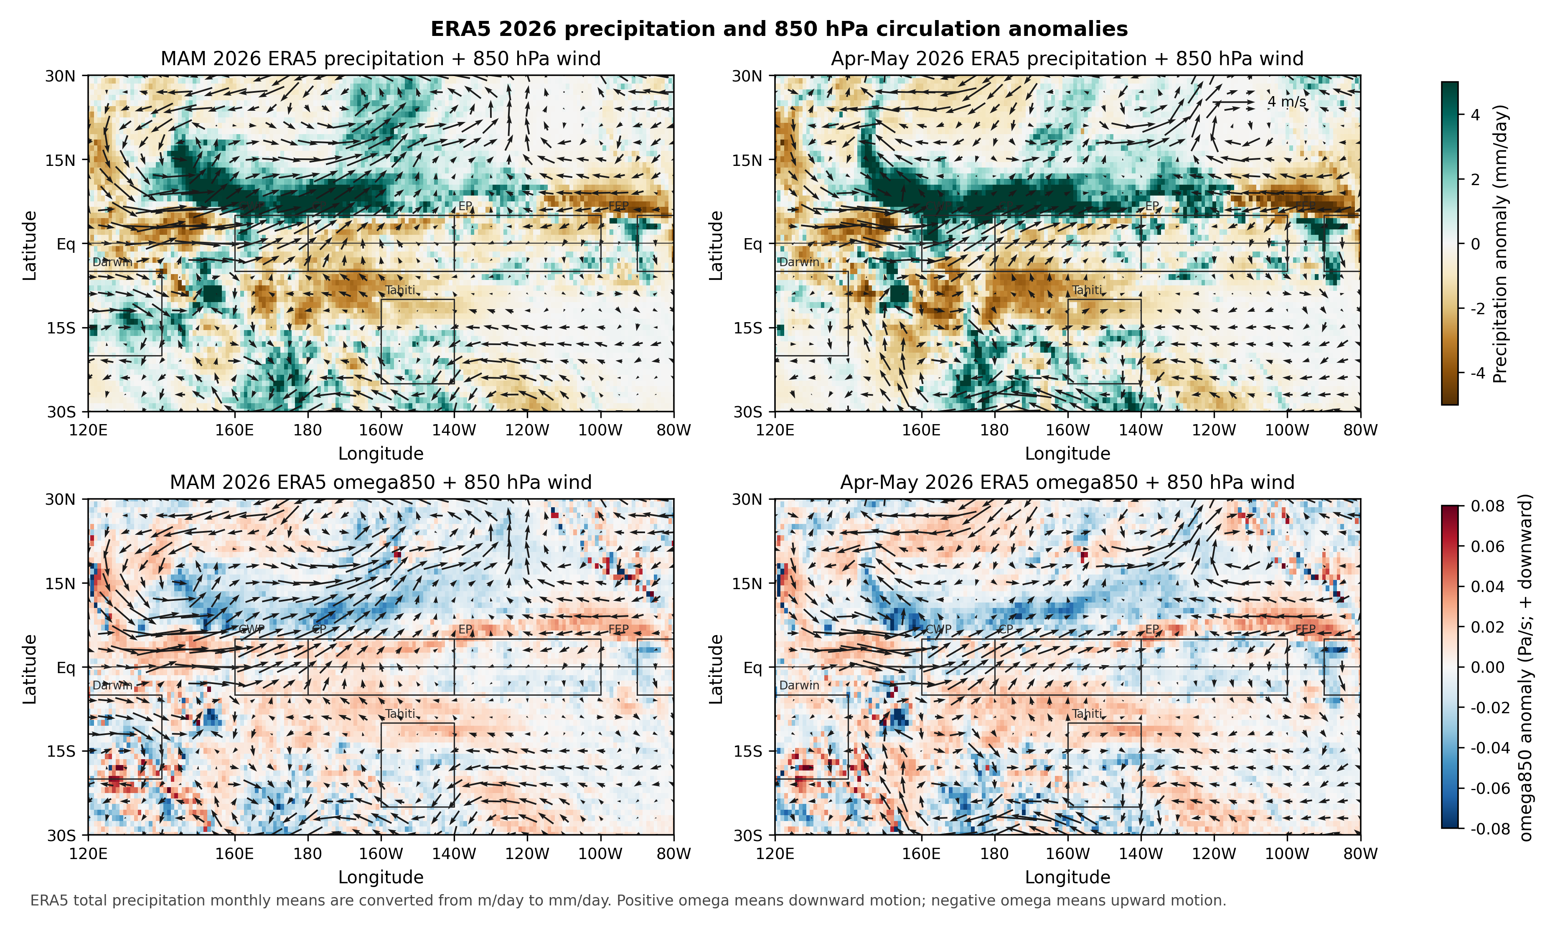
ERA5 u850, Rainfall, and Vertical Motion: Recovery Is Not Synchronous
What the figure shows
Datasets: ERA5 total precipitation, 850 hPa zonal wind, and 850 hPa pressure velocity.
Key reading: u850 turns westerly in MAM/Apr-May, indicating that the low-level wind branch is catching up. However, rainfall remains displaced westward/northward, and central-Pacific omega850 does not show a stable strong upward-motion response.
Main conclusion: the wind-pressure branch recovers before the rainfall-convection branch.
Slide 8 | Figure: ERA5 rainfall, u850, omega850
ENSO/FEP 2026 diagnostic

Slide 9
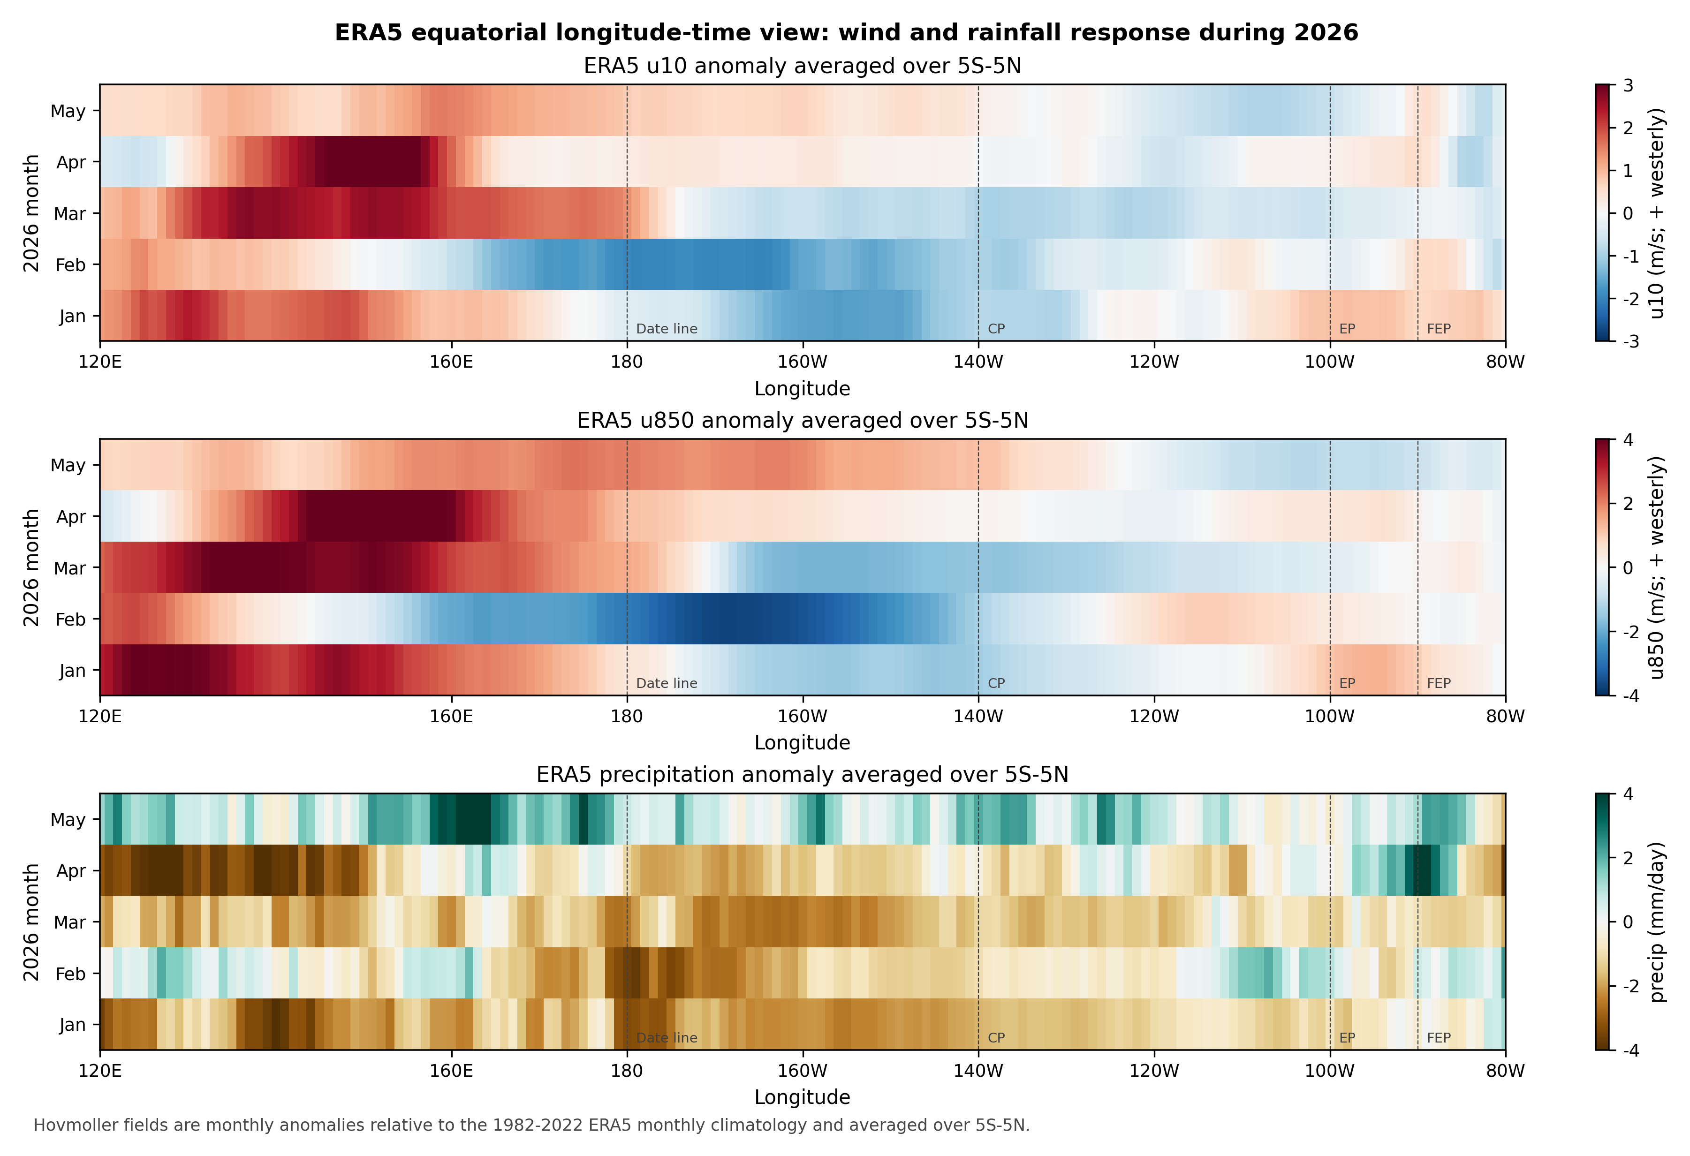
Longitude-Time View: Early Easterlies, Spring Wind Recovery, Rainfall Lag
What the figure shows
Datasets: ERA5 equatorial-mean u10, u850, precipitation, and omega850 anomalies.
Key reading: January-February shows clear central-Pacific easterly anomalies. From March to May, central-western Pacific winds gradually turn westerly. Rainfall remains broadly weak from January to April and becomes more locally positive only in May.
This is the most direct evidence for staged recovery rather than all-season decoupling.
Slide 9 | Figure: ERA5 equatorial Hovmoller
ENSO/FEP 2026 diagnostic

Slide 10
Key Numbers: 2026 Shows Staged Coupling Recovery
Period | Metric | Anomaly | Interpretation
Jan | Central-Pacific u10 | -1.15 m/s | Early easterlies; not the canonical El Nino westerly response
Feb | Central-Pacific u850 | -2.95 m/s | Strong lower-tropospheric easterly anomaly
Feb | SOI-like MSLP | +2.63 hPa | Pressure gradient remains La Nina-like
MAM | CWP u850 | +0.98 m/s | Spring low-level wind begins to recover westerly
MAM | Central-Pacific rainfall | -0.87 mm/day | Rainfall remains below climatology
Apr-May | CWP u850 | +1.47 m/s | Wind recovery becomes clearer
Apr-May | SOI-like MSLP | -1.16 hPa | Pressure branch shifts toward El Nino-like
Apr-May | Central-Pacific rainfall | -0.26 mm/day | Rainfall approaches recovery but is not strongly positive
One-sentence takeaway
Takeaway: SST/FEP leads; Jan-Feb wind-pressure and rainfall are asynchronous; Mar-May wind-pressure recovers; rainfall-convection lags.
Slide 10 | Table: ERA5 regional summary
ENSO/FEP 2026 diagnostic

Slide 11
What ERA5 Changes Compared with the Earlier Version
Earlier version
Current interpretation
Using OISST, GPCP, OLR, and NCEP data only through January-February, the earlier version could say that SST had begun warming while low-level wind, pressure, and rainfall had not responded synchronously. It could not determine whether the weak response persisted into spring.
With ERA5 through May, the conclusion becomes more nuanced: early asynchrony is real, but wind and pressure begin to recover toward an El Nino-like state in March-May. The most important branch to track next is rainfall, OLR, and vertical motion, which still show lagged, northward, or fragmented responses.
Slide 11 | stage assessment
ENSO/FEP 2026 diagnostic

Slide 12
Next Steps: Turn 2026 into a Same-Metric Comparison with 2023/24
• Wait for the June 2026 ERA5 monthly mean to construct formal AMJ 2026, rather than using MAM or Apr-May as proxies.
• Insert ERA5 wind-pressure diagnostics into the existing response-ratio / observed-vs-expected framework for direct 2023-versus-2026 comparison.
• Recalculate 2023/24 AMJ/JJA using the same ERA5 variables to avoid dataset-dependent interpretation.
• Add 200 hPa divergence or velocity potential to diagnose the upper branch of the Walker circulation.
• Keep both OLR and GPCP constraints to test whether convection/rainfall shifts from west/north displacement toward the equatorial central-eastern Pacific.
A concrete post-presentation work line
A working title could expand from “2023/24 strong El Nino air-sea decoupling” to “Asynchronous developing-season responses of SST, wind-pressure, rainfall, and the Walker circulation: a 2023/24 reproduction and 2026 real-time comparison.”
Slide 12 | next steps
ENSO/FEP 2026 diagnostic

Slide 13
Data Links and Local Files
Category | Dataset / file | Link or local path
ERA5 | Monthly single levels | https://cds.climate.copernicus.eu/datasets/reanalysis-era5-single-levels-monthly-means
ERA5 | Monthly pressure levels | https://cds.climate.copernicus.eu/datasets/reanalysis-era5-pressure-levels-monthly-means
SST | NOAA OISST v2.1 | https://www.ncei.noaa.gov/products/optimum-interpolation-sst
Rainfall | GPCP monthly precipitation | https://psl.noaa.gov/data/gridded/data.gpcp.html
Convection | CPC Blended OLR | https://psl.noaa.gov/data/gridded/data.cpc_blended_olr-1deg.html
Local report | ERA5 figure notes | reports/2026_ERA5再分析气象图说明.md
Local table | ERA5 regional summary | data/derived/research_2026/current_2026_era5_region_summary.csv
Note: all anomalies are relative to the 1982-2022 same-month climatology; full 2026 AMJ still requires the June monthly mean.
Slide 13 | source slide
ENSO/FEP 2026 diagnostic

