Slide 1
Enabling FPGA Remote Access in the Cloud with RDMA solution
Zhuangdi Zhu, Fei Chen, Michael R Hines, Salman A Baset and Yonghua Lin

Slide 2
Outline
Introduction
Background
Architecture Overview
Design and Implementation
Project Road Map

Slide 3



ZHU, ZHUANGDI 朱庄翟 (dí)
Introduction
2011.9-now Undergraduate Student
Nanjing University of Science and Technology
2014.10-now Admission to Master’s Degree
Nanjing University
2014.7-2014.12 Exchange Student (CSC Full Scholarship)
Australian National University
Previous Project: working with Michael Hines(IBM CRL), Salman Baset (IBM Watson) and Alex Liu (Michigan State Univ and Nanjing Univ) on A Measurement Study of RDMA Performance on Multi-tenant Environment - VMs and Containers

Slide 4
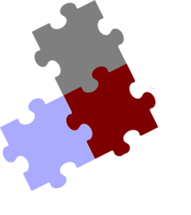
Introduction
Intern Project in IBM CRL
Proposed Topic: Utilizing RDMA to Enable FPGA Remote Access in the Cloud
High Performance Computing
FPGA
Virtualization
Cloud
High Performance Network
RDMA

Slide 5

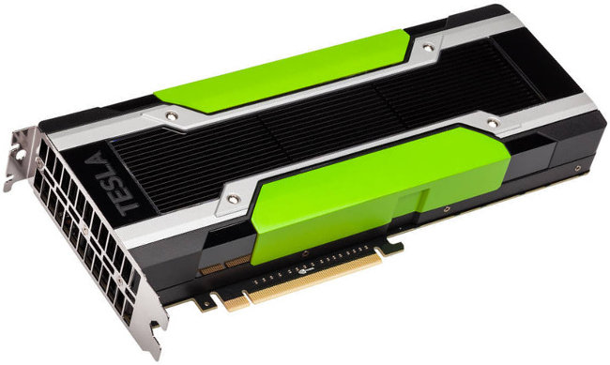
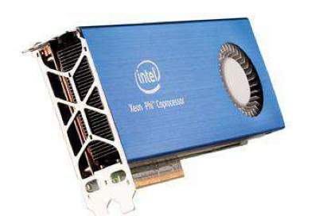
Background
Accelerator/FPGA
Heterogeneous computing (CPU + Accelerator) is becoming a trend in clusters
Accelerators
GPGPU
Xeon Phi
FPGA
FPGA hardware acceleration
Move bottleneck computations from software to FPGA
Performance and power saving
Intel Xeon Phi 7120X
Altera Stratus V FPGA
Nvidia Tesla GPU K80

Slide 6

Background
Existing work
App.
VM
Container
App.
App.
VM
VM
Container
Container
Fei Chen, etc. Enabling FPGAs in the cloud. IEEE CF’14

Slide 7

Existing Work
Background
Proposed Work
VM
VM
Client
Client
Client
Client
Client
Client
Virt-ACC
Virt-ACC
Virt-ACC
Virt-ACC
RDMA
FPGA
RDMA
FPGA
?
RDMA
RDMA
VM
VM
Virt-Remote-ACC
Client
Client
Client
Client
Client
Client

Slide 8
Challenges of enabling FPGA in the cloud
Background
Innovation Required
Proposed Solutions
FPGA resource abstraction
FPGA Local virtualization
Scalable acceleration fabric
RDMA solution
FPGA scheduling in cloud
Scheduling technology

Slide 9
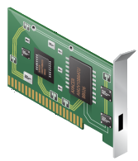
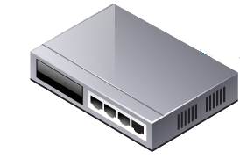
Background
What is RDMA
Buffers
Buffers
Application
RDMA provides high-throughput, low-latency networking:
Zero-copy
Kernel bypass
No CPU Involvement
Message based transaction
User
Sockets API
RDMA Verbs API
Kernel
Sockets
Buffers Headers
Kernel Bypass
TCP
IPv4/IPv6
Network Device
Device Driver
Three protocols
Infiniband(IB)
RDMA Over Converged Ethernet(RoCE)
Internet Wide Area RDMA Protocol(iWARP)
Host Channel Adapter
InfiniBand
iWARP
RoCE
InfiniBand Switch
Ethernet
Switch

Slide 10
Background
RDMA Programming
RDMA_CM Programming
RDMA Communication Manager
#include <rdma/rdma_cma.h>
Used to establish communication over RDMA transports.
rdma_xxxx and rdma data structure
IBVERBS Programming
libibverbs is an implementation of the RDMA verbs
#include <infiniband/verbs.h>
It handles the control path of creating, modifying, querying and destroying resources
ibv_xxxx and ibv data structure
App
App
Buf
Buf
OS
NIC
NIC
OS
switch

Slide 11
Design and Implementation
Architecture Overview
Classification
Transparent Accelerator Service Layer
Scheduler
Client(Application/VM/Container)
Communication
TCP/IP
Client <- - -> Service Layer
Service Layer <- - -> Scheduler
RDMA
RDMA HCA <- - -> RDMA HCA
DMA
FPGA<- - -> RDMA HCA
Application
VM
Container
Application
VM
Container
Transparent Accelerator Service Layer Transparent Accelerator Service Layer
RDMA
Scheduler
RDMA
FPGA

Slide 12
Design and Implementation
Scheduler Workflow ------ Connection Setup
Remote Access
Client<---> Service Layer
Service Layer< ---> Scheduler
Scheduler< --- > FPGA Usage
Local Access
Client <---> Service Layer
Service Layer< ---> Scheduler
Scheduler <--- > FPGA Usage
Client
Client
Scheduler
1
2
3
1
Transparent Accelerator Service Layer Transparent Accelerator Service Layer
2
RDMA
RDMA
FPGA
Remote Access
Remote Access
3
Client
2
1
3
Blue lines: remote access
Transparent Accelerator Service Layer
Orange lines: remote access
4
2
Green lines: local access
RDMA
FPGA
Local Access

Slide 13
Design and Implementation
Scheduler
Example
Scheduling Algorithm
First Come First Service
Priority Scheduling
Process | Burst Time | Arrival Time | Priority
P1 | 7 | 0.0 | 3
P2 | 4 | 2.0 | 2
P3 | 1 | 4.0 | 1
P4 | 4 | 5.0 | 2
First Come First Service Scheduling
p1
P2
P3
P4
0
7
11
12
16
Priority Scheduling
p1
P3
P2
P4

Slide 14
Design and Implementation
Computing Data Transfer
Local Client
DMA Transfer
Remote Client
RDMA Transfer
Client
Application
Scheduler
Transparent Accelerator Service Layer Transparent Accelerator Service Layer
RDMA
RDMA
FPGA
Remote Access
RDMA Data Transfer
Local Access
Application
DMA Transfer
RDMA Transfer
Transparent FPGA Service Layer
Blue lines: remote access
FPGA
RDMA
Orange lines: remote access
Remote Access
Green lines: local access

Slide 15
TCP/IP VS. RDMA
client
server
TCP/IP transfer
setup
transfer
setup
User
App
data
data
bind listen
accept
User
App
connect
send
copy
copy
recv
Kernel
Stack
data
data
HCA
HCA
Wire
Wire
client
server
RDMA transfer
setup
transfer
setup
User
App
rdma_
post_
send
data
data
rdma_bind
rdma_listen
rdma_accept
User
App
rdma_
post_
recv
rdma_
connect
copy
Kernel
Stack
Kernel
Stack
HCA
HCA
Wire
Wire
blue real lines: control information
dotted lines: user data
green lines: control and data

Slide 16
Process of Computing Data Transfer
Application
Buffer
HCA
Buffer
FPGA
Buffer
Ethernet/RDMA
FPGA
FPGA
RDMA
DMA Transfer
RDMA Transfer
with Two Copy
FPGA
Buffer
FPGA
Buffer
PCIe Bridge
RDMA
FPGA
RDMA
FPGA
RDMA
RDMA
RDMA Transfer
without Copy
RDMA Transfer
with One Copy

Slide 18
Project Road Map
1. Presentation
2. Code for RPC Client-Server Program
1. Code for RDMA Transfer
2. Skeleton of the Thesis
Entry
My timeline
Code for Schedulerrogram code
2. Finish my thesis
System Improvement
March 19th
April 10th
April 20th
May 31th
June 10th
Chei Fei and Michael’s
time line
RDMA Environment
Tuning
FPGA Global Sceduler API

Slide 20
Thank You

Slide 21
What is RDMA
Background
Your Application
Remote
data transfers between nodes in a network
Direct
no Operating System Kernel involvement in transfers
everything about a transfer offloaded onto Interface Card
Memory
transfers between user space application virtual memory
no extra copying or buffering
Access
send, receive, read, write, atomic operations
User Space
Command Channel
Socket Layer
uverbs
Kernel
Data Channel
TCP
UDP
IP
Kernel mod
Ethernet Driver
Adapter Driver
RDMA Enabled Channel Adapter Card

