Slide 1
Vehicular Ad Hoc Networks: A Survey
Zhuangdi Zhu

Slide 2
Outline
Introduction & Motivation
Research Fields
Questions & Challenges
Current/Future Works

Slide 3
Introduction & Motivation
What Is VANET ^{[1]}
An Variation of Mobile Ad Hoc Network(MANET)^{[2]}.
MANET
VANET/V2V
V2I
V2V
V2X
“Vehicle-to-Vehicle”, https://en.wikipedia.org/wiki/Vehicle-to-vehicle
“Mobile Ad Hoc Network”,https://en.wikipedia.org/wiki/Mobile_ad_hoc_network
Notes:
“Vehicle-to-Vehicle”, https://en.wikipedia.org/wiki/Vehicle-to-vehicle
“Mobile Ad Hoc Network”,https://en.wikipedia.org/wiki/Mobile_ad_hoc_network

Slide 4




Introduction & Motivation
The Status Quo of VANET
Nation/Area | USA | Europe | Japan/China
System Focus | V2V safety | V2I Mobility | V2V & V2I Safety & Mobility
Organization & Projects | PATH, ITS | C2C CC, SAFESPOT, FleetNet | ITS in Japan, CCSA in China
Notes:
“SAFESPOT,” www.safespot-eu.org
“ComprehensivePlanforITSinJapan”, www.mlit.go.jp/road/ITS/topindex/topindex_g06_2.html
“China ITS Industry Alliance”, http://www.c-its.org/
“Car 2 Car,” http://www.car-to-car.org
H. Hartenstein et al., “Position-Aware Ad Hoc Wireless Net- works for Inter-Vehicle Communications: The FleetNet Project,” MobiHoc ’01: Proc. 2nd ACM Int’l. Symp. Mobile Ad Hoc Net- working & Computing, New York: ACM Press, 2001, pp. 259–62.

Slide 5
Introduction & Motivation^{[1]}
Motivation
Safety
Mobility
Environment
http://www.its.dot.gov/factsheets/connected_vehicles_work.htm

Slide 6
Introduction & Motivation
VANET Features
Highly Dynamic Topology
Availability of Geographical Position
Predictability of Vehicle movements
Hard Delay Constraints
High Speed Movement
Intermittent Connection

Slide 7
Research Fields^{[1]}
I
Safety App
Comfort App
Application, Presentation, Session
Upper Layers
IEEE 1609.1
& Applications
Security
Transport Layer
Networking Services
Transport Layer Protocol
Routing Protocols
Mobility Model & Simulation
IEEE 1609.3
Network Layer
QoS
Data Link Layer
IEEE 1802.2
LLC SubLayer
IEEE 1609.4
MAC Layer Issue
MAC SubLayer
IEEE 1802.11
Physical Layer
IEEE 802.11 P
Physical Layer
Physical Layer Issue
OSI Model
WAVE Model
1. Karagiannis G: A survey and tutorial on requirements, architectures, challenges, standards and solutions[J]. Communications Surveys & Tutorials, IEEE, 2011, 13(4): 584-616.
Notes:
Karagiannis G, Altintas O, Ekici E, et al. Vehicular networking: A survey and tutorial on requirements, architectures, challenges, standards and solutions[J]. Communications Surveys & Tutorials, IEEE, 2011, 13(4): 584-616.

Slide 8
Research Fields
Upper Layers:
Safety applications^{[1]}
Event Based
Notify emergency messages
Broadcast scheme
Comfort Applications
Awareness based
Internet connectivity
Peer-to-peer communication
Unicast or multicast schemes
Upper Layers
Networking Services
MAC Layer
Physical Layer
J. Harding et al., “Vehicle-to-vehicle communications: Readiness of V2V technology for application,” Nat. Highway Traffic Safety Admin., Washington, DC, USA, Tech. Rep. DOT HS 812 014, Aug. 2014.
Notes:
J. Harding et al., “Vehicle-to-vehicle communications: Readiness of V2V technology for application,” Nat. Highway Traffic Safety Admin., Washington, DC, USA, Tech. Rep. DOT HS 812 014, Aug. 2014.

Slide 9
Music/Map Downloading
Back-seat Games
Navigation
Comfort Applications
Electronic Toll Collection
Emergency Brake Warning
Forward Collision Warning
Intersection Movement Assist
Blind Spot and Lane Change Warning
Do not Pass Warning
Safety Applications

Slide 10
Research Fields
Upper Layers:
The Status Quo and Feature Trends
Research Issue | Target | Current Status | Main Approach | Future Trends
Safety Application | Reduce Collision of Data Transmission from upper layers | Control Channel load | 1. Estimation based beacon dissemination 2. Application layer scheduling: SDMA | Adaptive application level scheduling Dynamic transmission interval control
Yousefi S, Fathy M, Bastani S. Vehicular Ad Hoc Networks: Current Issues and Future Challenges[J]. Mobile Ad Hoc Networks: Current Status and Future Trends, 2011: 329-377.

Slide 11
Research Fields
Networking Services
Transport Layer Protocols
Upper Layers
Transport Layer Protocols
Routing Protocols
Mobility Model & Simulation
Networking Services
Proactive & Reactive^{[17]}
MAC Layer
Physical Layer

Slide 12
Research Fields
Networking Services
Transport Layer Protocols
Transport Layer Protocols | Features | Limitations in case of VANET
TCP | Handshake ACK | Handshake is time consuming ACK leads to collision Confused between failure and congestion
UDP | Best effort | Not reliable
Application Type | Current States | Feature Trend
Safety | UDP | UDP+ application layer reliability support
Comfort | Customized version of TCP | Customized version of TCP UDP + FEC tecniques

Slide 13
Research Fields
Networking Services
Routing Protocols
Upper Layers
Transport Layer Protocols
Routing Protocols
Mobility Model & Simulation
Networking Services
Proactive & Reactive^{[17]}
MAC Layer
Physical Layer

Slide 14
Research Fields
Networking Services
Routing Protocols:
Transmission strategies based classification
Routing Protocols
Unicasting
Multicasting
Broadcasting
Routing Information based classification
Routing Protocols
Topology based
Position based

Slide 15
Research Fields
Networking Services
Routing Protocols:
Broadcast^{[1]}
Broadcasting Type | Characteristics | Advantages | Disadvantages
Multi-hop | Smart flooding Probability/ delay based | Low latency No need for large storage space | Broadcast storm No persistency
Single-hop | Periodic broadcast Vary broadcast interval Rely on node mobility | Persistency No broadcast storm | Slow Large storage space
Panichpapiboon S. A review of information dissemination protocols for vehicular ad hoc networks[J]. Communications Surveys & Tutorials, IEEE, 2012, 14(3): 784-798.
Notes:
Panichpapiboon S, Pattara-Atikom W. A review of information dissemination protocols for vehicular ad hoc networks[J]. Communications Surveys & Tutorials, IEEE, 2012, 14(3): 784-798.

Slide 16
Research Fields
Networking Services
Routing Protocols:
Broadcast
Broadcasting
Multi-hop
Single-hop
Delay
Probabilistic
Network Coding
Fixed Broadcast Interval
Adaptive Broadcast Interval
UMB
SB
EDB
…
Weighted
p-persistence
OAPB
AutoCast
…
CODEB
EBCD
DifCode
…
TrafficInfo
TrafficView
…
CRCP
Abiding Geocast
SODAD
…
Notes:
Panichpapiboon S, Pattara-Atikom W. A review of information dissemination protocols for vehicular ad hoc networks[J]. Communications Surveys & Tutorials, IEEE, 2012, 14(3): 784-798.
UMB: Urban multi-hop broadcast: broadcast + hidden node + reliability
SB: Smart broadcast
EDB: Efficient Directional Broadcast
OAPB: Optimized adaptive probabilistic broadcast
CPCR: Collision ratio Control Protocol: change broadcast interval based on number of packet collision

Slide 17
Research Fields
Networking Services
Routing Protocols:
Multicast^{[1]}
Multicast Routing
Tree Based
Mesh Based
Group Forwarding Based
Core Based
MAODV
AMRoute
ODMRP
CAMP
CTB
AMRIS
ODMRP
Patel B, Shah K. A Survey on Vehicular Ad hoc Networks[J]. IOSR Journal of Computer Engineering (IOSR-JCE) Vol, 2013, 15: 34-42.
Notes:
Patel B, Shah K. A Survey on Vehicular Ad hoc Networks[J]. IOSR Journal of Computer Engineering (IOSR-JCE) Vol, 2013, 15: 34-42.

Slide 18
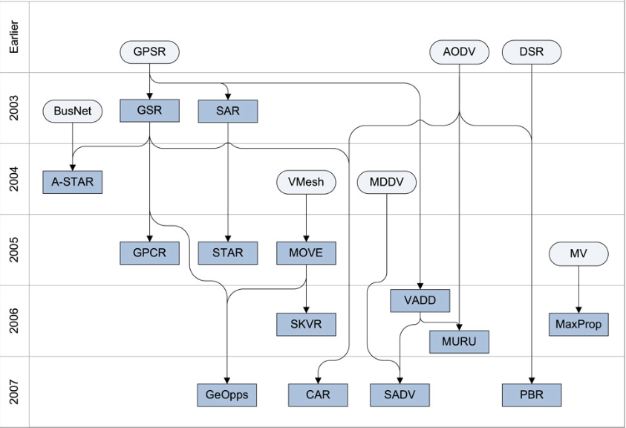
Research Fields
Networking Services
Routing Protocols
Unicast^{[1]}
J. Bernsen and D. Manivannan, “Unicast routing protocols for vehicular ad hoc networks: A critical comparison and classification,” Pervasive and Mobile Computing, vol. 5, no. 1, pp. 1–18, Feb. 2009.
Notes:
1. J. Bernsen and D. Manivannan, “Unicast routing protocols for vehicular ad hoc networks: A critical comparison and classification,” Pervasive and Mobile Computing, vol. 5, no. 1, pp. 1–18, Feb. 2009.

Slide 19
Research Fields
Internal Layers
Routing Protocols:
From applications point of view
Routing Protocols
For Comfort Applications
Unicasting
Multicasting
For Safety Applications
Broadcasting

Slide 20
Research Fields
Networking Services
Routing Protocols: Transmission strategies based classification
Transmission Strategies |  | Communication Type | Example | Advantages | Disadvantages
Unicasting |  | One-to-one | AODV, DSR, GPSR | Less network Overhead More privacy | Less reliable Link maintenance
Broadcasting |  | One-to-all inside broadcast domain | BROADCOMM, DV-CAST | Reliable | Bandwidth Collision & congestion
Multicasting | Geocast | One-to-X, using geographic address | Mobicast, ROVER, ZOR | Efficient routing Less network consumption | bandwidth
 | Cluster | Cluster + head | COIN, CBDRP | Less packet delivery | Dividing group Select head
Notes:
1. Patel B, Shah K. A Survey on Vehicular Ad hoc Networks[J]. IOSR Journal of ComputerEngineering (IOSR-JCE) Vol, 2013, 15: 34-42.

Slide 21
Research Fields
Networking Services
Routing Protocols
Routing Information based classification^{[1]}
Routing Protocols
Topology Based Protocols
Proactive
Reactive
Hybrid
Position Based Protocols
FSR
DSDV
OLSR
AODV^{[2]}
DSR
…
ZRP
…
1. Marwa Altayeb, Imad Mahgoub, “ A Survey of Vehicular Ad hoc Networks Routing Protocols,” ISSR Journals, 2013, Vol. 3, No. 3, pp. 829-846.
2. Perkins, C. E. And Royer, E. M. (1999), “Ad-Hoc On-Demand Distance Vector Routing,” Proc. IEEE WMCSA ‟99, New Orleans, LA, Feb. 1999 ,pp. 90-100.
Notes:
1. Marwa Altayeb, Imad Mahgoub, “ A Survey of Vehicular Ad hoc Networks Routing Protocols,” ISSR Journals, 2013, Vol. 3, No. 3, pp. 829-846.
2. Perkins, C. E. And Royer, E. M. (1999), “Ad-Hoc On-Demand Distance Vector Routing,” Proc. IEEE WMCSA ‟99, New Orleans, LA, Feb. 1999 ,pp. 90-100.

Slide 22
Research Fields
Networking Services
Routing Protocols
Routing Information based classification
Routing Protocols
Topology Based Protocols
Position Based Protocols
DTN/non-DTN
Beacon/non-Beacon
Overlay/non-overlay
Vehicular Assisted Data Delivery
Geographical Opportunistic Routing
Greedy Perimeter Stateless Routing
Yousefi S, Fathy M, Bastani S. Vehicular Ad Hoc Networks: Current Issues and Future Challenges[J]. Mobile Ad Hoc Networks: Current Status and Future Trends, 2011: 329-377.
Notes:
1. Marwa Altayeb, Imad Mahgoub, “ A Survey of Vehicular Ad hoc Networks Routing Protocols,” ISSR Journals, 2013, Vol. 3, No. 3, pp. 829-846.
2. Perkins, C. E. And Royer, E. M. (1999), “Ad-Hoc On-Demand Distance Vector Routing,” Proc. IEEE WMCSA ‟99, New Orleans, LA, Feb. 1999 ,pp. 90-100.
3. Vehicular Ad Hoc Networks: Current Issues and Future Challenges

Slide 23
Research Fields
Networking Services
Routing Protocols
Routing Protocols
Topology Based Protocols
Position Based Protocols
Classified by forwarding/recovery strategies
Forwarding Strategies^{[1]}
Recovery Strategies^{[2]}
Greedy Forwarding
Improved Greedy Forwarding
Direction Greedy Forwarding
Predictive Directional Greedy
Right-hand rule
Carry-and-forward
Path-recalculation
Sardar Muhammad Bilal, Carlos Jesus Bernardos, Carmen Guerrero; Position-based routing in vehicular networks: A survey; Journal of Network and Computer Applications 36(2013) 685-697.
Fonseca A,Vazao T. Applicability of position-based routing for VANET in highways and urban environment. Journal of Network
and Computer Applications JNCA1084-8045 2009.

Slide 24
Research Fields
Networking Services
Routing Protocols
Main Challenges: Connectivity & Interference & Delay
Related Issues | Application Type | Current Status | Limitations | Future Trends
Non-broadcast scheme | Comfort Application | Position based Greedy forwarding Routing Recovery | No consideration on connectivity Collision delay | Hybrid DTN and non-DTN routing Connectivity & Interference aware routing Geographic-opportunistic routing schemes
Broadcast scheme | Safety Application | Geographical Restricted Priority /probability | Broadcast Storm Delay & Collision Scalability | Interference aware broadcast • Broadcast adaption based on application needs
Notes:
Sardar Muhammad Bilal, Carlos Jesus Bernardos, Carmen Guerrero; Position-based routing in vehicular networks: A survey; Journal of Network and Computer Applications 36(2013) 685-697.
Fonseca A,Vazao T. Applicability of position-based routing for VANET in highways and urban environment. Journal of Network
and Computer Applications JNCA1084-8045 2009.

Slide 25
Research Fields
Networking Services
Mobility Model & Simulation
Upper Layers
Routing Protocols
QoS Support
Mobility Model & Simulation
Networking Services
MAC Layer
Physical Layer

Slide 26
Research Fields
Networking Services
Mobility Model & Simulation^{[1]}
Traffic Simulator
Network
Simulator
Traffic Simulator
Network
Simulator
Vehicular Trace
Generation
Communication Generation
Vehicular Trace
Generation
Communication Generation
Isolated Simulation of Network & Traffic
Co-simulation of Network & Traffic
Härri J, Filali F, Bonnet C. Mobility models for vehicular ad hoc networks: a survey and taxonomy[J]. Communications Surveys & Tutorials, IEEE, 2009, 11(4): 19-41.
Notes:
Härri J, Filali F, Bonnet C. Mobility models for vehicular ad hoc networks: a survey and taxonomy[J]. Communications Surveys & Tutorials, IEEE, 2009, 11(4): 19-41.

Slide 27
Research Fields
Networking Services
Mobility Model & Simulation^{[1]}
Road Traffic Simulator
Macroscopic
Microscopic
Wireless Network Simulator
Proprietary
Open Source
OPNET
QualNet
NS-2
GloMoSim
OMNET++
OMNET++
NCTUns
Proprietary
Open Source
Paramics
CORSIM
SUMO
MOVE
FreeSim
STRAW
1. F.J. Martinez. A survey and comparative study of simulators for vehicular ad hoc networks (VANETs). Wireless Communications and Mobile Computing, 2009.
Notes:
F.J. Martinez. A survey and comparative study of simulators for vehicular ad hoc networks (VANETs). Wireless Communications and Mobile Computing, 2009.

Slide 28
Research Fields
Networking Services
Mobility Model & Simulation
Normal Schemes:
Offline:(Isolated)
MOVE^{[1]}: Java + SUMO
Online(co-simulated): road traffic simulator integrated with network simulator:
TraNs^{[2]}: Java + SUMO + NS2
NCTUns^{[3]}: C⁺⁺ + GUI Support
H. Füßler, M. “Studying vehicle movements on highways and their impact on ad- hoc connectivity,” in ACM Mobicom 2005, Aug. 2005.
Piorkowski M TraNS: realistic joint traffic and network simulator for VANETs[J]. ACM SIGMOBILE mobile computing and communications review, 2008
Wang S Y. NCTUns 6.0: a simulator for advanced wireless vehicular network research[C]//Vehicular Technology Conference 2010 IEEE
Notes:
H. Füßler, M. Torrent-Moreno, M. Transier, R. Krüger, H. Hartenstein, and W. Effelsberg, “Studying vehicle movements on highways and their impact on ad- hoc connectivity,” in ACM Mobicom 2005, Aug. 2005.
“U.S. Census Bureau. TIGER, TIGER/Line and TIGER-Related Products,” http://www.census.gov/geo/www/tiger/.
Sherali Zeadally, Ray Hunt, Yuh-Shyan Chen, Angela Irwin, Aamir Hassan, Vehicular ad hoc networks (VANETS): status, results,
and challenges, Telecommum Syst, 2010
4. Piorkowski M, Raya M, Lugo A L, et al. TraNS: realistic joint traffic and network simulator for VANETs[J]. ACM SIGMOBILE mobile computing and communications review, 2008, 12(1): 31-33.
5. Wang S Y, Lin C C. NCTUns 6.0: a simulator for advanced wireless vehicular network research[C]//Vehicular Technology Conference (VTC 2010-Spring), 2010 IEEE 71st. IEEE, 2010: 1-2.

Slide 29
Research Fields
Networking Services
Mobility Model & Simulation
The Status Quo and Future Trends:
Integrated simulators coupling traffic and networks are in development.
Specifications of APIs for coupling traffic flow and networking simulators are in need.
Traffic Simulator
Communication Interface
Network
Simulator
Network
Feedback
Vehicular Trace
Generation
Communication Generation
Traffic
Feedback

Slide 30
Research Fields
MAC Layer
MAC Layer :
Goal: Time & space sharing
Main schemes:
Contention-free protocols:
CDMA, FDMA, TDMA
Example: WiMAX-> IEEE 802.16d
TDMA Scheme:
Require RSUs to create and manage the
TDMA slot reservation schedule.
Require real-time system(GPS) for location
and time information
Contention-based protocols:
CSMA, ECDA, CSMA/CA
Example: IEEE 802.11 P -> ECDA + CSMA/CA
Upper Layers
Networking Services
MAC Layer
Physical Layer
Notes:
D. Bertsekas and R. Gallager, Data Networks, Prentice-Hall, 2001.
Hadded M, Muhlethaler P, Laouiti A, et al. TDMA-Based MAC Protocols for Vehicular Ad Hoc Networks: A Survey, Qualitative Analysis, and Open Research Issues[J]. Communications Surveys & Tutorials, IEEE, 2015, 17(4): 2461-2492.
IEEE Standard for Information Technology— Telecommunications and Information Exchange Between Systems—Local and Metropolitan Area Networks—Specific Requirements Part 11: Wireless LAN Medium Access Control (MAC) and Physical Layer (PHY) and Physical Layer (PHY) Specifications Amendment 6: Wireless Access in Vehicular Envi- ronments, Std. 802.11p-2010, 2010.

Slide 31
Research Fields
MAC Layer
The Status Quo and Feature Trends
Issues | Application Type | Current Status | Feature Trends
MAC Layer Protocols DSRC versus WiMAX | Safety | WiMAX is at starting points | Support of mesh and ad hoc mode of mobile WiMAX (IEEE 802.16e)
 | Comfort | Preliminary research show promise of WiMAX | Invoking WiMAX for V2I applications Implementation of joint DSRC/WiMAX infrastructure
Notes:
D. Bertsekas and R. Gallager, Data Networks, Prentice-Hall, 2001.
Hadded M, Muhlethaler P, Laouiti A, et al. TDMA-Based MAC Protocols for Vehicular Ad Hoc Networks: A Survey, Qualitative Analysis, and Open Research Issues[J]. Communications Surveys & Tutorials, IEEE, 2015, 17(4): 2461-2492.
IEEE Standard for Information Technology— Telecommunications and Information Exchange Between Systems—Local and Metropolitan Area Networks—Specific Requirements Part 11: Wireless LAN Medium Access Control (MAC) and Physical Layer (PHY) and Physical Layer (PHY) Specifications Amendment 6: Wireless Access in Vehicular Envi- ronments, Std. 802.11p-2010, 2010.

Slide 32
Research Fields
Physical Layer
Technology :
Radio, infrared, VHF,
millimeter wave
Standards:
IEEE 802.11 a, b, g or p technology
Solutions not based on
IEEE 802.11^{[1]}
Upper Layers
Networking Services
MAC SubLayer
Physical Layer
H. Hartenstein et al., “Position-Aware Ad Hoc Wireless Net- works for Inter-Vehicle Communications: The FleetNet Project,” MobiHoc ’01: Proc. 2nd ACM Int’l. Symp. Mobile Ad Hoc Net- working & Computing, New York: ACM Press, 2001, pp. 259–62.
Notes:
“IEEE 802.11”, https://en.wikipedia.org/wiki/IEEE_802.11
H. Hartenstein et al., “Position-Aware Ad Hoc Wireless Net- works for Inter-Vehicle Communications: The FleetNet Project,” MobiHoc ’01: Proc. 2nd ACM Int’l. Symp. Mobile Ad Hoc Net- working & Computing, New York: ACM Press, 2001, pp. 259–62.

Slide 33
Research Fields
Physical Layer
Current Standards
Nation/Area | USA | Europe | Japan/China
Broadcasting Frequency | 5.9 GHz, | 5.9 GHz | 5.8 GHz
Wireless Protocol | IEEE Standard 802.11p | IEEE Standard 802.11p | IEEE Standard 802.11p
DSRC^{[1]} Protocol | IEEE 1609 | IEEE 1609 | ARIB STD-T75 ^{[2]}
“Dedicated Short Range Communicaions”, https://en.wikipedia.org/wiki/Dedicated_short-range_communications
“Association of Radio Industry and Business”, http://www.arib.or.jp/english/
Notes:
“Dedicated Short Range Communicaions”, https://en.wikipedia.org/wiki/Dedicated_short-range_communications
“Association of Radio Industry and Business”, http://www.arib.or.jp/english/

Slide 34
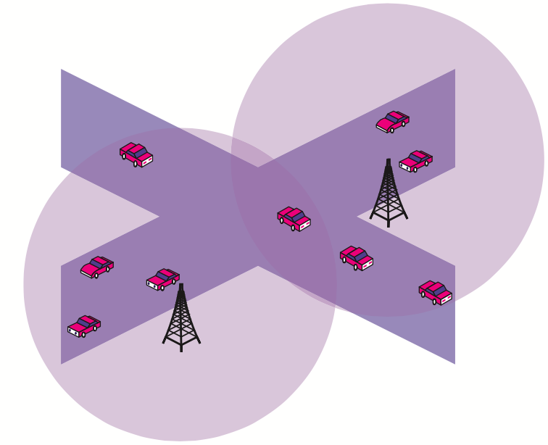
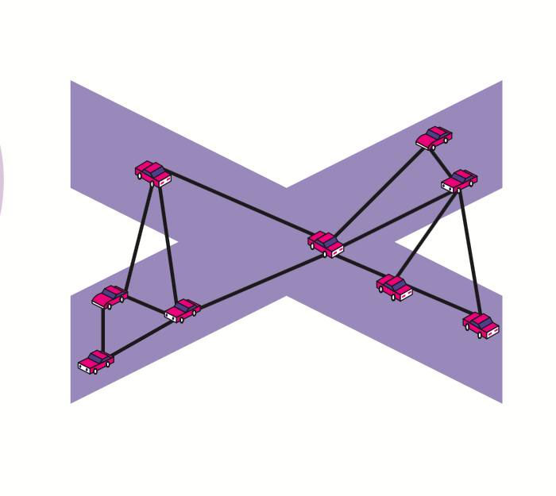
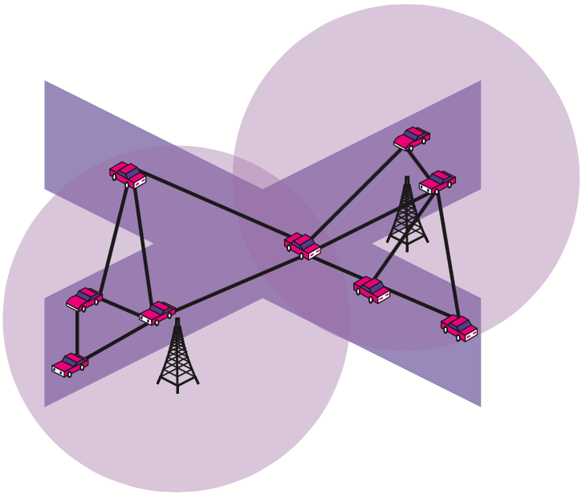
Research Fields
Physical Layer
Architecture Classification^{[1]}
(1) Ad Hoc
(2) WLAN/Cellular
(3) Hybrid^{[1,2]}
M. Watfa, Advances in Vehicular Ad-Hoc Networks: Developments and Challenges, ser. Intelligent Transport Systems. IGI Global, 2010.
V. Namboodiri, M. Agarwal, and L. Gao, “A study on the feasibility of mobile gateways for vehicular ad-hoc networks,” in Proceedings of the First International Workshop on Vehicular Ad Hoc Networks, pp. 66–75, 2004.
Notes:
1. M. Watfa, Advances in Vehicular Ad-Hoc Networks: Developments and Challenges, ser. Intelligent Transport Systems. IGI Global, 2010.

Slide 35
Research Fields
Networking Services
Security ^{[1]}:
Contradictory properties
Authentication & Liability
Masquerade attack & denial of behavior
Privacy & Anonymity
Eaversdrop
Leakage of identity info
(location & movement patterns)
Upper Layers
Security
Networking Services
MAC Layer
Physical Layer
1. Hubaux J P, Capkun S, Luo J. The security and privacy of smart vehicles[J]. IEEE Security & Privacy Magazine, 2004, 2(LCA-ARTICLE-2004-007): 49--55.

Slide 36
Research Fields
Networking Services
Security : Schemes
Certification Authorities(CAs)
The issue of certificate revocation^{[35]}
Use Keys
Use pseudonym to improve privacy^{[33][34]}
Use asymmetric cryptography for safety message

Slide 37
Research Fields
Networking Services
Security: the Status Quo
Lack of specification for a real security system
Lack of performance evaluation

Slide 38
Research Fields
Networking Services
QoS Support
Upper Layers
Reliability
Networking Services
Low Loss Rate
Qos
Bounded Delay
MAC Layer
Low Collision Rate
Physical Layer
…

Slide 39
Research Fields
Networking Services
QoS Requirements
Current Standard Solutions
Reliability
Low Loss Rate
?
Alternative Solutions
IEEE 802.11 P
Bounded Delay
TDMA based Protocols
Low Collision Rate
…
Notes:
Hadded M, Muhlethaler P, Laouiti A, et al. TDMA-Based MAC Protocols for Vehicular Ad Hoc Networks: A Survey, Qualitative Analysis, and Open Research Issues[J]. Communications Surveys & Tutorials, IEEE, 2015, 17(4): 2461-2492.
Re-broadcast to achieve reliability^{[14]}
Change the transmission range of the emergency messages^{[15]}

Slide 40
Questions & Challenges
Scalability of VANET
Bandwidth limitations, processing power, transmission frequency
A long way to go to achieve high take-up level
How to Cope with Sparse and Partitioned Network in Initial Deployment?
Use mobility to counterbalance sparsity^{[1]}
Require GPS and map info
Existing solutions in MANET may help ^{[2]}
How to Reach a Consensus on Upper Stacks?
Applications for VANETs have not been clearly defined yet.
H. Wu, R. Fujimoto, R. Guensler, and M. Hunter, “MDDV: A Mobility-Centric Data Dissemination Algorithm for Vehicular Networks,” Vehicular Ad Hoc Networks, 2004.
M. M. B. Tariq, M. H. Ammar, and E. W. Zegura, “Message Ferry Route Design for Sparse Ad Hoc Networks with Mobile Nodes,” MobiHoc, 2006, pp. 37–48.
Notes:
H. Wu, R. Fujimoto, R. Guensler, and M. Hunter, “MDDV: A Mobility-Centric Data Dissemination Algorithm for Vehicular Networks,” Vehicular Ad Hoc Networks, 2004.
M. M. B. Tariq, M. H. Ammar, and E. W. Zegura, “Message Ferry Route Design for Sparse Ad Hoc Networks with Mobile Nodes,” MobiHoc, 2006, pp. 37–48.

Slide 41
Questions & Challenges
How to guarantee Connectivity?
High mobility of nodes leads to frequent fragmentation
Partition and merge of networks due to high mobility of nodes
Predicting and message queuing ^{[1][2]}
Mobility increases throughput in MANET^{[3]}
K. Wu and J. Harms, “Performance Study of Proactive Flow Handoff for Mobile Ad Hoc Networks,” Wireless Networks, vol. 12, no. 1, 2006, pp. 119–35
H. Menouar, M. Lenardi, and F. Filali, “Improving Proactive Routing in VANETs with the MOPR Movement Prediction Framework,” Proc. 7th Int’l. Conf. Intelligent Transport Sys- tems, 2007, pp. 438–43.
M. Torrent-Moreno, P. Santi, and H. Hartenstein, “Fair Shar- ing of Bandwidth in VANETs,” Vehicular Ad Hoc Networks, 2005.
Notes:
J. Blum, “Adaptive Space Division Multiplexing: An Improved Link Layer Protocol for Inter-Vehicle Communication,” IEEE Int’l. Conf. WiMob 2005, vol. 3, 2005, pp. 22–24.
K. Dobashi, “Adaptive MAC Protocol for High-Load Inter- Vehicle Communication,” Wireless and Mobile Computing, Networking and Commun. Mag., vol. 44, no. 1, 2006, pp. 74–82.
K. Wu and J. Harms, “Performance Study of Proactive Flow Handoff for Mobile Ad Hoc Networks,” Wireless Networks, vol. 12, no. 1, 2006, pp. 119–35
H. Menouar, M. Lenardi, and F. Filali, “Improving Proactive Routing in VANETs with the MOPR Movement Prediction Framework,” Proc. 7th Int’l. Conf. Intelligent Transport Sys- tems, 2007, pp. 438–43.
M. Torrent-Moreno, P. Santi, and H. Hartenstein, “Fair Shar- ing of Bandwidth in VANETs,” Vehicular Ad Hoc Networks, 2005.
L. Liu et al., “A Vehicle-to-Vehicle Communication Protocol for Cooperative Collision Warning,” 1st Annual Int’l. Conf. Mobile and Ubiquitous Systems: Networking and Services, MOBIQUITOUS 2004.

Slide 42
Current/Future Works
ManyTalks
System architecture
A many-to-many communication scheme for V2V system.
Main approach
Use 4D range naming scheme for addressing and routing.
Use MDBI-Tree for caching and forwarding request.
Use intermediate node processing to reduce packet redundancy.

Slide 43
ManyTalks
4D Range Naming
Advantages | Helps in calculating the priority of a request
Concerns | 1. The geographical range for pull and push packet may approach but not coincide. 2. MDBI-Tree caches large volume of requests that cannot be matched by any reply 3. Request time out leads to low success ratio
Potential improvements | 1. Specify the granularity for the 4D range of pull/push packet. 2. Adjust the packet caching/removing strategy: Remove cached request when the ratio of intersection between a reply range and the request range come to a threshold (instead of being exactly covered or equaled). … 3. Modify geographical range from rectangular to circular area ( center + radius) 4. …

Slide 44
ManyTalks
MDBI-Tree
Status | 1. Caching and removing in each application’s MDBI-Tree is range-concerned but content-ignorant. Request is cached in application’s request table based on the spatial & temporal(4-D) range that the request specifies,not the content itself.
Advantages | Helps in calculating the request priority Redundancy avoidance Memory saving
Concerns | A request is removed from cache as long as the 4-D range of an reply message covers/equals that of the request. This is based on the assumption that each application is concerned about only one kind of information. Imagine a simple scenario: vehicle A requests the speed information of vehicles within region R1, then a reply containing location info of vehicles within the region R2 comes. If the R2 covers region R1, the request will be removed from the cached table. But what vehicle A wants is speed not location information. Should users resort to different applications for request different information? -> leads to another kind of redundancy and memory overhead.
Potential improvements | Use range-concerned and content-aware caching strategy . …

Slide 45
ManyTalks
Open questions
Data transmission strategy should serve upper layer applications.
Is Many Talks system applicable for both safety and comfort application?
Emergency broadcast for safety applications( No pull but only push)

Slide 46
Thank You

Slide 47
Research Fields
Networking Services
Mobility Model & Simulation
VANET Mobility Model Classification
Mobility Model for VANETs
Synthetic Model^{[1]}
Survey-based Model
Trace-based Model^{[12]}
Traffic Simulator-based Model
RWP^{[5]}
Udel^{[2]}
Agenda-based^{[3]}
ETH ^{[4]}
Street Random WayPoint^{[11]}
PARAMICS[5]
CORSIM [6]
VISSIM [7]
SUMO [8]
CrawDaD^{[9]}
UMASSDiesel- Net^{[10]}
Notes:
Khope S S, Gayakwad S V, Dhagdi S T. Vehicular Mobility Simulation For VANET[J]. International Journal of Advanced Research in Computer Science, 2013, 4(6).
UDel Models For Simulation of Urban Mobile Wireless Networks, http: //udelmodels.eecis.udel.edu/
Q. Zheng, X. Hong, and J. Liu, ”An Agenda-based Mobility Model” in Proc. 39th IEEE Annual Simulation Symposium (ANSS-39-2006), Huntsville AL , April 2006.
Realistic Vehicular Traces http://lst.inf.ethz.ch/ad-hoc/car-traces
Paramics: Microscopic Traffic Simulation, http://www.paramics- online. com/
CORSIM: Microscopic Traffic Simulation Model, http://www- mctrans. ce.ufl.edu/featured/TSIS/Version5/corsim.htm
ptv simulation - VISSIM, http://www.english.ptv.de/cgi- bin/traffic/traf vissim.pl
SUMO - Simulation of Urban Mobility, http://sumo.sourceforge.net
Community Resource for Archiving Wireless Data At Dartmouth (Craw- dad), http://crawdad.cs.dartmouth.edu
UMass Diverse Outdoor Mobile Environment (DOME), http://prisms.cs.umass.edu/dome
H. Füßler, M. Torrent-Moreno, M. Transier, R. Krüger, H. Hartenstein, and W. Effelsberg, “Studying vehicle movements on highways and their impact on ad- hoc connectivity,” in ACM Mobicom 2005 Aug. 2005.
V. Naumov, R. Baumann, and T. Gross, “An evaluation of inter-vehicle ad hoc networks based on realistic vehicular traces,” in MobiHoc ’06: Proceedings of the 7th ACM International Symposium on Mobile Ad Hoc Networking and Computing, pp. 108–119, 2006.

Slide 48
Research Fields
Networking Services
Routing Protocols: Comparison of Position based protocols
Protocols | Forwarding Strategy | Traffic Awareness | Recovery Strategy | Simulator Scenario
GPSR | Greedy | N | Right-hand-rule | Highway
GSR | Greedy along path | N | Greedy | Urban
A-STAR | Greedy along path | Y | Recalculate path | Urban
GPCR | Restricted Greedy | N | Right-hand-rule | Urban, Real city model
GyTAR | Improved Greedy | Y | Carry & Forward | Urban
DGR | Directional Greedy | N | Carry & Forward | Highway
PDGR | Predictive Directional greedy | N | Carry & Forward | Highway
Notes:
1. . Marwa Altayeb, Imad Mahgoub, “ A Survey of Vehicular Ad hoc Networks Routing Protocols,” ISSR Journals, 2013, Vol. 3, No. 3, pp. 829-846.

