Slide 1
Vehicular Ad Hoc Networks: A Survey
Zhuangdi Zhu

Slide 2
Agenda
Introduction & Motivation
Research Fields
Questions & Challenges
Future Works

Slide 3
Introduction & Motivation
What Is VANET ^{[1]}
An Variation of Mobile Ad Hoc Network(MANET)^{[2]}.
MANET
VENET/V2V
V2I
V2V
V2X
Notes:
“Vehicle-to-Vehicle”, https://en.wikipedia.org/wiki/Vehicle-to-vehicle
“Mobile Ad Hoc Network”,https://en.wikipedia.org/wiki/Mobile_ad_hoc_network

Slide 4




Introduction & Motivation
The Status Quo of VANET
Nation/Area | USA | Europe | Japan/China
System Focus | V2V safety | V2I Mobility | V2V & V2I Safety & Mobility
Organization & Projects | PATH^{[1]}, ITS^{[2]} | C2C CC^{[6]}, SAFESPOT^{[3]}, FleetNet^{[7]} | ITS in Japan^{[4]}, CCSA in China^{[5]}
Notes:
“PATH,” www.path.berkeley.edu
“USDoT ITS program,” www.its.dot.gov/factsheets/connected_vehicles_work.htm
“SAFESPOT,” www.safespot-eu.org
“ComprehensivePlanforITSinJapan”, www.mlit.go.jp/road/ITS/topindex/topindex_g06_2.html
“China ITS Industry Alliance”, http://www.c-its.org/
“Car 2 Car,” http://www.car-to-car.org
H. Hartenstein et al., “Position-Aware Ad Hoc Wireless Net- works for Inter-Vehicle Communications: The FleetNet Project,” MobiHoc ’01: Proc. 2nd ACM Int’l. Symp. Mobile Ad Hoc Net- working & Computing, New York: ACM Press, 2001, pp. 259–62.

Slide 5
Introduction & Motivation
Motivation
Safety
Mobility
Environment

Slide 6
Introduction & Motivation
VANET Features
Highly Dynamic Topology
Availability of Geographical Position
Predictability of Vehicle movements
Hard Delay Constraints

Slide 7
Research Fields
I
Safety App
Comfort App
Application, Presentation, Session
Upper Layers
IEEE 1609.1
& Applications
Security
Transport Layer
Networking Services
Routing Protocols
QoS Support
Mobility Model & Simulation
IEEE 1609.3
Network Layer
Data Link Layer
IEEE 1802.2
LLC SubLayer
MAC Layer Issue
IEEE 1609.4
MAC SubLayer
IEEE 1802.11
Physical Layer Issue
Physical Layer
IEEE 802.11 P
Physical Layer
OSI Model
WAVE Model

Slide 8
Research Fields
Physical Layer
Technology :
Radio, infrared, VHF,
millimeter wave
Standards:
IEEE 802.11 a, b, g or p technology^{[1]}
Minor solutions not based on IEEE 802.11^{[2]}
Upper Layers
Networking Services
LLC SubLayer
MAC SubLayer
Physical Layer
Notes:
“IEEE 802.11”, https://en.wikipedia.org/wiki/IEEE_802.11
H. Hartenstein et al., “Position-Aware Ad Hoc Wireless Net- works for Inter-Vehicle Communications: The FleetNet Project,” MobiHoc ’01: Proc. 2nd ACM Int’l. Symp. Mobile Ad Hoc Net- working & Computing, New York: ACM Press, 2001, pp. 259–62.

Slide 9
Research Fields
Physical Layer
Current Standards
Nation/Area | USA | Europe | Japan/China
Broadcasting Frequency | 5.9 GHz, | 5.9 GHz | 5.8 GHz
Wireless Protocol | IEEE Standard 802.11p | IEEE Standard 802.11p | IEEE Standard 802.11p
DSRC^{[1]} Protocol | IEEE 1609 | IEEE 1609 | ARIB STD-T75 ^{[2]}
Notes:
“Dedicated Short Range Communicaions”, https://en.wikipedia.org/wiki/Dedicated_short-range_communications
“Association of Radio Industry and Business”, http://www.arib.or.jp/english/

Slide 10
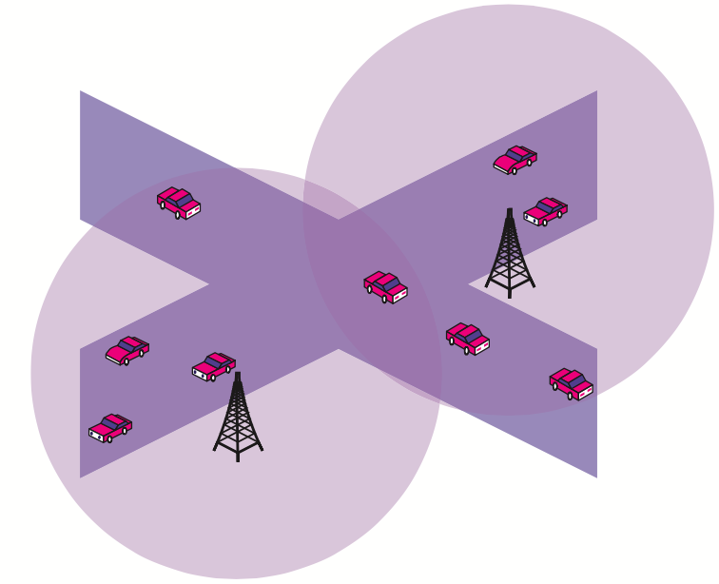
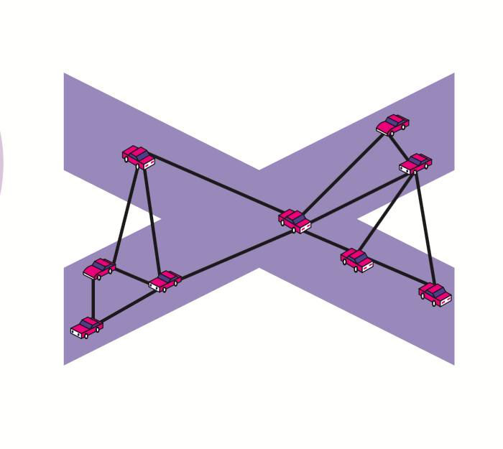
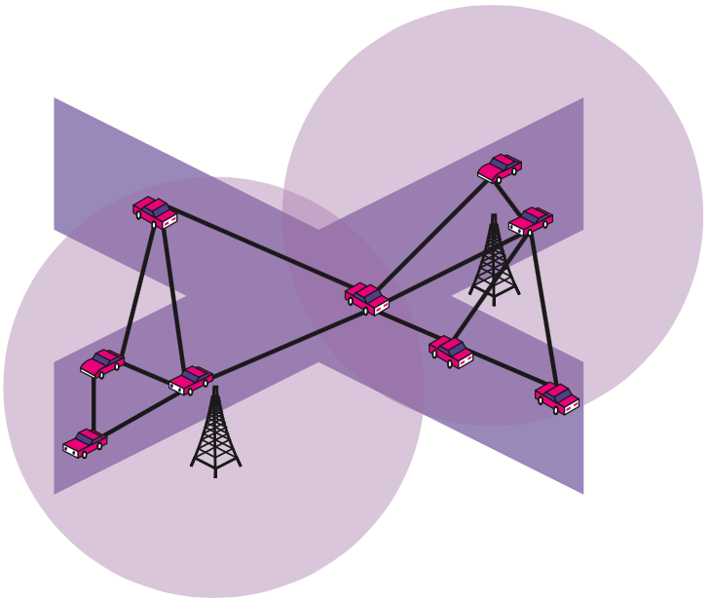
Research Fields
Physical Layer
Architecture Classfication
(1) Ad Hoc
(2) WLAN/Cellular
(3) Hybrid

Slide 11
Research Fields
MAC Layer
MAC Layer ^{[1]}:
Goal: Time & space sharing
Main schemes:
Contention-free protocols ^{[2]}:
CDMA, FDMA, TDMA
Example: FleetNet -> slotted Aloha
TDMA Scheme:
Require RSUs to create and manage the
TDMA slot reservation schedule.
Require real-time system(GPS) for location
and time information
Contention-based protocols ^{[3]}:
CSMA, ECDA, CSMA/CA
Example: IEEE 802.11 P -> ECDA + CSMA/CA
Upper Layers
Networking Services
LLC SubLayer
MAC SubLayer
Physical Layer
Notes:
D. Bertsekas and R. Gallager, Data Networks, Prentice-Hall, 2001.
Hadded M, Muhlethaler P, Laouiti A, et al. TDMA-Based MAC Protocols for Vehicular Ad Hoc Networks: A Survey, Qualitative Analysis, and Open Research Issues[J]. Communications Surveys & Tutorials, IEEE, 2015, 17(4): 2461-2492.
IEEE Standard for Information Technology— Telecommunications and Information Exchange Between Systems—Local and Metropolitan Area Networks—Specific Requirements Part 11: Wireless LAN Medium Access Control (MAC) and Physical Layer (PHY) and Physical Layer (PHY) Specifications Amendment 6: Wireless Access in Vehicular Envi- ronments, Std. 802.11p-2010, 2010.

Slide 12
Research Fields
Upper Layers:
Safety applications^{[1]}
Event Based
Notify emergency messages
Broadcast scheme
Comfort Applications
Awareness based
Internet connectivity
Peer-to-peer communication
Unicast or multicast schemes
Upper Layers
Networking Services
LLC SubLayer
MAC SubLayer
Physical Layer
Notes:
J. Harding et al., “Vehicle-to-vehicle communications: Readiness of V2V technology for application,” Nat. Highway Traffic Safety Admin., Washington, DC, USA, Tech. Rep. DOT HS 812 014, Aug. 2014.

Slide 13
Music Downloading
Back-seat Games
…
Comfort Applications
Emergency Brake Warning
Forward Collision Warning
Intersection Movement Assist
Blind Spot and Lane Change Warning
Do not Pass Warning
Safety Applications

Slide 14
Research Fields
Networking Services
Routing Protocols
Upper Layers
Routing Protocols
QoS Support
Mobility Model & Simulation
Networking Services
Proactive & Reactive^{[17]}
LLC SubLayer
MAC SubLayer
Physical Layer

Slide 15
Research Fields
Networking Services
Routing Protocols:
Transmission strategies based classification
Routing Protocols
Unicasting
Multicasting
Broadcasting
Routing Information based classification
Routing Protocols
Topology based
Position based

Slide 16
Research Fields
Networking Services
Routing Protocols:
Broadcasting^{[1]}
Broadcasting Type | Characteristics | Advantages | Disadvantages
Multi-hop | Smart flooding Probability/ delay based | Low latency No need for large storage space | Broadcast storm No persistency
Single-hop | Periodic broadcast Vary broadcast interval Rely on node mobility | Persistency No broadcast storm | Slow Large storage space
Notes:
Panichpapiboon S, Pattara-Atikom W. A review of information dissemination protocols for vehicular ad hoc networks[J]. Communications Surveys & Tutorials, IEEE, 2012, 14(3): 784-798.

Slide 17
Research Fields
Networking Services
Routing Protocols:
Broadcast ^{[1]}
Broadcasting
Multi-hop
Single-hop
Delay
Probabilistic
Network Coding
Fixed Broadcast Interval
Adaptive Broadcast Interval
UMB
SB
EDB
…
Weighted
p-persistence
OAPB
AutoCast
…
CODEB
EBCD
DifCode
…
TrafficInfo
TrafficView
…
CRCP
Abiding Geocast
SODAD
…
Notes:
Panichpapiboon S, Pattara-Atikom W. A review of information dissemination protocols for vehicular ad hoc networks[J]. Communications Surveys & Tutorials, IEEE, 2012, 14(3): 784-798.

Slide 18
Research Fields
Networking Services
Routing Protocols:
Multicast^{[1]}
Multicast Routing
Tree Based
Mesh Based
Group Forwarding Based
Core Based
AMRoute
ODMRP
CAMP
CTB
AMRIS
ODMRP
Notes:
Patel B, Shah K. A Survey on Vehicular Ad hoc Networks[J]. IOSR Journal of Computer Engineering (IOSR-JCE) Vol, 2013, 15: 34-42.

Slide 19
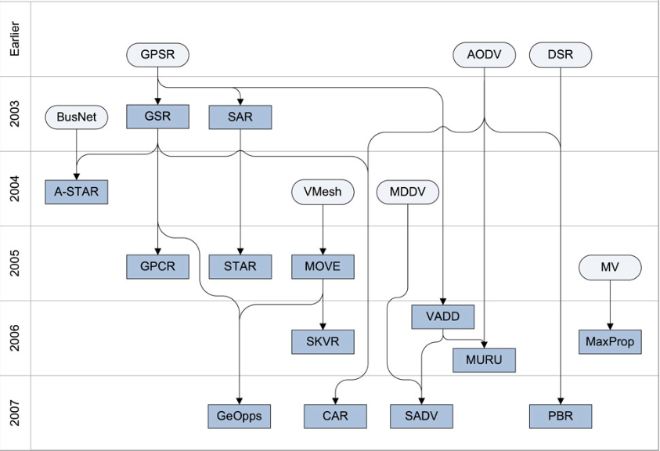
Research Fields
Networking Services
Routing Protocols
Unicast^{[1]}
Notes:
1. J. Bernsen and D. Manivannan, “Unicast routing protocols for vehicular ad hoc networks: A critical comparison and classification,” Pervasive and Mobile Computing, vol. 5, no. 1, pp. 1–18, Feb. 2009.

Slide 20
Research Fields
Networking Services
Routing Protocols: Transmission strategies based classification^{[1]}
Transmission Strategies |  | Communication Type | Example | Advantages | Disadvantages
Unicasting |  | One-to-one | AODV, DSR, GPSR | Less network Overhead More privacy | Less reliable Link maintenance
Broadcasting |  | One-to-all inside broadcast domain | BROADCOMM, DV-CAST | Reliable | Bandwidth Collision & congestion
Multicasting | Geocast | One-to-X, using geographic address | Mobicast, ROVER, ZOR | Efficient routing Less network consumption | bandwidth
 | Cluster | Cluster + head | COIN, CBDRP | Less packet delivery | Dividing group Select head
Notes:
1. Patel B, Shah K. A Survey on Vehicular Ad hoc Networks[J]. IOSR Journal of ComputerEngineering (IOSR-JCE) Vol, 2013, 15: 34-42.

Slide 21
Research Fields
Networking Services
Routing Protocols
Routing Information based classification^{[1]}
Routing Protocols
Topology Based Protocols
Proactive
Reactive
Hybrid
Position Based Protocols
FSR
DSDV
OLSR
AODV^{[2]}
DSR
…
ZRP
…
Notes:
1. Marwa Altayeb, Imad Mahgoub, “ A Survey of Vehicular Ad hoc Networks Routing Protocols,” ISSR Journals, 2013, Vol. 3, No. 3, pp. 829-846.
2. Perkins, C. E. And Royer, E. M. (1999), “Ad-Hoc On-Demand Distance Vector Routing,” Proc. IEEE WMCSA ‟99, New Orleans, LA, Feb. 1999 ,pp. 90-100.

Slide 22
Research Fields
Networking Services
Routing Protocols
Routing Information based classification
Routing Protocols
Topology Based Protocols
Position Based Protocols
Classified by forwarding/recovery strategies
Forwarding Strategies^{[1]}
Recovery Strategies^{[2]}
Greedy Forwarding
Improved Greedy Forwarding
Direction Greedy Forwarding
Predictive Directional Greedy
Right-hand rule
Carry-and-forward
Path-recalculation
Notes:
Sardar Muhammad Bilal, Carlos Jesus Bernardos, Carmen Guerrero; Position-based routing in vehicular networks: A survey; Journal of Network and Computer Applications 36(2013) 685-697.
Fonseca A,Vazao T. Applicability of position-based routing for VANET in highways and urban environment. Journal of Network
and Computer Applications JNCA1084-8045 2009.

Slide 23
Research Fields
Networking Services
Routing Protocols: Comparison of Position based protocols
Protocols | Forwarding Strategy | Traffic Awareness | Recovery Strategy | Simulator Scenario
GPSR | Greedy | N | Right-hand-rule | Highway
GSR | Greedy along path | N | Greedy | Urban
A-STAR | Greedy along path | Y | Recalculate path | Urban
GPCR | Restricted Greedy | N | Right-hand-rule | Urban, Real city model
GyTAR | Improved Greedy | Y | Carry & Forward | Urban
DGR | Directional Greedy | N | Carry & Forward | Highway
PDGR | Predictive Directional greedy | N | Carry & Forward | Highway
Notes:
1. . Marwa Altayeb, Imad Mahgoub, “ A Survey of Vehicular Ad hoc Networks Routing Protocols,” ISSR Journals, 2013, Vol. 3, No. 3, pp. 829-846.

Slide 24
Research Fields
Networking Services
Security ^{[10]}:
Contradictory properties
Authentication & Liability
Masquerade attack & denial of behavior
Privacy & Anonymity
Eaversdrop
Leakage of identity info
(location & movement patterns)
Upper Layers
Security
Networking Services
LLC SubLayer
MAC SubLayer
Physical Layer

Slide 25
Research Issues
Networking Services
Security ^{[10]}: Schemes
Certification Authorities(CAs)
The issue of certificate revocation^{[35]}
Use Keys
Use pseudonym to improve privacy^{[33][34]}
Use asymmetric cryptography for safety message

Slide 26
Research Issues
Networking Services
Security: the Status Quo
Lack of specification for a real security system
Lack of performance evaluation

Slide 27
Research Fields
Networking Services
QoS Support
Upper Layers
Routing Protocols
QoS Support
Mobility Model & Simulation
Networking Services
Reliability
Low Loss Rate
LLC SubLayer
Bounded Delay
MAC SubLayer
Low Collision Rate
Physical Layer
…

Slide 28
Research Fields
Internal Layers
QoS Requirements
Current Standard Solutions
Reliability
Low Loss Rate
?
Alternative Solutions
IEEE 802.11 P
Bounded Delay
TDMA based Protocols
Low Collision Rate
…
Notes:
Hadded M, Muhlethaler P, Laouiti A, et al. TDMA-Based MAC Protocols for Vehicular Ad Hoc Networks: A Survey, Qualitative Analysis, and Open Research Issues[J]. Communications Surveys & Tutorials, IEEE, 2015, 17(4): 2461-2492.
Re-broadcast to achieve reliability^{[14]}
Change the transmission range of the emergency messages^{[15]}

Slide 29
Research Fields
Networking Services
Mobility Model & Simulation
Upper Layers
Routing Protocols
QoS Support
Mobility Model & Simulation
Networking Services
LLC SubLayer
MAC SubLayer
Physical Layer

Slide 30
Research Fields
Networking Services
Mobility Model & Simulation^{[1]}
Traffic Simulator
Network
Simulator
Traffic Simulator
Network
Simulator
Vehicular Trace
Generation
Communication Generation
Vehicular Trace
Generation
Communication Generation
Isolated Network & Traffic Simulator
Embedded Network & Traffic Simulator
Notes:
Härri J, Filali F, Bonnet C. Mobility models for vehicular ad hoc networks: a survey and taxonomy[J]. Communications Surveys & Tutorials, IEEE, 2009, 11(4): 19-41.

Slide 31
Research Fields
Networking Services
Mobility Model & Simulation
Normal Schemes:
Output (trace files) can be used as input for a network simulator (NS-2/3) ^{[2]} :
MOVE^{[1]}: Java + SUMO
Integrate with network simulator:
TraNs^{[4]}: Java + SUMO + NS2
NCTUNS^{[5]}: C⁺⁺ + GUI Support
Notes:
H. Füßler, M. Torrent-Moreno, M. Transier, R. Krüger, H. Hartenstein, and W. Effelsberg, “Studying vehicle movements on highways and their impact on ad- hoc connectivity,” in ACM Mobicom 2005, Aug. 2005.
“U.S. Census Bureau. TIGER, TIGER/Line and TIGER-Related Products,” http://www.census.gov/geo/www/tiger/.
Sherali Zeadally, Ray Hunt, Yuh-Shyan Chen, Angela Irwin, Aamir Hassan, Vehicular ad hoc networks (VANETS): status, results,
and challenges, Telecommum Syst, 2010
4. Piorkowski M, Raya M, Lugo A L, et al. TraNS: realistic joint traffic and network simulator for VANETs[J]. ACM SIGMOBILE mobile computing and communications review, 2008, 12(1): 31-33.
5. Wang S Y, Lin C C. NCTUns 6.0: a simulator for advanced wireless vehicular network research[C]//Vehicular Technology Conference (VTC 2010-Spring), 2010 IEEE 71st. IEEE, 2010: 1-2.

Slide 32
Research Fields
Networking Services
Mobility Model & Simulation
VANET Mobility Model Classification
Mobility Model for VANETs
Synthetic Model^{[1]}
Survey-based Model
Trace-based Model^{[12]}
Traffic Simulator-based Model
RWP^{[5]}
Udel^{[2]}
Agenda-based^{[3]}
ETH ^{[4]}
Street Random WayPoint^{[11]}
PARAMICS[5]
CORSIM [6]
VISSIM [7]
SUMO [8]
CrawDaD^{[9]}
UMASSDiesel- Net^{[10]}
Notes:
Khope S S, Gayakwad S V, Dhagdi S T. Vehicular Mobility Simulation For VANET[J]. International Journal of Advanced Research in Computer Science, 2013, 4(6).
UDel Models For Simulation of Urban Mobile Wireless Networks, http: //udelmodels.eecis.udel.edu/
Q. Zheng, X. Hong, and J. Liu, ”An Agenda-based Mobility Model” in Proc. 39th IEEE Annual Simulation Symposium (ANSS-39-2006), Huntsville AL , April 2006.
Realistic Vehicular Traces http://lst.inf.ethz.ch/ad-hoc/car-traces
Paramics: Microscopic Traffic Simulation, http://www.paramics- online. com/
CORSIM: Microscopic Traffic Simulation Model, http://www- mctrans. ce.ufl.edu/featured/TSIS/Version5/corsim.htm
ptv simulation - VISSIM, http://www.english.ptv.de/cgi- bin/traffic/traf vissim.pl
SUMO - Simulation of Urban Mobility, http://sumo.sourceforge.net
Community Resource for Archiving Wireless Data At Dartmouth (Craw- dad), http://crawdad.cs.dartmouth.edu
UMass Diverse Outdoor Mobile Environment (DOME), http://prisms.cs.umass.edu/dome
H. Füßler, M. Torrent-Moreno, M. Transier, R. Krüger, H. Hartenstein, and W. Effelsberg, “Studying vehicle movements on highways and their impact on ad- hoc connectivity,” in ACM Mobicom 2005 Aug. 2005.
V. Naumov, R. Baumann, and T. Gross, “An evaluation of inter-vehicle ad hoc networks based on realistic vehicular traces,” in MobiHoc ’06: Proceedings of the 7th ACM International Symposium on Mobile Ad Hoc Networking and Computing, pp. 108–119, 2006.

Slide 33
Research Fields
Networking Services
Mobility Model & Simulation
The Status Quo:
Integrated simulators coupling traffic and networks is in development.
Specifications of APIs for coupling traffic flow and networking simulators are in need.
Traffic Simulator
Communication Interface
Network
Simulator
Network
Feedback
Vehicular Trace
Generation
Communication Generation
Traffic
Feedback

Slide 34
Questions & Challenges
Scalability of VANET
Bandwidth limitations, processing power, transmission frequency
A long way to go to achieve high take-up level
Multi-channel synchronization in MAC Layer
Single transceiver per vehicle
Co-channel interference problem
How to Cope with Sparse and Partitioned Network in Initial Deployment?
Use mobility to counterbalance sparsity^{[21]}
Require GPS and map info
Existing solutions in MANET may help ^{[22]}

Slide 35
Questions & Challenges
How to Re-design IP Stacks for VANET Networks?
TCP/IP Stack is designed for wired network and is inadequate for MANET or VANET^{[32]}.
CB MANET aims to build completely new IP Stacks^{[23]}.
How to Reach a Consensus on Other Stacks?
TCP/IP is ubiquitous.
Applications for VANETs have not been clearly defined yet.

Slide 36
Questions & Challenges
How to Cope with High Node Density?
Traffic jam or accident happens
Solutions in wired network cannot handle spatial reuse
Slotted approaches ^{[12][13]}
How to guarantee Connectivity?
Connectivity is a real challenge due to high mobility of nodes
Parition and merge of networks due to high mobility of nodes
Predicting and message queuing ^{[19][20]}
Mobility increases throughput in MANET^{[15]}
How to support Time-Critical Traffic?
Current WLAN solutions have no time constraints
Broadcast storm during transmitting emergency message
Existing solutions(Number, rate, range)
Rebroadcast to achieve reliability^{[14]}
Change the transmission range of the emergency messages^{[15]}

Slide 37
Thank You

Slide 38
References
“Vehicle-to-Vehicle”, https://en.wikipedia.org/wiki/Vehicle-to-vehicle
“PATH,” www.path.berkeley.edu
“USDoT ITS program,” www.its.dot.gov/factsheets/connected_vehicles_work.htm
“SAFESPOT,” www.safespot-eu.org
“ComprehensivePlanforITSinJapan”, www.mlit.go.jp/road/ITS/topindex/topindex_g06_2.html
“China ITS Industry Alliance”, http://www.c-its.org/
http://ieeexplore.ieee.org/xpl/login.jsp?tp=&arnumber=4450627&url=http%3A%2F%2Fieeexplore.ieee.org%2Fxpls%2Fabs_all.jsp%3Farnumber%3D4450627
Hybrid VANET Network…
Routing: Ad Hoc …
http://ieeexplore.ieee.org/xpl/login.jsp?tp=&arnumber=1306972&url=http%3A%2F%2Fieeexplore.ieee.org%2Fiel5%2F8013%2F29015%2F01306972
H. Hartenstein et al., “Position-Aware Ad Hoc Wireless Net- works for Inter-Vehicle Communications: The FleetNet Project,” MobiHoc ’01: Proc. 2nd ACM Int’l. Symp. Mobile Ad Hoc Net- working & Computing, New York: ACM Press, 2001, pp. 259–62.
https://users.ece.cmu.edu/~sazimi/SAE2011.pdf

Slide 39
References
J. Blum, “Adaptive Space Division Multiplexing: An Improved Link Layer Protocol for Inter-Vehicle Communication,” IEEE Int’l. Conf. WiMob 2005, vol. 3, 2005, pp. 22–24.
K. Dobashi, “Adaptive MAC Protocol for High-Load Inter- Vehicle Communication,” Wireless and Mobile Computing, Networking and Commun. Mag., vol. 44, no. 1, 2006, pp. 74–82.
L. Liu et al., “A Vehicle-to-Vehicle Communication Protocol for Cooperative Collision Warning,” 1st Annual Int’l. Conf. Mobile and Ubiquitous Systems: Networking and Services, MOBIQUITOUS 2004.
M. Torrent-Moreno, P. Santi, and H. Hartenstein, “Fair Shar- ing of Bandwidth in VANETs,” Vehicular Ad Hoc Networks, 2005.
M. Grossglauer and D. N. C. Tse, “Mobility Increases the Capacity of Ad Hoc Wireless Networks,” IEEE/ACM Trans. Net., vol. 10, no. 4, 2002, pp. 477–86.
L. Viennot, P. Jacquet, and T. Clausen, “Analyzing Control Traffic Overhead Versus Mobility and Data Traffic Activity in Mobile Ad-Hoc Network Protocols,” Wireless Networks, vol. 10, no. 4, 2004, pp. 447–55.
I. Stojmenovic and X. Lin, “Power-Aware Localized Routing in Wireless Networks,” IEEE Trans. Parallel and Distributed Sys- tems, vol. 12, no. 11, 2001, pp. 1122–33.
K. Wu and J. Harms, “Performance Study of Proactive Flow Handoff for Mobile Ad Hoc Networks,” Wireless Networks, vol. 12, no. 1, 2006, pp. 119–35.
H. Menouar, M. Lenardi, and F. Filali, “Improving Proactive Routing in VANETs with the MOPR Movement Prediction Framework,” Proc. 7th Int’l. Conf. Intelligent Transport Sys- tems, 2007, pp. 438–43.
H. Wu, R. Fujimoto, R. Guensler, and M. Hunter, “MDDV: A Mobility-Centric Data Dissemination Algorithm for Vehicular Networks,” Vehicular Ad Hoc Networks, 2004.

Slide 40
References
M. M. B. Tariq, M. H. Ammar, and E. W. Zegura, “Message Ferry Route Design for Sparse Ad Hoc Networks with Mobile Nodes,” MobiHoc, 2006, pp. 37–48.
“Control-Based Mobile Ad-Hoc Networking Program,” 2005; http://www.darpa.mil/sto/solicitations/CBMANET
V. Namboodiri, M. Agarwal, and L. Gao, “A Study on the Feasibility of Mobile Gateways for Vehicular Ad-Hoc Net- works,” Proc. VANET’04, 2004.
R. Wakikawa et al., “Design of Vehicle Network: Mobile Gate- way for MANET and NEMO Converged Communication,” Proc. 2nd ACM Int’l. Wksp. Vehicular Ad Hoc Networks, ACM Press, 2005, pp. 81–82.
B. Ducourthial, Y. Khaled, and M. Shawky, “Conditional Transmissions: A Strategy for Highly Dynamic Vehicular Ad Hoc Networks,” Heudiasyc lab. UMR CNRS 6599, Université de Technologie de Compiégne, Tech. Rep., 2006.
“Car 2 Car,” http://www.car-to-car.org
J. Bransted and L. M. Kristensen, “Specification and Performance Evaluation of Two Zone Dissemination Protocols for Vehicular Ad-Hoc Networks,” anss, vol. 0, 2006, pp. 68–79.
R. Fracchia, “Knowing Vehicles Location Helps Avoiding Broadcast Packets Storm,” PerCOMW, vol. 0, 2006, pp. 118–23.

Slide 41
References
S. Ghandeharizade, S. Kapadia, and B. Krishnamachari, “PAVAN: A Policy Framework for Content Availability in Vehicular Ad-Hoc,” Vehic. Ad Hoc Networks, 2004.
T. Repantis and V. Kalogeraki, “Data Dissemination in Mobile Peer-to-Peer Networks,” Mobile Data Management, 2005.
Revealing TCP Unfairness Behavior in 802.11 Based Wireless Multi-Hop Networks, vol. 2, 2001.
P. Papadimitratos et al., “Architecture for Secure and Private Vehicular Communications,” Proc. 7th Int’l. Conf. Intelligent Transport Systems, 2007, pp. 339–34.
J. Freudiger et al., “Mix-Zones for Location Privacy in Vehicu- lar Networks,” WiN-ITS, 2007.
S. Miscali, “Efficient Certificate Revocation, MIT Laboratory for Computer Science, “ Tech. Rep. TM-542b, Mar. 1996, Tech. Rep.
J. Broch, D.A. Maltz, D.B. Johnson, Y.-C. Hu, and J. Jetcheva, “A performance comparison of multi-hop wireless ad hoc network routing protocols,” in Mobile Computing and Networking, pp. 85–97, 1998.
“U.S. Census Bureau. TIGER, TIGER/Line and TIGER-Related Products,” http://www.census.gov/geo/www/tiger/.
H. Füßler, M. Torrent-Moreno, M. Transier, R. Krüger, H. Hartenstein, and W. Effelsberg, “Studying vehicle movements on highways and their impact on ad- hoc connectivity,” in ACM Mobicom 2005, Aug. 2005.
V. Naumov, R. Baumann, and T. Gross, “An evaluation of inter-vehicle ad hoc networks based on realistic vehicular traces,” in MobiHoc ’06: Proceedings of the 7th ACM International Symposium on Mobile Ad Hoc Networking and Computing, pp. 108–119, 2006.
H. Hartenstein et al., “Position-Aware Ad Hoc Wireless Net- works for Inter-Vehicle Communications: The FleetNet Project,” MobiHoc ’01: Proc. 2nd ACM Int’l. Symp. Mobile Ad Hoc Net- working & Computing, New York: ACM Press, 2001, pp. 259–62.

Slide 42
USA V2V | Europe V2I | China & Japan V2V&V2I
PATH^{[2]}, ITS^{[3]} Awareness-based Improve safety | C2C CC^{27]} SAFESPOT^{[4]}, FleeNet^{[40]} Event-based Improve Mobility | Japan: JSK^{[5]} China: CCSA^{[6]} …

Slide 43
Research Fields
Internal Layers
Routing Protocols^{[8]}
Topology based (Ad hoc routing)^{[9]}
Position based (Geographical routing)^{[10]}
C2C CC uses geographic routing schemes[27]
//Conditional transmission^{[26]} is a generalization of this technology
Scale well with dynamic network
Optimizing routing path^{[18]}
More studies in need
Cluster based
Geocast

Slide 44
Research Fields
Internal Layers
Routing Protocols:
From applications point of view
Routing Protocols
For Comfort Applications
Unicasting
Multicasting
For Safety Applications
Broadcasting

Slide 45
Research Fields
Internal Layers
Internet Connectivity
Application Layer
Internal Layers
Routing Protocols
Internet Connectivity
Data Dissemination
QoS Support
Security
Models & Simulation
Proactive & Reactive^{[17]}
PHY/MAC Layer
VANET Architecture

Slide 46
Research Issues
VANET Networking
Data Dissemination:
Cannot use group address but node positions
Safety applications: broadcast within a zone under all conditions
Either use hop counts^{[28]} or use vehicle location info^{[29]}
No comparison studies exist and further investigation is in need .
Comfort application:
Use infrastructure support ^{[30]}
Build completely independent peer-to-peer system^{[31]}

Slide 47
Research Issues
VANET Networking
Internet Connectivity
Vehicles within a network
Use multi-homed vehicles as gateways[24]
Use infrastructure gateways
Vehicles Crossing networks
[25]

Slide 48
