Slide 1
Internet of Vehicles: From Intelligent Grid to Autonomous Cars and Vehicular Clouds
Mario Gerla*, Eun-Kyu Lee*, Giovanni Pau*^,Uichin Lee#
*UCLA CSD, ^UPMC, #KAIST
IEEE World Forum on Internet of Things 2014
March, Seoul Korea

Slide 2
Evolution of Urban Fleet of Vehicles
From a collection of sensor platforms
Collect/deliver sensor data to drivers and Internet cloud.
To the Internet of Vehicles (IOV)
Share sensor inputs to optimize local utility functions (e.g., autonomous driving).
In this talk:
Identify unique challenges of IOV as opposed to conventional IOT models (say, Internet of Energy).
Specify Vehicular Cloud as a promising solution.
What leads to the cloud?
What are technical challenges?
What services the cloud can provide?

Slide 3
Comparison: IOV and IOT in Energy
Vehicle evolution | Smart Grid/IOE (energy)
Manual first | Manual setting of thermostat
Cloud assisted. (navigator, intelligent highway, lane reservations, multimodal transportation) | Cloud controlled guidance in settings to human operators.
Self driving autonomous cars For comfort on freeways and for safety on surface roads Here, vehicle interactions (via V2V communications) are CRITICAL | Intelligent buildings and energy grids Full automation – sensors/actuators select best operating conditions (for energy savings and human comfort) Mostly still controlled from BIG cloud; but considerable local autonomy; limited P2P interaction between Energy Things

Slide 4
Mobility/V2V Communications Makes IOV Unique
Smart Grid: Objects are hierarchically controlled.
This enormously helps scalability from room to building to city
Vehicular Cloud: Vehicles cannot be hierarchically partitioned and controlled.
Mobility handling & real-time, low latency V2V requirements
Many platooning papers stress critical need of V2V.
But these are not critical concerns in IOE/m-Health IOT apps

Slide 5
Computing Models:
Internet Cloud Computing (e.g., Amazon, Google)
Data center model
Immense computer, storage resources
Broadband connectivity
Services, virtualization, security
Mobile Cloud Computing (traditional)
What most researchers mean:
Access to the Internet Cloud from mobiles
Tradeoffs between local and cloud computing (e.g., offloading)
P2P Model: Mobile Computing Cloud
Mobile nodes increasingly powerful (storage, process, sensors)
Emerging distributed apps (e.g., localized sensing/computing)

Slide 6
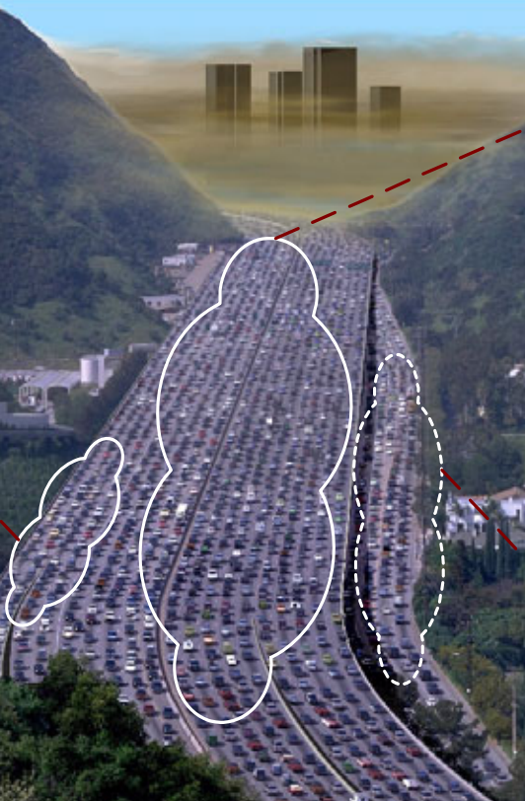
Vehicular Cloud
Observed trends/characteristics:
1. Vehicles are powerful sensor platforms
GPS, video cameras, pollution, radars, acoustic, etc.
2. Spectrum is scarce => Internet upload expensive
3. More local data must be processed on vehicles
road alarms (pedestrian crossing, electr. brake lights, etc.)
surveillance (video, mechanical, chemical sensors)
environment mapping via “crowdsourcing”
accident, crime witnessing (for forensic investigations, etc.)
Vehicular Computing Cloud
Data storage/processing on vehicles
Vehicular cloud

Slide 7
Vehicular Cloud vs. Internet Cloud
Both offer a significant pool of resources:
Computing, storage, communications
Differences:
Main vehicle cloud asset (and limit): mobility
Vehicle cloud services are location relevant
Data Sources: from drivers or environment
Services: to drivers or to community
Vehicle cloud can be sparse, intermittent
Vehicle cloud interacts with:
Internet cloud
Pedestrian/bicycle (smartphones) cloud
Very different business model than Internet Cloud

Slide 8
Vehicle Cloud Challenges and Services
Challenges
Security / Privacy
Congested wireless medium
Content dissemination/discovery
Internet Cloud vs. Local Vehicle Cloud
Fair sharing (e.g., medium access), incentives
Common Cloud Services
Efficient handling of above challenges
Uniform solutions across heterogeneous apps and platforms

Slide 9
Vehicular Cloud
Vehicles in the same geographic domain form a P2P cloud to collaborate in some activity
Related work:
MobiCloud – Dijian Huang
MAUI – MSR
Auton Vehi Clouds – S. Olariu
IC Net On Wheels – Fan Bai GM
food and gas info.
regulating entrance to the
highway

Slide 10
Emerging Vehicle Applications
Safe navigation
Location-relevant content distribution
Urban sensing
Efficient, intelligent, clean transport

Slide 11
Safe Navigation
Forward Collision Warning, Intersection Collision Warning
Platooning (e.g., trucks)
Advisories to other vehicles about road perils
“Ice on bridge”, “Congestion ahead”,….
Autonomous driving

Slide 12
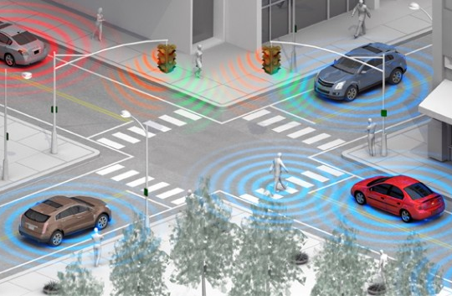
V2V Communications for Safe Driving
Curb weight: 3,547 lbs Speed: 65 mph Acceleration: - 5m/sec^2 Coefficient of friction: .65 Driver Attention: Yes

Slide 13
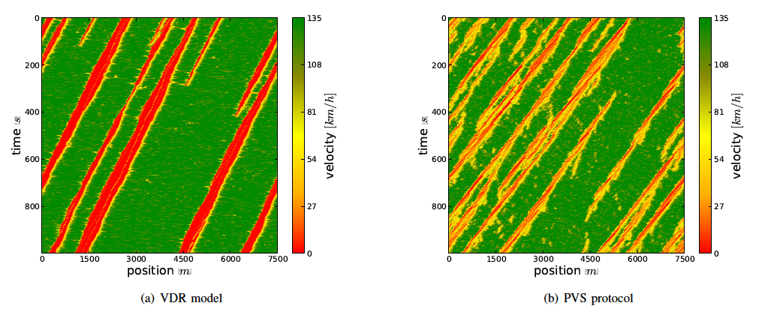
V2V and cruise control to avoid Shockwave formations
VDR = Velocity Dependent Randomization: normal drive
PVS = Partial Velocity Synchronization: advanced cruise control
A Study on Highway Traffic Flow Optimization using Partial Velocity Synchronization, Markus Forster, Raphael Frank, Thomas Engel, 2013

Slide 14
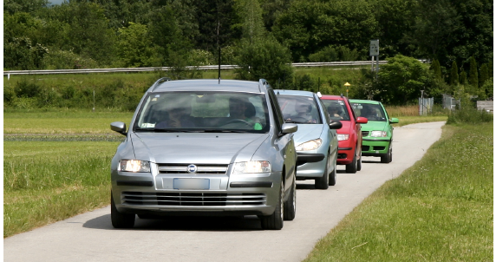
V2V for Platooning
Study will offer insight into autonomous vehicle grids

Slide 15
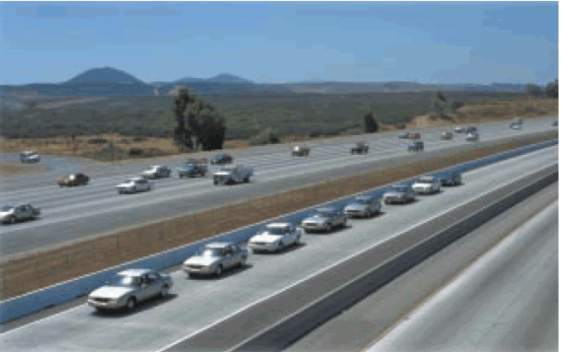
Autonomous Vehicle Control
V2V more critical as autonomous car penetration increases

Slide 16
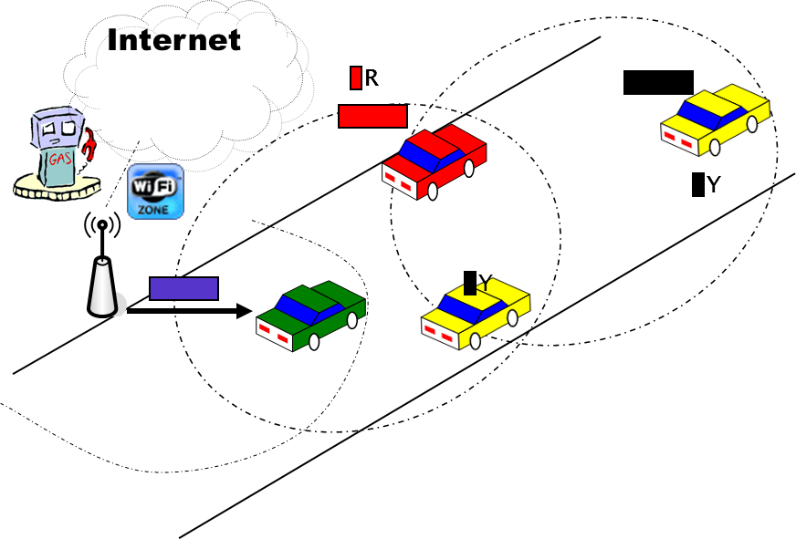

V2V for Location Relevant Content Delivery
Traffic information
Local attractions, advertisements
Tourist information
Accidents, crimes
CarTorrent
MobEyes, CarTel

Slide 17
Information Centric Networking for IOV
Ad-hoc net use cases:
Rural and emergency scenarios
Tactical battlefield
Autonomous driving, shopping mall crowdsourcing, etc.
Common characteristics:
Info centric, interm. connected, fast deployment, opportunistic routing and caching based on context
Info-centric Context-Aware Ad-hoc Net (ICAN)
Extends and integrates ICN, DTN, and opportunistic routing and caching in one network architecture

Slide 18
ICAN Requirements
Push- and pull-based application support
Must push to cars info of imminent danger
Context-aware operations
Select routing and caching algorithms based on network/app context
Fast deployment/reconfiguration

Slide 19
Network Entity Representation
Data, node, and geo-location are all addressable network entities/objects; representation = address
Data: assume ICN hierarchical naming [1]
Format: application_id/data_object_id/chunk_id
Node: unique node identifier
IP or MAC addresses
Geo-location: to support unicast/geocast applications
GPS coordinates
GPS coordinate + diameter
[1] Jacobson, Van, et al. "Networking named content." Proceedings of the 5th international conference on Emerging networking experiments and technologies. ACM, 2009.

Slide 20
Context
From the representation, ICAN extracts the context of each entity and of associated packets/chunks
Two types of context:
Application related (e.g., real time, private/public)
Network condition related (e.g., congestion, connectivity)
From context, ICAN determines suitable processing and forwarding policies (e.g., push, dissemination, shortest path)

Slide 21
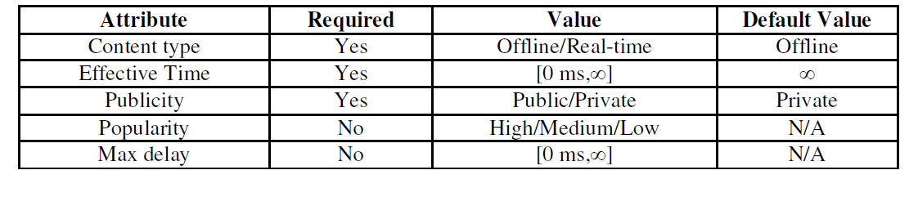
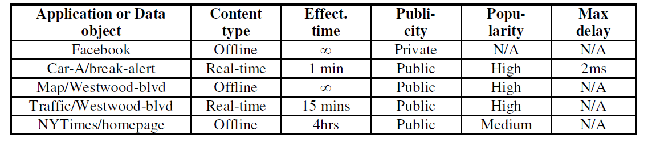
Context: Application
Context: metadata associated with application or data-object
Meta-data Format
Examples

Slide 22
Context: Network Conditions
Associated with Node Metadata
Locally maintained and generated by nodes
Location: GPS coordinates
Neighbor list
Maintained by overhearing the ongoing traffic
Out-of-contact node list
Implicitly detected by observing the retransmission failures towards known destinations
Nodes can:
Retrieve app and net metadata from data chunks
Explicitly request metadata

Slide 23

On-Demand Metadata Dissemination
Provider
Requester
Eligible Source
(Cache)
Exploration Interest
Exploration reply = Source list (ID+location) + metadata
The metadata is propagated to many relays.

Slide 24
Conclusions
Vehicular Cloud: a model for the systematic implementation of services in the vehicular grid
Services to support vehicle app (e.g., safe navigation, intelligent transport, etc.)
Services to support external apps (e.g., surveillance, forensic investigation, etc.)
Recent events favor the development of V2V and thus of Vehicular Cloud services
USDOT V2V endorsement
The emergence of autonomous vehicles (Google Car etc.)
Case study: Content dissem/retrieval service
ICAN = ICN + context (app. and network) awareness

Slide 25
Conclusions (cont)
As vehicles become more autonomous, the need for V2V communications will increase
The wireless radio technology landscape will change dynamically given spectrum scarcity and value
The future autonomous vehicle must be radio and spectrum “agile” in order to deliver safety, efficiency and comfort as promised
To support this, the Vehicle Cloud will offer (via crowd sourcing) spectrum awareness service

