Slide 1

CSE237B Embedded System Software Final Project
Hao Zhuang*, Xinan Wang*
Computer Science & Engineering
University of California, San Diego
Spring 2015
* PhD students
More time?

Slide 2
Outline
Main idea & time synchronize formula
Flow of designed application
Data loss and treatment
Application design
Corresponding optimization approach and results
Video (if necessary)

Slide 3
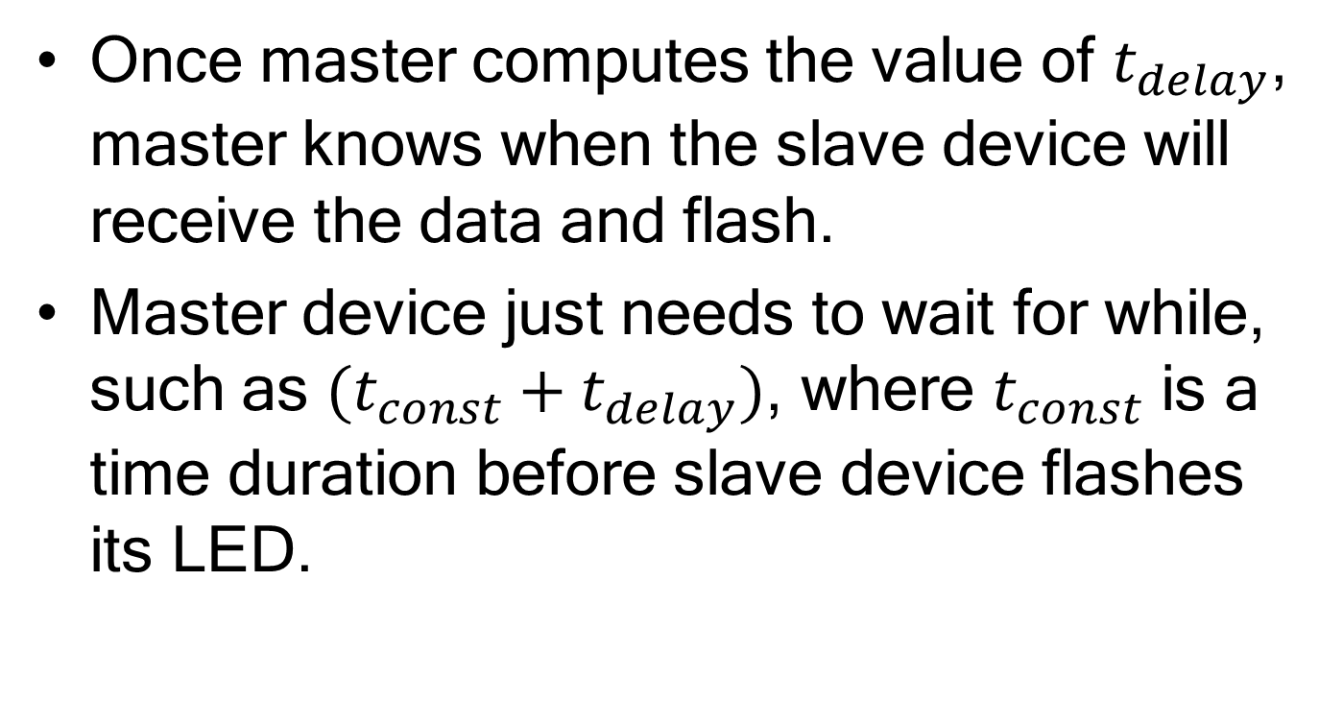
Simple idea (by local time & delay)
Once master computes the value of $t_{delay}$, master knows when the slave device will receive the data and flash.
Master device just needs to wait for while, such as $({t_{const}+t}_{delay})$, where $t_{const}$ is a time duration before slave device flashes its LED.

Slide 4


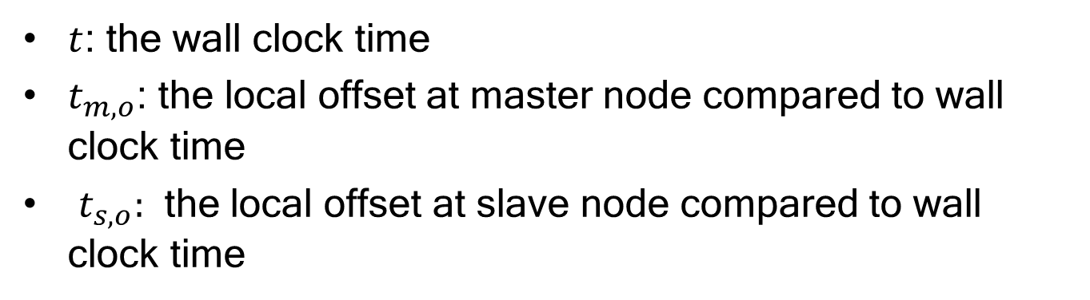
Time Sync.
Slave node
$$t_{s}=t+t_{s,o}$$
Msg send to slave node
$$t_{m}=t+t_{m,o}$$
Msg send back
Master node
$t$: the wall clock time
$t_{m,o}$: the local offset at master node compared to wall clock time
$t_{s,o}:$ the local offset at slave node compared to wall clock time

Slide 5



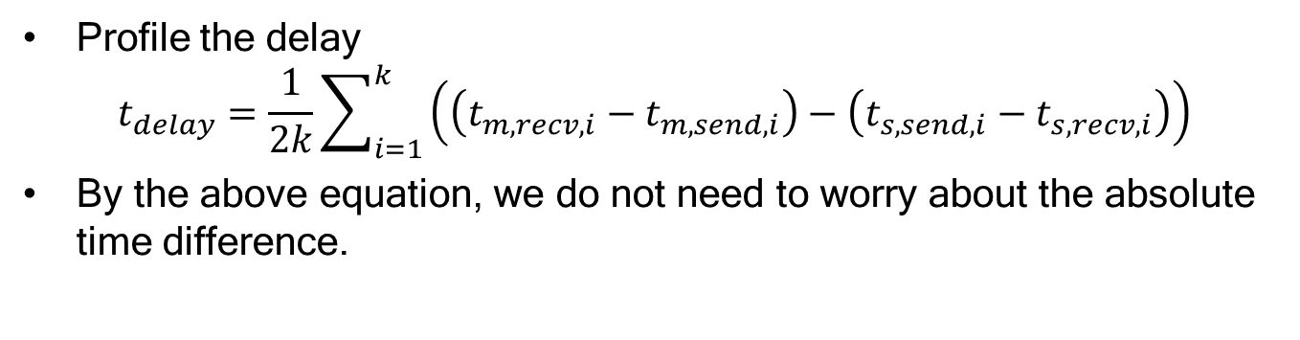





Time Sync.
Slave node
$$t_{s,rev,1}$$
$$t_{s,send,1}$$
$$t_{s,rev,k}$$
$$t_{s,send,k}$$
Msg send to slave node
$$t_{m,send,1}$$
$$t_{m,recv,1}$$
$$t_{m,send,k}$$
$$t_{m,recv,k}$$
Msg send back
Master node
Profile the delay
$$t_{delay}=\frac{1}{2k}\sum_{i=1}^{k}{\left(\left(t_{m,recv,i}−t_{m,send,i}\right)−\left(t_{s,send,i}−t_{s,recv,i}\right)\right)}$$
By the above equation, we do not need to worry about the absolute time difference.

Slide 6
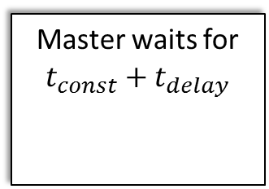
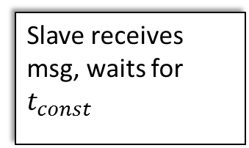
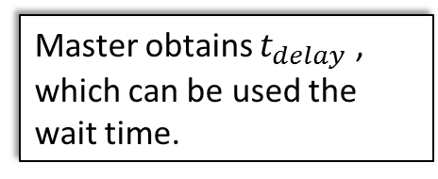
Flow of the Application
Time Sync.: Master & Slave communicate with each other first
Master obtains $t_{delay}$ , which can be used the wait time.
Msg send to slave node
Msg send back
Master sends msg
Xbee transport
Slave device keeps looping
Master waits for $t_{const}+t_{delay}$
Slave receives msg, waits for $t_{const}$
We want they flash at the same wall-clock time
Master device flashes!
Slave device flashes!

Slide 7
Data loss and select
Data loss: xbee (serial port) may miss some bytes, even though it is thought to be reliable.
Based on Piazza: “Data loss should not happen at the serial port, the ZigBee link is a reliable transport. It will retransmit lost data automatically.
The possible reason:
“Eventually it will give up after many retries, but if this is happening, then you have a lot of interferences. What maybe be happening that looks like data loss is overflowing the buffers. If you do not read data quick enough, then eventually the OS throws that data out, especially if more data is incoming.”

Slide 8
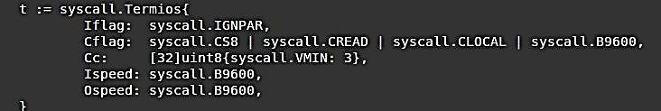
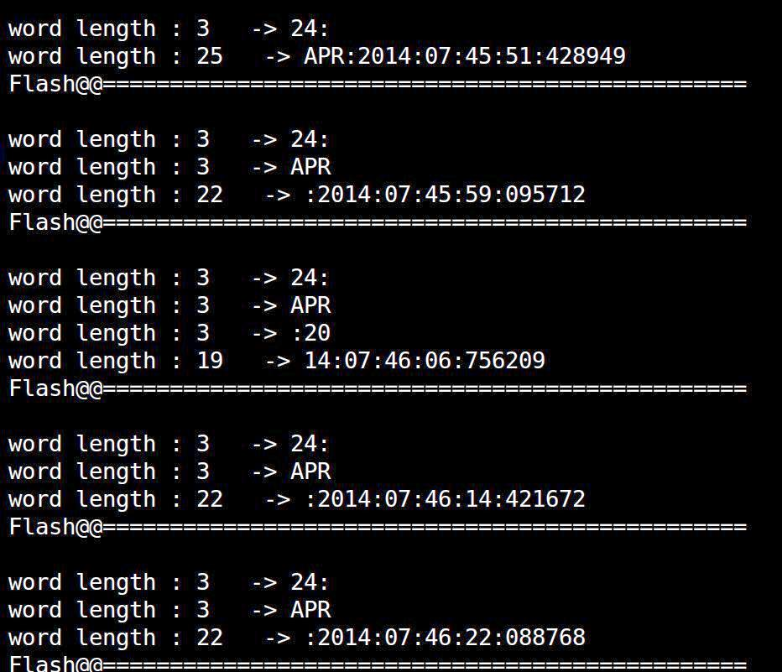
Lower bound of received data size for serial ports
At Sean’s go code for serial port
Limit the package size to 3 instead of 22 in the original code.
Besides, in our code, we use ‘\n’ as terminal character. We pad three copy of ‘\n’.
We still observe the different pattern, but it is more stable than before.
We don’t implement new protocol. Our treatment seems “ugly” but solve problem.
Data received pattern at the slave device

Slide 9
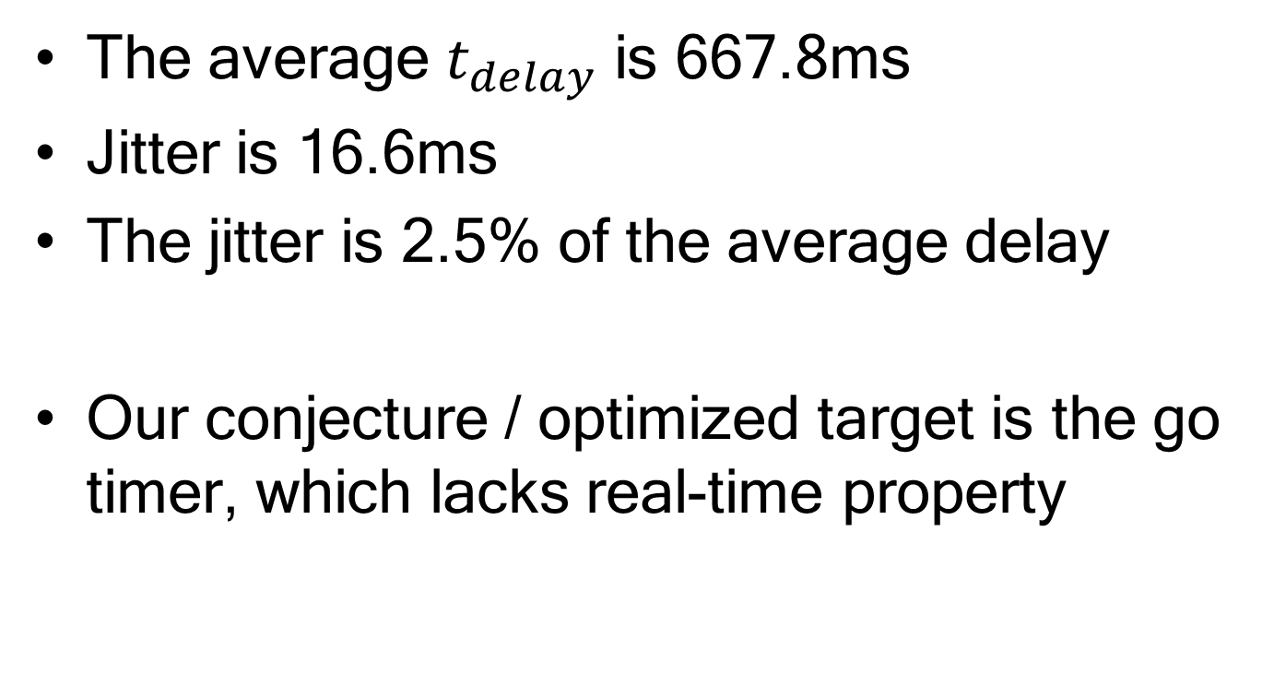
Results
The average $t_{delay}$ is 667.8ms
Jitter is 16.6ms
The jitter is 2.5% of the average delay
Our conjecture / optimized target is the go timer, which lacks real-time property

Slide 10

Flow of the “Busy” Application
A busy real-time server with many concurrent tasks running in background
Time Sync.: Master & Slave communicate with each other first
Master obtains $t_{delay}$ , which can be used the wait time.
Xbee transport
A busy client with many concurrent tasks
Master sends msg
Xbee transport
Master waits for $t_{const}+t_{delay}$
Slave receives msg, waits for $t_{const}$
Timer overhead
Timer overhead
Master device flashes!
Slave device flashes!

Slide 11
Why Timer & Treatment
Google Go language does not aim at REAL real-time.
When there are numbers of gorountine, it will need to switch around ~10ms. The timer inside each goroutine will introduce overhead.
What if we use low-level programming, such as C, when real-time system processing the multi-tasks and still use the majority of application written in Go

Slide 12
Use low level C language as a timer*
Wrap the timefd_create function from C langauge. Replace sleep function in go language
The target: reduce the interference from gorountine scheduling, which might affect the performance for Xbee communications
*thanks Zhou Fang for the discussions

Slide 13
Improvement
 | C timer (ms) | Go timer (ms)
1 | 840.419 | 873.041
2 | 790.126 | 767.778
3 | 810.911 | 970.844
4 | 919.484 | 1018.664
5 | 734.467 | 836.936
Avg delay | 819.08 | 893.45
jitter | 185.02 | 250.89
ms: millisecond

Slide 14
video
@ youtube
Devices
http://youtu.be/ymR_jhiu93w
Screen
http://youtu.be/mLajdNfa5yU
@Dropbox
Devices
https://www.dropbox.com/s/6g9didoirjrwmvl/2015-06-07%2020.01.11.mp4?dl=0
Screen
https://www.dropbox.com/l/Q1BDteJe24nhodVXVy7oMr

Slide 15

Acknowledgement
TA Sean Hamilton’s go code for serial port programming
Zhou Fang’s discussions and the libcgo reference
Thanks to the nice picture from André Mayer, http://www.slideshare.net/andre_mayer/go-21274198
Thanks to the nice picture from original website of Go Language https://golang.org/doc/

