Slide 1
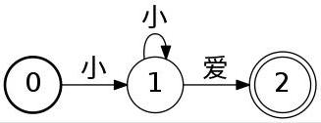
FSA

Slide 2
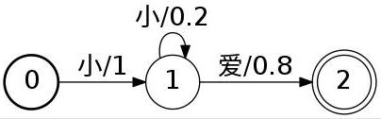
WFSA

Slide 3
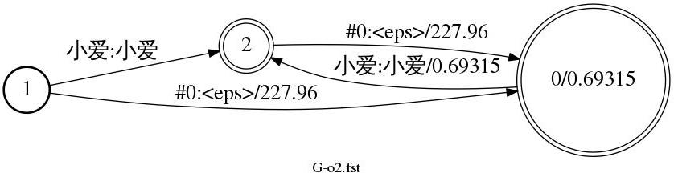
WFST
cat lm-o2.arpa
\data\
ngram 1=3
Ngram 2=2
\1-grams:
-0.30103 </s>
-99 <s> -99
-0.30103 小爱 -99
\2-grams:
0 <s> 小爱
0 小爱 </s>
\end\
arpa2fst --disambig-symbol=#0 --max-arpa-warnings=-1 \
--read-symbol-table=words.txt \
lm-o2.arpa G-o2.fst
fstprint --isymbols=words.txt --osymbols=words.txt G-o2.fst
1 2 小爱 小爱
1 0 #0 <eps> 227.955917
0 2 小爱 小爱 0.693147242
0 0.693147242
2 0 #0 <eps> 227.955917
2

Slide 4
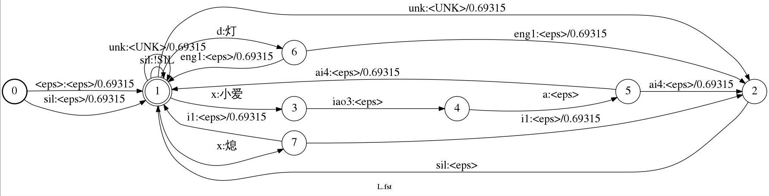
L.FST
$ cat word2phone.txt
小爱 x iao3 a ai4
熄 x i1
灯 d eng1
$ fstprint --isymbols=data/lang/phones.txt --osymbols=data/lang/words.txt data/lang/L.fst
0 1 <eps> <eps> 0.693147182
0 1 sil <eps> 0.693147182
1 1 sil !SIL
1 1 unk <UNK> 0.693147182
1 2 unk <UNK> 0.693147182
1 3 x 小爱
1 6 d 灯
1 7 x 熄
1
2 1 sil <eps>
3 4 iao3 <eps>
4 5 a <eps>
5 1 ai4 <eps> 0.693147182
5 2 ai4 <eps> 0.693147182
6 1 eng1 <eps> 0.693147182
6 2 eng1 <eps> 0.693147182
7 1 i1 <eps> 0.693147182
7 2 i1 <eps> 0.693147182

Slide 5

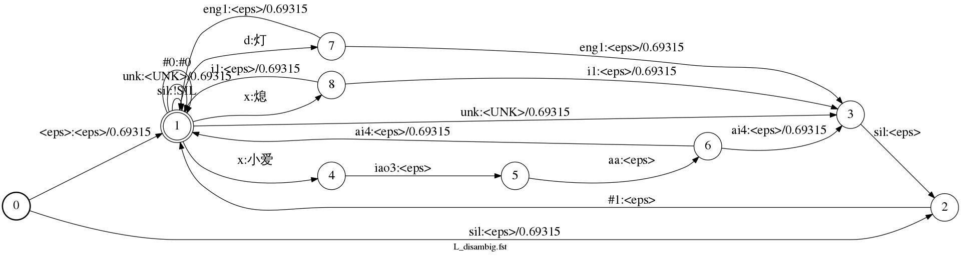
L.fst与L_disambig.fst

Slide 6
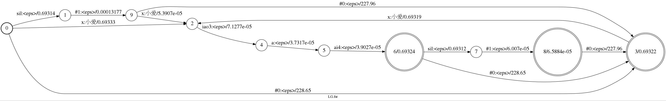
LG.fst = L_disambig.fst o G.fst

