Slide 1
基于多组学（多模态）数据的胃腺癌分型（分类）研究

Slide 2
实验背景
Gastric cancer was the world’s third leading cause of cancer mortality in 2012, responsible for 723,000 deaths.
The vast majority of gastric cancers are adenocarcinomas, which can be further subdivided into intestinal and diffuse types according to the Lauren classification.
An alternative system, proposed by the World Health Organization, divides gastric cancer into papillary【乳突的】, tubular【管状的】, mucinous (colloid) 【黏液的】and poorly cohesive 【低分化】carcinomas.
These classification systems have little clinical utility, making the development of robust classifiers that can guide patient therapy an urgent priority.

Slide 3
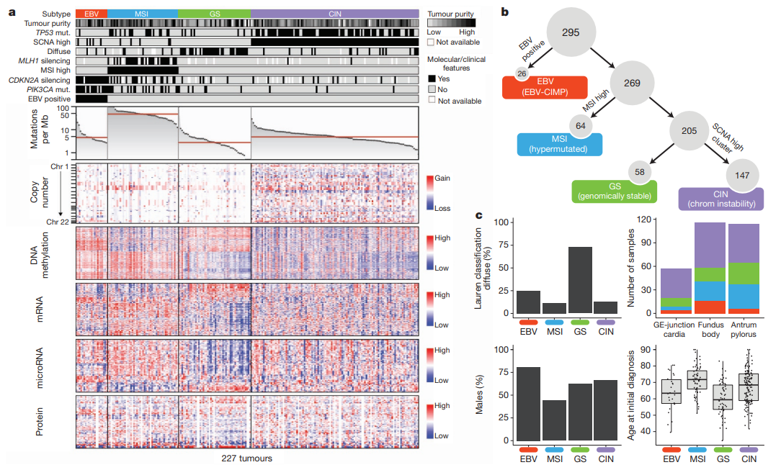
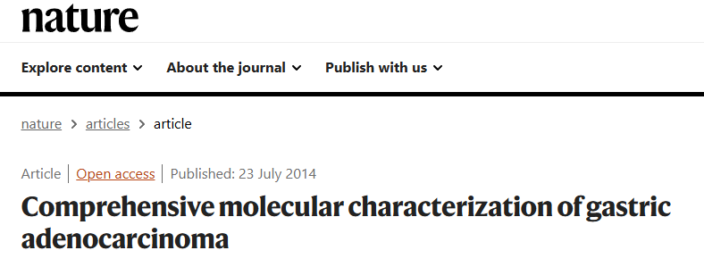
Gastric Adenocarcinoma

Slide 4
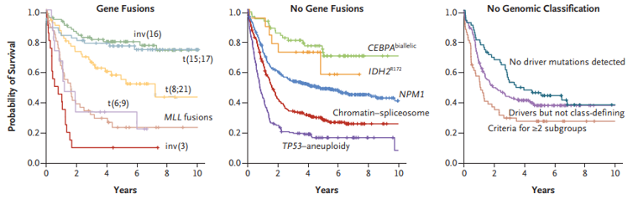
实验设计
实验目的：建立一个鲁棒的具有临床意义的胃癌分型系统
实验数据：遗传变异（突变谱、拷贝数变异谱）、DNA甲基化数据、基因表达数据、miRNA表达数据、蛋白质数据、表型数据（临床特征和随访数据）。
数据类型：连续型、离散型。
实验方法：例如无监督聚类、支持向量机、基于网络的方法等。
结果评估：例如鲁棒性、临床相关性、与前人结果比较等。
项目分工：提交实验报告时，请明确说明项目分工和贡献度。
提交时间：2025年5月25日前。

Slide 5
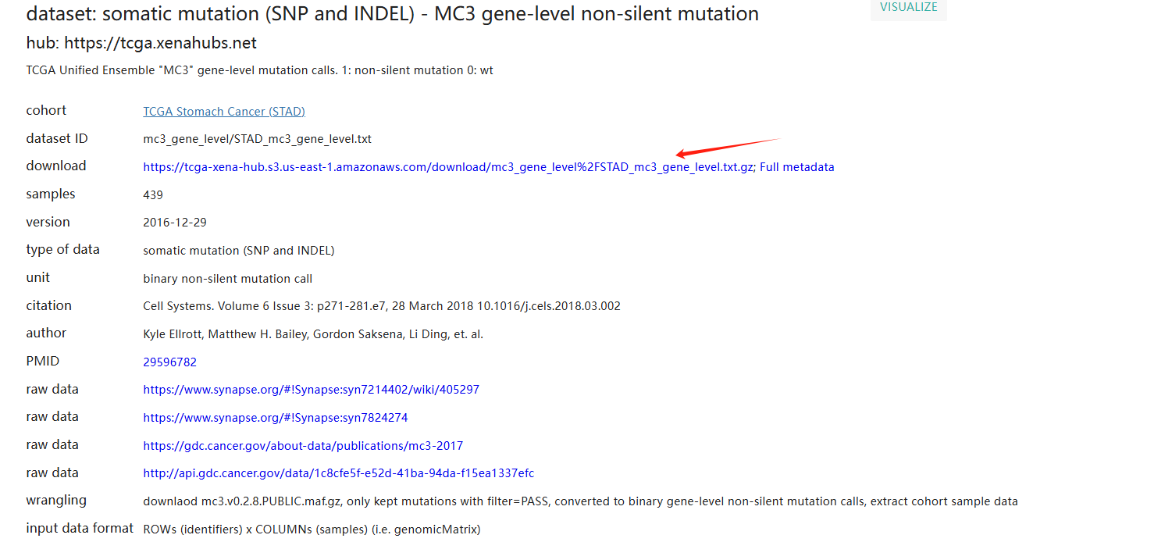
Somatic mutation (SNP and INDEL)
网址：https://xenabrowser.net/datapages/?dataset=mc3_gene_level%2FSTAD_mc3_gene_level.txt&host=https%3A%2F%2Ftcga.xenahubs.net&removeHub=https%3A%2F%2Fxena.treehouse.gi.ucsc.edu%3A443

Slide 6
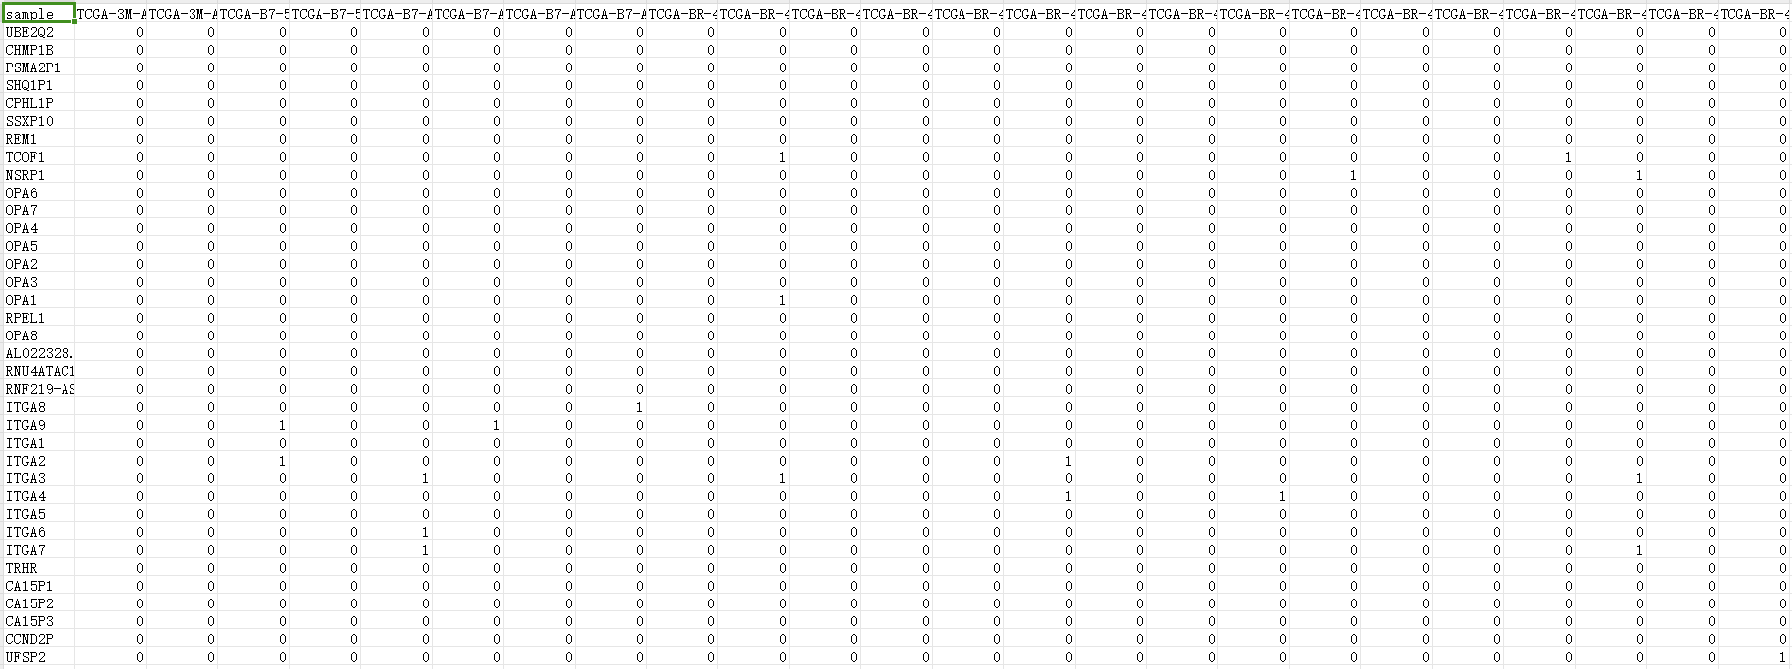
Somatic mutation (SNP and INDEL)
备注：TCGA Unified Ensemble "MC3" gene-level mutation calls. 1: non-silent mutation 0: wt

Slide 7
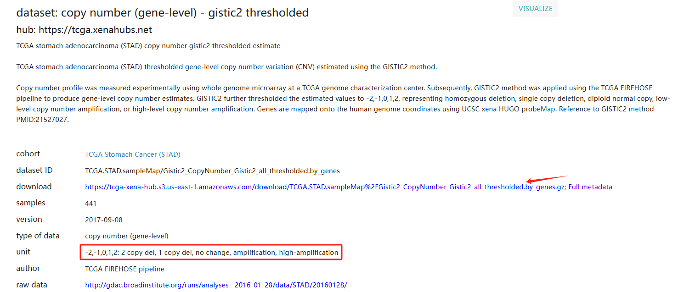
Copy number (gene-level)
网址：https://xenabrowser.net/datapages/?dataset=TCGA.STAD.sampleMap%2FGistic2_CopyNumber_Gistic2_all_thresholded.by_genes&host=https%3A%2F%2Ftcga.xenahubs.net&removeHub=https%3A%2F%2Fxena.treehouse.gi.ucsc.edu%3A443

Slide 8
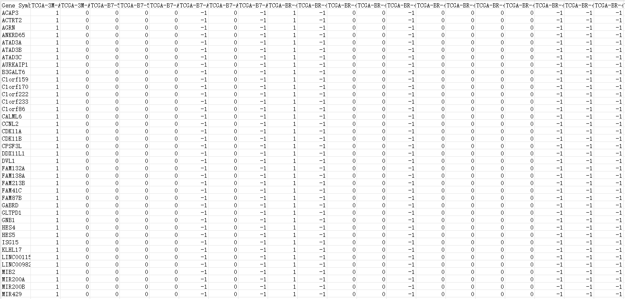
Copy number (gene-level)
备注：GISTIC2 further thresholded the estimated values to -2,-1,0,1,2, representing homozygous deletion, single copy deletion, diploid normal copy, low-level copy number amplification, or high-level copy number amplification.

Slide 9
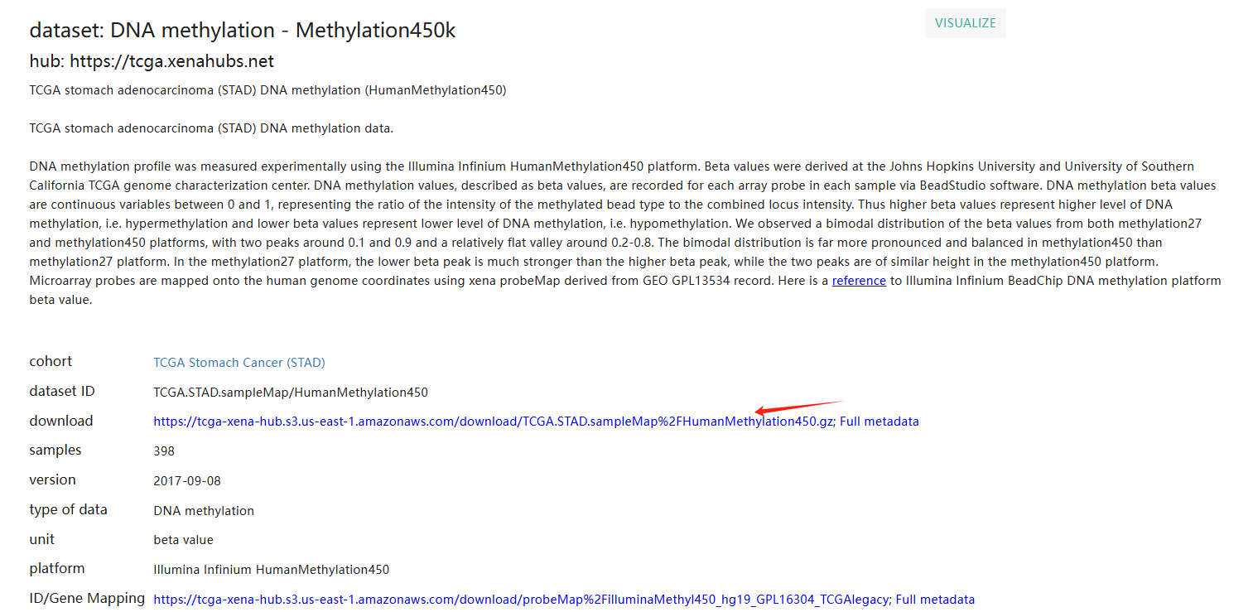
DNA methylation - Methylation450k
网址：https://xenabrowser.net/datapages/?dataset=TCGA.STAD.sampleMap%2FHumanMethylation450&host=https%3A%2F%2Ftcga.xenahubs.net&removeHub=https%3A%2F%2Fxena.treehouse.gi.ucsc.edu%3A443

Slide 10
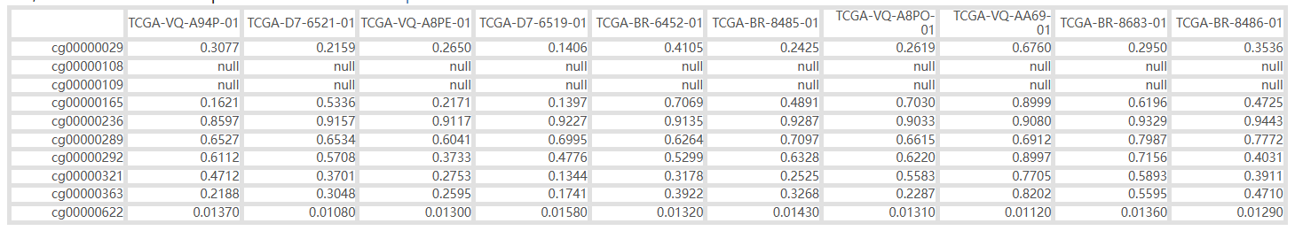
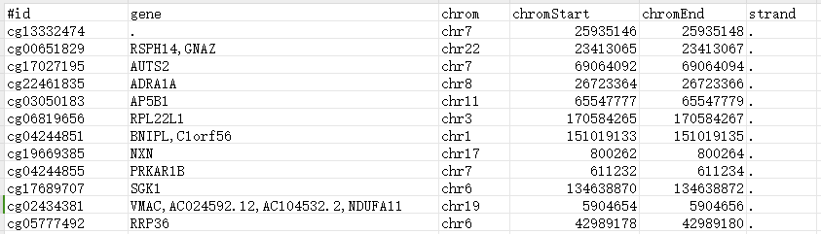
DNA methylation - Methylation450k
备注：DNA methylation beta values are continuous variables between 0 and 1.
Thus higher beta values represent higher level of DNA methylation, i.e. hypermethylation and lower beta values represent lower level of DNA methylation, i.e. hypomethylation.

Slide 11
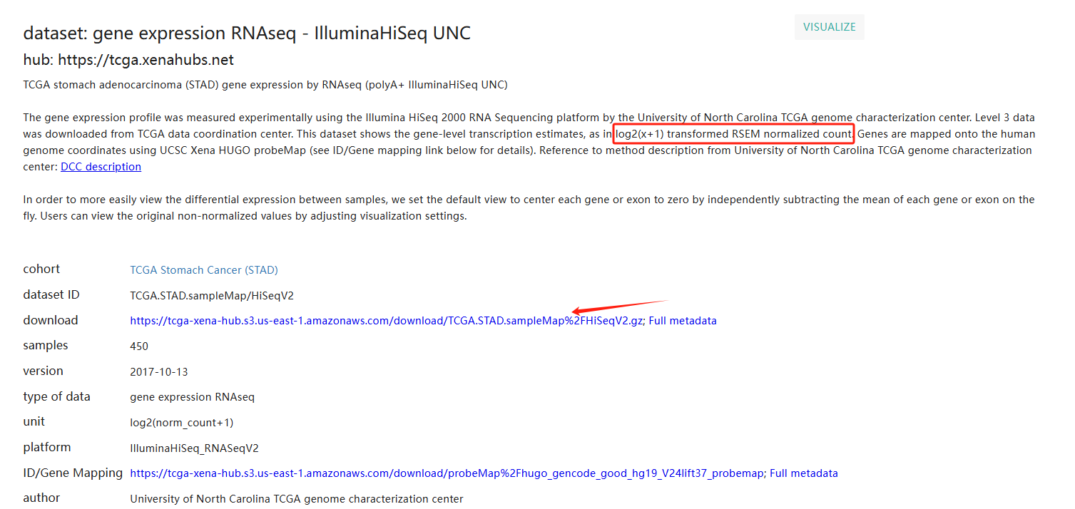
Gene expression RNAseq-IlluminaHiSeq
网址：https://xenabrowser.net/datapages/?dataset=TCGA.STAD.sampleMap%2FHiSeqV2&host=https%3A%2F%2Ftcga.xenahubs.net&removeHub=https%3A%2F%2Fxena.treehouse.gi.ucsc.edu%3A443

Slide 12
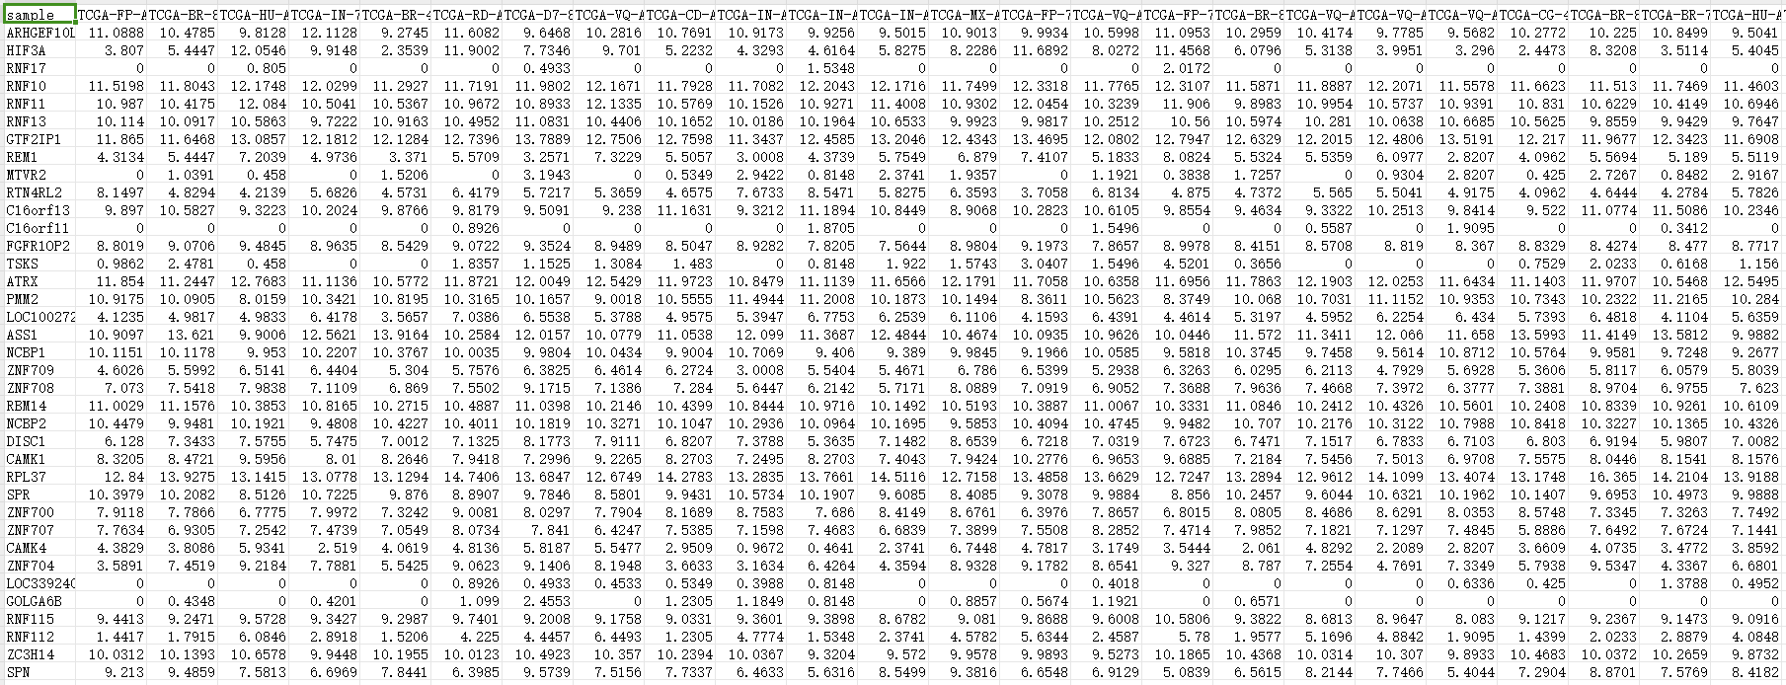
Gene expression RNAseq-IlluminaHiSeq
备注：This dataset shows the gene-level transcription estimates, as in log2(x+1) transformed RSEM normalized count.

Slide 13
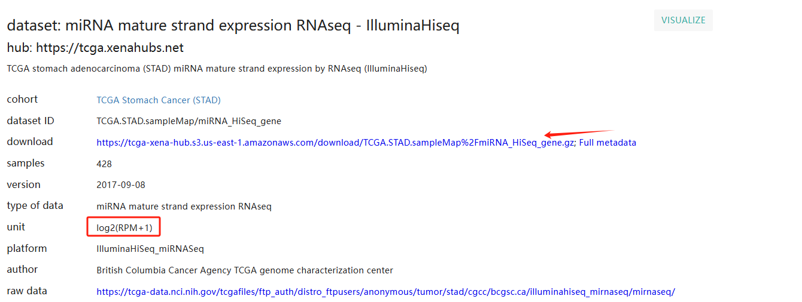
miRNA mature strand expression RNAseq - IlluminaHiseq
网址：https://xenabrowser.net/datapages/?dataset=TCGA.STAD.sampleMap%2FmiRNA_HiSeq_gene&host=https%3A%2F%2Ftcga.xenahubs.net&removeHub=https%3A%2F%2Fxena.treehouse.gi.ucsc.edu%3A443

Slide 14
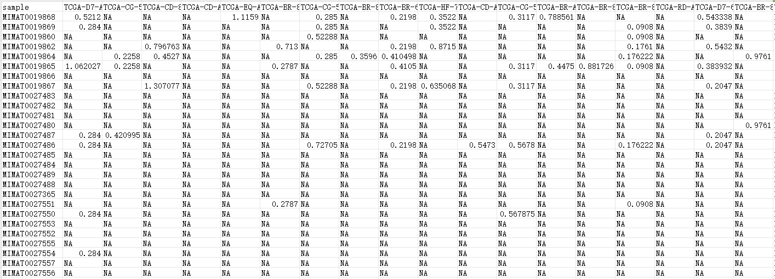
miRNA mature strand expression RNAseq - IlluminaHiseq
备注：For each sample, all isoform expression for the same miRNA mature strand are added together, log2(total_RPM +1) transformed.

Slide 15
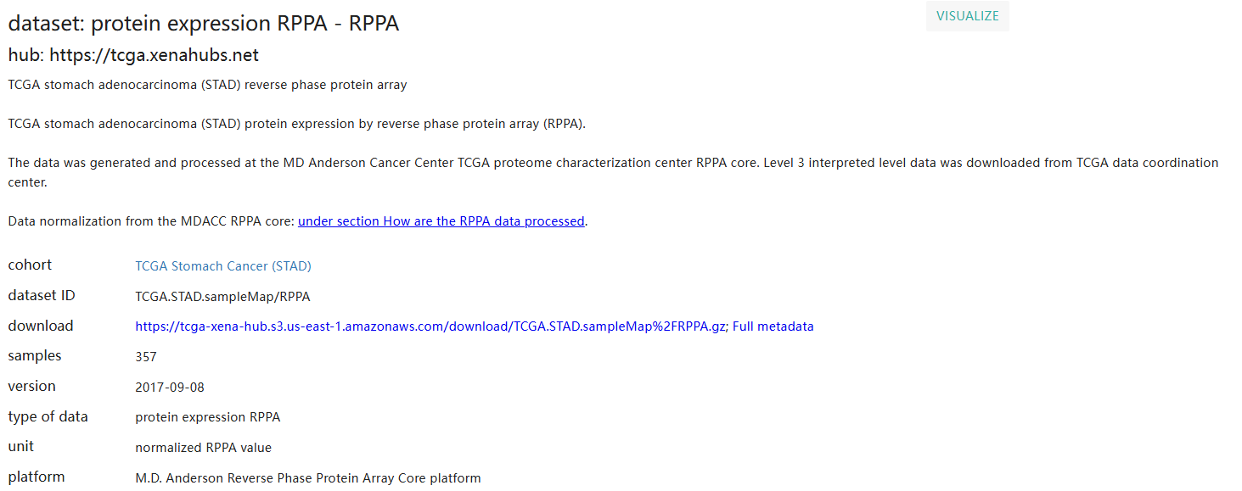
Protein expression RPPA
网址：https://xenabrowser.net/datapages/?dataset=TCGA.STAD.sampleMap%2FRPPA&host=https%3A%2F%2Ftcga.xenahubs.net&removeHub=https%3A%2F%2Fxena.treehouse.gi.ucsc.edu%3A443

Slide 16
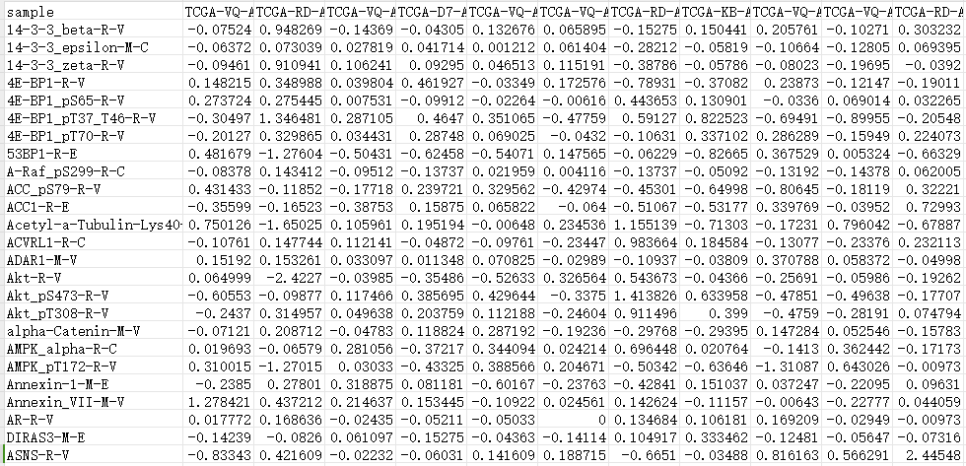
Protein expression RPPA
备注：Data normalization.

Slide 17
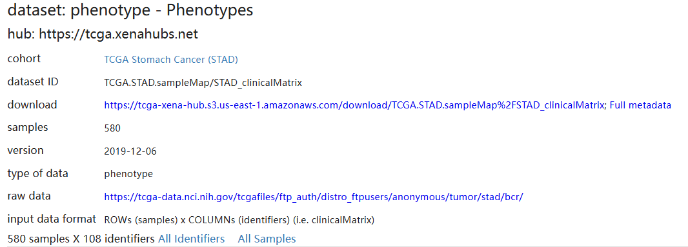
Phenotype
网址：https://xenabrowser.net/datapages/?dataset=TCGA.STAD.sampleMap%2FSTAD_clinicalMatrix&host=https%3A%2F%2Ftcga.xenahubs.net&removeHub=https%3A%2F%2Fxena.treehouse.gi.ucsc.edu%3A443

Slide 18
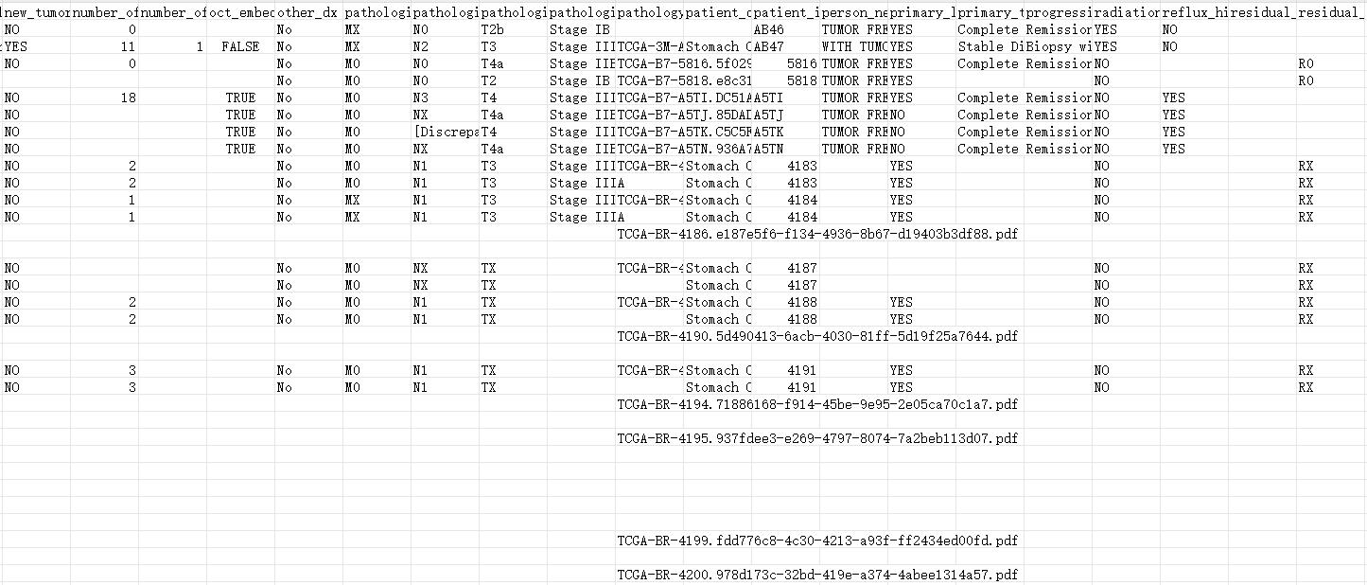
Phenotype
备注：580 samples X 108 identifiers.

Slide 19
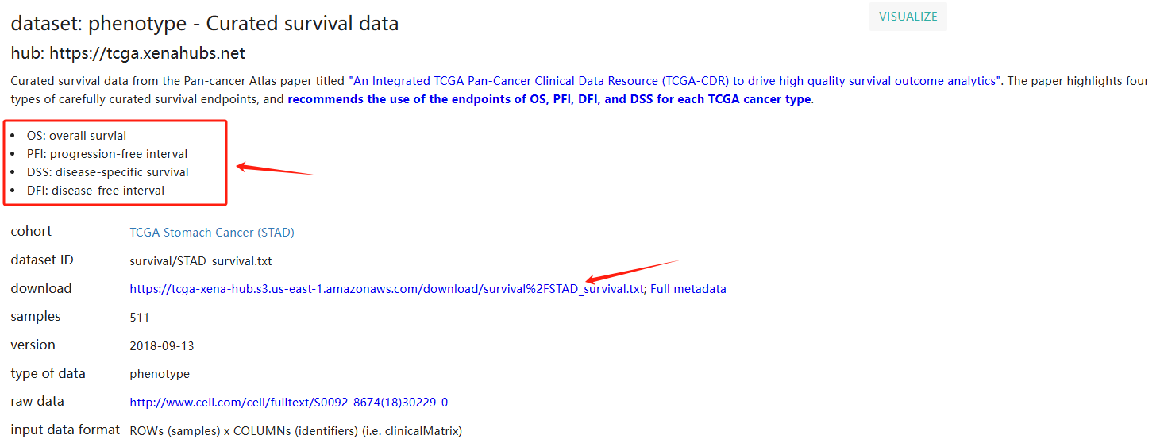
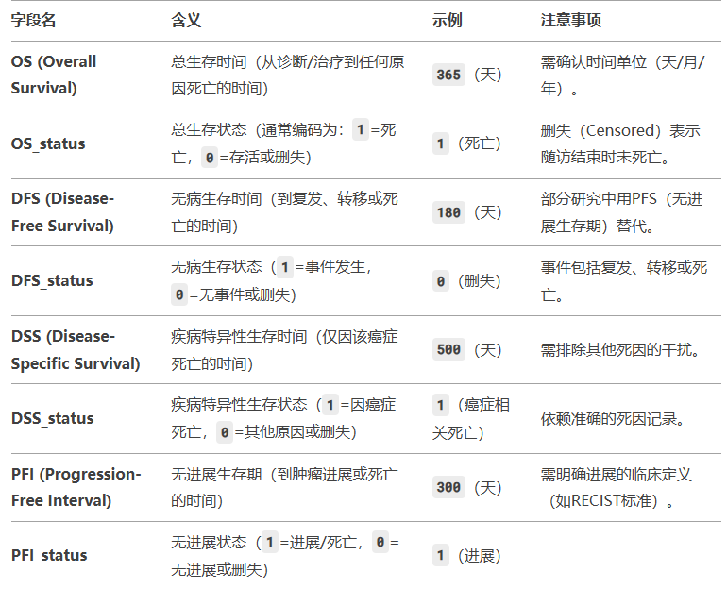
Phenotype - Curated survival data
网址：https://xenabrowser.net/datapages/?dataset=survival%2FSTAD_survival.txt&host=https%3A%2F%2Ftcga.xenahubs.net&removeHub=https%3A%2F%2Fxena.treehouse.gi.ucsc.edu%3A443

Slide 20
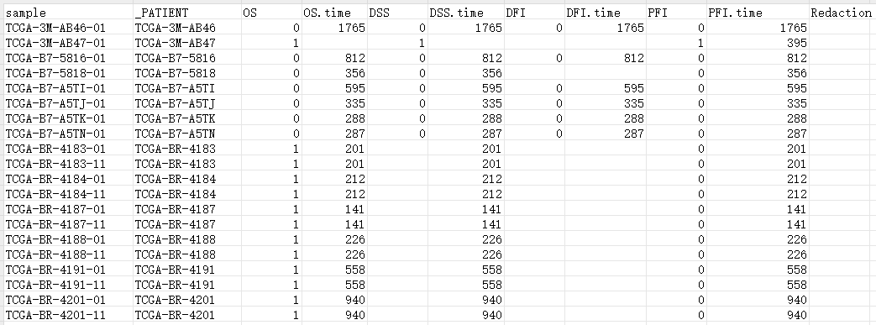
Phenotype - Curated survival data
备注：Curated survival data from the Pan-cancer Atlas paper titled "An Integrated TCGA Pan-Cancer Clinical Data Resource (TCGA-CDR) to drive high quality survival outcome analytics". The paper highlights four types of carefully curated survival endpoints, and recommends the use of the endpoints of OS, PFI, DFI, and DSS for each TCGA cancer type.

Slide 21
剩下课程安排
第八周（4月18/19日），实验课，旗山东1-303
第九周（4月25/26日），实验课，旗山东1-303
第十一周（5月9/10日），理论课（小组进展汇报、答疑），旗山东3-307
考试时间：拟定于第十二周（5月17号/周六晚19:00-20:30）
考试地点：等待学院安排，群上通知
实验报告提交时间：第十三周（5月25号之前），邮箱：bioinformatics_fzu@163.com

Slide 22
福州大学科技园7号楼5层512
医工交叉研究院
医疗大数据与智能医学
邮箱：bioinformatics_fzu@163.com
QQ群号: 1003742409

