Slide 1

法律声明
本课件包括：演示文稿，示例，代码，题库，视频和声音等，小象学院拥有完全知识产权的权利；只限于善意学习者在本课程使用，不得在课程范围外向任何第三方散播。任何其他人或机构不得盗版、复制、仿造其中的创意，我们将保留一切通过法律手段追究违反者的权利。
课程详情请咨询
微信公众号：小象
新浪微博：ChinaHadoop

Slide 2
神经序列模型 V
主讲人： 史兴
07/26/2017

Slide 3
提纲
勘误：RNNLM实现细节
Seq2Seq 实现细节
Attention 实现细节
勘误：LSTM 与 beam_search
Beam Search 实现细节

Slide 4
勘误：RNNLM实现细节
多层lstm的实现
错误的代码：
seqModel.py:108
single_cell = tf.contrib.rnn.MultiRNNCell([single_cell] * num_layers, state_is_tuple=True)
导致每层的参数共享

Slide 5
勘误：RNNLM实现细节
多层lstm的实现
正确的代码：
seqModel.py:103-116
single_cell = tf.contrib.rnn.MultiRNNCell([lstm_cell() for _ in xrange(num_layers)], state_is_tuple=True)

Slide 6
Seq2Seq 代码实现
地址：https://github.com/shixing/xing_nlp/tree/master/Seq2Seq
文件夹说明

Slide 7
Seq2Seq 代码实现
run.py
_buckets
def train() #训练
def read_data() #数据填入buckets
输入语句的反向
在输出语句末尾添加EOS
def beam_decode() #beam search
def read_data_test() #测试数据读取

Slide 8
Seq2Seq 代码实现
seqModel.py
def __init__() # 初始化
注意多层LSTM的实现

Slide 9
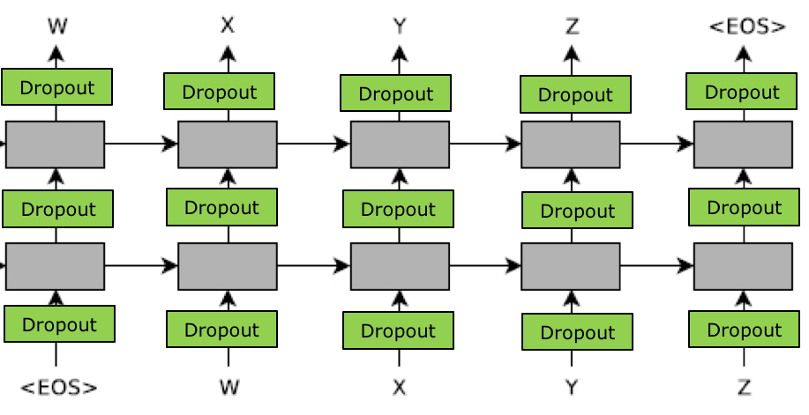
Seq2Seq 代码实现
self.losses = [ loss1, loss2 ]
self.source_embed = [ ] [ ]

Slide 10
Seq2Seq 代码实现
seqModel.py
def get_batch() #增加padding
source在前面加padding, target在后面加padding
a b c -> 1 2 3 _EOS
_PAD _PAD a b c -> 1 2 3 _EOS _PAD
def basic_seq2seq() # 连接encoder decoder
注意scope问题

Slide 11
Seq2Seq 代码实现
运行代码
/sh: bash train_small.sh
字符串复制问题
a, b, c → a, b, c
理想的PPT应该是多少？

Slide 12
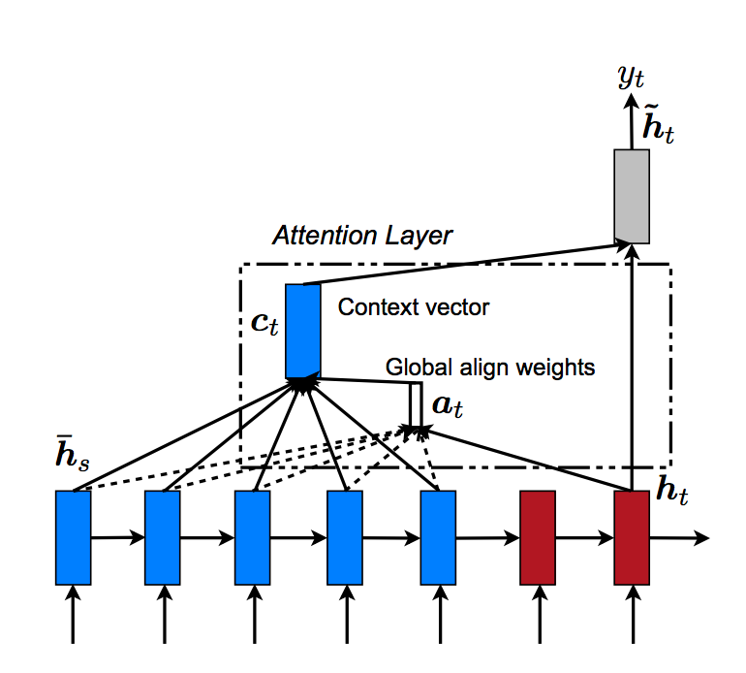
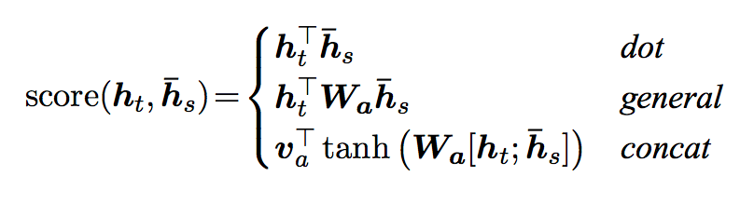
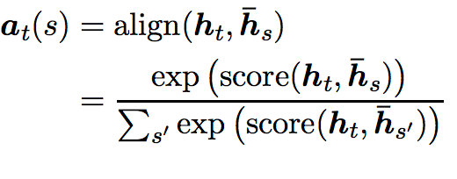


Attention 代码实现
Attention
$$c_{t}=\sum_{s′}{a_{t}\left(s^{′}\right)}\overline{h_{s′}}$$
Figure from https://arxiv.org/pdf/1508.04025.pdf

Slide 13
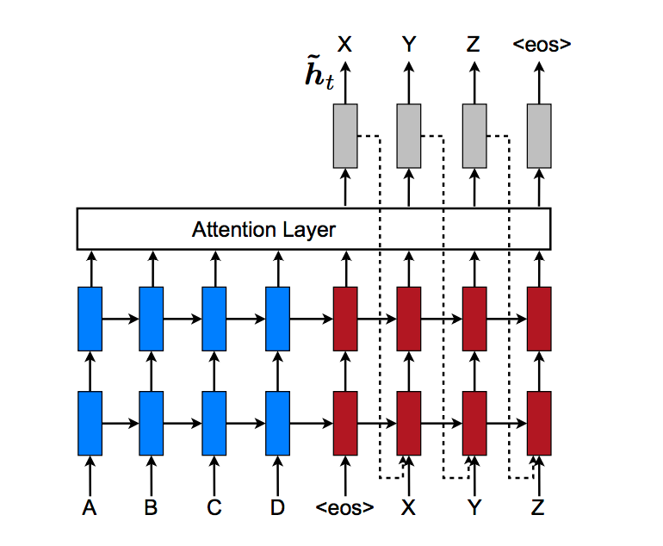
Attention
Attention
feed-input：下一个单词知道上一个单词的attention
Figure from https://arxiv.org/pdf/1508.04025.pdf

Slide 14
Attention 代码实现
seqModel.py
def attention_seq2seq()
conv2d

Slide 15
勘误：LSTM 与 beam_search
下图表示实际是带有markov假设的
p(e1|F)
p(e1|F)
p(e2|e1,F)
p(e2|e1)
p(e3|e2,e1,F)
p(e3|e2)
Markov
e1
e2
e3
a
0.3
0.4
0.3
a
0.4
0.4
0.2
a
0.5
F
0.4
0.2
0.4
0.3
0.4
0.3
b
b
b
0.3
0.2
c
0.5
0.2
0.3
c
0.7
0.1
0.2
c
15

Slide 16
勘误：LSTM 与 beam_search
LSTM并没有markov假设
F | p(e1|F) | e1 | p(e2|e1,F) | e2 | p(e3|e2,e1,F) | e3
F | 0.3 | a | 0.8 | a | 0.3 | a
 |  |  |  |  | 0.7 | b
 |  |  | 0.2 | b | 0.8 | a
 |  |  |  |  | 0.2 | b
 | 0.7 | a | 0.5 | a | 0.3 | a
 |  |  |  |  | 0.7 | b
 |  |  | 0.5 | b | 0.5 | a
 |  |  |  |  | 0.5 | b
16

Slide 17

勘误：LSTM 与 beam_search
最优解：穷举法 $O({\left|V\right|}^{N})$
F | p(e1|F) | e1 | p(e2|e1,F) | e2 | p(e3|e2,e1,F) | e3
F | 0.3 | a | 0.8 | a | 0.3 | a
 |  |  |  |  | 0.7 | b
 |  |  | 0.2 | b | 0.8 | a
 |  |  |  |  | 0.2 | b
 | 0.7 | a | 0.5 | a | 0.3 | a
 |  |  |  |  | 0.7 | b
 |  |  | 0.5 | b | 0.5 | a
 |  |  |  |  | 0.5 | b
17

Slide 18
勘误：LSTM 与 beam_search
Beam Search (beam_size = 2)
F | p(e1|F) | e1 | p(e2|e1,F) | e2 | p(e3|e2,e1,F) | e3
F | 0.3 | a | 0.8 | a | 0.3 | a
 |  |  |  |  | 0.7 | b
 |  |  | 0.2 | b | 0.8 | a
 |  |  |  |  | 0.2 | b
 | 0.7 | b | 0.5 | a | 0.3 | a
 |  |  |  |  | 0.7 | b
 |  |  | 0.5 | b | 0.5 | a
 |  |  |  |  | 0.5 | b
b : 0.7
a : 0.3
18

Slide 19
勘误：LSTM 与 beam_search
Beam Search (beam_size = 2)
F | p(e1|F) | e1 | p(e2|e1,F) | e2 | p(e3|e2,e1,F) | e3
F | 0.3 | a | 0.8 | a | 0.3 | a
 |  |  |  |  | 0.7 | b
 |  |  | 0.2 | b | 0.8 | a
 |  |  |  |  | 0.2 | b
 | 0.7 | b | 0.5 | a | 0.3 | a
 |  |  |  |  | 0.7 | b
 |  |  | 0.5 | b | 0.5 | a
 |  |  |  |  | 0.5 | b
b : 0.7 | ba: 0.35
a : 0.3 | bb: 0.35
19

Slide 20
勘误：LSTM 与 beam_search
Beam Search (beam_size = 2)
F | p(e1|F) | e1 | p(e2|e1,F) | e2 | p(e3|e2,e1,F) | e3
F | 0.3 | a | 0.8 | a | 0.3 | a
 |  |  |  |  | 0.7 | b
 |  |  | 0.2 | b | 0.8 | a
 |  |  |  |  | 0.2 | b
 | 0.7 | b | 0.5 | a | 0.3 | a
 |  |  |  |  | 0.7 | b
 |  |  | 0.5 | b | 0.5 | a
 |  |  |  |  | 0.5 | b
b : 0.7 | ba: 0.35 | bab: 0.245
a : 0.3 | bb: 0.35 | bba: 0.175
20

Slide 21


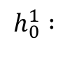

勘误：LSTM 与 beam_search
潜在Bug#1
a:0.3 b:0.7
a:0.3 b:0.7
a:0.3 b:0.7
a:0.3 b:0.7
错误：
$$h_{0}^{2},c_{0}^{2}$$
$$h_{0}^{1},c_{0}^{1}$$
f1 f2 f3
_GO
_GO
[0.2,-0.3]
[0.2,-0.3]
$$h_{1}^{1} :$$
[1.0,-3.3]
[1.0,-3.3]
$$h_{0}^{1} :$$
=》
21

Slide 22

勘误：LSTM 与 beam_search
a:0.5 b:0.5
a:0.8 b:0.2
$$h_{0}^{2},c_{0}^{2}$$
$$h_{0}^{1},c_{0}^{1}$$
f1 f2 f3
b
a
[1.0,-3.3]
[1.0,-3.3]
[-1.3,-0.3]
[1.1,-1.5]
[-1.3,-0.3]
[-1.3,-0.3]
$$h_{1}^{1} :$$
=》
$$h_{2}^{1} :$$
=》
潜在Bug#2
22

Slide 23


勘误：LSTM 与 beam_search
a:0.3 b:0.7
a:0.5 b:0.5
$$h_{0}^{2},c_{0}^{2}$$
$$h_{0}^{1},c_{0}^{1}$$
f1 f2 f3
a
b
[-1.3,-0.3]
[-1.3,-0.3]
[-1.5,-2.3]
[1.8,-2.1]
$$h_{2}^{1} :$$
=》
$$h_{3}^{1} :$$
23

Slide 24
勘误：LSTM 与 beam_search
a:0.3 b:0.7
a:0.5 b:0.5
$$h_{0}^{2},c_{0}^{2}$$
$$h_{0}^{1},c_{0}^{1}$$
f1 f2 f3
a
b
[-1.3,-0.3]
[-1.3,-0.3]
[-1.5,-2.3]
[1.8,-2.1]
$$h_{2}^{1} :$$
=》
$$h_{3}^{1} :$$
24

Slide 25
Beam Search 代码实现
Single-step Decoder
self.top_index
self.top_value
self.eos_value
a:0.3 b:0.7
a:0.5 b:0.5
$$h_{0}^{2},c_{0}^{2}$$
decode2after_ops
$$h_{0}^{1},c_{0}^{1}$$
encode2before_ops
f1 f2 f3
a
b
self.sources
self.after_state
[-1.5,-2.3]
[1.8,-2.1]
self.beam_parent
[0,0]
self.inputs
红色：placeholder
蓝色：variable
箭头：operation
self.before_state
[-1.3,-0.3]
[-1.2,-0.5]
after2before_ops
25

Slide 26
Beam Search 代码实现
Single-step Decoder
$$h_{0}^{2},c_{0}^{2}$$
$$h_{0}^{1},c_{0}^{1}$$
encode2before_ops
f1 f2 f3
self.sources
红色：placeholder
蓝色：variable
箭头：operation
self.before_state
[-1.3,-0.3]
[-1.2,-0.5]
26

Slide 27
Beam Search 代码实现
Single-step Decoder
self.top_index
self.top_value
self.eos_value
a:0.3 b:0.7
a:0.5 b:0.5
decode2after_ops
a
b
self.after_state
[-1.5,-2.3]
[1.8,-2.1]
self.inputs
红色：placeholder
蓝色：variable
箭头：operation
self.before_state
[-1.3,-0.3]
[-1.2,-0.5]
27

Slide 28
Beam Search 代码实现
Single-step Decoder
self.after_state
[-1.5,-2.3]
[1.8,-2.1]
self.beam_parent
[0,0]
红色：placeholder
蓝色：variable
箭头：operation
self.before_state
[-1.3,-0.3]
[-1.2,-0.5]
after2before_ops
28

Slide 29
Beam Search 代码实现
self.top_index
self.top_value
self.eos_value
a:0.3 b:0.7
a:0.5 b:0.5
beam_step(index=0)
$$h_{0}^{2},c_{0}^{2}$$
decode2after_ops
$$h_{0}^{1},c_{0}^{1}$$
encode2before_ops
f1 f2 f3
a
b
self.sources
self.after_state
[-1.5,-2.3]
[1.8,-2.1]
self.inputs
红色：placeholder
蓝色：variable
箭头：operation
self.before_state
[-1.3,-0.3]
[-1.2,-0.5]
29

Slide 30
Beam Search 代码实现
self.top_index
self.top_value
self.eos_value
a:0.3 b:0.7
a:0.5 b:0.5
beam_step(index>0)
decode2after_ops
a
b
self.sources
self.after_state
[-1.5,-2.3]
[1.8,-2.1]
self.beam_parent
[0,0]
self.inputs
红色：placeholder
蓝色：variable
箭头：operation
self.before_state
[-1.3,-0.3]
[-1.2,-0.5]
after2before_ops
30

Slide 31
Beam Search 代码实现
run.py
beam_decode()
潜在bug#1
EOS
当生成EOS的时候，就加入候选句子中
最后一步时，直接强制输出beam中所有的句子，需要查询EOS的值
最长最短的控制(max_ratio, min_ratio)

Slide 32
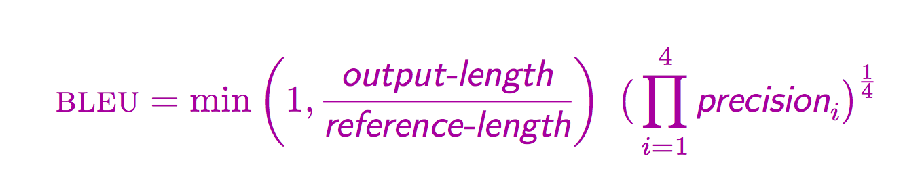
Beam Search 代码实现
BLEU score
评价机器翻译的标准

Slide 33
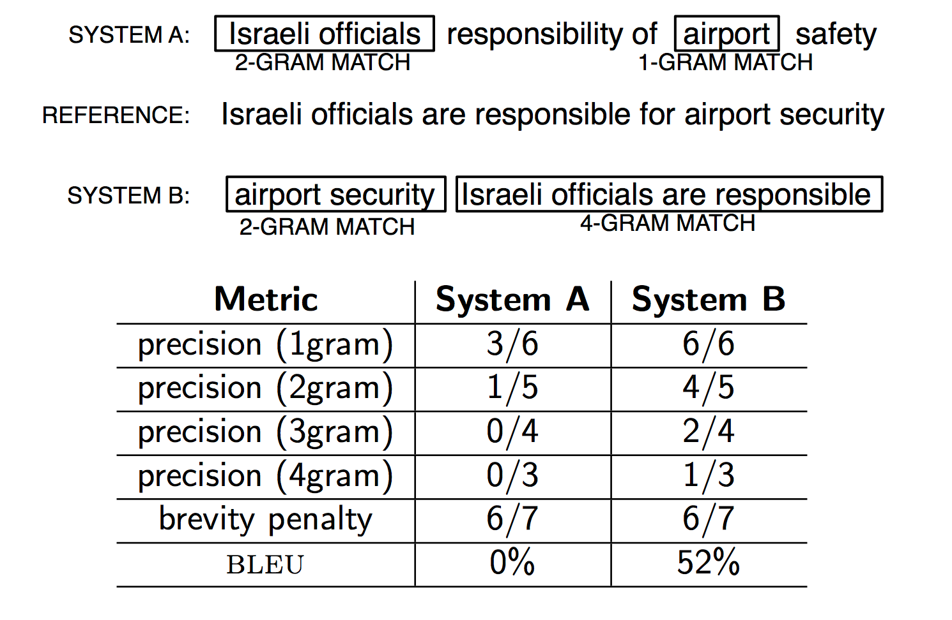
Beam Search 代码实现
BLEU score

Slide 34
Beam Search 代码实现
BLEU score
bash beam_decode_small.sh
bash bleu_small.sh

Slide 35
Beam Search 代码实现
高难度，高价值的作业
实现attention model的beam search
def beam_attention_seq2seq()
feed_input是否需要加before_ht_att和after_ht_att

Slide 36

联系我们
小象学院：互联网新技术在线教育领航者
微信公众号：大数据分析挖掘
新浪微博：ChinaHadoop

