Slide 1

法律声明
本课件包括：演示文稿，示例，代码，题库，视频和声音等，小象学院拥有完全知识产权的权利；只限于善意学习者在本课程使用，不得在课程范围外向任何第三方散播。任何其他人或机构不得盗版、复制、仿造其中的创意，我们将保留一切通过法律手段追究违反者的权利。
课程详情请咨询
微信公众号：小象
新浪微博：ChinaHadoop

Slide 2
神经序列模型 VI
主讲人： 史兴
07/28/2017

Slide 3
提纲
Beam Search 实现细节(续)
Seq2Seq 模型可视化
Hidden States 可视化
Word Embedding 可视化
Attention 可视化

Slide 4
Beam Search 实现细节(续)
Tensorflow 一般的工作流程
1)“画图”：构造计算图(computation graph)
入口： placeholder
出口：任何一个可以计算的操作(operation)或者中间变量(tensor)
parameters
5
tensor/op
3
6
4
placeholder
1
2

Slide 5
Beam Search 实现细节(续)
Tensorflow 一般的工作流程
1)“画图”：构造计算图(computation graph)
2) 对图进行“编译”：必要的优化
构建图和编译图都是比较耗时的
一旦图画好，后续的操作最好不要对图进行更改
parameters
5
tensor/op
3
6
4
placeholder
1
2

Slide 6
Beam Search 实现细节(续)
Tensorflow 一般的工作流程
3) 进行图计算 session.run(output_feed, input_feed)
“图”和“外界”交流的唯一途径
仅仅进行必要的计算
output_feed = [5], input_feed = ?
output_feed = [3], input_feed = ?
parameters
5
tensor/op
3
6
4
placeholder
1
2

Slide 7
Beam Search 实现细节(续)
Tensorflow 一般的工作流程
3) 进行图计算 session.run(output_feed, input_feed)
首先调用: session.run([3], [1])
然后再要计算5，output_feed = [5], input_feed = ?
parameters
5
tensor/op
3
6
4
placeholder
1
2

Slide 8
Beam Search 实现细节(续)
Tensorflow 一般的工作流程
3) 进行图计算 session.run(output_feed, input_feed)
首先调用: session.run([3], [1])
然后再要计算5，output_feed = [5], input_feed = [1,2]
每次调用session.run, 中间变量的都需要重新计算，但是参数parameter的值不会重新计算
如何改变节省计算量？
parameters
5
tensor/op
3
6
4
placeholder
1
2

Slide 9
Beam Search 实现细节(续)
Tensorflow 一般的工作流程
方案一:
将计算结果从“图”中取出来，保存在“外部”
temp = session.run([3],[1])
将外部结果再重新输入“图中”
session.run([5],[7=temp,2])
parameters
5
tensor/op
3
7
6
4
placeholder
1
2

Slide 10
Beam Search 实现细节(续)
Tensorflow 一般的工作流程
方案一:
如果3是一个比较大的矩阵？
数据来回复制耗费时间
如果“图”在GPU上面呢？
更加耗费时间！
parameters
5
tensor/op
3
7
6
4
placeholder
1
2

Slide 11
Beam Search 实现细节(续)
Tensorflow 一般的工作流程
方案二: 将temp作为一个参数放在“图”中
画图：1 = tf.placeholder; 3 = f(1);
temp = tf.get_variable(); 6=tf.get_variable()
2= tf.placeholder(); 4=f(2); 5=h(temp,6,4)
copy = temp.assign(3)
调用： session.run([3,copy],[1])
session.run([5],[2])
operation
parameters
5
assign
tensor/op
3
temp
6
4
placeholder
1
2

Slide 12
Beam Search 实现细节(续)
Tensorflow 一般的工作流程
方案二: 将temp作为一个参数放在“图”中
可不可以把temp变成中间变量？
画图：1 = tf.placeholder; 3 = f(1);
temp = ?
operation
parameters
5
assign
tensor/op
3
temp
6
4
placeholder
1
2

Slide 13
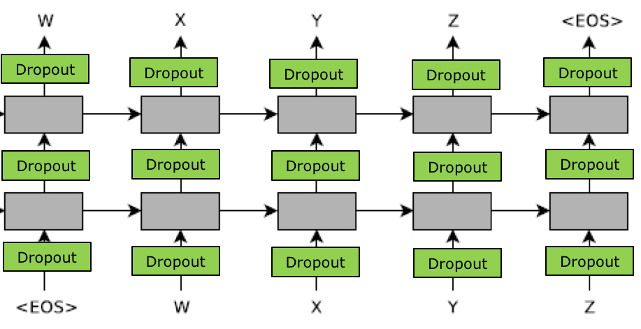


Beam Search 实现细节(续)
a:0.5 b:0.5
a:0.8 b:0.2
output_feed = [ ]
$$h_{0}^{2},c_{0}^{2}$$
$$h_{0}^{1},c_{0}^{1}$$
f1 f2 f3
b
a
input_feed = [[f1,f2,f3],[_GO,_GO],[b,a]] ?
13

Slide 14
Beam Search 代码实现
Single-step Decoder
self.top_index
self.top_value
self.eos_value
a:0.3 b:0.7
a:0.5 b:0.5
$$h_{0}^{2},c_{0}^{2}$$
decode2after_ops
$$h_{0}^{1},c_{0}^{1}$$
encode2before_ops
f1 f2 f3
a
b
self.sources
self.after_state
[-1.5,-2.3]
[1.8,-2.1]
self.inputs
红色：placeholder
蓝色：variable
箭头：operation
self.before_state
[-1.3,-0.3]
[-1.2,-0.5]
self.beam_parent
[0,0]
after2before_ops
14

Slide 15
Beam Search 代码实现
beam_step(index=0)
a:0.3 b:0.7
a:0.5 b:0.5
self.top_index
self.top_value
self.eos_value
session.run([encoder2before_ops],[[f1,f2,f3]])
session.run([[self.top_index,…],decode2after_ops],[self.inputs]
$$h_{0}^{2},c_{0}^{2}$$
decode2after_ops
$$h_{0}^{1},c_{0}^{1}$$
encode2before_ops
f1 f2 f3
a
b
self.sources
self.after_state
[-1.5,-2.3]
[1.8,-2.1]
self.inputs
红色：placeholder
蓝色：variable
箭头：operation
self.before_state
[-1.3,-0.3]
[-1.2,-0.5]
15

Slide 16
Beam Search 代码实现
beam_step(index>0)
self.top_index
self.top_value
self.eos_value
a:0.3 b:0.7
a:0.5 b:0.5
session.run([after2before_ops],[self.beam_pareent])
session.run([[self.top_index,…],decode2after_ops],
[self.inputs])
decode2after_ops
a
b
self.after_state
[-1.5,-2.3]
[1.8,-2.1]
self.beam_parent
[0,0]
self.inputs
红色：placeholder
蓝色：variable
箭头：operation
self.before_state
[-1.3,-0.3]
[-1.2,-0.5]
after2before_ops
16

Slide 17
Beam Serach 实现细节(续)
SeqModel.py
run.py
def beam_decode():
source_inputs
target_inputs
beam_parent
top_value
top_index
eos_value
5
assign
3
temp
6
4
1
2
model.beam_step()

Slide 18
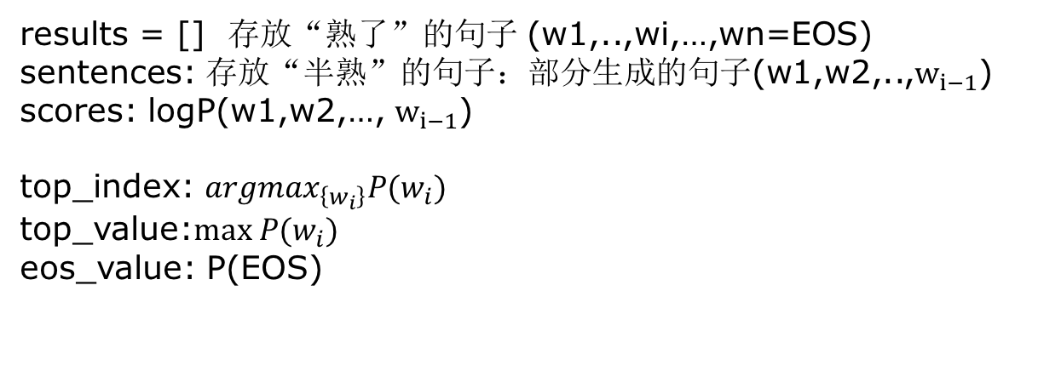
Beam Serach 实现细节(续)
run.py:beam_decode()
变量：
source_inputs = [f_1, f_2, f_3]
 | scores | sentences | beam parent | target inputs | top index | top value | eos value
0
1
results = [] 存放“熟了”的句子 (w1,..,wi,…,wn=EOS)
sentences: 存放“半熟”的句子：部分生成的句子(w1,w2,..,$w_{i−1}$)
scores: logP(w1,w2,…, $w_{i−1}$)
top_index: $argmax_{\left\{w_{i}\right\}}P(w_{i})$
top_value:$max P(w_{i})$
eos_value: P(EOS)

Slide 19
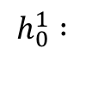

Beam Search 代码实现 index = 0
 | scores | sentences | beam parent | target inputs | top index | top value | eos value
0 | 0.0 | [] | 0 | _GO
1 | 0.0 | [] | 1 | _GO
$$h_{0}^{1},c_{0}^{1}$$
f1 f2 f3
_GO
_GO
$$h_{0}^{1} :$$
[0.2,-0.3]
[0.2,-0.3]
=》
$$h_{1}^{1} :$$
19

Slide 20
Beam Search 代码实现 index = 0
 | scores | sentences | beam parent | target inputs | top index | top value | eos value
0 | 0.0 | [] | 0 | _GO | b, a | 0.7,0.3 | 0.0001
1 | 0.0 | [] | 1 | _GO | b, a | 0.7,0.3 | 0.0001
$$h_{0}^{1},c_{0}^{1}$$
f1 f2 f3
_GO
_GO
[0.2,-0.3]
[0.2,-0.3]
$$h_{1}^{1} :$$
[1.0,-3.3]
[1.0,-3.3]
$$h_{0}^{1} :$$
=》
20

Slide 21
Beam Search 代码实现 index = 0
 | scores | sentences | beam parent | target inputs | top index | top value | eos value
0 | 0.0 | [] | 0 | _GO | b, a | 0.7,0.3 | 0.0001
1 | 0.0 | [] | 1 | _GO | b, a | 0.7,0.3 | 0.0001
index = 0
global_queue = [(score, beam_index, word_index)]
= [(0+0.7,0, b),
(0+0.3,0, a)]
target_inputs = [b, a]
scores = [0.7,0.3]
beam_parent = [0,0]
sentences = [[b], [a]]
21

Slide 22
Beam Search 代码实现 index = 1
 | scores | sentences | beam parent | target inputs | top index | top value | eos value
0 | 0.7 | [b] | 0 | b
1 | 0.3 | [a] | 0 | a
$$h_{0}^{1},c_{0}^{1}$$
b
a
[1.0,-3.3]
[1.0,-3.3]
[1.0,-3.3]
[1.0,-3.3]
$$h_{1}^{1} :$$
=》
22

Slide 23

Beam Search 代码实现 index = 1
 | scores | sentences | beam parent | target inputs | top index | top value | eos value
0 | 0.7 | [b] | 0 | b | a, b | 0.5,0.5 | 0.001
1 | 0.3 | [a] | 0 | a | a, b | 0.8,0.2 | 0.001
$$h_{0}^{1},c_{0}^{1}$$
b
a
[1.0,-3.3]
[1.0,-3.3]
[1.0,-3.3]
[1.0,-3.3]
[-1.3,-0.3]
[1.1,-1.5]
$$h_{1}^{1} :$$
=》
$$h_{2}^{1} :$$
23

Slide 24
Beam Search 代码实现 index = 1
 | scores | sentences | beam parent | target inputs | top index | top value | eos value
0 | 0.7 | [b] | 0 | b | a, b | 0.5,0.5 | 0.001
1 | 0.3 | [a] | 0 | a | a, b | 0.8,0.2 | 0.001
index =1
global_queue = [(score, beam_index, word_index)]
= [(0.7*0.5,0, a),
(0.7*0.5,0, b),
(0.3*0.8,1, a),
(0.3*0.2,1, b)]
target_inputs = [a, b]
scores = [0.35,0.35]
beam_parent = [0,0]
sentences = [[b,a], [b,b]]
24

Slide 25

Beam Search 代码实现 index = 2
 | scores | sentences | beam parent | target inputs | top index | top value | eos value
0 | 0.35 | [b,a] | 0 | a
1 | 0.35 | [b,b] | 0 | b
$$h_{0}^{1},c_{0}^{1}$$
a
b
[-1.3,-0.3]
[1.1,-1.5]
[-1.3,-0.3]
[1.1,-1.5]
$$h_{2}^{1} :$$
=》
25

Slide 26

Beam Search 代码实现 index = 2
 | scores | sentences | beam parent | target inputs | top index | top value | eos value
0 | 0.35 | [b,a] | 0 | a | b, a | 0.7,0.3 | 0.0001
1 | 0.35 | [b,b] | 0 | b | a, b | 0.5,0.5 | 0.0001
$$h_{0}^{1},c_{0}^{1}$$
a
b
[-1.3,-0.3]
[1.1,-1.5]
[-1.3,-0.3]
[1.1,-1.5]
$$h_{3}^{1} :$$
[-1.5,-2.3]
[1.8,-2.1]
$$h_{2}^{1} :$$
=》
26

Slide 27
Beam Search 代码实现 index = 2
 | scores | sentences | beam parent | target inputs | top index | top value | eos value
0 | 0.35 | [b,a] | 0 | a | b, a | 0.7,0.3 | 0.0001
1 | 0.35 | [b,b] | 0 | b | a, b | 0.5,0.5 | 0.0001
index = 2
global_queue = [(score, beam_index, word_index)]
= [(0.35*0.7,0, b),
(0.35*0.3,0, b),
(0.35*0.5,1, a),
(0.35*0.5,1, b)]
target_inputs = [b, a]
scores = [0.245,0.175]
beam_parent = [0,1]
sentences = [[b,a,b], [b,b,a]]
27

Slide 28
Beam Search 代码实现 index = 3
 | scores | sentences | beam parent | target inputs | top index | top value | eos value
0 | 0.245 | [b,a,b] | 0 | b | b, a | 0.7,0.2 | 0.1
1 | 0.175 | [b,b,a] | 1 | a | a, b | 0.5,0.3 | 0.2
$$h_{0}^{1},c_{0}^{1}$$
b
a
[-1.5,-2.3]
[1.8,-2.1]
[-1.5,-2.3]
[1.8,-2.1]
$$h_{3}^{1} :$$
[0.4, 2.2]
[1.2,-1.1]
$$h_{2}^{1} :$$
=》
28

Slide 29
Beam Search 代码实现 index = 3
 | scores | sentences | beam parent | target inputs | top index | top value | eos value
0 | 0.245 | [b,a,b] | 0 | b | b, a | 0.7,0.2 | 0.1
1 | 0.175 | [b,b,a] | 1 | a | a, b | 0.5,0.3 | 0.2
index = 3 == (max-length-1) 最后一步
global_queue = [(score, beam_index, word_index)]
= [(0.245*0.1, 0, EOS),
(0.175*0.2, 1, EOS)]
target_inputs = [EOS, EOS]
scores = [0.035,0.0245]
beam_parent = [1,0]
sentences = [[b,b,a,EOS], [b,a,b,EOS]]
results = [([b,b,a,EOS],0.035)
([b,a,b,EOS],0.0245)]
29

Slide 30
Beam Search 代码实现 回到index=2
如果top_index是中包含EOS怎么办?
 | scores | sentences | beam parent | target inputs | top index | top value | eos value
0 | 0.35 | [b,a] | 0 | a | EOS, a | 0.7,0.2 | 0.1
1 | 0.35 | [b,b] | 0 | b | a, b | 0.5,0.5 | 0.0001
index = 2
global_queue = [(score, beam_index, word_index)]
= [(0.35*0.7,0, EOS),
(0.35*0.2,0, a),
(0.35*0.5,1, a),
(0.35*0.5,1, b)]
results = [([b,a,EOS], 0.245)]
target_inputs = [a, b]
scores = [0.175,0.175]
beam_parent = [1,1]
sentences = [[b,b,a], [b,b,b]]
30

Slide 31
Beam Search 代码实现
Single-step Decoder
self.top_index
self.top_value
self.eos_value
a:0.3 b:0.7
a:0.5 b:0.5
$$h_{0}^{2},c_{0}^{2}$$
decode2after_ops
$$h_{0}^{1},c_{0}^{1}$$
encode2before_ops
f1 f2 f3
a
b
self.sources
self.after_state
[-1.5,-2.3]
[1.8,-2.1]
self.inputs
红色：placeholder
蓝色：variable
箭头：operation
self.before_state
[-1.3,-0.3]
[-1.2,-0.5]
self.beam_parent
[0,0]
after2before_ops
31

Slide 32
Beam Search 代码实现
SeqModel.py
init_beam_decoder() # “画”额外的“图”
beam_with_buckets() #
beam_basic_seq2seq() # Single-step decoder
beam_attention_seq2seq() # TODO
show_before_state() # 调试用
show_after_state() # 调试用
beam_step()
get_batch_test()
32

Slide 33
Seq2Seq 代码实现
self.losses = [ loss1, loss2 ]
self.source_embed = [ ] [ ]

Slide 34
Seq2Seq 代码实现
为什么不“画”成这样？
self.losses = [ loss1, loss2 ]
sess.run([loss2],[s1,s2,t1,t2])
sess.run([loss1],[?]
[ ] [ ]
s1
s2
t1
t2

Slide 35
Beam Search 代码实现
beam_with_buckets()
self.source_embed = [ ] [ ]

Slide 36
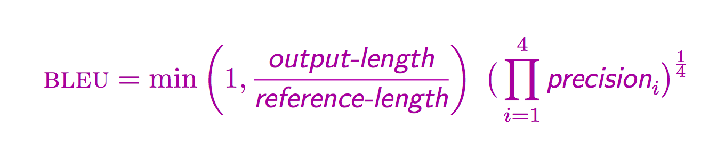
Beam Search 代码实现
BLEU score
评价机器翻译的标准

Slide 37
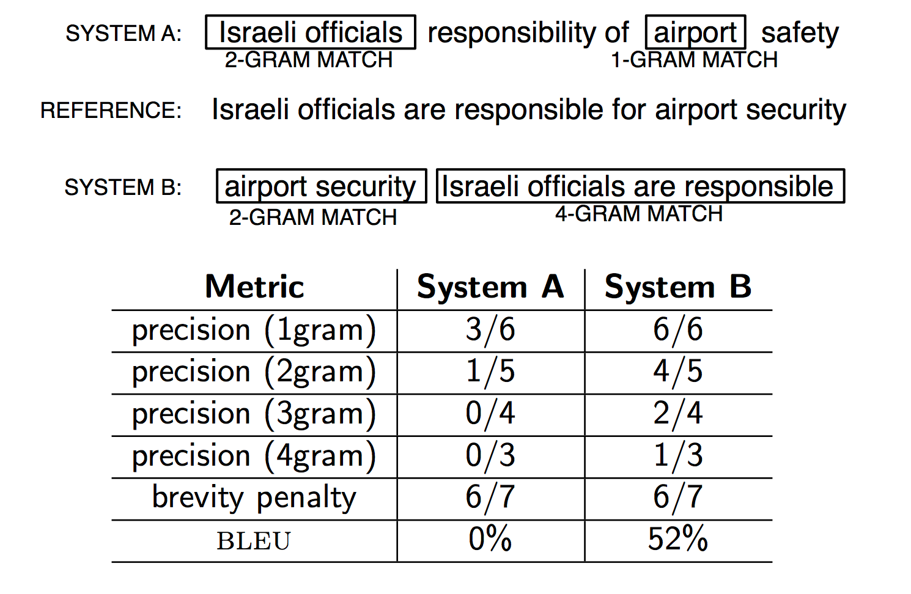
Beam Search 代码实现
BLEU score

Slide 38
Beam Search 代码实现
BLEU score
bash beam_decode_small.sh
bash bleu_small.sh

Slide 39
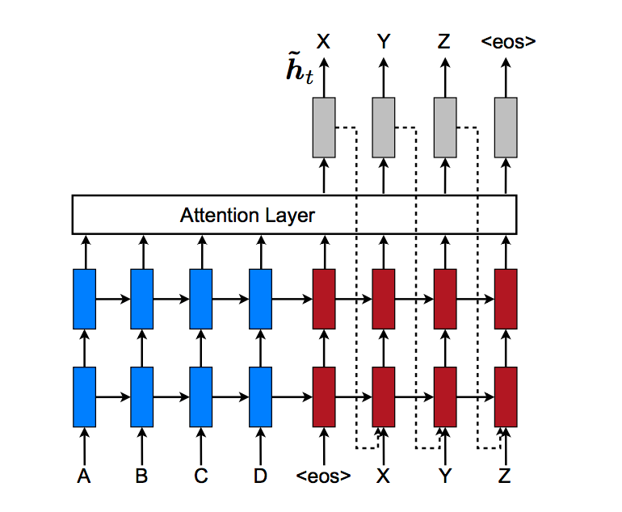
Beam Search 代码实现
高难度，高价值的作业
实现attention model的beam search
beam_attention_seq2seq()
feed_input是否需要加before_ht_att和after_ht_att
一周时间实现，实现成功的有神秘礼物

Slide 40
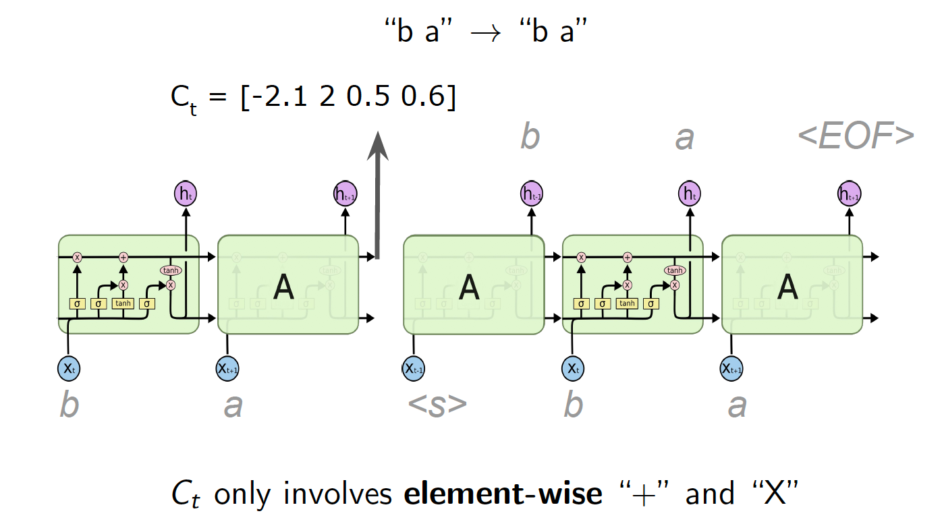
Seq2Seq 模型可视化
Hidden State 可视化

Slide 41
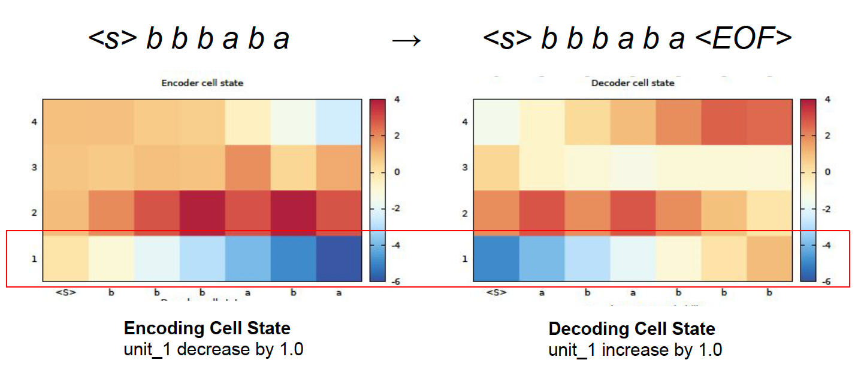
Seq2Seq 模型可视化
Hidden State 可视化

Slide 42
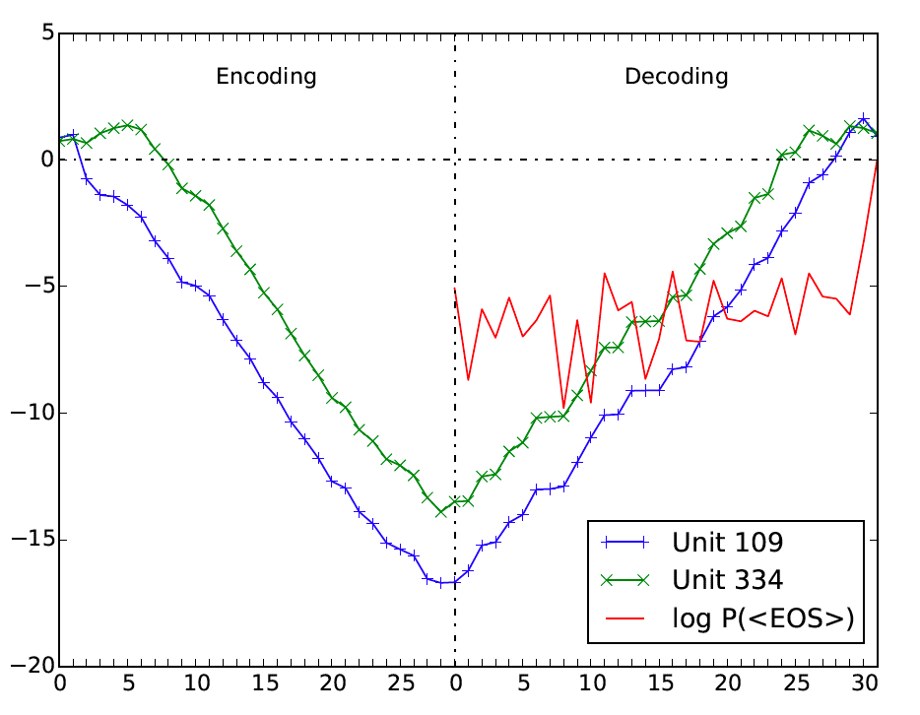
Seq2Seq 模型可视化
Hidden State 可视化
French-English 机器翻译模型

Slide 43

联系我们
小象学院：互联网新技术在线教育领航者
微信公众号：大数据分析挖掘
新浪微博：ChinaHadoop

