Slide 1
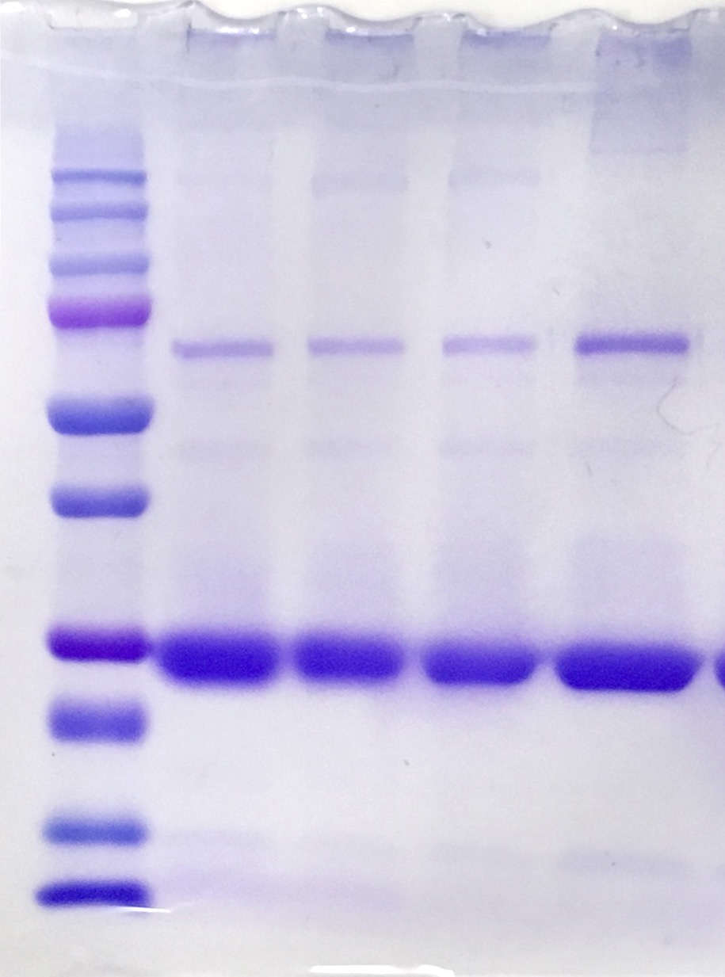
Molecular Weight (kDa)
250
150
100
75
Albumin
50
37
25
ApoA1
20
15
10
1
2
3
4
5

