Slide 1
Robotics & Embedded Systems Club
Club Project PPT
From Embedded Basics
to Working Robots
A 3-minute introduction to our club, our learning path, and two hands-on engineering projects.
STM32
Arduino
Robot Body
ROS 2
Robotics & Embedded Systems Club | 1/6
Notes:
About 20 seconds. Open by saying that the club connects learning and building: we teach microcontrollers first, then turn those skills into projects that solve visible problems.

Slide 2
What Our Club Does
We build a bridge from basic electronics lessons to complete, testable prototypes.
STM32 Basics
Arduino Basics
So far, our foundation work has focused on microcontroller programming, sensor input, motor/output control, simple debugging, and turning a circuit idea into a physical system.
Board setup
GPIO and timing
Serial communication
Motor/control thinking
Sensor reading
Relay/output control
Prototype wiring
Real-world automation
Robotics & Embedded Systems Club | 2/6
Notes:
About 25 seconds. Explain the club simply: not just lectures, not just competitions. The goal is to let members learn a platform, build a circuit, test it, and then show a working outcome. This sets up Cindy's Arduino project.

Slide 3
Project 1: Cindy's Automatic Watering System
The Arduino lecture becomes a useful daily-life prototype.
Process
Target Outcome
It reads soil moisture under the surface and only waters when moisture falls below the normal threshold. The design helps plants survive during long trips, reduces difficulty for older people, and avoids wasting water in everyday irrigation.
Built the main circuit
Connected sensor and pump control
Ran field tests and experiments
About 30% less water than manual watering
Runs with very little intervention
Manual adjustment no more than once per week
Robotics & Embedded Systems Club | 3/6
Notes:
About 35 seconds. Say this project shows why the Arduino lesson matters. The key idea is not watering on a timer; it waters only when the soil needs it. Mention the expected 30 percent water saving and weekly-or-less manual adjustment target.

Slide 4
Project 2: From STM32 Board to Robot Body
Outcome so far: a grounded robot workflow from firmware, through ROS 2 command topics, to physical mechanical parts.
Controller
Firmware
Robot System
Started from STM32-style board practice and embedded control fundamentals.
Lower-controller code integrates motors, IMU attitude estimation, SBUS input, and serial communication.
Iterated toward a wheel-foot robot with ROS 2 bridge, URDF/RViz visualization, and following logic.
Robotics & Embedded Systems Club | 4/6
Notes:
About 35 seconds. Transition from Cindy's project: the same embedded thinking scales up. Start from a board, then firmware, then the robot body. Mention that the current resources include lower-controller firmware, ROS 2 base bridge, URDF/RViz assets, following-system code, and STL mechanical files.

Slide 5
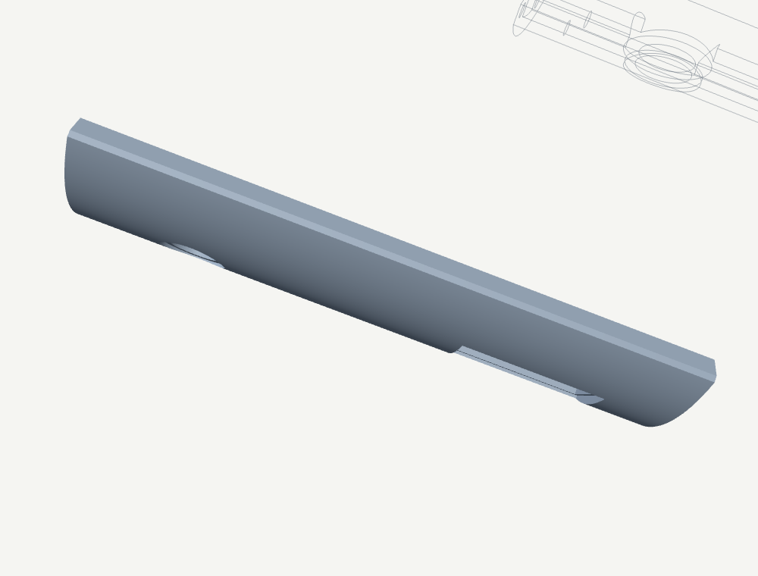
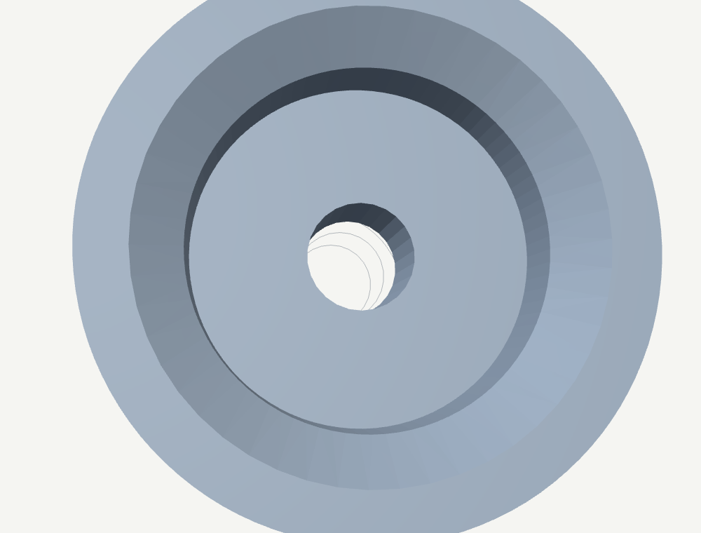
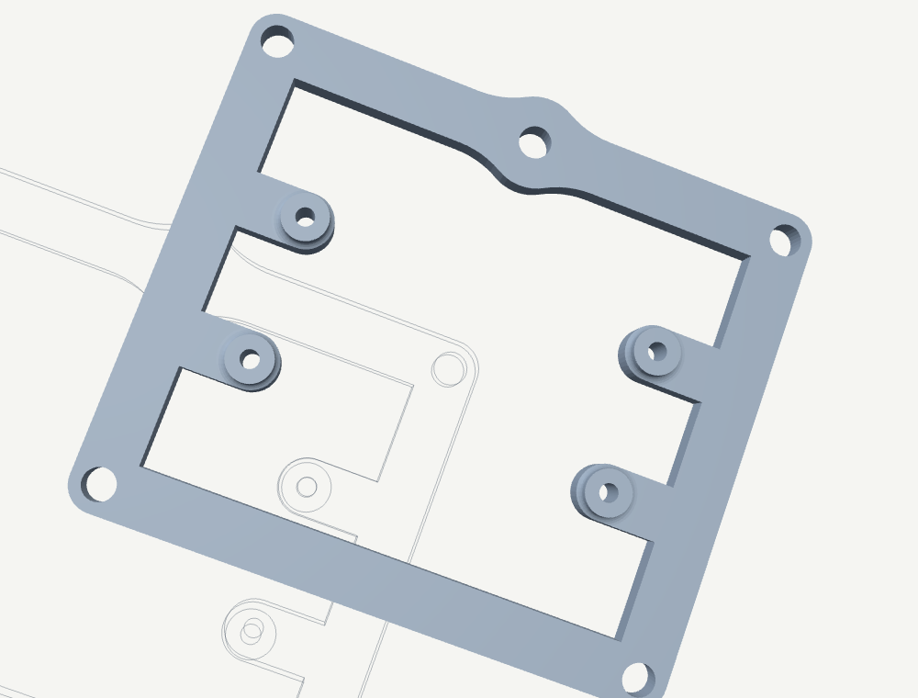
Engineering Files: Parts That Become the Body
These STL files are not decorations. They are printable mechanical resources used to move from a controller demo toward a complete robot structure.
back_shell.stl
bolt_pin.stl
bracket_1.stl
Show these as the bridge from digital design to physical assembly.
Robotics & Embedded Systems Club | 5/6
Notes:
About 30 seconds. Tell the audience these are the engineering files. Point to the back shell, bolt pin, and bracket. The important message is that the project is no longer only code; it has parts that can be printed, assembled, tested, and revised.

Slide 6
Final Outcome: Live Robot Demonstration
What the outcome shows
A club learning path that produced working prototypes:
1. Microcontroller lectures
2. Cindy's Arduino watering system
3. A robot pipeline from firmware to body design
Next step: insert the final robot video here.
Leave this area blank for the robot video
Robotics & Embedded Systems Club | 6/6
Notes:
About 25 seconds plus the video. Close by saying the outcome is the process itself: members learned embedded systems, made a useful Arduino product, and started a more ambitious robot project. Then play or insert the final video manually.

