Slide 1
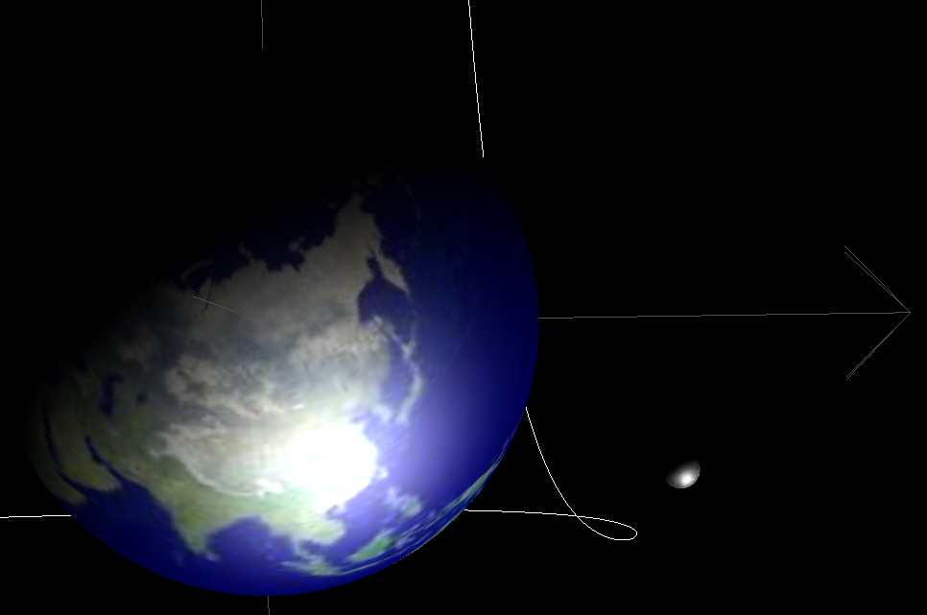
JAT
Java Astrodynamics Toolkit
Tobias Berthold Dave Gaylor 12-7-2003

Slide 2
What is JAT?
Open Source Astrodynamics Library written in Java
Software library, not an application
Goals:
  Graduate earlier!
  Faster development
    Allows more time on research, less time coding
    Ease of use is critical: smart design, good documentation, example programs
    More users/developers = faster evolution
    Build on the work of others instead of always starting from scratch

Slide 3
Why Java?
Object-oriented
  Enhances re-use
  Helps developers manage complexity
Java was written to make it easier to develop bug free code faster based on lessons learned from C, C++, etc.
Everything needed to develop and run Java programs is available for free!
  No reliance on expensive compilers or Matlab licenses
Java is portable: truly write once, run anywhere
Java provides mechanisms to automate documentation (HTML)
It looks great on your resume!

Slide 4
Java standard libraries
These are features built into the Java language:
  Graphical User Interface (GUI)
  Graphics
  Parallel processing
  Networking and Internet
  Databases
  3D visualization (OpenGL)
  Realtime (embedded) processing

Slide 5
The Power of Sharing Code
Publishing your code makes you write better code
  More comments and documentation
  Better choice of variable names
  Take fewer shortcuts
Software gets better with age
  Bugs found faster
  New features requested
Learn from others
  Example code
  Programming techniques, problem solving strategies

Slide 6
Planned Features
Astrodynamic constants
Time transformations
Coordinate transformations
Quaternions
Orbit element conversions
Gravity models: Two-body, N-body, Restricted three body problem, JGM-3
Third body effects due to sun and moon or other planets
Atmospheric drag models: Harris-Priester density model
Solar radiation pressure
Lambert Targeting
Kepler Equation solver
Numerical Integrators: fixed and adaptive step-size Runge-Kutta
JPL Ephemerides
Orbit estimation: batch and Kalman filter methods
Trajectory optimization: Direct and indirect methods
Linear equation solver
Non-linear equation solvers, including Newton-Raphson and Regula Falsi
Linear Algebra (based on JAMA and JMAT)
3-D Visualization for orbits and trajectories
GPS, INS and integrated GPS/INS simulation

Slide 7
JAT architecture (Version 1.0)
JAT Packages:
  CM :Celestial Mechanics,
  Forces: Force Models (gravity, drag, etc.)
  EPH: Planetary Ephemeris
  VR: Virtual Reality 3D
  DEMO: Example programs
  ALG: Algorithms (Runge-Kutta, Newton’s Method, NLE solvers)
  JMAT: Matrices and Vectors (based on JAMA)
  TimeRef: Time conversions and reference systems
  GPS: GPS constellation, GPS navigation
  Sensors: Gyros, Accelerometers
External Packages:
  Sun Java3D
  Ptolemy Plot (ptplot)

Slide 8
Interested?
Join the collective!
JAT Webpage:
  http://gps.csr.utexas.edu/~gaylor/asl/jat.html
Other language libraries: Matlab, C/C++
  http://gps.csr.utexas.edu/~gaylor/asl/asl_page.html

