Slide 1
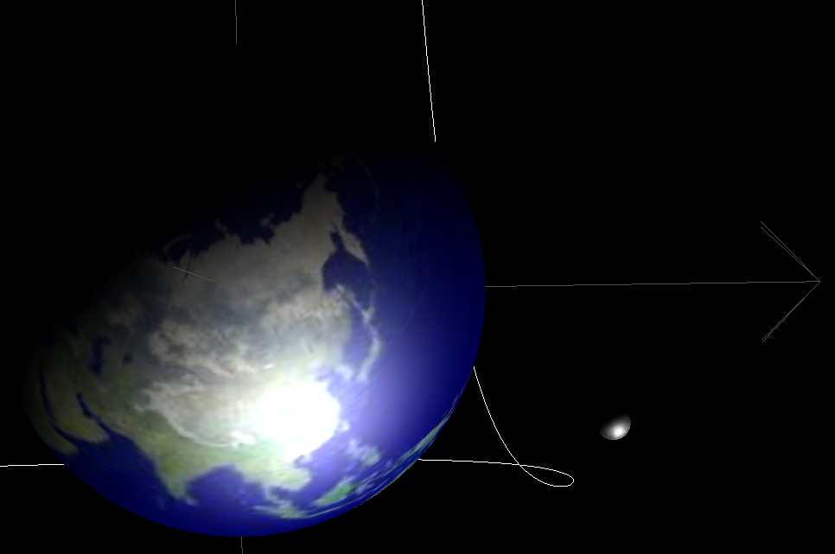
JAT
Java Astrodynamics Toolkit
Tobias Berthold Dave Gaylor 10-17-2002

Slide 2
Why a computer presentation in an Orbital Mechanics meeting?
Orbital Mechanics without computers not thinkable anymore
Almost all problems can’t be solved analytically, therefore numerical solutions sought
Space flight created computers!
Coding takes up most of the time
Computers allow visualization of data: Plots etc.
Process control: space craft computer controlled
JAT is an attempt to make coding easier

Slide 3
FORTRAN vs. Java
FORTRAN prevalent in Astrodynamics applications
Many numerical software libraries exist in FORTRAN, not many (yet) in Java
FORTRAN is faster than Java
You can teach yourself FORTRAN – Java: not!
Resistance at NASA against changes of existing software

Slide 4
Advantages of Java
Java is a modern language:
Object-oriented: makes re-use, complex projects, and collaboration easier
Dynamic memory management: can add and remove objects at runtime
Java is a safe language:
Access control of data: helps prevent accidental overwriting of data
Automatic memory management: better than C++
Consequent type checking: double, int, etc.

Slide 5
Advantages of Java (2)
Automatic generation of documentation in HTML
Java is free: download from www.sun.com
Open source
Language specification includes many libraries, so your code will work with future versions without changes
Java is coming! Java books now take up more shelf space in book stores than any other language.

Slide 6
Java standard libraries
Graphics and Graphical User Interface
Parallel processing
Networking and Internet
Databases
3D visualization (OpenGL)
Realtime processing

Slide 7
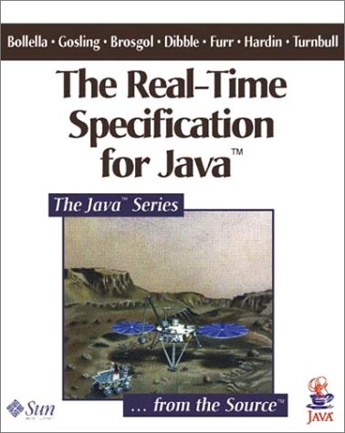

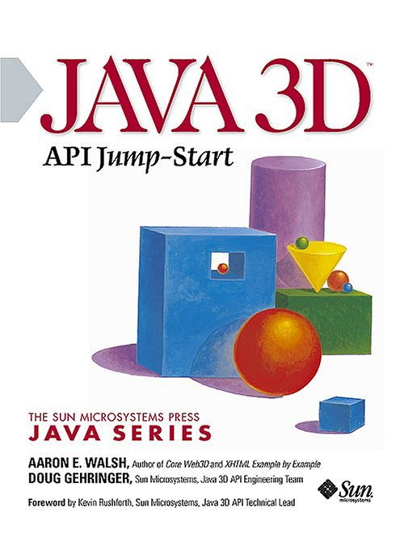
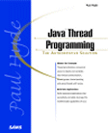
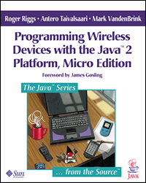
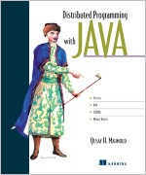
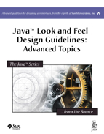
Some books on Java…

Slide 8
Other Java libraries
Pisces: Don Pearson, JSC, Houston
CODES: Jim Baer

Slide 9
Goals of JAT
Make the coding part easier, so the researcher can concentrate on the Astrodynamics part

Slide 10
JAT Project
Astrodynamics software
Not a single application, but rather a software library
Join efforts of Java developers
Open source
Internet
Design overall architecture, then let contributors fill in pieces
Web site at
http://gps.csr.utexas.edu/~gaylor/asl/jat.html

Slide 11
Planned Features
Astrodynamics constants
Time transformations
Coordinate transformations
Quaternions
Orbit element conversions
Gravity models: Two-body, N-body, Restricted three body problem, JGM-3
Third body effects due to sun and moon
Atmospheric drag models: Harris-Priester density model
Solar radiation pressure
Lambert Targeting
Kepler Equation solver
Accurate orbit propagation
Integrators: fixed and adaptive step-size Runge-Kutta
JPL Ephemerides
Orbit estimation: batch and Kalman filter methods
Trajectory optimization: Direct and indirect methods
Linear equation solver
Non-linear equation solvers, including Newton-Raphson and Regula Falsi
Linear Algebra (based on JAMA and JMAT)
3-D Visualization for orbits and trajectories
GPS, INS and integrated GPS/INS simulation

Slide 12
JAT architecture (Version 1.0)
JAT Packages:
  CM :Celestial Mechanics, Force Models (gravity, drag, etc.)
  EPH: Planetary Ephemeris
  VR: Virtual Reality 3D
  DEMO: Example programs
  ALG: Algorithms (Runge-Kutta, Newton’s Method, NLE solvers)
  MATVEC: Matrices and Vectors (based on JAMA)
  TimeRef: Time conversions and reference systems
  GPS: GPS constellation, GPS navigation
  Sensors: Gyros, Accelerometers
External Packages:
  Sun Java3D
  Ptolemy Plot (ptplot)

Slide 13
Using JAT
An example of an application of JAT:
Finding the Julian date

Slide 14
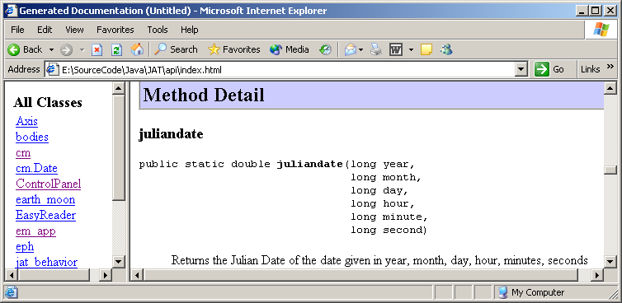
Using JAT (1)
Find the function in the documentation..

Slide 15
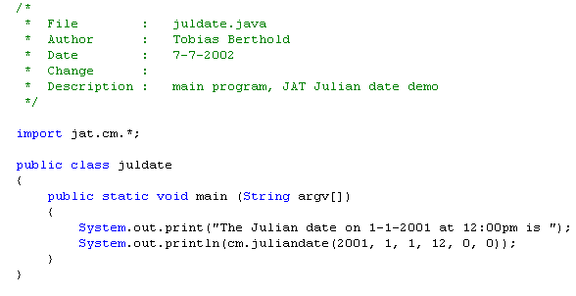
Using JAT (2)
Write the source code..

Slide 16
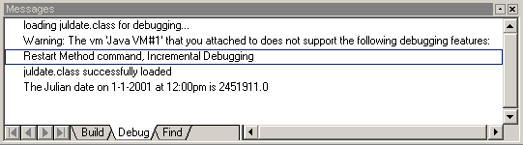
Using JAT (3)
Run the program

Slide 17
Using JAT
Another example:
Find the position of Mars on 10-17-2002 at 12:00pm

Slide 18
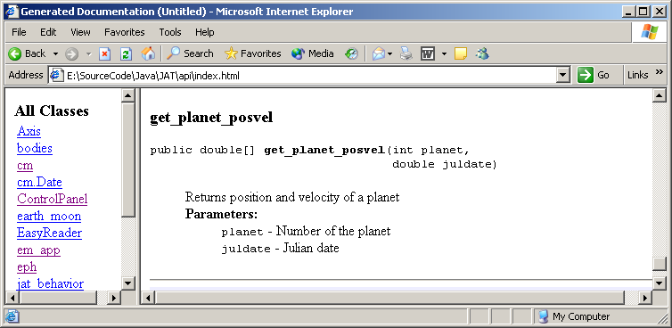
Using JAT (1)
Find the doc

Slide 19
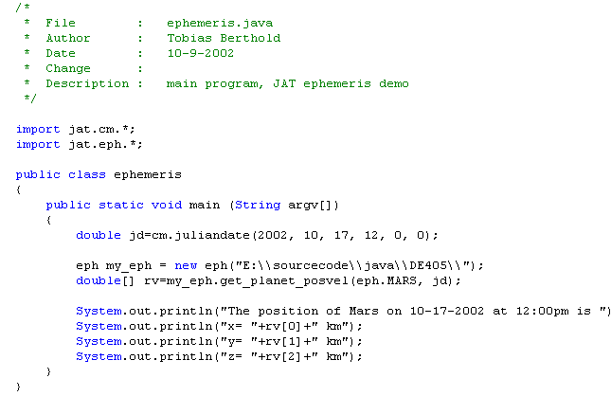
Using JAT (2)
Source code

Slide 20
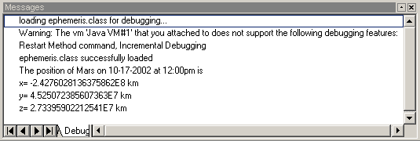
Using JAT (3)
Run the program

Slide 21
Using JAT
Another example:
Integrate a simple oscillator and plot the result

Slide 22
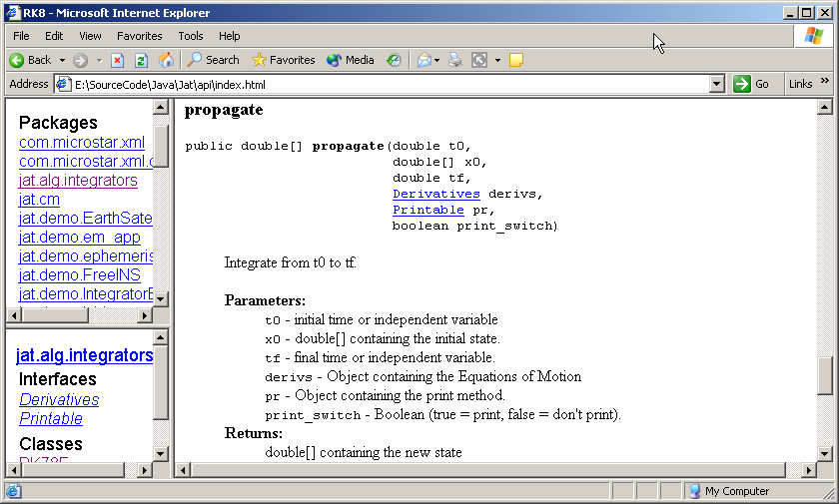
Using JAT (1)
Find the doc

Slide 23
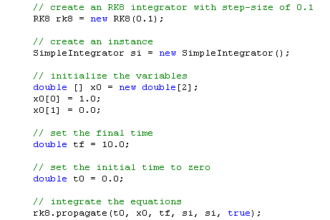
Using JAT (2)

Slide 24
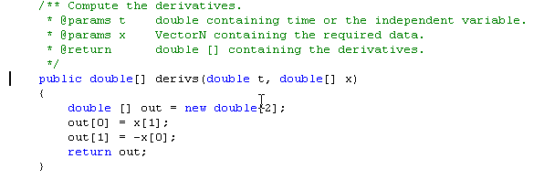
Using JAT (2)
Source code:

Slide 25
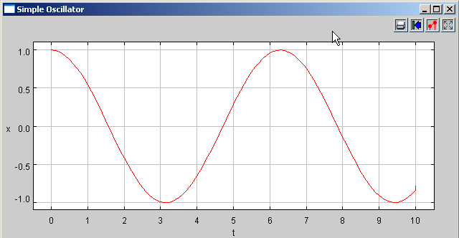
Using JAT (3)
Run the program

Slide 26
Virtual Reality Example
Earth moon system
Java3D uses OpenGL
The “virtual world” is constructed by adding objects to a tree structure

Slide 27
Earth moon scenegraph tree
Virtual Universe
Locale
Earth-moon system
Axis
Trajectory
Light
View
Animation
Earth
Moon
Spacecraft

Slide 28
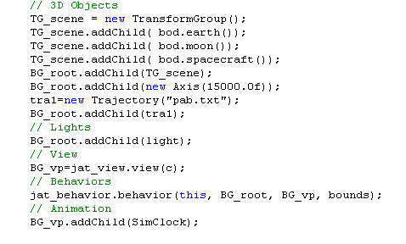
Earth moon system

Slide 29
Next up:
Trajectory optimization
Complex mission scenarios
Real time Solar system
Asteroids
Space shuttle docking simulation

