Slide 1
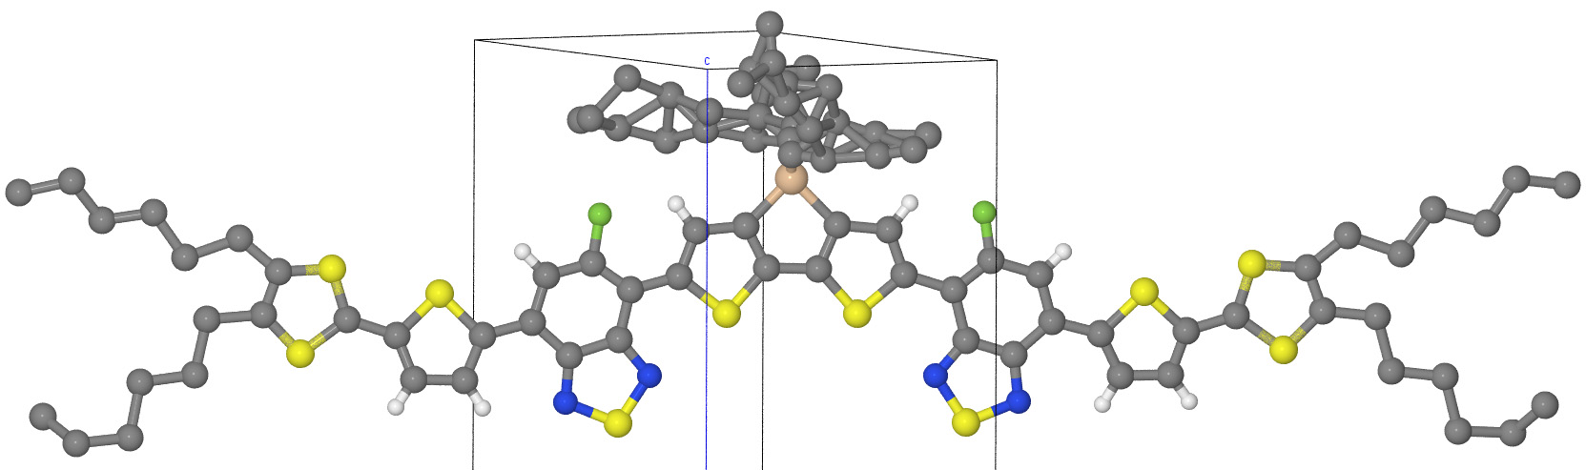
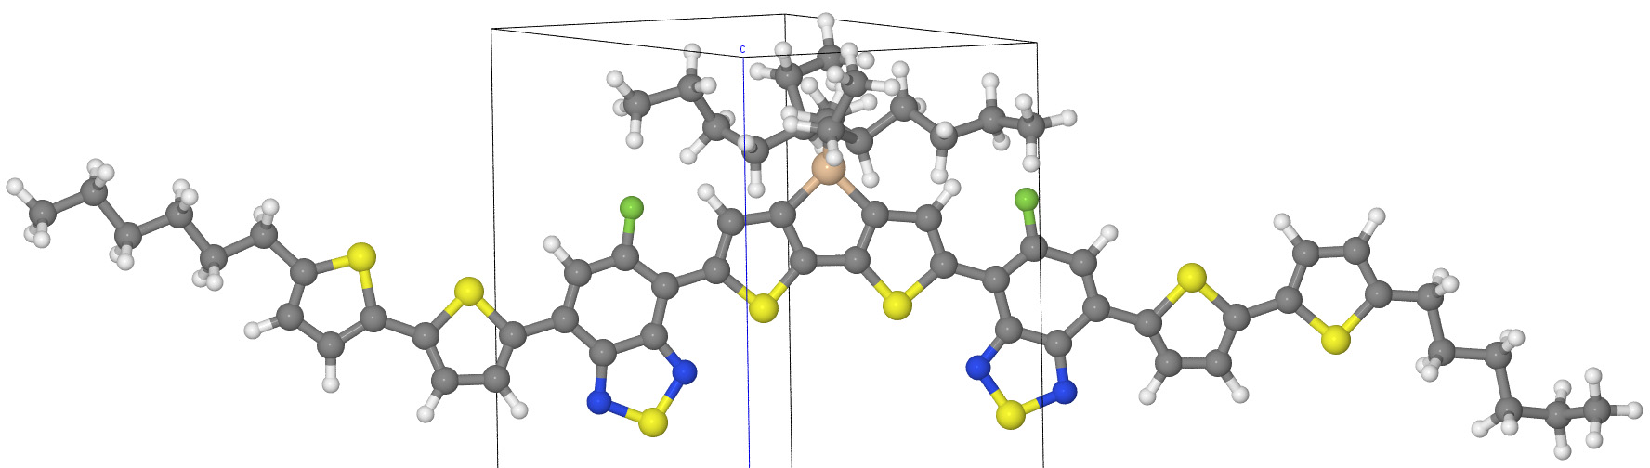
X-ray: raw vs cleaned geometry
November-December, 2019
Computational Chemistry and Materials Modeling

