Slide 1

Presentation
Contributors: John Doe, Ivan Ivanov
Date: 01/09/2016
For Survey of Materials course, Skoltech University

Slide 2
Outline
Here you give an overview of you presentation to prepare you audience for the talk
Introduction
Motivation (optional)
Main part / review/results
Case studies (optional)
Conclusions

Slide 3
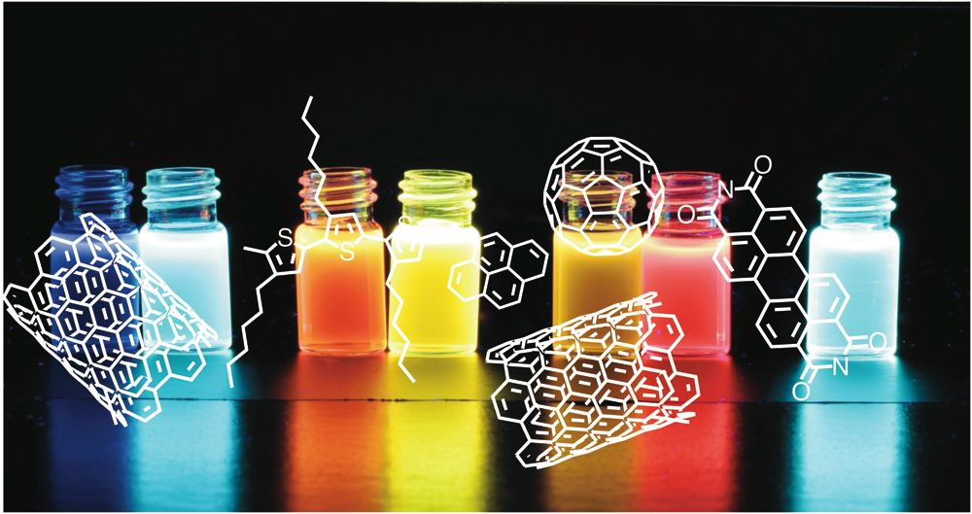
Introduction / Motivation
Do not overload your slides. One or two main ideas per each slide is optimal
General information on the topic. Why we decided to do research on this specific theme. This is what we are trying to find/prove/investigate
You can add pictures that illustrate your words. It’s ok to have 2-3 slides in this section, and spend about 1-2 minutes on it.
Carbon chemistry is interesting to study. Nanotubes are awesome.
Give references if possible.
Yao et. al., Chem. Rew.,2016

Slide 4
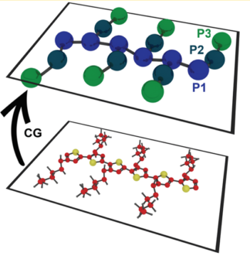
Results/discussion
This is the main part where your own work is shown. If you are making a review, try to rework you source materials and present the results in a way consistent with your topic.
-This is a structure of our polymer
Present you results in the most clear and readable way. Give captions and lables for your figures and tables,
- This is a course-graining procedure for out polythiophene model polymer
When making a review, give the refs!!
Yao et. al., Chem. Rew.,2016

Slide 5
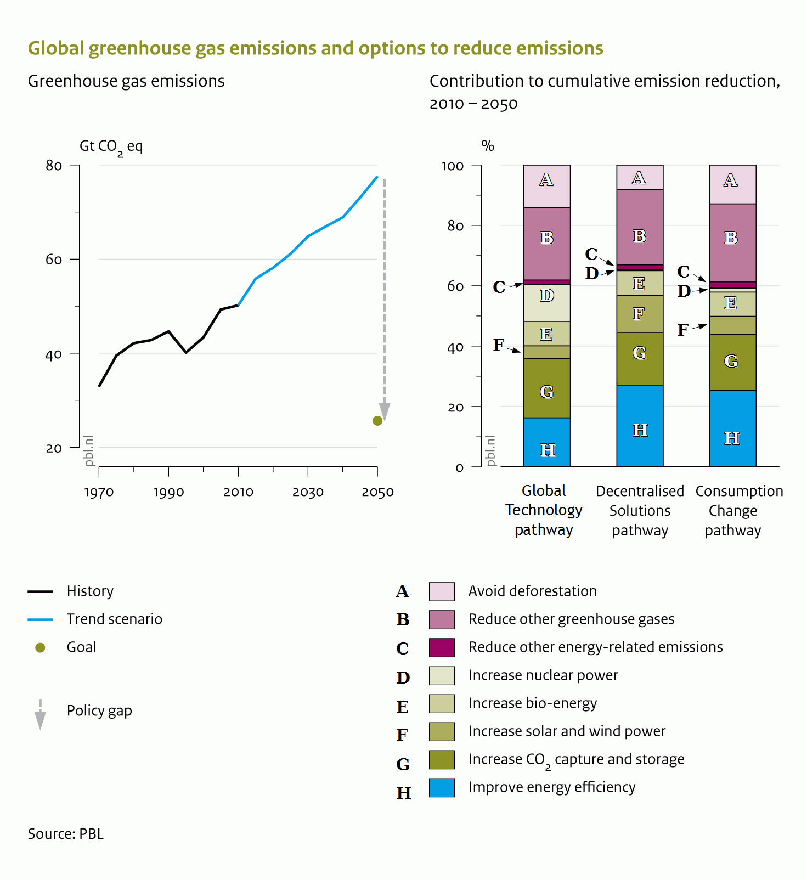
Results/ discussion 2
CO2 emission increases every year.
In 1970 year it was not so big
In 1990 it increased
In 2010 even higher
In 2030 it’s OMG
In 2050 don’t even think about it
I love long lists
Even longer list
Let me make it even longer
Etc
Useless unreadable information
Do not make long lists, it’s not worth it
First think if you can make a plot or a scheme from your data. Big tables and lists are less readable.

Slide 6
Conclusions
We noticed that CO2 emissions are increasing every year
We suggest the following methods to fight global warming
What we thought was true is not true at all
In this section you give a very clear and short answers to questions raised in your Motivation part OR in you ASSIGNMENT. E.g. if you’re asked to show some trends within an element group, then you can simply put it here. The conclusions must not be too obvious.

Slide 7
Thank you for attention!
Contributions:
John Doe ( tables and pictures)
Ivan Ivanov ( presentation)
Always write acknowledgments and contributions

