Slide 1
Visualization examples analysis
ZHU GREJUN
1009699

Slide 2
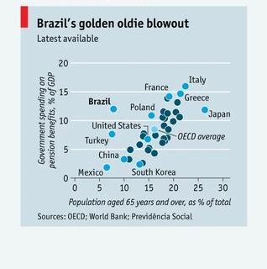
Case one
This image shows the relationship between pension spending and the proportion of older people in each country.
issues：Insufficient differentiation of data points
The use of the same blue dots for all data points makes it difficult to quickly differentiate between different countries, and the crowded location of labels for some of the country names makes it easy to create visual confusion.
Improves：
Use different colors or shapes to distinguish countries in different geographic regions (e.g. Europe, Asia, America, etc.)
Add clear illustrations
Optimize tab layout, consider using guide lines
Add appropriate grid lines
Consider using an interactive design that allows users to hover to view detailed data

Slide 3
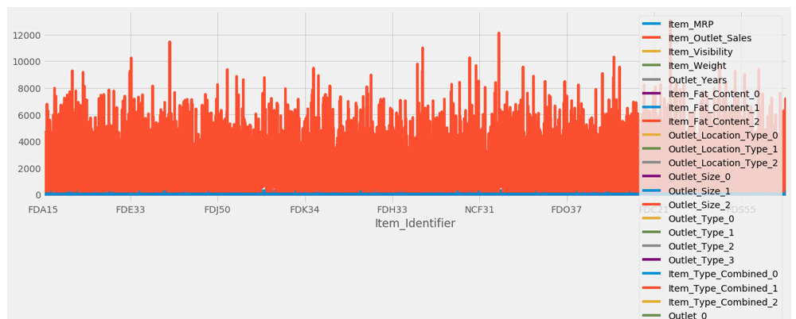
Case two
Issues：
Charts contain too many variables, causing visual clutter
Right-hand legend is too long and takes up a lot of space
The values of many variables are too small and almost invisible in the charts
Product identifiers on the X-axis are too dense and labels overlap
Colors are not differentiated
Suggestions for improvement：
Consider using other chart types, for example:
Use separate line charts for key indicators
Bar charts are used for categorical data
Proportional data use pie charts or stacked percentage charts
Use similar color palettes for related variables，Add appropriate white space

Slide 4
THANK YOU

