Slide 1
NetChain
Scale-Free Sub-RTT Coordination
Presenter:
Haoyu Zhu 19-910-025 haozhu@ethz.ch
Francisco Dumont 18-946-681 fdumontd@student.ethz.ch

Slide 2
Introduction
Key-Value storage
Network(Programmable Switch based)
< 1RTT
Fault-tolerant
Fast fail-over and recovery
Scalable

Slide 3
Chain-backup

Slide 4
Consistent hashing: DHT
Key
SW1
SW2
2³²-1
0
SW3
SW4

Slide 5
Packet organization
Ethernet
IP
UDP
NetChain
Count
S0
...
Sn
OP
Seq
Key
Value
2Byte
4*Count Byte
2Byte
4Byte
2Byte
8Byte

Slide 6
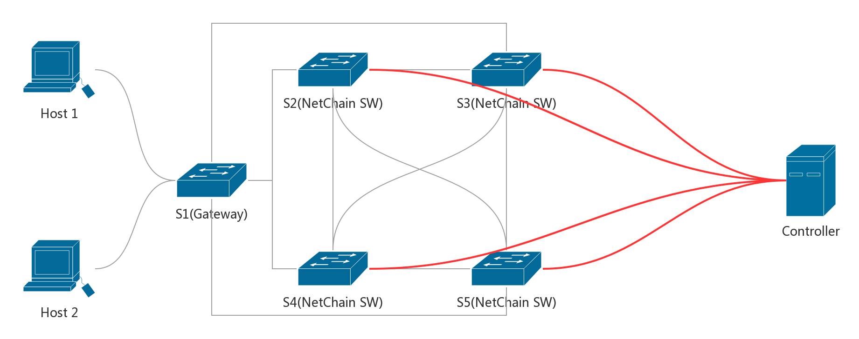
Topology

Slide 7
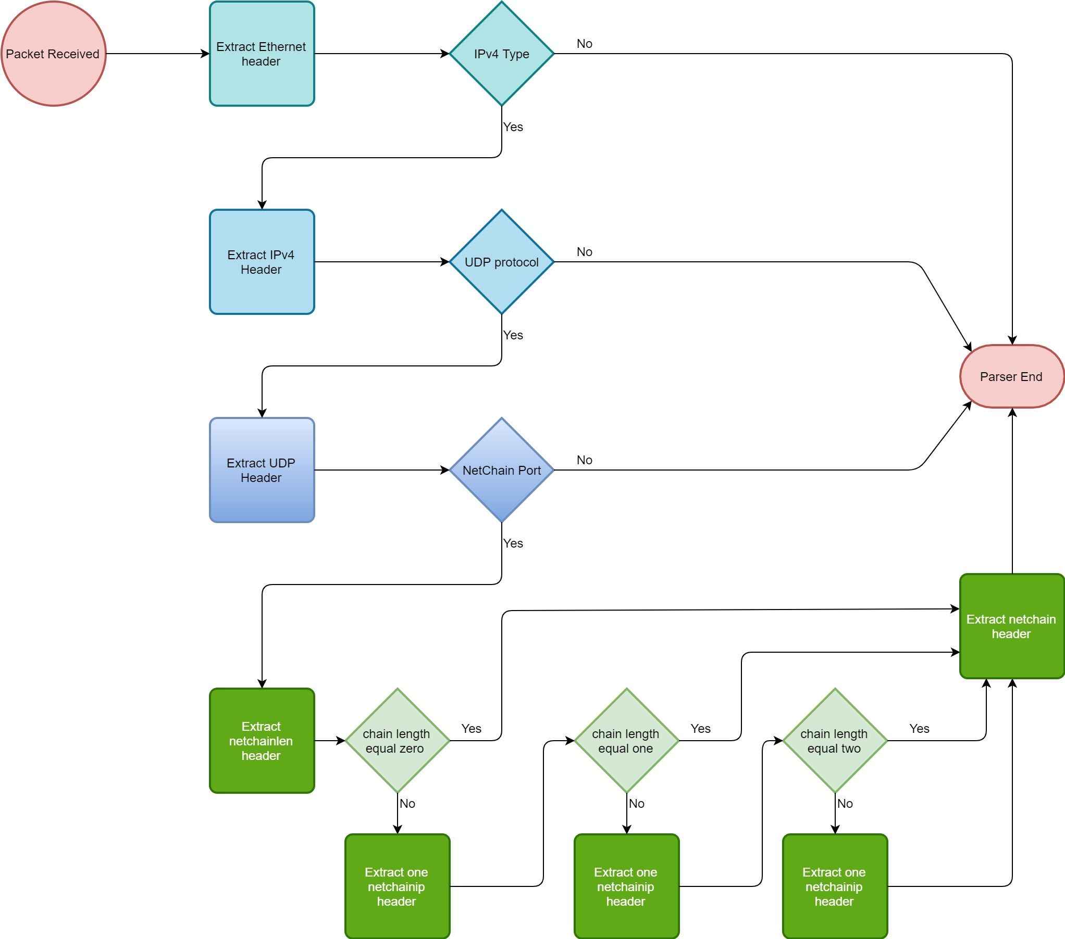
Implementation-Switch Parser

Slide 8
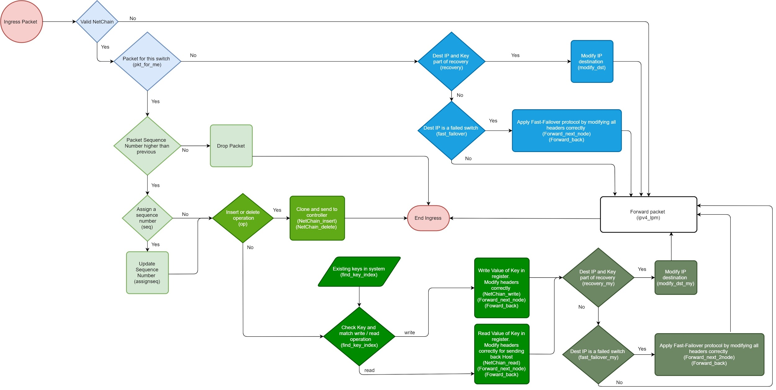
Implementation-Switch Ingress Processing

Slide 9
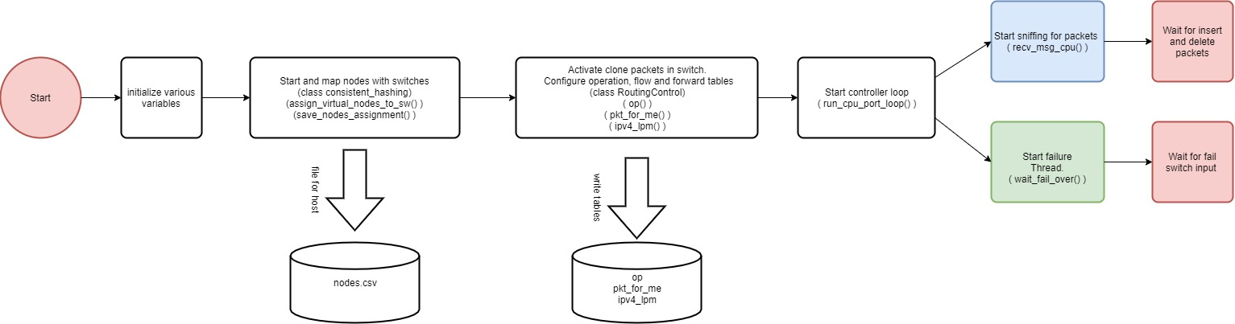
Implementation-Controller Initialization

Slide 10
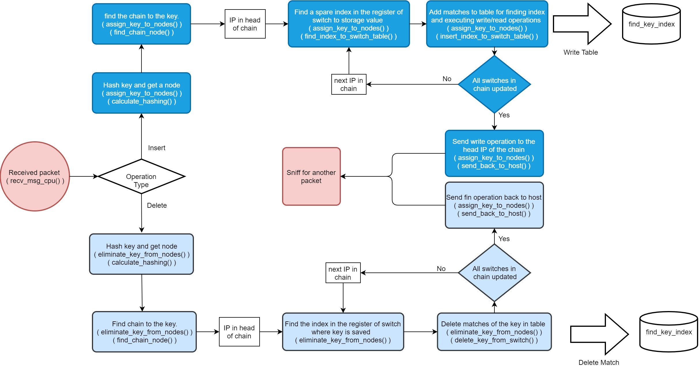
Implementation-Controller receive packets

Slide 11
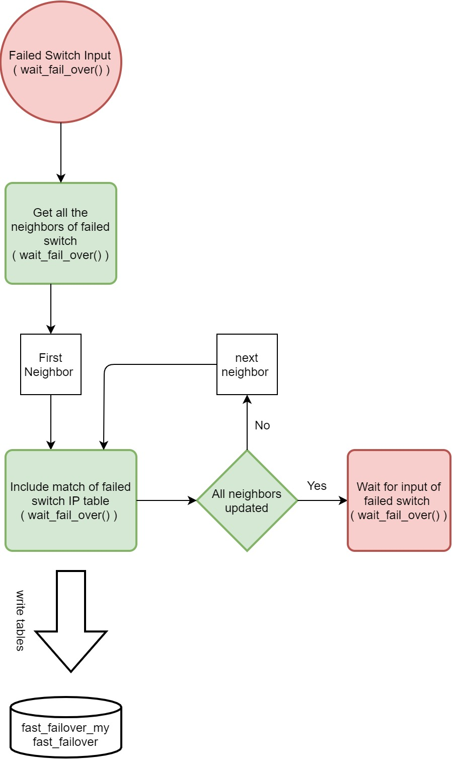
Implementation-Controller fast Failover

Slide 12
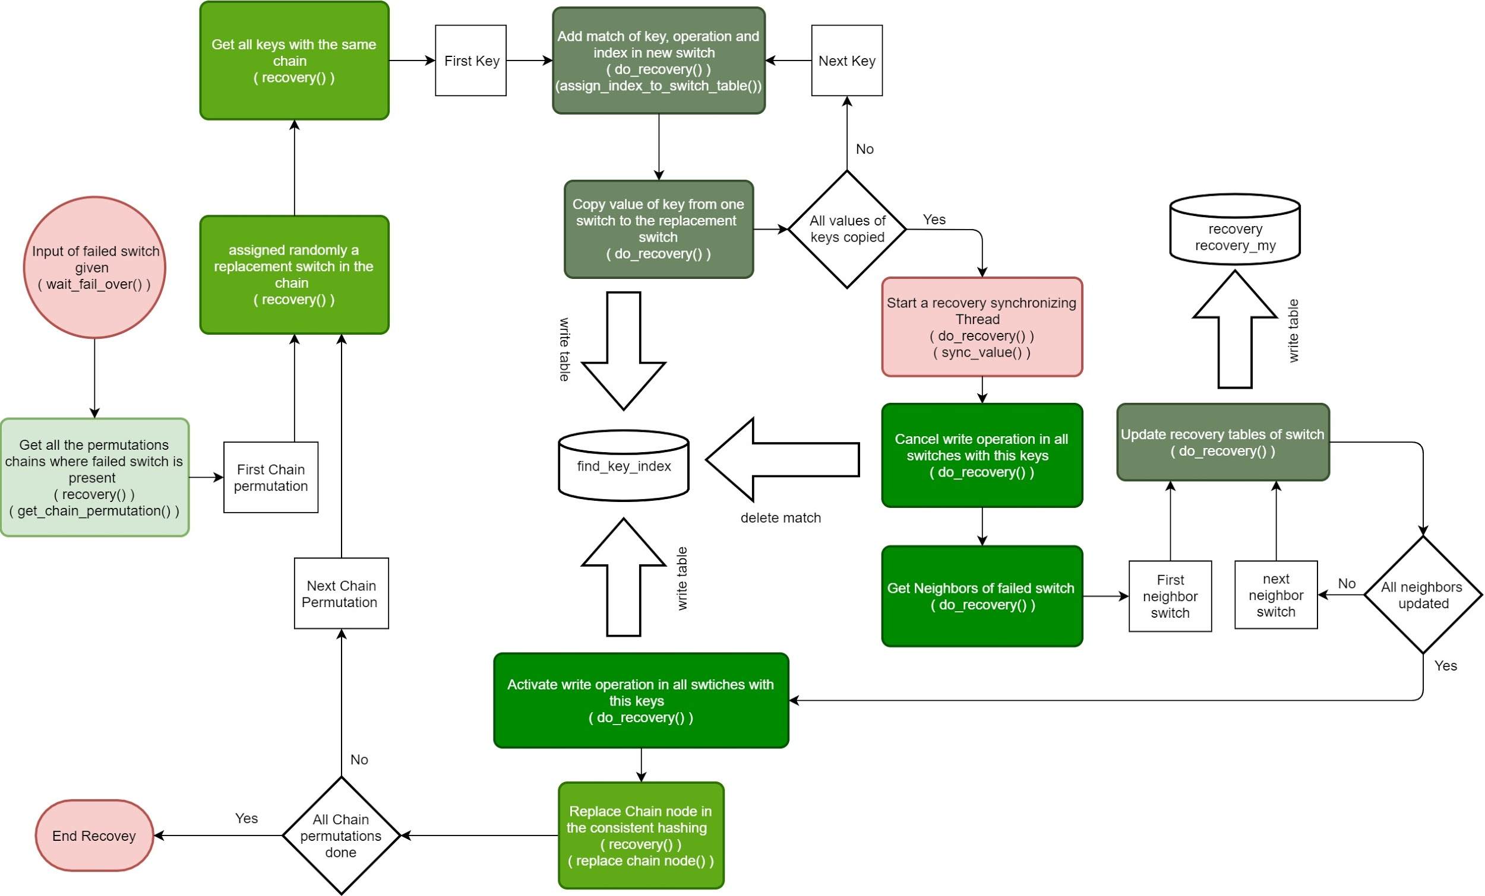
Implementation-Controller Recovery

Slide 13
Implementation-Host
Written in C++
Including normal program and evaluation program
Communicate with controller using one csv file
Multi-thread throughput testing

Slide 14
Evaluation
Average key Insert cost : 60ms
Average key write cost : 8ms
Average key read cost : 4ms
Maximum throughput : ~500Queue/sec
Failover time spent : <1 Queue timeout
Fail recovery time cost : Approx. 20 Queue timeout when moving 4096 keys

Slide 15
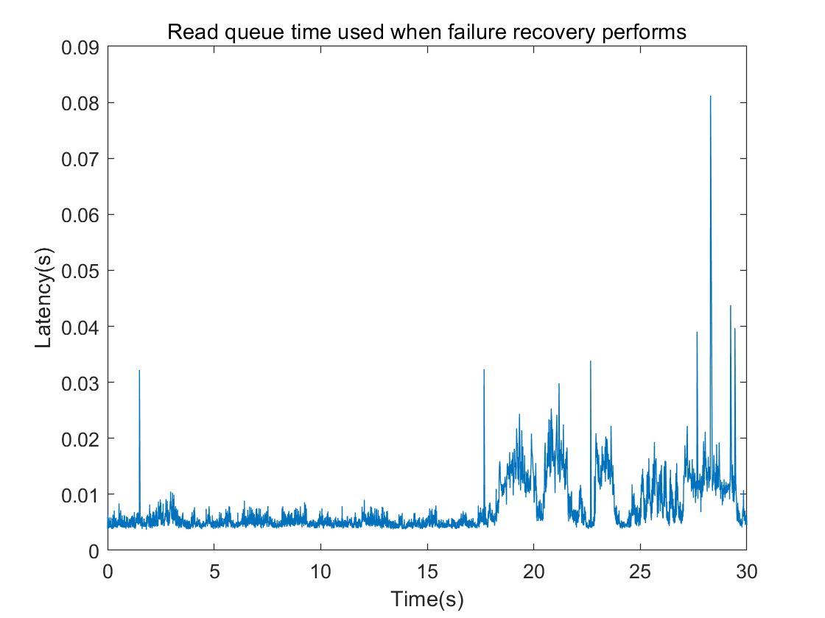
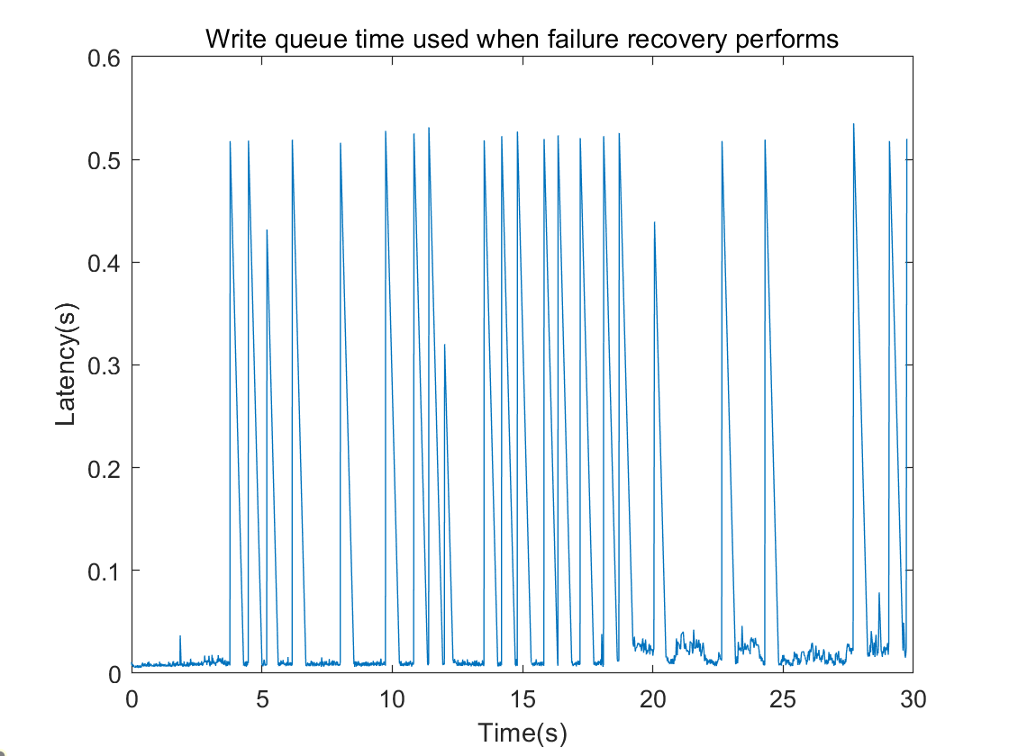
Evaluation

Slide 16
Conclusion
Offloading key-value storage from server
Chain-replication
Consistent hashing
Good fault-tolerance and recovery ability
Scalability

Slide 17
Demo
Functionallity
Failure handing

Slide 18
Q&A
?

