Slide 1
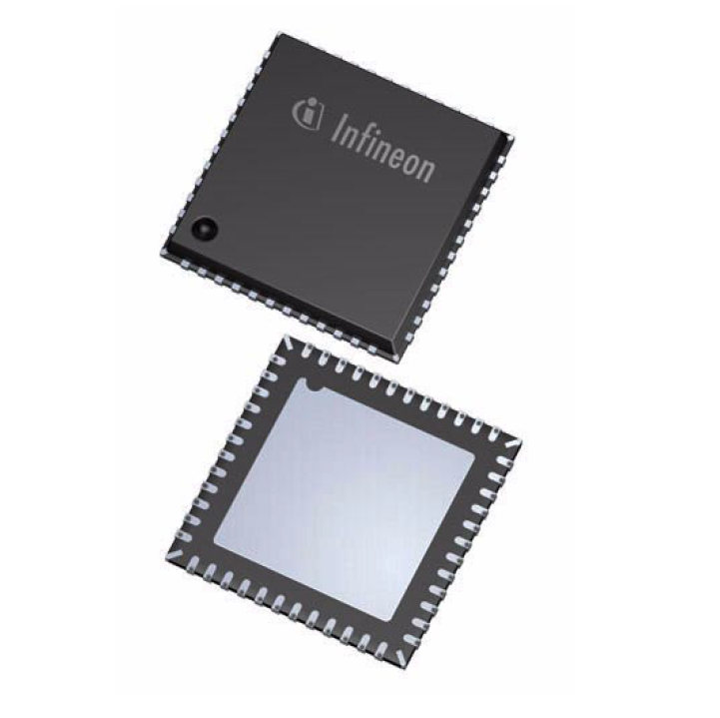
AURIX Interrupt Study
Luis Arellano, Huy Dinh
Hochschule Darmstadt

Slide 2
Outline
Interrupts
AURIX Interrupt System
  Overview
  Hardware
  Hardware signal flow
  Sample Configuration
Current pre-OS interrupt implementation
  Overview
  Interrupt Handler table
  Example
Interrupt during OS runtime
ESR interrupt setup
  Overview
  External Request Unit (ERU)
Appendix
  CPU to ICU interrupt interface
  Steps performed by the CPU in case of an interrupt request
  Interrupt Vector table
  The common dispatcher
  Contexts in AURIX
University of Applied Sciences Darmstadt

Slide 3
AURIX Interrupt System - Overview
An interrupt is a signal sent by a hardware or software module to a CPU/DMA module to stop current operations and either start an Interrupt Service Routine or a DMA service.
After an Interrupt Service Routine has been serviced, normal operation the previous context will be resumed
In the AURIX, interrupts can be either software or hardware-generated, these interrupt-enabled modules are called interrupt/service request sources.
University of Applied Sciences Darmstadt

Slide 4
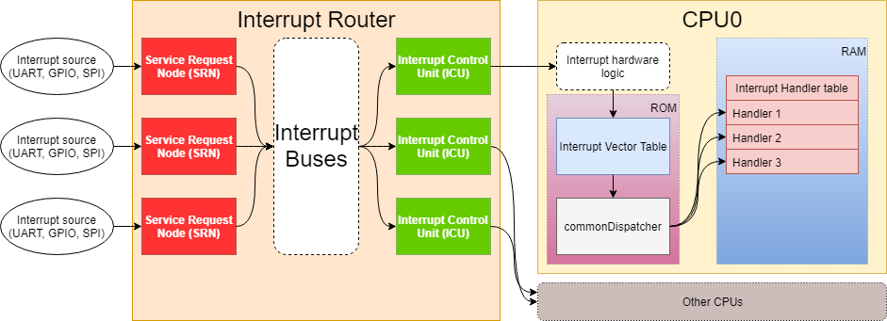
AURIX Interrupt System - Overview
The components making up the interrupt system can be generalized into
    Hardware: The Interrupt Router consisting of Service Request Nodes (SRN), Interrupt Buses and Interrupt Control Units (ICU).
    Software (Implementation-specific): the Interrupt vector table, the common dispatcher and the interrupt handler table.
University of Applied Sciences Darmstadt

Slide 5
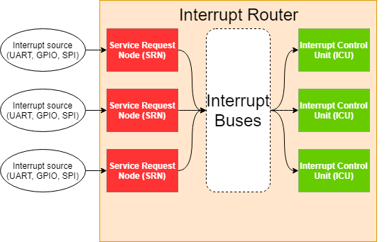
AURIX Interrupt System – Hardware – Interrupt Router
The Interrupt Router is a collection of hardware components to process and direct interrupt signals from interrupt sources (either external or internal) to the correct processor (CPU). It consists of:
    Service Request Nodes (SRN)
    Interrupt Control Unit (ICU)
University of Applied Sciences Darmstadt

Slide 6
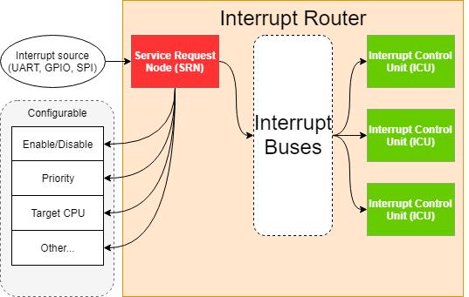
AURIX Interrupt System – Hardware – SRN
Service Request Nodes are the components that directly connect to external interrupt triggering sources and wire them to further logics. Several configurations can be done through the SRN:
    Enable/Disable the interrupt.
    Priority of the interrupt.
    Which CPU services the interrupt.
University of Applied Sciences Darmstadt

Slide 7
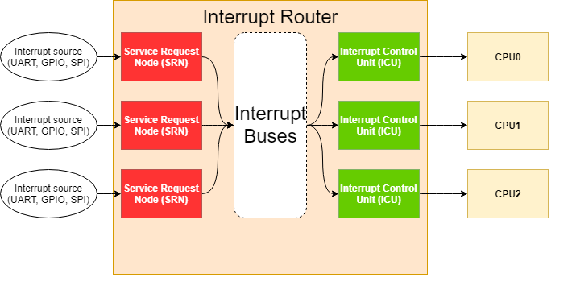
AURIX Interrupt System – Hardware – ICU
Interrupt Control Units (ICU) are in charge of interrupt arbitration (selecting one interrupt from several competing interrupts) and send the interrupt request to the selected CPU. The Interrupt Router assigns one ICU to each CPU.
Several pieces of information about current and past interrupts can be read from the ICU. This information will come in handy in the software part of the implementation.
University of Applied Sciences Darmstadt

Slide 8
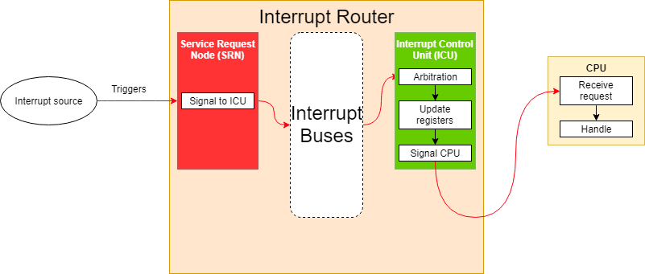
AURIX Interrupt System – Hardware Signal Flow
When an enabled interrupt is triggered, the following course of operations happen:
    The SRN forward the triggered interrupt through the interrupt bus to the specific ICU.
    ICU performs interrupt arbitration, updates information in its registers and signal the CPU.
    The CPU receives and handles the interrupt.
University of Applied Sciences Darmstadt

Slide 9
AURIX Interrupt System – Sample configuration
Sample scenario: setting up SRN for reception of UART bytes in ASCLIN3 with a priority of 43.
    Set up the priority by writing 43 to ASCLIN3RX_SRN.SRPN
    Select CPU0 by writing 0 to ASCLIN3RX_SRN.TOS
    Clear the pending request by setting ASCLIN3RX_SRN.CLRR
    Enable the interrupt by setting ASCLIN3RX_SRN.SRE
When ASCLIN3 receives a byte with the previous configuration:
    ASCLIN3RX_SRN acknowledges that the interrupt is enabled, set the pending flag and forward the request to the ICU in charge of CPU0.
    The ICU receives the request. If there is no other pending interrupt of higher priorities, it will update the current CPU priority to 43, then signals the CPU.
    The CPU receives the request and handles it by making use of the software implementation found in the next chapter.
University of Applied Sciences Darmstadt

Slide 10
Current Pre-OS interrupt implementation - Overview
The current implementation consists of the following software components:
  Interrupt vector table located on FLASH.
  Interrupt handler table located on RAM.
  The commonDispatcher function.
  The interrupt vector table is always called when an interrupt request is received by the CPU. (More information can be found in the appendix)
University of Applied Sciences Darmstadt

Slide 11
Current Pre-OS interrupt implementation - Overview
The interrupt vector table calls the commonDispatcher function, who then calls the handlers located inside the handler table located on RAM corresponding with the pending interrupt priority.
The handler table is arranged in such a way that the index of a handler entry defines the priority of the interrupt it targets with an offset of 1 (interrupt at index 0 has priority 1)
Pending Interrupt Priority
Handler Table
Handler[0]
Handler[1]
…
Handler[PIPN - 1]
…
Null terminator
read
Interrupt vector table
CommonDispatcher
call
call
University of Applied Sciences Darmstadt

Slide 12
Current Pre-OS interrupt implementation – Interrupt Handler table
The interrupt handlers table is an null-terminated array with maximum 255 interrupt handler entries, each of which contains:
  Function pointer to the handler function of the interrupt.
  The Service Request Control register of the interrupt source (unique to every interrupt source).
  The service provider (CPU/DMA module) that will service the IRQ
  The index of an interrupt entry defines its priority, starting from priority 1 for index 0 (since priority 0 is invalid)
  → This table is used for configuration of pre-OS interrupt.
University of Applied Sciences Darmstadt

Slide 13
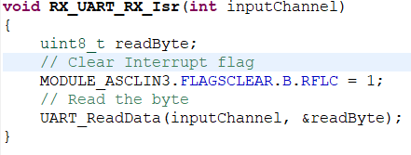
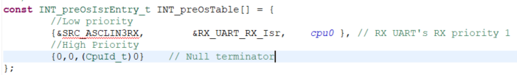

Current Pre-OS interrupt implementation – Example config – UART reception
Wrote interrupt handler for ASCLIN3 receiving interrupt
Add the corresponding entry to the preOS interrupt handler table
Select the interrupt handler table and install the table entries, enabling preOS interrupts
University of Applied Sciences Darmstadt

Slide 14
Interrupt during OS runtime - Overview
During OS runtime, the OS (PXROS) takes over the handling of interrupts by moving the interrupt vector table to its own implementation => Common dispatcher and the old handler table become obsolete.
Configuration of OS interrupts are done through an OS interrupt handler table, each of whose entries contains:
  Function pointer to the handler function of the interrupt.
  The Service Request Control register of the interrupt source (unique to every interrupt source).
  The service provider (CPU/DMA module) that will service the IRQ
  Task identifier of the task in charge of the interrupt.
University of Applied Sciences Darmstadt

Slide 15
Interrupt during OS runtime – Interrupt Handler table
The OS interrupt handle table is null-terminated, the index of each entry defines the priority with an offset of 2 (For example, index 2 means that the interrupt has priority 4). This is due to the fact that interrupt priority 1 is reserved by the OS
Index | Priority
0 | 2
1 | 3
2 | 4
… | …
Null terminator
University of Applied Sciences Darmstadt

Slide 16
Interrupt during OS runtime – Example config – UART reception
Write interrupt handler for ASCLIN3 receiving interrupt
Add a task identifier for the interrupt-enabled task to the enum INT_osIsrTaskId_t
University of Applied Sciences Darmstadt

Slide 17
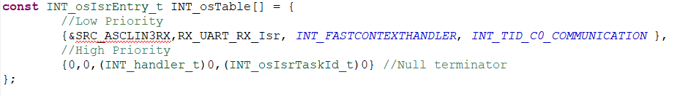
Interrupt during OS runtime – Example config – UART reception
Add the corresponding entry to the OS interrupt handler table before the null terminator
Select the OS interrupt handler table.
Within the task context, call INT_osInstallIsrTable with the task identifier representing the same task. This will install all the interrupts that are associated with this task in the selected table
University of Applied Sciences Darmstadt

Slide 18
ESR: External Service Requests
ESR interface pins are provided to give an external indication of internal resets, and to provide a mechanism for external sources to trigger internal resets:
ESR pin functions:
Reset request trigger
Wakeup trigger
Reset indication output
Trap request trigger
The ESR pins can be used in various ways:
ESR inputs can trigger a reset
ESR outputs can provide a reset indication
ESR inputs can trigger a trap (NMI)
ESR pins can be used as general data I/O pins
ESR inputs can trigger a wake-up from standby mode
University of Applied Sciences Darmstadt

Slide 19
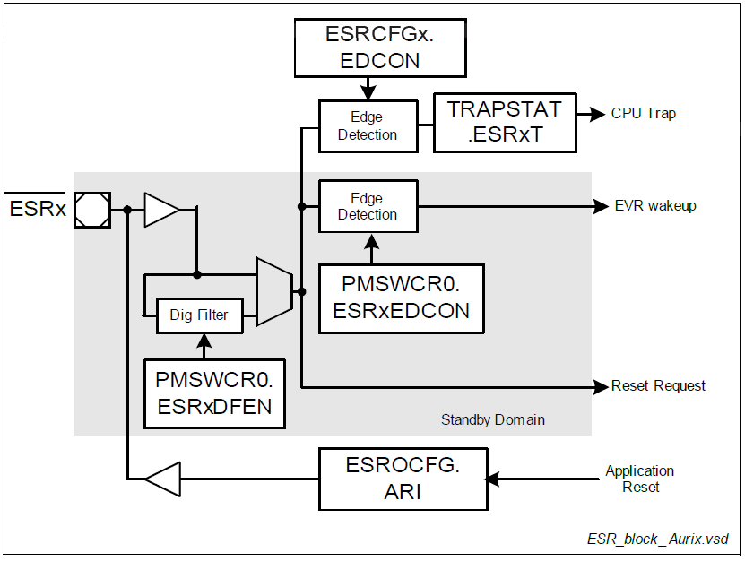
ESR: External Service Requests
University of Applied Sciences Darmstadt

Slide 20
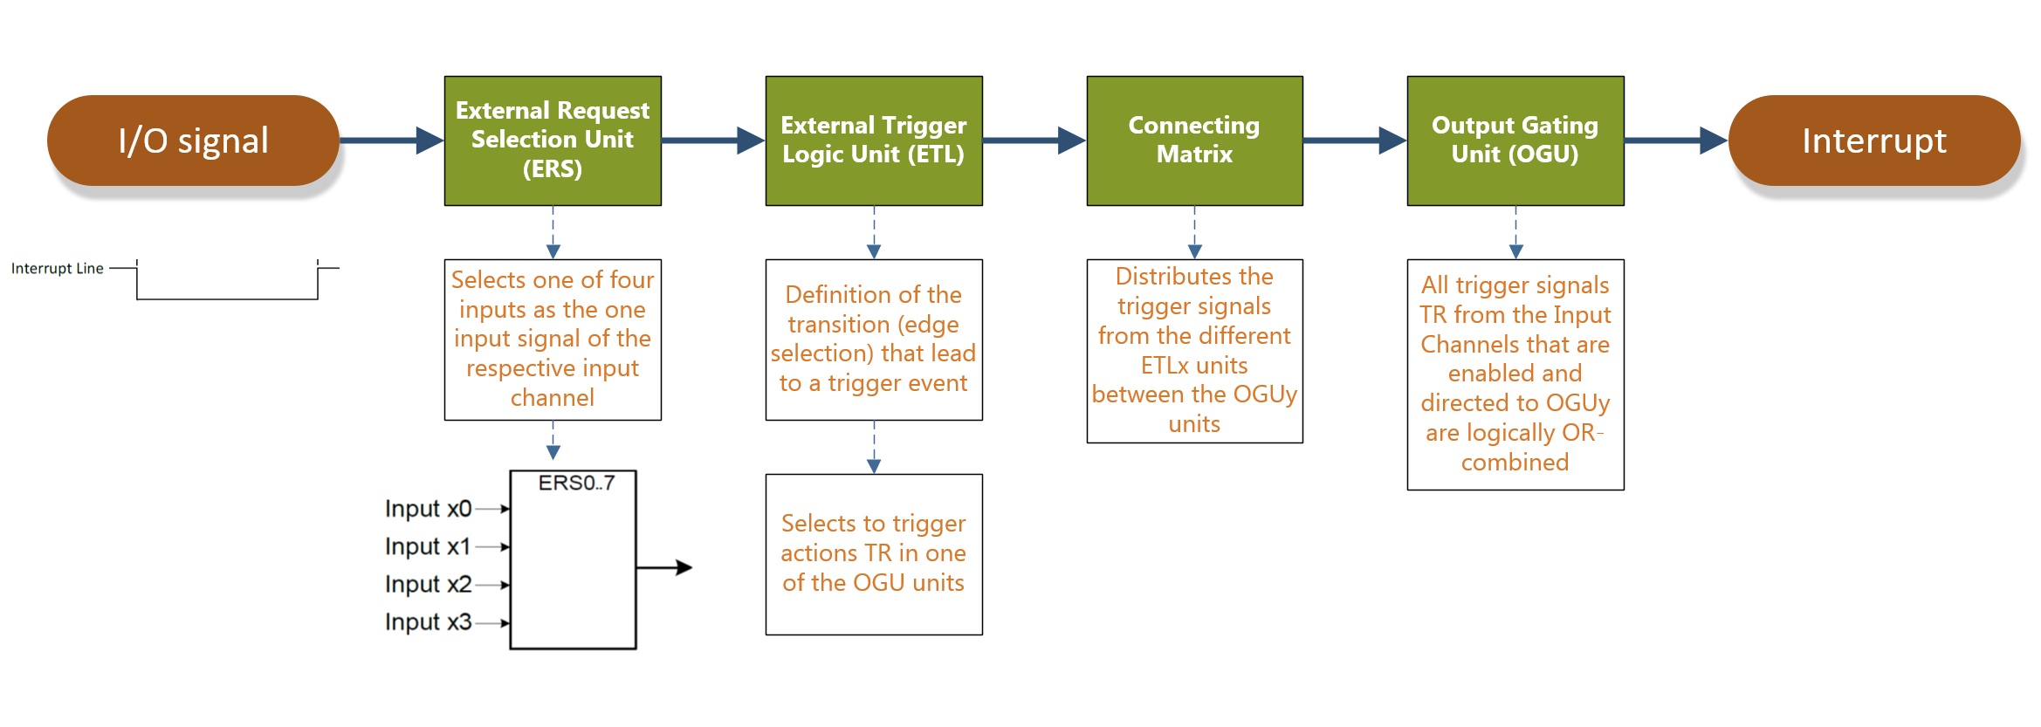
ERU External Request Unit
The External Request Unit (ERU) is a versatile event and pattern detection unit.
Generation of interrupts based on selectable trigger events at different inputs
University of Applied Sciences Darmstadt

Slide 21
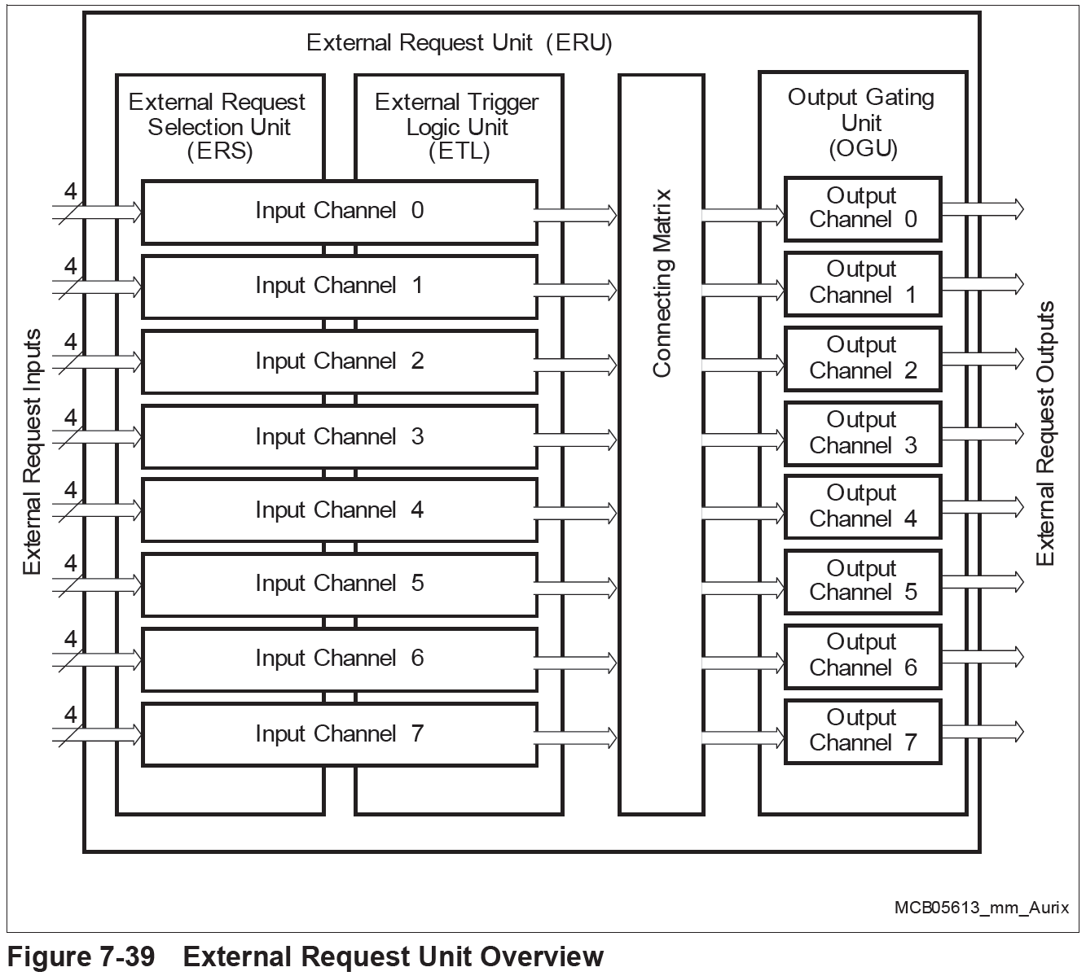
ERU - Overview
8 independent Input Channels x for input selection and conditioning of trigger or gating functions
A Connecting Matrix defines the events of the Input Channels that lead to a reaction of an Output Channel
8 independent Output Channels for combination of events, definition of their effects and distribution to the system (interrupt generation)
University of Applied Sciences Darmstadt

Slide 22
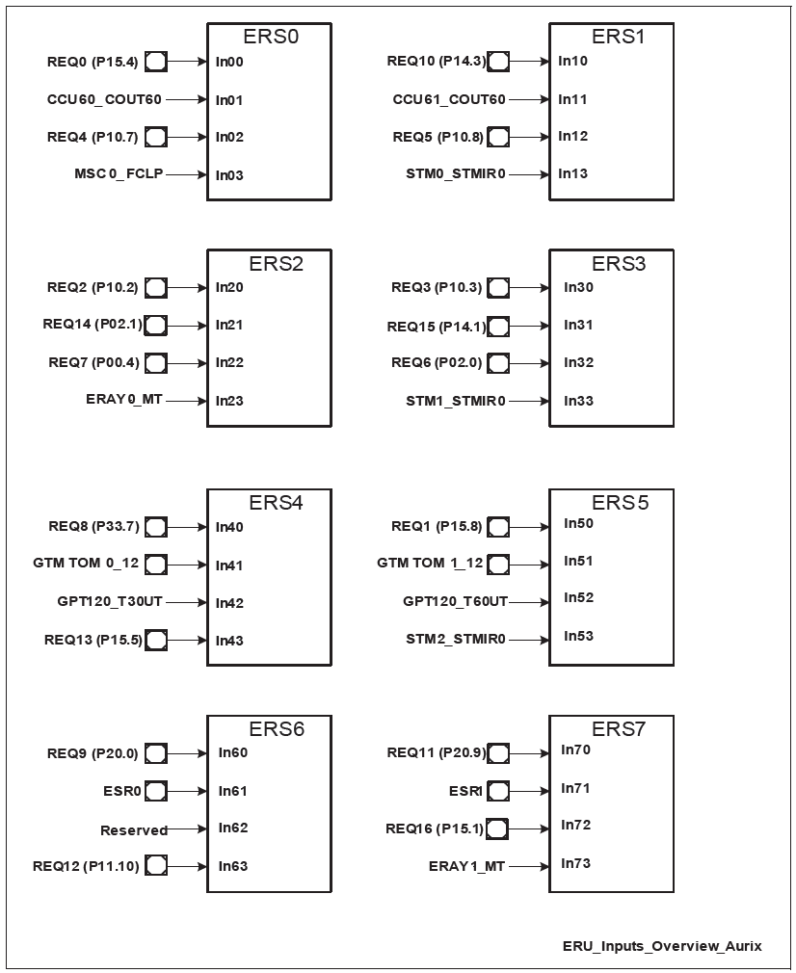
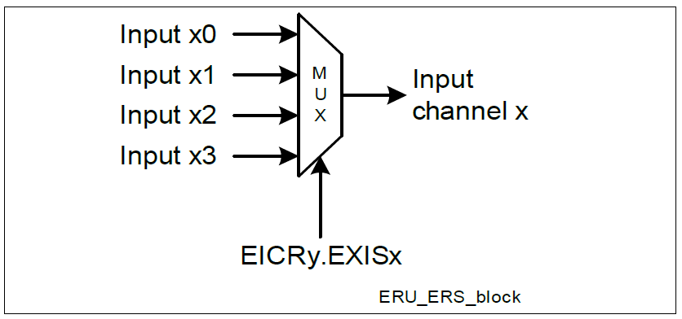
ERU – External Request Selecter (ERS)
Each ERS selects one of four inputs as the one input signal of the respective input channel
The ERS unit for channel x is controlled via bit field EICRy.EXISx
University of Applied Sciences Darmstadt

Slide 23
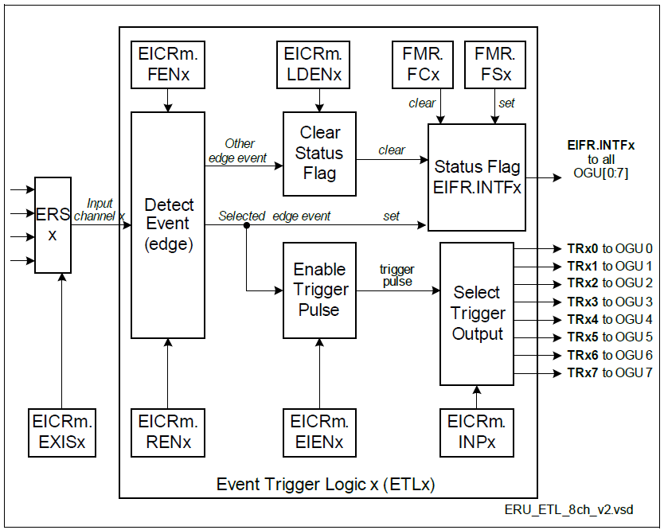
ERU Input – Event Trigger Logic (ETL)
For each Input Channel_x, an event trigger logic ETL_x derives a trigger event and a status.
Each ETLx is based on an edge detection block, where the detection of a rising or a falling edge can be individually enabled
Selects to trigger actions TR in one of the OGU units.
The trigger becomes active when the selected edge event is detected
University of Applied Sciences Darmstadt

Slide 24
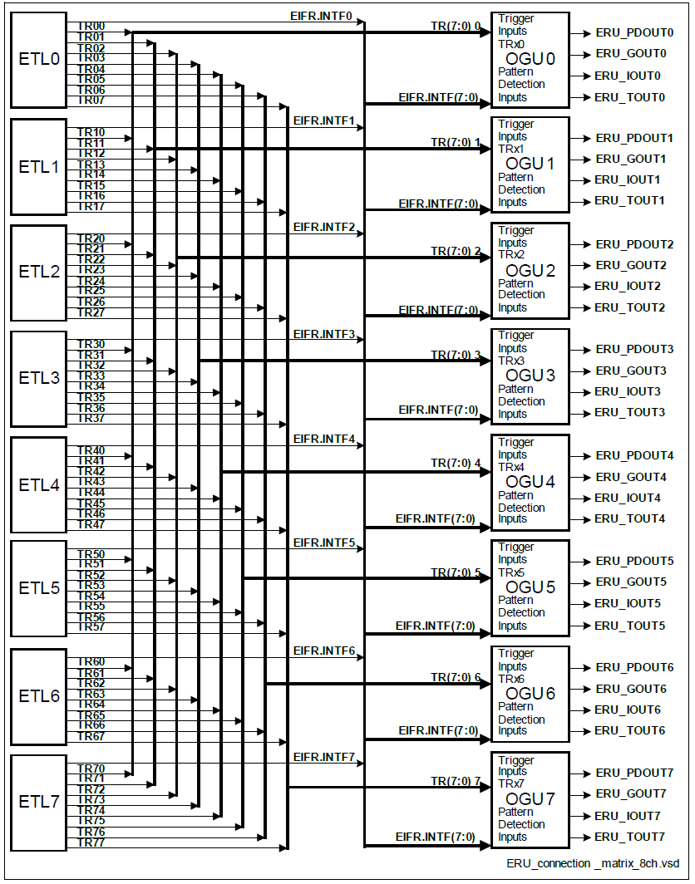
ERU Connecting Matrix
The connecting matrix distributes the trigger signals (TRxy) and status signals (EIFR.INPFx) from the different ETLx units between the OGUy units
University of Applied Sciences Darmstadt

Slide 25
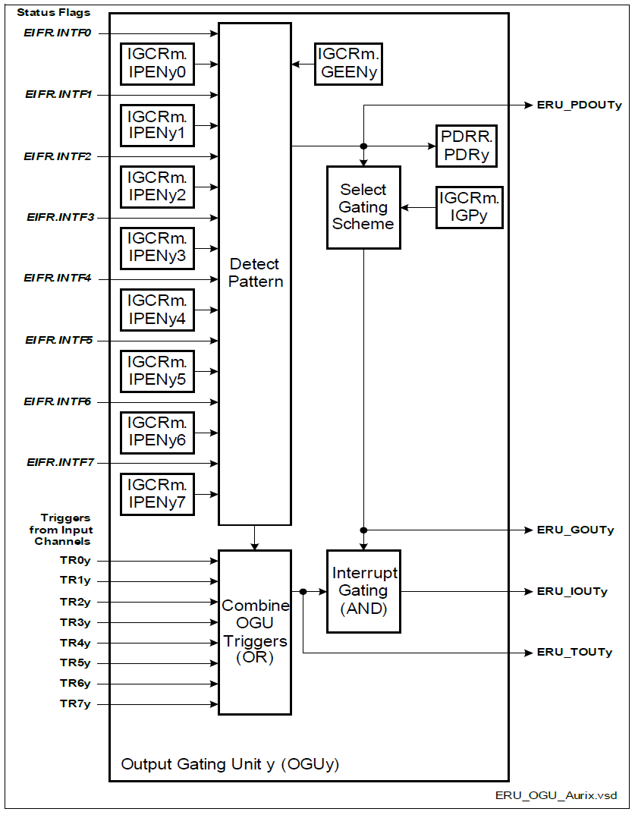
ERU Output – Output Gating Unit (OGU)
All trigger signals TRxy from the Input Channels that are enabled and directed to OGUy and a pattern change event (if enabled) are logically OR-combined
Each OGUy units generates 4 output signals that are distributed to the system
University of Applied Sciences Darmstadt

Slide 26
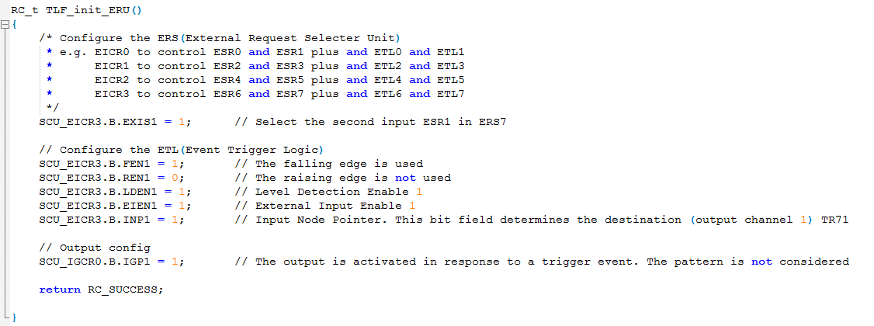
ERU configuration
University of Applied Sciences Darmstadt

Slide 27
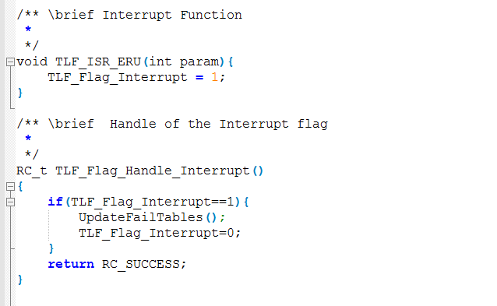
ERU interrupt Function
University of Applied Sciences Darmstadt

Slide 28
Appendix - SRN
Each SRN has a Request Control (SRC) register that contains:
  Enable/disable information
  Service Request Set bit and Service Request Clear bit
  Service Request Priority Level vector (8-bit)
  Service provider (Who will receive the interrupt to handle, either one of the CPUs or an DMA module).
  Service request status bit
  Software-initiated service request set and reset bits
  Integrity errors signalled to the Safety Monitor Unit (SMU)
  Interrupt Sticky and Overflow bits
University of Applied Sciences Darmstadt

Slide 29
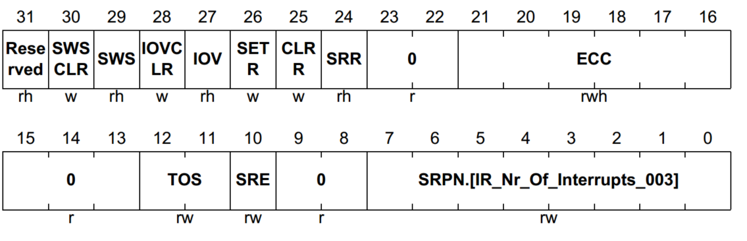
Appendix - SRN
SRC register layout:
Some important fields:
  SRE: Enable/disable interrupt
  SRPN: priority of the interrupt
  SET R/CLR R: Set/Clear request
  TOS: Specify the service provider, also connects the SRN to the corresponding ICU (see next page)
University of Applied Sciences Darmstadt

Slide 30
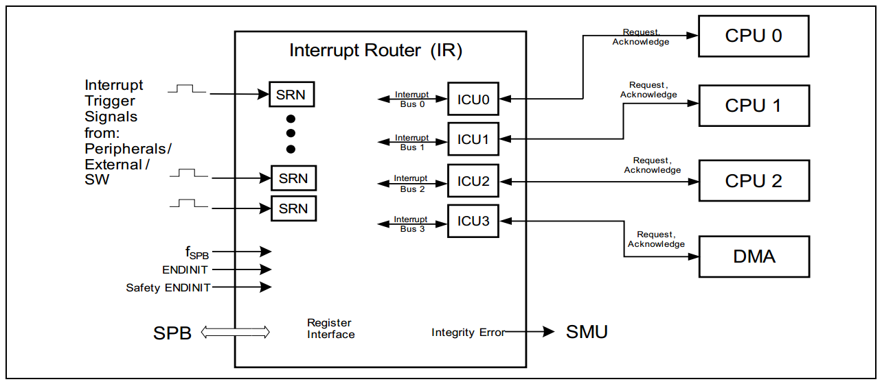
Appendix– ICU and CPU
TC29x User’s Manual, page 1608
The SRNs are connected to the interrupt signal sources, then connects to all Interrupt Control Units (ICU)s through interrupt buses configurable in the SRC’s TOS field.
An ICU is connected to one service provider and handles interrupt arbitration (deciding which among competing interrupts should be handled at a time then forward the winning interrupt to the service provider based on the priority).
University of Applied Sciences Darmstadt

Slide 31




Appendix - ICU to CPU interface
After the arbitration process, the ICU sends information about the interrupt request to the CPU connected to it and receives an acknowledge signal back from the CPU.
The CPU ICU interface contains an Interrupt Control Register (ICR) that holds the current CPU priority number (CCPN), the global interrupt enable/disable bit (IE) and the pending interrupt priority number (PIPN).
The Base Interrupt Vector (BIV) points to the start of an interrupt/vector table that contains handlers for interrupts.
ICU
CPU
ICR
IE
CCPN
PIPN
BIV
University of Applied Sciences Darmstadt

Slide 32
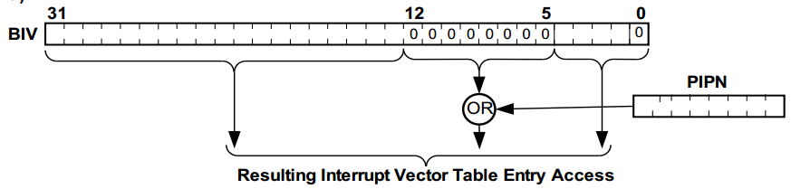
Appendix - ICU to CPU interface - BIV
BIV works out the address of a handler by OR’ing its “interrupt priority mask” with the current pending priority (PIPN). The result is the address of the handler inside the vector table. See below.
BIV can be configured to select the spacing between entries
  If BIV[0] = 1
    Spacing between table entries = 8 bytes
    BIV[9:3] is the interrupt priority mask
  If BIV[0] = 0
    Spacing between table entries = 32 bytes
    BIV[12:5] is the interrupt priority mask (as demonstrated in the picture above)
University of Applied Sciences Darmstadt

Slide 33
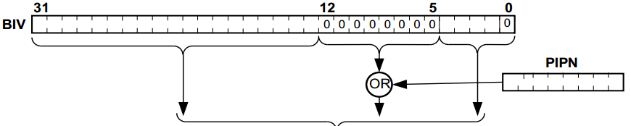
Appendix - ICU to CPU interface - BIV
Example BIV configured with:
  32-byte spacing
  Interrupt masking value of 0x00
  → There will be 255 output table entry addresses exactly 32 bytes apart
Interrupt Vector Table
Starting address (INT0) | INT0 Handler begin
[32 bytes] | INT0 Handler body
Starting address + 32 | INT1 Handler begin
[32 bytes] | INT1 Handler body
Starting address + 64 | INT2 Handler begin
[32 bytes] | INT2 Handler body
Starting address + 96 | INT3 Handler begin
[32 bytes] | INT3 Handler body
… | …
Resulting Vector
Table Entry Address
Resulting Vector
Table Entry Address
University of Applied Sciences Darmstadt

Slide 34
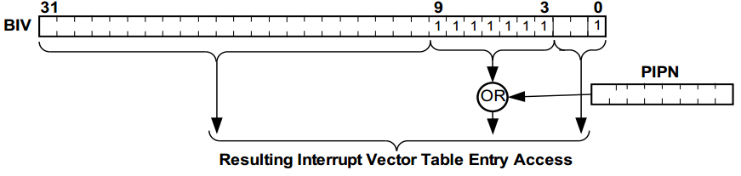
Appendix– ICU to CPU interface- BIV
This mechanism means that if the 8-bit long interrupt priority mask has a value of 255 (0xFF), the value of PIPN will not matter to the outcome of the process. All interrupts will be directed to one single handler and the vector table needs only 1 entry.
This example is covered in the User’s Manual with a 8-byte spacing vector table. (See below)
TC29x User’s Manual, page 1633
University of Applied Sciences Darmstadt

Slide 35
Appendix – Steps performed by the CPU in case of an interrupt request
When an enabled interrupt wins the interrupt arbitration process and is sent to the CPU, the CPU will:
  Save the upper context (more information regarding contexts in the appendix), update A[11] (Return address) with the current program counter.
  If not using interrupt stack, set A[10] Stack pointer to ISP (Interrupt Stack Pointer) (PSW.IS = 1)
  Set I/O mode to Supervisor (PSW.IO = 0b10), enable memory protection using the interrupt memory protection map (PSW.PRS = 0b00), clear Call Depth Counter (PSW.CDC).
  Disable write to A[0], A[1], A[8] and A[9] (PSW.GW = 0)
  Disable global interrupts.
  Save CCPN (Current Priority Number) to Previous CPU Priority Number (PCPN)
  Save PIPN (Pending Interrupt Priority Number) to CCPN (Current CPU Priority Number)
  Entry address of the interrupt vector table is calculated and entered
University of Applied Sciences Darmstadt

Slide 36
Appendix– Interrupt vector table
The implementation of the interrupt vector table can be found in src_BSW/srv/interrupt_init.c
This table contains only one entry that calls commonDispatcher which will dispatch the interrupt to the corresponding handler
University of Applied Sciences Darmstadt

Slide 37
Appendix– Interrupt vector table
Before calling the handler, these conditions need to be ensured by the entry in the vector table:
  Both the lower context and the higher context are saved. (higher context would have already been saved by the CPU)
  CCPN is loaded with PIPN (to update the current priority the CPU runs on).
  Interrupts are enabled.
And after calling the handler:
  Lower context and higher context are restored
  Jump to the previous program counter
University of Applied Sciences Darmstadt

Slide 38
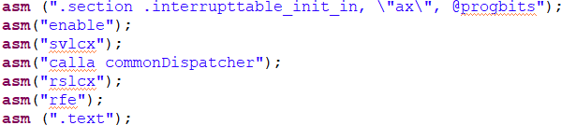
Appendix – Interrupt vector table
The content of the current interrupt vector table is found below
Assembly instructions:
ENABLE: enable interrupts since interrupts was previously disabled automatically.
SVLCX: save lower context (the upper context is already saved automatically by the CPU)
[There is no need to manually load PIPN into CCPN since this would have been already carried out by the CPU]
CALLA: Call commonDispatcher;
RSLCX: restore lower context
RFE: return from exception/interrupt to the previously saved Program counter, restoring the higher context in the process
University of Applied Sciences Darmstadt

Slide 39
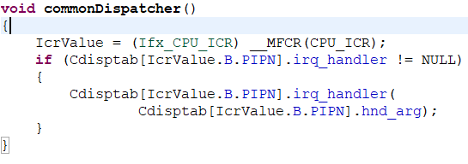
Appendix– The common dispatcher
The common dispatcher is a function named commonDispatcher which is called by the interrupt vector table to dispatch interrupts to their corresponding handlers.
The content of the function is found below
The function first reads the pending interrupt priority from ICR.PIPN then checks if a handler has been assigned to that priority. If yes, the function will call the handler with the preset argument.
University of Applied Sciences Darmstadt

Slide 40
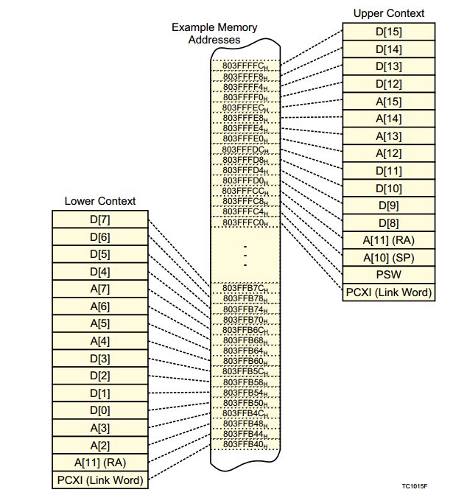
Appendix – Contexts in AURIX
The context is subdivided into the upper context and the lower context.
  Upper context: Consists of the upper address registers A[10] to A[15] and the upper data registers D[8] to D[15]. The upper context also includes PCXI and PSW. These registers are designated as non-volatile for purposes of function-calling (their contents are preserved across calls).
  Lower context: Consists of the lower address registers A[2] to A[7], the lower data registers D[0] to D[7], A[11] (Return Address) and PCXI.
University of Applied Sciences Darmstadt

