Slide 1
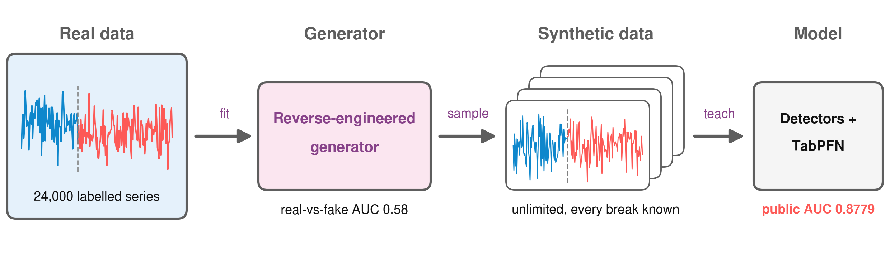
Let the generator teach the model
Structural-break detection: rebuild how the data was made, then learn from synthetic data
0.8779 public AUC 0.8741 out-of-fold AUC #2 of 6 finalists after qualification
Team BreakPoint · KU Applied AI Challenge 2026 (KU-SBB) · Final, 11 November
Notes:
[~15 s] Hello, we are team BreakPoint. Our one idea: instead of only learning from 24,000 labels, we rebuilt the process that generated the data, and let synthetic data teach the model what the labels cannot. Our best submission scores 0.878 public AUC.
中文提示：开场一句话讲核心思路：反推生成器，让假数据来教模型。报 0.878。

Slide 2
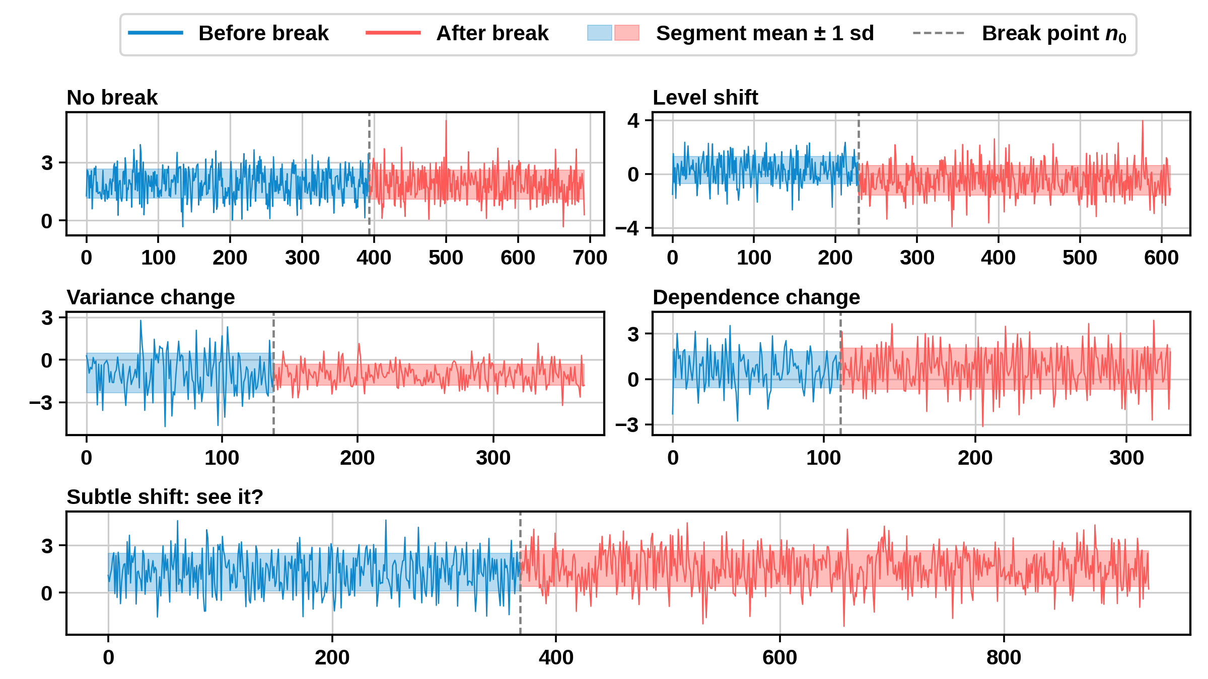
Breaks range from obvious to invisible
The task
Known boundary: did the process change there? ROC-AUC on 4,000 test series.
What can change
Level, variance, dependence or the noise distribution.
Why it is hard
About 1 in 3 level / variance breaks is as small as the last panel.
Synthetic examples from our generator. Dashed line = known boundary n0; band = segment mean ± 1 sd.
Team BreakPoint · KU-SBB final
2
Notes:
[~45 s] Each series has a known boundary; we predict whether the process changed there. It can be the level, the variance, the dependence, or the noise itself. The first panels are easy. Now look at the last one: there is a level shift of a quarter of a standard deviation — can you see it? In our calibrated generator about one in three level or variance breaks is this small. 24,000 labels cannot teach every such change in every kind of series, so we needed another source of supervision.
中文提示：先讲任务；指着最后一格问“看得出吗？”——0.27 个标准差的水平变化；生成器里约 1/3 的水平/方差断点这么小；所以需要标签以外的监督来源。

Slide 3
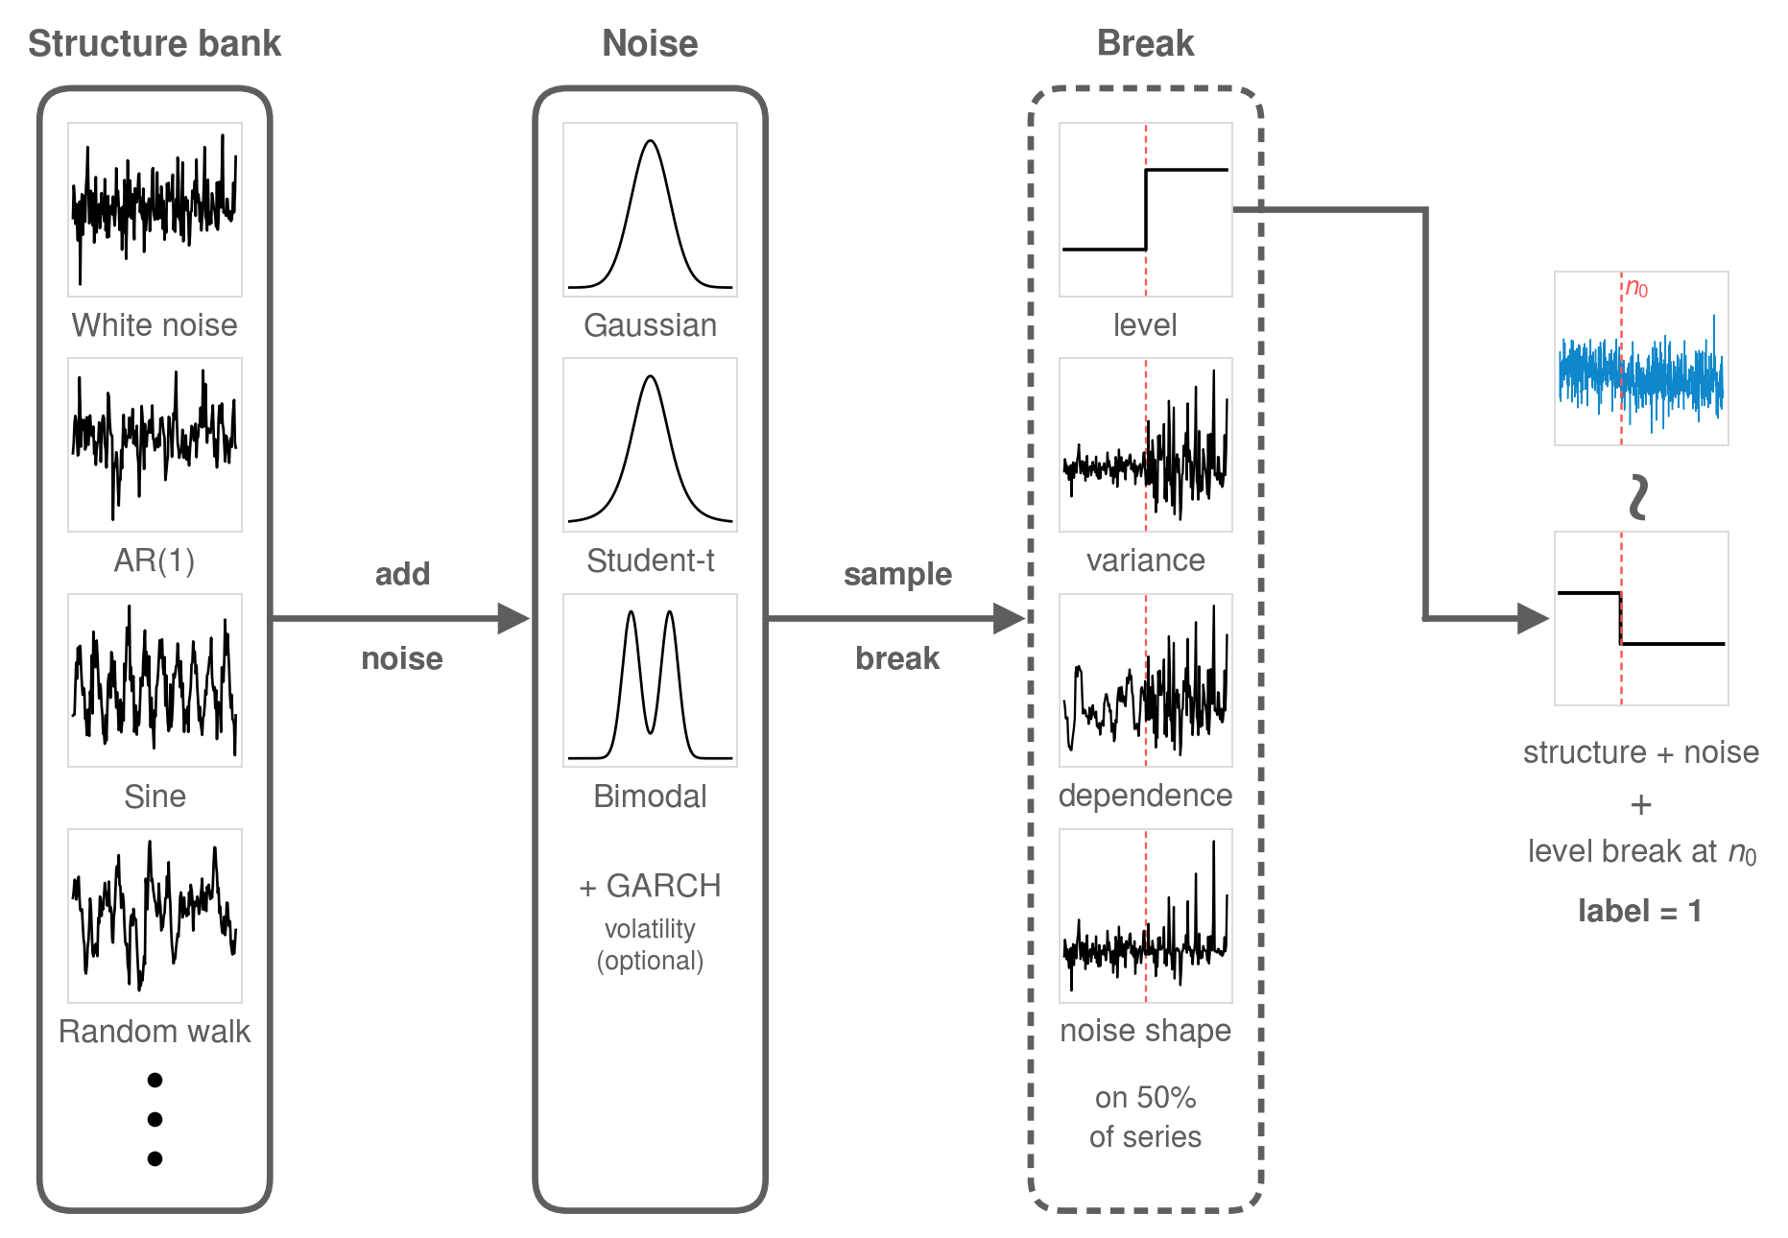
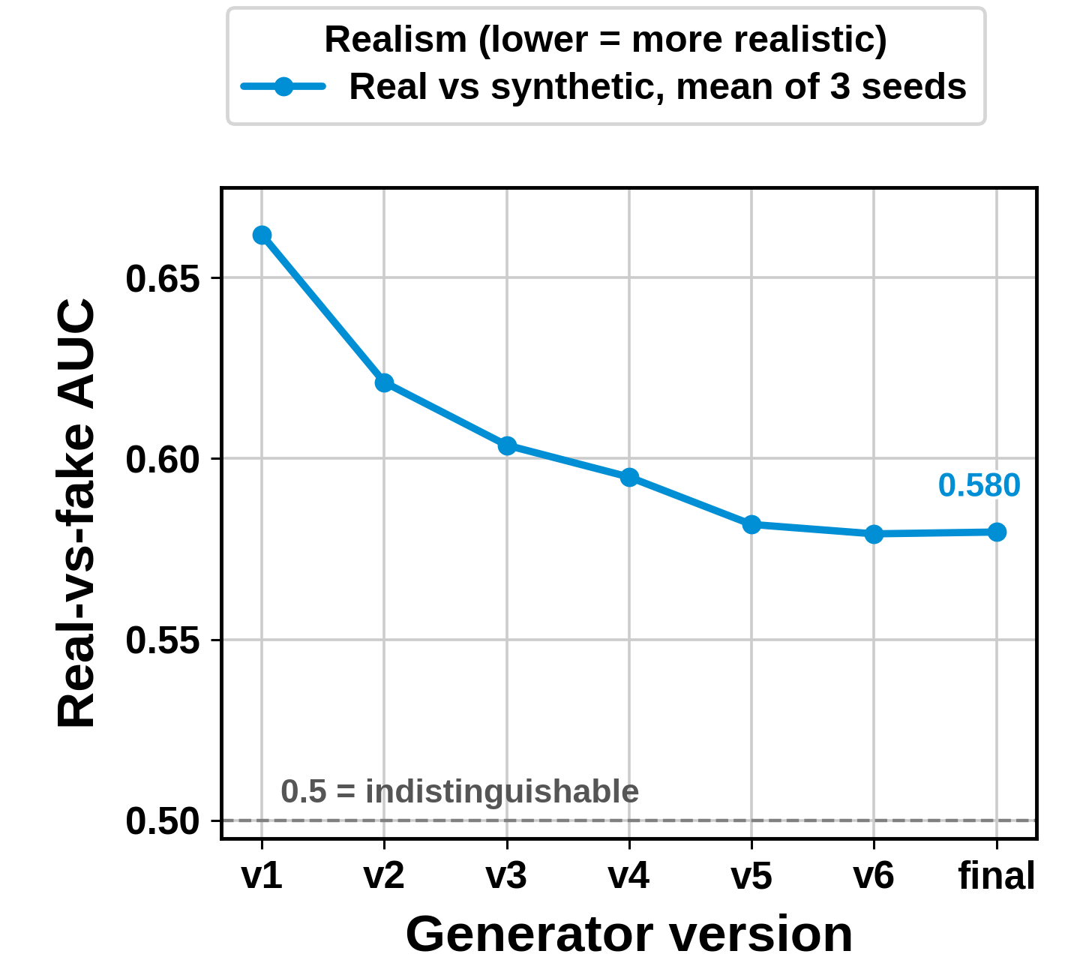
We reverse-engineered the generator behind the data
Recipe fitted by matching real series (ku_gen.py in the repo): structure → noise → optional break at n0
Mean of 3 seeds, noise ±0.003
Team BreakPoint · KU-SBB final
3
Notes:
[~50 s] Key choice. By fitting every real series we inferred the recipe: a structure, a noise type, and optionally one break. We kept adjusting the recipe until a classifier could hardly tell real from fake: its AUC fell from 0.66 to 0.58, where 0.5 means indistinguishable. With a realistic generator we get unlimited labelled data, with all hidden parameters known.
中文提示：逐条拟合真实序列推出配方：结构→噪声→断点；真实度（真假判别 AUC）0.66 降到 0.58（0.5=分不出）；从此有无限多带标签、参数全知的数据。

Slide 4
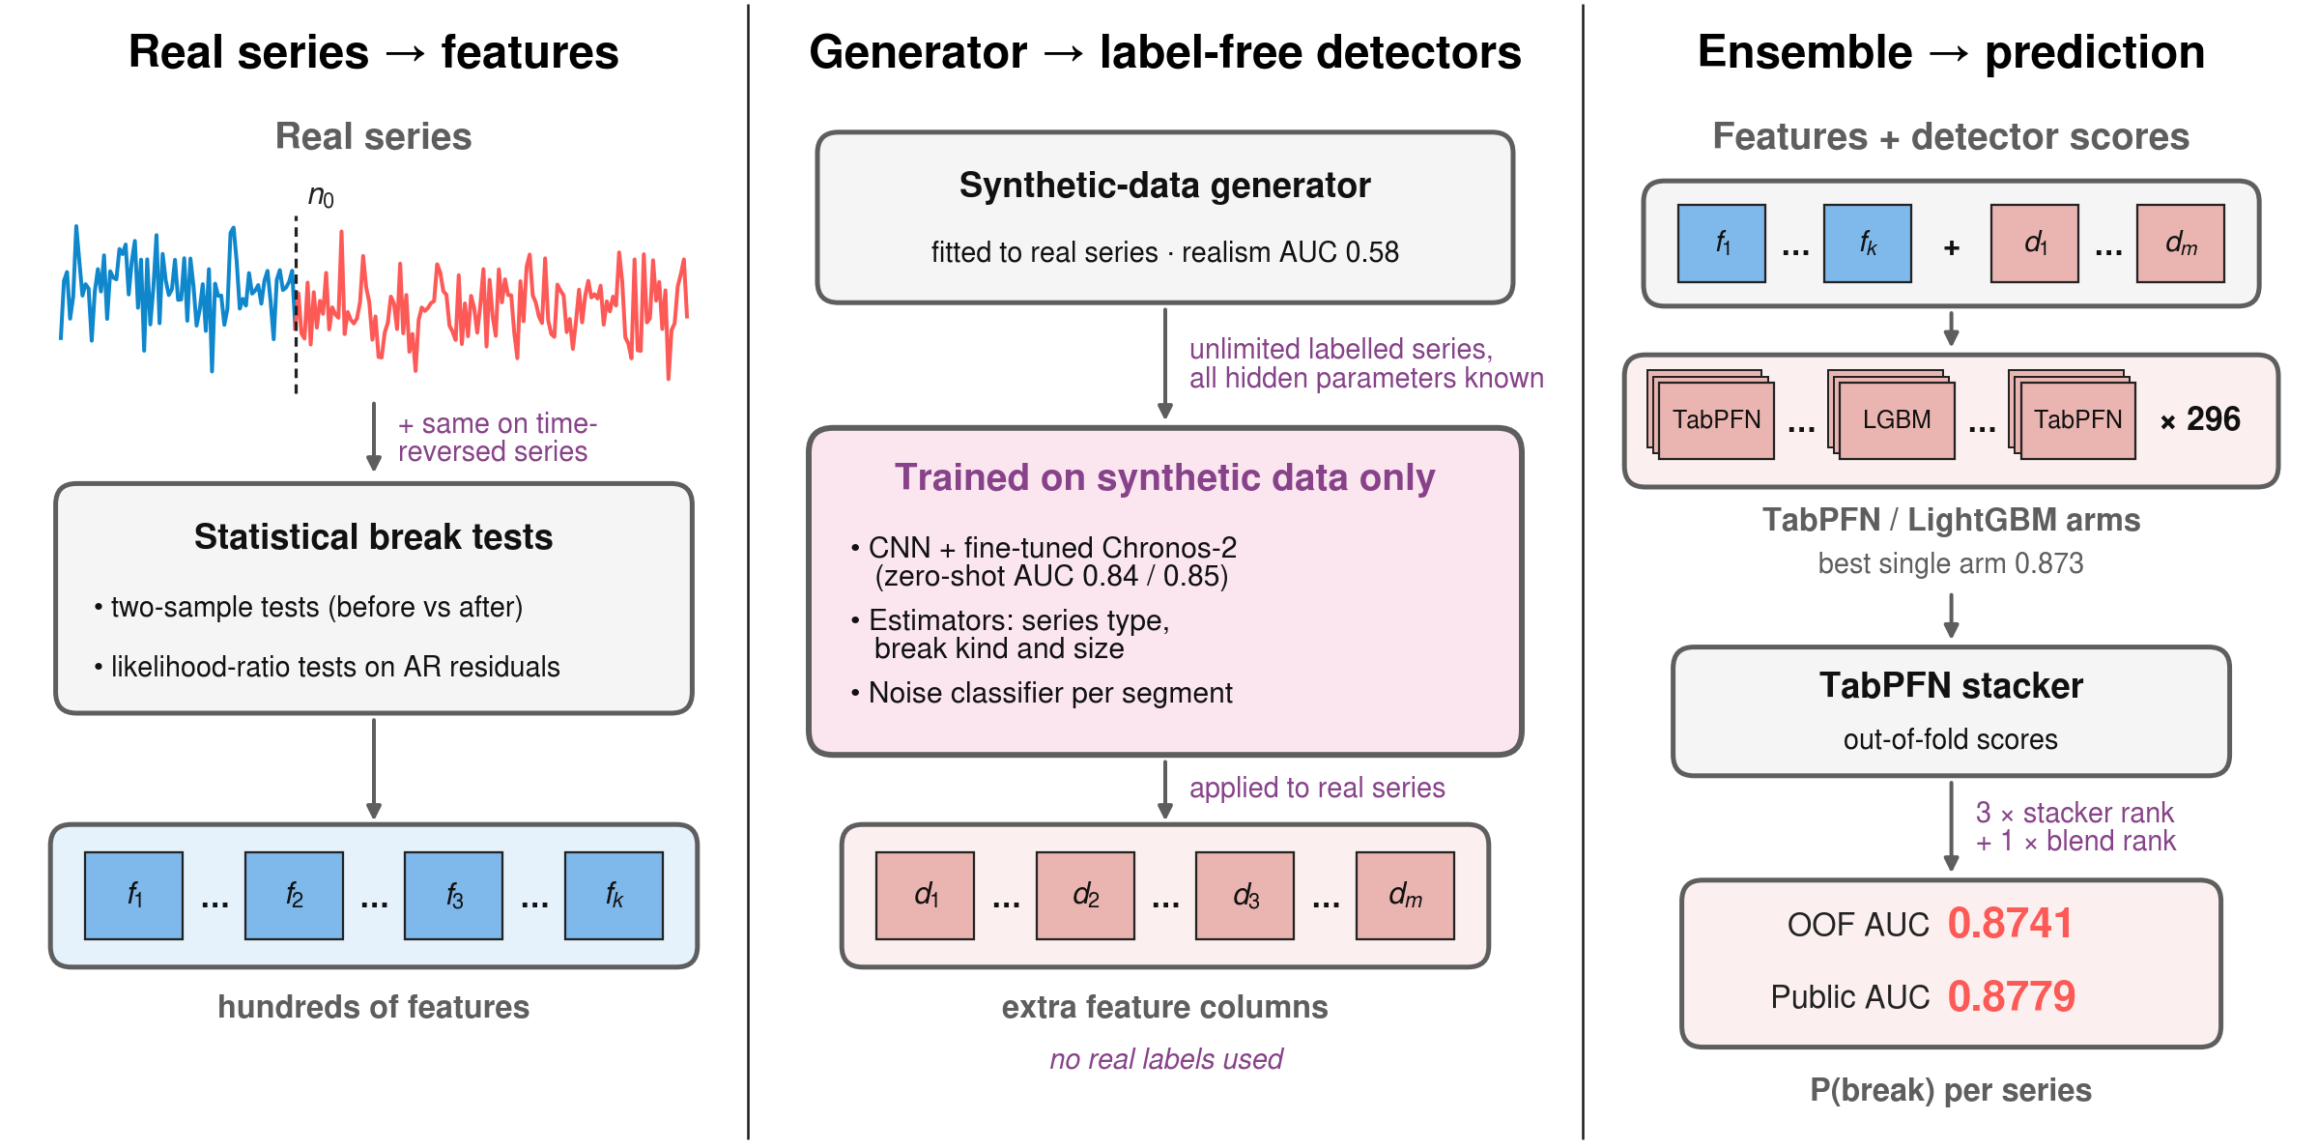
Label-free signals feed a TabPFN ensemble
Team BreakPoint · KU-SBB final
4
Notes:
[~50 s] The pipeline. Left: real series get classic statistics — two-sample tests and likelihood-ratio break tests on AR residuals — computed on the series and on its time-reversed copy. Middle: the generator trains three things without any real label: estimators of the series type and break size, a CNN and a fine-tuned Chronos-2 that detect breaks zero-shot at AUC 0.84 and 0.85, and a noise classifier per segment. Right: TabPFN, a pretrained tabular transformer, reads these features; a second TabPFN stacks the arms.
中文提示：左=真实序列统计特征(+时间反转)；中=生成器训练的三样东西，全程不用真实标签；右=TabPFN 分支 + TabPFN 堆叠。

Slide 5
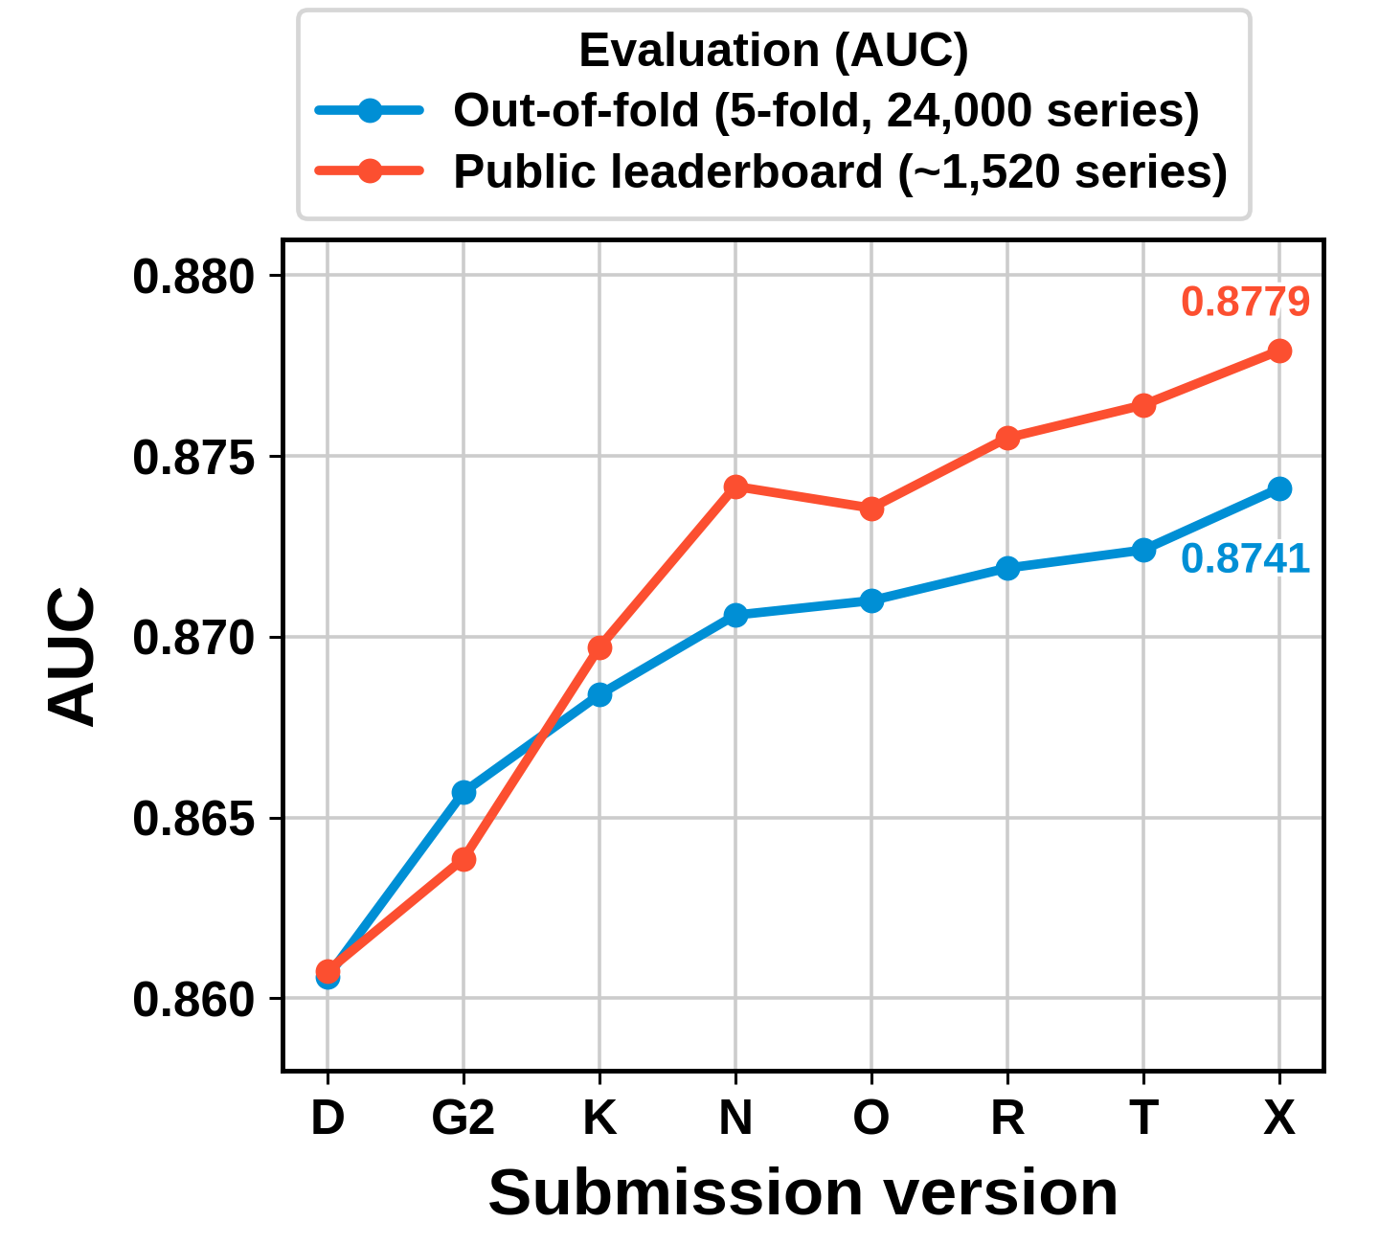
Every gain had to survive fold-clean validation
1
Fold-clean
5-fold stratified CV; selection, TabPFN context and stacker fitted inside each training fold
2
Two-stage test
Fast screen, then full-setting confirm with a paired bootstrap CI; quick gains usually halve
3
Decide by OOF
Public LB = ~1,520 series, noise ±0.009 (larger than most gains); OOF on 24,000 series is ±0.002
D = CPU-auditable LightGBM, G2 = qualification, X = best (blendXFS)
Team BreakPoint · KU-SBB final
5
Notes:
[~45 s] Validation. All label-dependent steps — feature selection, TabPFN context, stacker — are fitted inside the training folds. Each change is screened fast, then confirmed at full settings with a paired bootstrap; quick gains usually halve, and we only kept what survived. The public leaderboard uses about 1,500 series, so its noise is about ±0.009 — larger than most of our improvements — so we decided by out-of-fold AUC. The chart shows both rising together across our submissions.
中文提示：所有用标签的步骤都在折内；快速筛→正式确认+配对 bootstrap，快速增益通常减半；公榜只有约 1500 条、噪声 ±0.009，按 OOF 决策；图里 OOF 和公榜同步上升。

Slide 6
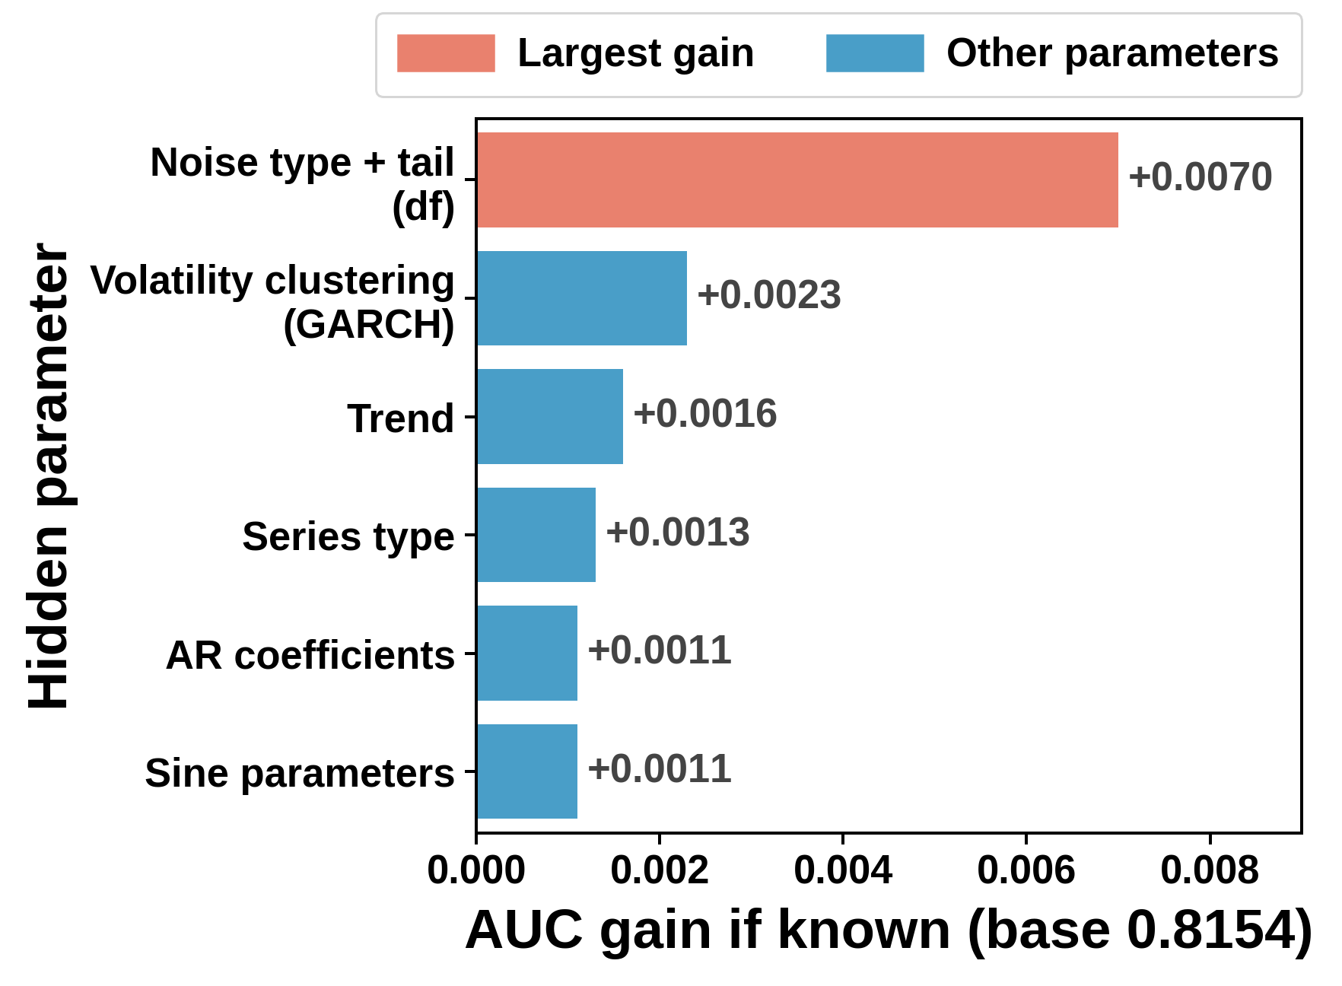
An oracle experiment showed where the fixable error is
How the oracle works
1
Synthetic data
every hidden parameter of every series is known
2
Tell the model
add the true value as an extra feature, retrain
Measure
AUC gain = what better estimation of it is worth
3
Biggest lever: the noise distribution before the boundary
LightGBM on 90k synthetic series, tested on 30k held out; baseline 0.815
Team BreakPoint · KU-SBB final
6
Notes:
[~40 s] How we found our last gain. On synthetic data we know every hidden parameter. So we asked: if the model were told the true value, how much would AUC rise? The answer points to what is worth estimating better. The noise distribution before the boundary was worth +0.007 — more than all other parameters together.
中文提示：假数据里所有隐藏参数已知→把真值当特征给模型→AUC 涨多少=把它估准值多少；噪声分布最值钱 +0.007，比其他加起来还多。

Slide 7
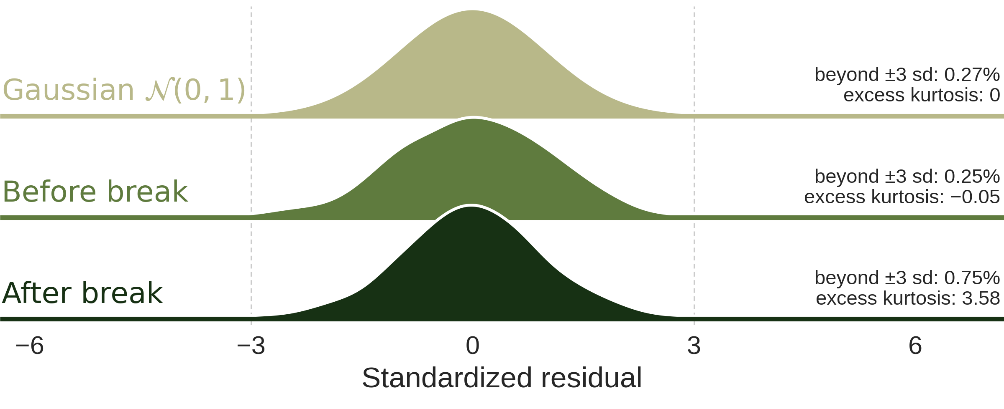
A noise classifier per segment turned this into score
Same spread, heavier tails after the break
Same pipeline, plus the noise classifier
Best LightGBM
0.8567 → 0.8588
Best TabPFN arm
0.8716 → 0.8729
Stacker (OOF)
0.8733 → 0.8741
Public AUC
0.8764 → 0.8779
One synthetic series; AR(5) residuals, each segment standardized to sd 1
LightGBM gain confirmed: +0.0021, 95% CI +0.0011 to +0.0032
Team BreakPoint · KU-SBB final
7
Notes:
[~45 s] So we trained a classifier on synthetic segments — after removing the AR structure — that predicts the noise type, tail weight and volatility clustering. We apply it before and after the boundary and compare. In this example the spread is the same but the tails are heavier after the boundary — a variance test misses it. It improved every level: best LightGBM, best TabPFN arm, the stacker, and the public score from 0.876 to 0.878.
中文提示：在假数据上训练“看噪声”的分类器（去掉 AR 结构后）；断点前后各判一次再比较；例子：方差相同、尾部变重，方差检验看不出；四层都涨，公榜 0.876→0.878。

Slide 8
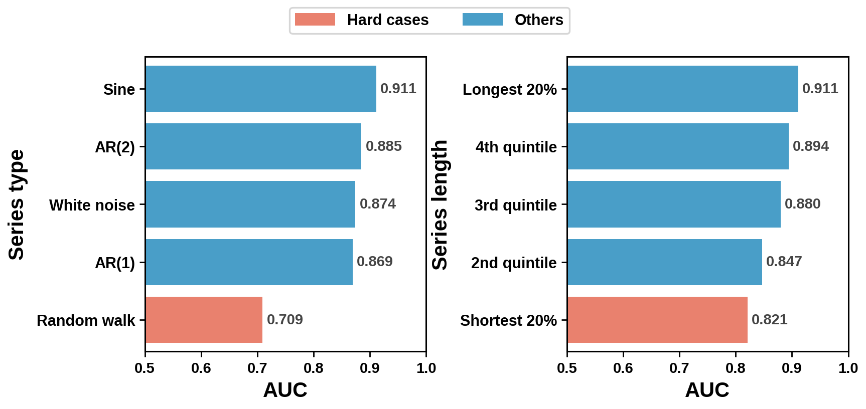
Limitations: hard series, compute, generator
Out-of-fold AUC: errors concentrate in random walks and short series
Hard series
Random walks (0.71) are equally hard on synthetic data, so this looks intrinsic; short series are harder too.
Compute
Best model needs a GPU and 296 arms; the best single arm is within 0.0012, so most arms are redundant.
Audit route
A bit-exact LightGBM route (0.861 public) runs in 31 s on 2 CPU cores; the GPU route is documented step by step.
Generator
Still detectable (0.58); synthetic breaks are slightly smaller than real ones.
Team BreakPoint · KU-SBB final
8
Notes:
[~40 s] Limitations. Random-walk series stay hard, AUC 0.71, and the generator is equally weak there, so this looks intrinsic. Short series are harder too. The best model is GPU-heavy: hundreds of arms, although the best single arm is within 0.0012 of the stacker — most arms are redundant. For the 2-core CPU audit we keep a bit-exact LightGBM route at 0.861. And the generator is still detectable: synthetic breaks are slightly smaller than real ones.
中文提示：RW 序列 0.71（假数据上也一样难，本质难）；短序列难；GPU 重、分支冗余（单分支只差 0.0012）；CPU 审核有逐位可复现的 LightGBM 路线 0.861；生成器仍可被识别，假断点偏小。

Slide 9
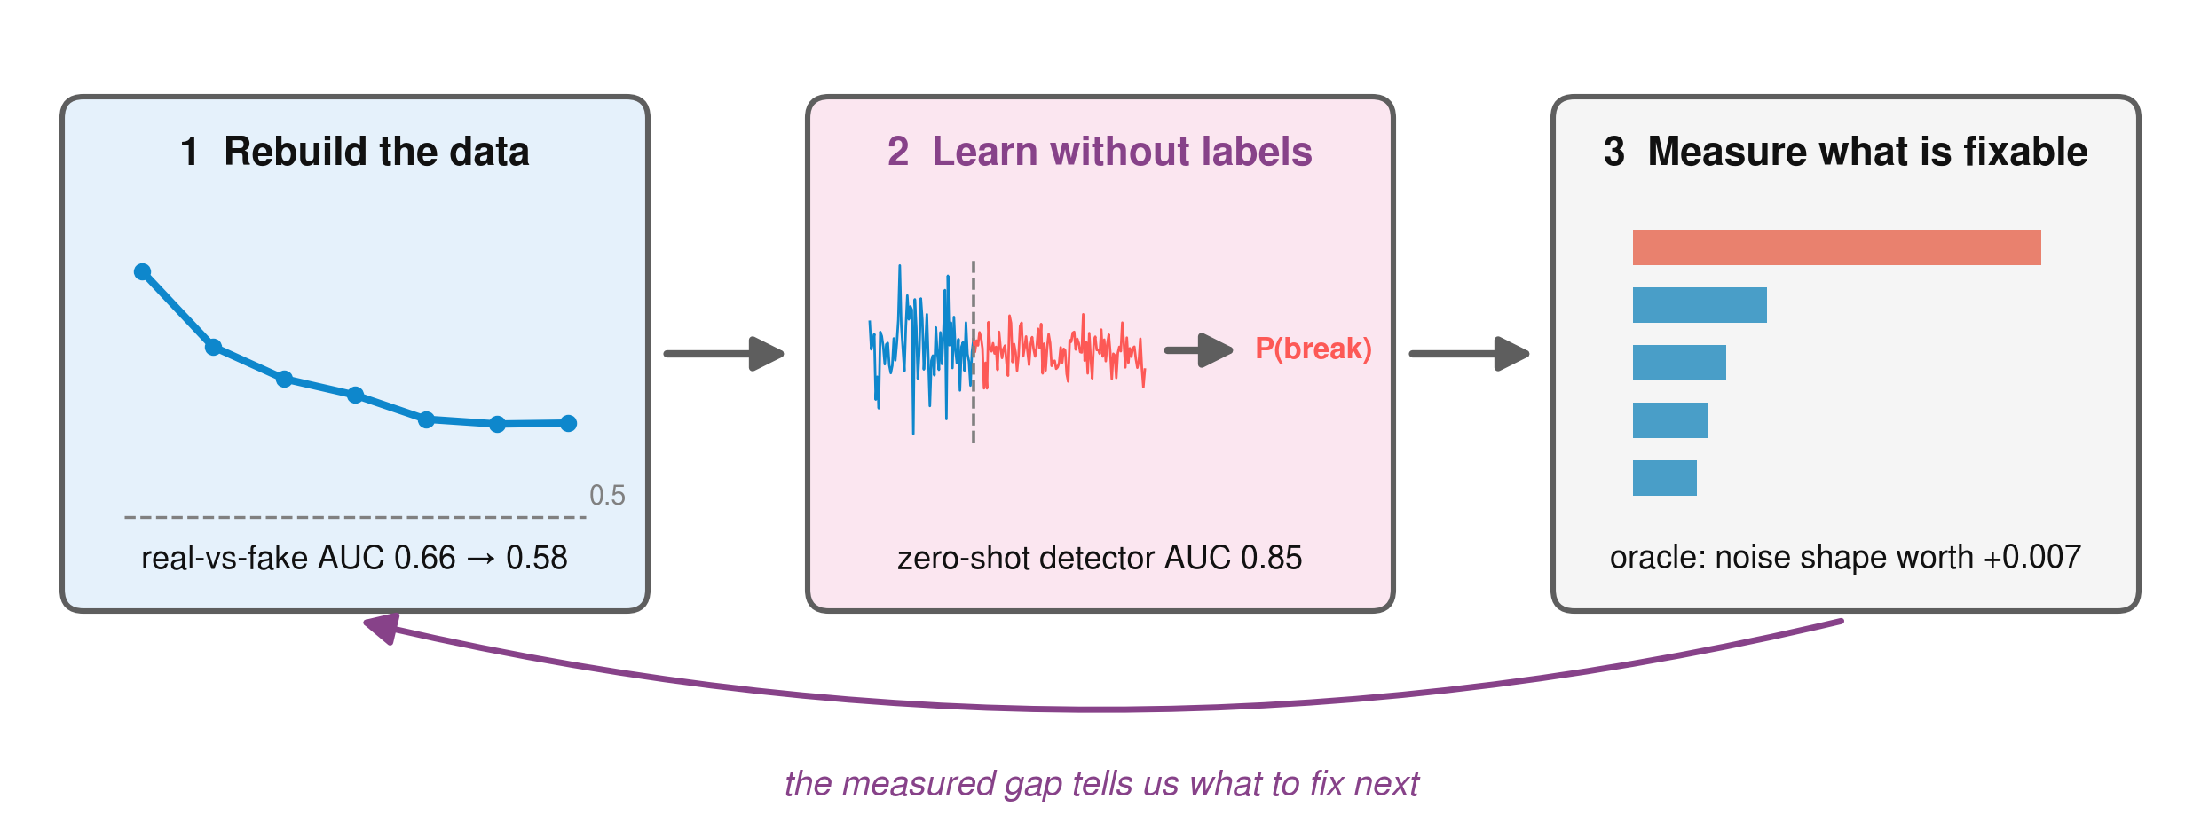
Model how the data was made, then learn from it
Thank you — questions welcome
Notes:
[~15 s] To sum up: model how the data was made, learn from it without labels, and measure what is fixable before building. Thank you, we are happy to take questions.
中文提示：三句话总结，然后请提问。

