Slide 1

Chapter２ MICROPROCESSOR-BASED SYSTEMS
2.1 Introduction
2.2 Architecture of 8086 Microprocessor
2.3 8086 CPU Registers
2.4 8086 Pins and Functions
2.5 8086 Memory Organization
2.6 8086 Memory and I/O Operation Cycles

Slide 2
OBJECTIVES
Upon finishing this chapter, you will learn:
 Architecture of 8086 CPU(the operation of the execution unit and the bus interface unit)
 8086 CPU Registers(the internal registers array)
 Pins and Functions of 8086/8088 CPU
 Memory Segmentation and address organization
 Memory and I/O operation cycles

Slide 3
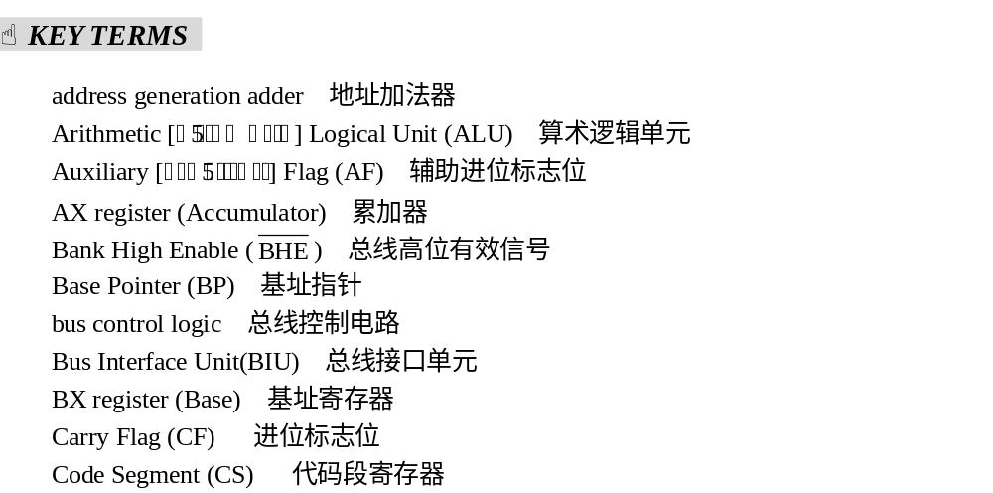

Slide 4
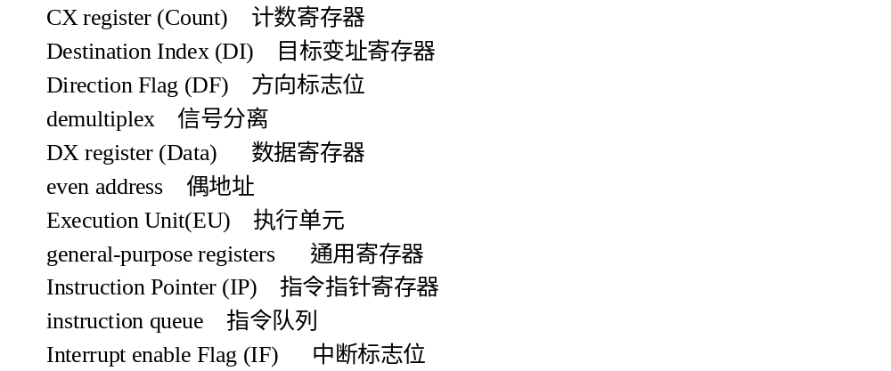

Slide 5
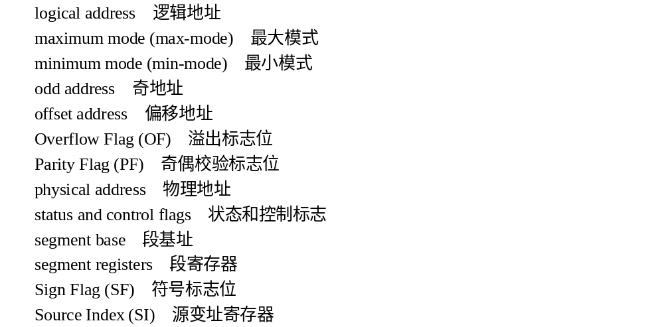

Slide 6
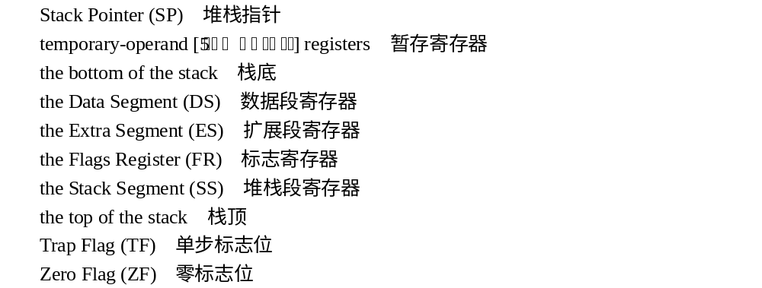

Slide 7
2.1 Introduction
Since the 80x86 microprocessor family has a typical basic structure, its arrival on the computer scene has quickly taken the lead in the personal computer market. In other words, the 80x86 processor is used everywhere, from dedicated control systems to fast network file servers. Today, the Pentium offers compatibility with all previous 80x86 machines, with many new architectural improvements.

Slide 8
Intel 8086 is a 16 bit microprocessor, and it has 16 bit data bus and 20 bit address bus. However, the different microprocessor has different internal architecture and different features, but the internal architecture of Intel 8088 microprocessor is same as 8086 microprocessor except 8088 microprocessor has 8 bit data bus. They both employ parallel processing—that is, they are implemented with several simultaneously operating processing units. They can directly address 1 megabytes of memory. The memory used by 8086 microprocessor is bytes and each byte can be addressed uniquely with 20 bit addresses.

Slide 9
The external memory of 8086 microprocessor is divided into two banks: even bank and odd bank. The even bank of memory is accessed by even address like 00000H, 00002H, 00004H … up to 0FFFFEH and odd bank of memory is addressed by odd addresses like 00001H, 00003H, 00005H … up to 0FFFFFH. A 16 bit word of 8086 microprocessor is stored in two consecutive addresses as bytes. An instruction word of 8086 microprocessor accesses memory starting with even address.

Slide 10
Intel 8086 microprocessor, developed by Intel Corporation, has three versions: Intel 8086, Intel 8086-2 and Intel 8086-4. They are similar in architecture except their speed of operation: maximum clock frequency of 5 MHz, 8 MHz and 4 MHz respectively.
In this chapter, we will present the features of the 80x86 microprocessor family and mainly discuss the architecture of 8086 microprocessor. Pin function, mode of operation, clock generation and bus timing etc of 8086 microprocessor will be covered, leaving the hardware and software details to the upcoming chapters. From this chapter you will learn that the 80x86 is a machine with many possibilities.

Slide 11
2.2 Architecture of 8086 Microprocessor
Figure 2.1 illustrates the internal architecture of the 8086 processor. It contains two processing units: the Bus Interface Unit (BIU) and the Execution Unit (EU). Each unit has dedicated functions and both operate at the same time. In essence, this parallel processing effectively makes the fetch, decoding and execution of instructions independent on 8088/8086 microprocessor systems. BIU and EU are shown on both sides of the dotted line in Figure 2.1. There will be a brief introduction to the two parts below.

Slide 12
The BIU is the 8086’s connection to the outside world. By interface, we mean the path by which it connects to external devices, like memory or I/O devices. The BIU is responsible for performing all external bus operations. ¹Its functions include address generation, instruction fetching, instruction queuing, reading and writing of data operand for memory, inputting or outputting data for input/output peripherals, and bus control logic. These information transfers take place over the system bus.

Slide 13
This bus includes a 16-bit bidirectional data bus, a 20-bit address bus, and the signal control bus needed to control transfers over the bus, but for data bus there are some differences here with the 8088 microprocessor. The BIU is not only responsible for performing bus operations; it also performs other functions related to instruction and data acquisition. For instance, it is responsible for instruction queuing and address generation. As we can see in Figure 2.1, to implement these functions, the BIU contains the segment registers, the instruction pointer, the address generation adder, bus control logic, and an instruction queue.

Slide 14
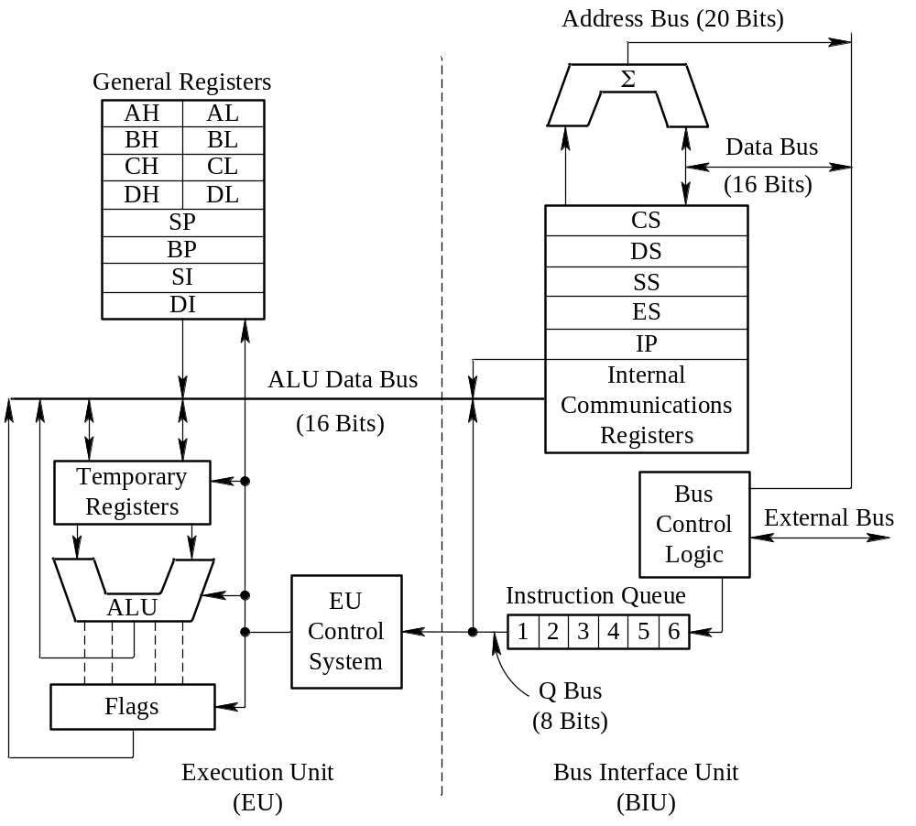
Figure 2.1 Internal structure of 8086 CPU(Courtesy of Intel Corporation)

Slide 15
[Reading Material] The BIU uses a mechanism known as an instruction queue to implement a pipelined architecture. This queue permits the 8086 to prefetch up to 6 bytes (4 bytes for the 8088) of instruction code. Whenever the queue is not full—that is, it has room for at least 2 more bytes, and at the same time, the execution unit is not asking it to read or write data from memory—the BIU is free to look ahead in the program by prefetching the next sequential instructions. Prefetched instructions are held in the first-in first-out (FIFO) queue.

Slide 16
Whenever a byte is loaded at the input end of the queue, it is automatically shifted up through the FIFO to the empty location nearest the output. Here the code is held until the execution unit is ready to accept it. Since instructions are normally waiting in the queue, the time needed to fetch many instructions of the microcomputer’s program is eliminated. If the queue is full and the EU is not requesting access to data in memory, the BIU does not need to perform any bus operations. These intervals of no bus activity, which occur between bus operations, are known as idle states.

Slide 17
The EU is responsible for decoding and executing instructions. Notice in Figure 2.1 that it consists of the Arithmetic Logical Unit (ALU) with temporary-operand registers, status and control flags, general-purpose registers, and EU control system. The EU access instructions from the output end of the instruction queue and data from the general-purpose registers or memory. It reads one instruction byte after the other, decodes them, generates data addresses if necessary, passes addresses to the BIU and requests it to perform the read or write operations to memory or I/O, and finally performs the operation specified by the instruction.

Slide 18
The ALU performs the arithmetic, logic, and shift operations required by an instruction, sometimes it use temporary operand registers. During execution of the instruction, the EU may test the status and control flags, and updates these flags based on the results of executing the instruction. So the fetching, decoding and execution of instruction forms one cycle, and these processes are driven by EU control system.

Slide 19
[Reading Material] The arithmetic and logical unit (ALU) is where most of the action takes place inside the CPU. For example, if you want to add the value five to the AX register, the CPU will operate like this:
Copies the value from AX into the ALU;
Sends the value five to the ALU;
Instructs the ALU to add these two values together;
Moves the result back into the AX register.

Slide 20
As a matter of fact, the ALU is one of the 8086 microprocessor’s major logic functions. It contains the processor’s data processing logic. Figure 2.2 illustrates the operation structure of ALU.
The ALU has two input ports. On the diagram they are labeled IN. The ALU also has one output port, labeled OUT, in additional one mark information-flag register. An input port is made up of the logic circuits used to get a data word out of a logic device. Most logic devices have one or more input ports and a single output port. The simplest analogy, for example, is the AND gate. It has two inputs and an output. These are also called the AND gate’s input ports and output port.

Slide 21
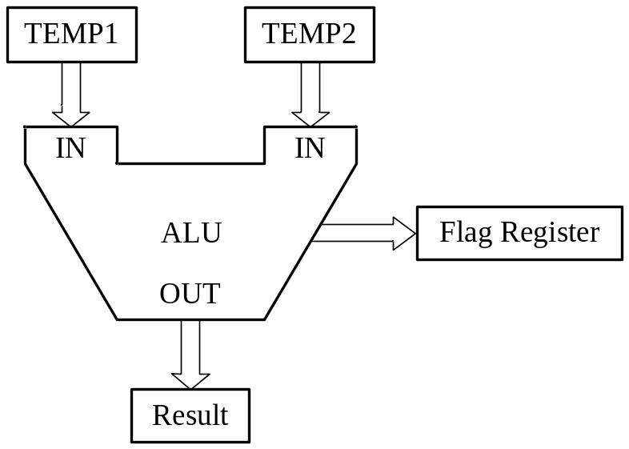
Figure 2.2 The operation structure of ALU

Slide 22
Both of the input ports are buffered by a temporary register (shown as Temp 1 and Temp 2 on the diagram); that is, each port has a register that temporarily stores one data word, holding the word for the ALU.
The 8086 microprocessor’s internal bus is connected to the ALU’s two input ports through the two temporary registers. This allows it to take data from any device on the processor’s internal data bus. Often, the ALU gets its data from a special register called the accumulator.

Slide 23
In the 8086 microprocessor, the accumulator is the AX register. The ALU’s single output port allows it to send a data word over the bus to any device connected to the bus. Frequently, data is sent to the accumulator. When the ALU adds two words, for example, one of the two words is placed in the accumulator. After the addition is performed, the resulting data word is sent to the accumulator and stored there.

Slide 24
The ALU works on either one or two data words, depending on the kind of operation performed. The ALU uses input ports as necessary. Since addition requires two data words, for example, an addition operation uses both ALU input ports.
Complementing a data word, conversely, uses only one input port. To complement a data word all of the word’s bits that are logic 1 are set to logic 0, and all of the word’s bits that are logic 0 are set to logic 1. As you can see, the ALU needs to work on only one word to perform a complement operation. That is why the complement operation uses only one input port.

Slide 25
The ALU is used whenever it is necessary to change or test a data word. ALU functions are part of the 8086 microprocessor’s architecture. The ALU’s main functions are listed as below:
ADD Complement
Subtract Shift right
AND Shift left
OR Increment
Exclusive OR Decrement

Slide 26
The important point to remember is that any instruction that changes data must use the ALU. Because the ALU processes data, but does not store any data, it may not be part of some programming models.

Slide 27
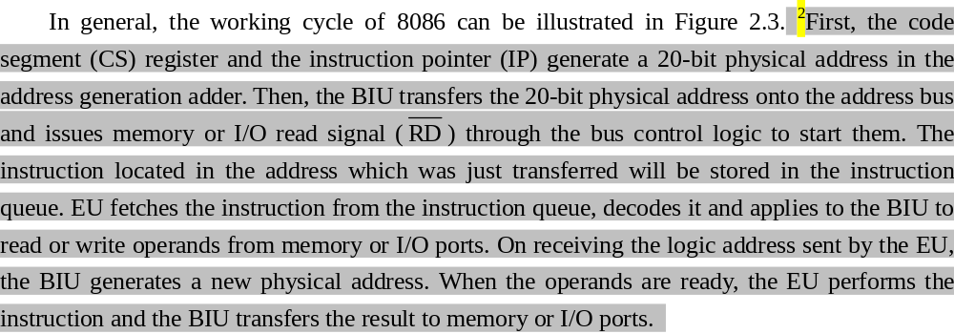

Slide 28
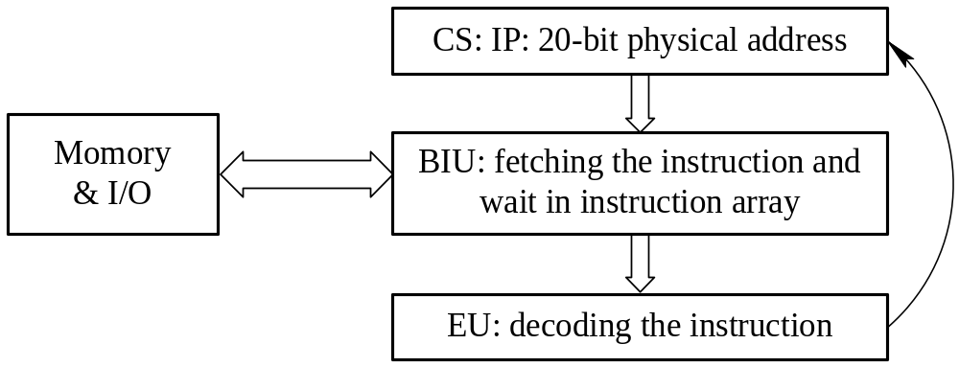
Figure 2.3 Working cycle of microprocessor

Slide 29
2.3 8086 CPU Registers
Registers are main storage used to save data in microprocessor. The 8086 microprocessor contains fourteen 16-bit registers in total which referred to as AX, BX, CX, DX, SP, BP, SI, DI, CS, DS, SS, ES, IP, and FLAGS. They can be divided into three categories: general purpose registers, segment registers, and miscellaneous registers, which are distributed in EU, BIU and elsewhere.

Slide 30
2.3.1 Registers in EU
The 8086 microprocessor contains four data registers referred to as AX, BX, CX, and DX, are shown in Table 2.1. All are 16 bits wide and may be split up into two halves of 8 bits each. During program execution, they hold temporary values which are frequently used as intermediate results. Software can read, load, or modify their contents. Any of the four registers can be used as the source or destination of an operand during an arithmetic operation such as ADD or a logic operation such as AND. The advantage of storing these data in internal registers instead of memory during processing is that they can be accessed much faster.

Slide 31
Five other 16-bit registers are available for use as pointer or index registers. These registers are the Stack Pointer (SP), Base Pointer (BP), Source Index (SI), Destination Index (DI), and Instruction Pointer (IP) (late we will talk about IP latter). None of the five may be divided up in a manner similar to the data registers.

Slide 32
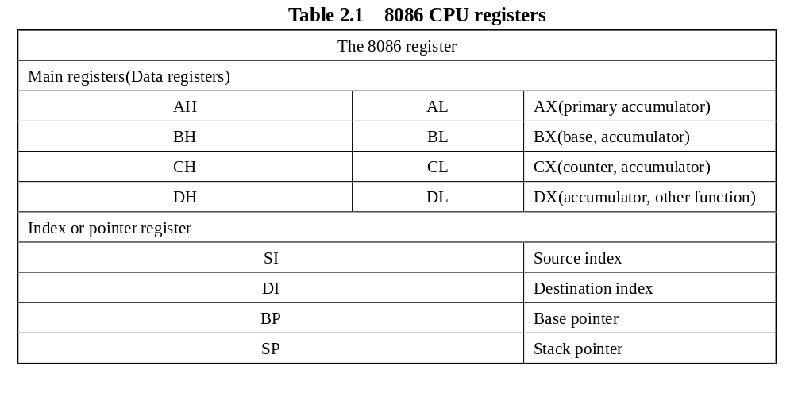

Slide 33
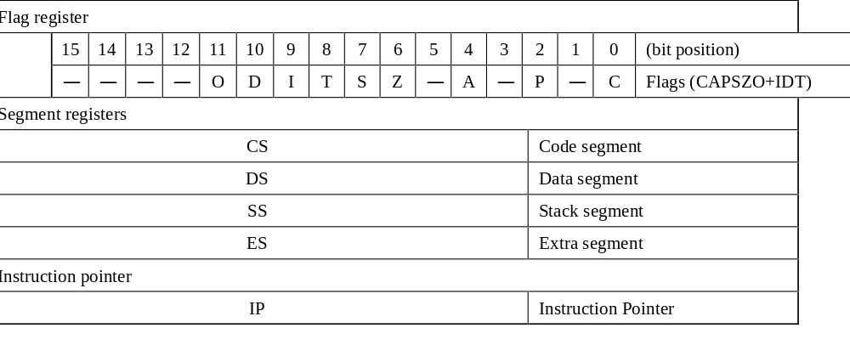

Slide 34
The SP, BP, SI, and DI registers are pointer and index registers, respectively, as shown in Table 2.1. Software uses the value held in an index register to reference data in memory relative to the data segment or extra segment register, and a pointer register to access memory locations relative to the stack segment register. Just as for the data registers, the values held in these registers can be read, loaded, or modified through software. This is done prior to executing the instruction that references the register for address offset. Unlike the general-purpose data register, the pointer and index registers are only accessed as words.

Slide 35
In order to use the offset address in a register, the instruction simply specifies the register that contains the value. The values in SP and BP are used as offsets from the current value of SS during the execution of instructions that involve the stack segment of memory and permit easy access to storage locations in the stack part of memory. The value in SP always represents the offset of the next stack location that is to be addressed. That is, combining SP with the value in SS (SS:SP) results in an physical address that points to the top of the stack (TOS).

Slide 36
The BP register (Base Pointer) is similar to the BX register. You’ll generally use this register to access parameters and local variables in a procedure. BP may represent an offset relative to the SS; however, it is used to access data within the stack segment of memory. To do this, it is employed as the offset in an addressing mode called the based addressing mode. One use of BP is to reference parameters that are passed to a subroutine by way of the stack. In this case, instructions are included in the subroutine that use based addressing to access the values of parameters from the stack.

Slide 37
The SI and DI registers (Source Index and Destination Index) are called as index registers. They have some special purposes as well. You may use these registers as pointers (much like the BX register) to indirectly access memory. You will also use these registers with the 8086 string instructions when processing character strings.

Slide 38
Normally, the index registers are used to hold offset addresses for instructions that access data stored in the data segment of memory and are automatically combined with the value in the DS or ES register during address calculation. In instruction that involve the indexed addressing, the source index (SI) register holds an offset address that identifies the location of a source operand, and the destination index (DI) register holds an offset for a destination operand. Basically we use DS:SI and ES:DI combination.

Slide 39
[Reading Material] The AX register (Accumulator) is where most arithmetic and logical computations take place. Although you can do most arithmetic and logical operations in other registers, it is often more efficient to use the AX register for such computations. Also, the accumulator (AX) is used automatically in multiply and divide operations and in instructions that access I/O ports. The BX register (Base) is commonly used to hold indirect addresses.

Slide 40
The CX register (Count) as its name implies, counts things. It is often used to count off the number of iterations in a loop or specify the number of characters in a string. It can be used as a counter in certain loop instructions, providing up to 65,536 (216) passes through a loop before termination. The lower half of CX, the 8-bit CL register, is also used as a counter in shift/rotate operations. The DX register (Data) has two special purposes: it holds the overflow from certain arithmetic operations, and it holds I/O addresses as a pointer when accessing data on the 8086 I/O bus. It is also used in multiply and divides operations.

Slide 41
Each of these data registers can be accessed either as a whole (16 bits) for word data operations or as two 8-bit registers for byte-wide data operations. An X after the register letter identifies the reference of a register as a word; for instance, the 16-bit accumulator is referenced as AX. Similarly, the other three word registers are referred to as BX, CX, and DX. On other hand, when referencing one of these registers on a byte-wide basis, following the register name with the letter H or L, respectively, identifies the high byte and low byte.

Slide 42
For the A register, the most significant byte is referred to as AH and the least significant byte as AL; the other byte-wide register pairs are BH and BL, CH and CL, and DH and DL. When software places a new value in one byte of a register, for instance AL, the value in the other byte (AH) does not change. This ability to process information in either byte location permits more efficient use of the limited register resources of the 8086 microprocessor. Actually, some of the data registers may also store address information such as a base address or an input/output address; for example, BX could hold a 16-bit base address.

Slide 43
Earlier we pointed out that any of the data registers can be used as the source or destination of an operand during an arithmetic operation such as ADD, or a logic operation such as AND. However, for some operations, an operand that is to be processed may be located in memory instead of the internal register. In this case, an index address is used to identify the location of the operand in memory; for example, string instructions use the index registers to access operands in memory. SI and DI, respectively, are the pointers to the source and destination locations in the memory. The index registers can also be source or destination registers in arithmetic and logical operations. For example, an instruction may add 2 to the offset value in SI to increment its value to point to the next word-wide storage location in memory.

Slide 44
2.3.2 Registers in BIU
Another group of registers is the segment registers. The 8086 microprocessor uses four segment registers to control all accesses to memory or I/O. The code segment (CS) is used during instruction fetches, the data segment (DS) is most often used by default when reading or writing data, the stack segment (SS) is used during stack operation such as subroutine calls and returns, and the extra segment (ES) is used for anything the programmer wishes. All segment registers are 16 bits long, and also are used to construct a 20-bit physical address.

Slide 45
A segment is a 64Kbyte block of memory starting on any 16-byte boundary. Thus, 00000, 00010, 00020, 20000, 8CE90, and E0840 are all examples of valid segment addresses. The information contained in a segment register is combined with the address contained in another 16-bit register to form the required 20-bit physical address.

Slide 46
In Figure 2.4, which shows how to generate a memory physical address, the code segment register contains A000H and the instruction pointer contains 5F00H. The processor forms the 20-bit address A5F00H in the following ways: first, the data in the code segment register is shifted 4 bits to the left, which has the effect of turning A000H into A0000H. Then the contents of the instruction pointer are added, finally giving A5F00H.

Slide 47
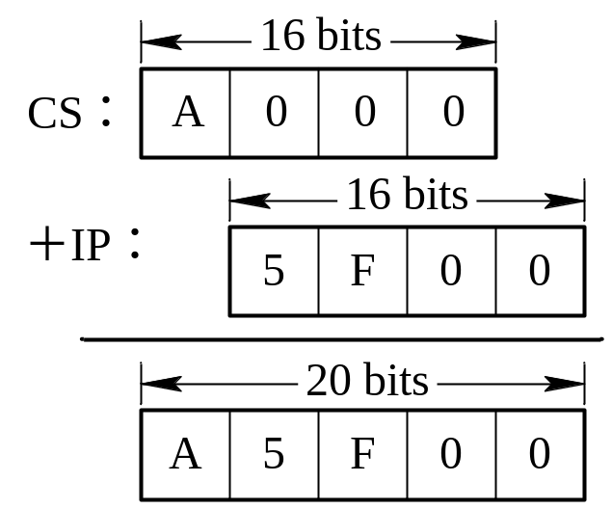
Figure 2.4 Generating a 20-bit address in real mode

Slide 48
There are two special purpose registers on the 8086 microprocessor: the instruction pointer (IP) and the flags register (FR). You do not access these registers the same way you access the other 8086 registers. Instead, the microprocessor generally manipulates these registers directly.
The IP register contains the address of the current execution instruction. In other words, it identifies the location of the next word of instruction code to be fetched from the current code segment of memory.

Slide 49
This is a 16-bit register which provides a pointer into the current code segment (16 bits lets the programmer select any one of 65,536 different memory locations), and it is similar to a program counter; however, it contains the offset of the next word of instruction code instead of its actual address. This is because IP and CS are both 16 bits in length, but a 20-bit address is needed to access memory. Internal to the 8086, the offset in IP is combined with the current value in the CS register to generate the actual address of the instruction code. Therefore, the value of the address for the next code access is often denoted as CS:IP.

Slide 50
[Reading Material] It has been discussed that how the CS register and IP register generate the instruction address, but here gives some further operation explanations.
During normal operations, the 8086 fetches instructions from the code segment of memory, stores them in its instruction queue, and executes them one after the other. Every time a word of code is fetched from memory, the 8086 updates the value in IP such that it points to the first byte of the next sequential word of code—that is, IP is incremented by 2. Actually, the 8086 prefetches up to six bytes of instruction code into its internal code queue and hold them there waiting for execution.

Slide 51
After an instruction is read from the output of the instruction queue, it is decoded; if necessary, operands are read from either the data segment of memory or internal registers. Next, the operation specified in the instruction is performed on the operands and the result is written back to either an internal register or a storage location in memory. The 8086 is now ready to execute the next instruction in the code queue.
Executing an instruction that loads a new value into the CS register changes the active code segment; thus, any 64Kbyte segment of memory can be used to store the instruction code.

Slide 52
2.3.3 Flags Register
The status register, also called the flags register, is another 16-bit register within the 8086. Unlike the other registers holding eight or sixteen-bit values on the 8086, the flags register is simply a collection of one bit value which help determine the current state of the processor. Although the flags register is 16 bits wide, the 8086 uses only nine of those bits. Figure 2.5 shows the organization of this register. Bits 1, 3, 5, and 12~15 are undefined.

Slide 53
Figure 2.5 The organization of Flag Register

Slide 54
The flags are divided into two groups: status flags and control flags. Six of these bits represent status flags: the Carry Flag (CF), Parity Flag (PF), Auxiliary Flag (AF), Zero Flag (ZF), Sign Flag (SF), and Overflow Flag (OF), which we call “CAPSZO”. The logic states of these status flags indicate conditions that are produced as the result of executing an instruction—that is, after execution an instruction, such as ADD, specific flag bits are reset (logic 0) or set (logic 1) based on the result that is produced.

Slide 55
Let us summarize the operation of these flags:
(1) The carry flag (CF—Bit 0): CF is set if there is a carry-out or a borrow-in for the most significant bit of the result during the execution of an instruction. Otherwise, CF is reset.
(2) The parity flag (PF—Bit 2): PF is set if the result produced by the instruction has even parity—that is, if it contains an even number of bits at the 1 logic level. If parity is odd, PF is reset.
(3) The auxiliary carry flag (AF—Bit 4): AF is set if there is a carry-out from the low nibble into the high nibble or a borrow-in from the high nibble into the low nibble of the low byte in a 16-bit word. Otherwise. AF is reset.

Slide 56
(4) The zero flag (ZF—Bit 6): ZF is set if the result produced by an instruction is zero. Otherwise, ZF is reset.
(5) The sign flag (SF—Bit 7): The MSB of the result is copied into SF. Thus, SF is set if the result is a negative number or reset if it is positive.
(6) The overflow flag (OF—Bit 11): When OF is set, it indicates that the signed result is out of range. If the result is not out of range, OF remains reset.

Slide 57
[Reading Material] For example, at the completion of execution of a byte-addition instruction, the carry flag (CF) could be set to indicate that the sum of the operands caused a carry-out condition. The auxiliary carry flag (AF) could also set due to the execution of the instruction. This depends on whether or not a carry-out occurred from the least significant nibble to the most significant nibble when the byte operands are added. The sign flag (SF) is also affected, and it reflects the logic level of the MSB of the result. The overflow flag (OF) is set if there is a carry-out of the sign bit, but no carry into the sign bit (an indication of overflow).

Slide 58
Of these flags, zero, carry, sign, and overflow are used by the programmers all the time. The 8086 provides instructions within its instruction set that are able to use these flags to alter the sequence in which the program is executed; for instance, a jump to another part of the program could be conditionally initiated by testing for ZF equal to logic. This operation is called jump on zero.

Slide 59
The other three implemented flag bits—the Direction Flag (DF), the Interrupt enable Flag (IF), and Trap Flag (TF), which we call “IDT” —are control flags. These three flags provide control functions of the 8086 as follows:
(7) The trap flag (TF—Bit 8): If TF is set, the 8086 goes into the single-step mode of operation. When in the single-step mode, it executes an instruction and then jumps to a special service routine that may determine the effect of executing the instruction. This type of operation is very useful for debugging program.

Slide 60
(8) The interrupt flag (IF—Bit 9): For the 8086 to recognize maskable interrupt requests at its interrupt (INT) INPUT, the IF flag must be set. When IF is reset, requests at INT are ignored and the maskable interrupt interface is disabled.
(9) The direction flag (DF—Bit 10): The logic level of DF determines the direction in which string operations will occur. When set, the string instruction automatically decrements the address; therefore, the string data transfers proceed from high address to low address. On the other hand, resetting DF cause the string address to be incremented –that is, data transfers proceed from low address to high address.

Slide 61
The instruction set of the 8086 includes instructions for saving, loading, or manipulating the flags; for instance, special instructions are provided to permit user software to set or reset TF, DF, and IF at any point in the program (e.g., just prior to the beginning of a string operation, DF is reset so that the string address automatically increments).

Slide 62
[Reading Material] In the status register, the overflow flag is easy to use mistakenly. It will be discussed as an emphasis here. First, it is very important to know what is overflow. In the last chapter, it has been introduced that how to indicate a value as a complement code. The range for 8-bit value is +127~-128, and the range for 16-bit value is +32767~-32768. If the value goes beyond this range, overflow will happen. As a matter of fact, it presents the result is wrong. See the example below:

Slide 63
3AH+7H=B6H, that is 58+124=182 in decimal system. The result of 182 is out of -128~+127, so OF=1; B6H is -74 as a complement code. Obviously, the result is wrong.
In fact, there is a shortcut to judge whether the result is overflow or not. When two values with the same sign added and the result has the contrary sign to the original value, overflow happens. In this case, the result is obviously wrong. In other cases, overflow would never happen.

Slide 64
Another emphasis is the difference between the carry and overflow flag. The carry flag indicates whether the result of the arithmetic operation of unsigned values is beyond the range or not; the result is still correct. However, the overflow flag indicates whether the result of the arithmetic operation of signed values is beyond the range or not; the result is wrong if an overflow happens.

Slide 65
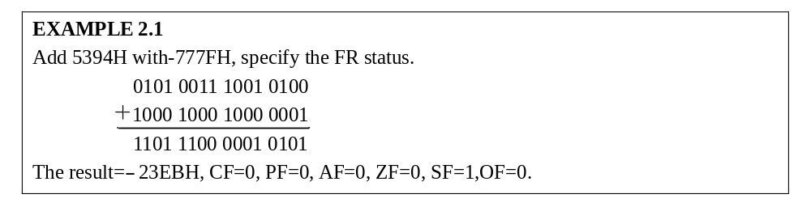

Slide 66
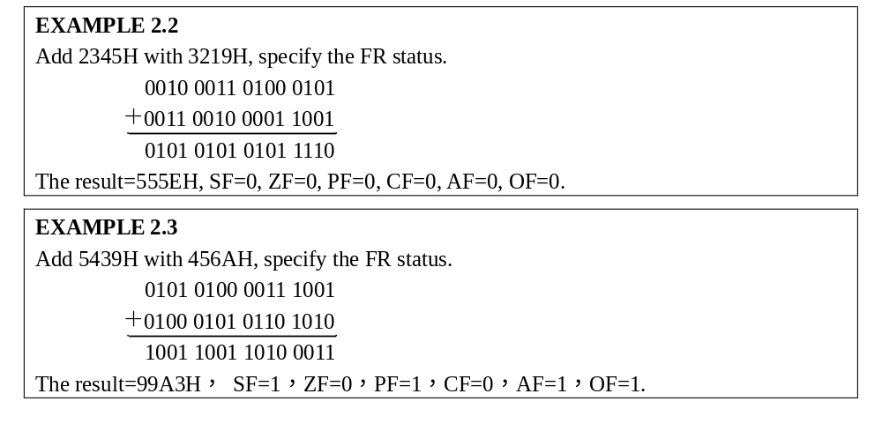

Slide 67
2.4 8086 Pins and Functions
Till now we know some of the 8086’s specifications, but it is necessary for us to cover them again in more detail.
The 8086 is a 16-bit microprocessor that communicates with the outside world via a 16-bit bidirectional data bus, which requires the 8086 to perform one read cycle to fetch this 16-bit data. The 8086’s 20-bit address bus can access 1 megabyte of memory (2²⁰=1,048,576 bytes, to be exact).

Slide 68
Control signals are provided that enable external circuitry to take over the 8086’s buses, and two interrupt lines are included to provide maskable and non-maskable interrupt capability. A number of status outputs are available, which may be used to decode any of the internal CPU states, and other control signals are provided to allow interfacing with other peripherals. These output or input flux will be completed through pins.

Slide 69
2.4.1 8086 Pins
The 8086 has two functional modes of operation: minimum mode (min-mode) and maximum mode (max-mode). Certain pins on the processor have been designed for dual purposes, one for min-mode and the other for max-mode. Figure 2.6 shows a pinout diagram of the 8086. Table 2.2 shows signals common used in minimum and maximum modes of 8086.

Slide 70
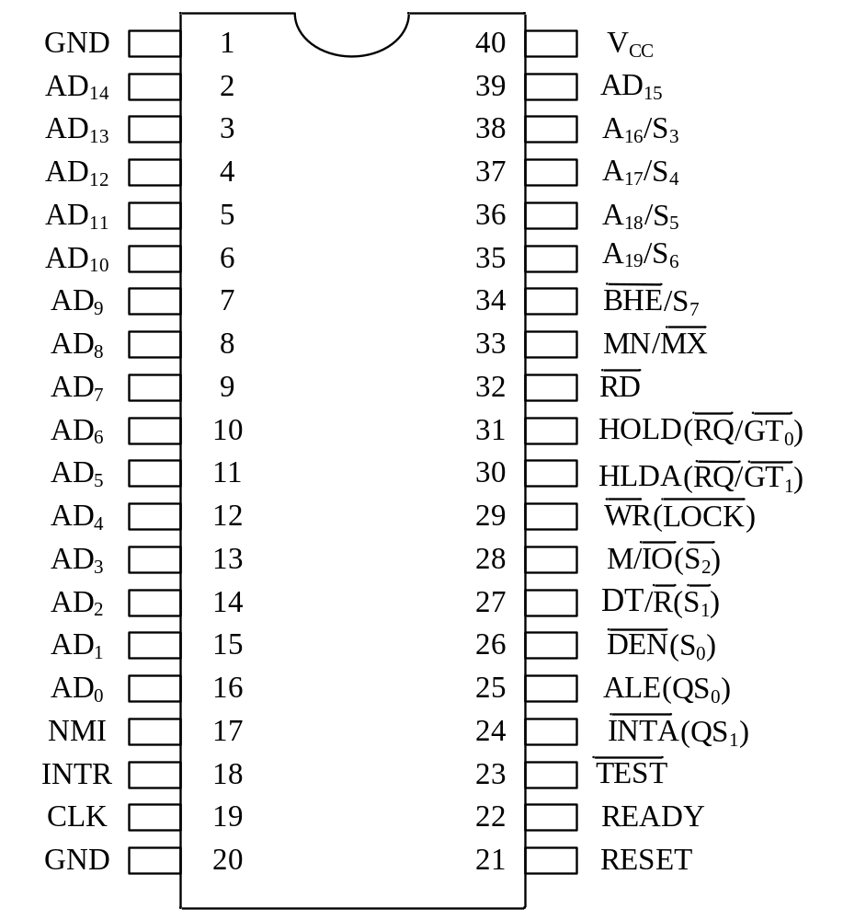
Figure 2.6 The pinout of the 8086 micropressor(Courtesy of Intel Corporation)

Slide 71
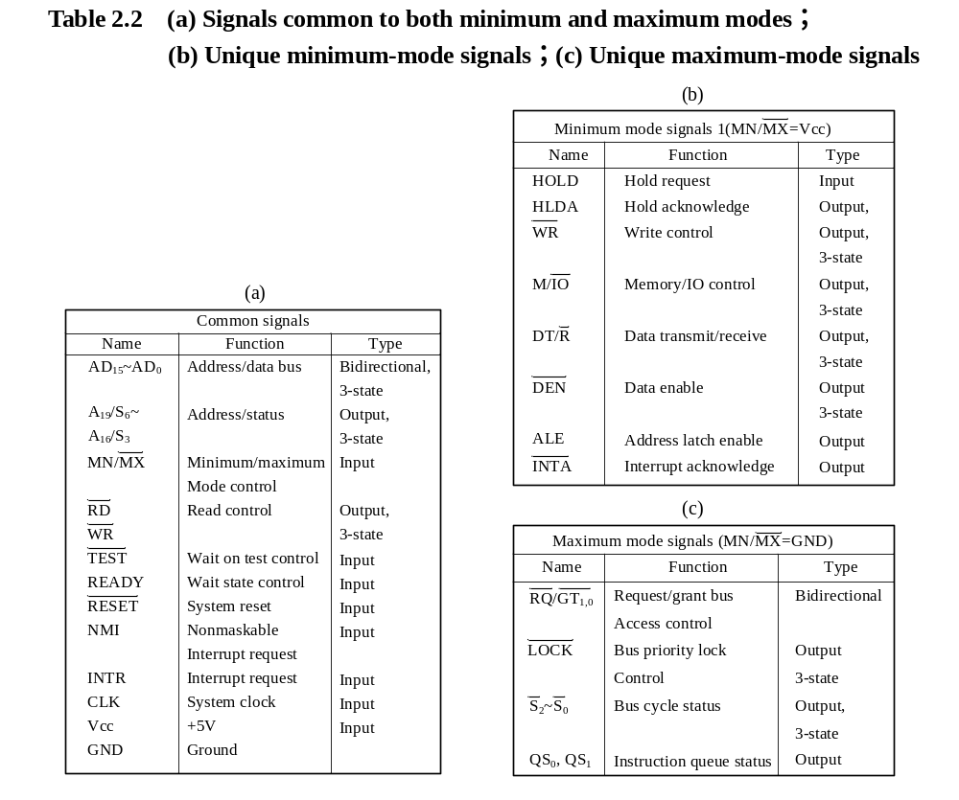

Slide 72
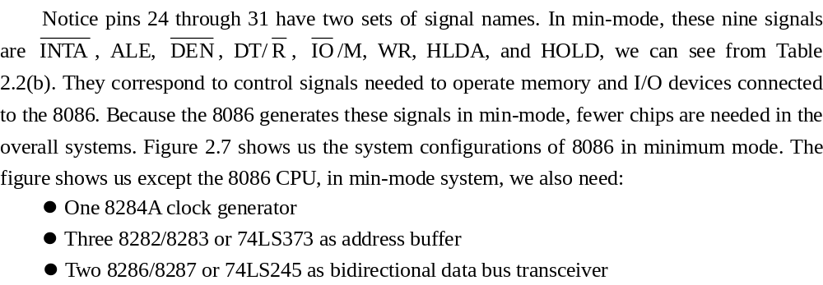

Slide 73
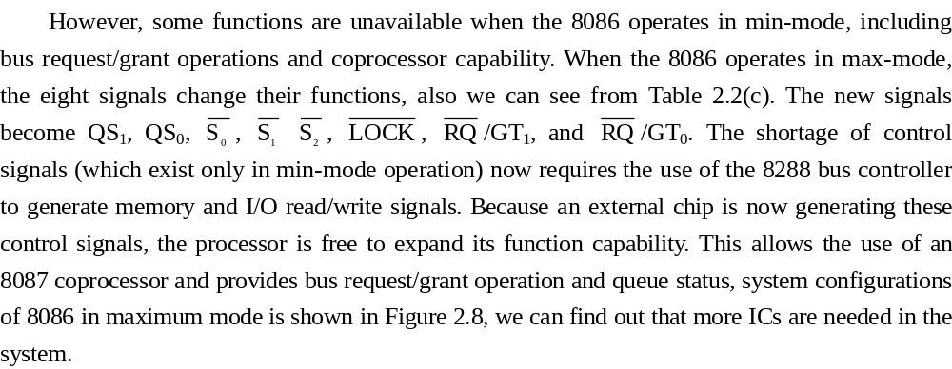

Slide 74
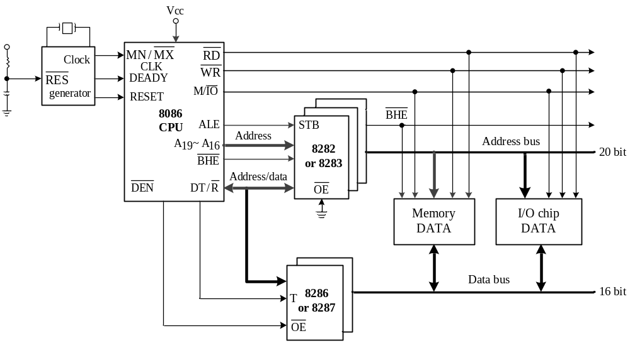
Figure 2.7 System configurations of 8086 in minimum mode microprocessor(Courtesy of Intel Corp)

Slide 75
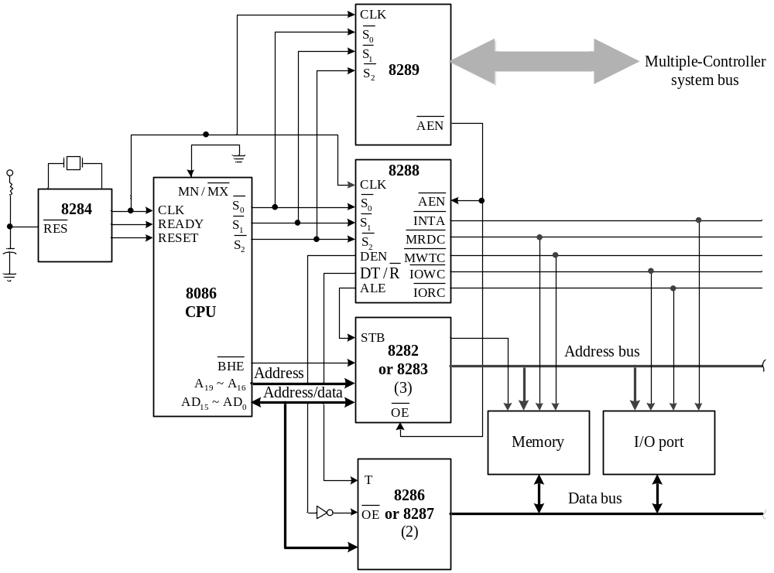
Figure 2.8 System configurations of 8086 in maximum mode

Slide 76
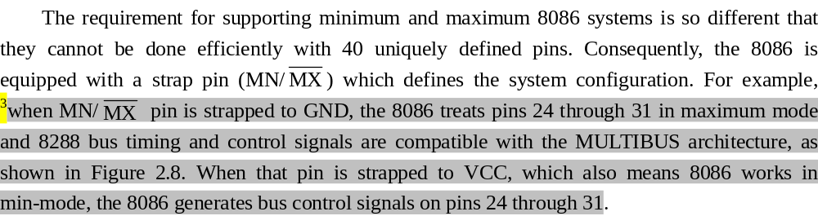

Slide 77
2.4.2 Pin Functions of 8086 CPU in Min-mode
1．AD15~AD0 (Address/Data Bus)
The 16 address/data lines have two functions. During the address portion of a memory access cycle, they hold address information. The 8086 ALE signal (a system control signal) tells the system hardware when to latch this information. During the data transfer portion of the memory address cycle, these lines are the 8086 16-bit data bus. But address lines A15 to A8 serve only a single function on the 8088.

Slide 78
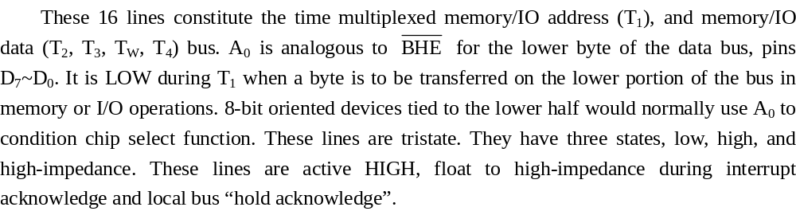

Slide 79
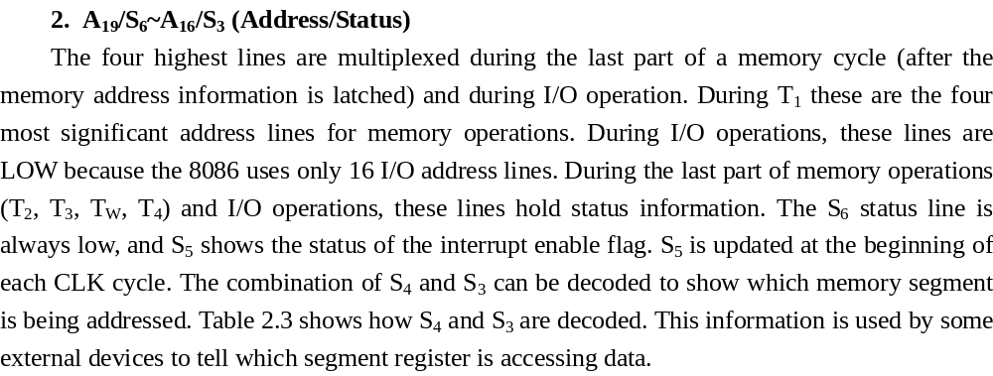

Slide 80
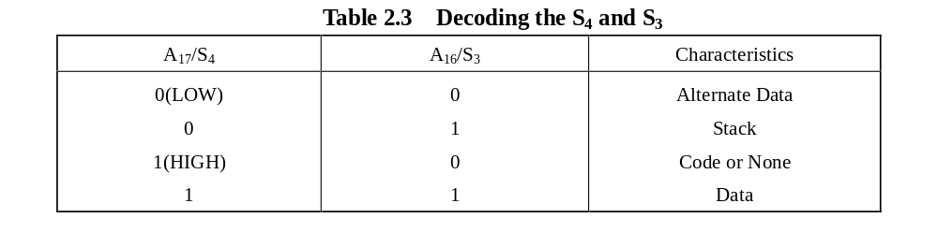

Slide 81
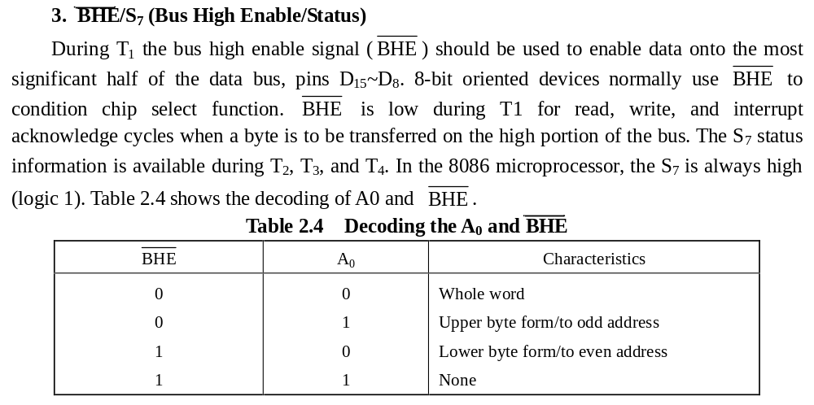

Slide 82
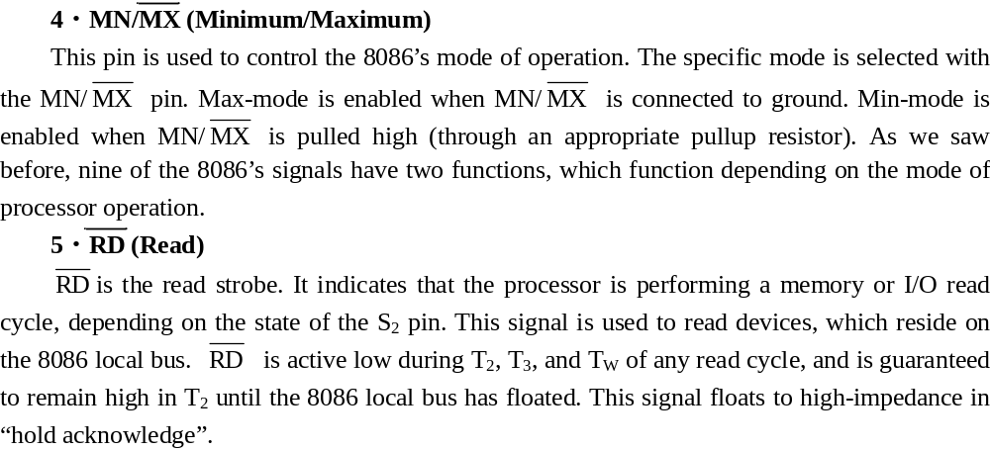

Slide 83
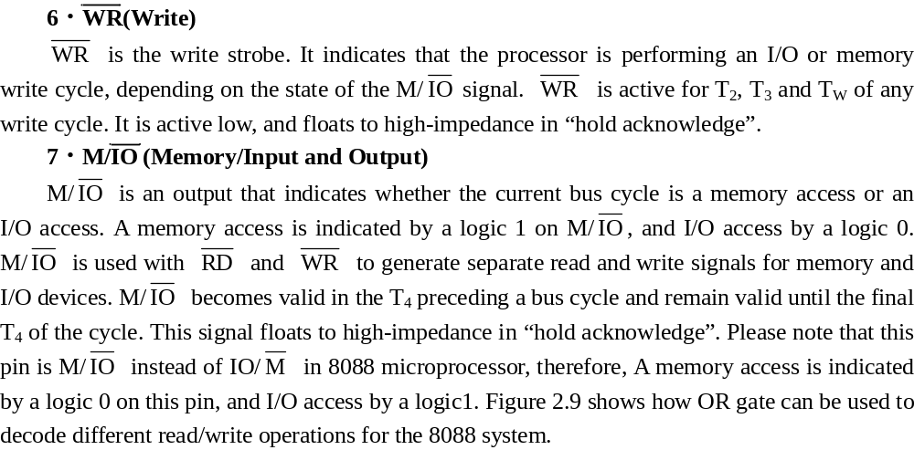

Slide 84
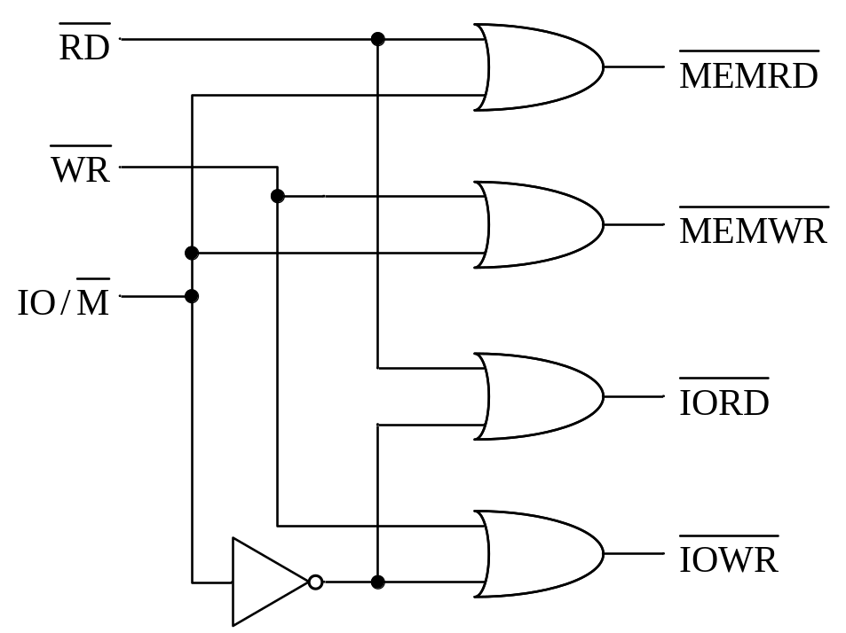
Figure 2.9 Decoding 8088 memory and I/O read/write signals

Slide 85
8．ALE (Address Latch Enable)
ALE is an output signal used to demultiplex the 8086’s address/data bus. ALE is usually used to control an external latch capable of storing the signals of the address bus. ALE goes high to indicate that the 8086 is outputting address information. Take another look at the pinout diagram of 8086 in Figure 2.6 and note the signal AD₁₅ through AD₀. These sixteen signals perform two functions. They operate as A₁₅ through A₀ during the beginning of a bus cycle, usually at T₁, and D₁₅ through D0 for the rest of the bus cycle.

Slide 86
So, AD15 through AD₀ are constantly switching back and forth between address bus mode and data bus mode. The processor uses ALE to indicate when AD₁₅ through AD₀ contain address information. Figure 2.10 shows one way that the address/data lines may be demultiplexed. A 74LS373 octal D latch is used to capture A₁₅ through A₀ when enabled by ALE. This capture is illustrated in Figure 2.11. ALE is a high pulse active during T₁ of any bus cycle and is never floated.

Slide 87
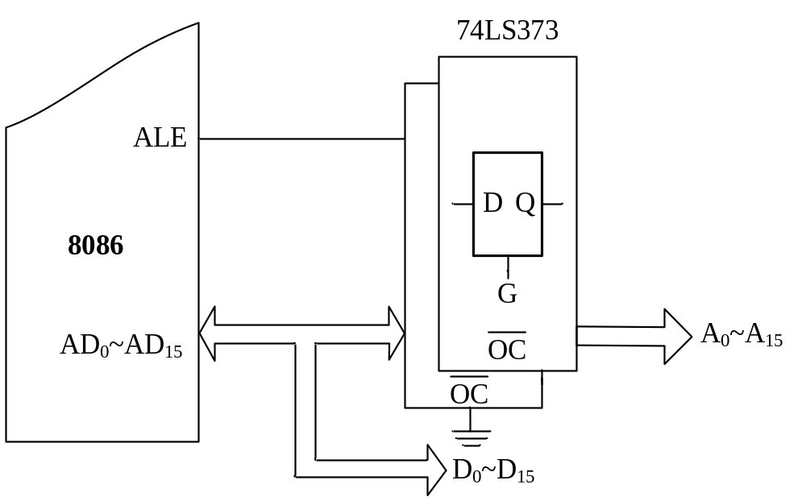
Figure 2.10 Demultiplexing the 8086’s address/data bus

Slide 88
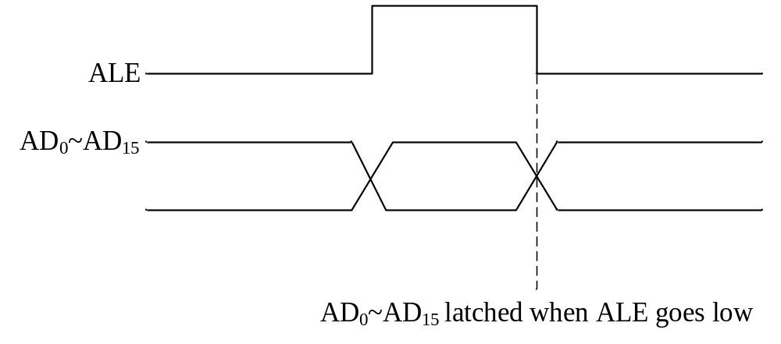
Figure 2.11 Latching the lower address byte

Slide 89
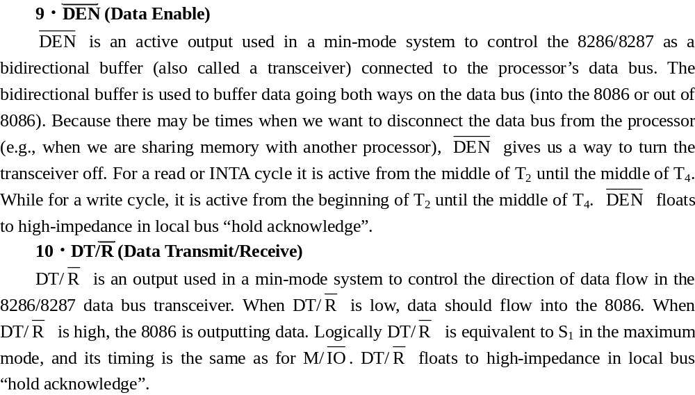

Slide 90
11．READY (Ready)
READY is an input that informs the processor that the selected memory or I/O device is ready to complete a data transfer. READY is often used to synchronize the fast processor with a slow memory or I/O device that may need an extended bus cycle to perform a read or write operation. A high logic level on READY indicates that the 8086 may go ahead and complete the bus cycle. A low logic level causes the processor to extend the bus cycle with all signals frozen at their current logic levels. This means that the processor keeps the address lines, data bus, and control signals in their current states so that the external device may use them for a longer period of time. In fact, the 8086 would check the state of READY during T3 of any bus cycle. If the signal is low, the 8086 would insert one or several TWs after T3 until READY turns to high and then goes into T4 to complete the data transfer.

Slide 91
12．RESET (Reset)
RESET is the signal that really gets the processor running after a power-up. It is very important to RESET the 8086 when power is first applied to guarantee that the 8086 begins doing intelligent things. A high logic level is needed to activate the RESET input, which must remain high for at least four clock cycles to ensure proper operation. RESET can be applied during program execution as well, as a sort of panic button used to start the program over from the beginning. After the 8086 accepts the signal, it stops the current operation, and clears all the registers and the instruction queue except CS. CS is set to be FFFFH. It means that when the 8086 restarts execution, it will fetch the first instruction from memory, beginning at address FFFF0H. This requires some type of ROM data at that address guarantee that the 8086 begins running correctly. RESET is internally synchronized.

Slide 92
13．INTR (Interrupt Request)
INTR is a level triggered input, which is sampled during the last clock cycle of each instruction to determine if the processor should enter into an interrupt acknowledge operation. If INTR is logic 1 during the last clock cycle of an instruction and the interrupt flag (IF) is logic 1, the 8086 microprocessor will enter into an interrupt acknowledge operation after the currently executing instruction operation. The interrupt type for INTR is actually read from the processor’s data bus during an interrupt acknowledged cycle.

Slide 93
The 16-bit interrupt vector read from the data bus is internally converted into the proper address for the interrupt vector table—that is, a subroutine is vectored via an interrupt vector lookup table located in system memory. INTR requires a high logic level to be recognized. Leaving INTR in a high state could cause repeated interrupts, so it is necessary to design circuitry to prevent this from happening. A bit in the processor’s status register that is used to enable/disable INTR is called the interrupt enable flag (IF). Using the IF to disable INTR can be done easily with software, and is referred to as masking. It can be internally masked by software resetting the interrupt enable flag as logic 0.

Slide 94
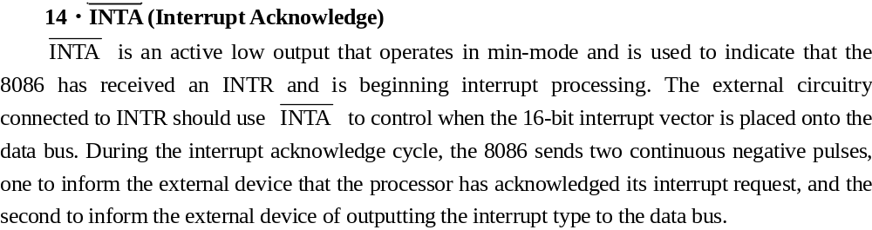

Slide 95
15．NMI (Non-Maskable Interrupt)
NMI requires a rising edge to be recognized, as indicated in Figure 2.12. It cannot be internally disable (masked) by software, hence its name. NMI generates a type-2 interrupt. NMI is recognized by the 8086 at the end of the currently executing instruction. The address of type-2 ISR (interrupt service routine) is then read from a table containing all ISR addresses. This input is internally synchronized.

Slide 96
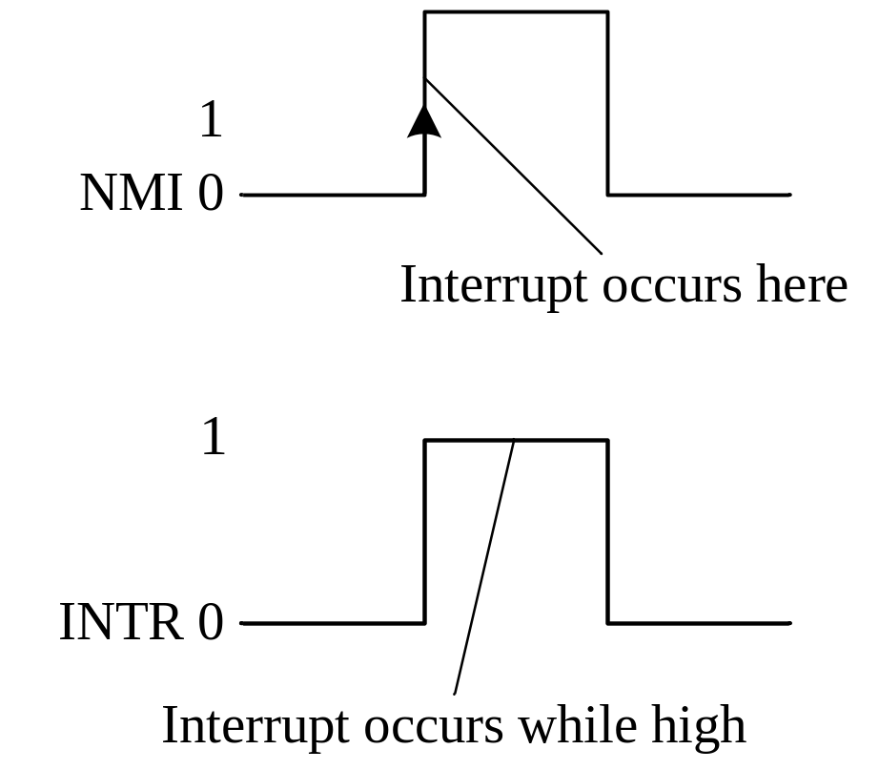
Figure 2.12 NMI and INTR signals

Slide 97
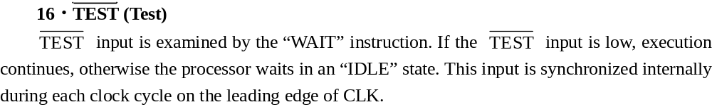

Slide 98
17．HOLD (Hold Request)
HOLD is a min-mode input that is used to place the processor into a suspended execution state. While the 8086 is in a hold state, it does not continue program execution. In fact, many of the processor’s outputs are automatically tri-stated to prevent conflict on the system bus. The most common use of HOLD is in a computer system having two or more processors that need to share a bus. If the processors share memory (such as EPROM or RAM space), only one processor may access memory at a time.

Slide 99
When a processor wishes to take control of the buses and access memory, it must first issue a HOLD request to the other processors in the system, which will suspend their processing and release the system bus. A high logic level is needed to activate HOLD. Furthermore, the 8086 will remain held only as long as the HOLD input remains high. The processor will resume program execution where it left off as soon as HOLD goes low.

Slide 100
18．HLDA ( Hold Acknowledge)
HLDA is a min-mode output used to indicate to external devices that the 8086 has suspended execution (via HOLD). HLDA will go to a high logic level to show that the processor has actually stopped execution. Technically, another device should take over the system bus only after HLDA goes high. When execution resumes (i.e., HOLD has been taken low), HLDA will go low.

Slide 101
19．CLK (Clock)
The CLK input requires a digital waveform with a 33 percent duty cycle. This waveform is shown in Figure 2.13. A 33 percent duty cycle means that the digital level is high one-third of the time. The 8086’s clock period is 200 ns, corresponding to a frequency of 5 MHz. 8086-1’s frequency is 10 MHz, and 8086-2’s frequency is 8 MHz. Even though the clock input is internally buffered, the clock signal should be kept at a constant frequency (via the 8284 and a crystal oscillator) for best operation.

Slide 102
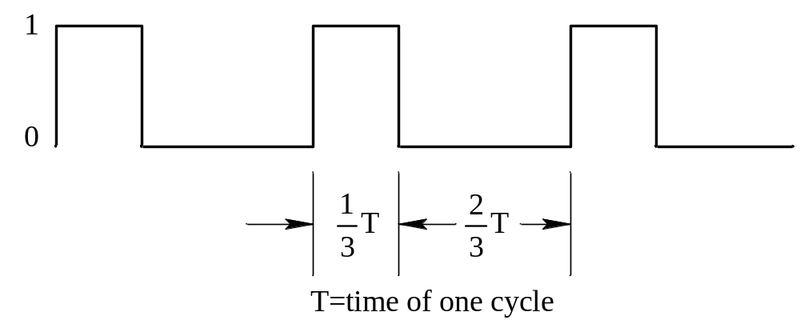
Figure 2.13 Three cycles of the CLK waveform

Slide 103
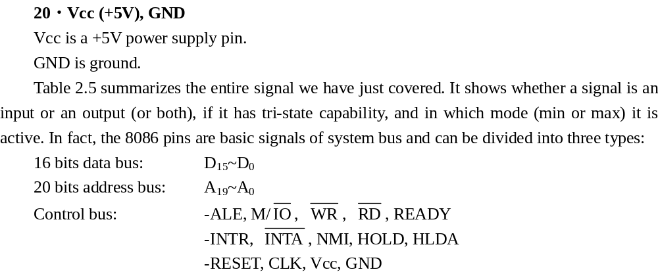

Slide 104
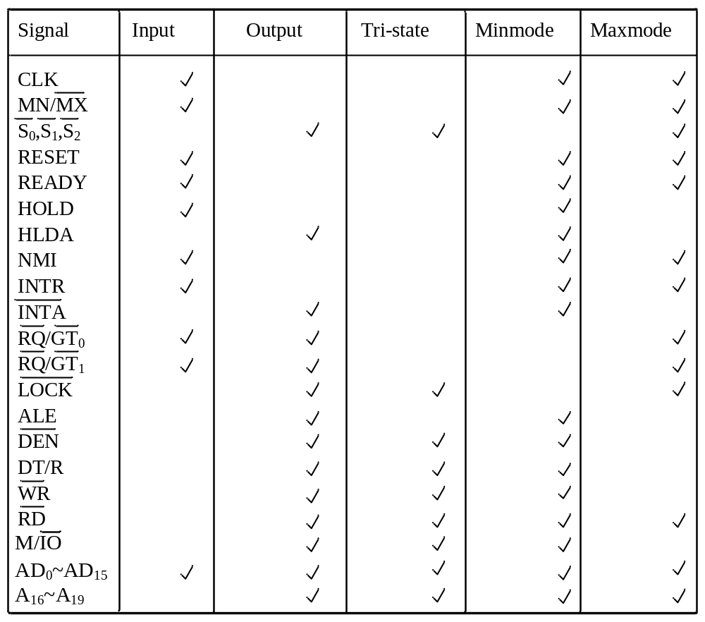
Table 2.5 8086 signal summary

Slide 105
2.5 8086 Memory Organization
Whether simple or complex, every microprocessor-based system has memory, which is a very important part where information is stored and transferred. Memory capacity, memory organization, and memory speed (access time) are important features of 8086/8088 system.

Slide 106
2.5.1 Formation of Physical Address
Before we talk about the memory segmentation, one important concept should be told, that is “physical address”. As we all know, one significant function of the BIU is address generation. A segment base and an offset address describe a logical address in the 8086 microcomputer system. An offset address represents the displacement of a storage location in memory from the segment base address in a segment register—that is, it is used as a pointer or index to select a specific storage location within 64 KB segment of memory.

Slide 107
As Figure 2.14 shows, both the segment base and offset are 16-bit quantities, since all registers and memory locations used in address calculations are 16 bits long. However, the physical address, an absolutely address that is used to access memory, is 20 bits in length and is an unique address. ⁴The generation of the physical address involves combining a 16-bit offset value that is located in the instruction pointer, a base register, an index register, or a pointer register and a 16-bit segment base value that is located in one of the segment registers.

Slide 108
Figure 2.15 shows how a segment base value in a segment register and an offset value are combined to form a physical address. The value in the segment register is shifted left by four bit positions, with its LSBs (Least Significant Bits) filled with zeros. This shifted value gives a segment address, the location where the segment starts. The offset value is then added to the 16 LSBs of the shifted segment value. The result of this addition is the 20-bit physical address.

Slide 109
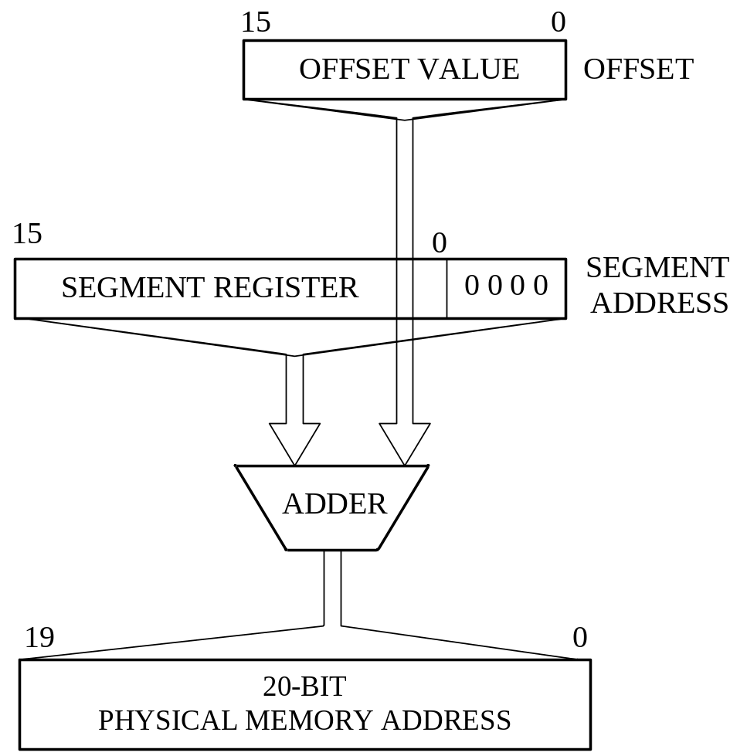
Figure 2.14 Process to generate a physical address

Slide 110
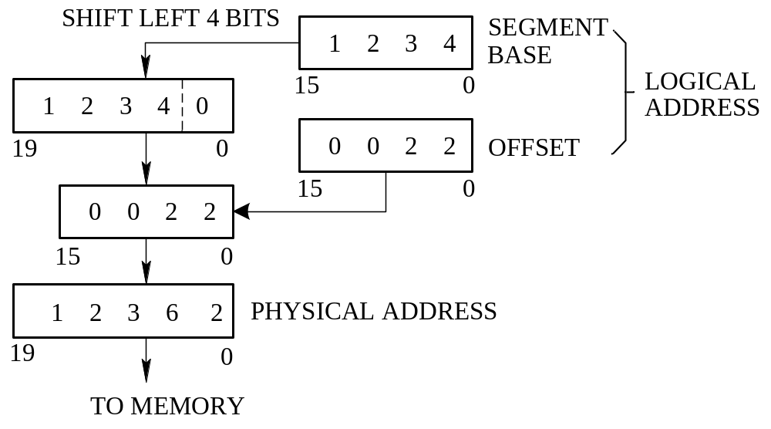
Figure 2.15 Generating a memory address

Slide 111
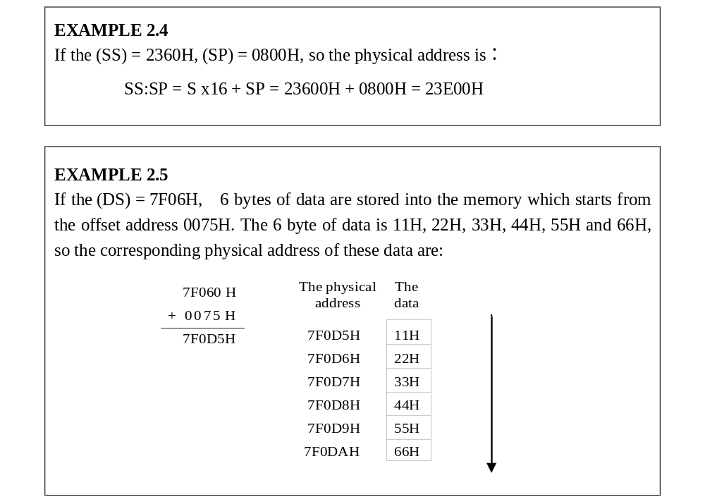

Slide 112
[Reading Material] The source of the offset value depends on which type of memory reference is taking place. It can be the base pointer (BP) register, stack pointer (SP) register, base (BX) register, source index (SI) register, destination index (DI) register, or instruction pointer (IP). An offset can even be formed from the contents of several of these registers. On the other hand, the segment base value always resides in one of the segment registers: CS, DS, SS, or ES.

Slide 113
For instance, when an instruction acquisition takes place, the source of the segment base value is always the code segment (CS) register, and the offset value is always the instruction pointer (IP). This physical address can be denoted as CS: IP. Sometimes if the value of a variable is written to memory during execution of an instruction, typically the segment base is specified by the data segment (DS) register and the offset value by the destination index (DI) register—that is, the physical address is given as DS: DI.

Slide 114
A provision called the segment-override prefix is used to change the segment from which the variable is accessed; for example, a prefix could be used to make a data access occur in which the segment base is in the ES register. We give it ES:DI instead of DS:DI. Another example is the stack address that is needed when pushing parameters into the stack. This physical address is formed from the value of the segment base in the stack segment (SS) register and offset in the stack pointer (SP) register and is described as SS: SP. The segment-override prefix will be discussed in detail in Chapter 3.

Slide 115
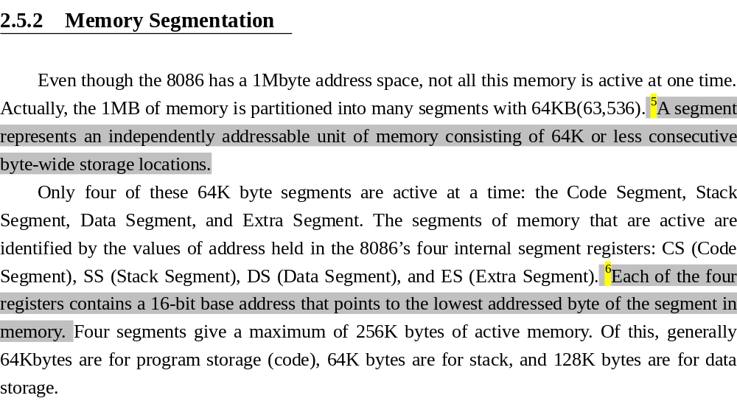

Slide 116
The values held in these registers are referred to as the current-segment register values; for example, the value in CS points to the first word-wide storage location in the current code register. Code is always fetched from memory as words, not as bytes.
Figure 2.16 illustrates the segmentation of memory. In this diagram, the 64Kbyte segments are identified with letters such as A, B, and C. The data segment (DS) register labeled B, acts as the current data-storage segment.

Slide 117
This is one of the segments in which data that are to be processed by the microcomputer are stored. For this reason, this part of the microcomputer’s memory address space must contain read/write storage locations that can be accessed by instructions as storage locations for source and destination operands. CS selects E as the code segment. It is this segment of memory from which instructions of the program are currently being fetched for execution. The stack segment (SS) register contains H, thereby selecting the 64Kbyte segment labeled as H for use as a stack. Finally, the extra segment (ES) register is loaded with value J such that segment J of memory functions as a second 64Kbyte data storage segment.

Slide 118
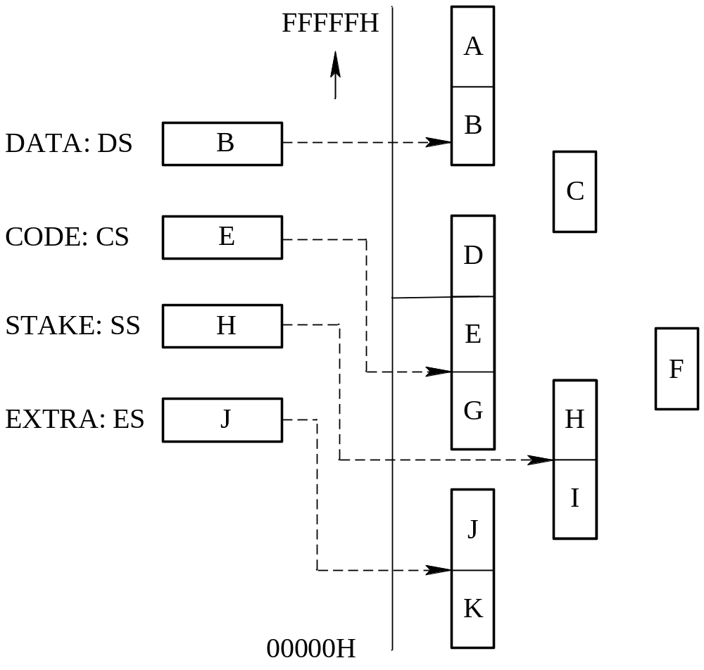
Figure 2.16 Contiguous, adjacent, disjointed, and overlapping segment.

Slide 119
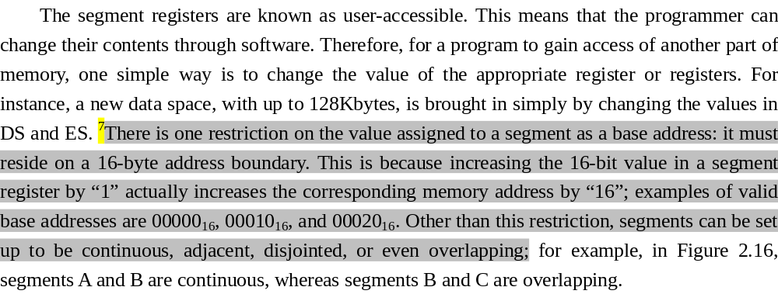

Slide 120
The four segments registers representing four base addresses would add different offsets offered by different pointer registers or index registers to form the physical addresses. We can see in Figure 2.17, it gives us a brief summarization. The offset is given by the IP for the code segment, and instructions are always fetched with using the CS register. That is CS: IP.
Data is usually fetched with respect to the DS register. The effective address (EA) is the offset. The EA depends on the addressing mode. It can be SI, DI, or BX.

Slide 121
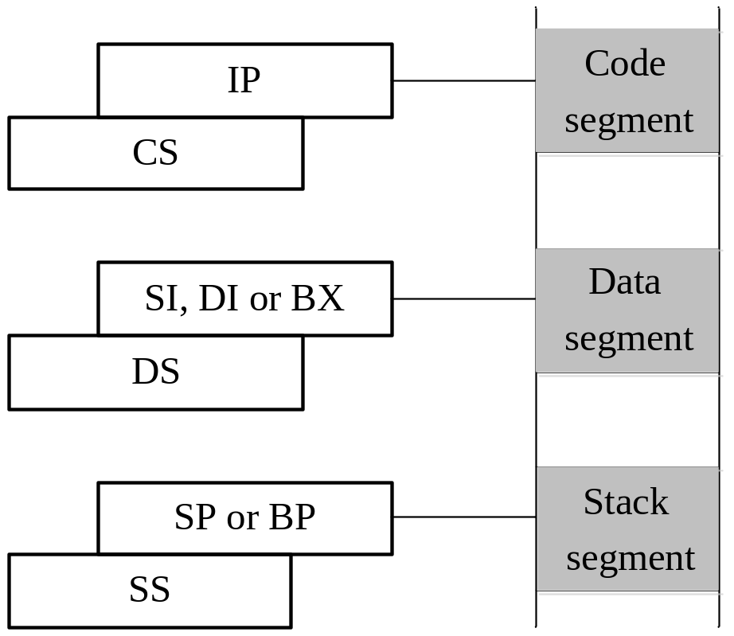
Figure 2.17 Memory addressing for code, data and stack segment.

Slide 122
As to the stack, the offset is given by the SB:IP register. The stack segment is always referenced with respect to the SS register. SS: SP indicates the forming of the top or the last address of the stack. The stack grows towards decreasing memory locations and the SP points to the last or top item on the stack.

Slide 123
2.5.3 Hardware Organization of the Memory Address Space
From a hardware point of view, the memory address spaces of the 8088- and 8086-based microcomputers are organized differently. Figure 2.18(a) shows that the 8088’s memory subsystem is implemented as a single 1M×8 memory bank. In Figure 2.18(a), these byte-wide storage locations are assigned to consecutive addresses over the range from 00000H through FFFFFH.

Slide 124
During memory operations, a 20-bit address is applied to the memory bank over address lines A₀ through A₁₉, which selects the storage location that is to be accessed. Bytes of data are transferred between the 8088 and memory over data bus lines D₀ through D₇.

Slide 125
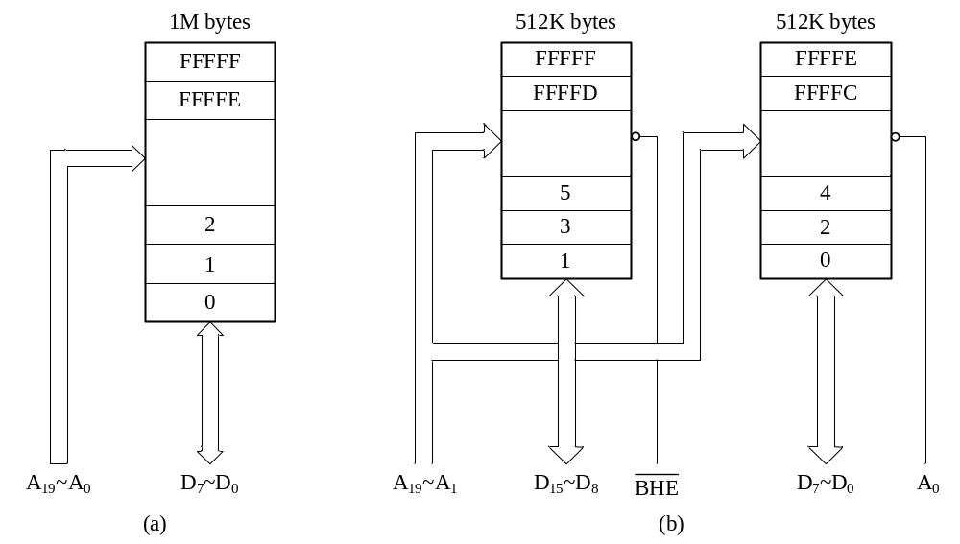
Figure 2.18 (a) 1M × 8 memory bank of 8088；(b) High and low memory banks of 8086

Slide 126
For the 8086’s 1Mbyte memory address space, as shown in Figure 2.18(b), it is implemented as two independent 512Mbyte banks: the low (even) bank and the high (odd) bank. Data bytes associated with an even address (00000H, 00002H, etc.) reside in the low bank, and those with odd addresses (00001H, 00003H, etc.) reside in the high bank. For the 8086 address bits, A₁ through A₁₉ select the storage location that is to be accessed. They are applied to both banks in parallel.

Slide 127
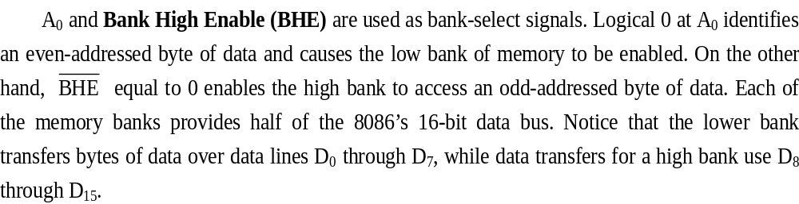

Slide 128
We just saw that the memory subsystem of the 8086-based microcomputer system is actually organized as 8-bit bytes, not as 16-bit words. However, the contents of any two consecutive byte storage locations can be accessed as a word, and the higher-addressed byte is its most significant byte. You can read the material below and understand how a byte and a word of data are read from memory.

Slide 129
[Reading Material] The 8086 microprocessor performs byte and word data transfers differently from the 8088. Figure 2.19(a) shows that when a byte-memory operation is performed to address X, an even-addressed storage location in the low bank is accessed. Therefore, A₀ is set to logic 0 to enable the low bank of memory and BHE to logic 1 to disable the high bank. As shown in the block diagram, data are transferred to or from the lower bank over data bus lines D₀ through D₇. Line D₇ carries the MSB of the byte, and D₀ the LSB.

Slide 130
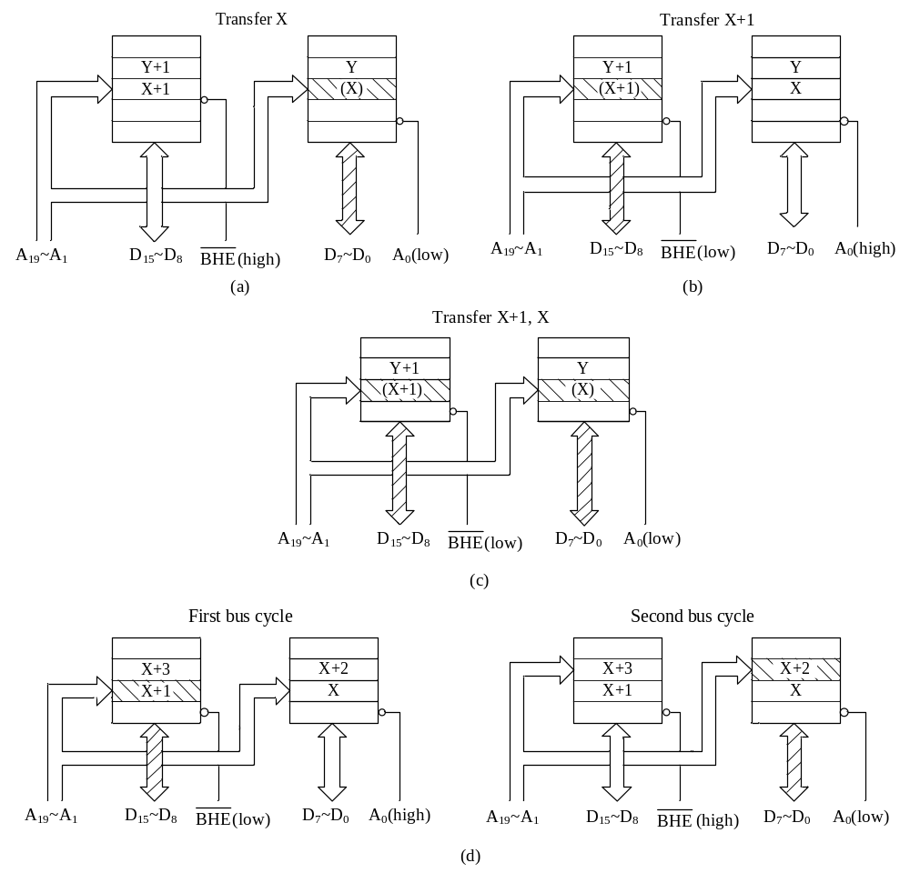
Figure 2.19 (a) Even-address byte transfer by the 8086；(b) Odd-address byte transfer by the 8086；
(c) Even-address word transfer by the 8086；(d) Odd-address word transfer by the 8086

Slide 131
On the other hand, to access a byte of data at an odd address such as X + 1 in Figure 2.19(b), A0 is set to logic 1 and BHE to logic 0. This enables the high bank of memory and disables the low bank. Data are transferred between the 8086 and the high bank over bus lines D₈ through D₁₅. Here D₁₅ represents the MSB and D₈ the LSB.

Slide 132
Whenever an even-addressed word of data is accessed, both the high and low banks are accessed at the same time. Figure 2.19(c) illustrates how a word at even address X is accessed. Note that both A₀ and BHE equal 0; therefore, both banks are enabled. In this case, bytes of data are transferred from or to both banks at the same time. This 16-bit word is transferred over the complete data bus D₀ through D₁₅. The bytes of an even-addressed word are said to be aligned and can be transferred with a memory operation that takes just one bus cycle.

Slide 133
A word at an odd-addressed boundary is said to be unaligned. That is, the least significant byte is at the lower address location in the high memory bank. This is demonstrated in Figure 2.19(d). Here we see that the odd byte of the word is located at address X+1 and the even byte at address X+2.
Two bus cycles are required to access an unaligned word. During the first bus cycle, the odd byte of the word, which is located at address X + 1 in the high bank, is accessed. This is accompanied by select signals A₀=1 and BHE =0 and a data transfer over D₈ through D15. Even though the data transfer uses data lines D₈ through D₁₅, to the processor it is the low byte of the addressed data word.

Slide 134
Next, the 8086 automatically increments the address so that A₀=0. This represents the next address in memory, which is even. Then a second memory bus cycle is initiated. During this second cycle, the even byte located at X+2 in the low bank is accessed. The data transfer takes place over bus lines D₀ through D₇. This transfer is accompanied by A₀=0 and BHE = 1. To the processor, this is the high byte of the word data.

Slide 135
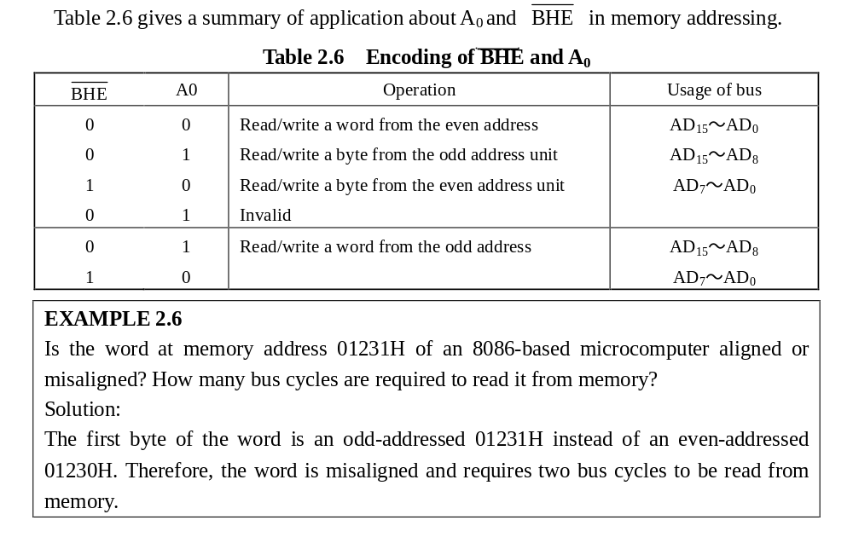

Slide 136
2.5.4 Stack
As indicated earlier, the stack is implemented in the memory of the 80x86 microprocessor, and it is used for temporary storage of information such as data or addresses. For instance, when a call instruction is executed, the 8086 automatically pushes the current values in CS and IP onto the stack. As part of the subroutine, the contents of other registers may also be saved on the stack by executing push instructions (e.g., when the instruction PUSH SI is executed, it causes the contents of SI to be pushed onto the stack). Near the end of the subroutine, pop instructions are included to pop values from the stack back into their corresponding internal registers (e.g., POP SI causes the value at the top of the stack to be popped back into SI).

Slide 137
At the end of the subroutine, a RET instruction causes the values of CS and IP to be popped off the stack and put back into the internal register where they originally resided.
The stack is 64Kbytes or less long and is organized from a software point of view as 32K words. Figure 2.20 shows that the segment base value in the SS register points to the lowest address word in the current stack. The contents of the SP or BP register give offset in the stack segment of memory.

Slide 138
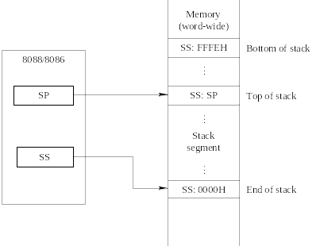
Figure 2.20 Stack segment of memory

Slide 139
In Figure 2.20, SP contains an offset value that points to a storage location in the current stack segment. The address obtained from the contents of SS and SP (SS:SP) is the physical address of the last storage location in the stack to which data were pushed. This memory address is known as the top of the stack. At the microcomputer’s startup, the value in SP is 0000H and after being decremented2 due to PUSH, ends up at FFFEH. Combining this value with the current value in SS gives the highest-addressed word location in the stack (SS:FFFEH)—that is, the bottom of the stack.

Slide 140
The 8086 can push data and address information onto the stack from its internal registers or a storage location in memory. Data transferred to and from the stack are word-wide and byte-wide. Each time a word is to be pushed onto the top of the stack, the value in SP is first automatically decremented by two, and then the contents of the register are written into the stack part of memory. Therefore, the stack grows down in memory from the bottom of the stack, which corresponds to the physical address SS:FFFEH, toward the end of the stack, which corresponds to the physical address SS:0000H.

Slide 141
When a value is popped from the top of the stack, the reverse of this sequence occurs. The physical address defined by SS:SP points to the location of the last value pushed onto the stack. Its contents are first popped off the stack and put into the specific register within the 8086; the SP is automatically incremented by two. The top of the stack then corresponds to the address of the previous value pushed onto the stack.

Slide 142
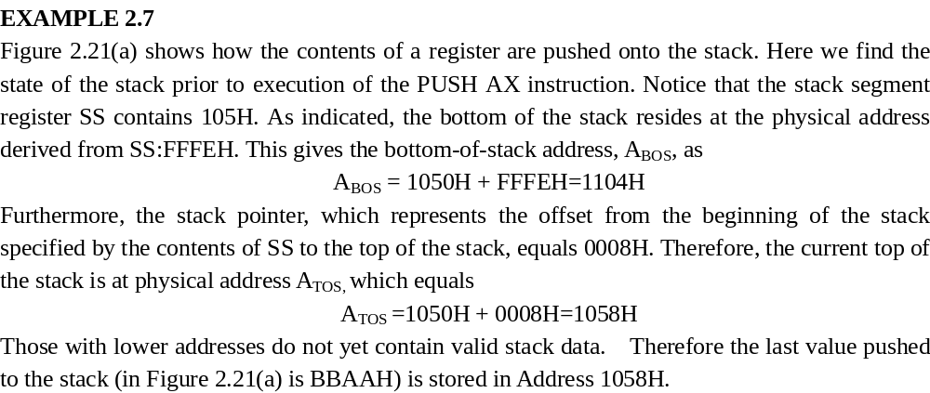

Slide 143
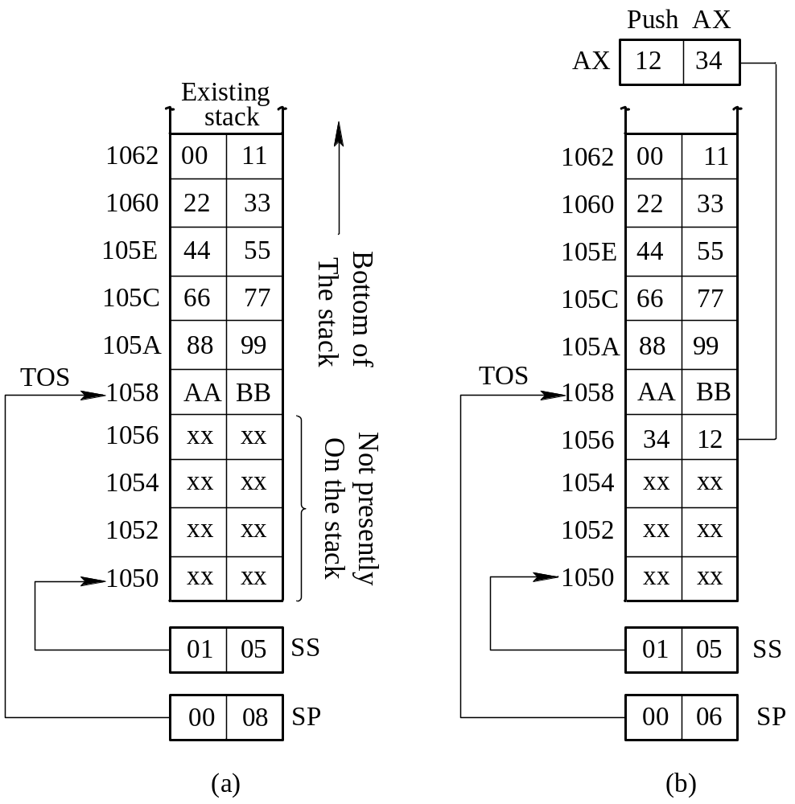
Figure 2.21 (a) Stack just prior to push operation；
(b) Stack after execution of the PUSH AX instruction

Slide 144
Addresses with higher values than that of the top of the stack, 1058H, contain valid stack data. Figure 2.21(b) demonstrates what happens when the PUSH AX instruction is executed. Here we see that AX initially contains the number 1234H. Notice that execution of the push instruction causes the stack pointer to be decremented by two but does not affect the contents of the stack segment register. Therefore, the next stack access is to the location corresponding to address 1056H. This location is where the value in AX is pushed. Notice that the most significant byte of AX, which equals 12H, now resides in memory address 1057H, and the least significant byte of AX, which is 34H, is held in memory address 1056H.

Slide 145
Let us next look at an example in which stack data are popped from the stack back into the registers from which they were pushed. Figure 2.22 illustrates this operation.
EXAMPLE 2.8
In Figure 2.22(a), the stack is shown to be in the state prior to PUSH AX example. That is, SP equals 0006H, SS equals 105H, the address at the top of the stack equals 1056H, and the word at the top of the stack equals 1234H.

Slide 146


Slide 147

Figure 2.22 (a) Stack just prior to pop operation；
(b) Stack after the execution of the POP AX and POP BX instruction

Slide 148
Any number of stacks may exist in an 8086 microcomputer. Simply changing the value in the SS register brings in a new stack. For instance, executing the instruction MOV SS, DX loads a new value from DX into SS. Although many stacks can exist, only one can be active at a time.

Slide 149
2.6 8086 Memory and I/O Operation Cycles
Microprocessors are clocked synchronous state machines, that is, they perform some actions when they receive a clock edge or the processor bus unit takes some actions when the clock signal occurs.

Slide 150
2.6.1 Bus Cycle and Timing for 8086 Memory or I/O
A bus cycle is composed of four or more T states, numbered T₁, T₂, T₃, and T₄, where each T state represents the time of one CLK period, which we call a clock cycle, depends on the CLK frequency. For example, if an 8086 has a CLK frequency of 5 MHz, the time of one T state is 200 ns, and a four-state bus cycle takes 0.8 μs. A T state is the smallest amount of time on which the processor can perform any function.

Slide 151
In Figure 2.23, 4-clock-cycle is the shortest time that the processor can use for carrying out a read or an input cycle. Since all instructions are composed of a number of T states, instruction execution time, which we also call an instruction cycle, depends on the instrution length or how many bus cycles. The 8086 routinely performs a number of different types of bus cycles. Memory read, memory write, I/O read, I/O write, and interrupt acknowledge are most of the important ones.

Slide 152

Figure 2.23 The relationship of clock cycle, bus cycle and instruction cycle

Slide 153


Slide 154


Slide 155

Figure 2.24 8086 read bus cycle timing (min-mode)

Slide 156
2．8086 CPU write bus cycle
Figure 2.25 illustrates the write bus cycle timing of the 8086 in the min-mode. It is similar to that read cycle in Figure 2.24.

Slide 157

Figure 2.25 8086 write bus cycle timing (min-mode)

Slide 158


Slide 159
SUMMARY
1．The 8086 microprocessor is a 16-bit machine with a 16-bit data bus and a 20-bit address bus. This allows for 220, or 1 MB of addressing space.
2．The execution unit (EU) and the bus interface unit (BIU) allow the 8086/8088 to execute software more efficiently than earlier 8-bit microprocessors.
3．Wheneve the 8086/8088 is reset, the processor fetches its first instruction from address FFFF0H and sets the interrupts disabled. On the PC, this address points to boot instructions in the motherboard’s system ROM, which begins the process of booting DOS.

Slide 160

5．Internally, both processors are almost identical. Any program written for the 8088 will run without change of the 8086, and vice versa. This means that the instruction sets are mostly identical. Much of what will be said also applies to the 8088.

Slide 161
6．The general purpose registers of the 8086/8088 are composed of four 16-bit registers (AX, BX, CX, and DX) or as eight 8-bit registers (AH, AL, BH, BL, CH, CL, DH, and DL).
7．The 8086 processor has the capability of operating in minimum mode or maximum mode. Both modes have different ways of dealing with the external buses; thus we see that some pins on the processors have two functions. The use of maximum mode requires some additional hardware outside the CPU to generate bus control signals. A minimum mode system requires a minimum of external hardware to implement a system.

Slide 162
8．It is useful to understand that the 8088 and 8086 have different memory organization, to master how to access memory and I/O.
9．Logical memory is the memory system viewed by the programmer; physical memory is the actual structure of the memory viewed by the hardware designer.
10．Bus timing is very important to understand the microcomputer structure and programming. A bus cycle that consists of four clocking periods acts as the basic system timing. Each bus cycle is able to write or read one number between the microprocessor and the memory or I/O.

Slide 163


Slide 164
NOTE
1. Its functions include address generation, instruction fetching, instruction queuing, reading and writing of data operand for memory, inputting or outputting data for input/output peripherals, and bus control logic.
BIU的功能有：产生地址、取指、指令队列、从存储器读写数据、与外设I/O输入输出数据以及产生总线控制逻辑。

Slide 165
2. First, the code segment (CS) register and the instruction pointer (IP) generate a 20-bit physical address in the address generation adder. Then, the BIU transfers the 20-bit physical address onto the address bus and issues memory or I/O read signal () through the bus control logic to start them. The instruction located in the address which was just transferred will be stored in the instruction queue. EU fetches the instruction from the instruction queue, decodes it and applies to the BIU to read or write operands from memory or I/O ports. On receiving the logic address sent by the EU, the BIU generates a new physical address. When the operands are ready, the EU performs the instruction and the BIU transfers the result to memory or I/O ports.

Slide 166
首先，CS与IP在地址加法器中共同产生20位的物理地址。然后BIU将20位地址传送到地址总线，将其发送给存储器，触发来读取数据。所发送地址中的指令存在指令队列中。EU会从队列中取指令，对其解码然后通过BIU来对存储器或外设进行操作。BIU在收到EU发送的逻辑地址后，将产生一个物理地址，在指令周期完成后进行读写。操作数准备好后，EU执行指令，BIU将结果传送给存储器或I/O端口。

Slide 167


Slide 168
4. The generation of the physical address involves combining a 16-bit offset value that is located in the instruction pointer, a base register, an index register, or a pointer register and a 16-bit segment base value that is located in one of the segment registers.
物理地址由16位的基址和16位的偏移地址构成。偏移地址一般存在指令指针寄存器、基址寄存器、变址寄存器或指针寄存器中；基址则存在基址(段)寄存器中。

Slide 169
5. A segment represents an independently addressable unit of memory consisting of 64K or less consecutive byte-wide storage locations.
一个段代表存储器中独立的可寻址单元，大小为64K字节，或者说是容量稍小的连续的字节存储单元。
6. Each of the four registers contains a 16-bit base address that points to the lowest addressed byte of the segment in memory.
这四个寄存器的任一个都含有一个16位的基地址，这个基地址指向存储器中段的初始(最低)地址。

Slide 170
7. There is one restriction on the value assigned to a segment as a base address: it must reside on a 16-byte address boundary. This is because increasing the 16-bit value in a segment register by “1” actually increases the corresponding memory address by “16”; examples of valid base addresses are 00000₁₆, 00010₁₆, and 00020₁₆. Other than this restriction, segments can be set up to be continuous, adjacent, disjointed, or even overlapping…

Slide 171
因为段基址值为16位，所以段基址范围是有限制的。由于16进制数的1代表十进制数的16，所以当地址值增加1时表示在存储器上地址值要增加16，例如，有效的基地址可以是00000₁₆，00010₁₆和00020₁₆。除了这个限制，段与段之间可以是连续的、相邻的、分隔的或重叠的。

Slide 172
STUDY QUESTIONS
1. Name all of the general purpose registers and some of their special functions.
2. How are the segment registers used to form a 20-bit address?
3. (a) If CS contains 03E0H and IP contains 1F20H, from what address is the next instruction fetched?
(b) If SS contains 0400H and SP contains 3FFEH, where is the top of the stack located?
(c) If a data segment deigns at address 24000H, what is the address of the last location in the segment?

Slide 173

4. Explain what the instruction array and data caches are used for.
5. What is the EU and BIU, and what purpose in the microcomputer?
6. Two memory locations, beginning at address 3000H, contain the bytes 34H and 12H. What is the word stored at location 3000H? See Figure 2.26 for details.
Figure 2.26 For question 6

Slide 174
7. What is a physical address? What are the differences between the 8086 logical and physical memory maps?
8. May memory segments overlap? If so, what is the minimum number of overlapped bytes other than 0?
9. How many of the 16 flag bits actually contain information? Explain the functions.
10. Show how a 786H is stored in a word and a double word if both the word and double word begin at memory address B0000H.

Slide 175


11. What are differences between flag CF and OF? Give some examples to show these differences.
12. List the differences between the 8086 and the 8088 microprocessors.
13. Explain the operation of the pin and the instruction.
14. Explain the purpose of ALE pin, when does ALE float to its high-impedance state?
15. Briefly describe the purpose of each T state in 8086/8088 bus cycle.

Slide 176
16. If the CLK input to the 8086/8088 is 4 MHz, how long is a bus cycle?
17. How much time is allowed for memory access when the 8086/8088 is operated with a 5-MHz clock?
18. When DT/ is a logic 1, what condition does it indicate about the operation of the 8086/8088?

