Slide 1

Super Desktop Assistant
Project Achievement Report
August 2026 • AI Innovation & Research Lab
Notes:
Hello everyone, welcome to the project achievement report for the Super Desktop Assistant. Today, I will present a revolutionary AI agent that brings the power of multiple AI models directly to your desktop, running entirely on local hardware. Let's dive into the details of this exciting project.

Slide 2





Executive Summary
Project: Super Desktop Assistant
A unified local-first AI agent merging LLM, Vision, Speech, and Image Generation into a single conversational interface—powered entirely by the AMD Radeon PRO W7900 GPU with ROCm, delivering a private, cloud-independent experience.
Core Innovation: Dynamic DAG Orchestration
The system dynamically rewrites user prompts to activate specialized "expert" models, and leverages a sophisticated DAG parallel system to maximize local GPU utilization for complex multimodal tasks.
100% Local & Private
Eliminates cloud API costs and latency, ensuring complete data privacy with no external data transmission—ideal for secure enterprise and personal use.
+11% & +109% Performance Gains
Significantly faster text generation and a massive boost in long-context prefill speed on the AMD Radeon PRO W7900, enabling real-time AI interactions.
Unified 48GB GPU Resource
Co-locates a 32B-parameter multimodal LLM, image generator, and speech processor on a single GPU, demonstrating exceptional edge AI consolidation.
Robust 4-Layer Agent Architecture
Ensures reliable task planning, execution, and failure handling through a sophisticated hierarchical design, guaranteeing system stability.
Notes:
To begin, let's look at the executive summary. The Super Desktop Assistant is a groundbreaking AI agent designed to run entirely locally on an AMD Radeon PRO W7900 GPU. Its key innovation lies in a smart orchestration system that maximizes GPU performance. Our major achievements include full local operation for ultimate privacy, significant performance boosts through ROCm optimizations, efficient VRAM management, and a robust four-layer architecture.

Slide 3
Table of Contents
01Introduction The Vision of a Local AI Assistant & Problem Statement
06Model Selection & Deployment Optimized Models for Local Execution & Integration
02Core Innovation The "Rewrite → Activate → Maximize" Pipeline
07AMD GPU Optimization Unleashing the Power of ROCm & OpenCL
03Application Scenarios Real-World Use Cases Across Industries
08Hardware Cognition Analyzing the RDNA3 Roofline Performance Model
04System Architecture A Robust Four-Layer Design for Scalability
09VRAM Budgeting Efficiently Managing 48GB of GPU Memory
05Core Capabilities The Swiss Army Knife of Local AI Features
10Performance End-to-End Workflow
11Conclusion Key Differentiators
Notes:
Here's the roadmap for today's presentation. We'll start with the vision and problem statement, then dive deep into our core innovations, application scenarios, system architecture, and capabilities. We'll also cover model deployment, our extensive GPU optimizations, hardware analysis, VRAM management, and conclude with a summary of our achievements.

Slide 4



Introduction: The Problem with Current AI Services
Data Privacy Concerns
Prohibitive Costs & Dependency
Chronic Tool Fragmentation
Cloud-based AI forces uploading sensitive data—screenshots, voice recordings, and personal documents—creating major security vulnerabilities and exposing your information to potential breaches.
Recurring API calls quickly inflate costs, especially for heavy usage. Additionally, you’re tethered to an internet connection—AI access is lost offline, crippling mobility and flexibility.
Users juggle disjointed apps for chat, image generation, and coding, creating a fragmented workflow. Critical context is lost between tools, leading to inefficiency and cognitive overload.
THE BOTTOM LINE:These systemic flaws turn AI from a productivity catalyst into a restrictive liability.
Notes:
Let's start with the problem. Current AI services present three major hurdles: data privacy, high costs, and tool fragmentation. Uploading sensitive data to the cloud is a significant risk. Continuous API calls add up financially and create a dependency on internet access. And switching between different apps for different tasks breaks your workflow and wastes time.

Slide 5
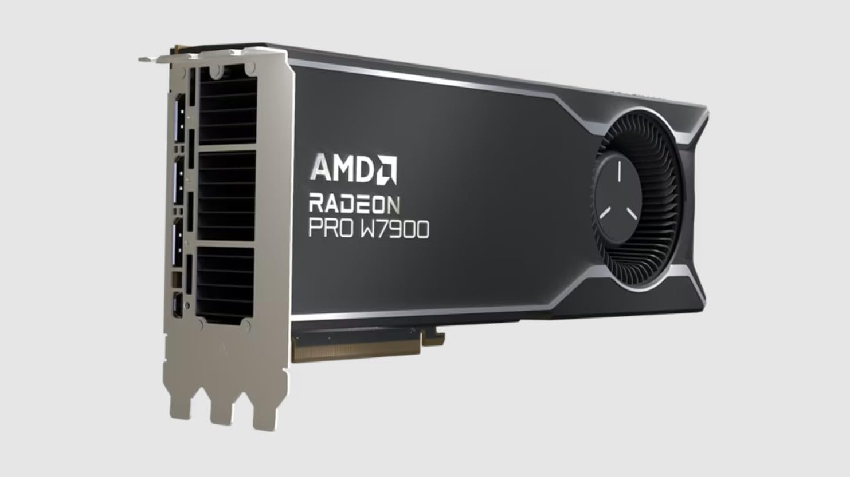

1.2. Our Solution: One Interface, All Local AI on AMD Radeon
TheSuper Desktop Assistantredefines AI interaction with a unified chat interface where every model runs directly on your AMD Radeon GPU. This approach eliminates cloud latency and dependency, putting the power of AI entirely in your hands.
Absolute Data Sovereignty
Your data never leaves your machine. All processing—from prompts to outputs—happens locally, ensuring complete privacy and compliance.
Zero Operational Costs
No recurring API fees or cloud subscription bills. Invest once in your Radeon hardware and own unlimited, free compute power forever.
CORE CONCEPT: THE LOCAL AI CONDUCTOR
“One sentence input, parallel AI output. The system orchestrates LLM, Vision, and Image models as a directed acyclic graph (DAG), all accelerated by ROCm on your AMD Radeon GPU.”
Seamless Unified Workflow
A single interface for all AI needs—LLM chat, image generation, and speech processing—no context switching between disconnected apps.
Notes:
Our solution is the Super Desktop Assistant. It's a single interface where all AI runs locally on your AMD Radeon GPU. This means absolute privacy, zero ongoing costs, and a seamless workflow. The core concept is unified orchestration: you give a single command, and the system intelligently breaks it down into parallel tasks for different AI models, all running on your local hardware.

Slide 6



2. Core Innovation: The "Rewrite → Activate → Maximize" Pipeline
01 Rewrite
02 Activate
03 Maximize
Real-Time Prompt Enhancement
Parallel Expert Model Execution
GPU Utilization Optimization
Dynamically rewrites basic user commands into professional-grade prompts. It injects expert tags and granular details on-the-fly, turning vague requests into precise instructions for the AI.
Intelligently activates specialized local models (LLM, Vision, Speech) in parallel. Each "expert" model operates concurrently, ensuring complex multi-modal tasks are handled efficiently and accurately.
Engineered with DAG parallelism and ROCm optimizations to fully exploit AMD Radeon GPU potential. This unlocks unprecedented performance for both short and long-context AI workloads.
+11%
Text Generation Speed
+109%
Long-Context Prefill
"One sentence in → expert-grade prompts, powered by your local GPU."
Transforming simple user intent into high-quality AI output with unmatched speed.
Notes:
Now, let's explore our core innovation: the "Rewrite, Activate, Maximize" pipeline. First, it rewrites simple user commands into professional-grade prompts. Then, it activates the appropriate expert AI models for the task. Finally, it maximizes the utilization of your local GPU through parallel processing and deep optimizations, resulting in significant performance gains.

Slide 7




3. Application Scenarios: Real-World Use Cases
The Super Desktop Assistant excels in practical, everyday tasks, demonstrating measurable efficiency and versatility across different AI modalities—all accessible through a unified interface.
01. Text Generation
02. Vision Analysis
Prompt: "Write a five-character quatrain about autumn." ⏱️ Latency: ~18s— Generates poetic, context-aware responses with natural language flow, adapting to creative or formal prompts.
Prompt: "Describe this image's content and artistic style." ⏱️ Latency: ~3s— Rapidly extracts visual details, objects, and stylistic elements for real-time image understanding.
03. Voice-Activated Workflow
04. Image Generation
Prompt: "Wake word: draw a cyberpunk cat." 🔄 Flow: Fully Integrated— Seamless speech-to-text conversion triggers downstream AI pipelines for hands-free control.
Prompt: "Draw an anime girl with silver hair in a neon city." ⏱️ Latency: ~45s— Produces high-fidelity visuals from detailed prompts, including initial model loading and rendering time.
★ The "visible performance" across these diverse tasks underscores the assistant's role as a transformative productivity enhancer.
Notes:
Let's see how this works in practice. Here are some real-world use cases. From generating poetry in about 18 seconds, to analyzing images in 3 seconds, to voice-activated image generation, the assistant handles a variety of tasks efficiently. The table shows the end-to-end latency for each scenario, demonstrating its versatility and tangible performance.

Slide 8



3.1. Application Scenarios: Examples
Text Generation
Image Generation
Voice-Activated Creation
"早秋惊落葉，飄零似客心..." — A classical five-character quatrain about autumn, showcasing the LLM's creative and poetic capabilities.
Prompt: "Draw an anime girl with silver hair." High-fidelity character art generated in seconds with customizable styles.
Wake Word: "Draw a cyberpunk cat." Hands-free generation responding to natural voice commands for a seamless workflow.
Notes:
To make it more concrete, here are some actual outputs. On the left, you see a classical Chinese poem generated by the LLM. In the middle, an anime girl created from a simple text prompt. And on the right, a cyberpunk cat generated using voice commands. All of these were created seamlessly within the same interface.

Slide 9
4. System Architecture: A Robust Four-Layer Design
The Super Desktop Assistant is built on a robust, four-layer agent architecture that ensures reliable and efficient task execution, with each layer specializing in distinct operational roles to maintain system stability and adaptability.
L1 UserAgent
Input Sanitization & Preprocessing: Manages query truncation, entity extraction, malicious injection filtering, and configuration interception to standardize user requests.
L2 Supervisor
Core Orchestration: Converts LLM outputs into executable JSON DAGs (Planner), executes via topological sorting with parallelism (Executor), and routes tasks to specialists (Router).
L3 Foremen
Specialized Expert Agents: Houses LLMForeman, SpeechForeman, ImageForeman—each equipped with 8+ tools and intelligent fallback mechanisms for domain-specific tasks.
L4 Foundation
Unified Interface: Combines MCP (Model Context Protocol) contracts with the ai-coin API layer, providing a standardized bridge to foundational models and persistent memory systems.
Notes:
The foundation of our system is a robust four-layer architecture. At the top, the UserAgent handles input preprocessing. Below it, the Supervisor acts as the brain, planning, executing, and routing tasks. The Foremen layer contains the specialized AI experts. And the bottom layer provides a unified API to the underlying models. This structure ensures reliable and efficient task execution.

Slide 10

4.1. Architecture Deep Dive
01 / UserAgent (The Gateway)
02 / Supervisor (The Orchestrator)
The system's front door, responsible for cleaning and standardizing raw user input. It handles truncation, entity extraction, and validation to ensure only high-quality, structured data propagates downstream.
The central "brain" that parses intent using an LLM to generate a Task DAG. It performs topological sorting for parallel execution and intelligently routes each subtask to the appropriate specialized expert in Layer 3.
03 / Foremen (Domain Specialists)
04 / MCP Contract & API Layer
AI experts for specific domains (LLM, Speech, Image). Each foreman is equipped with a suite of tools—e.g., ImageForeman integrates 8+ vision tools—with graceful degradation to handle partial tool failures.
A unified abstraction layer that decouples foremen from underlying models. It provides a consistent API for model interaction, simplifying upgrades, swapping models, and integrating new AI services.
Structured Task DAG
Robust Failure Propagation
Decomposes complex tasks into a directed acyclic graph for efficient parallel execution and dependency management.
Gracefully skips dependent tasks on upstream failures, preventing cascading errors and ensuring system stability.
Notes:
Let's take a closer look at each layer. Layer 1, the UserAgent, is the entry point, responsible for cleaning and standardizing input. Layer 2, the Supervisor, is the brain that parses commands, generates a Task DAG, and orchestrates parallel execution. Layer 3, the Foremen, are the specialized AI experts for domains like vision or language, each with their own toolbox. Layer 4 provides a unified API that abstracts the underlying models. Key features include the structured Task DAG for handling complex workflows and a robust failure propagation mechanism that prevents cascading errors, ensuring the system remains stable even if individual components fail.

Slide 11
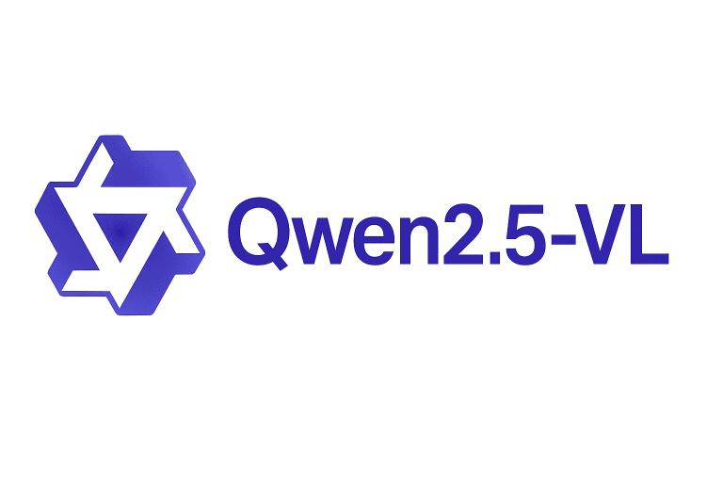
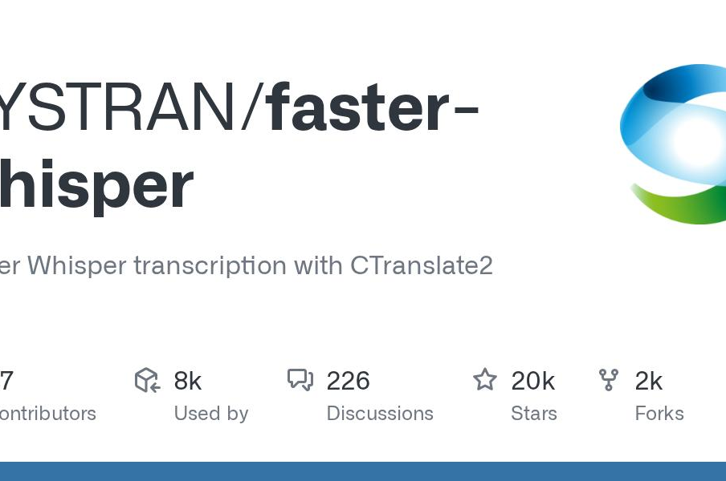



5. Core Capabilities: A Swiss Army Knife of Local AI
LLM & Vision Analysis
Powered by Qwen2.5-VL, it handles up to 8 rounds of tool reasoning and multimodal image understanding for complex tasks.
Local Speech Powerhouse
Features faster-whisper for ultra-accurate STT and Kokoro-82M for natural TTS, all running offline with zero latency.
AI Image Generation
Leverages ComfyUI with custom degradation models to produce high-quality, stylized images directly on your desktop.
8 Agent Tools Suite
Natural Language Setup
100% Local & Private
Equipped with file I/O, web search, memory management, and more to extend AI's real-world utility.
A unique feature that lets you configure the system through casual dialogue—no confusing menus.
All processing runs offline on your device. Enjoy maximum speed with complete data privacy.
Notes:
Our assistant is like a Swiss Army knife for local AI. It combines powerful LLM reasoning, vision analysis, speech-to-text powered by faster-whisper, text-to-speech with the Kokoro model, and high-quality image generation via ComfyUI. Additionally, it includes 8 agent tools and a unique feature that allows configuration through natural language dialogue.

Slide 12


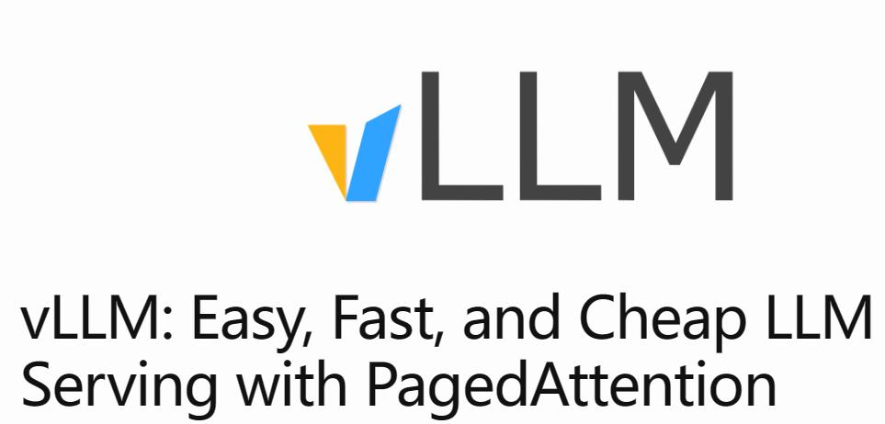
6. Model Selection & Local Deployment
All AI models are deployed locally on a single AMD Radeon PRO W7900, eliminating any cloud dependency and ensuring full control over data privacy, security, and low-latency inference.
Role | Model Architecture | Size / Params | Port | Runtime Env
LLM + Vision | Qwen2.5-VL-32B-Instruct-AWQ | 20.7 GB (VRAM) | 8000 | vLLM (ROCm Optimized)
Text-to-Speech | Kokoro-82M (Chinese) | 82M Parameters | 8766 | ONNX Runtime (CPU)
Speech-to-Text | faster-whisper-medium | ~1.5 GB (RAM) | 8766 | CTranslate2 (CPU Int8)
Image Gen | MiaoMiao Anima v1.1 (DiT) | 3.99 GB (VRAM) | 8188 | ComfyUI (ROCm)
100% Private & Offline
Optimal Resource Isolation
High-Perf Engine vLLM powers fast inference with PagedAttention, critical for real-time interactions.
No external API calls or data exfiltration. Complete on-device processing ensures compliance and data sovereignty.
CPU handles lightweight speech tasks, reserving the GPU's full 24GB VRAM for high-throughput LLM and image generation.
Notes:
Here's a breakdown of the models we selected and how they are deployed. The large Qwen2.5-VL model runs on the GPU using vLLM with ROCm. Speech tasks are offloaded to the CPU to free up GPU resources for more intensive tasks like LLM and image generation. This 100% local deployment strategy ensures maximum privacy and reliability.

Slide 13

7. AMD GPU Optimization: Unleashing the Power of ROCm
This project heavily leverages and optimizes for the AMD Radeon PRO W7900 and the ROCm platform, delivering transformative performance gains through deep framework and hardware-level optimizations.
Text Generation Speed
Before: 12.3 tokens/s After: 13.7 tokens/s
Performance Boost +11%
16k Long-Context Prefill
Before: 7.95 seconds After: 3.80 seconds
Performance Boost +109%
These breakthrough results were achieved through low-level optimizations of the ROCm open software platform, unlocking the full compute potential of AMD’s RDNA™ 3 architecture for demanding AI workloads.
Notes:
A major focus of this project was optimizing for the AMD Radeon PRO W7900 and the ROCm platform. Our efforts have paid off with significant performance gains. We achieved an 11% improvement in text generation speed and a remarkable 109% improvement in long-context prefill speed, more than doubling it.

Slide 14

7.1. Key Optimization Techniques
01. Stable Kernel Fix
02. Bandwidth Efficiency
03. Triton Kernel Tuning
Transitioned from bfloat16 to float32 accumulation to resolve critical crashes in the ROCm Triton `tl.dot` kernel, ensuring rock-solid stability for large-scale matrix multiplications and uninterrupted workload execution.
Increased AWQ block size from 32 to 128 for large matrices (N=27648). This adjustment directly improved memory bandwidth efficiency by+10%, significantly reducing data transfer bottlenecks.
Synergized block size tuning with fp32 accumulation to achieve a decode speed of13.7 tok/s. This optimized path is now the default in our vLLM build, replacing the slower FP16 matmul baseline.
These optimizations demonstrate our deep dive into the hardware-software stack, leveraging low-level kernel tuning to unlock the full potential of the architecture for state-of-the-art inference performance.
Notes:
So, how did we achieve these gains? Through three key techniques. First, we switched from bfloat16 to float32 accumulation to fix a critical kernel crash. Second, we tuned the AWQ block size from 32 to 128, boosting bandwidth efficiency by 10%. Finally, by combining these changes, we optimized the AWQ Triton kernel to reach the new speed record. These changes are now part of our custom vLLM build.

Slide 15
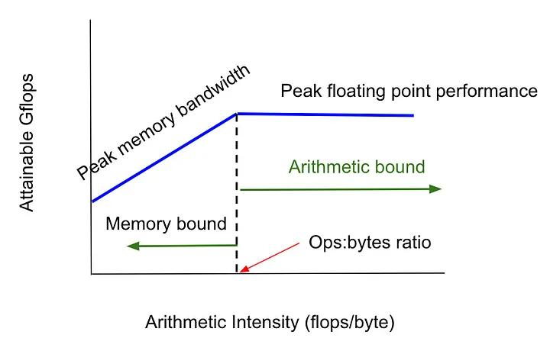
8. Hardware Cognition: Understanding the RDNA3 Roofline Model
Effective optimization starts with understanding hardware limits. We use the Roofline model to analyze the Radeon PRO W7900, identifying bottlenecks and opportunities for AI text generation.
Decode is Bandwidth-Bound Text generation’s decode phase (M=1) cannot utilize the GPU’s WMMA cores, making it strictly memory-bound. The theoretical throughput ceiling for this hardware is approximately 54 tokens/s.
Pushing the Hardware Limits Post-optimization, we achieved 13.7 tokens/s, utilizing 25% of the theoretical ceiling (up from 23%). This demonstrates significant progress toward the physical limits of the RDNA3 architecture.
FP16 / BF16 WMMA
123 TFLOPS
INT4 WMMA
245 TOPS
FP8 Support
N/A RDNA3 Arch
Notes:
Optimization isn't guesswork; it's based on a deep understanding of the hardware. Using the Roofline model, we analyzed the RDNA3 architecture. We found that text generation decode is memory bandwidth-bound, with a theoretical ceiling of about 54 tokens per second. Our achieved speed of 13.7 tokens/s is 25% of that ceiling, up from 23% before our optimizations, showing we're effectively pushing the hardware to its limits.

Slide 16
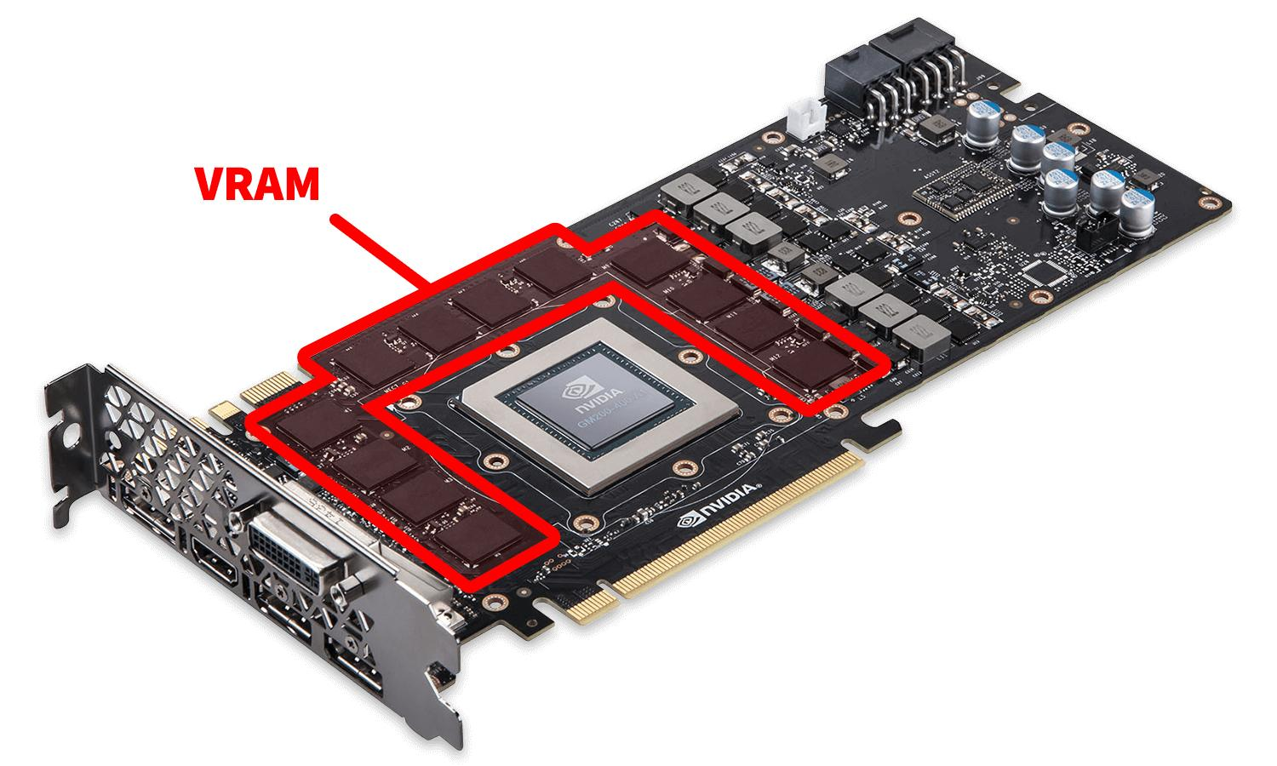
9. VRAM Budgeting: Efficiently Managing 48 GB
To run multiple large models concurrently on a single GPU, strategic VRAM allocation is critical. Our 48 GB budgeting strategy ensures all components coexist harmoniously, eliminating OOM (Out of Memory) errors and maintaining high throughput.
01. Resident Core (vLLM Qwen2.5-VL-32B) ~32 GB Utilized (72% of capacity). Includes model weights (20.7G), vision encoder (~2G), and a 36k token KV cache (~9G). Kept persistently in VRAM for ultra-low latency inference.
02. On-Demand (ComfyUI Image Generation) ~8 GB Allocated dynamically. The image pipeline is loaded only when needed for generation tasks and immediately released afterward to free up VRAM for other processes.
03. CPU Offloading (Speech & Audio) 0 GB VRAM Usage. TTS/STT workloads are fully delegated to CPU cores, completely isolating audio processing from GPU memory contention.
Total: 40 GB / 48 GB (✅ Under Limit) This "resident + on-demand" model guarantees headroom for peak loads, enabling seamless parallel execution of multimodal AI workflows without throttling or crashes.
Notes:
Another major challenge is managing the 48GB of VRAM on the W7900. Our strategy is a combination of resident and on-demand memory. The large Qwen model stays resident in about 32GB of VRAM. The image generation model is loaded on-demand, using another 8GB. Speech tasks are offloaded to the CPU. This totals about 40GB, well within the 48GB limit, ensuring smooth concurrent operation without memory errors.

Slide 17




10. End-to-End Performance: A Complete Workflow
Task: "Draw an anime girl with silver hair."— A complete generation process from raw user intent to a high-quality visual output, orchestrated seamlessly on a single local GPU.
01. Input
02. Plan (0.5s)
03. Prompt (10s)
04. Render (35s)
05. Deliver
User initiates the process by entering a natural language creative command into the interface.
Supervisor's Planner parses the intent and automatically generates a task DAG for execution.
LLMForeman rewrites and enhances the prompt to professional, model-optimized standards.
ImageForeman loads the model and renders the final image with high fidelity.
The finished visual asset is returned to the user interface for download or further use.
⏱ Total Time: ~45 Seconds— Achieved entirely on a single AMD Radeon Pro W7900 GPU with zero cloud dependency.
Full DAG Orchestration
Zero Cloud Latency
Robust Fallbacks
Complex workflows managed automatically on a single powerful GPU.
Local processing eliminates network round-trips for instant responses.
Graceful degradation ensures task completion even if backends fail.
Notes:
To illustrate the system's capabilities, let's walk through a complete workflow. The user commands the system to draw an anime girl. The supervisor generates a task DAG, the LLM builds a professional prompt, and the image model renders the picture. The total end-to-end time is about 45 seconds. This demonstrates full DAG orchestration, zero cloud dependency, and robust failure handling.

Slide 18


11. Conclusion: Why It Stands Out
Real-time Prompt Rewriting
Intelligent Expert Routing
Unmatched Performance
Instantly elevates plain user commands into expert-crafted prompts, unlocking the full potential of local AI models.
Dynamically assigns each task to the most specialized local AI model, ensuring precision and efficiency for every request.
Achieves+11%generation speed and+109%prefill speed via advanced DAG parallelism and ROCm tuning.
100% Local & Private
Robust Scalable Design
3-Tier Degradation System
Your data never leaves the machine. Enjoy the power of AI without compromising on privacy or security.
Built on a four-layer agent architecture with DAG parallel orchestration for handling complex, multi-step AI workflows.
Guarantees uninterrupted service availability by seamlessly switching to fallback models if primary backends fail.
Masterclass in Efficiency:LLM, Vision, Speech, and Image models coexist in just 48GB VRAM — the ultimate all-in-one local AI interface.
Notes:
In conclusion, the Super Desktop Assistant stands out for several key reasons. It offers real-time prompt rewriting, intelligent expert activation, and maximized local AI utilization with proven performance gains. It's fully local and private, built on a robust architecture with graceful degradation, and masterfully manages VRAM to run multiple large models on a single GPU. It truly is one interface for all your local AI needs.

Slide 19


Thank You
Empowering the future of personal AI computing — Innovate, create, and transform with us.
Notes:
Thank you for your attention. We believe the Super Desktop Assistant is a game-changer for personal AI computing, and we're excited to continue developing its capabilities.

