Slide 1

Zhuiy 金曲年度回顾

Slide 2
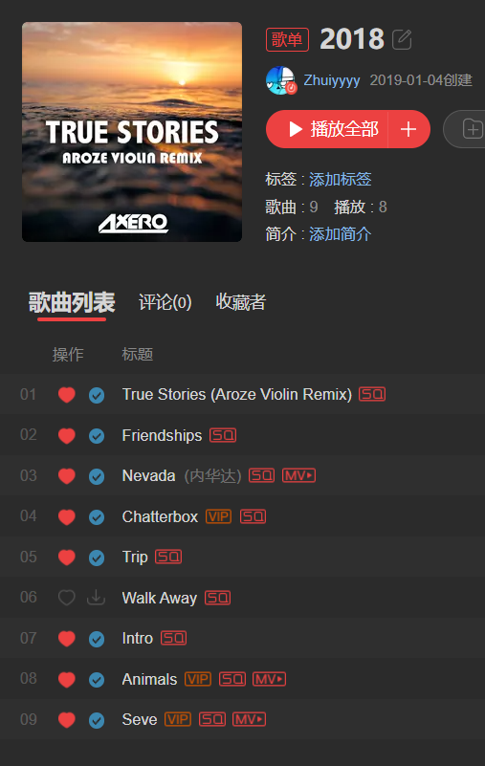
2018年度歌单 1/9
04-Chatterbox

Slide 3
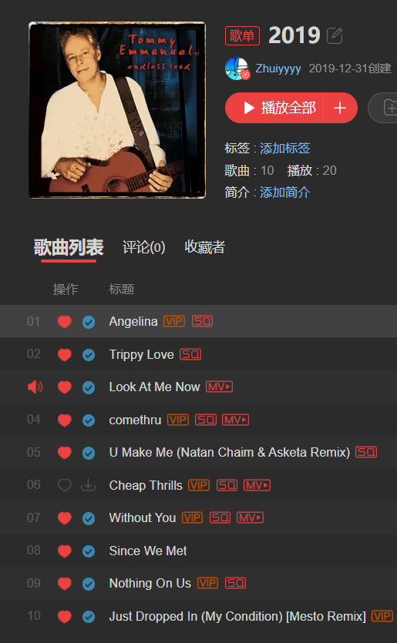
2019年度歌单 6/10
01-Angelina
02-Trippy love
03-Look at Me Now
05-U Make Me (Remix)
08-Since We Met
09-Nothing On Us

Slide 4
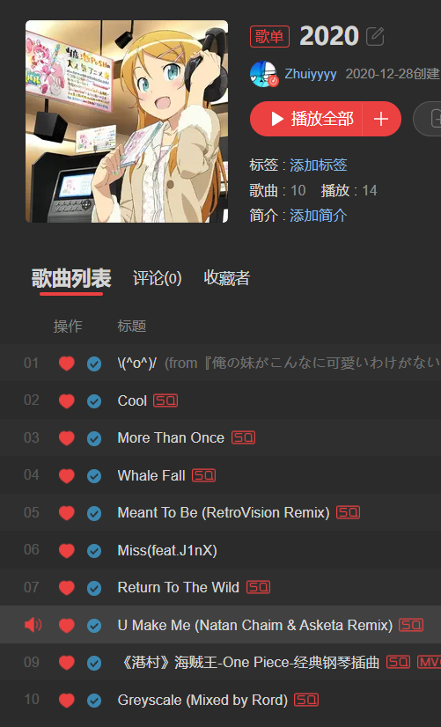
2020年度歌单 8/10
01-\(^o^)/
02-Cool
03-More Than Once
05-Meant To Be (Remix)
07-Return To The Wild
08-U make Me (Remix) 蝉联
09-《港村》
10-Grescale

Slide 5
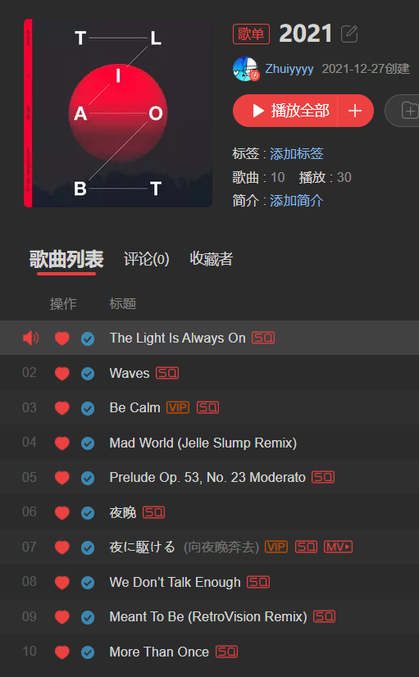
2021年度歌单 8/10
01-The Light Is Always On
02-Waves
03-Be calm
04-Mad World (Remix)
05-Prelude Op. 53, No. 23 Moderato
08-We Don’t Talk Enough
09-Meant To Be (Remix) 蝉联
10-More Than Once 蝉联

Slide 6
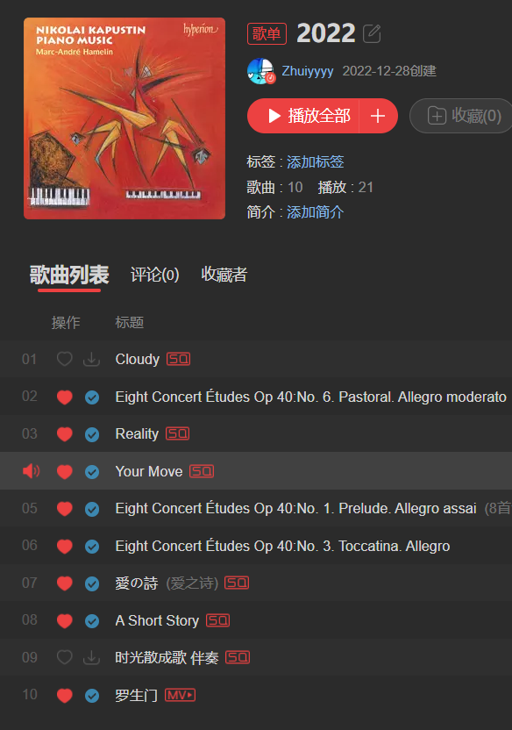
2022年度歌单 8/10
02-Op. 40, No. 6
03-Reality
04-Your Move
05-Op. 40, No. 1
06-Op. 40, No. 3
07-爱の诗
08-A Short Story
10-罗生门

Slide 7
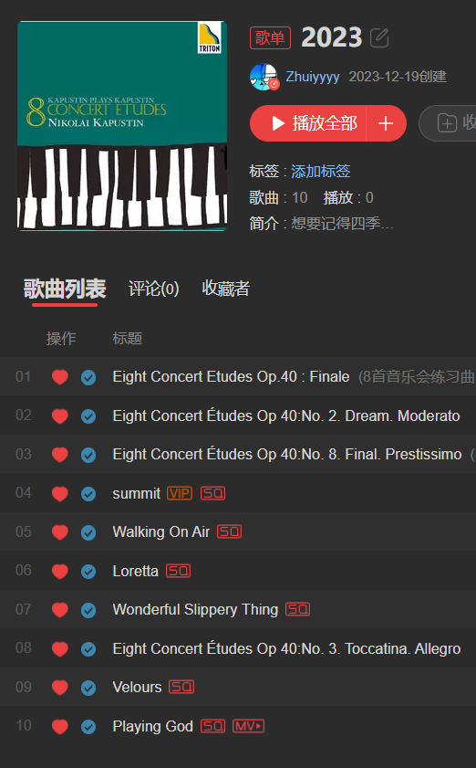
2023年度歌单 9/10
01-Op. 40, No. 8
02-Op. 40, No. 2
03-Op. 40, No. 8
04-summit
06-Loretta
07-Wonderful Slippery Thing
08-Op. 40, No. 3
09-Velours
10-Playing God

Slide 8
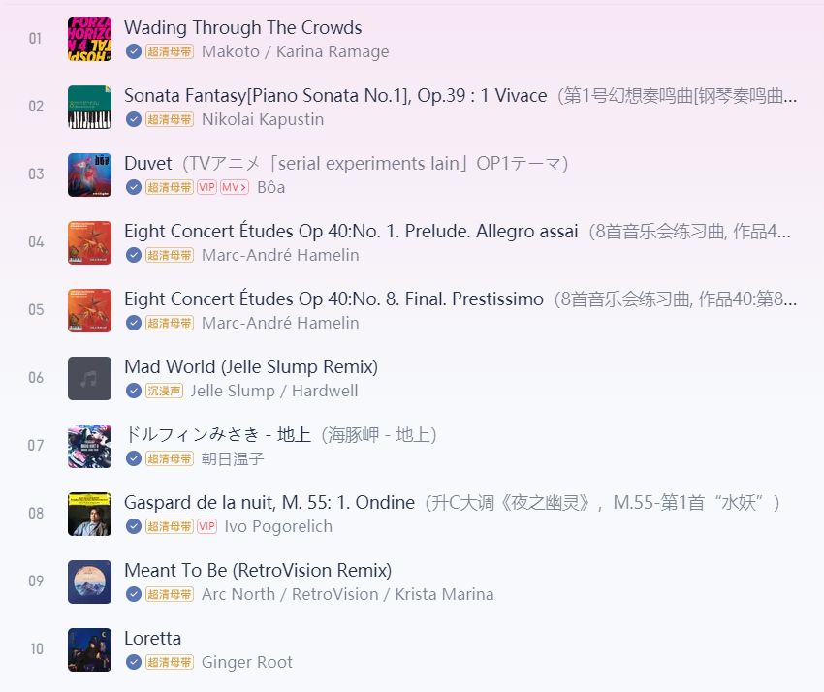
2024年度歌单 10/10
01-Wading Trough The Crowds
02-Op. 39 : 1
03-Duvet
04-Op. 40, No. 1
05-Op. 40, No. 8
06- Mad World (Remix)
07-ドルフィンみさき - 地上
08-M. 55 : 1
09-Meant To Be (Remix)
10-Loretta

Slide 9
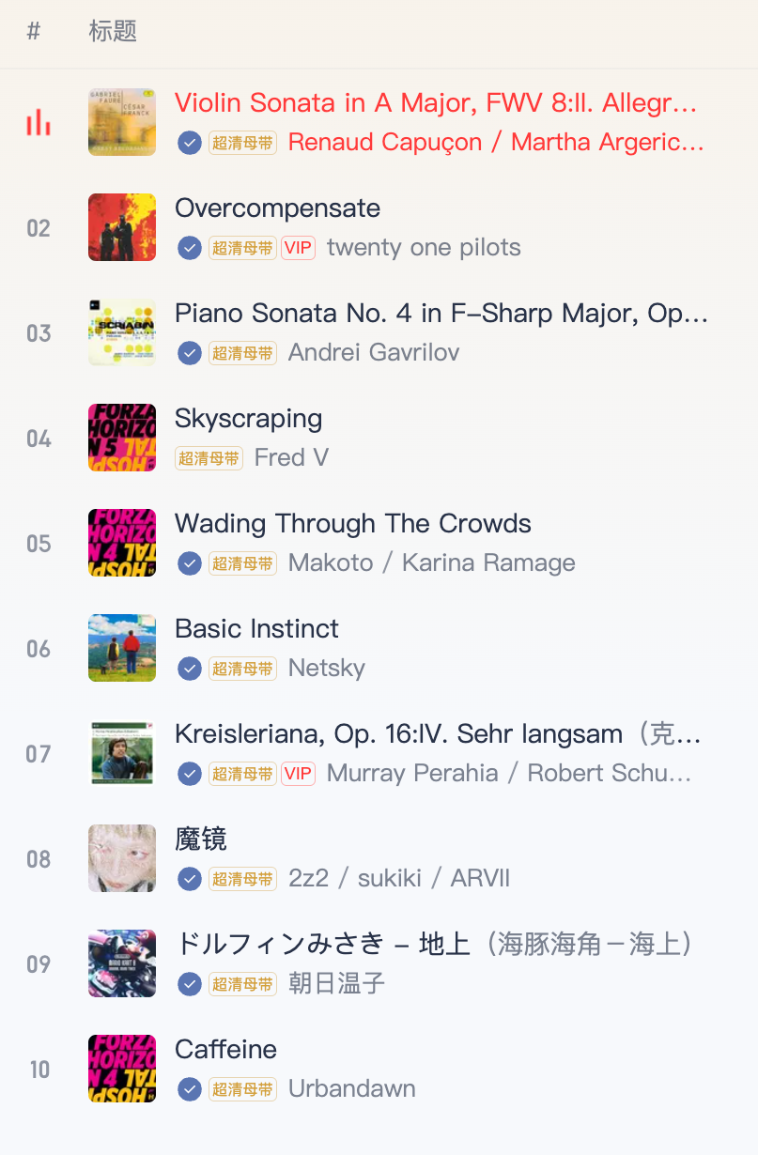
2025年度歌单 10/10
01-Violin Sonata in A Major, FWV 8:II. Allegro
02-Overcompensate
03-Piano Sonata No. 4 in F-Sharp Major, Op. 30
04-Skycraping
05-Wading Through The Crowds 蝉联
06-Basic Instinct
07-Kreisleriana, Op. 16:IV. Sehr langsam
08-魔镜
09-ドルフィンみさき - 地上 蝉联
10-Caffeine

