Slide 1
Cobar SQL Parser 介绍

Slide 2
Select id, member_id from wp_image where member_id = ‘123’
SQL Parser
select
exprList
from
=
id
member_id
wp_image
member_id
‘123’

Slide 3
Select id, member_id from wp_image
where member_id = ‘123’
id | member_id | desc
2 | 123 | …
8 | 123 | …
id | member_id | desc
2 | 123 | …
4 | ath000 | …
5 | ath000 | …
8 | 123 | …
id | member_id | desc
4 | ath000 | …
5 | ath000 | …
Notes:
Parser的目的：为路由提供依据
Confluence上的路由图

Slide 4
Select id, member_id from wp_image
where member_id = ‘123’
select
Parse
exprList
from
=
id
member_id
wp_image
member_id
‘123’
id | member_id | desc
2 | 123 | …
8 | 123 | …
id | member_id | desc
2 | 123 | …
4 | ath000 | …
5 | ath000 | …
8 | 123 | …
id | member_id | desc
4 | ath000 | …
5 | ath000 | …
Notes:
Parser的目的：为路由提供依据
Confluence上的路由图

Slide 5
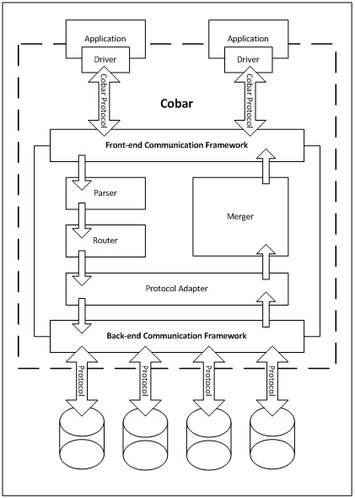
Cobar 1.0.4
中的
SQL Parser
Notes:
Cobar 1.0.4架构，中间标注parser位置

Slide 6
SQL语句支持度有限
select trim(leading ‘ ’ from desc) from tb1 where id = 9
Cobar
SQL Parser
报错
Router
id = 1,4,7,10…
id = 2,5,8,11...
id = 3,6,9,12...

Slide 7
支持不解析SQL
/*!cobar: select, tb1.id=9*/ select
trim(leading ‘ ’ from desc) from tb1 where id = 9
Cobar
SQL Parser
Router
select trim(leading ‘ ’ from desc)
from tb1 where id = 9
id = 1,4,7,10…
id = 2,5,8,11...
id = 3,6,9,12...

Slide 8
缺点
数据拆分不再对用户透明

Slide 9
性能不高
PreparedStatement缓存Parse结果
select * from tb1 where id = ?
select
相同的SQL只解析一次
*
from
=
tb1
id
?
param = 5
第一次执行
param = 7
第二次执行
param = 2
第三次执行
……

Slide 10
问题
Prepared Statement 默认取消
String sql = "select * from t1 where id=?";
PreparedStatement ps = conn.prepareStatement(sql);
ps.setLong(1, 5);
ps.executeQuery();
5.0.4 之后的mysql-jdbc-connector
select * from tb1 where id = 5

Slide 11
解析结果非AST
从SQL中只提取部分信息
select * from tb1 where id = ? and member_id = ?
update tb1 set gmt=? where id in (?,?,?,?)
无法调整sql内容
id: 2,4,6,8
id in (1,2,3,4)
... where id in (1,2,3,4)
cobar
id in (1,2,3,4)
id: 1,3,5,7

Slide 12
Cobar 1.0.* 现有SQL Parser
支持SQL有限
性能不高
部分信息丢失

Slide 13
支持SQL有限
性能不高
部分信息丢失
开发新的 SQL Parser

Slide 14

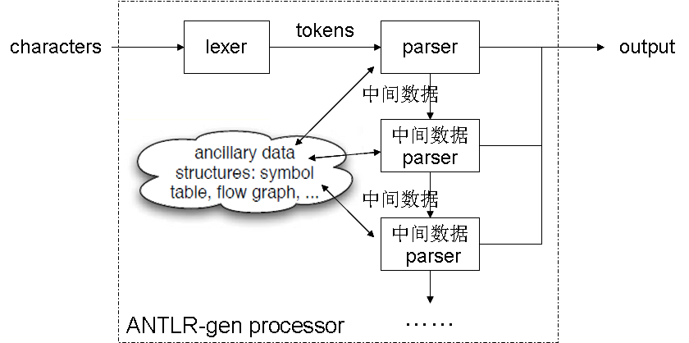
ANTLR调研
ANTLR
Notes:
Antlr调研

Slide 15
手写第一版
AST
Expression Parser
DML Parser
token
token
token
token
……
Lexer
类似ANTLR方式
  LL(*)、递归下降
MySQL 5.5语法
Char Reader
SQL String

Slide 16
手写第一版
AST
Expression Parser
DML Parser
4
性能 倍于1.0.4
……
token
token
token
token
Lexer
类似ANTLR方式
  LL(*)、递归下降
MySQL 5.5语法
Char Reader
SQL String

Slide 17

Druid-SQL
性能优于手写第一版
  14%
功能实现存在较大问题
  一些特性不支持
  语法元素、表达式定义与MySQL标准不符

Slide 18


下一步
Druid-SQL
Parser
手写第一版
Parser
功能改造
最终
Parser
性能调优

Slide 19
手写第二版
Druid
手写第一版
Parser
Parser
Model
Lexer
Model
Lexer
借鉴
复用
借鉴
手写第二版

Slide 20
功能对比
 | 1.0.4 | 手写v1 | Druid | 手写v2
‘don\’t’ | NO | YES | NO | YES
.123e-2 | YES | YES | NO | YES
7Eleven | NO | YES | NO | YES
_latin 0x123 | NO | YES | NO | YES
‘abc’ ‘def’ | NO | YES | YES | YES
INSERT('Quadratic', 3, 4, 'What') | NO | YES | NO | YES
TRIM(LEADING 'x' FROM 'xxxbarxxx') | NO | YES | NO | YES
Union select | YES | YES | NO | YES
table join | PART | PART | PART | YES
…… | ……
Notes:
版本：
1.0.4: http://svn.alibaba-inc.com/repos/ali_cn/commons/amoeba/tags/cobar-1.0.6-r/
Druid: http://code.alibabatech.com/svn/druid/trunk -r 262
手写v2: http://svn.alibaba-inc.com/repos/ali_platform/cobar/app/branches/20110613_1.2.0-dev/ -r 95254

Slide 21
性能对比
 | 1.0.4 | 手写v1 | Druid | 手写v2 | 手写v2 sqlgen
Simple | 25.6 | 1.76 | 3.1 | 0.9
Short | 43.2 | 8.6 | 7.6 | 4.1 | 5.2
Short2 | 63.4 | 17.6 | 15.4 | 9.8
Long | 75.2 | 25.9 | 22.3 | 14.6
Long2 | 94.4 | 35.4 | 31.2 | 22.3
Notes:
单位微秒

Slide 22
simple: "select id from t1“
short: " seLEcT id, member_id , image_path \t , image_size , STATUS, gmt_modified from wp_image wheRe \t\t\n id = ? AND member_id\t=\t-123.456"
short2: "select count(*) from MESSAGE_REC_RECORD where RECEIVER_VACOUNT =? and RECEIVER_ID in ( ? , ? , ? , ? , ? , ? , ? , ? , ? , ? , ? , ? ) and RECEIVER_STATUS in ( ? , ? ) and SPAM_STATUS in ( ? ) and DELETE_STATUS = ?"
long: "select ID, GMT_CREATE, GMT_MODIFIED, INBOX_FOLDER_ID, MESSAGE_ID, FEEDBACK_TYPE, TARGET_ID, TRADE_ID, SUBJECT, SENDER_ID, SENDER_TYPE, S_DISPLAY_NAME, SENDER_STATUS, RECEIVER_ID, RECEIVER_TYPE, R_DISPLAY_NAME, RECEIVER_STATUS, SPAM_STATUS, REPLY_STATUS, ATTACHMENT_STATUS, SENDER_COUNTRY, RECEIVER_COUNTRY,APP_FROM,APP_TO,APP_SOURCE,SENDER_VACOUNT,RECEIVER_VACOUNT, DISTRIBUTE_STATUS,ORG_RECEIVER_ID,CUSTOMER_ID,OPERATOR_ID,OPERATOR_NAME,FOLLOW_STATUS,DELETE_STATUS,FOLLOW_TIME,BATCH_COUNT from MESSAGE_REC_RECORD where RECEIVER_VACOUNT =? and ID = ?"
long2: "select A.ID , A.GMT_CREATE , A.GMT_MODIFIED , A.MESSAGE_ID , A.SENDER_COMPANY_ID, A.SENDER_ID, A.SENDER_IP, A.SENDER_TYPE, A.SENDER_COMPANY , A.SENDER_ADDRESS , A.SENDER_COUNTRY , A.SENDER_ZIP , A.SENDER_PHONE , A.SENDER_FAX , A.SENDER_EMAIL , A.RECEIVER_COMPANY_ID, A.RECEIVER_ID, A.RECEIVER_TYPE, A.RECEIVER_COMPANY , A.RECEIVER_ADDRESS , A.RECEIVER_COUNTRY , A.RECEIVER_ZIP , A.RECEIVER_PHONE , A.RECEIVER_FAX , A.RECEIVER_EMAIL , A.TARGET_ID, A.FEEDBACK_TYPE, A.FEEDBACK_CATEGORY, A.SUBJECT, A.APP_SOURCE , A.ATTACHMENT_IDS , B.REMARK , A.S_DISPLAY_NAME , A.R_DISPLAY_NAME , A.RELATED_FEEDBACK_IDS , A.NOTICE_MESSAGE , B.PROPERTIES, A.APP_FROM,APP_TO,A.SENDER_VACOUNT,A.RECEIVER_VACOUNT from MESSAGE_DETAIL A,MESSAGE_DETAIL_REMARK_PROPERTIES B where A.ID = ? and A.ID = B.ID"

Slide 23
GC对比
 | YGC | YGCT
1.0.4 | 2838 | 0.803
手写v1 | 410 | 0.116
Druid | 397 | 0.090
手写v2 | 229 | 0.057
手写v2+sql生成 | 263 | 0.074

Slide 24
手写第二版内部
功能实现
性能优化

Slide 25
MySQL 5.5 语法结构
SQL语句
Set/Show
Delete
Update
Insert
Replace
Select
语法元素
Call
...
OrderBy
Limit
Table References
表达式
基本元素
Identifier
Keyword
Variable
Literal
Punctuation

Slide 26
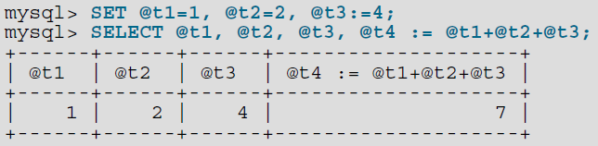
基本元素
Keyword
  227个关键字，不区分大小写
Identifier
  schema、table、column、index、alias 、keyword…
    SELECT aNy FROM t1 WHERE id IN AnY (SELECT id FROM t2)
  `select`、table1 ./*spam*/id、7Up
Punctuation
  ,、:=、>、!、~ …
Variable
  User-Def
  SystemVariable：@@version

Slide 27
基本元素 - Literal
String Literal
  N’abc’、_latin1’abc’、’abc’ ’def’
  ”abc””d”、’abc\’d’
Number Literal
  123、.123、123.、123.e4、.123E-4
  123e4 vs 123e4f
Hex/Bit Literal
  0x89af、x’89af’、0b101011、b’101011’
  _latin1 0x89af

Slide 28
MySQL 5.5 语法结构
SQL语句
Set/Show
Delete
Update
Insert
Replace
Select
语法元素
Call
...
OrderBy
Limit
Table References
表达式
基本元素
Identifier
Keyword
Variable
Literal
Punctuation

Slide 29
语法元素 – Table References
table_references: table_reference {',' table_reference}
table_reference: table_factor {
['INNER'|'CROSS‘] 'JOIN' table_factor [join_condition]
| 'STRAIGHT_JOIN' table_factor ['ON' conditional_expr]
| ('LEFT'|'RIGHT') ['OUTER‘] 'JOIN' table_reference join_condition
| 'NATURAL' [('LEFT'|'RIGHT') ['OUTER‘] ] 'JOIN' table_factor
}
table_factor:
tbl_name [[’AS’] alias] [index_hint_list]
| table_subquery [’AS’] alias
| '(' table_references ')'
join_condition: 'ON' conditional_expr | 'USING' '('column_list')'
index_hint_list: index_hint {index_hint}
index_hint:
'USE' ('INDEX'|'KEY') [ 'FOR' ('JOIN'|'ORDER' 'BY'|'GROUP' 'BY') ] '(' [index_list] ')'
| 'IGNORE' ('INDEX'|'KEY') [ 'FOR' ('JOIN'|'ORDER' 'BY'|'GROUP' 'BY') ] '(' index_list ')'
| 'FORCE' ('INDEX'|'KEY') [ 'FOR' ('JOIN'|'ORDER' 'BY'|'GROUP' 'BY') ] '(' index_list ')'
index_list: index_name {',' index_name}

Slide 30
MySQL不支持的MySQL语法
规则1
table_reference: table_factor 'JOIN' table_factor [join_condition]
table_reference: table_factor 'LEFT' 'JOIN' table_reference join_condition
规则2
tb1
LEFT JOIN
t2
JOIN
t3
USING (id)

Slide 31
MySQL不支持的MySQL语法
规则1
table_reference: table_factor 'JOIN' table_factor [join_condition]
table_reference: table_factor 'LEFT' 'JOIN' table_reference join_condition
规则2
tb1
LEFT JOIN
t2
JOIN
t3
USING (id)
table_factor

Slide 32
MySQL不支持的MySQL语法
规则1
table_reference: table_factor 'JOIN' table_factor [join_condition]
table_reference: table_factor 'LEFT' 'JOIN' table_reference join_condition
规则2
tb1
LEFT JOIN
t2
JOIN
t3
USING (id)
table_factor
table_factor
table_reference
规则2
table_reference

Slide 33
MySQL不支持的MySQL语法
规则1
table_reference: table_factor 'JOIN' table_factor [join_condition]
table_reference: table_factor 'LEFT' 'JOIN' table_reference join_condition
规则2
tb1
LEFT JOIN
t2
JOIN
t3
USING (id)
table_factor
table_factor
table_factor
join_condition
规则1
table_reference
规则2
table_reference

Slide 34
MySQL不支持的MySQL语法
规则1
table_reference: table_factor 'JOIN' table_factor [join_condition]
table_reference: table_factor 'LEFT' 'JOIN' table_reference join_condition
规则2
tb1
LEFT JOIN
t2
JOIN
t3
USING (id)
table_factor
table_factor
table_factor
join_condition
规则1
table_reference
ERROR!
规则2
table_reference

Slide 35
MySQL不支持的MySQL语法
规则1
table_reference: table_factor 'JOIN' table_factor [join_condition]
table_reference: table_factor 'LEFT' 'JOIN' table_reference join_condition
规则2
table_reference
规则2
table_reference
规则1
table_factor
table_factor
table_factor
join_condition
tb1
LEFT JOIN
t2
JOIN
t3
USING (id)
table_factor
table_factor
table_factor
join_condition
规则1
table_reference
ERROR!
规则2
table_reference

Slide 36
MySQL不支持的MySQL语法
规则1
table_reference: table_factor 'JOIN' table_factor [join_condition]
table_reference: table_factor 'LEFT' 'JOIN' table_reference join_condition
规则2
table_reference
规则2
table_reference
规则1
table_factor
table_factor
table_factor
join_condition
tb1
LEFT JOIN
t2
JOIN
t3
USING (id)
table_factor
table_factor
table_factor
join_condition
规则1
table_reference
ERROR!
规则2
table_reference

Slide 37
Table References的表达式特性
table_references: table_reference {',' table_reference}
table_reference : ’(’ table_references ')'
| ’(’ query { ’UNION’ query} ’)’ [’AS’] alias
query : ’(’ query ’)’ | ’SELECT ...’
规则1
规则2
规则2
( ( select ...) UNOIN (select...) ) AS t1
规则1
( ( t1, t2), t3 )
LL(1)
类似于表达式：
expr: ’(’ expr ’)’ | tableRefs | subquery

Slide 38
MySQL 5.5 语法结构
SQL语句
Set/Show
Delete
Update
Insert
Replace
Select
语法元素
Call
...
OrderBy
Limit
Table References
表达式
基本元素
Identifier
Keyword
Variable
Literal
Punctuation

Slide 39
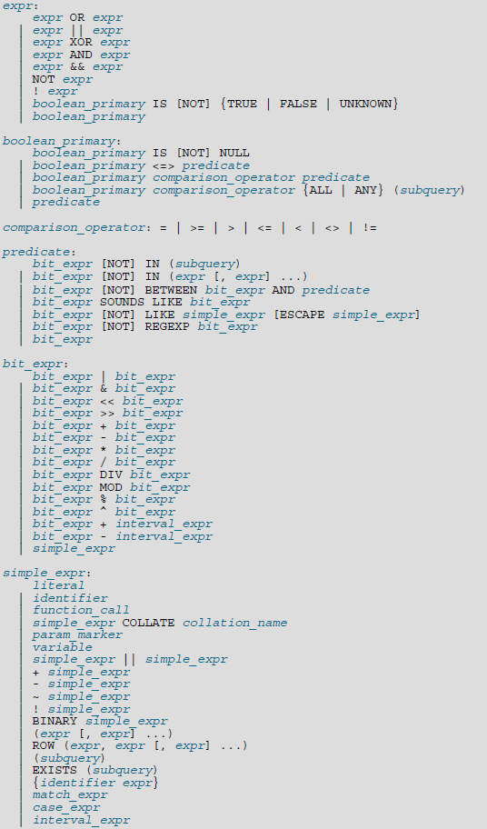
表达式
优先级和结合型
  MySQL Manual文档不精确
  文档+实验
特殊函数
  Keyword作为函数名：23个
    INSERT('Quadratic', 3, 4,
    'What')
  非规则参数列表：13个
    SELECT TRIM(BOTH 'x' FROM 'xxxbarx')
特殊Identifier
  1 >= any + 2
  1 >= any (select …)

Slide 40
MySQL 5.5 语法结构
SQL语句
Set/Show
Delete
Update
Insert
Replace
Select
语法元素
Call
...
OrderBy
Limit
Table References
表达式
基本元素
Identifier
Keyword
Variable
Literal
Punctuation

Slide 41
手写第二版内部
功能实现
性能优化

Slide 42
架构调整
DML Parser
Expression Parser
DML Parser
token
token
token
token
Expression Parser
Lexer
Lexer
token
SQL char[]
Char Reader
SQL String
第二版LL(1)
第一版LL(*)

Slide 43
词法层次
_latin1 0x123
  _latin1 0x123d
’abc’ ’def’
table1/*spam*/. col2
_latin1
0x123
_latin1
0x123d
’abc’
’def’
table1
.
col2

Slide 44
其它
去掉对象化的Token
初始化Lexer
缓存大写ID
建立特殊Identifier的Map
ThreadLocal String’s Buffer
回溯时继续当前指针往下扫描
…

Slide 45
性能对比
 | 1.0.4 | 手写v1 | Druid | 手写v2 | 手写v2 sqlgen
Simple | 25.6 | 1.76 | 3.1 | 0.9
Short | 43.2 | 8.6 | 7.6 | 4.1 | 5.2
Short2 | 63.4 | 17.6 | 15.4 | 9.8
Long | 75.2 | 25.9 | 22.3 | 14.6
Long2 | 94.4 | 35.4 | 31.2 | 22.3
Notes:
simple: "select id from t1"
short: " seLEcT id, member_id , image_path \t , image_size , STATUS, gmt_modified from wp_image wheRe \t\t\n id = ? AND member_id\t=\t-123.456"
short2: "select count(*) from MESSAGE_REC_RECORD where RECEIVER_VACOUNT =? and RECEIVER_ID in ( ? , ? , ? , ? , ? , ? , ? , ? , ? , ? , ? , ? ) and RECEIVER_STATUS in ( ? , ? ) and SPAM_STATUS in ( ? ) and DELETE_STATUS = ?"
long: "select ID, GMT_CREATE, GMT_MODIFIED, INBOX_FOLDER_ID, MESSAGE_ID, FEEDBACK_TYPE, TARGET_ID, TRADE_ID, SUBJECT, SENDER_ID, SENDER_TYPE, S_DISPLAY_NAME, SENDER_STATUS, RECEIVER_ID, RECEIVER_TYPE, R_DISPLAY_NAME, RECEIVER_STATUS, SPAM_STATUS, REPLY_STATUS, ATTACHMENT_STATUS, SENDER_COUNTRY, RECEIVER_COUNTRY,APP_FROM,APP_TO,APP_SOURCE,SENDER_VACOUNT,RECEIVER_VACOUNT, DISTRIBUTE_STATUS,ORG_RECEIVER_ID,CUSTOMER_ID,OPERATOR_ID,OPERATOR_NAME,FOLLOW_STATUS,DELETE_STATUS,FOLLOW_TIME,BATCH_COUNT from MESSAGE_REC_RECORD where RECEIVER_VACOUNT =? and ID = ?"
long2: "select A.ID , A.GMT_CREATE , A.GMT_MODIFIED , A.MESSAGE_ID , A.SENDER_COMPANY_ID, A.SENDER_ID, A.SENDER_IP, A.SENDER_TYPE, A.SENDER_COMPANY , A.SENDER_ADDRESS , A.SENDER_COUNTRY , A.SENDER_ZIP , A.SENDER_PHONE , A.SENDER_FAX , A.SENDER_EMAIL , A.RECEIVER_COMPANY_ID, A.RECEIVER_ID, A.RECEIVER_TYPE, A.RECEIVER_COMPANY , A.RECEIVER_ADDRESS , A.RECEIVER_COUNTRY , A.RECEIVER_ZIP , A.RECEIVER_PHONE , A.RECEIVER_FAX , A.RECEIVER_EMAIL , A.TARGET_ID, A.FEEDBACK_TYPE, A.FEEDBACK_CATEGORY, A.SUBJECT, A.APP_SOURCE , A.ATTACHMENT_IDS , B.REMARK , A.S_DISPLAY_NAME , A.R_DISPLAY_NAME , A.RELATED_FEEDBACK_IDS , A.NOTICE_MESSAGE , B.PROPERTIES, A.APP_FROM,APP_TO,A.SENDER_VACOUNT,A.RECEIVER_VACOUNT from MESSAGE_DETAIL A,MESSAGE_DETAIL_REMARK_PROPERTIES B where A.ID = ? and A.ID = B.ID"

