Slide 1
HF-HappyFitting
Yi Rong, Zhenyang Guo, Zipei Chen

Slide 2
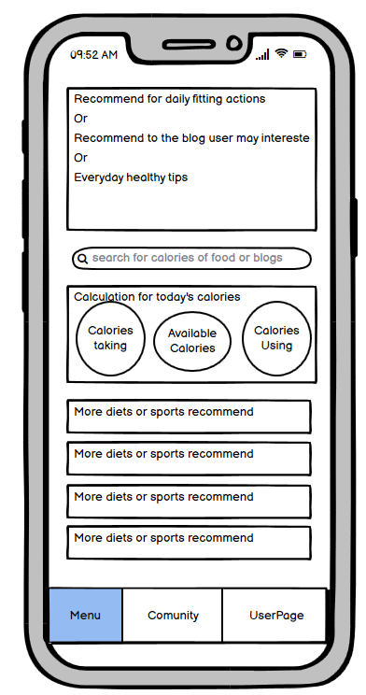
Concept & Image
Tells user the calories for your food
Makes people healthier
Aid software for pro
Community for common interests

Slide 3
Key Functional Requirements
Phone number verifying
Community
Menu
Healthy tips
User information tracking
Recommend courses

Slide 4
Key Non-Functional Requirements
Clear and organized UI
Speed
Scientific and high-performance algorithm
Larger database
Better algorithms

Slide 5
Use cases & Diagram

Slide 6
Login process
<include>
<include>
Customer
New account creating
User info
Entering
Verifying
Phone number
Login
<<include>>
Verify
Password
Display
Login Error
Forgot
Passowrd
<include>
<<include>>
Set new
Password
Verifying
Phone number

Slide 7
Community Forum
Set Personal
Info
Customer
Community
Forum
View Tracking date

Slide 8
User Page
Community
Forum
Customer
Menu
Create
New topic
Leave
Comments

Slide 9
Healthy tips appear during loading
<include>
Healthy
Tips appear
Customer
Loading

Slide 10
Fitness courses & Data tracking
<include>
Physical
Activities
Info tracking
Customer
Fitness
Courses
Menu

Slide 11
Courses Recommend
User
Page
User info
Fill in
Course
Recommend
Customer

Slide 12
System Constraints
Language: Java
Platform: Android
Budget & Schedule: Need money for building database & propagate the software
Miscellaneous: Deadline of the project

Slide 13
Thank you for listening

