Slide 1
HF-HappyFitting
Yi Rong, Zhenyang Guo, Zipei Chen

Slide 2
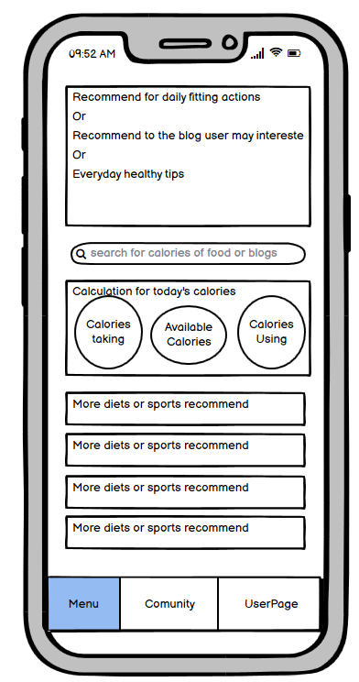
Concept & Image
Tells user the calories for your food
Makes people healthier
Aid software for pro
Community for common interests

Slide 3
Key Functional Requirements
Login Process
Menu
Community
User Page

Slide 4
Key Functional Requirements
Healthy tips
During the initialization loading, there would appear some healthy tips
User information tracking
1. tracking the exercise length after users start lessons
2. computing the calorie consumptions based on the type physical activities.
3.store these information in the database

Slide 5
Key Non-Functional Requirements
Clear and organized UI
Speed
Scientific and high-performance algorithm
Larger database
Better algorithms

Slide 6
System Constraints
Language: Java
Platform: Android
Budget & Schedule: Need money for building database & propagate the software
Miscellaneous: Deadline of the project

Slide 7
Thank you for listening

Slide 8
Login process
<include>
<include>
Customer
New account creating
Verifying
Phone number
User info
Entering
Login
<<include>>
Verify
Password
Display
Login Error
Forgot
Password
<include>
<<include>>
Verifying
Phone number
Set new
Password
Back

Slide 9
Menu
<include>
Physical
Activities
Info tracking
Customer
Fitness
Courses
Menu
Calorie
Calculator
Searching
<include>
Calories Info
<include>
Related Courses
Back

Slide 10
Community Forum
Login Process
Community
Forum
Customer
Create
New topic
View articles
& comments
Back

Slide 11
User Page
Login
User
Page
Customer
User info
Fill in
Course
Recommend
Back

