Slide 1

Targeted MLE for Variable Importance and Causal Effect with
Clinical Trial and
Observational Data
Mark van der Laan
works.bepress.com/mark_van_der_laan
Division of Biostatistics,
University of California, Berkeley

Slide 2
Outline
Standard approaches for variable importance
Novel general targeted Maximum Likelihood approach to estimation
Clinical trial data
  Standard approach
  Alternative: T-MLE
  Example: Clinical Sepsis Trial (FDA collaboration)
Observational data
  Point treatment
  Longitudinal treatment
  Example: Treatment of resistant HIV-infection

Slide 3
If Scientific Goal . . .
Predict phenotype from genotype
of the HIV virus
. . .Super Learner!
If Scientific Goal . . .
For HIV-positive patient, determine importance of genetic mutations on treatment response
. . .Variable Importance!

Slide 4
Analytic approach
Standard approach:
  Fit a single multivariable regression E(Y|A,W)
    i.e. Regress clinical response on treatment, confoudners
Is this the best approach for answering the scientific question of interest?
What is the scientific question?
  Construct best predictor vs.
  Estimate importance of each mutation

Slide 5
Prediction vs. Importance
Prediction – create a model that the clinician will use to help predict risk of a disease for the patient.
Importance – trying to investigate the causal association of a treatment or risk factor (biomarker) and a disease outcome.

Slide 6
Variable Importance for Biomarker Discovery
Variable Importance for discrete A:
  Ψ(a) =E(Y₁)-E(Y₀) =E[E(Y|A=a,W)-E(Y|A=0,W)]
  Nonparametric model.
Variable Importance for general A (discrete and continuous) based on semiparametric regression model:
E(Y|A=a,W)-E(Y|A=0,W)]=m(A,W|β)

Slide 7
Biomarker Discovery
Standard approach:
-- Univariate unadjusted regression.
  Fit a single multivariable (MV) regression E(Y|A,W)
    i.e. Regress clinical response on treatment, confounders
  Variable coefficient interpreted as importance measure
Notes:
Please, correct dash.

Slide 8

Biomarker Discovery
randomForest (Breiman (1996,1999))
  Classification and Regression tree-based algorithm
  Bootstrap aggregation of trees with Cross-Validation to assess misclassification rates
  Variable values are permuted. Importance is a measure of the effect this permuting has on the misclassification rate average over all trees

Slide 9
Limitations of MV regression
Requires assuming a model on E(Y|A,W)
High-dimensional → model will be wrong
  Misspecification of model →
  Bias in estimates of parameter of interest
    Ex: E(Y|A,W)= m(A,W|β) + γ(W)
    Even misspecification of γ(W) can bias estimates of β (and thus of parameter of interest)
  Under null hypothesis, as N→∞, will falsely reject null with Pr→1

Slide 10
Illustration: False Rejection of Null
Data Generation- A has no effect on Y
  n= 1000; W= N(0,1);
  p= 1/(1+exp(-2*W)); A= Binomial(p);
  Y= W³ + N(0,1)
Parameter of Interest= Variable Importance of A
True ψ =E(E(Y|A=1,W)-E(Y|A=0,W)) =0
Standard Linear Regression
  Assume model E(Y|A,W)=β₀+ β₁A+ β₂AW+ β₃W
    β₀= 0.3 (p<0.01) β₁= 0.2 (p=0.02)
    β₂= -1.3 (p<0.01) β₃= 2.3 (p<0.01)
  Yields estimate of ψ = 0.3
Notes:
P-values foe each

Slide 11
Simulation Result: Misspecification Results in Biased Effect Estimate
Data Generation
  n= 1000; W= N(0,1);
  p= 1/(1+exp(-2*W)); A= Binomial(p);
  Y= A+AW+W³
Parameter of Interest= Variable Importance of A
True ψ =E(E(Y|A=1,W)-E(Y|A=0,W)) =1
Standard Linear Regression
  Assume model E(Y|A,W)=β₀+ β₁A+ β₂AW+ β₃W
    β₀= 0.8 (p<0.01) β₁= -0.5 (p=0.02)
    β₂= 3.6 (p<0.01) β₃= 1.0 (p<0.01)
  Yields estimate of ψ = -0.5
Notes:
P values for each

Slide 12
More Limitations of MV regression
What about model selection on E(Y|A,W)?
Best bias-variance tradeoff for E(Y|A,W) is wrong bias-variance tradeoff for parameter of interest
How to do Inference?

Slide 13
Limitations of Random Forest
Drawbacks for Variable Importance
Resulting predictor set is high-dimensional, resulting in incorrect bias-variance trade-off for individual variable importance measure (E[Y|A,W])
  Seeks to estimate the entire model, including all covariates
  Does not target the variable of interest
  Final set of variable importance measures may not include covariate of interest
Variable Importance measure lacks interpretability
No formal Inference (p-values) available for variable importance measures

Slide 14
Targeted Maximum Likelihood
MLE- aims to do good job of estimating whole density
Targeted MLE- aims to do good job at parameter of interest
  General decrease in bias for parameter of Interest
  Fewer false positives
  Honest p-values, inference, multiple testing

Slide 15
Philosophy of Targeted Estimator
^
Given initial P-estimator, find updated P* in the model which gives:
Large bias reduction for parameter of interest (target feature)
  E.g. by requiring that it solves the efficient influence curve equation ∑_{i=1}D*(P)(O_{i})=0.
Small increase of log-likelihood relative to the initial P estimator
Targeted log-likelihood loss -log p* can be used for selection.

Slide 16
Targeted Maximum Likelihood
Estimation Flow Chart
Inputs
The model is a set of possible probability distributions
of the data
Initial P-estimator of the
probability distribution of the data: P
ˆ
Model
ˆ
ˆ
User Dataset
P
P*
Targeted P-estimator of the
probability distribution
of the data
O(1), O(2),
… O(n)
P
Observations
_{TRUE}
True probability distribution
Target feature map: Ψ( )
Ψ(P_{TRUE})
Initial feature estimator
ˆ
ˆ
Ψ(P)
Ψ(P*)
Targeted feature estimator
Target feature values
True value
of the target feature
Target Feature
better estimates are closer to ψ(P_{TRUE})

Slide 17
Iterative Targeted MLE
Identify optimal strategy for “stretching” initial P
  Small “stretch” -> maximum change in target
Given strategy, identify optimum amount of stretch by MLE
Apply optimal stretch to P using optimal stretching function -> 1st-step targeted maximum likelihood estimator
Repeat until the incremental “stretch” is zero
  Some important cases: 1 step to convergence
Final probability distribution solves efficient influence curve equation
Iterative T-MLE: double robust & locally efficient
^

Slide 18
Iterative targeted MLE to estimate a median
ˆ
Starting with the initial P-estimator P, determine optimal “stretching function” and “amount of stretch”, producing a new P-estimator.
Continue repeating until further stretching is essentially zero
ˆ
ˆ
ˆ
ˆ
ˆ
ˆ
ˆ
p – density of P – initial P estimator
ˆ
p₁
ˆ
p₂
p_{TRUE}
actual
probability
distribution
function
…
ˆ
p_{k-1}
ˆ
ˆ
p_{k} = density of P* – targeted P estimator
0
20
0
10
40
Survival time
Median for P_{TRUE}

Slide 19
Technical Intermezzo to Explain Targeted MLE
Motivation of targeted learning
Relation with estimating function based learning (e.g. double robust IPCW estimation, van der Laan, Robins, 2002)
Advantages of Targeted MLE relative to estimating function based estimation.

Slide 20
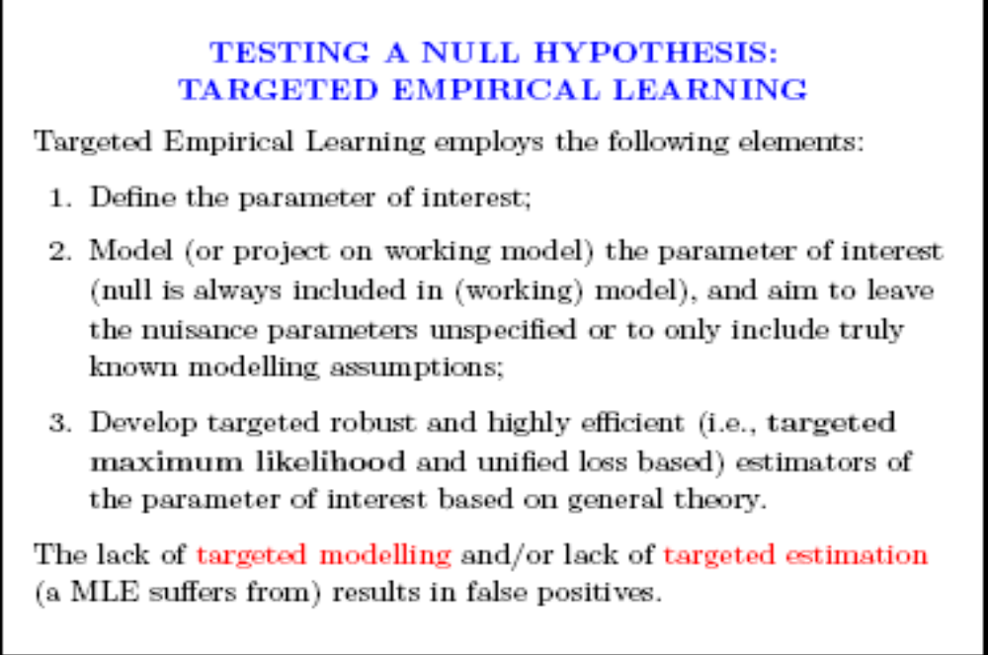

Slide 21
Let D(p) be the efficient influence curve for the parameter of interest at density p in the model.
Locally (double robust) efficient estimation can be based on the estimating function derived from D(p)
(see van der Laan, Robins, 2002, Springer, for the general estimating function based methodology)

Slide 22
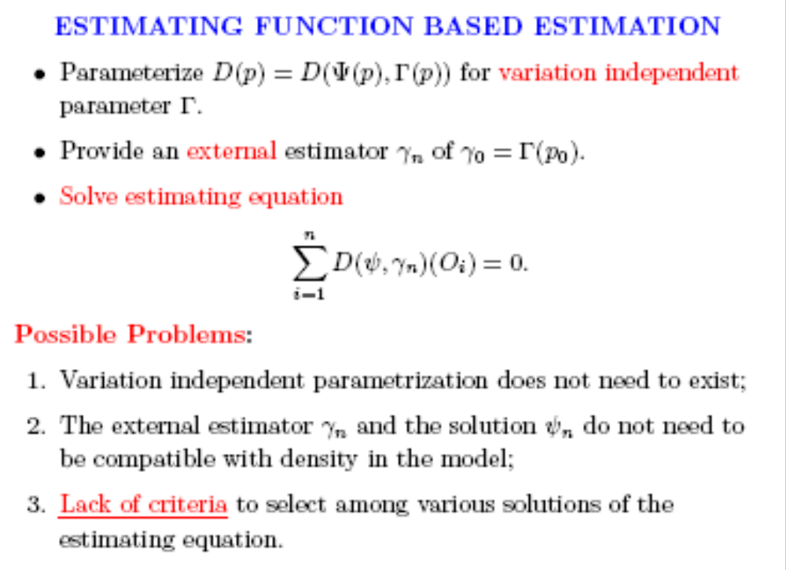

Slide 23
These problems with estimating function based estimation are completely addressed by targeted MLE.
Targeted MLE naturally allows for data adaptive targeted selection of choices such as the working model, and, as a consequence, also generalizes to non-pathwise differentiable parameters, as shown in van der Laan, Rubin (2006)

Slide 24
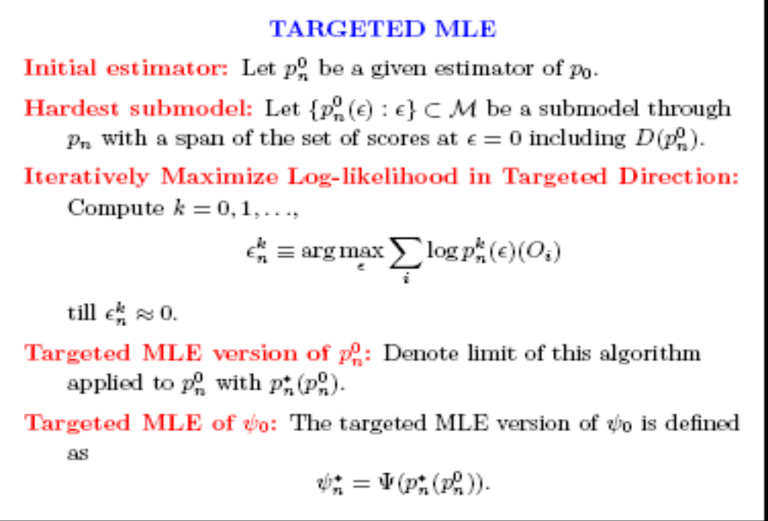

Slide 25
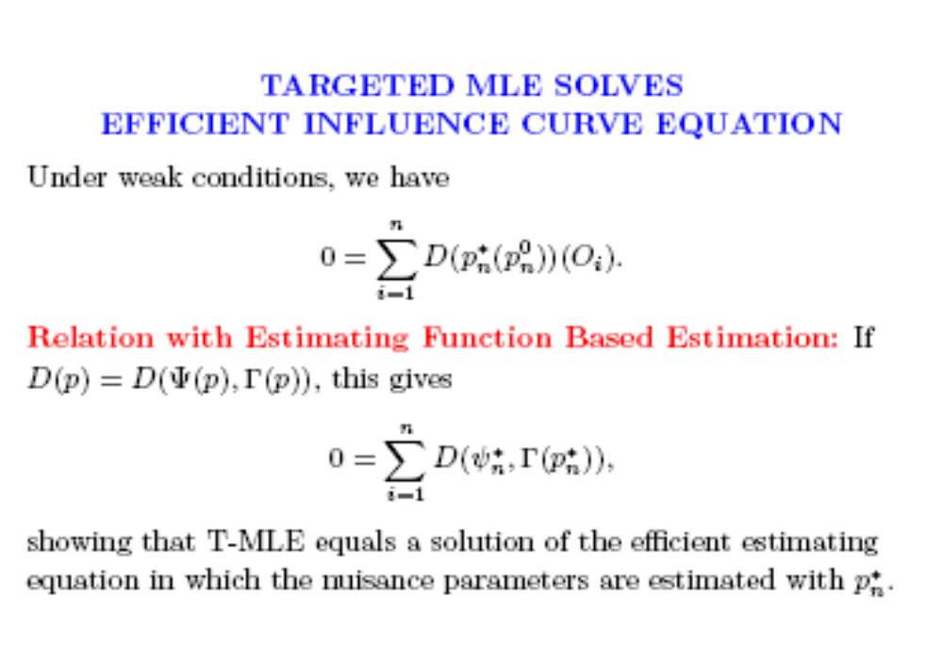

Slide 26
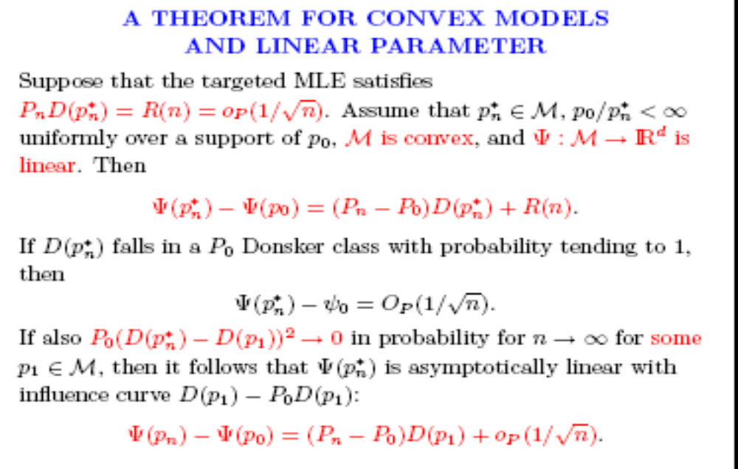

Slide 27
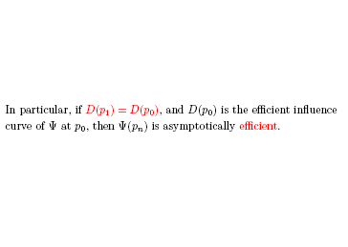

Slide 28
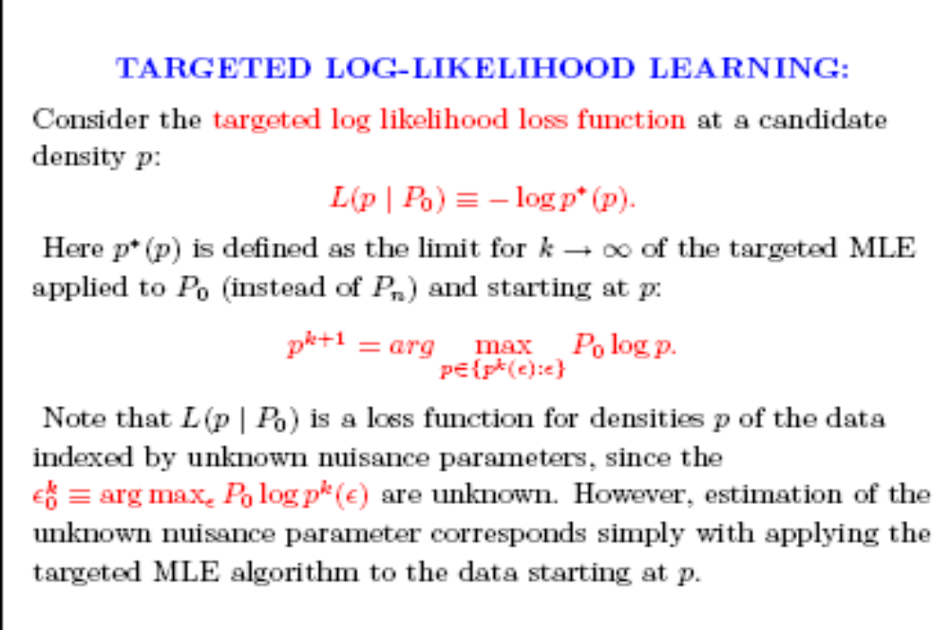

Slide 29
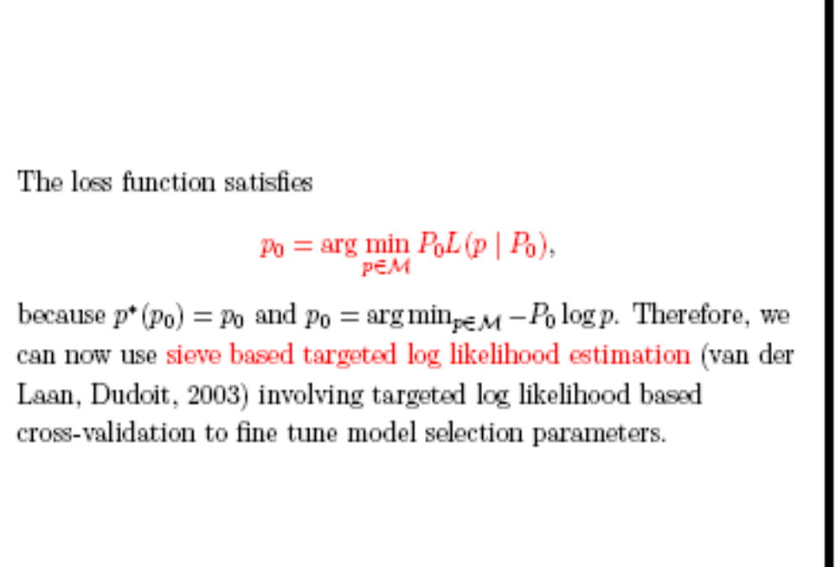

Slide 30
Example: tMLE applied to Clinical Trial Data
Impact of Treatment on Disease

Slide 31
Clinical Trial Data
Treatment (A) is randomized
Standard approach:
  Compare mean outcome (Y) in two treatment groups: E(Y|A=1) vs. E(Y|A=0)
  Bias due to misspecification not a problem (typically, only assume randomization)
Low power -> large sample sizes often needed to detect effect

Slide 32
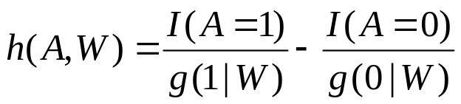
Targeted (T-MLE) Approach to Analyzing Randomized Trials
Measure additional predictors of outcome: W
Regress Y on A, W and add h(A,W) (also Robins)
  Then average regression over W for fixed treatment a: E_{n}Y_{a}
Take difference: E_{n}Y₁-E_{n}Y₀
Makes no model assumptions beyond randomization
  As with standard approach
By including covariates W that are strong predictors of Y, reduce variability
Smaller sample sizes needed to detect effect

Slide 33
Simulation Result: T-MLE Improves Efficiency in Randomized Trial
Data Generation- A is randomized
  W₁= N(2,2); W₂=Uniform(3,8); A=Binomial(p=0.5);
  P(Y=1|A,W) = 1/(1+exp(-(1.2A-5W₁²+2W₂)))
  Simulation run 5000 times for each sample size
 | N=50 | N=100 | N=250 | N=500 | N=1000
Unadjusted MSE | 1.80E-02 | 9.20E-03 | 3.70E-03 | 2.00E-03 | 8.90E-04
Prop. H₀ rejected | 0.06 | 0.06 | 0.07 | 0.09 | 0.10
Targeted MLE Relative MSE | 3.5 | 6.7 | 11.3 | 13.3 | 13.0
Prop. H₀ rejected | 0.09 | 0.11 | 0.27 | 0.42 | 0.68
Notes:
W1= uniform (0,2) – replace kelly simulation 3

Slide 34
Example: Sepsis Analysis
Outcome Y: survival (0/1) at 28 days
Treatment A: placebo (0), drug(1)
Baseline covariates W: Age, sex, ethnicity, etc.
Estimate risk difference (RD) in survival at 28 days between treated and placebo groups
  Parameter of Interest: E(Y₁)-E(Y₀) =E[E(Y|A=1,W)-E(Y|A=0,W)]
    P(Y = 1|A = 1) = 0.715, P(Y = 1|A = 0) = 0.680
 | Survival
 | Died (0) | Survived(1)
Treatment
Placebo (0) | 337 | 717
Test Drug (1) | 306 | 766
Notes:
W1= uniform (0,2) – replace kelly simulation 3

Slide 35
Example: Sepsis Analysis
Estimate risk difference (RD) and relative risk (RR) in survival at 28 days between treated and placebo groups
  Parameters of Interest:
  RD=E(Y₁)-E(Y₀) =E[E(Y|A=1,W)-E(Y|A=0,W)]
  RR=E(Y₁)/E(Y₀) =E[E(Y|A=1,W)]/E[E(Y|A=0,W)]

Slide 36
Example: Unadjusted Estimates
        Results not significant at 0.05 level…drug not approved
Estimator | Estimate | p-value (SE)
RD | 0.034 | 0.085 (0.019)
RR | 1.05 | 0.085 (0.020)

Slide 37
Example: Adjusted Analysis
By using covariates W that are strong predictors of Y, we can reduce variability (improve efficiency)
Data consist of 175 baseline covariates (including dummy variables)
  38 associated (with outcome) baseline covariates with FDR adjusted p-values < 0.01

Slide 38
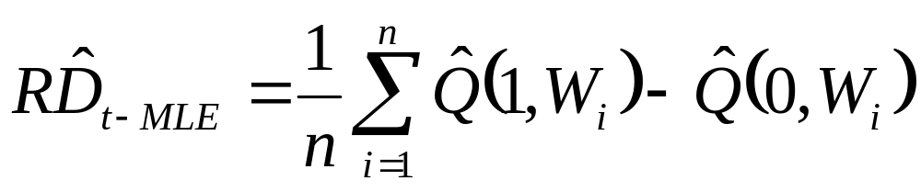
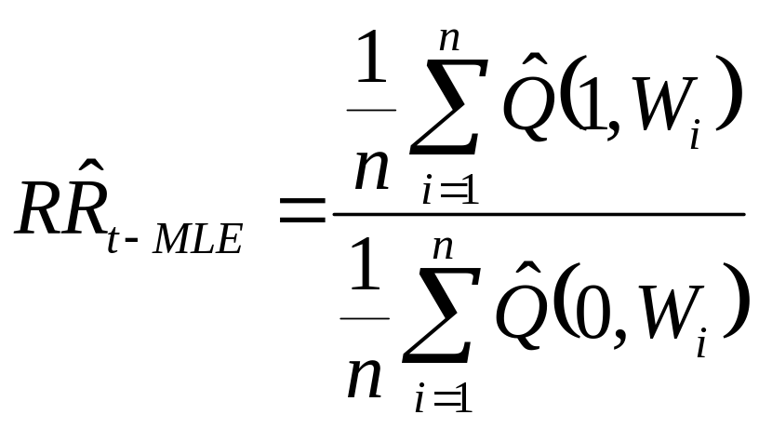
Example: adjusted (t-MLE)
Targeted MLE involves estimating Q(A,W), in this example it is the logistic regression of Y on A and W
t-MLE estimates:

Slide 39
Example: Adjusted (t-MLE)
Estimate Q(A,W) using 3 methods:
  All 38 associated covariates in main term only model
  Single most associated covariate as main term only
  Backwards Deletion main term only model based on cross-validated R² using 38 covariates as candidates

Slide 40
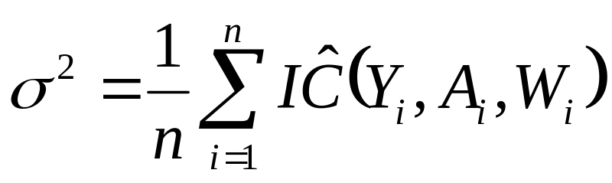
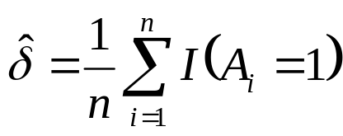
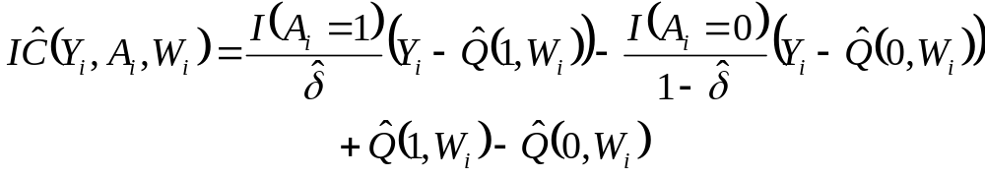
Example: Adjusted (t-MLE)
Variance estimate for Adjusted Estimates based on Influence Curve:
where with for RD estimator:

Slide 41
Example: Adjusted (t-MLE)
 | Unadjusted | Single Covariate | Backwards Deletion | All Associated Covariates
RD
Estimate | 0.034 | 0.035 | 0.043 | 0.046
p-value (RE) | 0.085 (1.000) | 0.043 (1.137) | 0.009 (1.202) | 0.004 (1.209)
RR
Estimate | 1.05 | 1.051 | 1.063 | 1.068
p-value (RE) | 0.085 (1.000) | 0.043 (1.137) | 0.009 (1.205) | 0.004 (1.211)

Slide 42
Summary (1)
Targeted approach improves efficiency
  Measure strong predictors of outcome in clinical trial
Implications
  Improved power for clinical trials
  Smaller sample sizes needed
  Possible to employ earlier stopping rules
  Less need for homogeneity in sample
    More representative sampling
    Expanded opportunities for subgroup analyses

Slide 43
(Post-Market Data)
Observational Studies

Slide 44
Analysis of Observational Data
Treatment not randomized
  Need to control for confounding by covariates (W) to estimate causal effect
  Assume no unmeasured confounders
(W sufficient to control for confounding)
Standard approach:
  Fit a single multivariable regression E(Y|A,W)
  i.e. Regress clinical response on treatment, confounders

Slide 45
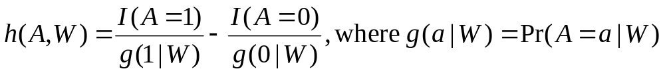
Targeted Maximum Likelihood
Implementation just involves adding a covariate h(A,W) to the regression model
Requires estimating g(A|W)
  E.g. probability of treatment given confounders
Robust: Estimate is consistent if either
  g(A|W) is estimated consistently
  E(Y|A,W) is estimated consistently

Slide 46
Summary (2)
Estimating causal effects from non-randomized data requires controlling for confounders
Under standard approaches, model misspecification can lead to bias
Targeted -MLE
  General decrease in bias
  Fewer false positives

Slide 47
Example: Biomarker Discovery
HIV resistance mutations

Slide 48
Biomarker Discovery: HIV resistance mutations
Goal: Rank a set of genetic mutations based on their importance for determining an outcome
  Mutations (A) in the HIV protease enzyme
    Measured by sequencing
  Outcome (Y) = change in viral load 12 weeks after starting new regimen containing saquinavir
How important is each mutation for viral resistance to this specific protease inhibitor drug?
  Inform genotypic scoring systems
Notes:
Saquinair is wrong, email maya or oliver for change.

Slide 49
Stanford Drug Resistance Database
All Treatment Change Episodes (TCEs) in the Stanford Drug Resistance Database
  Patients drawn from 16 clinics in Northern CA
333 patients on saquinavir regimen
Baseline
Viral Load
Final
Viral Load
<24 weeks
12 weeks
TCE (Change >= 1 Drug)
Change in Regimen
Table 2: LPV

Slide 50
Parameter of Interest
Need to control for a range of other covariates W
  Include: past treatment history, baseline clinical characteristics, non-protease mutations, other drugs in regimen
Parameter of Interest: Variable Importance
ψ = E[E(Y|A_{j}=1,W)-E(Y|A_{j}=0,W)]
  For each protease mutation (indexed by j)

Slide 51
Parameter of Interest
If assume no unmeasured confounders
(W sufficient to control for confounding)
Causal Effect is same as W-adjusted Variable Importance
  E(Y₁)-E(Y₀)=E[E(Y|A=1,W)-E(Y|A=0,W)]= ψ
  Same advantages to T-MLE

Slide 52
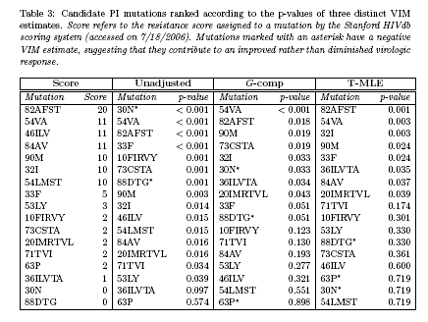

Slide 53
Example # 1: Mutation Rankings Based on Variable Importance
Current Score | Mutation | VIM | VIM p-value | Crude | Crude p-value
35 | 90M | 0.70 | 0.00 | 0.76 | 0.00
40 | 48VM | 0.79 | 0.00 | 1.07 | 0.00
0 | 30N | -0.78 | 0.00 | -1.06 | 0.00
10 | 82AFST | 0.46 | 0.01 | 0.35 | 0.03
10 | 54VA | 0.46 | 0.01 | 0.31 | 0.11
10 | 73CSTA | 0.67 | 0.03 | 0.80 | 0.00
2 | 20IMRTVL | 0.32 | 0.07 | 0.26 | 0.18
1 | 36ILVTA | 0.28 | 0.10 | 0.27 | 0.12
2 | 10FIRVY | 0.27 | 0.13 | 0.48 | 0.00
5 | 88DTG | -0.23 | 0.24 | -0.50 | 0.33
2 | 71TVI | 0.18 | 0.29 | 0.14 | 0.37
5 | 32I | -0.18 | 0.58 | -0.20 | 0.55
2 | 63P | 0.06 | 0.77 | 0.11 | 0.56
5 | 46ILV | 0.13 | 0.98 | 0.27 | 0.10
Notes:
Cut crude here?
adjusted for multiple testing; excluding those mutations with ETA violations
ranked by VIM p-value
Note- 30N only strange one- some evidence that is indeed protective

Slide 54
Summary (3)
Targeted approaches (targeted marginal structural model combined with IPTW or T-MLE estimation) can provide effect estimates in settings where
  Randomization is not feasible
  Standard approaches do not permit control of confounding

Slide 55

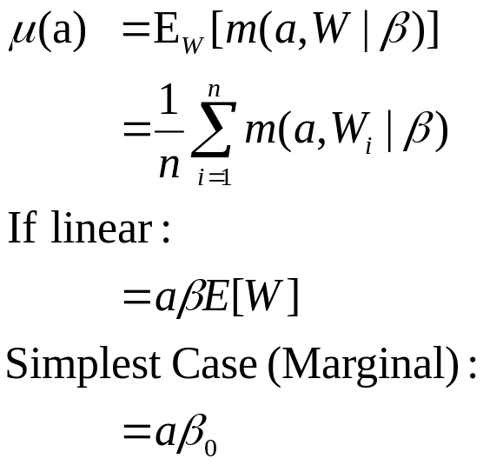
Model-based Variable Importance
When the variable of interest (A) is continuous
  - Given Observed Data: O=(A,W,Y)~P_{o}
W*={possible biomarkers, demographics, etc..}
A=W*_{j} (current biomarker of interest)
W=W*_{-j}
- Measure of Importance:
→

Slide 56
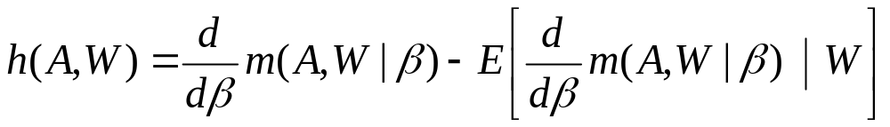

Targeted Maximum Likelihood
Implementation just involves adding a covariate h(A,W) to the regression model
  When m(A,W|β) is linear
Requires estimating E(A|W)
  E.g. Expected value of A given confounders W
Robust: Estimate is consistent if either
  g(A|W) is estimated consistently
  E(Y|A,W) is estimated consistently

Slide 57
Model-based Variable Importance
Basic Inputs
Model specifying only terms including the variable of interest
  i.e. m(A,V|b)=a*(b^{T}V)
Nuisance Parameters
E[A|W] treatment mechanism
(confounding covariates on treatment)
E[ treatment | gene expression, gender, age, etc. . .]
E[Y|A,W] Initial model attempt on Y given all covariates W
(output from linear regression, Random Forest, etc. . .)
E[ tumor response | treatment, gene expression, gender, age, etc. . .]
Robust Method: Takes a non-robust E[Y|A,W] and accounting for treatment mechanism E[A|W] produces consistent estimator given
g(A|W) is estimated consistently
  E(Y|A,W) is estimated consistently
Method will perform the same as the non-robust method or better
Targeted MLE uses MLE → model selection methods are applicable

Slide 58
V-modified Variable Importance
Goal: Identify Biomarkers which modify treatment
  Given Observed Data: O=(A,W,Y)~P_{o}
W*={possible biomarkers, demographics, etc..}
V=W*_{j} (current biomarker of interest)
A=treatment
W=W*_{-j}
- Parameter of Interest

Slide 59
RECALL ETA

Slide 60
Closing Remarks
Variable Importance vs. Prediction
  Different scientific questions
  Different analytic methods appropriate
  If no unmeasured confounding,
  Variable Importance = Causal Effect
Targeted MLE is alternative approach to estimating variable importance
  General decrease in bias
  Protection under the null; fewer false positives
Notes:
skip

Slide 61
Closing Remarks
Targeted MLE fully exploits covariate information in (sequentially) randomized trials, while still being fully robust (as an unadjusted analysis).
Robust causal inference methods are available to analyze sequentially randomized trials.
Causal effect models with corresponding targeted estimators (t-MLE/IPTW) can be effectively used to assess effects (e.g. safety analysis) in post market data analysis taking into account confounding and informative censoring.
Bias due to lack of experimentation in data needs to be established in observational data analysis: ETA simulation.

Slide 62
Acknowledgements
UC Berkeley
  Oliver Bembom
  Kelly Moore
  Maya Petersen
  Dan Rubin
  Cathy Tuglus
Johns Hopkins University
  Richard Moore
UC San Francisco
  Steven Deeks
University of North Carolina, Chapel Hill
  Joseph Eron
  Sonia Napravnik
The patients…

Slide 63
References
Oliver Bembom, Maya L. Petersen , Soo-Yon Rhee , W. Jeffrey Fessel , Sandra E. Sinisi, Robert W. Shafer, and Mark J. van der Laan, "Biomarker Discovery Using Targeted Maximum Likelihood Estimation: Application to the Treatment of Antiretroviral Resistant HIV Infection" (August 2007). U.C. Berkeley Division of Biostatistics Working Paper Series. Working Paper 221.
http://www.bepress.com/ucbbiostat/paper221
Mark J. van der Laan, Eric C. Polley, and Alan E. Hubbard, "Super Learner" (July 2007). U.C. Berkeley Division of Biostatistics Working Paper Series. Working Paper 222.
http://www.bepress.com/ucbbiostat/paper222
Mark J. van der Laan and Daniel Rubin, "Targeted Maximum Likelihood Learning" (October 2006). U.C. Berkeley Division of Biostatistics Working Paper Series. Working Paper 213.
http://www.bepress.com/ucbbiostat/paper213
Yue Wang, Maya L. Petersen, David Bangsberg, and Mark J. van der Laan, "Diagnosing Bias in the Inverse Probability of Treatment Weighted Estimator Resulting from Violation of Experimental Treatment Assignment" (September 2006). U.C. Berkeley Division of Biostatistics Working Paper Series. Working Paper 211.
http://www.bepress.com/ucbbiostat/paper211
Merrill D. Birkner and Mark J. van der Laan, "Application of a Variable Importance Measure Method to HIV-1 Sequence Data" (November 2005). U.C. Berkeley Division of Biostatistics Working Paper Series. Working Paper 196.
http://www.bepress.com/ucbbiostat/paper196
Mark J. van der Laan, "Statistical Inference for Variable Importance" (August 2005). U.C. Berkeley Division of Biostatistics Working Paper Series. Working Paper 188.
http://www.bepress.com/ucbbiostat/paper188

Slide 65
Extra slides. . .

Slide 66
Simulation Result: Realistic vs. Truncation of Weights for IPTW
Data Generation- A is confounded, with ETA violations
  W=Uniform(-5,5); p=1/(1+e^{-1+1.5*W}); A=Binomial(p)
  No causal effect of A: Y= 2+4W²+N(0,1)
  Simulation run 5000 times for each sample size
 | N=50 | N=100 | N=250 | N=500 | N=1000
Naïve | -7.14 | -7.30 | -7.36 | -7.33 | -7.30
IPTW | 4.08 | 5.28 | 2.26 | 1.25 | 1.23
IPTW MSE | 755.3 | 2029.9 | 7077.9 | 4826.7 | 2590.9
IPTW-Truncated Weight | 3.92 | 5.75 | 6.39 | 6.84 | 6.74
IPTW-Truncated Weight MSE | 502.30 | 386.25 | 238.07 | 151.68 | 95.02
IPTW-REAL | 0.24 | 0.06 | 0.02 | 0.00 | 0.01
IPTW-REAL MSE | 12.32 | 5.42 | 1.91 | 0.89 | 0.44
Notes:
W1= uniform (0,2) – replace kelly simulation 3

Slide 67
Realistic Causal Effect
ψ = E{E[Y|A=d(1)(W),W]-E[Y|A=d(0)(W),W]}
  d(1)(W)= {a=1 if g(1|W)>α; a=0 otherwise}
  d(0)(W)= {a=0 if g(0|W)>α; a=1 otherwise}
Similar to Intent-to-Treat analysis
  Estimates effect of randomly assigning the intervention,
  But… accepts that some individuals may not be able to comply with the regimen to which they are assigned
Targeted MLE estimators available

Slide 68
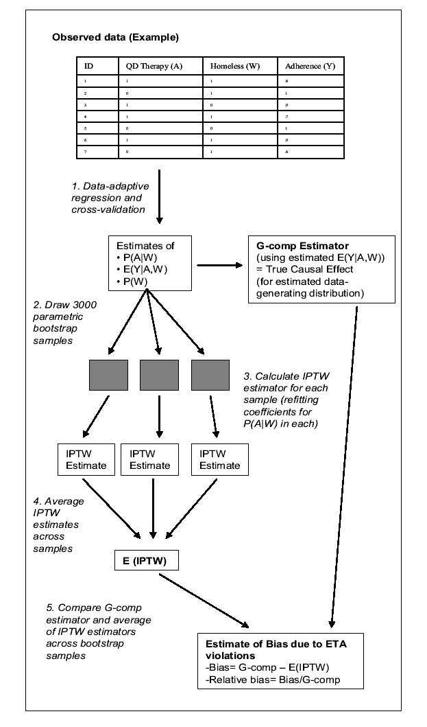

Slide 69
Data Examples
Ex. 1: Rank the importance of HIV mutations for protease inhibitor resistance
  With R Shafer (Stanford)
Ex. 2: Estimate the causal effect of interventions to improve adherence to antiretrovirals
  With D Bangsberg (UCSF)
Notes:
Biomarker discovery, causala effect from observational data as in post market data anlaysis registries

Slide 70
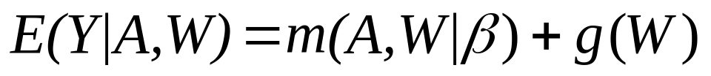
Model-based Variable Importance
When the variable of interest (A) is continuous
Parameter of interest
Semi-parametric Representation
Given Observed Data: O=(A,W,Y)~P_{o}
g(W) is unspecified
Estimate at A=a, given linear model for m:

Slide 71
Define a Measure of Variable Importance
Given Observed Data: O=(A,W,Y)~P_{o}
W*={possible biomarkers, demographics, etc..}
A=W*_{j} (current biomarker of interest)
W=W*_{-j}
Measure of Importance:

