Slide 1
Biomarker Discovery
Analysis
Targeted Maximum Likelihood
Cathy Tuglus, UC Berkeley Biostatistics
November 7th-9th 2007 BASS XIV Workshop with Mark van der Laan

Slide 2
Overview
Motivation
Common methods for biomarker discovery
  Linear Regression
  RandomForest
  LARS/Multiple Regression
Variable importance measure
  Estimation using tMLE
  Inference
  Extensions
  Issues
Two-stage multiple testing
Simulations comparing methods

Slide 3
“Better Evaluation Tools
– Biomarkers and Disease”
#1 highly-targeted research project in FDA “Critical Path Initiative”
  Requests “clarity on the conceptual framework and evidentiary standards for qualifying a biomarker for various purposes”
  “Accepted standards for demonstrating comparability of results, … or for biological interpretation of significant gene expression changes or mutations”
Proper identification of biomarkers can . . .
  Identify patient risk or disease susceptibility
  Determine appropriate treatment regime
  Detect disease progression and clinical outcomes
  Access therapy effectiveness
  Determine level of disease activity
  etc . . .

Slide 4
Biomarker Discovery
Possible Objectives
Identify particular genes or sets of genes modify disease status
  Tumor vs. Normal tissue
Identify particular genes or sets of genes modify disease progression
  Good vs. bad responders to treatment
Identify particular genes or sets of genes modify disease prognosis
  Stage/Type of cancer
Identify particular genes or sets of genes may modify disease response to treatment

Slide 5
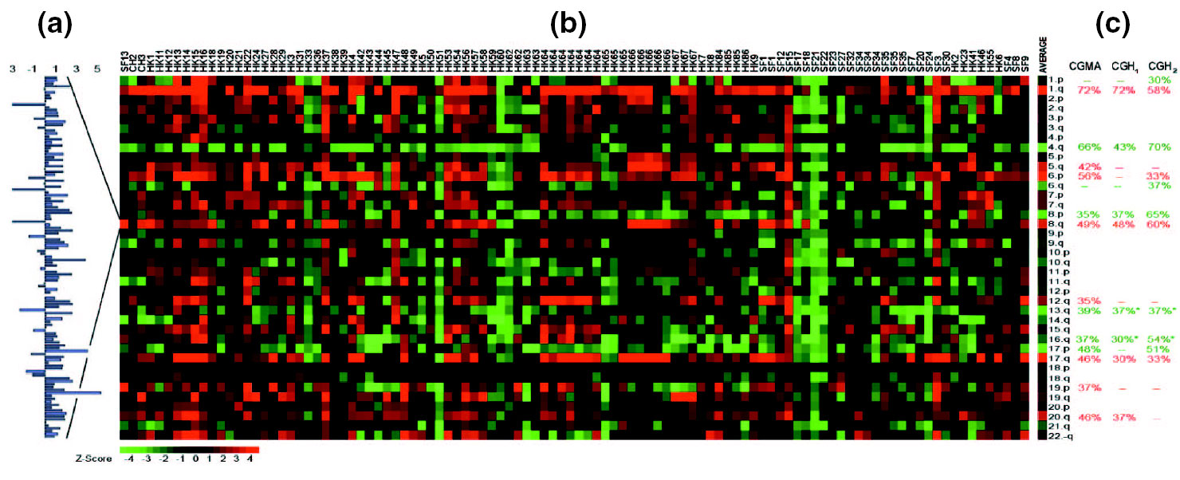
Biomarker Discovery
Set-up
Data: O=(A,W,Y)~P_{o}
Variable of Interest (A): particular biomarker or Treatment
Covariates (W): Additional biomarkers to control for in the model
Outcome (Y): biological outcome (disease status, etc…)
Gene Expression
(A,W)
Gene Expression
(W)
Disease status
(Y)
Treatment
(A)
Disease
status
(Y)

Slide 6
Causal Story
Ideal Result:
A measure of the causal effect of exposure on hormone level
Strict Assumptions:
Experimental Treatment Assumption (ETA)
  Assume that given the covariates, the administration of pesticides is randomized
Missing data structure
  Full data contains all possible treatments for each subject
Under Small Violations:
Causal Effect
VDL Variable Importance
measures

Slide 7
Possible Methods
Solutions to Deal with the Issues at Hand
Linear Regression
Variable Reduction Methods
Random Forest
tMLE Variable Importance

Slide 8
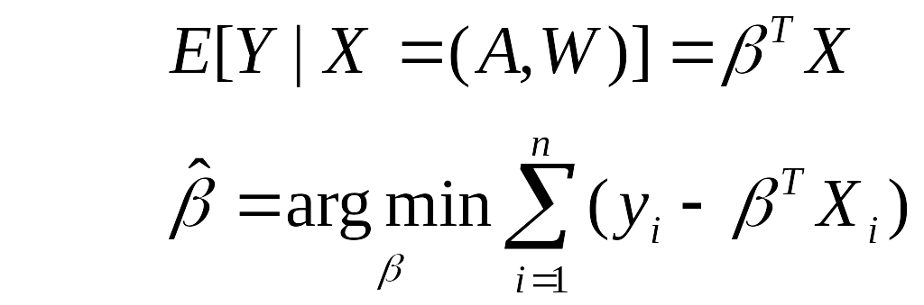
Common Approach
Linear Regression
Optimized using Least Squares
Seeks to estimate β
Notation: Y=Disease Status, A=treatment/biomarker 1, W=biomarkers, demographics, etc.
E[Y|A,W] = β₁*f ₁(A)+ β₂*f ₂(AW) +β₃*f ₃(W)+ . . .
Common Issues:
Have a large number of input variables -> Which variables to include???
  risk of over-fitting
May want to try alternative functional forms of the input variables
  What is the form of f₁, f ₂ , f ₃, . . .??
Improper Bias-Variance trade-off for estimating a single parameter of interest
  Estimation for all B bias the estimate of β₁
Use Variable Reduction Method:
Low-dimensional fit may discount variables believed to be important
May believe outcome is a function of all variables

Slide 9

What about Random Forest?
Breiman (1996,1999)
Classification and Regression Algorithm
Seeks to estimate E[Y|A,W], i.e. the prediction of Y given a set of covariates {A,W}
Bootstrap Aggregation of classification trees
  Attempt to reduce bias of single tree
Cross-Validation to assess misclassification rates
  Out-of-bag (oob) error rate
W₁
W₂
W₃
sets of covariates,
W={ W₁ , W₂ , W₃ , . . .}
0
0
1
1
Permutation to determine variable importance
Assumes all trees are independent draws from an identical distribution, minimizing loss function at each node in a given tree – randomly drawing data for each tree and variables for each node

Slide 10
Random Forest
Basic Algorithm for Classification, Breiman (1996,1999)
The Algorithm
  Bootstrap sample of data
  Using 2/3 of the sample, fit a tree to its greatest depth determining the split at each node through minimizing the loss function considering a random sample of covariates (size is user specified)
  For each tree. .
    Predict classification of the leftover 1/3 using the tree, and calculate the misclassification rate = out of bag error rate.
    For each variable in the tree, permute the variables values and compute the out-of-bag error, compare to the original oob error, the increase is a indication of the variable’s importance
  Aggregate oob error and importance measures from all trees to determine overall oob error rate and Variable Importance measure.
    Oob Error Rate: Calculate the overall percentage of misclassification
    Variable Importance: Average increase in oob error over all trees and assuming a normal distribution of the increase among the trees, determine an associated p-value
Resulting predictor set is high-dimensional

Slide 11
Random Forest
Considerations for Variable Importance
Resulting predictor set is high-dimensional, resulting in incorrect bias-variance trade-off for individual variable importance measure
  Seeks to estimate the entire model, including all covariates
  Does not target the variable of interest
  Final set of Variable Importance measures may not include covariate of interest
Variable Importance measure lacks interpretability
No formal inference (p-values) available for variable importance measures

Slide 12

Targeted Semi-Parametric
Variable Importance
van der Laan (2005, 2006), Yu and van der Laan (2003)
Given Observed Data: O=(A,W,Y)~P_{o}
Parameter of Interest : “Direct Effect”
Semi-parametric Model Representation with unspecified g(W)
For Example. . .
Notation: Y=Tumor progression, A=Treatment, W=gene expression, age, gender, etc. . .
E[Y|A,W] = β₁*f ₁(treatment)+ β₂*f ₂(treatment*gene expression)
+β₃*f ₃(gene expression)+β₄*f ₄(age)+ . . .
m(A,W|b) = E[Y|A=a,W] - E[Y|A=0,W] = β₁*f ₁(treatment)+ β₂*f ₂(treatment*gene expression)
No need to specify f ₃ or f ₄

Slide 13

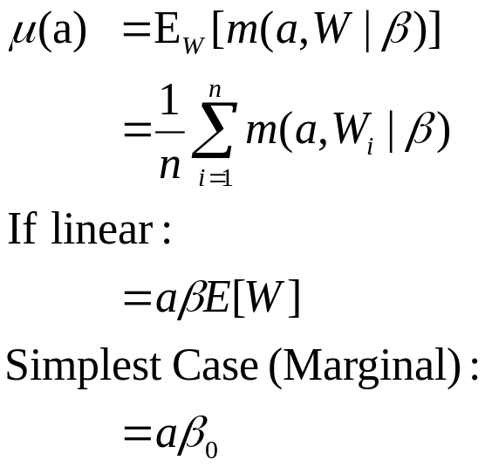
tMLE Variable Importance
General Set-Up
Given Observed Data: O=(A,W,Y)~P_{o}
W*={possible biomarkers, demographics, etc..}
A=W*_{j} (current biomarker of interest)
W=W*_{-j}
Parameter of Interest:
Gene Expression
(A,W)
Disease status
(Y)

Slide 14
Nuts and Bolts
Basic Inputs
Model specifying only terms including the variable of interest
  i.e. m(A,V|b)=a*(b^{T}V)
Nuisance Parameters
E[A|W] treatment mechanism
(confounding covariates on treatment)
E[ treatment | biomarkers, demographics, etc. . .]
E[Y|A,W] Initial model attempt on Y given all covariates W
(output from linear regression, Random Forest, etc. . .)
E[ Disease Status | treatment, biomarkers, demographics, etc. . .]
VDL Variable Importance Methods is a robust method, taking a non-robust E[Y|A,W] and accounting for treatment mechanism E[A|W]
  Only one Nuisance Parameter needs to be correctly specified for efficient estimators
VDL Variable Importance methods will perform the same as the non-robust method or better
New Targeted MLE estimation method will provide model selection capabilities

Slide 15
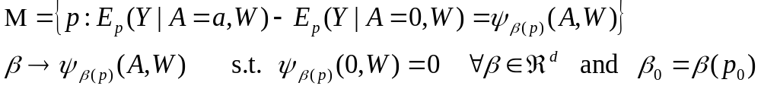

tMLE Variable Importance
Model-based set-up van der Laan (2006)
Given Observed Data: O=(A,W,Y)~P_{o}
Parameter of Interest:
Model:

Slide 16
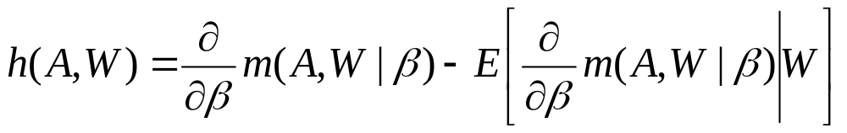
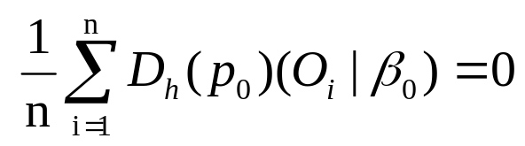
tMLE Variable Importance
Estimation van der Laan (2006 )
Can factorize the density of the data:
p(Y,A,W)=p(Y|A,W)p(A|W)p(W)
Define: Q(p)=p(Y|A,W) Q_{n}(A,W)=E[Y|A,W]
G(p)=p(A|W) G_{n}(W)=E[A,W]
Efficient Influence Curve:
True β(p_{o})= β₀ solves:

Slide 17
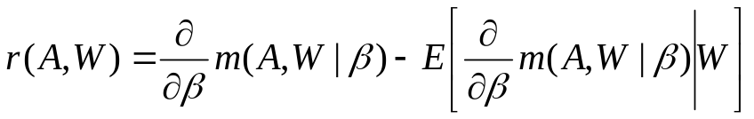
tMLE Variable Importance
Simple Solution Using Standard Regression van der Laan (2006 )
1) Given model m(A,W|β) = E[Y|A,W]-E[Y|A=0,W]
Estimate initial solution of Q⁰_{n}(A,W)=E[Y|A,W]=m(A,W|β)+g(W)
and find initial estimate β⁰
Estimated using any prediction technique allowing specification of m(A,W|β) giving β⁰
g(W) can be estimated in non-parametric fashion
3) Solve for clever covariate derived from the influence curve, r(A,W)
Update initial estimate Q⁰_{n}(A,W) by regressing Y onto r(A,W)
  with offset Q⁰_{n}(A,W) → gives ε = coefficients of updated regression
5) Update initial parameter estimate β and overall estimate of Q(A,W)
β⁰=β⁰+ε
Q_{n}¹(A,W)= Q⁰_{n}(A,W) +ε∗r(A,W)

Slide 18
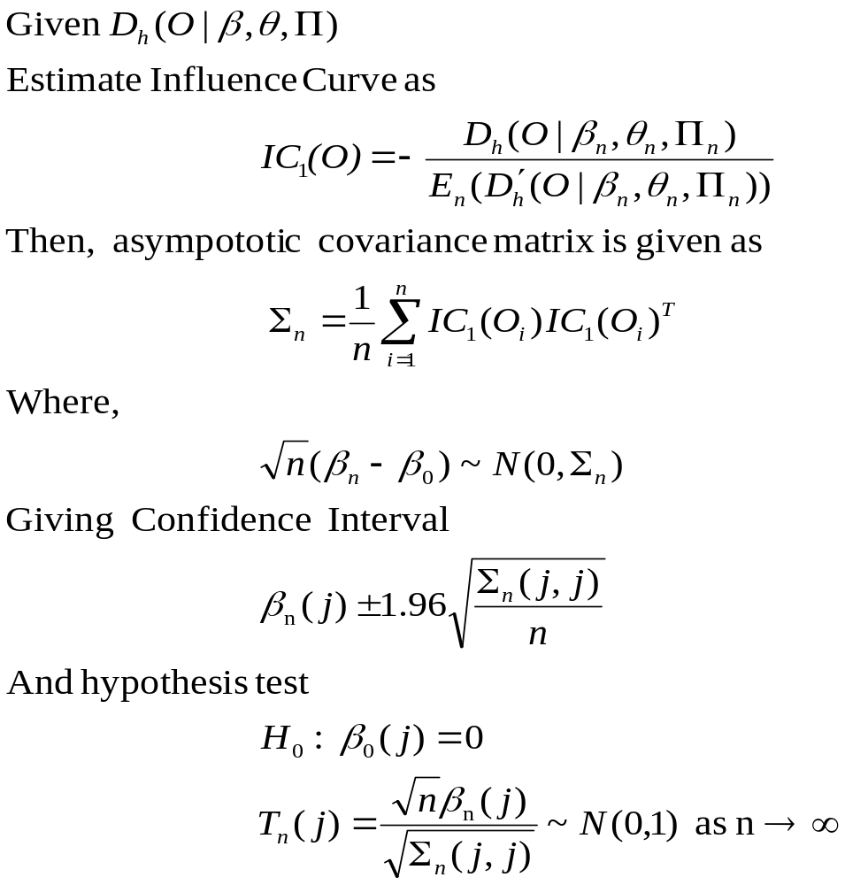
Formal Inference
van der Laan (2005)

Slide 19
“Sets” of biomarkers
The variable of interest A may be a set of variables (multivariate A)
  Results in a higher dimensional ε
  Same easy estimation: setting offset and projecting onto a clever covariate
Update a multivariate β
“Sets” can be clusters, or representative genes from the cluster
We can defined sets for each variable W’
  i.e. Correlation with A greater than 0.8
Formal inference is available
  Testing Ho: β‘=0, where β‘ is multivariate using Chi-square test

Slide 20
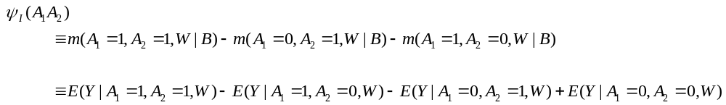
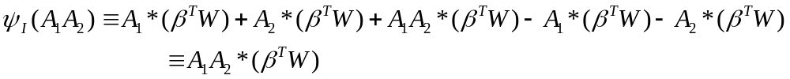
“Sets” of biomarkers
Can also extract an interaction effect
Given linear model for b,
Provides inference using hypothesis test for H_{o}: c^{T}b=0

Slide 21
Benefits of Targeted Variable Importance
Targets the variable of interest
  Focuses estimation on the quantity of interest
  Proper Bias-Variance Trade-off
Hypothesis driven
  Allows for effect modifiers, and focuses on single or set of variables
Double Robust Estimation
  Does at least as well or better than common approaches

Slide 22
Benefits of Targeted Variable Importance
Formal Inference for Variable Importance Measures
  Provides proper p-values for targeted measures
Combines estimating function methodology with maximum likelihood approach
Estimates entire likelihood, while targeting parameter of interest
Algorithm updates parameter of interest as well as Nuisance Parameters (E[A|W], E[Y|A,W])
  less dependency on initial nuisance model specification
Allows for application of Loss-function based Cross-Validation for Model Selection
  Can apply DSA data-adaptive model selection algorithm (future work)

Slide 23
Steps to discovery
General Method
Univariate Linear regressions
  Apply to all W
  Control for FDR using BH
  Select W significant at 0.05 level to be W’ (for computational ease)
Define m(A,W’|β)=A (Marginal Case)
Define initial Q(A,W’) using some data-adaptive model selection
  Completed for all A in W
  We use LARS because it allows us to include the form m(A,W|β) in the model
  Can also use DSA or glmpath() for penalized regression for binary outcome
Solve for clever covariate (1-E[A|W’])
  Simplified r(A,W) given m(A,W|β)=βA
  E[A|W] estimated with any prediction method, we use polymars()
Update Q(A,W) using tMLE
Calculate appropriate inference for μ(A) using influence curve

Slide 24
Simulation set-up
  > Univariate Linear Regression
    Importance measure: Coefficient value with associated p-value
    Measures marginal association
  > RandomForest (Brieman 2001)
    Importance measures (no p-values)
      RF1: variable’s influence on error rate
      RF2: mean improvement in node splits due to variable
  > Variable Importance with LARS
    Importance measure: causal effect
    Formal inference, p-values provided
    LARS used to fit initial E[Y|A,W] estimate W={marginally significant covariates}
  All p-values are FDR adjusted

Slide 25
Simulation set-up
  > Test methods ability to determine “true” variables under increasing correlation conditions
    Ranking by measure and p-value
    Minimal list necessary to get all “true”?
  > Variables
    Block Diagonal correlation structure: 10 independent sets of 10
    Multivariate normal distribution
    Constant ρ, variance=1
    ρ={0,0.1,0.2,0.3,…,0.9}
  > Outcome
    Main effect linear model
    10 “true” biomarkers, one variable from each set of 10
    Equal coefficients
    Noise term with mean=0 sigma=10
      “realistic noise”

Slide 26
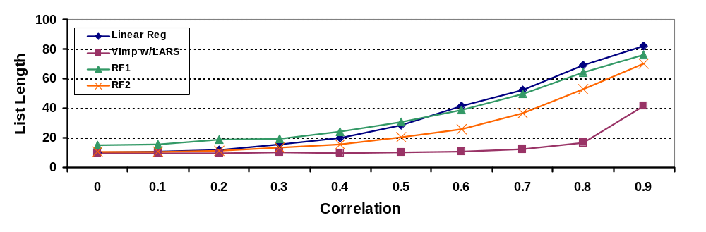
Simulation Results (in Summary)
Minimal List length to obtain all 10 “true” variables
No appreciable difference in ranking by importance measure or p-value
  plot above is with respect to ranked importance measures
List Length for linear regression and randomForest increase with increasing correlation, Variable Importance w/LARS stays near minimum (10) through ρ=0.6, with only small decreases in power
Linear regression list length is 2X Variable Importance list length at ρ=0.4 and 4X at ρ=0.6
RandomForest (RF2) list length is consistently short than linear regression but still is 50% than Variable Importance list length at ρ=0.4, and twice as long at ρ=0.6
Variable importance coupled with LARS estimates true causal effect and outperforms both linear regression and randomForest

Slide 27
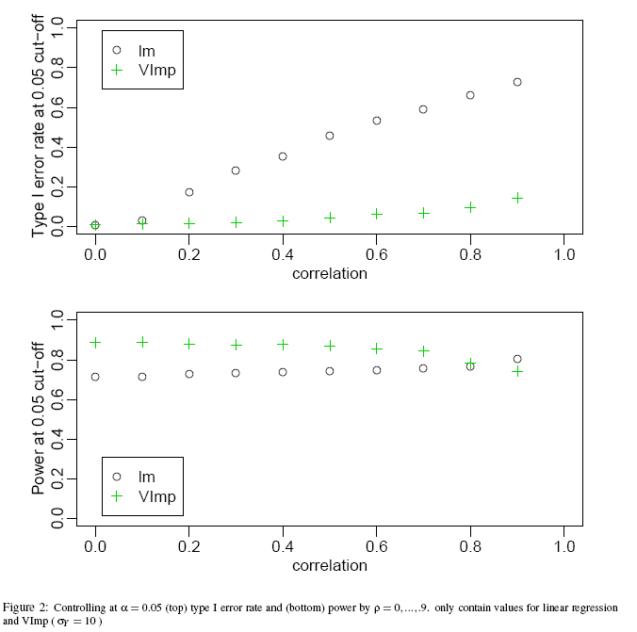
Results – Type I error and Power

Slide 28
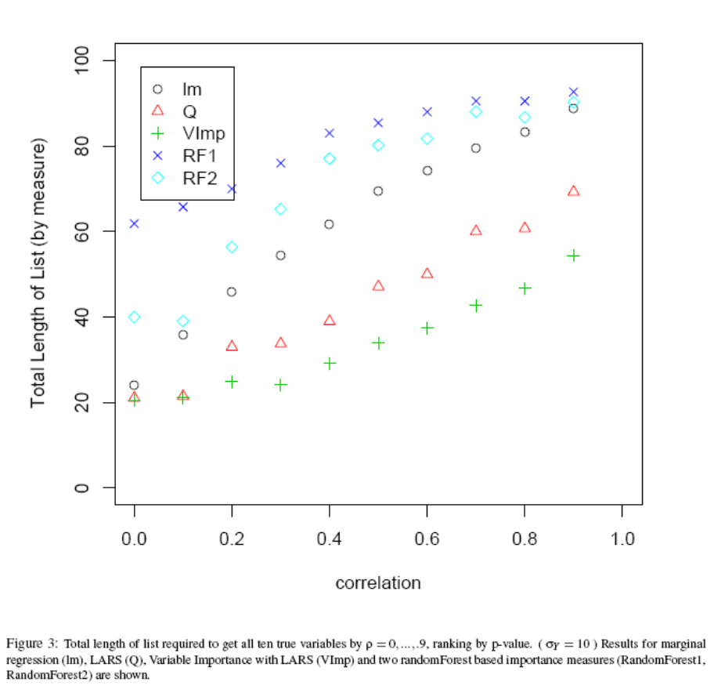
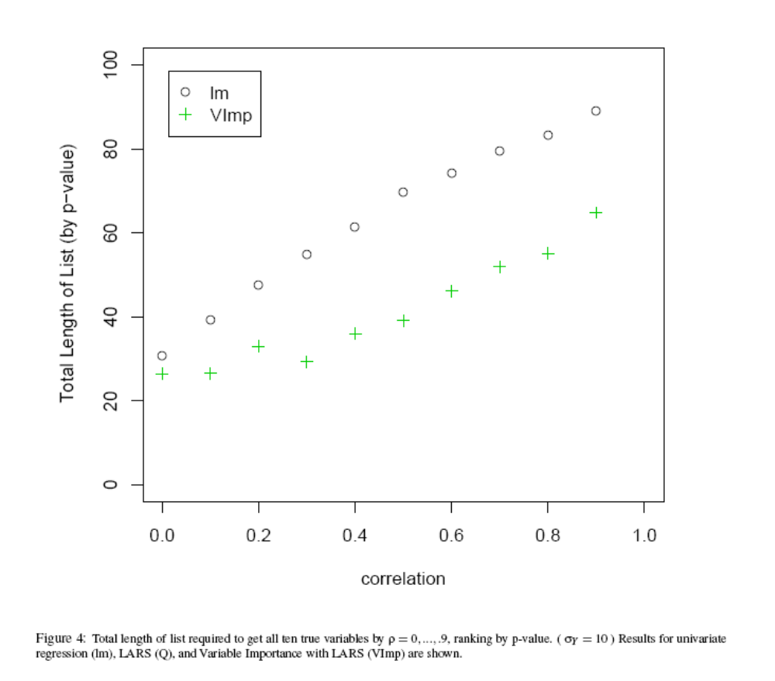
Results – Length of List

Slide 29
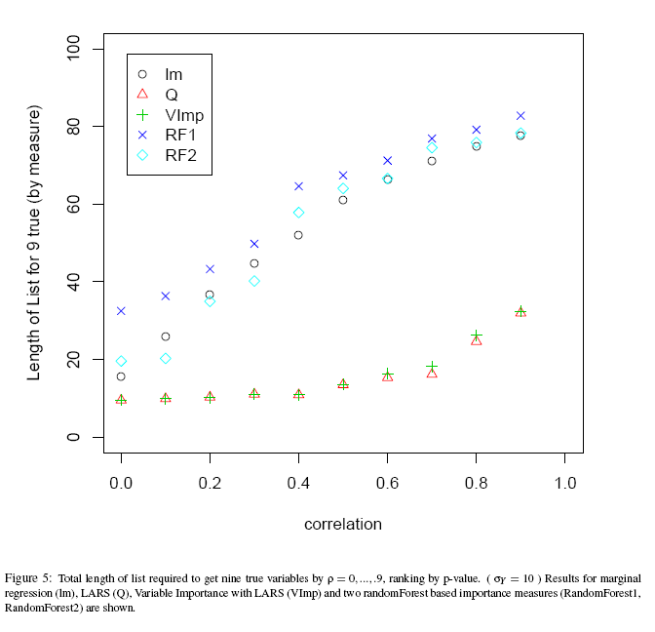
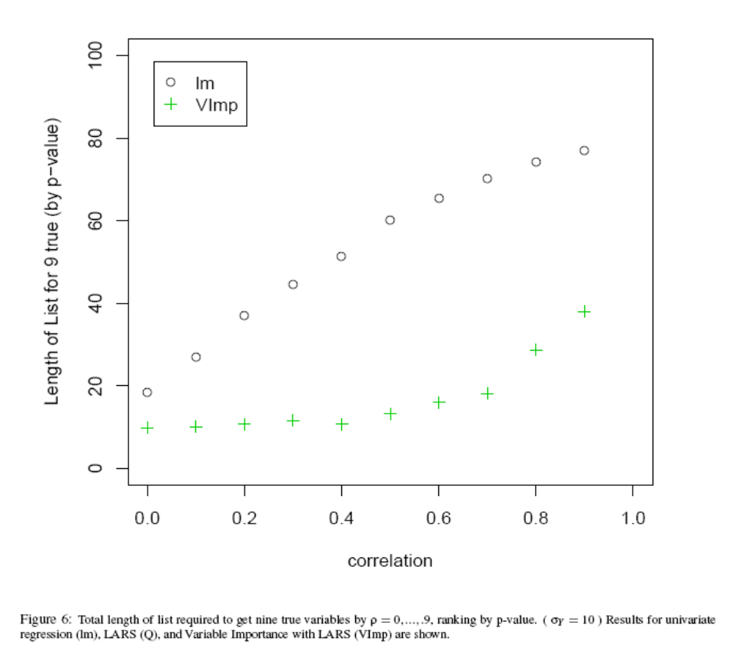
Results – Length of List

Slide 30
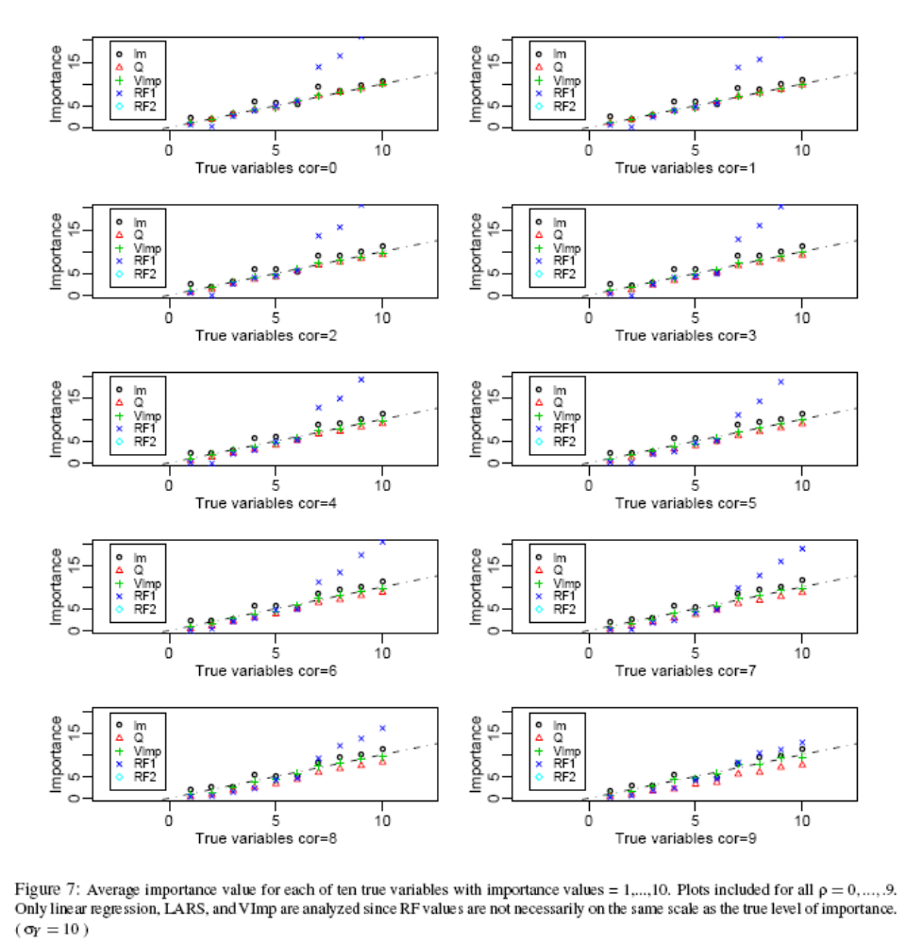
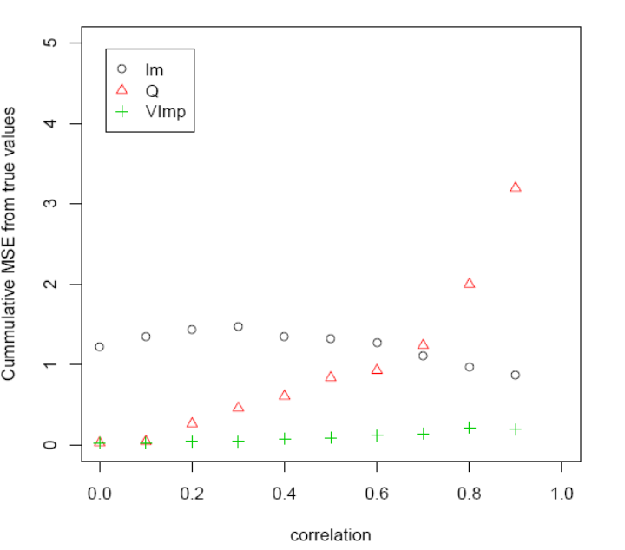
Results – Average Importance

Slide 31
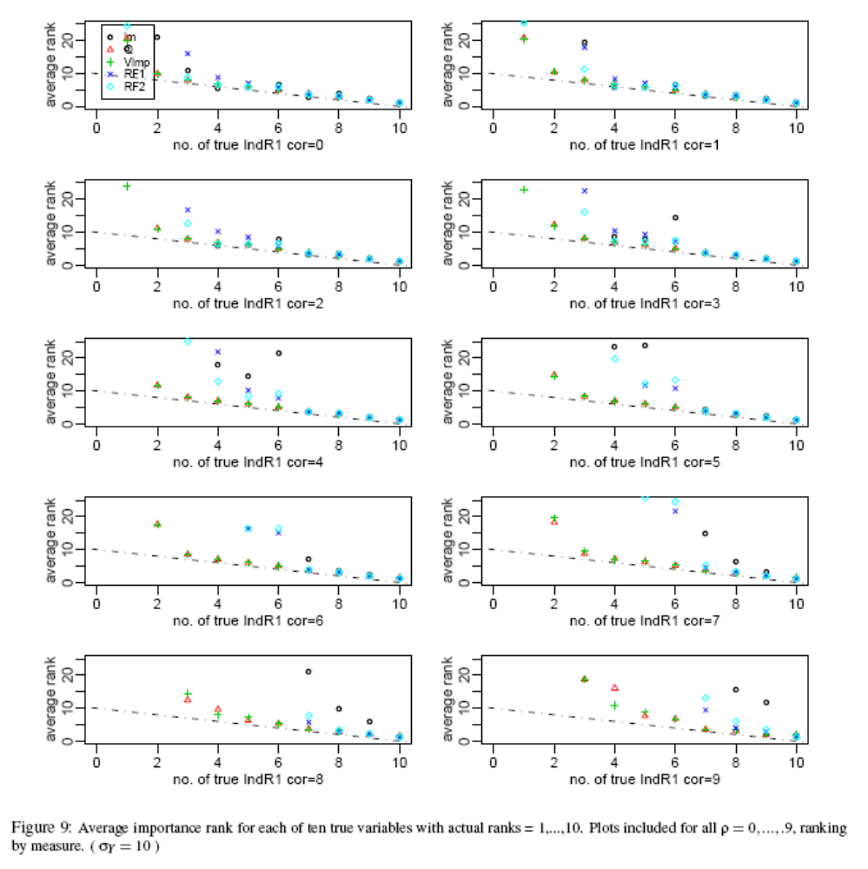
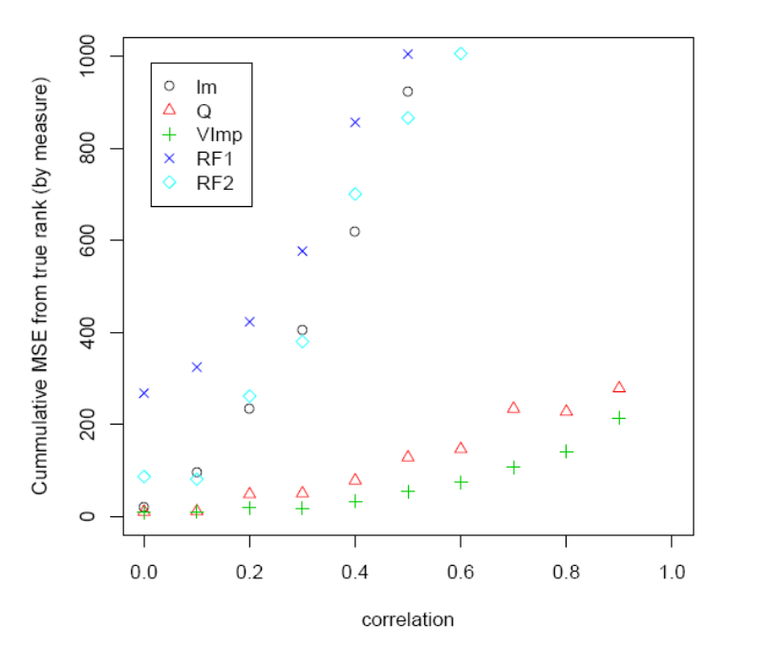
Results – Average Rank

Slide 32
ETA Bias
Heavy Correlation Among Biomarkers
In Application often biomarkers are heavily correlated leading to large ETA violations
This semi-parametric form of variable importance is more robust than the non-parametric form (no inverse weighting), but still affected
Currently work is being done on methods to alleviate this problem
  Pre-grouping (cluster)
  Removing highly correlated W_{i} from W*
  Publications forthcoming. . .
For simplicity we restrict W to contain no variables whose correlation with A is greater than ρ
  ρ=0.5 and ρ=0.75

Slide 33
Secondary Analysis
What to do when W is too large

Slide 34
Switch to MTP presentation

Slide 35
Application: Golub et al. 1999
Classification of AML vs ALL using microarray gene expression data
N=38 individuals (27 ALL, 11 AML)
Originally 6817 human genes, reduced using pre-processing methods outlined in Dudoit et al 2003 to 3051 genes
Objective: Identify biomarkers which are differentially expressed (ALL vs AML)
Adjust for ETA bias by restricting W’ to contain no variables whose correlation with A is greater than ρ
  ρ=0.5 and ρ=0.75

Slide 36
Steps to discovery
Golub Application – Slight Variation from General Method
Univariate regressions
  Apply to all W
  Control for FDR using BH
  Select W significant at 0.1 level to be W’ (for computational ease),
    Before correlation restriction W’ has 550 genes
    Restrict W’ to W’’ based on correlation with A (ρ=0.5 and ρ=0.75)
For each A in W . . .
Define m(A,W’’|β)=A (Marginal Case)
Define initial Q(A,W’’) using polymars()
  Find initial fit and initial β
Solve for clever covariate (1-E[A|W’’])
  E[A|W] estimated using polymars()
Update Q(A,W) and β using tMLE
Calculate appropriate inference for μ(A) using influence curve
Adjust p-values for multiple testing controlling for FDR using BH

Slide 37
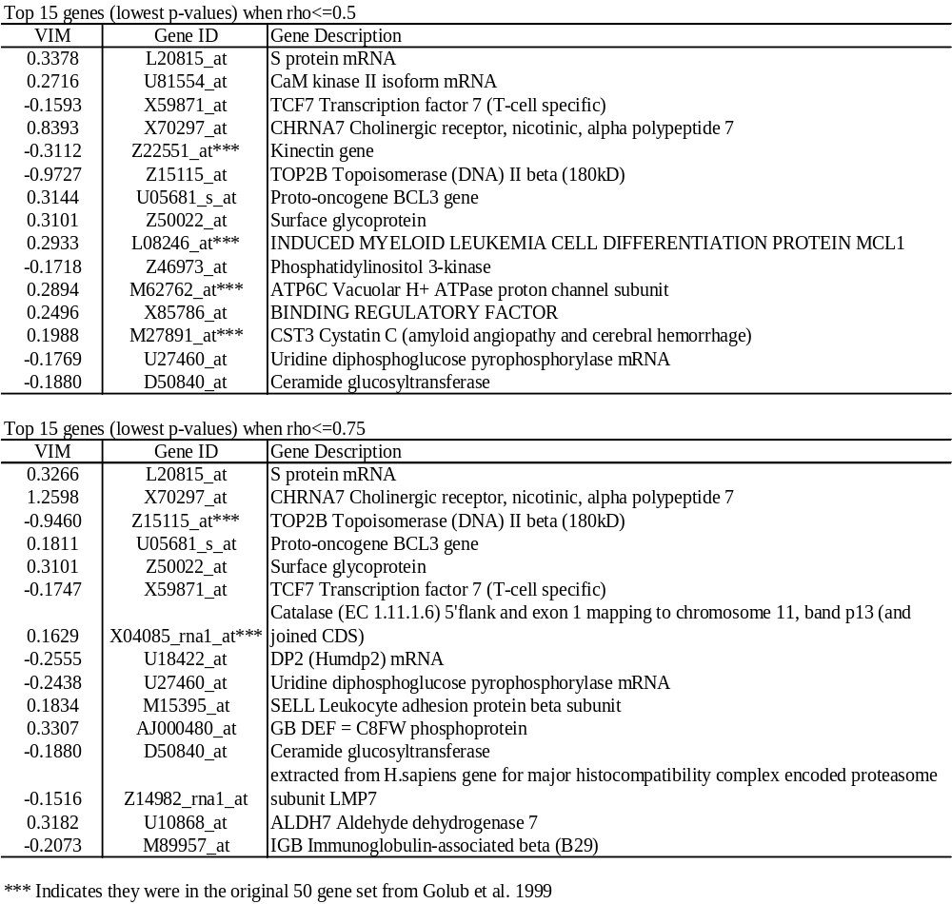
Golub Results – Top 15 VIM

Slide 38
Golub Results – Top 15 VIM

Slide 39
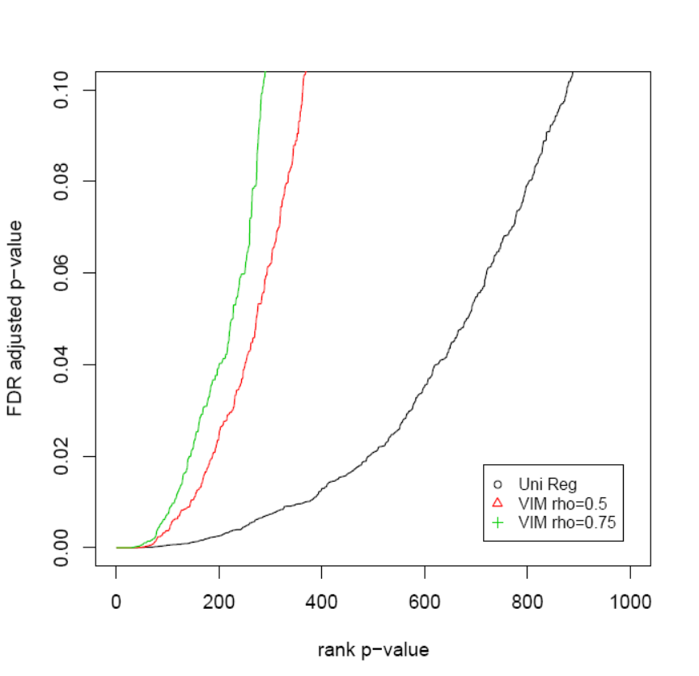
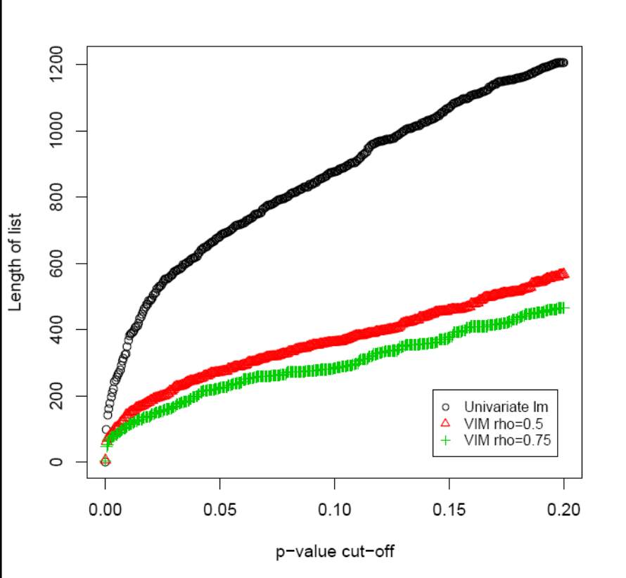
Golub Results – Comparison of Methods

Slide 40
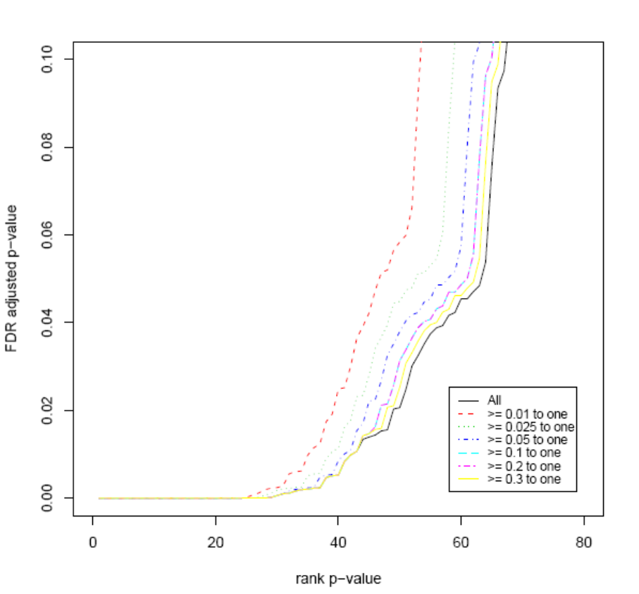
Golub Results – Better Q

Slide 41
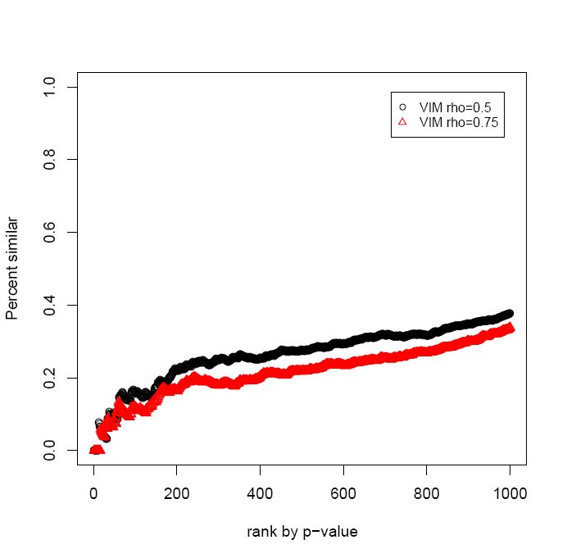
Golub Results – Comparison of Methods
Percent similar with Univariate Regression – rank by p-value

Slide 42
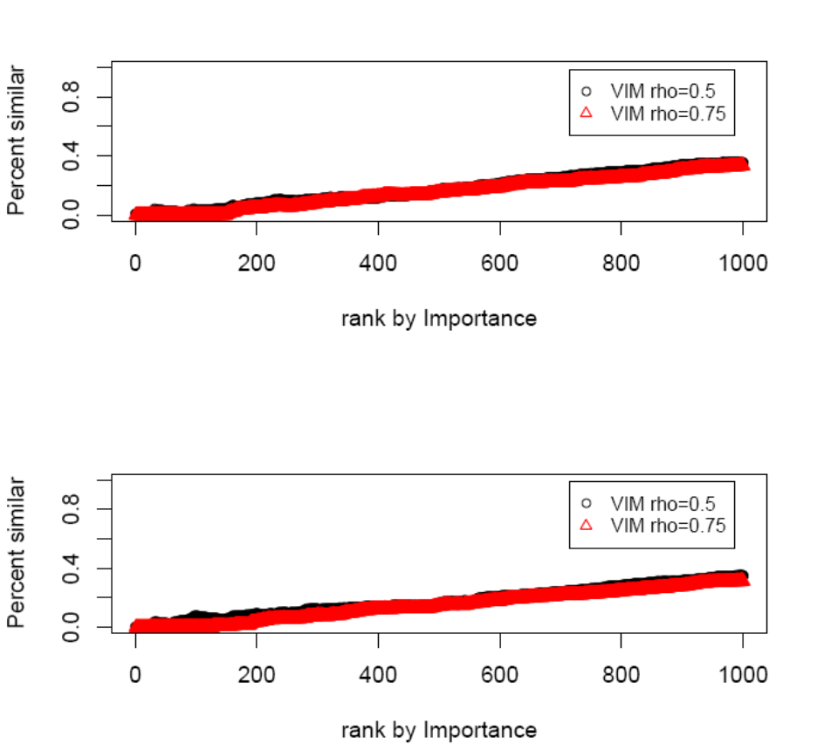
Golub Results – Comparison of Methods
Percent Similar with randomForest Measures of Importance

Slide 43
Acknowledgements
Mark van der Laan, Biostatistics, UC Berkeley
Sandrine Dudoit, Biostatistics, UC Berkeley
Alan Hubbard , Biostatistics, UC Berkeley
Dave Nelson, Lawrence Livermore Nat’l Lab
Catherine Metayer, NCCLS, UC Berkeley
NCCLS Group
References
L. Breiman. Bagging Predictors. Machine Learning, 24:123-140, 1996.
L. Breiman. Random forests – random features. Technical Report 567, Department of Statistics, University of California, Berkeley, 1999.
Mark J. van der Laan, "Statistical Inference for Variable Importance" (August 2005). U.C. Berkeley Division of Biostatistics Working Paper Series. Working Paper 188.
http://www.bepress.com/ucbbiostat/paper188
Mark J. van der Laan and Daniel Rubin, "Estimating Function Based Cross-Validation and Learning" (May 2005). U.C. Berkeley Division of Biostatistics Working Paper Series. Working Paper 180. http://www.bepress.com/ucbbiostat/paper180
Mark J. van der Laan and Daniel Rubin, "Targeted Maximum Likelihood Learning" (October 2006). U.C. Berkeley Division of Biostatistics Working Paper Series. Working Paper 213. http://www.bepress.com/ucbbiostat/paper213
Sandra E. Sinisi and Mark J. van der Laan (2004) "Deletion/Substitution/Addition Algorithm in Learning with Applications in Genomics," Statistical Applications in Genetics and Molecular Biology: Vol. 3: No. 1, Article 18. http://www.bepress.com/sagmb/vol3/iss1/art18
Zhuo Yu and Mark J. van der Laan, "Measuring Treatment Effects Using Semiparametric Models" (September 2003). U.C. Berkeley Division of Biostatistics Working Paper Series. Working Paper 136.
http://www.bepress.com/ucbbiostat/paper136

