Slide 1
Parallelizing Strassen's Algorithm
Project 4.1
Zhu Liang

Slide 2
Introduction
Strassen’s: divide multiplication into 7 sub-multiplications.

Slide 3
Outline
Parallelization
Implement
Result & Analysis
Summary

Slide 4
Parallelization
Multi Level Master-Slave
(Leader-Worker) network
Three Steps:
Distribute Data
Local Multiplication
Collect Result

Slide 5
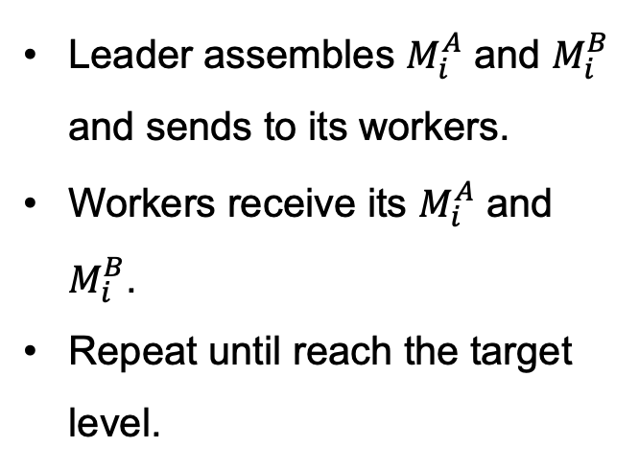
1. Distribute Data
Leader assembles $M_{i}^{A}$ and $M_{i}^{B}$ and sends to its workers.
Workers receive its $M_{i}^{A}$ and $M_{i}^{B}$.
Repeat until reach the target level.
root
target level

Slide 6

2. Local Multiplication
root
All processors run its local multiplication
target level

Slide 7
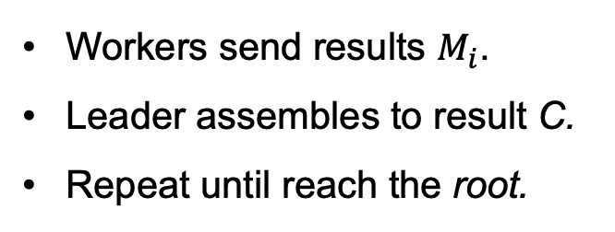
3. Collect Result
root
Workers send results $M_{i}$.
Leader assembles to result C.
Repeat until reach the root.
target level

Slide 8
Tree
Reuse leader as a worker.

Slide 9
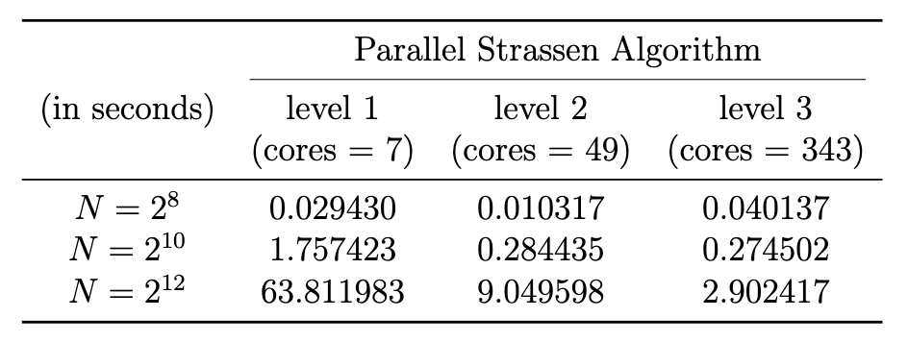
Results

Slide 10
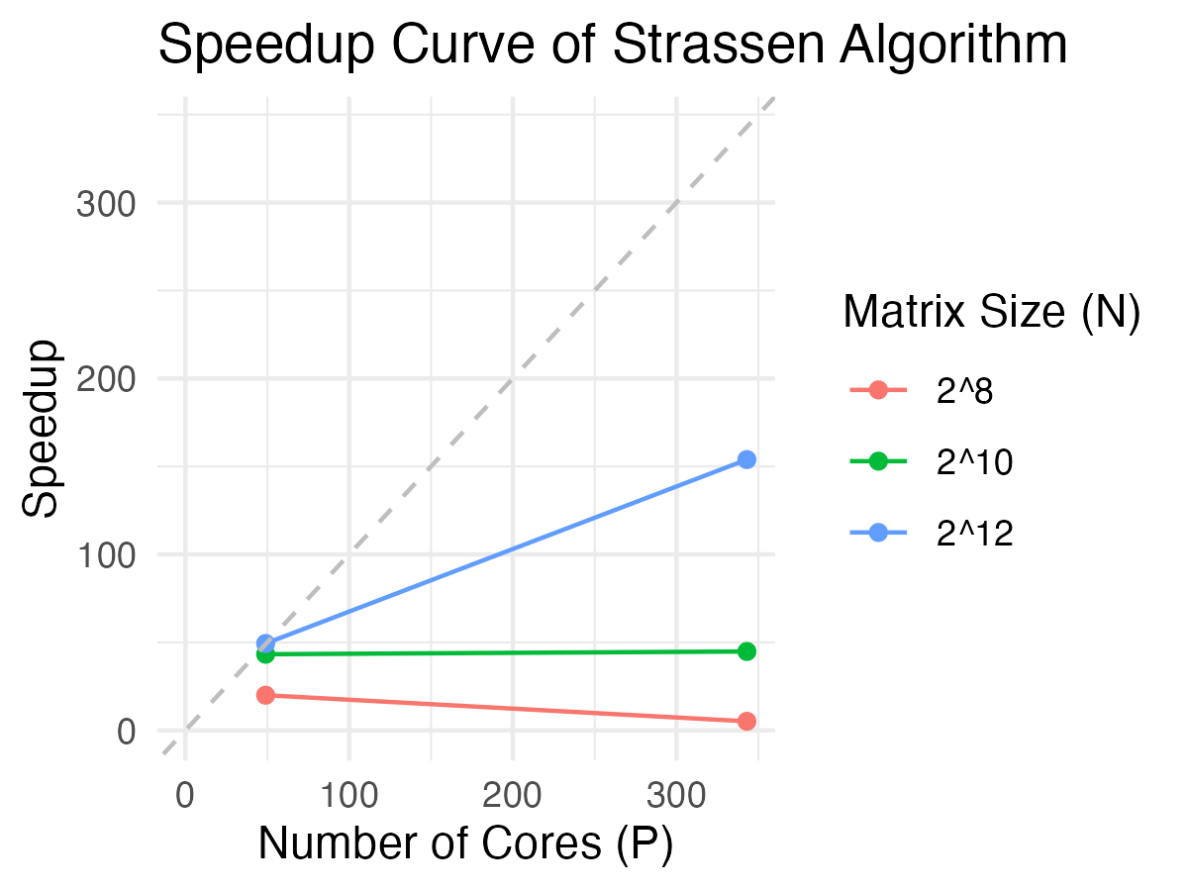
Results

Slide 11
Analysis
Key Factors Affecting Trends
Communication Overhead: Bottleneck at high processor counts, significant for small N
Computation to Communication Ratio: Better for large N, leading to higher speedup
Future Optimization
Improve load distribution among processors

Slide 12
Summary
Successfully implement the 3 levels via multi-level master-slave network.
Build a static recursive tree to determine leader-worker relationship.
It could further apply to higher levels of Strassens.

Slide 13
Q&A
Thanks for your attention!

