Slide 1
Parallelizing Strassen's Algorithm
Project 4.1
Zhu Liang

Slide 2
Introduction
Strassen’s: divide multiplication into 7 sub-multiplications.
It improves efficiency with a potential recursive approach.
This project:
Parallel implementation of Strassen's to leverage efficiency.
Explores three levels of recursive Strassen’s decomposition.

Slide 3
Table of Content
Parallel Implementation
Result & Analysis
Summary

Slide 4
Parallelization
Multi Level Master-Slave
(Leader-Worker) network
Three Steps:
Distribute Data
Local Multiplication
Collect Result

Slide 5
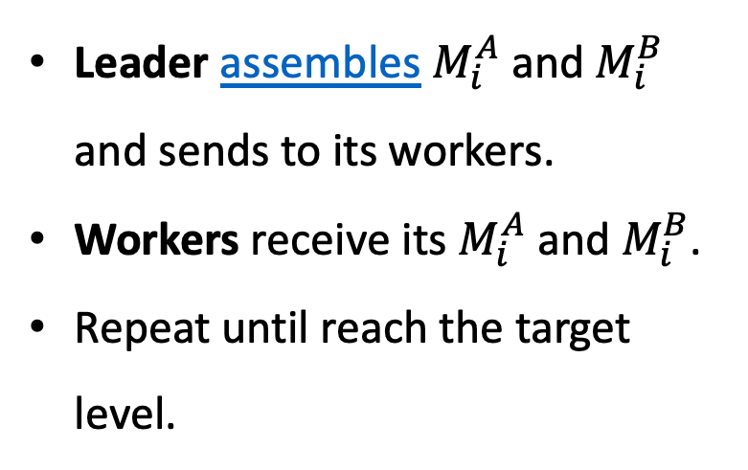
1. Distribute Data
Leader assembles $M_{i}^{A}$ and $M_{i}^{B}$ and sends to its workers.
Workers receive its $M_{i}^{A}$ and $M_{i}^{B}$.
Repeat until reach the target level.
root
target level

Slide 6

2. Local Multiplication
root
All processors run its local multiplication
target level

Slide 7
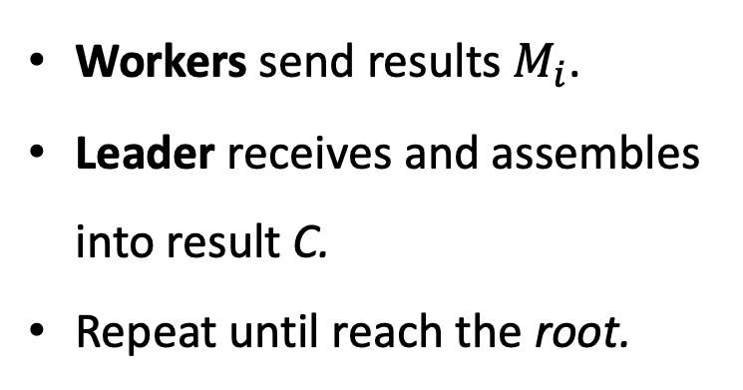
3. Collect Result
Workers send results $M_{i}$.
Leader receives and assembles into result C.
Repeat until reach the root.
root
target level

Slide 8
Static Leader-Worker Tree
Ranks determine a static Leader-Worker relationship.
Reuse leader as a worker.
Special Case: root processor
a dual role as both sender and receiver, which could lead to deadlock.
MPI data transfer is not necessary, direct memory copying.

Slide 9
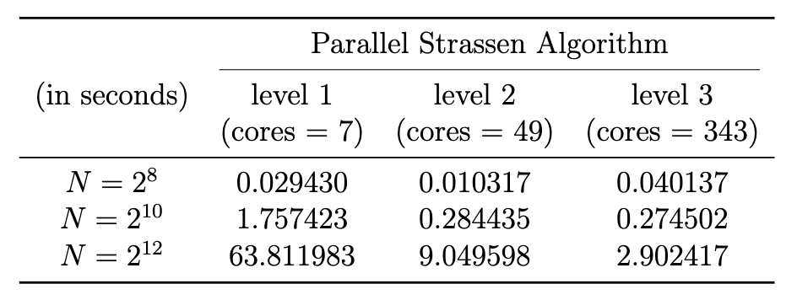
Results

Slide 10
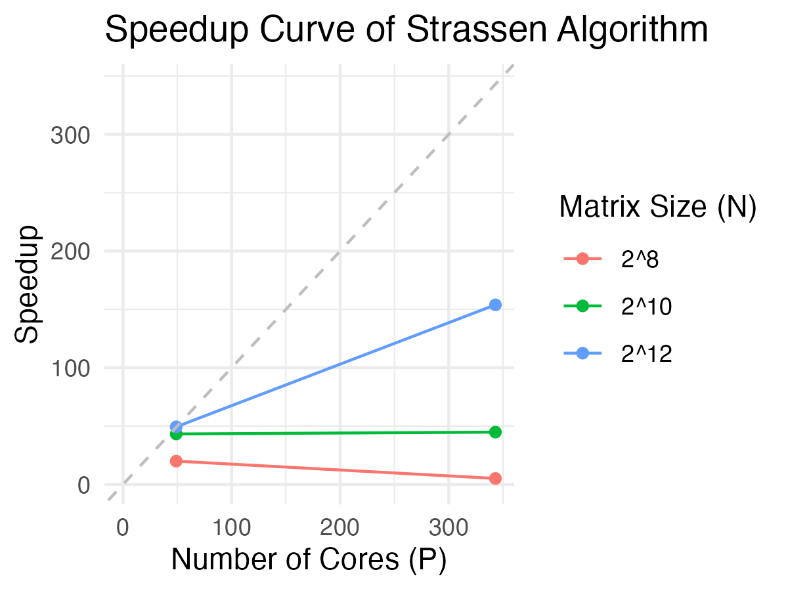
Results

Slide 11
Analysis
Trends
Speedup improves when matrices become larger.
Key Factors Affecting Trends
Communication Overhead: Bottleneck at high processor counts, significant for small N.
Computation to Communication Ratio: Better for large N, leading to higher speedup
Future Optimization
Improve load distribution among processors

Slide 12
Summary
Successfully implement the 3 levels via multi-level master-slave network.
Build a static recursive tree to determine leader-worker relationship.
It could further apply to higher levels of Strassen’s.

Slide 13
Q & A
Thanks for your attention!

Slide 14
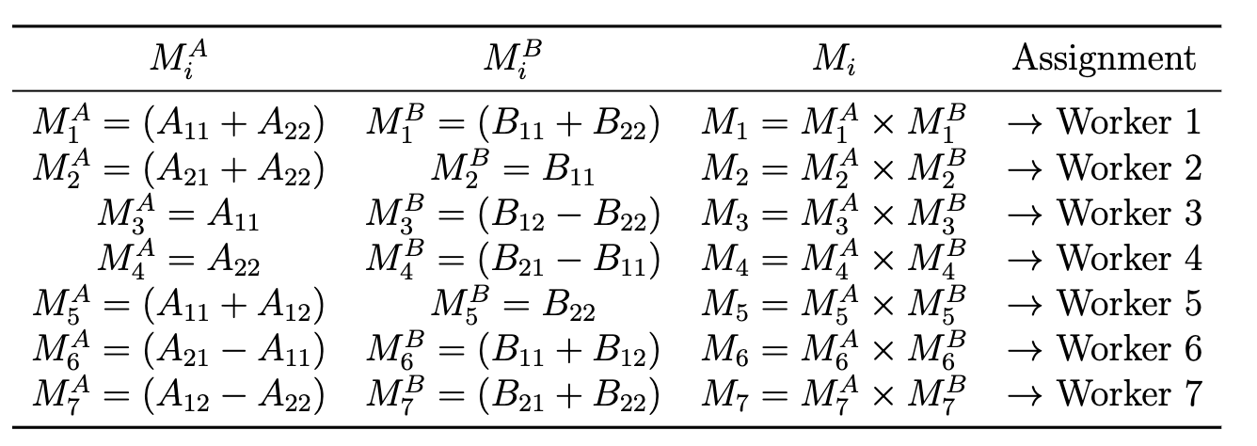
Appendix: Strassen’s Sub-Matrices

Slide 15
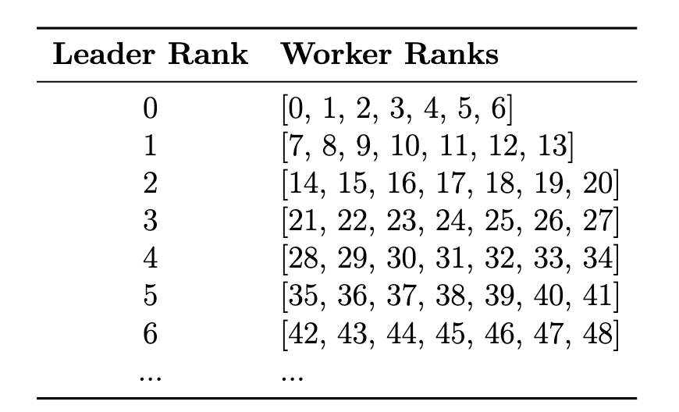
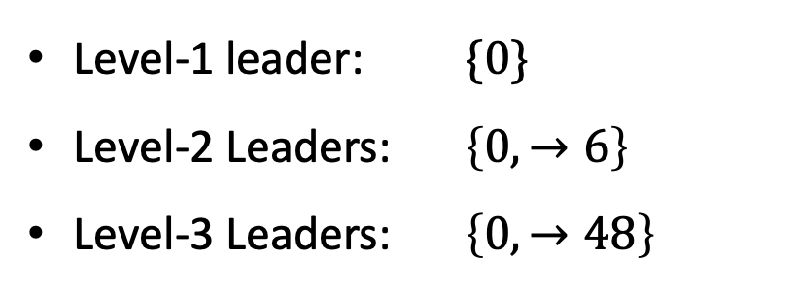
Appendix: Static Relationship Tree by Rank
Level-1 leader: $\{0\}$
Level-2 Leaders: $\left\{0, →6\right\}$
Level-3 Leaders: $\left\{0, →48\right\}$

