Slide 1
Parallelizing Strassen's Algorithm
Project 4.1
Zhu Liang

Slide 2
Introduction
Strassen’s: divide multiplication into 7 sub-multiplications.
It improves efficiency with a potential recursive approach.
This project:
Implements Strassen's algorithm in parallel to leverage efficiency.
Draws on insights from Chou, C. C., Deng, Y. F., Li, G., & Wang, Y. (1995), but applies a recursive strategy for efficient data distribution and collection.

Slide 3
Table of Content
Parallel Implementation
Result & Analysis
Summary

Slide 4
Parallelization
Multi Level Master-Slave
(Leader-Worker) network
root
Three Steps:
Distribute Data
Local Multiplication
Collect Result
target level

Slide 5
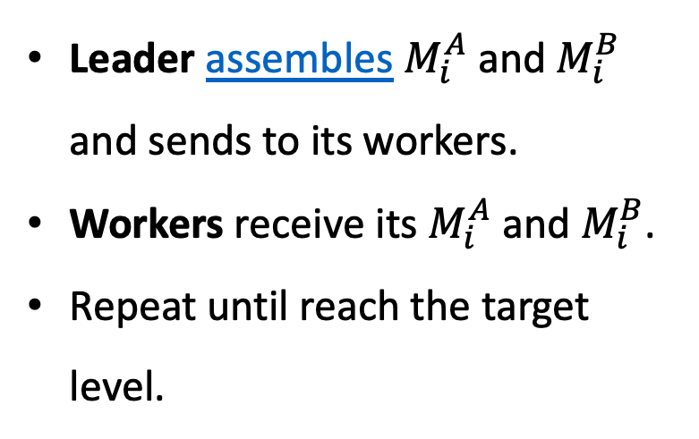




1. Distribute Data
Leader assembles $M_{i}^{A}$ and $M_{i}^{B}$ and sends to its workers.
Workers receive its $M_{i}^{A}$ and $M_{i}^{B}$.
Repeat until reach the target level.
root
$$⋯$$
target level
$$⋯$$
$$⋯$$
$$⋯$$

Slide 6




2. Local Multiplication
root
All processors run its local multiplication
$$⋯$$
target level
$$⋯$$
$$⋯$$
$$⋯$$

Slide 7
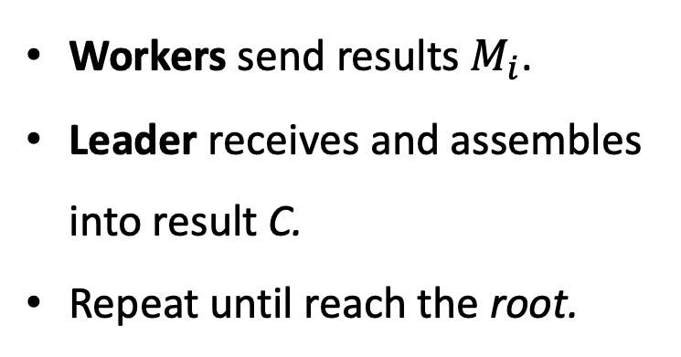


3. Collect Result
Workers send results $M_{i}$.
Leader receives and assembles into result C.
Repeat until reach the root.
root
$$⋯$$
target level
$$⋯$$
$$⋯$$
$$⋯$$

Slide 8
Static Leader-Worker Tree
Ranks determine a static Leader-Worker relationship.
Reuse leader as a worker.
Special Case: root processor
A dual role as both sender and receiver, which could lead to deadlock.
Instead, it performs direct memory copying of the data it requires.

Slide 9
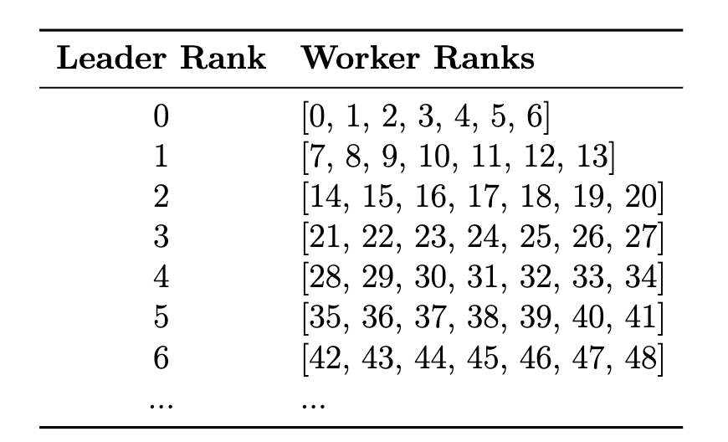
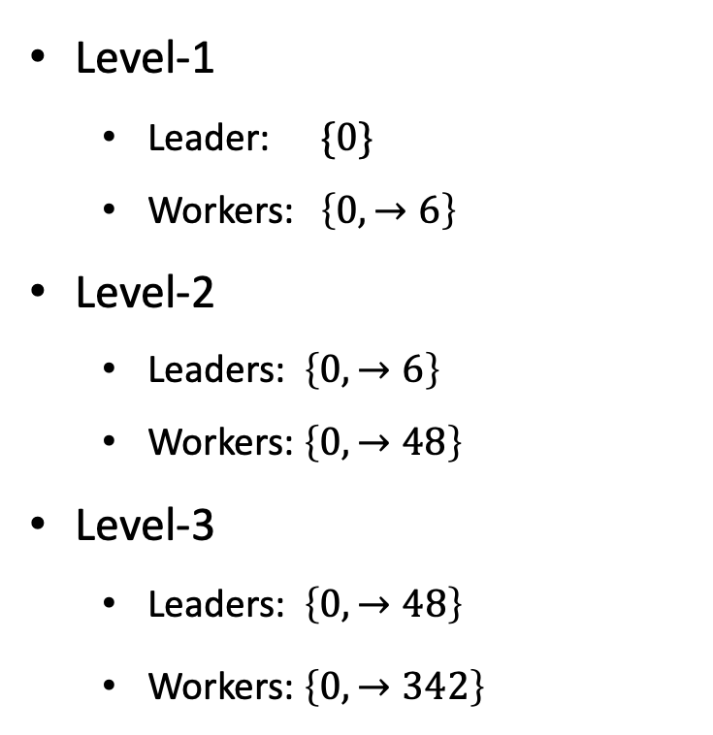
Static Relationship Tree by Rank
Level-1
Leader: $\{0\}$
Workers: $\left\{0, →6\right\}$
Level-2
Leaders: $\left\{0, →6\right\}$
Workers: $\left\{0, →48\right\}$
Level-3
Leaders: $\left\{0, →48\right\}$
Workers: $\left\{0, →342\right\}$

Slide 10
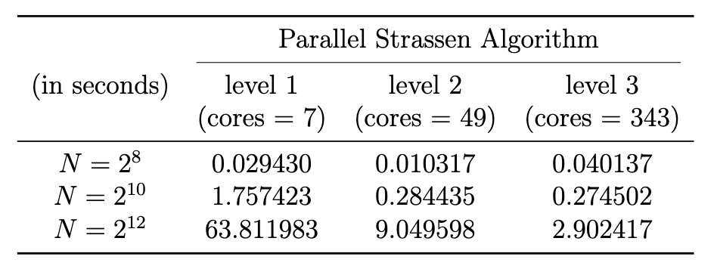
Results

Slide 11
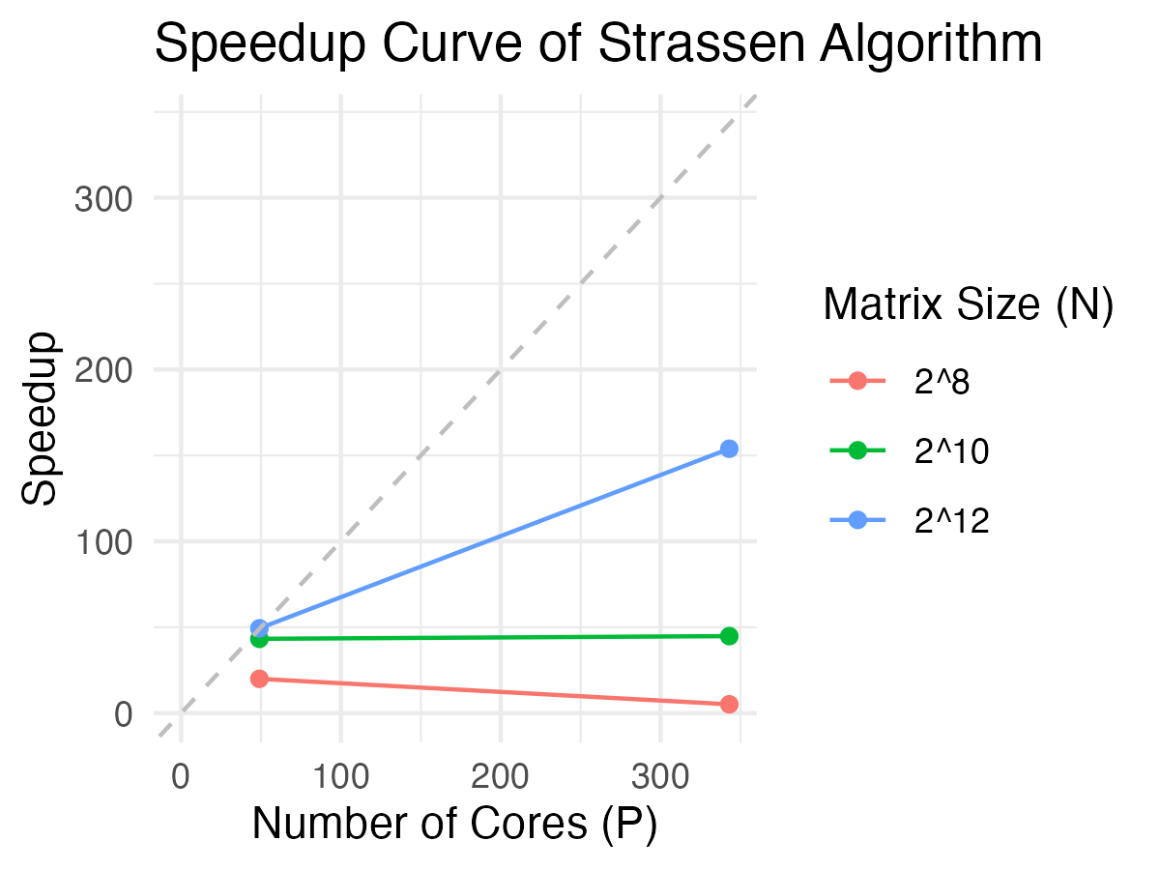
Results

Slide 12
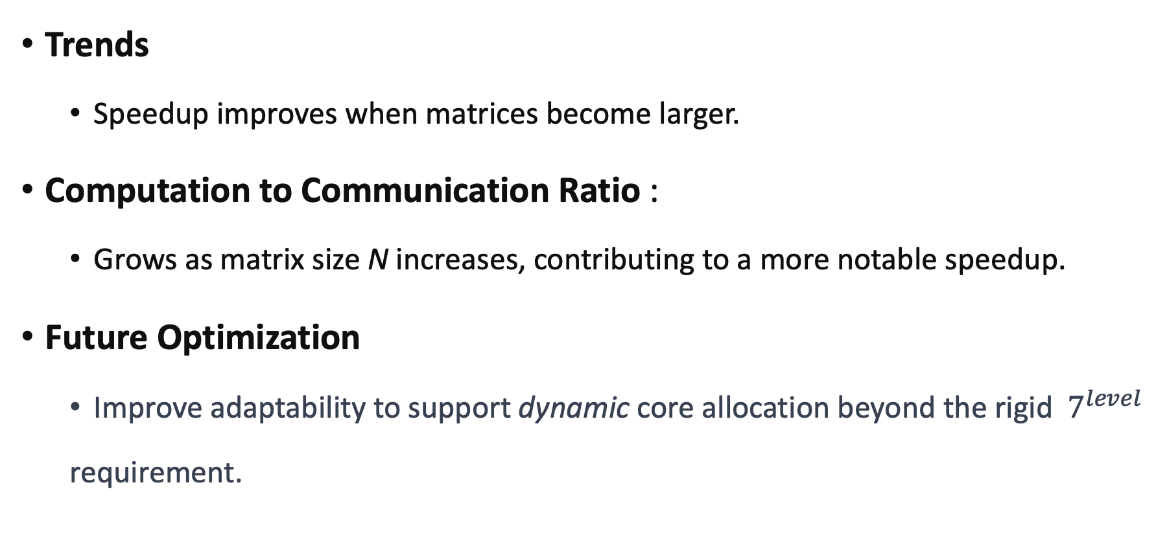
Analysis
Trends
Speedup improves when matrices become larger.
Computation to Communication Ratio :
Grows as matrix size N increases, contributing to a more notable speedup.
Future Optimization
Improve adaptability to support dynamic core allocation beyond the rigid $7^{level}$
requirement.

Slide 13
Summary
Successfully implement the 3 levels via a multi-level master-slave network.
Build a static tree to determine the leader-worker relationship.
Only necessary data is communicated.
Scalable to even higher levels of Strassen’s Algorithm.

Slide 14
Q & A
Thanks for your attention!

Slide 15
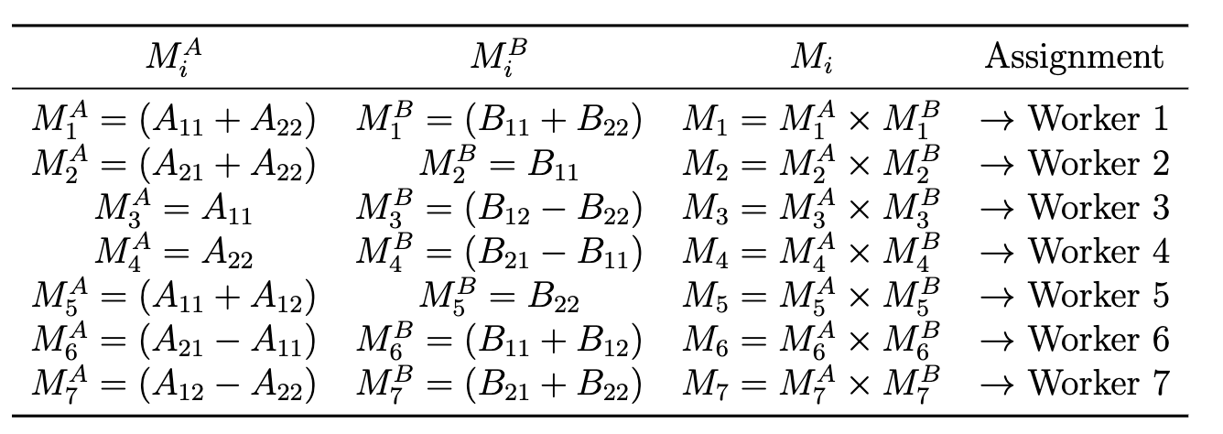
Appendix: Strassen’s Sub-Matrices

