Slide 1
Data Structure Ch6.4-5
Date: 2020/11/17
TA: 江政勳

Slide 2
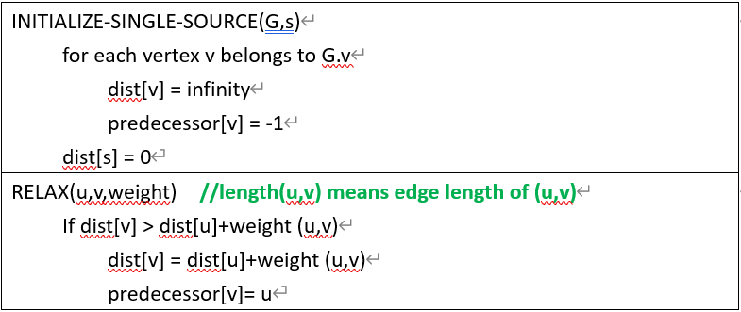
Q1 (1/2)
Many shortest path algorithms are based on two important concepts, INITIALIZE-SINGLE-SOURCE and RELAX. Please explain how RELAX works following the way INITIALIZE-SINGLE SOURCE is explained in the following.
Notes:
改題目給定固定Graph
NIL改成-1
length改成weight

Slide 3
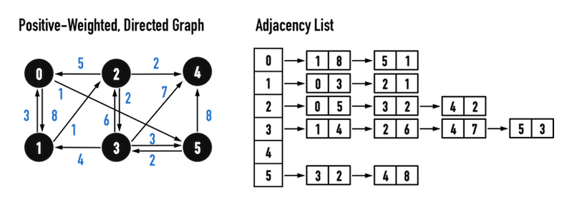
Q1 (2/2)
For a given graph G, please compute the shortest path (Dijkstra’s Algorithm) to all vertices in the input graph G starting from the single source vertex s{0}.

Slide 4
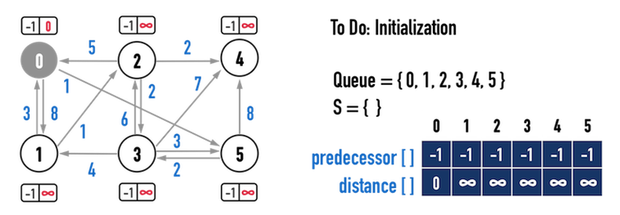
Q1_Ans
(Single Source Shortest Paths): Using the “INITIALIZE-SINGLE-SOURCE” and “RELAX” to do Dijkstra’s Algorithm.
Ref: http://alrightchiu.github.io/SecondRound/single-source-shortest-pathdijkstras-algorithm.html

Slide 5
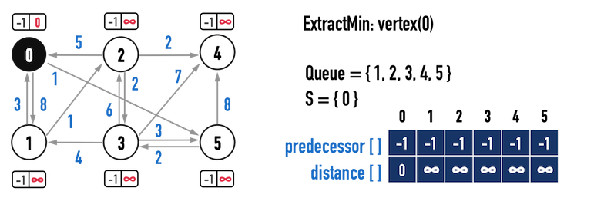
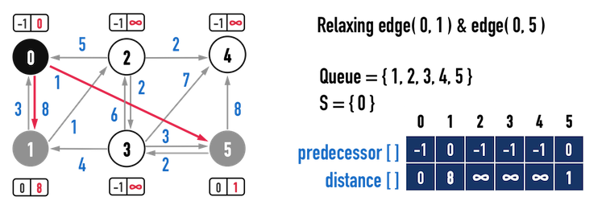
Q1_Ans
Loop 1:

Slide 6
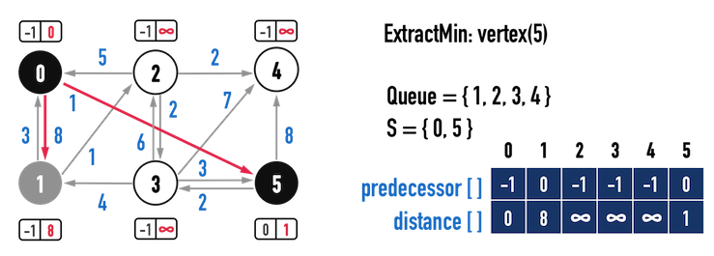
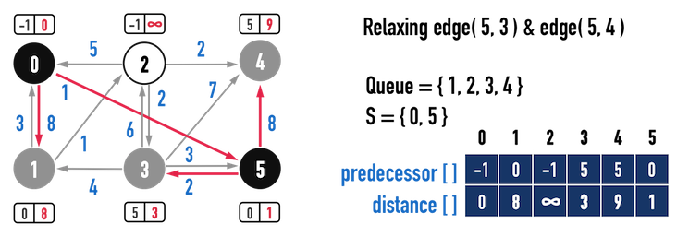
Q1_Ans
Loop 2:

Slide 7
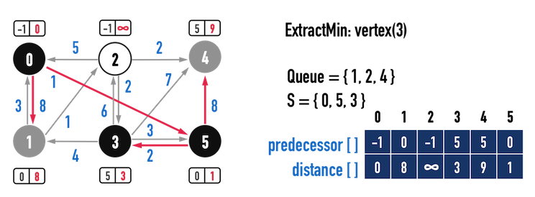
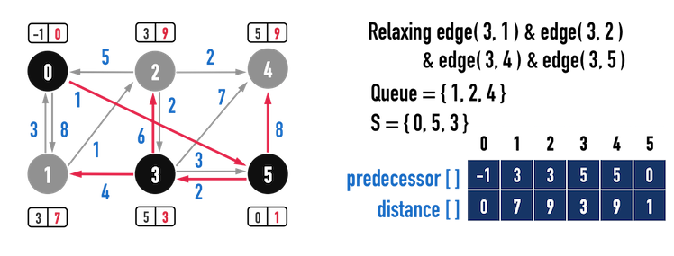
Q1_Ans
Loop 3:

Slide 8
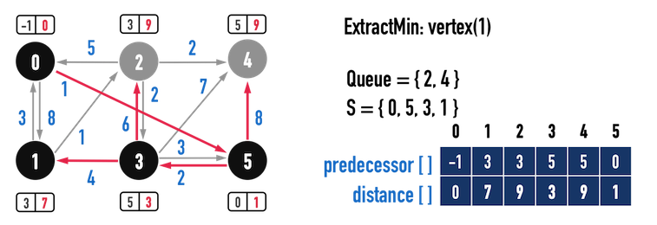
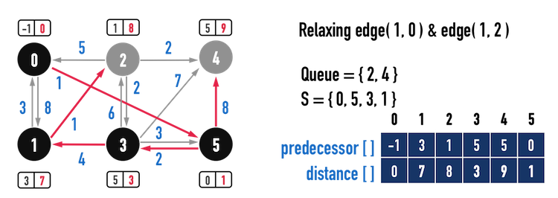
Q1_Ans
Loop 4:

Slide 9
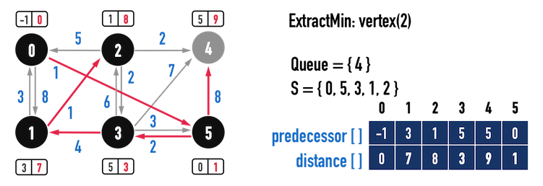
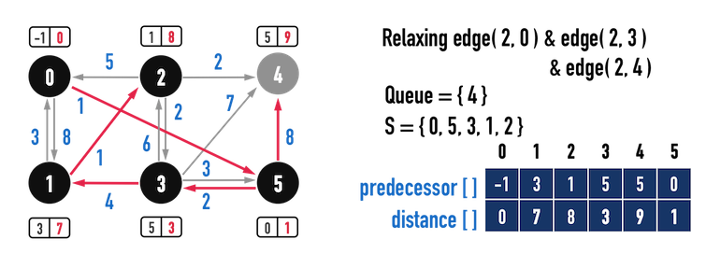
Q1_Ans
Loop 5:

Slide 10
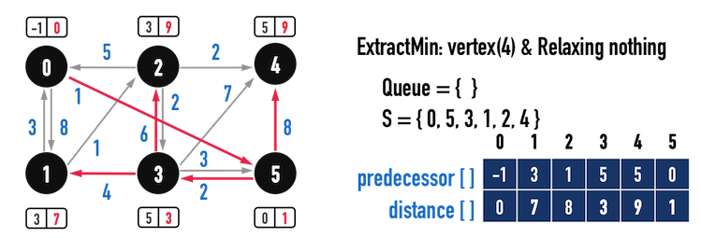
Q1_Ans
Loop 6:

Slide 11
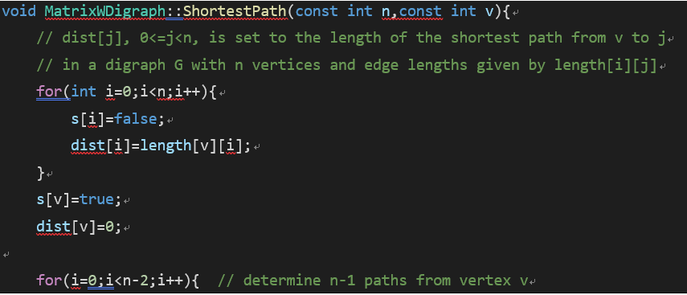
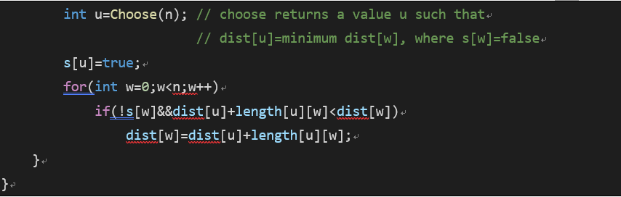
Q2 (1/2)
Read the following pseudocode for Dijkstra shortest path algorithm and then answer the questions.

Slide 12
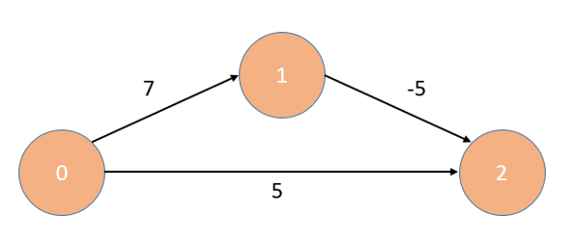
Q2 (2/2)
(1) Explain how the pseudocode work.
(2) When applying Dijkstra algorithm to the graph below starting from the vertex 0, what issue may occur?
Notes:
砍掉 (3)

Slide 13
Q2_Ans (1)
Explain how the pseudocode work.
Ans: (Ref: textbook for 6.4 Single Source All Destinations)
The algorithm ShortestPath as first given by Dijkstra, makes use of these observations to determine the cost of the shortest paths from v to all other vertices in G.
It is assumed that the n vertices of G are numbered 0 through n-1. The set S is maintained as a Boolean array with S(i) = false if vertex i is not in S and S(i) = true if it is.
It is assumed that the graph itself is represented by its length adjacency matrix with length[i][j] being the weight of the edge <i, j> in G.

Slide 14
Q2_Ans (1)
(continue)
If the next shortest path is to vertex u, then the path begins at v, ends at u and goes through only those vertices which are in S. To prove this we must show that all of the intermediate vertices on the shortest path to u must be in S.
for (i=0; i<n-2; i++) //determine (n-1) path from vertex v
The destination of the next path generated must be that vertex u which has the minimum distance, dist(u), among all vertices not in S.
int u = Choose(n); s[u] = true;
Having selected a vertex u as in (ii) and generated the shortest v to u path, vertex u becomes a member of S. At this point the length of the shortest paths starting at v, going through vertices only in S and ending at a vertex w not in S may decrease.
for (int w=0; w<n; w++)
if (! s[w]&&dist[u]+length[u][w] < dist[w]) dist[w] = dist[u]+length[u][w];

Slide 15
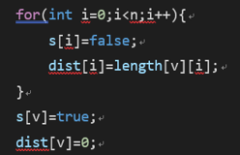
Q2_Ans (2)
(2) When applying Dijkstra algorithm to the graph below starting from the vertex 0, what issue may occur?
Set n = 3 and v = 0
The result:
s[0]=true
s[1]=false
s[2]=false
dist[0]=0
dist[1](=length[0][1])=7
dist[2](=length[0][2])=5

Slide 16
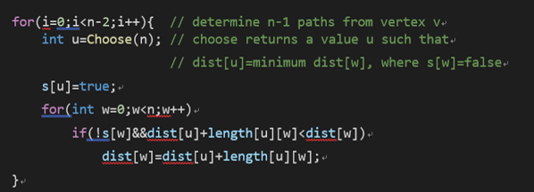
Q2_Ans (2)
The result:
u=2
s[0]=true
s[1]=false
s[2]=true
We known:
!s[w] when w=0 or 2 => if(0 && condition) = 0
The result:
w=1 => dist[2]+length[2][1] (not exist)
=> dist[2]+Large number>dist[1]
Ans:
dist[0] = 0
dist[1] = 7
dist[2] = 5 (not 2)

Slide 17
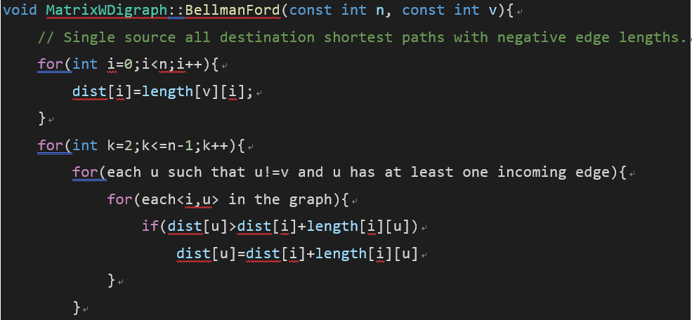
Q3
In addition to the Dijkstra algorithm, BellmanFord algorithm can also solve the single-source shortest paths problem. A sample BellmanFord pseudocode is listed below for your reference.

Slide 18
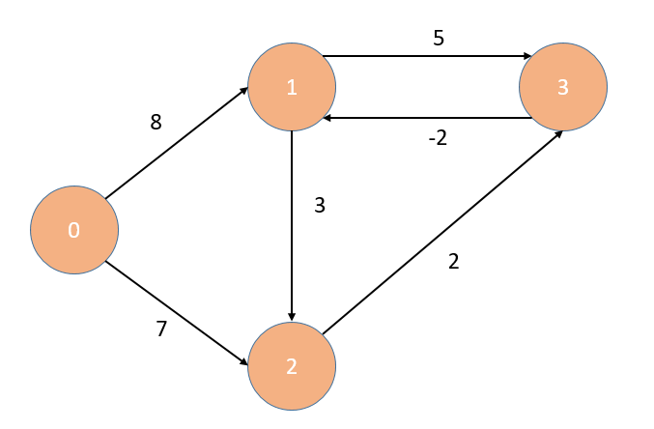
Q3
(1) Please explain the difference between the BellmanFord and the Dijkstra algorithm. Your answer should at least contain the difference of basic idea, and the time complexity.
(2)Please explain how can you apply the BellmanFord algorithm to find the shortest paths of the graph below. You may try to practice how to implement the algorithm.

Slide 19
Q3_Ans (1)
(1) Please explain the difference between the BellmanFord and the Dijkstra algorithm. Your answer should at least contain the difference of basic idea, and the time complexity.
Ans:(Ref:
Dijkstra alg. : Similar to Prim’s algorithm for minimum spanning tree. Starting from the source vertex, if the extended vertex is found to be the shortest path, it is added to the set (S), and continues until all vertices are added to the set. It searches for the next vertex through O(n) and updates the dist length through O(n) time, so it takes O(n²) to complete the shortest distance from the source vertex to all vertices.

Slide 20
Q3_Ans (1)
BellmanFord Alg.: The shortest path from the starting v to all the ending u can be completed by dynamic programming. Suppose that the shortest path from v to u is the shortest path from v to j followed by <j, u> in a Graph. We say i on the <i, u> are all candidates for j, and we are interested in the shortest path, so dist^{k}[u] = min {dist^{k-1}[u], mini{dist^{k-1} [i]+length[i][u]}}. The smallest i is the correct value of j. BellmanFord can find the shortest path length from the starting v to each of the other vertices in Graph (G) by recursively dist^{k} k= 2, …,n-1. It takes O(n²) for one iteration, and it takes O(n³) after all iterations.

Slide 21
Q3_Ans (2)
(2) Please explain how can you apply the BellmanFord algorithm to find the shortest paths of the graph below. You may try to practice how to implement the algorithm. (Ref: textbook for 6.4 Digraph with Negative Costs)
k | dist^{k} [4]
 | 0 | 1 | 2 | 3
1 | 0 | 8 | 7 | ∞
2 | 0 | 8 | 7 | 9
3 | 0 | 7 | 7 | 9

Slide 22
Q4
Although BellmanFord cannot find the shortest path of a graph with negative-cycle, it can be modified to check whether the graph has negative-cycles. Please explain how this can be done.

Slide 23
Q4_Ans
the Bellman–Ford algorithm simply relaxes all the edges, and does this |V|-1 times (if there are no negative cycles).
// Step 1: Initialize
// Step 2: RELAX edges repeatedly |V|-1
// Step 3: check for negative-weight cycles
for each edge (u, v) with weight w in edges do
if distance[u] + w < distance[v] then
error "Graph contains a negative-weight cycle“
// If the shortest path can be found after updating |V|-1 times, it means that between any edge (u, v), the weights add up to be negative, resulting in a continuous decrease in the path. At this point, we can determine that Graph (G) has a negative cycle.
Ref: https://en.wikipedia.org/wiki/Bellman%E2%80%93Ford_algorithm

Slide 24
Q5
The Floyd-Warshall algorithm is used to solve the All-Pairs Shortest Path problem. Please answer the following questions :
(1) What does All-Pairs Shortest Path mean?
(2) Explain the concept of the Floyd-Warshall algorithm.

Slide 25
Q5_Ans (1)
What does All-Pairs Shortest Path mean? (Ref: textbook for 6.4 All Pairs Shortest Paths)
The all-pairs shortest path calls for finding the shortest paths between all pairs of vertices u, v (u≠v).

Slide 26
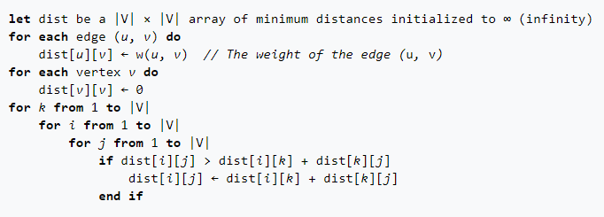
Q5_Ans (2)
(2) Explain the concept of the Floyd-Warshall algorithm.
Regarding each vertex in Graph as a starting vertex, then this problem can be solved as a problem of n independent “single source all destinations”.
Pseudocode: (O(n³))

Slide 27
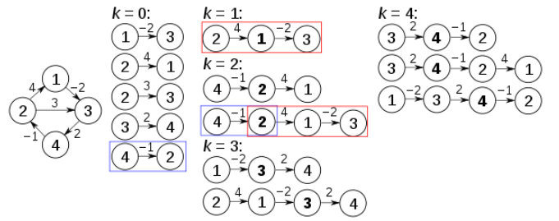
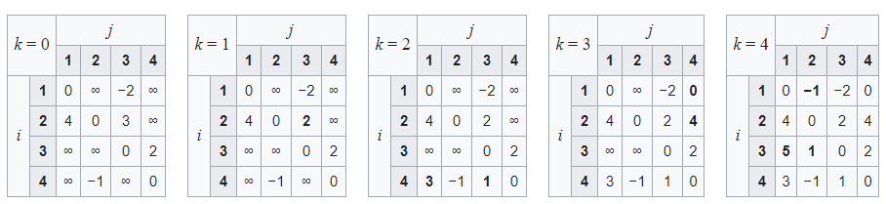
Q5_Ans (2): Example
Ref: https://en.wikipedia.org/wiki/Floyd%E2%80%93Warshall_algorithm

Slide 28
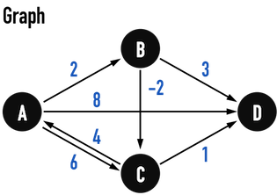
Q6
Please use Floyd-Warshall algorithm to find the shortest path of all vertices in following graph.

Slide 29
Q6_Ans
A⁻¹ | A | B | C | D
A | 0 | 2 | 6 | 8
B | ∞ | 0 | -2 | 3
C | 4 | ∞ | 0 | 1
D | ∞ | ∞ | ∞ | 0
A^{A} | A | B | C | D
A | 0 | 2 | 6 | 8
B | ∞ | 0 | -2 | 3
C | 4 | 6 | 0 | 1
D | ∞ | ∞ | ∞ | 0
1
A^{B} | A | B | C | D
A | 0 | 2 | 0 | 5
B | ∞ | 0 | -2 | 3
C | 4 | 6 | 0 | 1
D | ∞ | ∞ | ∞ | 0
A^{C} | A | B | C | D
A | 0 | 2 | 0 | 1
B | 2 | 0 | -2 | -1
C | 4 | 6 | 0 | 1
D | ∞ | ∞ | ∞ | 0
A^{D} | A | B | C | D
A | 0 | 2 | 0 | 1
B | 2 | 0 | -2 | -1
C | 4 | 6 | 0 | 1
D | ∞ | ∞ | ∞ | 0
3
4
2

Slide 30
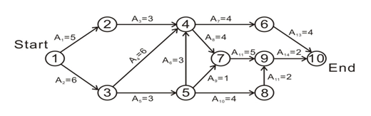
Q7
(1) Explain the concept of the AOE Network (Activity on Edge) and define what is a critical path.
(2) What is the critical path of the AOE network below? Explain your method.

Slide 31
Q7_Ans (1)
Explain the concept of the AOE Network (Activity on Edge) and define what is a critical path. (Ref: textbook for 6.5 AOE network)
AOE:
Directed edge: tasks or activities to be performed
Vertex: events which signal the completion of certain activities
Number: associated with each edge (activity) is the time required to perform the activity
Critical path:
A path that has the longest length and the total costs of all irreducible tasks to complete the project.
Notes:
AoE: 網路上的頂點(vertex)代表事件 (event)。事件發生意味著某項作業(task)已經完成。從某個頂點射出的邊所代表的作業，只有在該頂點所代表的事件發生後才可以開始執行。一個事件只有在所有射向這個頂點的作業都完成後才發生。
Critical path: 由於AOE網路裏的作業可以同時處理，完成整個計畫的最少時間因此是從開始頂點到完成頂點的最長路徑 (路徑長度即路徑上所有作業所需時間的總和)。擁有最大長度的路徑稱為critical path。

Slide 32
Q7_Ans (2)
(2) What is the critical path of the AOE network below? Explain your method.
Hint:
Step 1: Find ee (earliest time of edge)
Step 2: Find le (latest time of edge)
*If le[k] == ee [k] (Vertex of event k), iff e(i) == l(i) (Edge of task A_{i}). It represents a certain task before
a certain event that the time must be executed. This path of longest length ( we cannot ignore these
execution times) is a critical path.

Slide 33
Q7_Ans (2)
[#]: Vertex of event
Step 1_ee: (Ref: textbook for 6.5 AOE)
ee | [1] | [2] | [3] | [4] | [5] | [6] | [7] | [8] | [9] | [10] | Stack
Start | 0 | 0 | 0 | 0 | 0 | 0 | 0 | 0 | 0 | 0 | [1]
Output 1 | 0 | 5 | 6 | 0 | 0 | 0 | 0 | 0 | 0 | 0 | [3, 2]
Output 3 | 0 | 5 | 6 | 12 | 9 | 0 | 0 | 0 | 0 | 0 | [5, 2]
Output 5 | 0 | 5 | 6 | 12 | 9 | 0 | 10 | 13 | 0 | 0 | [8, 2]
Output 8 | 0 | 5 | 6 | 12 | 9 | 0 | 10 | 13 | 15 | 0 | [2]
Output 2 | 0 | 5 | 6 | 12 | 9 | 0 | 10 | 13 | 15 | 0 | [4]
Output 4 | 0 | 5 | 6 | 12 | 9 | 16 | 16 | 13 | 15 | 0 | [7, 6]
Output 7 | 0 | 5 | 6 | 12 | 9 | 16 | 16 | 13 | 21 | 0 | [9, 6]
Output 9 | 0 | 5 | 6 | 12 | 9 | 16 | 16 | 13 | 21 | 23 | [6]
Output 6 | 0 | 5 | 6 | 12 | 9 | 16 | 16 | 13 | 21 | 23 | [10]
Output 10

Slide 34
Q7_Ans (2)
5
12
16
0
16
21
23
6
9
Step 2_le:
13
le[10] = ee[10] = 23
le[6] = min{ le[10] - 4 }=19
le[9] = min{ le[10] - 2 } = 21
le[7] = min{ le[9] - 5 } = 16
le[4] = min{ le[6] - 4, le[7] - 4} = 12
le[2] = min{ le[4] - 3} = 9
le[8] = min{ le[9] – 2 } = 19
le[5] = min{ le[7] – 1, le[8] - 4} = 9
le[3] = min{ le[4] – 6, le[5] - 3} = 6
le[1] = min{ le[3] – 6, le[2] - 5} = 0
The red is critical path, which represents the execution time that must
be executed without margin.

Slide 35
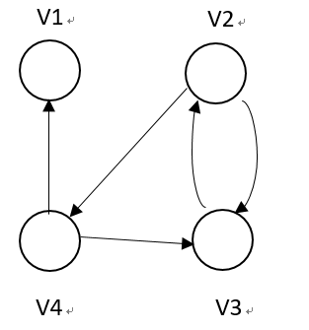
Q8
Please write a pseudo code that can implement your method to find a transitive closure of the graph below.

Slide 36
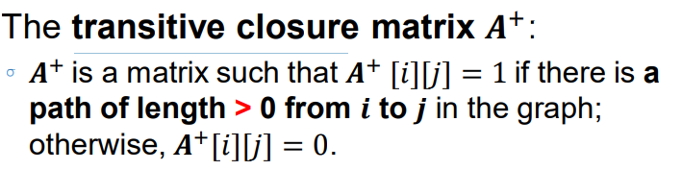
Q8_Ans
(Ref: slide for 6.4 Transitive Closure)
A⁺ | V1 | V2 | V3 | V4
V1 | 0 | 0 | 0 | 0
V2 | 1 | 1 | 1 | 1
V3 | 1 | 1 | 1 | 1
V4 | 1 | 1 | 1 | 1

Slide 37
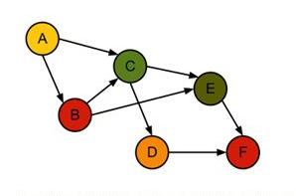
Q9
Please show step-by-step how you apply the DFS to find the topological order of the graph vertices.

Slide 38
Q9_Ans (1/11)
We use “time”, “discover/finish array” and “predecessor array” to implement DFS.
Predecessor: { }
discover
finish
time = 0 (not vertex found)
Ref: http://alrightchiu.github.io/SecondRound/graph-depth-first-searchdfsshen-du-you-xian-sou-xun.html

Slide 39
Q9_Ans (2/11)
Explain from the perspective of Vertex (C):
If recent time is 1
Predecessor: {A}
The first found C’s in-degree of vertex A
1
2 | 3
A
The A’s first found out-degree of vertex C. (time++)
C
If C would not exist any out-degree of vertices. (time++)
A是第一個透過搜尋到C的vertex，在關係上，我們把它視作C的Predecessor。
在我們找到新的vertex時，會將time++，並存到新vertex的discover array中，代表新vertex在該時刻(更新的time)被找到。
並依據DFS繼續從新節點持續往下找，直到沒辦法找到任何out-degree vertices為止，
我們就將time++，並存入finish array中，代表這個vertex的DFS已經做完。
Notes:
解釋discover跟finish怎麼去應用

Slide 40
Q9_Ans (3/11)
1
Notes:
找到第一個vertex(A)，並標示已經發現 ++time

Slide 41
Q9_Ans (4/11)
Found the first out-degree of vertex (C).
1
Predecessor: {A}
2
Notes:
接著尋找所有與vertex(A)相連的vertex，只要遇到第一個沒有搜尋過的，便把該vertex設為新的搜尋起點，並將該vertex的predecessor設為vertex(A)，以及++time。

Slide 42
Q9_Ans (5/11)
Repeat DFS from (C) to (F), we found (F) that would not exist any out-degree of vertices.
1
Predecessor: {A}
2
Predecessor: {C}
3
Predecessor: {E}
4 | 5
Notes:
然後持續前兩個步驟，不再贅述。
當F再也找不到任何「能夠抵達」的vertex時，代表以F作為起點的搜尋已經「結束」。並對finis進行++time，透過predicessor找回E。

Slide 43
Q9_Ans (6/11)
Finish (E).
1
Predecessor: {A}
2
Predecessor: {C}
3 | 6
Predecessor: {E}
4 | 5
Notes:
此時，E也沒有能夠抵達的vertex，代表E也「結束」，所以再E再finish ++time。

Slide 44
Q9_Ans (7/11)
Vertex (C) found the first out-degree of vertex (D) in the remaining vertices.
1
Predecessor: {A}
2
Predecessor: {C}
3 | 6
Predecessor: {E}
4 | 5
Predecessor: {C}
7 | 8
Notes:
然後沿E的predecessor回到C，並發現可以抵達vertex(D)。因為vertex(D)沒有可以抵達的vertex，所以也進行「結束」。

Slide 45
Q9_Ans (8/11)
Finish Vertex (D).
1
Predecessor: {A}
2 | 9
Predecessor: {C}
3 | 6
Predecessor: {E}
4 | 5
Predecessor: {C}
7 | 8
Notes:
沿D的predecessor回到C，發現沒有可以抵達的vertex，所以C也進行「結束」。並透過predecessor回到A。

Slide 46
Q9_Ans (9/11)
Finish Vertex (C).
1
Predecessor: {A}
2 | 9
Predecessor: {C}
3 | 6
Predecessor: {A}
Predecessor: {E}
10 | 11
4 | 5
Predecessor: {C}
7 | 8
Notes:
此時A還有vertex(B)可以抵達，並再predecessor存入A。然後，因為B後面也沒有能夠抵達的vertex，所以進行「結束」。

Slide 47
Q9_Ans (10/11)
Vertex (A) found the first out-degree vertex (B) in the last vertices.
1 | 12
Predecessor: {A}
2 | 9
Predecessor: {C}
3 | 6
Predecessor: {A}
Predecessor: {E}
10 | 11
4 | 5
Predecessor: {C}
7 | 8
Notes:
最後B透過predecessor回到A，發現vertex(A)再也沒有能夠抵達的vertex，就也進行「結束」。

Slide 48
Q9_Ans (11/11)
The topological order output according to the vertex of finish (from big to small):
A (12) > B (11) >C (9) >D (8) >E (6) >F (5)
1 | 12
Predecessor: {A}
2 | 9
Predecessor: {C}
3 | 6
Predecessor: {A}
Predecessor: {E}
10 | 11
4 | 5
Predecessor: {C}
7 | 8
Ref: https://www.geeksforgeeks.org/topological-sorting/
Notes:
最後B透過predecessor回到A，發現vertex(A)再也沒有能夠抵達的vertex，就也進行「結束」。
最先結束的Vertex會被”塗黑”，並放進stack中，當所有vertex都結束以後在一個個pop出來，就是我們的topological order。
為什麼由大到小，詳細看左下角連結。

Slide 49
Q10
Please give a practical example of applying the topological sorting or topological ordering. You must explain the meaning of the nodes and the edges in your example.

Slide 50
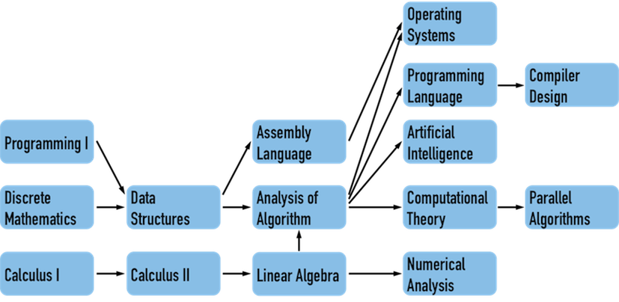
Q10_Ans
Topological order can solve problems that have a "sequential relationship", and "curriculum and its prerequisites" have this relationship.
Ref: http://alrightchiu.github.io/SecondRound/graph-li-yong-dfsxun-zhao-dagde-topological-sorttuo-pu-pai-xu.html

Slide 51
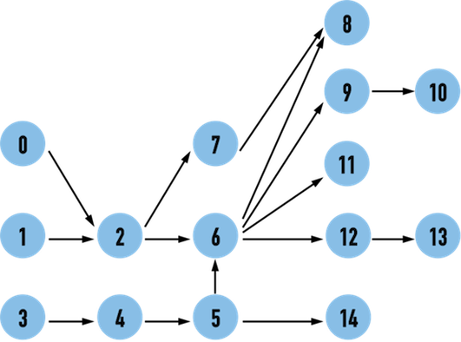
Q10_Ans
In symbolic representation, a vertex represents the course map of CS
For the edge, there are many applications (for examples):
AoV: Edge head can be used as a prerequisite course, and then we can sort our course content (topological order) for the graph.
AoE: Edge can represent each course. Statistics found how much time a student needs to spend. Then we can use the graph to find the critical path and can focus on critical courses to optimize teaching content for reducing overall time.

