Slide 1
Ch8 Hashing
Date: 2020/12/15
TA: 江政勳

Slide 2
Q1
Consider a hash table with 26 buckets and 3 slots. Assume that there are 12 distinct keys and each key begins with a capital letter. If we have the hash function h(k) map each key into a bucket using its leading letter and correspond the letters A to Z to the numbers 0 to 25. Please answer the followings questions :
a. Compute the loading factor of this table and explain what is loading factor.
b. Given the keys D, B, GH, GG, B2, C3, C2, C1, A2, B7, C6, GA, please convert them into home buckets and complete the hash table. In addition, you should indicate which keys are synonyms, and which keys cause overflow.

Slide 3
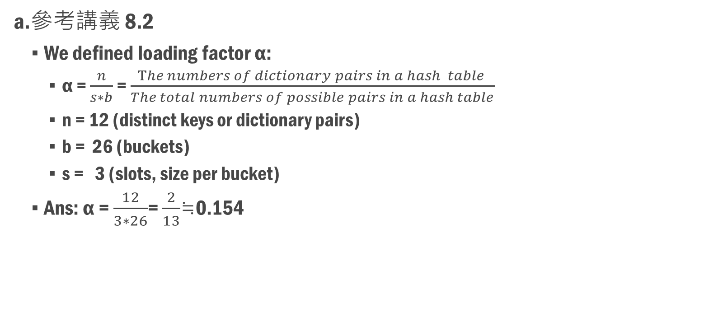
Q1_Ans (a)
a.參考講義 8.2
We defined loading factor α:
α = $\frac{n}{s∗b}$ = $\frac{The numbers of dictionary pairs in a hash table }{The total numbers of possible pairs in a hash table}$
n = 12 (distinct keys or dictionary pairs)
b = 26 (buckets)
s = 3 (slots, size per bucket)
Ans: α = $\frac{12}{3∗26}$= $\frac{2}{13}$≒0.154
Notes:
一個鍵值密度(key density)是n/T的比率，其中n是hash table裡的dictionary pairs而s*b是可能鍵值的總數。

Slide 4
Q1_Ans (b)
Ans:
Synonyms: h(k₁) = h(k₂)
B, B2, B7
C3, C2, C1, C6
G, GG, GA
Overflow:
(Bucket3 have no empty slots)
C6
Bucket, h(k) | Slot1 | Slot2 | Slot3 | Overflow
0 | A2
1 | B | B2 | B7
2 | C3 | C2 | C1 | C6
3 | D
4
5
6 | G | GG | GA
7
…
26
b.

Slide 5
Q2
Please propose a hash application. TAs provide the hash application in cryptography as below. Your answer should have the same integrity as TAs’ example.

Slide 6
Q2_Ans (1)
Secure Hash Algorithm (SHA)，這邊舉例SHA-1：
『安全雜湊演算法』（Secure Hash Algorithm, SHA）是美國 NIST 所制定的標準，於 1993 年與 1995 年分別發表 FIPS PUB 180 與 FIPS PUB 180-1，目前都通稱後面的版本為 SHA-1。
網路安全相關課程，會介紹SHA系列跟MD系列相關的知識及應用。
SHA 是以 MD4 為基礎發展出來的，其設計方式與 MD5 非常相似。首先我們列出 SHA-1 的特性，再來推演它的演算法，特性如下：
可以輸入不定長度的訊息，但不可以超過 2⁶⁴ 個位元。
附加位元後的訊息，以 512 位元為單位。
每個步驟計算與最後運算的結果，皆得到 160 個位元的雜湊值。
Ref: 翻轉電子書系列：資訊與網路安全概論

Slide 7
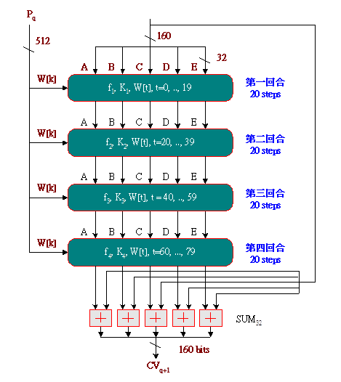
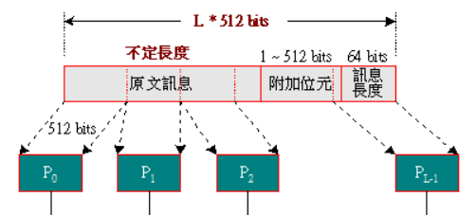
Q2_Ans (2)
P_{q} 傳遞訊息(將m bits的message透過Padding，並使得每一輸出區塊為512bits)
h(k) 為160 bits，會切分成5個32bits register做運算
運算分成 4 rounds，每一round進行20次加法、XOR、shift運算
總共重複做80次，最後再打亂位置排序利用logical 32bits SUM
產生160 bits hash value。
每次32 bits
Padding Message (P_{q})

Slide 8
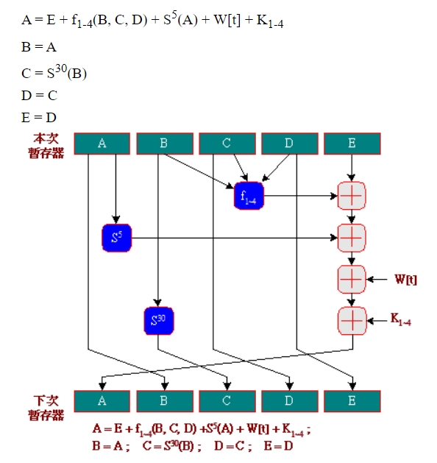
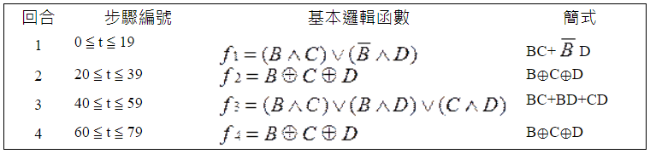
Q2_Ans (3)
這個步驟我們稱作Compression。
f_{1~4} 為steps執行到一定程度時，會換不同的常數代入運算，及
不同的邏輯運算。(Steps總共80個，每20個steps換一個輸入常數)。
S^{n} 代表對該32bits register做向左n個shift，且register為一
個circular，所以被擠出去的n個bits，會由register右側放入。
最後運算的結果，會打亂進行擺放，給下一次運算時，輸入的
register進行使用。
總結：通過大量常數加法、XOR、shift以及位置擺放打亂的操作
以後，我們可以獲得一個足夠隨機的hash value。
f_{1~4} 邏輯運算

Slide 9
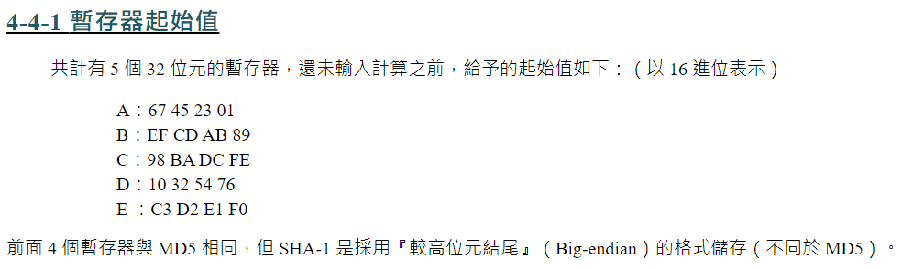
Q2_Ans (Appendix_1)

Slide 10
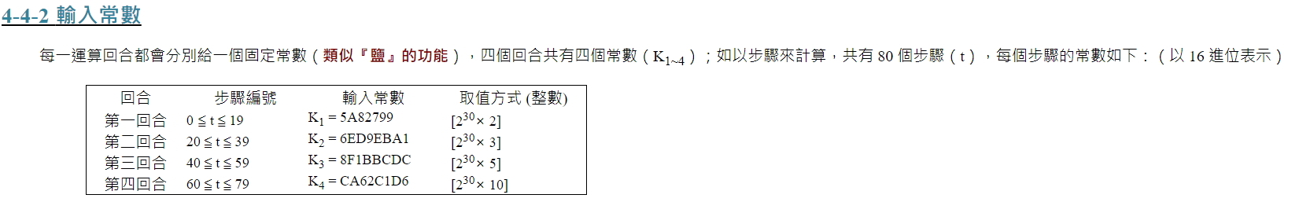
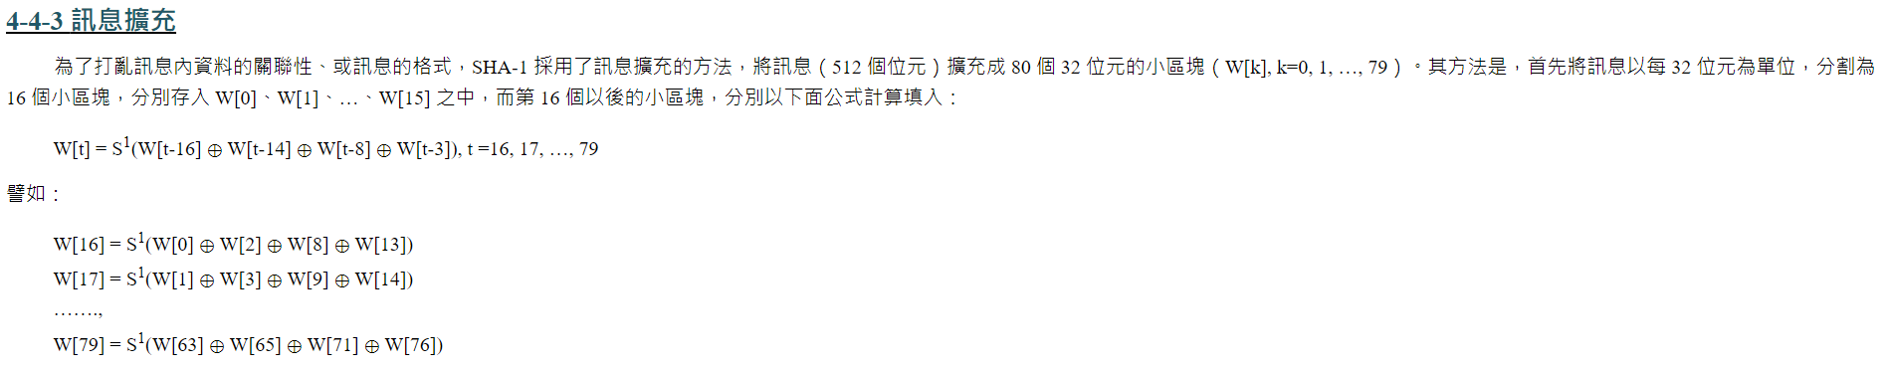
Q2_Ans (Appendix_2)

Slide 11
Q3 (a)
When implementing a hash table, one of the commonly used collision resolution methods is open addressing. Assume that k is the key, m is the size of the hash table, and each table entry can hold one key.
a. The simplest open addressing method is called linear probing, where if a slot is already occupied, the following slots are “probed” sequentially. Assume an auxiliary hash function h’(k)=k mod m. Please give the hash function h(k,i) of linear probing with the given auxiliary function, where i is the number of times the hash table has been probed with this key (and thus i always starts from 0).
https://alrightchiu.github.io/SecondRound/hash-tableopen-addressing.html
Notes:
https://exam.lib.ntu.edu.tw/sites/default/files/exam/graduate/108/108_graduate_413.pdf 台大108學年度碩士班考試試題

Slide 12
Q3 (b)
b. Linear probing is easy to implement but suffers from the problem of primary clustering. A more complex open addressing method which can mitigate this problem is double hashing, using a hash function in the form of h(k,i)=(h₁(k)+ih₂(k)) mod m, with two auxiliary hash functions h₁(k) and h₂(k). The number i is the number of times the hash table has been probed with the key k. Assume two auxiliary hash functions h₁(k)=k mod 16, h₂(k)=1+(k mod 15). Show the final hash table content after inserting all of the following keys to an initially empty hash table in the given order: {16,3,35,67,51,1,15,31,19,17}.

Slide 13
Q3 (c)
c. Prof. Alpha proposes a different double hashing method, using two auxiliary hash functions h1(k)=k mod 16 and h2(k)=2(k mod 8). Assume the table size m is 16. Please give an example to illustrate why Prof. Alpha’s method is problematic.

Slide 14
Q3_Ans (a)
a. h(k,i)=(h’(k)+i) mod m
h’(k)=k mod m 代入，得h(k) = ((k mod m)+i) mod m
If i is zero, then it maps to h(k) = k mod m, and this number must in the range of 0 to m-1.
However, if h(k, 0) maps to a nonempty entry, we calculate h(k, 1) = ((k mod m)+1) mod m as an alternative, this hash function maps to next entry of the previous entry.
If there is still nonempty in this entry, then we find h(k, 2) = h((k mod m)+2). By doing “previous i + 1”, we can iteratively find an empty entry, if there is at least one empty entry in the hash table.

Slide 15
Q3_Ans (b_1)
b. h(k, i) = ((k mod 16)+i*(1+(k mod 15))) mod m
Initial key set: {16,3,35,67,51,1,15,31,19,17}
h(16, 0) = (16%16) % 16 = 0
h(3, 0) = (3%16)%16 = 3
h(35, 0) = (35%16)%16 = 3 (collision) => h(35,1) = (35%16+(1+(35%15)))%16= 9
h(67, 0) = (67%16)%16 = 3 (collision) => h(67,1) = (67%16+(1+(67%15)))%16=11
h(51, 0) = (51%16)%16 = 3 (collision) => h(51, 1) = (51%16+(1+(51%15)))%16=10
h(1, 0) = (1%16)%16 = 1
h(15, 0) = (15%16) %16 = 15

Slide 16
Q3_Ans (b_2)
b. (continue)
h(31, 0) = (31%16) %16 =15 (collision)
=>h(31, 1) = (31%16+1*(1+(31%15)))%16=1 (collision)
=> h(31,2)=(31%16+2*(1+(31%15)))%16=3 (collision)
=> h(31, 3) = (31%16+3*(1+(31%15)))%16=5
h(19, 0) = 19%16 = 3 (collision) => h(19, 1) = (19%16+1*(1+(19%15)))%16 = 8
h(17, 0) = 17%16 = 1 (collision) => h(17, 1) = (17%16+1*(1+(17%15)))%16= 4

Slide 17
Q3_Ans (b_3)
Hash Table
0 | 16
1 | 1
2
3 | 3
4 | 17
5 | 31
6
7
8 | 19
9 | 35
10 | 51
11 | 67
12
13
14
15 | 15
b. (continue)

Slide 18
Q3_Ans (c)
c. h(k, i) = (k mod 16 + i * 2*(k mod 8)) mod m, set m=16
If the key A has the multiple of 16, we set k = 16A, where A ∈ N
h(16A, 0) = (16%16+0*2*(16A%8))%16=0，no matter how we change the value of i.
So, the collision always occurs and we cannot fix it by using this hash function.

Slide 19
Q4
Consider a hash function h(k)=k%D, where D is to be defined. We wish to find a proper D value using minimal number of attempts, while each attempt requires supplying the function with k and observing the result of h(k). Indicate how this may be achieved in the following two cases.
a. D is known to be a prime number in the range [10, 20].
b. D is of the form 2^{k}, where k is an integer in [1, 5].

Slide 20
Q4_Ans
a. The prime between [10, 20] => D may be 11, 13, 17 and 19.
我們假設k=20，並觀察h(k)=k % D可以發現，分別會得到9, 7, 3, 1，不同的D會有不同的h(k)結果，所以可以利用 h(20) 一次推導出D為哪一個質數。
b. D is of the form 2^{k} , when k is an integer in [1, 5] => D may be 2, 4, 8, 16, 32.
我們假設k=31，並觀察h(k)=k%D，會發現可能的結果是1, 3, 7, 15, 31，每一個出來的結果都不一樣，因此我們可以藉由 h(31) 推導 D 是哪一個2的k次方項。

Slide 21
Q5
Suppose that you are to design a Bloom filter with minimum P(u) with n=100000, m=5000, and u=1000.
a. Use any of the results obtained in the textbook, and determine the number of hash functions required. Show your computations.
b. What is the probability, P(u), of a filter error with the required number of hash functions computed above?

Slide 22
Q5_Ans
a. 跟 b. 一起解釋
已知 n=100000, m=5000, and u=1000.
由講義8.4.2 對Bloom filter design的介紹，為了最小化Bloom filter失誤機率，我們對P(u)進行微分，並設定其結果為0 (找極值)可以得到：
h = (log_{e}2)*(m/u) ~ 0.693*(m/u) = 3.465
取其upper bound及lower bound 獲得h = 3 or 4
我們再將 h 代入 P(u) 的公式中，算出不同hash function下的失誤機率，可得：
h=3, P(u)~e^{-u/n}*(1-e^{-uh/m})^{h} ~0.0909
h=4, P(u) ~e^{-u/n}*(1-e^{-uh/m})^{h} ~0.091
計算後發現，最小P(u)發生於h=3，並且失誤機率為0.0909 (9.09%)

Slide 23
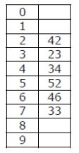
Q6
A hash table of length 10 uses open addressing with the hash function h(k)=k mod 10, and linear probing. After inserting 6 values into an empty hash table, the table is as shown below.
Which one of the following choices gives a possible order in which the key values could have been inserted in the table? (A) 46, 42, 34, 52, 23, 33 (B) 34, 42, 23, 52, 33, 46 (C) 46, 34, 42, 23, 52, 33 (D) 42, 46, 33, 23, 34, 52

Slide 24
Q6_Ans
(A)
(B)
0
1
2 | 42
3 | 52
4 | 34
5 | 23
6 | 46
7 | 33
8
9
0
1
2 | 42
3 | 23
4 | 34
5 | 52
6 | 33
7 | 46
8
9
It doesn’t create the hash table as the element 52 appears before 23
It doesn’t create the hash table as the element 33 appears before 46

Slide 25
Q6_Ans
(C)
(D)
0
1
2 | 42
3 | 23
4 | 34
5 | 52
6 | 46
7 | 33
8
9
0
1
2 | 42
3 | 33
4 | 23
5 | 34
6 | 46
7 | 52
8
9
It doesn’t create the hash table as the element 23 appears before 34
Ans: (C)

Slide 26
Q7
Which one of the following hash functions on integers will distribute keys most uniformly over 10 buckets numbered 0 to 9 for i ranging from 0 to 2020?
(A) h(i) =i^2 mod 10 (B) h(i) =i^3 mod 10 (C) h(i) = (11 ∗ i^2) mod 10 (D) h(i) = (12 ∗ i) mod 10
https://www.geeksforgeeks.org/gate-gate-cs-2015-set-2-question-43/

Slide 27
Q7_Ans (A)
(A) Since mod 10 is used, the last digit matters. If you do square all numbers from 0 to 9, you get following:
Number | Square | Last Digit
0 | 0 | 0
1 | 1 | 1
2 | 4 | 4
3 | 9 | 9
4 | 16 | 6
5 | 25 | 5
6 | 36 | 6
7 | 49 | 9
8 | 64 | 4
9 | 81 | 1

Slide 28
Q7_Ans (B)
(B) Since mod 10 is used, the last digit matters. If you do cube all numbers from 0 to 9, you get following:
Number | Cube | Last Digit
0 | 0 | 0
1 | 1 | 1
2 | 8 | 8
3 | 27 | 7
4 | 64 | 4
5 | 125 | 5
6 | 216 | 6
7 | 343 | 3
8 | 512 | 2
9 | 729 | 9

Slide 29
Q7_Ans (C)
(C) Since mod 10 is used, the last digit matters. If you do 11*square all numbers from 0 to 9, you get following:
Number | Square | Last Digit
0 | 0 | 0
1 | 11 | 1
2 | 44 | 4
3 | 99 | 9
4 | 176 | 6
5 | 275 | 5
6 | 396 | 6
7 | 539 | 9
8 | 704 | 4
9 | 891 | 1

Slide 30
Q7_Ans (D)
(D) Since mod 10 is used, the last digit matters. If you do 12*I all numbers from 0 to 9, you get following:
Number | Square | Last Digit
0 | 0 | 0
1 | 12 | 2
2 | 24 | 4
3 | 36 | 6
4 | 48 | 8
5 | 60 | 0
6 | 72 | 2
7 | 84 | 4
8 | 96 | 6
9 | 108 | 8

Slide 31
Q7_Ans Summary
(A), (B), (C) and (D) 從 i= 0~9，我們就可以觀察到 (A), (C) and (D)都有很嚴重的collision狀況，而(B)則相對比較均衡每一個值都在一個bucket裡面。
Ans: (B)
如果要更嚴謹的證明方法，就要寫程式跑 i=0~2020 mod 10之後，並算使用bucket的分布，並算出標準差，而擁有標準差最小的代表越均勻，也就是我們的(B)。

Slide 32
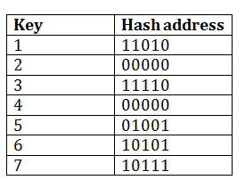
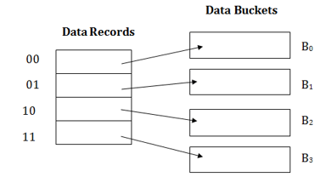
Q8
The dynamic hashing is used to overcome the problem of static hashing like bucket overflow without resulting in poor performance. Please answer the questions below.
(a) Please discuss the strengths and weaknesses of dynamic hashing.
(b) Consider the following grouping of keys mapped into buckets, depending on the prefix of their hash address. Please fill up the data buckets.
(C) If we need to insert key 9 with hash address 10001 into the above structure, what is the result of the insertion. (Please draw the similar structure as the second figure)
https://www.javatpoint.com/dbms-dynamic-hashing

Slide 33
Q8_Ans (a)
(a)
Advantages of dynamic hashing:
In this method, the performance does not decrease as the data grows in the system. It simply increases the size of memory to accommodate the data.
In this method, memory is well utilized as it grows and shrinks with the data. There will not be any unused memory lying.
This method is good for the dynamic database where data grows and shrinks frequently.
Disadvantages of dynamic hashing:
In this method, if the data size increases then the bucket size is also increased. These addresses of data will be maintained in the bucket address table. This is because the data address will keep changing as buckets grow and shrink. If there is a huge increase in data, maintaining the bucket address table becomes tedious.
In this case, the bucket overflow situation will also occur. But it might take little time to reach this situation than static hashing.

Slide 34
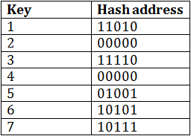
Q8_Ans (b)
(b)
The last two bits of 2 and 4 are 00. So it will go into bucket B₀. The last two bits of 5 and 6 are 01, so it will go into bucket B₁. The last two bits of 1 and 3 are 10, so it will go into bucket B₂. The last two bits of 7 are 11, so it will go into B₃.
Data Buckets
Data Records
Key2, Key4
B0
00
01
Key5, Key6
B1
10
Key1, Key3
B2
11
Key7
B3
Notes:
The dynamic hashing method is used to overcome the problems of static hashing like bucket overflow.
In this method, data buckets grow or shrink as the records increases or decreases. This method is also known as Extendable hashing method.
This method makes hashing dynamic, i.e., it allows insertion or deletion without resulting in poor performance.

Slide 35
Q8_Ans (c_1)
(c) Insert key 9 with hash address 10001 into the above structure
Since key 9 has hash address 10001, it must go into the first bucket. But bucket B1 is full, so it will get split.
The splitting will separate 5, 9 from 6 since last three bits of 5, 9 are 001, so it will go into bucket B1, and the last three bits of 6 are 101, so it will go into bucket B5.
Keys 2 and 4 are still in B0. The record in B0 pointed by the 000 and 100 entry because last two bits of both the entry are 00.
Keys 1 and 3 are still in B2. The record in B2 pointed by the 010 and 110 entry because last two bits of both the entry are 10.
Key 7 are still in B3. The record in B3 pointed by the 111 and 011 entry because last two bits of both the entry are 11.

Slide 36
Q8_Ans (c_2)
Ans:
Key2, Key4
000
001
Key5, Key9
010
011
Key1, Key3
100
101
Key7
110
111
Key6

