Slide 1
HW: 11/24 Ch. 7.1-4 Sorting

Slide 2
Q1
One day, one of your friends challenges you to play a game which requires you to guess a number, within the rage of 1 to 100, that he has set in mind. If you get a wrong guess, he would tell you the value is higher or lower than your guess. What is the maximum number of guesses that you can guarantee to get the right answer? Please prove your approach. [hint: Binary Search]

Slide 3
Ans 1:
The question is equivalent to find the existence of a element in sorted number array. If the guess is higher than the number, the player return that “Too high”. If the guess is lower, then return that “Too low”. As the binary search, each guess of middle value can exclude half of possible values, so the time complexity is O(log n).
The maximum number of guesses is log 100 -> 7 times

Slide 4
For example: the guess number is 33 and the range is 1 to 100.
int binarySearch(int arr[], int low_index, int high_index, int element)
{
if (high_index >= low_index) {
int mid = low_index + (high_index – low_index) / 2;
// If the element is present at the middle
if (arr[mid] == element)
return mid;
// If element is smaller than mid, then in left subarray
if (arr[mid] > element)
return binarySearch(arr, low_index, mid - 1, element);
// Else the element can only be present, in right subarray
return binarySearch(arr, mid + 1, high_index, element);
}
// We reach here when element is not present in array
return -1;
}
1, 2, …, 33,…,50, ….,99, 100 ->Choose 50, too high
1, 2, …,25 , 33,…,49 -> Choose 25, too low
26, …,33, …. 37, ….49 -> Choose 37, too high
26, … ,31, 32,33, …. 36 -> Choose 31, too low
32,33, 34 ,35, 36 -> Choose 34, too high
32,33 -> choose 32, too low
33 -> -> choose 33, exactly!!!

Slide 5
Q2
Please define what is a stable sorting algorithm and an unstable sorting algorithm, and then give an example to each type of sorting algorithm.

Slide 6
Ans:
stable sorting algorithm: The order of two equal keys appear same order after sorting algorithm. For example, Insertion sort, Merge Sort, Bubble Sort.
unstable sorting algorithm: The order of two equal keys may appear different order after sorting algorithm. For example, Heap Sort, Quick Sort.
For example: 4, 3, 5, 5, 7, 10, 9
Stable: 3, 4, 5, 5, 7, 9, 10
Unstable: 3, 4, 5, 5, 7, 9, 10

Slide 7
Q3
(a) Show the step-by-step insertion sort result of the following list, [5, 6, 3, 8, 2].
(b) Show the step-by-step merge sort result of the following list, [50, 10, 90, 30, 70, 40, 80, 60, 20]

Slide 8
Ans: (a) insertion sorting
5, 6, 3, 8, 2
-> 5, 6, 3, 8, 2
-> 5, 6, 3, 8, 2
-> 3, 5, 6, 8, 2
-> 3, 5, 6, 8, 2
-> 2, 3, 5, 6, 8

Slide 9
Ans: (b) merge sorting
50, 10, 90, 30, 70, 40, 80, 60, 20
10, 50, 30, 90, 40, 70, 60, 80, 20
10, 30, 50, 90, 40, 60, 70, 80, 20
10, 30, 40, 50, 60, 70, 80, 90, 20
10, 20, 30, 40, 50, 60, 70, 80, 90

Slide 10
Q4
Suppose that we are sorting an array of eight integers using quicksort, and we have just finished the first partitioning with the following resulted array: 2 5 1 7 9 12 11 10
Among the following statements which one is correct? Explain why.
The pivot could be either the array element containing 7 or 9.
The pivot could be the array element containing 7, but not 9.
The pivot is not the array element containing 7, but the one of 9.
Neither the array element containing 7 nor 9 is the pivot.

Slide 11
Ans: The pivot could be either the array element containing 7 or 9. (a)
Array which participated by pivot should each left elements lower than pivot, and each right elements higher than pivot.
If 7 is pivot: 2 5 1 7 9 12 11 10
The left elements are all lower than pivot, and the right elements are all higher than pivot.
If 9 is pivot: 2 5 1 7 9 12 11 10
The left elements are all lower than pivot, and the right elements are all higher than pivot.

Slide 12
Q5
Let P be a Quick Sort Program to sort numbers into ascending order using the first element as pivot. Suppose that the total number of comparisons is t1 if apply P to the inputs {1, 2, 3, 4, 5}, and is t2 if apply P to {4, 1, 5, 3, 2}. Then which of the following shall hold?
(a) t1=5 (b) t1<t2 (c) t1>t2 (d) t1=t2

Slide 13
Ans is (c) t1>t2
void QuickSort(int arr[], const int left, const int right){
if(left < right){
int i = left, j = right + 1, pivot = arr[left];
do{
do i++; while(arr[i] < pivot);
do j--; while(arr[j] > pivot);
if(i < j) swap(arr[i], arr[j]);
}while(i < j);
swap(arr[left], arr[j]);
QuickSort(arr, left, j - 1);
QuickSort(arr, j + 1, right);
}
}
T1: 1, 2, 3, 4, 5
-> 1, [2, 3, 4, 5] #comparison 6
-> 2, [3, 4, 5] #comparison 5
-> 3, [4, 5] #comparison 4
-> 4, [5] #comparison 3
T2: 4, 1, 5, 3, 2
->[3, 1, 2,] 4, [5] #comparison 6
-> [2, 1,] 3 #comparison 4
-> [1,] 2 #comparison 3

Slide 14

Q6
Please prove that under the limitation of comparison and interchange, the best time complexity of sorting algorithm is $O(n\log{n})$.

Slide 15
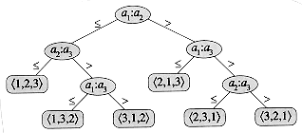
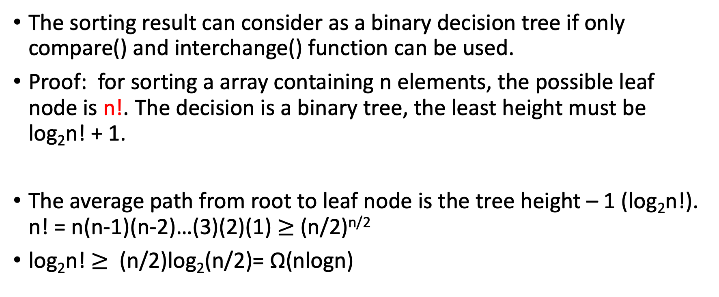
Ans
The sorting result can consider as a binary decision tree if only compare() and interchange() function can be used.
Proof: for sorting a array containing n elements, the possible leaf node is n!. The decision is a binary tree, the least height must be log₂n! + 1.
The average path from root to leaf node is the tree height – 1 (log₂n!). n! = n(n-1)(n-2)…(3)(2)(1) $≥$ (n/2)^{n/2}
log₂n! $≥$ (n/2)log₂(n/2)= Ω(nlogn)

Slide 16
Q7
Quicksort is a fast and commonly used comparison-based sorting algorithm. Please refer to the following quicksort pseudocode and answer questions listed after.
QUICKSORT(A,p,r)
1 if p<r
2 q=PARTITION(A,p,r)
3 QUICKSORT(A,p,q-1)
4 QUICKSORT(A,q+1,r)
PARTITION(A,p,r)
1 x=A[r]
2 i=p-1
3 for j=p to r-1
4 if A[j]<=x
5 i=i+1
6 exchange A[i] with A[j]
7 exchange A[i+1] with A[r]
8 return i+1

Slide 17
Q7
(a) Answer true or false :
(1) The output of QUICKSORT() above is a non-increasing sorted sequence.
(2) The QUICKSORT() above is a stable sorting algorithm.
(3) The QUICKSORT() above is an in-place sorting algorithm.
(b) The given version of QUICKSORT above cannot efficiently process the cases in which the input array has a large number of repeated elements. Analyze the worst-case running time which occurs when all n keys in the input array A are identical. Please show the complexity in the big-O notation in terms of n.

Slide 18
Ans (a)
F (1) The output of QUICKSORT() above is a non-increasing sorted sequence.
non-increasing: every next element is less than or equal to but not greater than any previous element. For example, 9, 8, 6, 3, 3, 1.
F (2) The QUICKSORT() above is a stable sorting algorithm.
F (3) The QUICKSORT() above is an in-place sorting algorithm.
An algorithm is in-place if it uses only a constant amount of memory in addition of that used to store the input. O(log n) stack space pointers

Slide 19
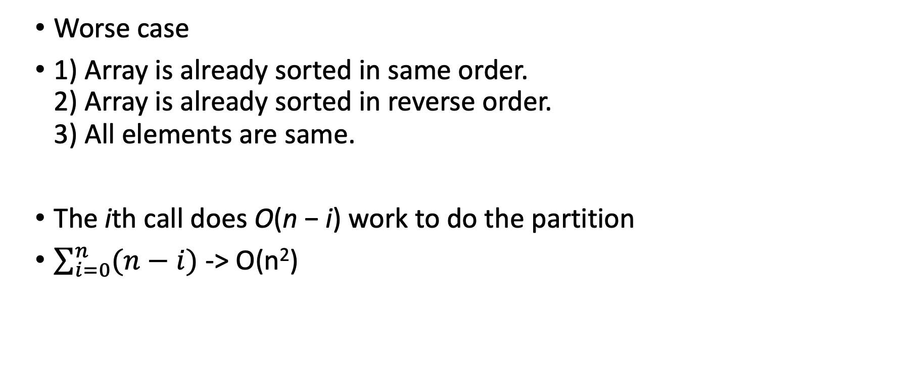
Ans (b)
Worse case
1) Array is already sorted in same order. 2) Array is already sorted in reverse order. 3) All elements are same.
The ith call does O(n − i) work to do the partition
$\sum_{i=0}^{n}{(n−i)}$ -> O(n²)

Slide 20
Q7
(c) To address the previously mentioned problematic case, we shall now develop a new partition algorithm PARTITIONTHREE() that separates the input keys into three groups, the ones that are smaller than, identical to, or larger than the pivot key x. The return values q1 and q2 represent the indices of the first and the last keys of the group that equals the pivot key. Please fill the blanks (A), (B), (C) in PARTITIONTHREE() below to complete the implementation, such that QUICKSORTTHREE() runs in O(n)-time when the input array has all n elements identical.

Slide 21
Q7
QUICKSORTTHREE(A, p, r)
1 if p<r
2 (q1,q2)=PARTITIONTHREE(A,p,r)
3 QUICKSORTTHREE(A,p,q1-1)
4 QUICKSORTTHREE(A,q2+1,r)
PARTITIONTHREE(A,p,r)
1 x=A[r]
2 q1=p
3 q2=r
4 j=p
5 while j<=q2
6 if A[j]<x
7 exchange A[j] with A[q1]
8 //(A)
9 j=j+1
10 elseif A[j]>x
11 exchange A[j] with A[q2]
12 //(B)
13 else
14 //(C)
15 return (q1,q2)

Slide 22
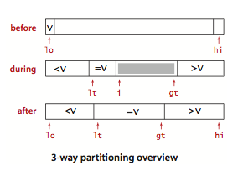
Ans (c)
PARTITIONTHREE(A,p,r)
1 x=A[r]
2 q1=p
3 q2=r
4 j=p
5 while j<=q2
6 if A[j]<x
7 exchange A[j] with A[q1]
8 //(A) q1 = q1 + 1
9 j=j+1
10 elseif A[j]>x
11 exchange A[j] with A[q2]
12 //(B) q2 = q2 - 1
13 else
14 //(C) j = j+1
15 return (q1,q2)

Slide 23
Ans (c)
Key idea: if the element is equal to pivot, put the elements in middle and quicksort() the left and right side part.

Slide 24
Q8
Write the status of the list (12, 2, 16, 30, 8, 28, 4, 10, 20, 6, 18) at the end of each iteration of the for loop of InserionSort (Program 7.5).

Slide 25
Ans
j [1] [2] [3] [4] [5] [6] [7] [8] [9] [10] [11]
- 12, 2, 16, 30, 8, 28, 4, 10, 20, 6, 18
2 2, 12, 16, 30, 8, 28, 4, 10, 20, 6, 18
3 2, 12, 16, 30, 8, 28, 4, 10, 20, 6, 18
4 2, 12, 16, 30, 8, 28, 4, 10, 20, 6, 18
5 2, 8, 12, 16, 30, 28, 4, 10, 20, 6, 18
6 2, 8, 12, 16, 28, 30, 4, 10, 20, 6, 18
7 2, 4, 8, 12, 16, 28, 30, 10, 20, 6, 18
8 2, 4, 8, 10, 12, 16, 28, 30, 20, 6, 18
9 2, 4, 8, 10, 12, 16, 20, 28, 30, 6, 18
10 2, 4, 6, 8, 10, 12, 16, 20, 28, 30, 18
11 2, 4, 6, 8, 10, 12, 16, 18, 20, 28, 30

Slide 26
Q9
Draw a figure similar to Figure 7.1 starting with the list (12, 2, 16, 30, 8, 28, 4, 10, 20, 6, 18).

Slide 27
Ans
1 2 3 4 5 6 7 8 9 10 11 left right
[12, 2, 16, 30, 8, 28, 4, 10, 20, 6, 18] 1 11
[4, 2, 6, 10, 8,] 12, [28, 30, 20, 16, 18] 1 5
[2,] 4, [6, 10, 8,] 12, [28, 30, 20, 16, 18] 1 1
2, 4, [6, 10, 8,] 12, [28, 30, 20, 16, 18] 3 5
2, 4, 6, [10, 8,] 12, [28, 30, 20, 16, 18] 4 5
2, 4, 6, [8,] [10,] 12, [28, 30, 20, 16, 18] 4 4
2, 4, 6, 8, [10,] 12, [28, 30, 20, 16, 18] 5 5
2, 4, 6, 8, 10, 12, [28, 30, 20, 16, 18] 7 11
2, 4, 6, 8, 10, 12, [16, 18, 20,] 28, [30,] 7 9
2, 4, 6, 8, 10, 12, 16, [18, 20,] 28, [30,] 8 9
2, 4, 6, 8, 10, 12, 16, 18, [20,] 28, [30,] 9 9
2, 4, 6, 8, 10, 12, 16, 18, 20, 28, [30,] 11 11
2, 4, 6, 8, 10, 12, 16, 18, 20, 28, 30

