Slide 1
Ch. 7.5-6 Sorting

Slide 2
Q1
Please use the merge sort algorithm to sort the following sequence and check if this algorithm is stable. Please show the running processes. Sequence: {26 17 93 31 55 20 44 77 1 63}.

Slide 3
Ans:
[26 17 93 31 55 20 44 77 1 63]
[26 17 93 31 55] [20 44 77 1 63]
[26 17] [93 31 55] [20 44] [77 1 63]
[26] [17] [93] [31 55] [20] [44] [77] [1 63]
[26] [17] [93] [31] [55] [20] [44] [77] [1] [63]
[17 26] [93] [31 55] [20 44] [77] [1 63]
[17 26] [31 55 93] [20 44] [1 63 77]
[17 26 31 55 93] [1 20 44 63 77]
[1 17 20 26 31 44 55 63 77 93]
void mergeSort(int arr[], int left, int right){
if(left >= right){
return;
}
int mid = (left + right-1)/2;
mergeSort(arr, left, mid);
mergeSort(arr, mid+1, right);
merge(arr, left, mid, right);
}

Slide 4
Ans: check if merge sort is stable
while (Left_index < Left_size && Right_index < Right_size) {
if (Left_temp[i] <= Right_temp[j]) {
arr[merge_index] = Left_temp[i];
Left_index++;
}
else {
arr[merge_index] = Right_temp[j];
Right_index ++;
}
merge_index ++;
}
Assume merge two subarray:
[20 30a 40 50] [30b 60 70 90]
-> [20 30a 30b …..]
1
2
3

Slide 5
Q2
Please complete the following table. You should give the time complexity in Big O notation and explain the result.
 | Best case | Worst case
Insertion Sort | (n-1)* 1, O(n) | 1+2+…+(n-1), O(n2)
Quick Sort | O(n logn) | O(n²)
Merge Sort | O(n logn) | O(n logn)

Slide 6
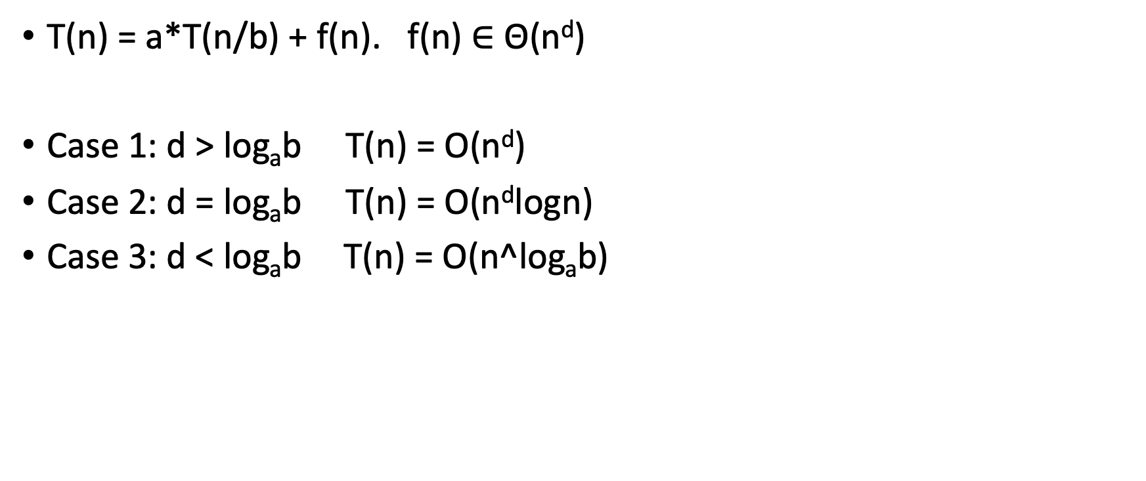
Master Theorem
Quick Sort:
Best case
T(n) = 2T(n/2) + θ(n)
=> O(n*logn)
.
Worst case
T(n) = T(n-1) + T(0) + θ(n)
= c(n-1) + c(n-2) ….. + c
= c(n-1)(n)/2 = O(n²)
T(n) = a*T(n/b) + f(n). f(n) $∈$ Θ(n^{d})
Case 1: d > log_{a}b T(n) = O(n^{d})
Case 2: d = log_{a}b T(n) = O(n^{d}logn)
Case 3: d < log_{a}b T(n) = O(n^log_{a}b)
Merge Sort:
Best case, Worst case
T(n) = 2T(n/2) + θ(n)
=> O(n*logn)
proof

Slide 7
Q3
Heap sort is unstable. Please give an example to demonstrate that the order of records with equal key is not preserved

Slide 8
Ans:
Assume a array: 50a 50b 30 20 10 build a max-heap tree
Remove first one:
Heapify:
The order of 50a is always greater than 50b
A[0] | A[1] | A[2] | A[3] | A[4]
50a | 50b | 30 | 20 | 10
A[0] | A[1] | A[2] | A[3] | A[4]
10 | 50b | 30 | 20 | 50a
A[0] | A[1] | A[2] | A[3] | A[4]
50b | 20 | 30 | 10 | 50a

Slide 9
Q4
Write the status of the list (12, 2, 16, 30, 8, 28, 4, 10, 20, 6, 18) at the end of each phase of MergeSort (Program 7.9) (iterative merge sort).

Slide 10
Ans:
12, 2, 16, 30, 8, 28, 4, 10, 20, 6, 18
partial result: 2 12 partial result: 16 30 partial result: 8 28 partial result: 4 10 partial result: 6 20
partial result: 2 12 16 30 partial result: 4 8 10 28 partial result: 6 18 20
partial result: 2 4 8 10 12 16 28 30 partial result: 6 18 20
partial result: 2 4 6 8 10 12 16 18 20 28 30

Slide 11
Q5
Suppose that we use Program 7.11 to obtain a Merge Sort function. Is the resulting function a stable sort? (Recursive merge sort)

Slide 12
Ans: check if merge sort is stable
void mergeSort(int arr[], int left, int right){
if(left >= right) return;
int mid = (left + right-1)/2;
mergeSort(arr, left, mid);
mergeSort(arr, mid+1, right);
merge(arr, left, mid, right);
}
Assume merge two subarray:
[20 30a 40 50] [30b 60 70 90]
-> [20 30a 30b …..]
1
2
3
while (Left_index < Left_size && Right_index < Right_size) {
if (Left_temp[i] <= Right_temp[j]) {
arr[merge_index] = Left_temp[i];
Left_index++;
}
else {
arr[merge_index] = Right_temp[j];
Right_index ++;
}
merge_index ++;
}

Slide 13
Q6
Write the status of the list (12, 2, 16, 30, 8, 28, 4, 10, 20, 6, 18) at the end of the first for loop as well as at the end of each iteration of the second for loop of HeapSort (Program 7.14).

Slide 14
Ans:
max-heap tree: 30 20 28 12 18 16 4 10 2 6 8
Each iteration of second loop:
Remove-heap tree: 28 20 16 12 18 8 4 10 2 6 [30]
Remove-heap tree: 20 18 16 12 6 8 4 10 2 [28 30]
Remove-heap tree: 18 12 16 10 6 8 4 2 [20 28 30]
Remove-heap tree: 16 12 8 10 6 2 4 [18 20 28 30]
Remove-heap tree: 12 10 8 4 6 2 [16 18 20 28 30]
Remove-heap tree: 10 6 8 4 2 [12 16 18 20 28 30]
Remove-heap tree: 8 6 2 4 [10 12 16 18 20 28 30]
Remove-heap tree: 6 4 2 [8 10 12 16 18 20 28 30]
Remove-heap tree: 4 2 [6 8 10 12 16 18 20 28 30]
Remove-heap tree: 2 [4 6 8 10 12 16 18 20 28 30]
Remove-heap tree: [2 4 6 8 10 12 16 18 20 28 30]

