Slide 1
Hw2 Ans
Date: 2020/09/29

Slide 2
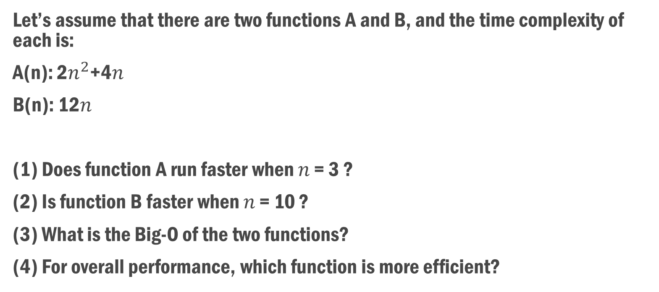
Question 1
Let’s assume that there are two functions A and B, and the time complexity of each is:
A(n): 2$n^{2}$+4𝑛
B(n): 12𝑛
(1) Does function A run faster when 𝑛 = 3 ?
(2) Is function B faster when 𝑛 = 10 ?
(3) What is the Big-O of the two functions?
(4) For overall performance, which function is more efficient?

Slide 3

Ans: Question 1
(1) Yes
(2) Yes
(3) A: O($n^{2}$) , B: O(𝑛)
(4) B

Slide 4
Question 2
Please rank 1~5 for the following cases from the best time complexity (the fastest) to the worst when n is big enough (ex: n = 100000)
f1 = θ(n) 2
f2 = θ(2^n) 5
f3 =θ(log n) 1
f4 = θ(n^2) 4
f5 = θ(nlogn) 3

Slide 5
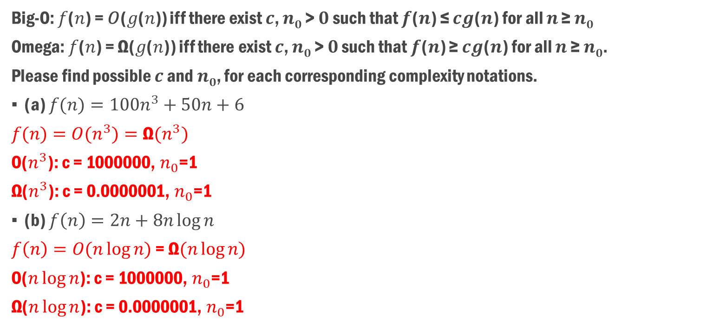
Question 3
Big-O: 𝑓(𝑛) = 𝑂(𝑔(𝑛)) iff there exist 𝒄, 𝒏_{𝟎} > 𝟎 such that 𝒇(𝒏) ≤ 𝒄𝒈(𝒏) for all 𝒏 ≥ 𝒏_{𝟎}
Omega: 𝑓(𝑛) = Ω(𝑔(𝑛)) iff there exist 𝒄, 𝒏_{𝟎} > 𝟎 such that 𝒇(𝒏) ≥ 𝒄𝒈(𝒏) for all 𝒏 ≥ 𝒏_{𝟎}.
Please find possible 𝒄 and 𝒏_{𝟎}, for each corresponding complexity notations.
(a) 𝑓$(n)=100n^{3}+50n+6$
𝑓$(n)=O(n^{3})=\text{Ω}(n^{3})$
O($n^{3}$): c = 1000000, $n_{0}$=1
$\text{Ω}$($n^{3}$): c = 0.0000001, $n_{0}$=1
(b) $f\left(n\right)=2n+8n\log{n}$
$f\left(n\right)=O(n\log{n)}$ = $\text{Ω}(n\log{n)}$
O($n\log{n}$): c = 1000000, $n_{0}$=1
$\text{Ω}$($n\log{n}$): c = 0.0000001, $n_{0}$=1

Slide 6
Question 4
According to the lecture video, a recursive code usually performs poorly, in memory usage, than a pure iterative code, while the time complexity appears to be the same. Explain why we often still adopt recursions in coding?
For small input size, the performance difference is negligible for recursion compared to iteration.
The code for recursion is easier to write compare to iteration.

Slide 7
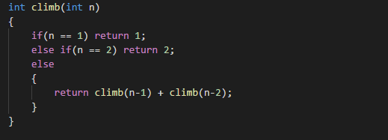
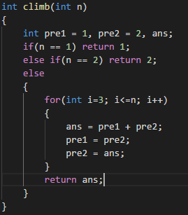
Question 5
What is the time complexity in Big-O for the following two codes? (爬樓梯，一次一階或兩階。計算爬 n 階樓梯有幾種方法)
(1) (2)

Slide 8
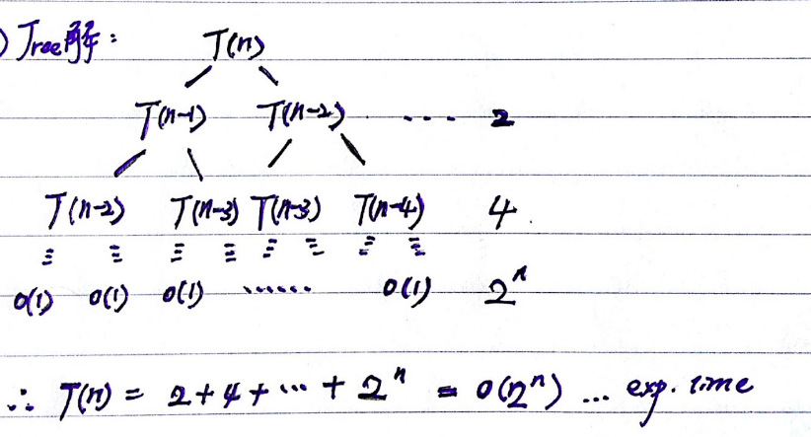

Ans: Question 5
1. O($2^{n}$) or O(${1.6}^{n}$)
T(n) = T(n-1) + T(n-2)
2. O(n)

Slide 9
Question 6
(1) Please write down the Pseudo Code of Fibonacci series using the iterative method.
(2) Please write down the Pseudo Code of Fibonacci series using the recursive method.
(3) Please calculate their performance using big-O notation, and which one is more efficient?

Slide 10
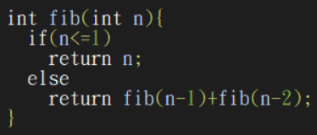
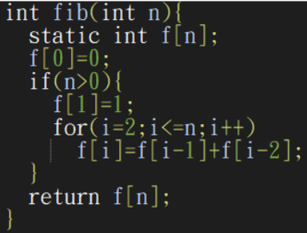

Ans: Question 6
Recursion: O($2^{n}$)
Iteration: O(n)

Slide 11
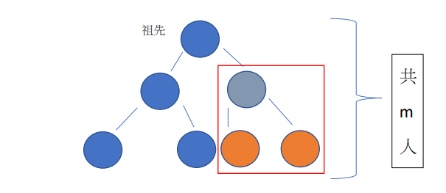
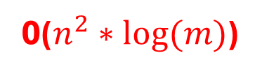
Question 7
給定一張族譜，其中只有一個祖先，每人都有 2 個小孩，配偶不必納入族譜。族譜總人數為 m 人，試找出此家族中 n 個成員彼此之間親等關係的時間複雜度(Big O, upper bound)。
親等的計算方式為:
假設我們想要計算兩個橘色的親等關係，我們先向上溯源到共同的祖先(灰色)， 由於灰色和兩個橘色的距離都是 1，所以兩個橘色之間的親等關係為: 1+1 = 2
O($n^{2}∗log⁡(m)$)

Slide 12
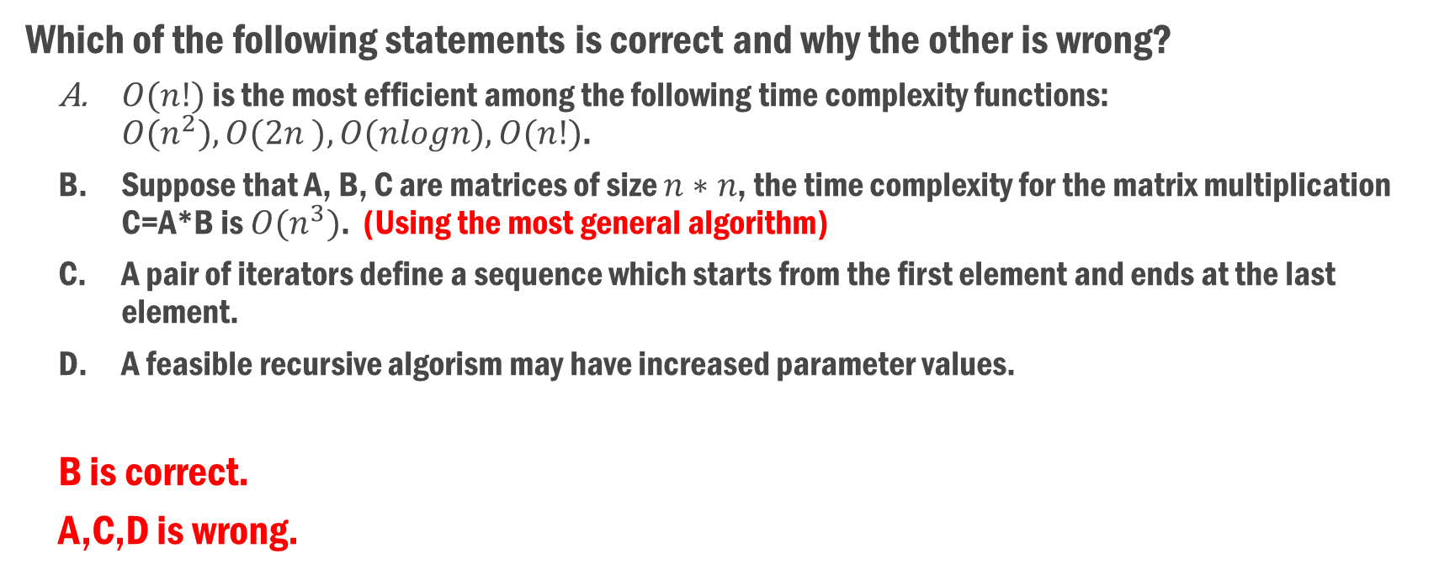
Question 8
Which of the following statements is correct and why the other is wrong?
$O(n!)$ is the most efficient among the following time complexity functions: $O(n^{2}), O(2n ), O(nlogn), O(n!)$.
Suppose that A, B, C are matrices of size $n∗n$, the time complexity for the matrix multiplication C=A*B is $O(n^{3})$. (Using the most general algorithm)
A pair of iterators define a sequence which starts from the first element and ends at the last element.
A feasible recursive algorism may have increased parameter values.
B is correct.
A,C,D is wrong.

Slide 13
Question 9
(1) Please write down the Pseudo Code of binary search using “while loop”?
(2) Please write down the Pseudo Code of binary search using “recursive”?
(3) Please analyze the time complexity of the above two Pseudo Code.

Slide 14
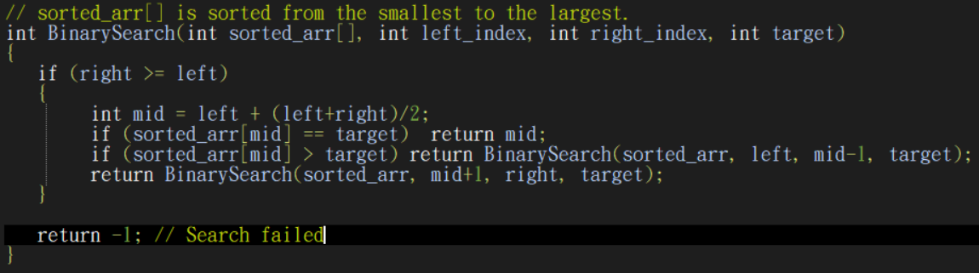
Ans: Question 9
Recursion: O(log n)

Slide 15
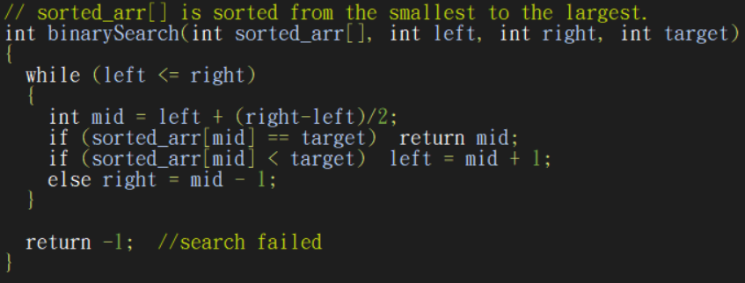
Ans: Question 9
Iteration: O(log n)

Slide 16
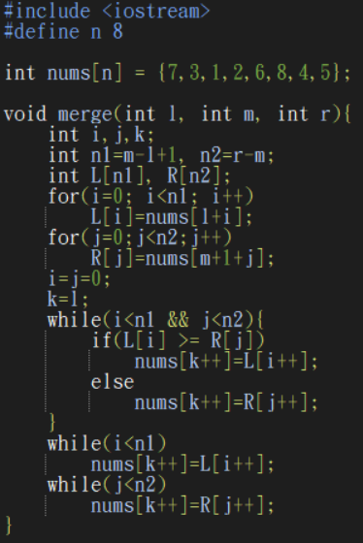
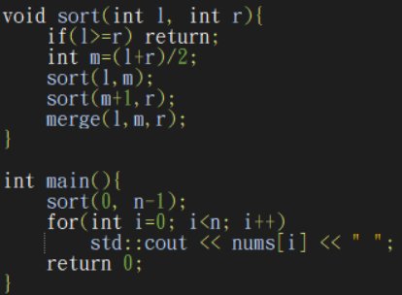
Question 10
Calculate the Space complexity of the sorting algorithm and show the results in Big-O (𝑂) notation.
Calculate the Time complexity of the sorting algorithm and show the results in Big-O (𝑂), Omega (Ω), Theta (Θ) notations.
Write down the output result of the code.

Slide 17
Ans: Question 10
Calculate the Space complexity of the sorting algorithm and show the results in Big-O (𝑂) notation.
Calculate the Time complexity of the sorting algorithm and show the results in Big-O (𝑂), Omega (Ω), Theta (Θ) notations.
Write down the output result of the code.
“Merge Sort”
O(n): The num array
Θ(n*log n), Ω(n*log n),𝑂(n*log n)
8 7 6 5 4 3 2 1
https://alrightchiu.github.io/SecondRound/comparison-sort-merge-sorthe-bing-pai-xu-fa.html

Slide 18
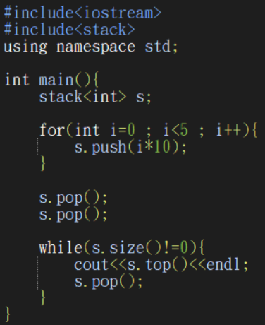
Question 11: Stack
20
10
0

Slide 19
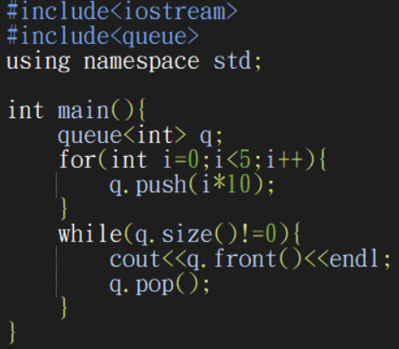
Question 11: Queue
0
10
20
30
40

Slide 20
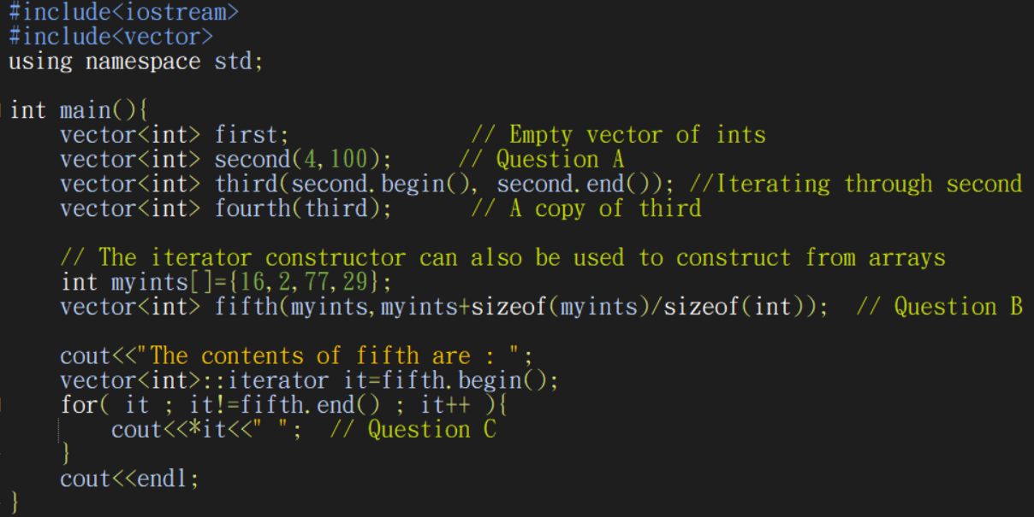
Question 12
What does this vector constructor “vector<int> second(4,100);” do?
What does this vector constructor “vector<int> fifth(myints,myints+sizeof(myints)/sizeof(int));” do?
Why do we need to dereference “it” for cout?

Slide 21
Ans: Question 12
vector<int> second(4,100):
Initialize the vector with capacity=4, and with all element=100.
vector<int> fifth(myints,myints+sizeof(myints)/sizeof(int)):
Initialize the vector with array “myints[]”, and import elemnts from the array indexed from 0 to sizeof(myints)/sizeof(int). (ALL elements)
Why do we need to dereference “it” for cout?
Iterators function as a pointer, which point to an “memory address”. So we need to dereference an iterator to get the actual value it points to.

Slide 22
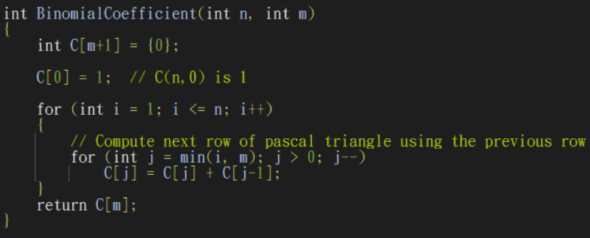
Question 13
Please design an algorithm to compute Binomial Coefficient C(n,m), and analyze the space complexity and time complexity of your algorithm.
C(n, m) = C(n-1, m-1) + C(n-1, m)
C(n, 0) = C(n, n) = 1
“Dynamic Programming”
Space: O(m) (A row in Pascal Triangle)
Time: O(n*m)
https://www.geeksforgeeks.org/binomial-coefficient-dp-9/

Slide 23
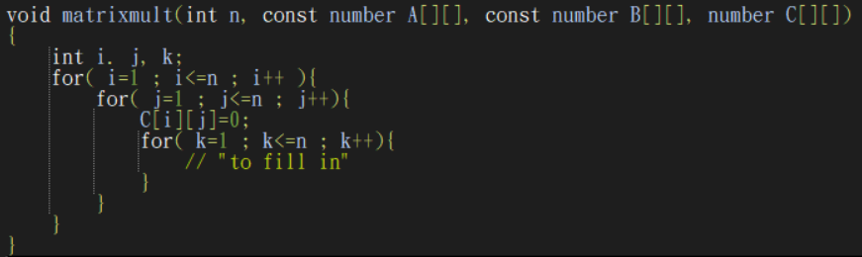
Question 14
A two-dimensional matrix multiplication is given below. A and B are two n*n two-dimensional matrices, and C is the output of A*B.
Please fill in the part marked “to fill in”.
Please compute time complexity in Big-O notation and explain why.
[Optional] This is not the most efficient algorithm of matrix multiplication. You can search for faster algorithm of matrix multiplication and share the idea in class.

Slide 24
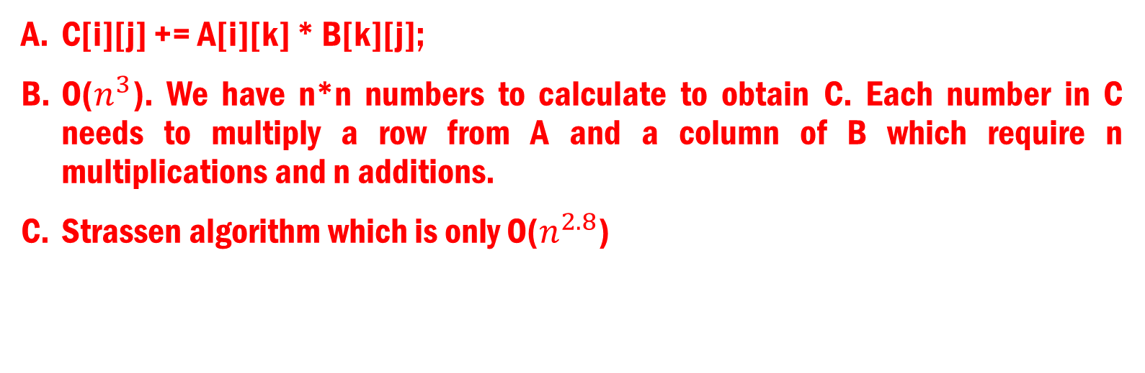
Ans: Question 14
C[i][j] += A[i][k] * B[k][j];
O($n^{3}$). We have n*n numbers to calculate to obtain C. Each number in C needs to multiply a row from A and a column of B which require n multiplications and n additions.
Strassen algorithm which is only O($n^{2.8}$)

Slide 25
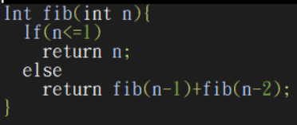
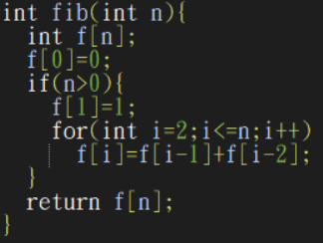
Question 15: Fibonacci Sequence
Need to correct some details of the code to make it compilable.
Without computing time complexity of these two algorithms, can you tell and explain which one is faster?
Discuss the merits and drawbacks of each version.

Slide 26
Ans: Question 15
Iteration version (right one) should be faster.
Iteration: Usually faster
Recurtion:
For small input size, the performance difference is negligible for recursion compared to iteration.
The code for recursion is easier to write compare to iteration.

Slide 27
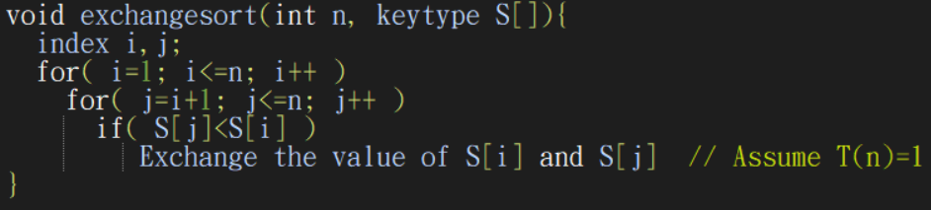
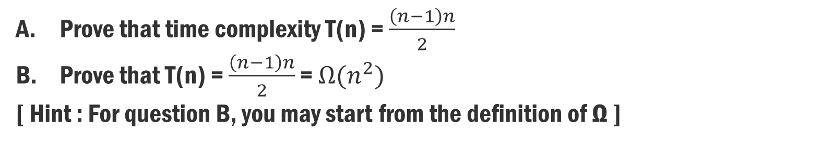
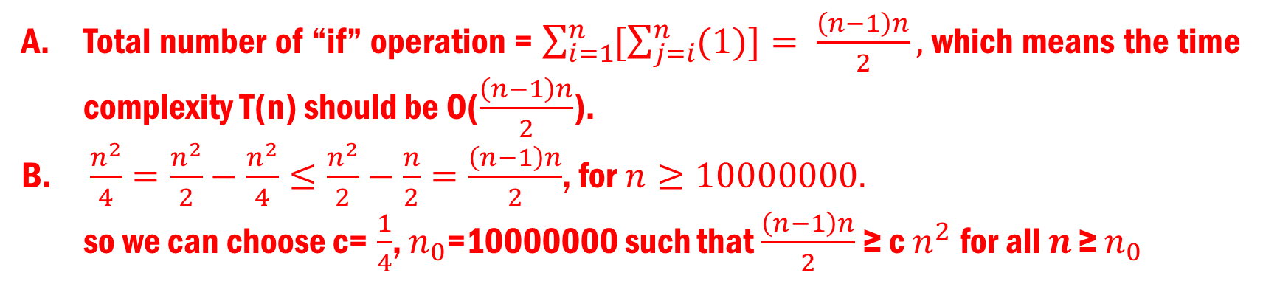
Question 16
Prove that time complexity T(n) = $\frac{\left(n−1\right)n}{2}$
Prove that T(n) = $\frac{\left(n−1\right)n}{2}$ = ${Ω(n}^{2})$
[ Hint : For question B, you may start from the definition of Ω ]
Total number of “if” operation = $\sum_{i=1}^{n}{[\sum_{j=i}^{n}{(1)]}}= \frac{\left(n−1\right)n}{2},$which means the time complexity T(n) should be O($\frac{\left(n−1\right)n}{2}$).
$\frac{n^{2}}{4}=\frac{n^{2}}{2}−\frac{n^{2}}{4}≤\frac{n^{2}}{2}−\frac{n}{2}=$ $\frac{\left(n−1\right)n}{2}$, for $n≥10000000.$
so we can choose c= $\frac{1}{4}$, $n_{0}$=10000000 such that $\frac{\left(n−1\right)n}{2}$≥ c $n^{2}$for all 𝒏 ≥ $n_{0}$

Slide 28
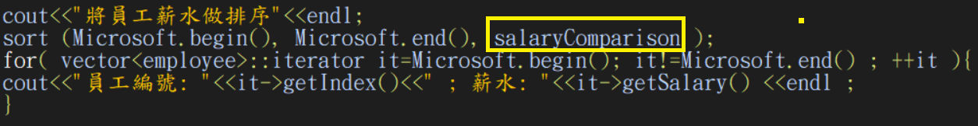
Question 17
bool salaryComparison(employee x1, employee x2) {return x1.getSalary() < x2.getSalary(); }
NOTE: salaryComparison should be a global function.

Slide 29
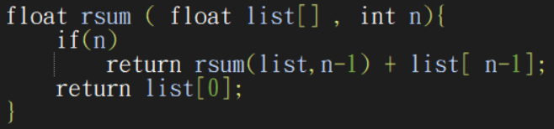
Question 18
Please analyze how many program-steps the following code implementation requires given an int argument n?
To sum up the whole list[] with n numbers
Θ(n)

Slide 30
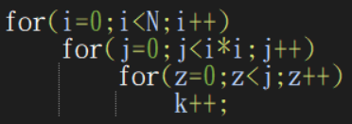
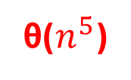
Question 19
Analyze the time complexity (using θ) of the following code.
θ($n^{5}$)

Slide 31

Question 20
Answer TRUE or FALSE to each question and explain why:
n logn = O($n^{2}$)
$n^{2}$ = O(n log²n)
O($n^{0.1}$) + O(logn) = O($n^{0.1}$)
True
False
True

Slide 32

Question 21
Rank the following functions by the order of growth rate:
log(n!)、n*($2^{n}$)、(logn)!、$2^{2\log{n}}$、n!、$2^{n}$、log(logn)、n
log(logn) < (logn)! < n < log(n!) < $2^{2\log{n}}$ < $2^{n}$ < n*($2^{n}$) < n!

Slide 33
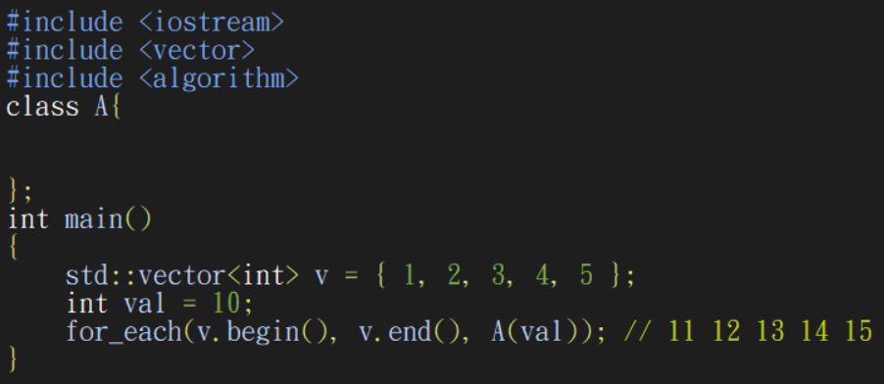
Question 22
Finish the following functor (class A) to make the code’s output confined from 11 to 15:

Slide 34
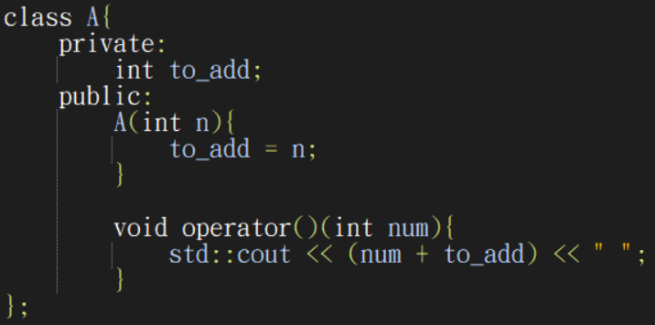
Ans: Question 22

