Slide 1
Hw3 Ans: Ch. 2 Array
Date: 2020/10/06

Slide 2
Question 1
A hacker is transmitting a virus through the internet. The virus has a special pattern denoted as P, and the value is “11101101”. Now we want to detect whether a downloaded file includes this kind of virus.
(a) We are going to use the KMP algorithm to detect, and need to build a failure function. Please fill out the blank below.
P[i] 1 1 1 0 1 1 0 1
F(i) -1 0
(b) Please implement the failure function in C++.
(c) Please evaluate the big-O of this program.

Slide 3
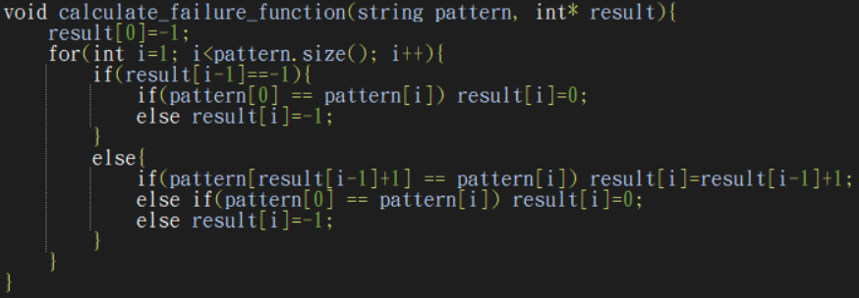
(Question 1) Ans:
P[i] 1 1 1 0 1 1 0 1
F(i) -1 0 1 -1 0 1 -1 0
O(n)

Slide 4
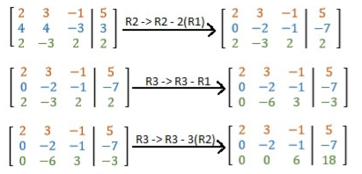

Question 2
給定一組n*n 且儲存在二維陣列中的矩陣和一組向量，請計算其時間複雜度。
$$O(n^{2})$$

Slide 5
Question 3
In the class, the teacher introduces two kinds of polynomial representation and its addition function.
Please analyze the advantages and disadvantages of these two methods from the aspect of memory, runtime and its algorithm of operations. (p.s. consider whether the polynomial is sparse or not)
After comparison of the two methods, which representation should we use for polynomial operation?

Slide 6
(Question 3) Ans:
a, b: two polynomials with max degree=D
a.terms=n, b.terms=m
When a,b are sparse, n,m << D; otherwise, n,m = D.
 | Basic |  | Only Non-zero terms
 | Sparse | Dense | Sparse | Dense
Time | D | D | n+m | D
Memory | 2D | 2D | 2(n+m) | 4D
Implementation | Easier |  | Harder

Slide 7
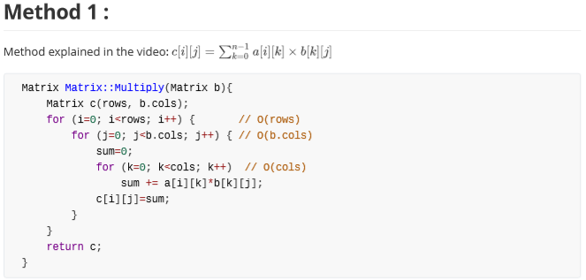
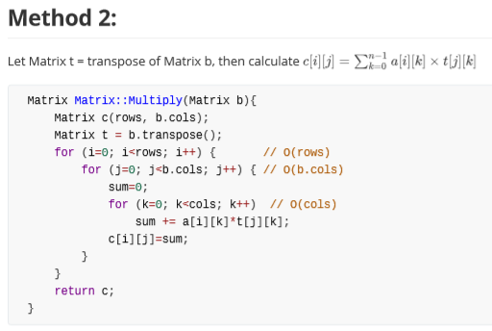
Question 4
Compare the two following versions of Matrix Multiplication. Which version runs faster on the same computer when the size of the matrix is large?

Slide 8

(Question 4) Ans:
both $O(n^{3})$
When n is large, method 2 should run faster in C/C++.

Slide 9
Question 5
Please write down the pseudo code of the inner product of two n-degree vectors, while most vector elements have value zero. Please utilize the fact of sparsity and implement an efficient code suitable for cases of large n.

Slide 10
Question 6
計算下列failure function
aaab -1 0 1 -1
babaa -1 -1 0 1 -1
abaabaabb -1 -1 0 0 1 2 3 4 -1

Slide 11
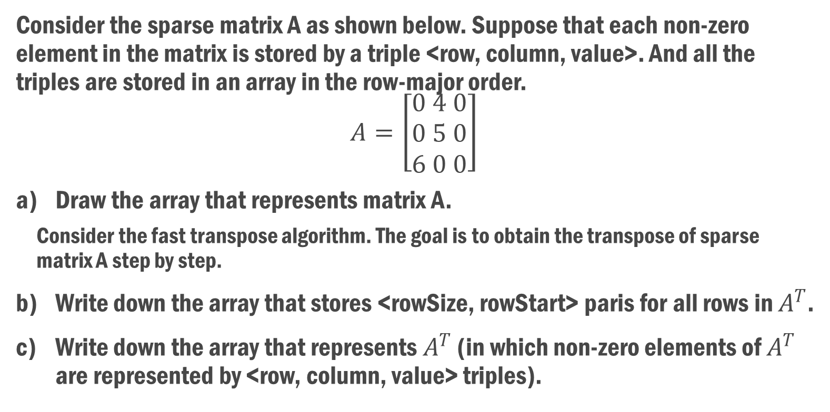
Question 7
Consider the sparse matrix A as shown below. Suppose that each non-zero element in the matrix is stored by a triple <row, column, value>. And all the triples are stored in an array in the row-major order.
$$A=\left[\begin{aligned}0 4 0 \\ 0 5 0 \\ 6 0 0\end{aligned}\right]$$
Draw the array that represents matrix A.
Consider the fast transpose algorithm. The goal is to obtain the transpose of sparse matrix A step by step.
Write down the array that stores <rowSize, rowStart> paris for all rows in $A^{T}$.
Write down the array that represents $A^{T}$ (in which non-zero elements of $A^{T}$ are represented by <row, column, value> triples).

Slide 12
(Question 7) Ans:
[(0,1,4), (1,1,5), (2,0,6)]
column | rowsize | rowstart
0 | 1 | 0
1 | 2 | 1
2 | 0 | n/a
 | row | column | value
[0] | 0 | 2 | 6
[1] | 1 | 0 | 4
[2] | 1 | 1 | 5

Slide 13
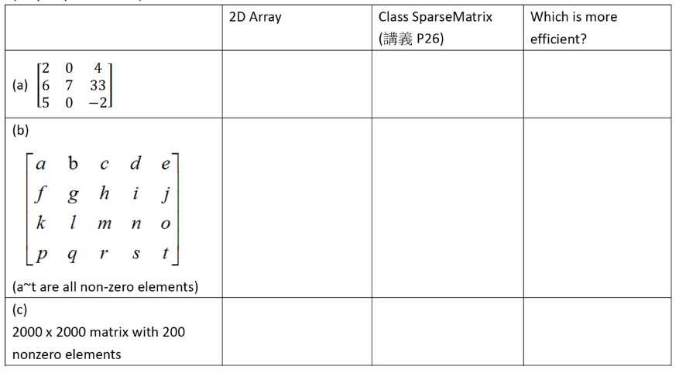
Question 8
Explain what a sparse matrix is?
Please calculate the approximate memory requirements of the matrices in the following for the two given methods and tell which one is more efficient.

Slide 14
(Question 8) Ans:
 | 2D-Array | SparseMatrix | Better?
(a) | 9 integers | 7*3 integers | 2D-Array
(b) | 20 integers | 20*3 integers | 2D-Array
(c) | 2000*2000 integers | 200*3 integers | SparseMatrix

Slide 15
Question 9
In the lecture video, we learned the basic concept of the Knuth-Morris-Pratt algorithm. To perform pattern matching using this algorithm, we need to find the f (failure) function of the pattern first.
Now, please find the f function of the following two patterns:
BCABCABAABCA
ABCDEFGZZXYJJ
If we want to perform pattern matching with these two strings using the Knuth-Morris-Pratt algorithm, which pattern will have significant advantages over the conventional one-by-one pattern matching method? Why? Compare these two algorithm’s (KMP and 1-by-1) time complexity in the worst case.

Slide 16
(Question 9) Ans:
-1 -1 -1 0 1 2 3 -1 -1 0 1 2
-1 -1 -1 -1 -1 -1 -1 -1 -1 -1 -1 -1 -1
First one
KMP: O(n+m), 1-by-1: O(n*m)

Slide 17
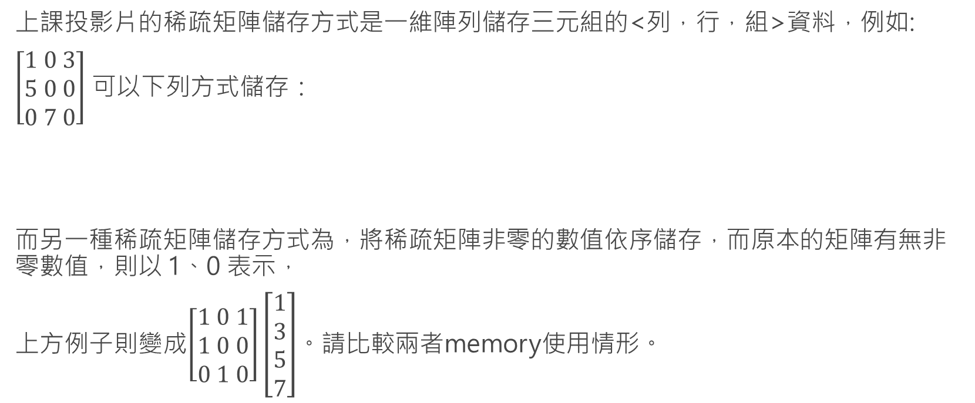
Question 10
上課投影片的稀疏矩陣儲存方式是一維陣列儲存三元組的<列，行，組>資料，例如:
$\left[\begin{aligned}1 0 3 \\ 5 0 0 \\ 0 7 0\end{aligned}\right]$ 可以下列方式儲存：
而另一種稀疏矩陣儲存方式為，將稀疏矩陣非零的數值依序儲存，而原本的矩陣有無非零數值，則以 1、0 表示，
上方例子則變成$\left[\begin{aligned}1 0 1 \\ 1 0 0 \\ 0 1 0\end{aligned}\right]\left[\begin{aligned}1 \\ 3 \\ 5 \\ 7\end{aligned}\right]$。請比較兩者memory使用情形。
 | 列 | 行 | 值
S[0] | 0 | 0 | 1
S[1] | 0 | 2 | 3
S[2] | 1 | 0 | 5
S[3] | 2 | 1 | 7

Slide 18

Ans: Question 10
3*terms
$n^{2}$+ terms

Slide 19
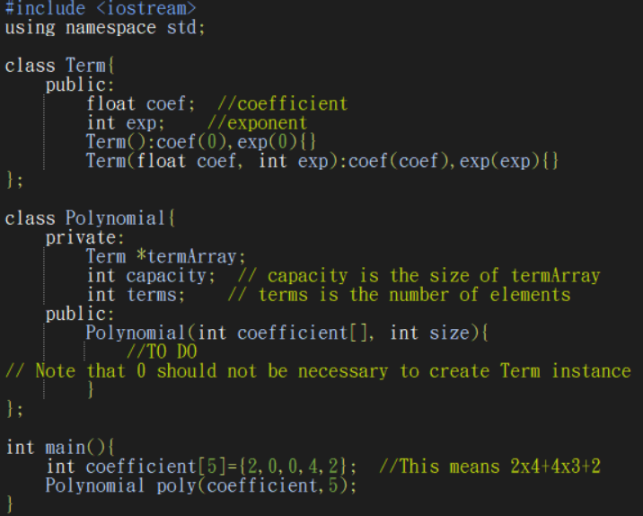
Question 11

Slide 20
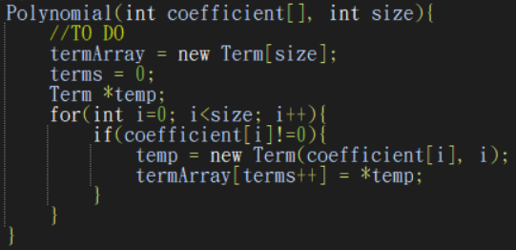
(Question 11) Ans:

Slide 21
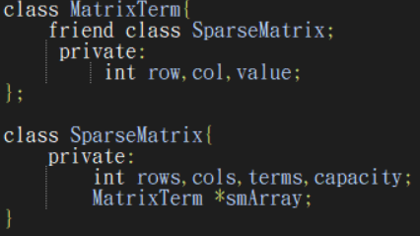
Question 12
When do we use Sparse Matrix to store a matrix ?
If we want to store the matrix below, what shall smArray contain?
1 0 3 0 1
0 0 0 1 0
0 0 1 0 0
0 0 0 1 1

Slide 22
(Question 12 ) Ans:
When there are a lot of zero terms.
[(0,0,1), (0,2,3), (0,4,1) , (1,3,1), (2,2,1) , (3,3,1), (3,4,1)]

Slide 23

Question 13
The time complexity of a 2-dimensional matrix multiplication is O($n^{3}$). It costs a lot in computing when you want to multiply two really large matrices. Please discuss whether the order of the matrix multiplication influence the computing time. For example, you may try to change the order of $M_{1}∗M_{2}$to $M_{2}∗M_{1}$and compute the result.

Slide 24
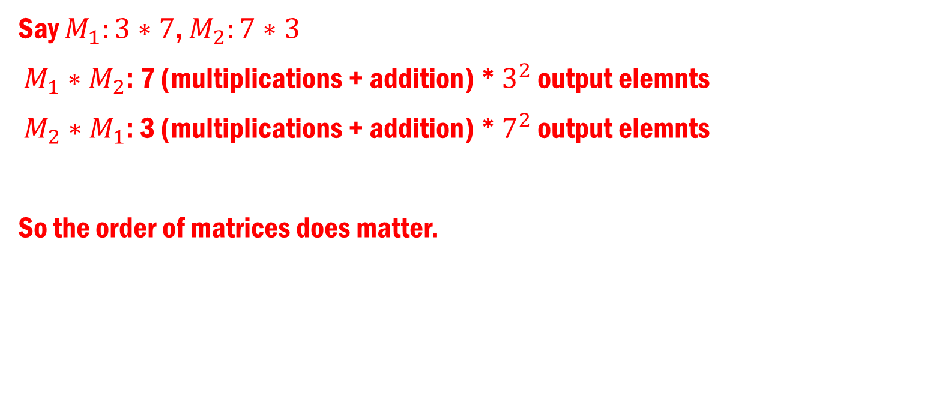
(Question 13) Ans:
Say $M_{1}:3∗7$, $M_{2}:7∗3$
$M_{1}∗M_{2}$: 7 (multiplications + addition) * $3^{2}$ output elemnts
$M_{2}∗M_{1}$: 3 (multiplications + addition) * $7^{2}$ output elemnts
So the order of matrices does matter.

Slide 25
Question 14
1 0 0 0
0 1 0 0
0 0 1 0
0 0 0 1
1 0 0 0 0 0 1 0
0 1 0 0 0 0 0 1
1 0 0
0 1 0
0 5 2
0 2 3
1 0 0 0 5 2
0 1 0 0 2 3

Slide 26
(Question 14) Ans:
Bonus

Slide 27
Question 15
Use “single linear list” and “one liner list per row” to represent the sparse matrix below :
15 0 0 22 0 -15
0 11 3 0 0 0
0 0 0 6 0 0
0 0 0 0 0 0
91 0 0 0 0 0
0 0 28 0 0 0
A[6][6]=

Slide 28
(Question 15) Ans:
Single linear list:
[(0,0,15), (0,3,22), (0,5,-15) , (1,1,11), (1,2,3) , (2,3,6), (4,0,91), (6,2,28)]
Single linear list per row:
[
[(0,15), (3,22), (5,-15)] ,
[(1,11), (2,3)],
[(3,6)],
[],
[(0,91)],
[(2,28)]
]

Slide 29
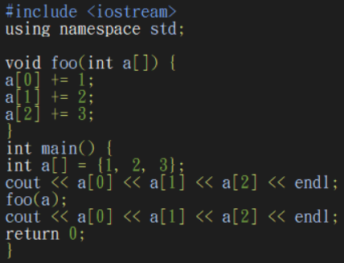
Question 16
Please write down the execution result of the code and answer the following question. Which parameter passing type (pass by value or pass by address) does the foo function use? Why not the other type?

Slide 30
(Question 16) Ans:
123
246
pass by address

Slide 31
Question 17
Consider the following declaration of a two-dimensional array in C++: Assuming that the main memory is byte-addressable and that an integer (4-byte) array A[n][m] is stored starting from memory address 0, what is the address of element A[40][50](n>41, m>51) ? There are two possible answers based on different storage method. (Row-major and column-major)

Slide 32
(Question 17) Ans:
Row-major: 40m+50
Column-major: 50n+40

Slide 33
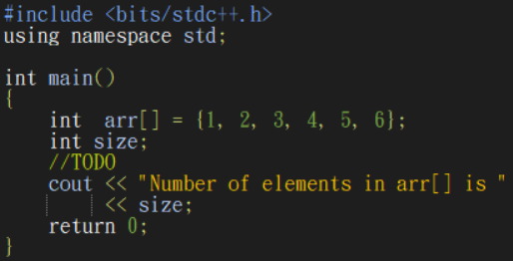
Question 18

Slide 34
(Question 18) Ans:
size = *(&arr+1)-arr

Slide 35
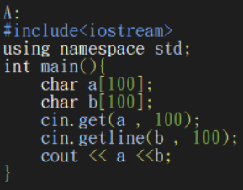
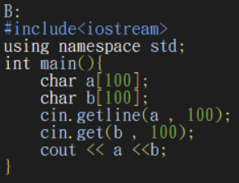
Question 19
What is the difference between code A and B ? Explain why the difference?

Slide 36
(Question 19) Ans:
cin.getline(): 一次讀一行，會剔除換行符號，且不會留換行符號在buffer內。
cin.get(): 一次讀一行，會剔除換行符號，且會留換行符號在buffer內。

Slide 37

Question 20
We need to build a multiplier to compute the power of 11, but the output of the multiplier, for example ${11}^{100}$, often exceeds the valid integer range (-2,147,483,648 to 2,147,483,647). Please describe how to deal with this situation using array.
Store it as string array.
Convert parts of string into integer.
Do calculation on the converted part, and store the outcome as partial result.
Repeat 2 and 3 until all parts are done, then combine all of the partial results into a final result.

