Slide 1


Clinically Calibrated Large Language Model Reasoning for Zero-Shot Cardiac MRI Pathology Classification from Segmentation-Derived Metrics
Zhuoan Li¹
1. Weldon School of Biomedical Engineering, Purdue University, West Lafayette, USA
Notes:
Hi Everyone is really happy to be here sharing my research clinically calibrated LLM reasoning for zero-shot cardiac MRI pathology classification from segmentation –derived metrics.

Slide 2
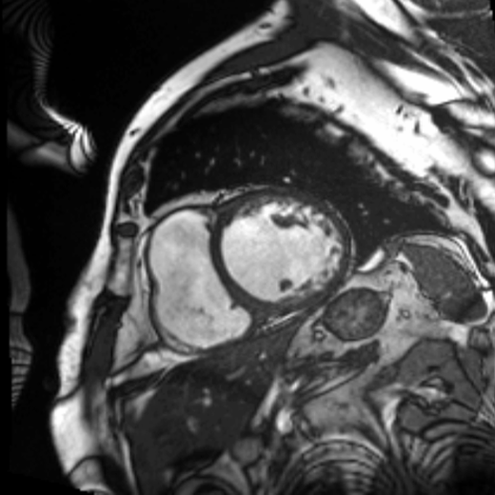
Can an LLM identify
cardiac disease from
three numbers?
14%
352
304
EF
EDV (mL)
ESV (mL)
Reference LV measurements
ACDC patient017
Notes:
0:00–0:27
Cardiac MRI can measure how well the heart pumps and how large its chambers are. This patient has an ejection fraction of fourteen percent and an enlarged ventricle. Our question is: can a general-purpose language model interpret these measurements and classify cardiac disease, without task-specific fine-tuning?
Scientific context
ACDC patient017. Reference EF 13.664423943955054%, EDV 351.9775390625 mL, ESV 303.8818359375 mL. True label and calibrated prediction: DCM. Cine supplied in power_pitch.zip/cine_patient017.gif. EF is derived from EDV and ESV, so these fields are not independent. Accepted abstract title: Clinically Calibrated Large Language Model Reasoning for Zero-Shot Cardiac MRI Pathology Classification from Segmentation-Derived Metrics
Sources
Study: https://github.com/zhuoanli/llm-cardiac-pathology
Results: https://github.com/zhuoanli/llm-cardiac-pathology/blob/main/results/llm_results.json
User-supplied SMRA2026_LLM_Cardiac_MRI_Abstract.pdf and original figures in LLM_shortpaper.zip.
SMRA logo: https://society4mra.org/wp-content/uploads/2025/09/smra_2026.png

Slide 3
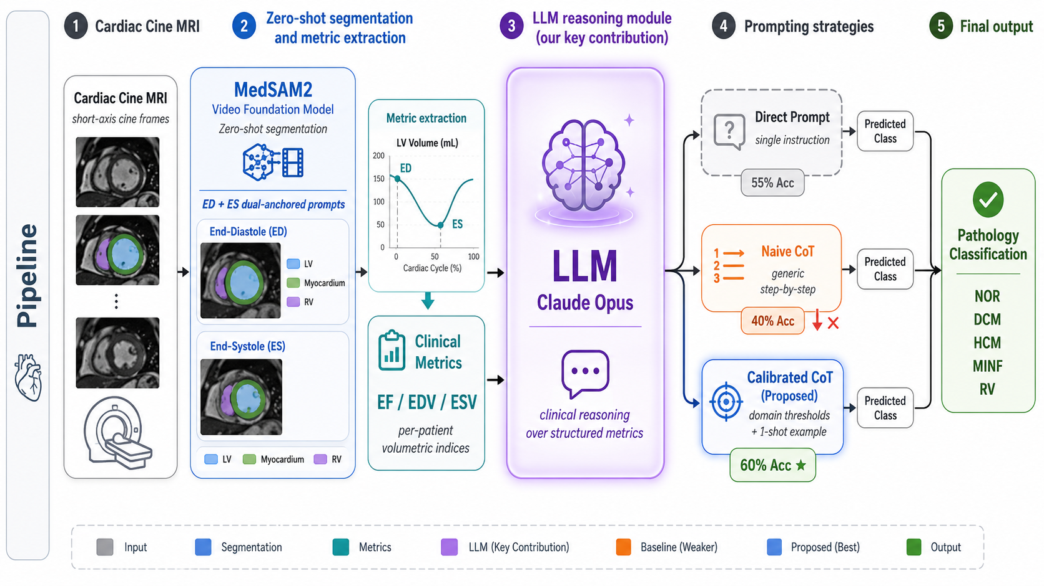

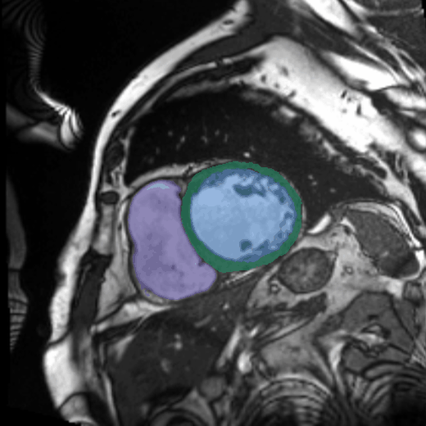
What did we ask the LLM to do?
Numerical MRI measurements and clinical instructions. No task-specific fine-tuning.
Prompt | What we ask
Direct | Choose one disease label
Stepwise | Assess EF, then volume, using supplied thresholds
Calibrated | Use revised thresholds and one worked DCM example
Cine MRI
Segmentation
Prompt example: EF 28%, EDV 310 mL, ESV 223 mL
Reduced function + dilated cavity. Label: DCM.
LLM input: EF, EDV and ESV as text
Reference LV metrics. 20 ACDC patients across 5 classes, with 4 cases per class.
Notes:
0:27–1:14
We tested Claude Opus on twenty ACDC patients across five balanced classes, using reference segmentation measurements. The LLM received EF and ventricular volumes as text. (click)
We compared three instructions. First, choose a disease label. Second, assess EF, then volume, using supplied thresholds. Third, revise those thresholds and provide a worked example: low EF plus an enlarged ventricle supports dilated cardiomyopathy. We changed the clinical guidance in the prompt, while keeping the model weights unchanged.
Scientific context
Source image: llm_fig1.png, abstract Figure 1, cropped to MRI/segmentation/metrics/LLM. The adjacent table explains the three prompt branches. The framework includes MedSAM2 segmentation; all headline prompt comparisons here use reference segmentation-derived metrics. Claude Opus receives EF, EDV and ESV as text, together with task instructions. Stepwise prompting already includes thresholds. Calibration changes thresholds and adds one worked DCM example, with no task-specific fine-tuning. The example in CALIBRATED_COT_PROMPT is EF 28%, EDV 310 mL, ESV 223 mL, label DCM. The calibrated condition is one-shot prompting. Thresholds are representative heuristics, not a validated clinical guideline implementation. The effects of threshold changes and the worked example are not isolated.
Sources
Study: https://github.com/zhuoanli/llm-cardiac-pathology
Results: https://github.com/zhuoanli/llm-cardiac-pathology/blob/main/results/llm_results.json

Slide 4
Revised criteria + an example reached 60%
Same LLM and reference measurements, different text instructions
12/20
correct cases
0.510
macro-F1
Exploratory results: one more correct case than the label-only prompt.
* 8/20 stepwise outputs lacked a final label, so parsing affects this comparison.
Notes:
1:14–1:47
With a label-only instruction, the LLM classified eleven of twenty cases correctly. The guided assessment classified eight. Revised criteria plus one example classified twelve, or sixty percent, compared with nine for the EF rule. This is exploratory: the gain over label-only prompting is one case, and incomplete outputs complicate the guided assessment result.
Scientific context
Source: abstract Figure 2 right panel and Table 1. Category order: random expectation, EF rule, direct, naive/stepwise CoT, calibrated CoT. Accuracy: 20% expected, 45%, 55%, 40%, 60%. Observed correct counts: 9, 11, 8, 12 of 20. Macro-F1 for the four observed methods: 0.325, 0.425, 0.369, 0.510. The source figure rounds macro-F1 to two decimals. Eight reference-metric stepwise outputs lack an explicit final LABEL. The fallback parser can affect recorded accuracy; the experiment does not isolate a causal effect of reasoning. One case changes accuracy by 5 percentage points.
Sources
Study: https://github.com/zhuoanli/llm-cardiac-pathology
Results: https://github.com/zhuoanli/llm-cardiac-pathology/blob/main/results/llm_results.json
User-supplied SMRA2026_LLM_Cardiac_MRI_Abstract.pdf and original figures in LLM_shortpaper.zip.

Slide 5
Where the LLM succeeded, and what it missed
Confusion matrix for calibrated prompting, 20 ACDC cases
Predicted class
 | NOR | DCM | HCM | MINF | RV
NOR | 4 | 0 | 0 | 0 | 0
DCM | 0 | 4 | 0 | 0 | 0
HCM | 1 | 0 | 0 | 2 | 1
MINF | 0 | 1 | 0 | 3 | 0
RV | 2 | 0 | 0 | 1 | 1
8 / 8
True
class
Normal and DCM cases
correctly labeled
0 / 4
HCM cases correctly labeled
Inputs omit wall thickness and right-ventricular measurements.
Notes:
1:47–2:20
The confusion matrix shows the clinical pattern. The calibrated prompt correctly labeled all eight normal and dilated cardiomyopathy cases, including our opening patient. It missed all four hypertrophic cardiomyopathy cases. We supplied function and cavity size, but no wall thickness. That motivates a specific next experiment: add morphology and test whether classification improves.
Scientific context
Source: abstract Figure 2 left panel. Rows are true labels and columns are predicted labels, both NOR, DCM, HCM, MINF, RV. Matrix: [[4,0,0,0,0],[0,4,0,0,0],[1,0,0,2,1],[0,1,0,3,0],[2,0,0,1,1]]. The diagonal sums to 12. 8/8 refers to correctly labeled true NOR and DCM cases, not perfect precision. HCM 0/4 concerns the calibrated configuration. All LLM conditions have zero HCM F1; the EF rule correctly classifies one HCM case. NOR: normal; DCM: dilated cardiomyopathy; HCM: hypertrophic cardiomyopathy; MINF: myocardial infarction; RV: right-ventricular abnormality. Missing morphology is a hypothesis for future controlled testing, not a proven information ceiling.
Sources
Study: https://github.com/zhuoanli/llm-cardiac-pathology
Results: https://github.com/zhuoanli/llm-cardiac-pathology/blob/main/results/llm_results.json
.

Slide 6



RESEARCH CONTRIBUTION
Clinical guidance
through language
Welcome to connect and discuss interesting research！
An LLM interpretation layer for quantitative MRI,
without task-specific fine-tuning.
Next: richer biomarkers and independent validation.
Zhuoan Li
Contact
github.com/zhuoanli/llm-cardiac-pathology
li4533@purdue.edu; zhuoanli07@gmail.com
Project page
Notes:
2:20–2:50
The contribution of this study is a clinically guided LLM classification layer for quantitative cardiac MRI, evaluated without task-specific fine-tuning. This pilot also identifies disease-specific failures that guide the next input design. We will test richer biomarkers in larger, independent cohorts. The goal is MRI interpretation that clinicians can guide through language. Thank you very much for your attention and welcome to scan the project page code and connect to learn details!
Scientific context
Contribution: a clinically guided LLM interpretation/classification layer for quantitative cardiac MRI, comparison of instructions without task-specific fine-tuning, and disease-specific error analysis. This is an exploratory 20-case feasibility study. It does not establish clinical readiness, reliable reasoning, superiority to a fully specified rule system, or generalizability. Independent validation and controlled evaluation of additional biomarkers are future work. The goal of clinician-guided interpretation through language is aspirational, not a demonstrated workflow outcome. QR code: https://github.com/zhuoanli/llm-cardiac-pathology
Sources
Study: https://github.com/zhuoanli/llm-cardiac-pathology
Results: https://github.com/zhuoanli/llm-cardiac-pathology/blob/main/results/llm_results.json

