Slide 1
The Battle of Neighborhoods
Meng Yu
March 22, 2019

Slide 2
Summary of Jinan and Qingdao
 | Jinan | Qingdao
Prefecture-level area | 10244km² | 11067km²
Population | 7321200 | 9290500
GDP | ￥886.2 billion | ￥1256.1 billion
Human Development Index | 0.811 | 0.822
Position | 36.38N 117.01E | 36.5N 120.2E

Slide 3
Problem
Compare the count of venues owned by eachborough of Jinan and Qingdao.
K-means clustering.
Choropleth and cluster map.

Slide 4
Data acquisition and cleaning
Data sources
Foursquare, Autonavi, Aliyun
Data cleaning
The data is already tidy and clean.
Feature selection
Generate the 1st - 10th most common venues of each neighborhood.

Slide 5
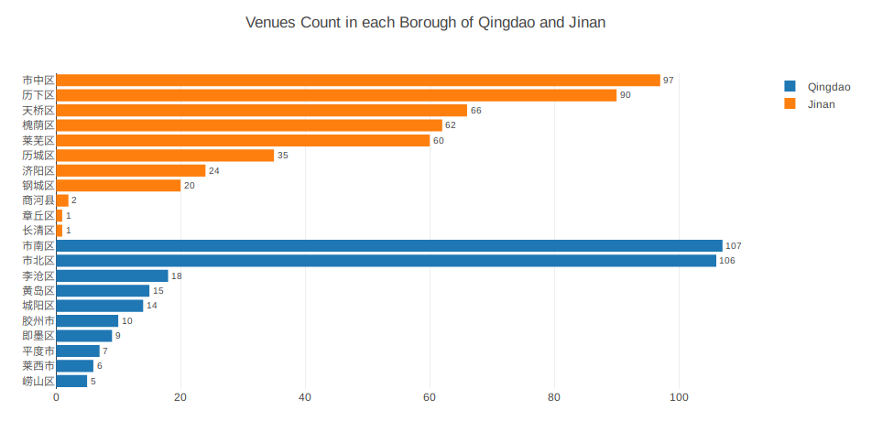
Venues count comparison

Slide 6
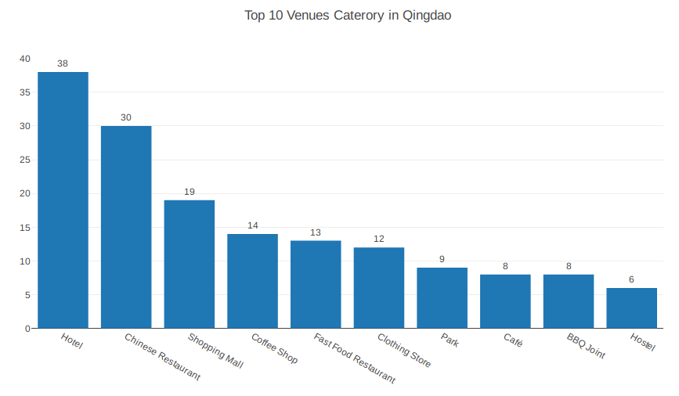
Top 10 venues category in Qingdao

Slide 7
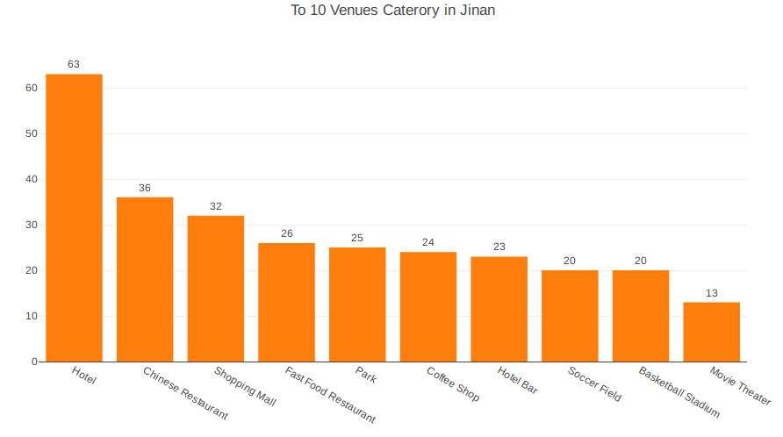
Top 10 venues category in Jinan

Slide 8
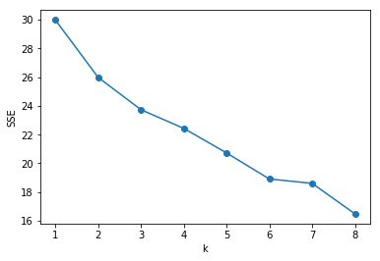
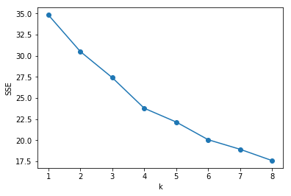
K-means clustering
 | Cluster 1 | Cluster 2 | Cluster 3 | Cluster 4 | Cluster 5 | Cluster 6
Jinan | 26 | 12 | 56 | 5 | NA | NA
QIngdao | 5 | 6 | 41 | 2 | 9 | 2

Slide 9
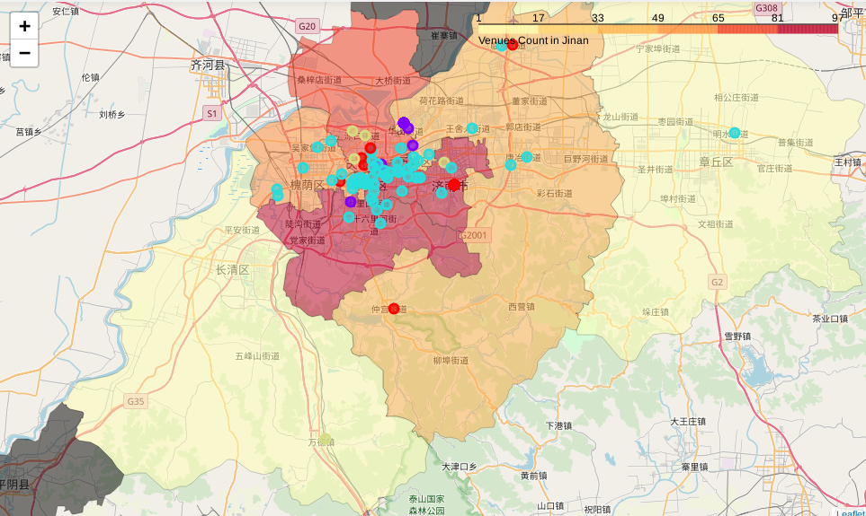
Choropleth and cluster map of Jinan

Slide 10
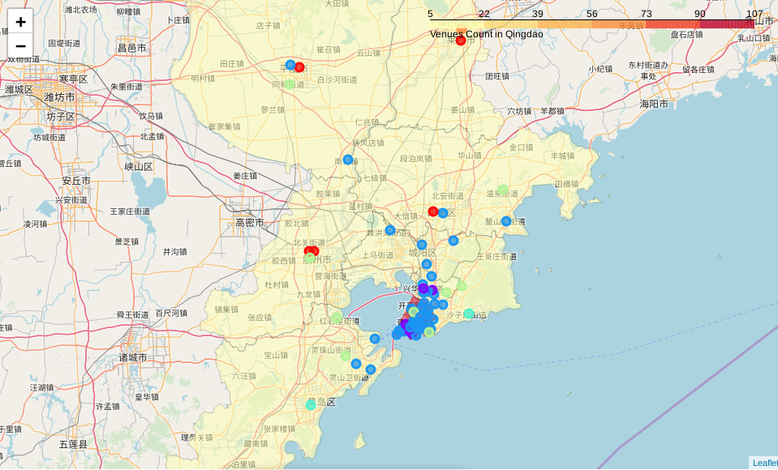
Choropleth and cluster map of Qingdao

Slide 11
Conclusions
Jinan have more venues, and the differences between boroughs are small.
Qingdao has fewer venues, with great differences among boroughs.
Venues in both cities are concentrated in their respective city centres.

Slide 12
Future directions
Foursquare cannot fully reflect the actual situation in China.
The results of clustering based on k-means are not ideal, which need to be improved in the future.

