Slide 1

Application of Machine Learning in Employee Profiling
Chen ZhuoFan (P2100746)
DAAA/FT/2A/04
30 July 2022

Slide 2
Problem Background
Data Exploration
Methodology
Optimization
Conclusion
Content

Slide 3


Problem Background
HR analytics is the process of collecting and analyzing of employee data to improve management strategics and business outcomes. Useful insights can be used to improve workforce processes and promote positive employee experience.
Employees in a company can be diverse in background and interest. Knowing employees helps the management team to understand their needs and expectations from the organization. This helps to adjust management strategies according to the needs and interest.
Good management strategies motivate employees to spare no effort in executing daily tasks and be positive. Most importantly , it helps to retain talents in the organization. Otherwise, improper management strategies can lead to disappointments and lose of employee.
In this paper, we will make use of machine learning techniques to assist us in clustering the employee so that we can better understand them.

Slide 4
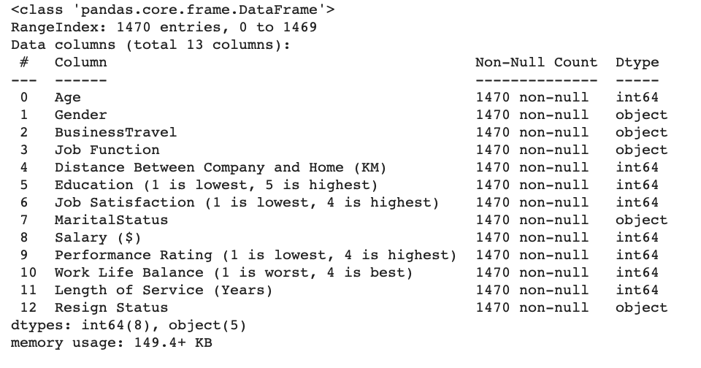
Dataset Information
The dataset used in the experiment was the “IBM HR Analytics Employee Attrition & Performance” obtained from Kaggle Machine Learning Community.
The initial datasets consist of 35 independent features.
The 35 features have been reduced to a subset of 13 independent features through feature selection by the contributors of the experiment.
The dataset attributes are shown in the figure below.
No. | Attributes | Value
1 | Age | Integer
2 | Gender | Male , Female
3 | Business Travel | Travel_Rarely, Travel Frequently, Non_Travel
4 | Job Function | Research & Development, Sales, Human Resources
5 | Distance Between Company and Home (KM) | Integer
6 | Education (1 is lowest, 5 is highest) | Integer - 1 'Below College' 2 'College' 3 'Bachelor' 4 'Master' 5 'Doctor'
7 | Job Satisfaction (1 is lowest, 4 is highest) | Integer - 1 'Low' 2 'Medium' 3 'High' 4 'Very High'
8 | Marital Status | Single , Married , Divorced
9 | Salary ($) | Integer
10 | Performance Rating (1 is lowest, 4 is highest) | Integer
11 | Work Life Balance (1 is worst, 4 is best) | Integer
12 | Length of Service (Years) | Integer
13 | Resign Status | Yes , No

Slide 5
Uni-variate Analysis
Missing Data
In the dataset, we observed no missing data
Distribution
The distribution of age is slightly positively skewed.
The length of service and the salary is heavily positively skewed
Most employees travel rarely (71%)
A large portion of employees are in the research & development department (65%)
Most employees are married (45%)
There is more male employee in the company
More than 70% of the employee have above degree qualifications
Low Variance
The work life balance attributes seems to have low variance
Outliers
We observed many extreme outliers in the salary and length of service attribute
Log Transformation
The skewed attributes does not seem to follow a log distribution

Slide 6
Bi-variate Analysis
Effect of Resign Status on Distribution
Employees that resign tend to be younger
Many employees that resign has a degree.
Employees that have high job satisfaction are less likely to resign.
Employees that resign seems to have lower salary.
Many employees that resign have poor work life balance
Single employees are more likely to resign
Relationship between Freshman and Resign
Many of the characteristic of people that resign seems to largely refer to postgraduate students that just come into the industry

Slide 7
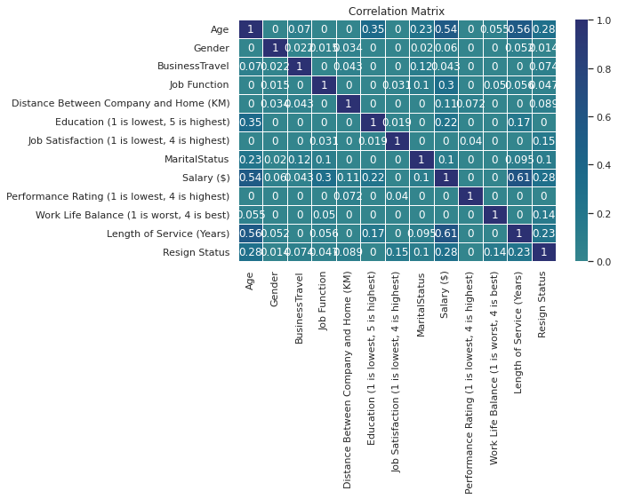
Bi-variate Analysis
Phik’s Correlation
From the correlation matrix , we did not see any strong correlation between the attributes.
The highest correlation among attributes was 0.56 from age and length of service.

Slide 8
Methodology

Slide 9
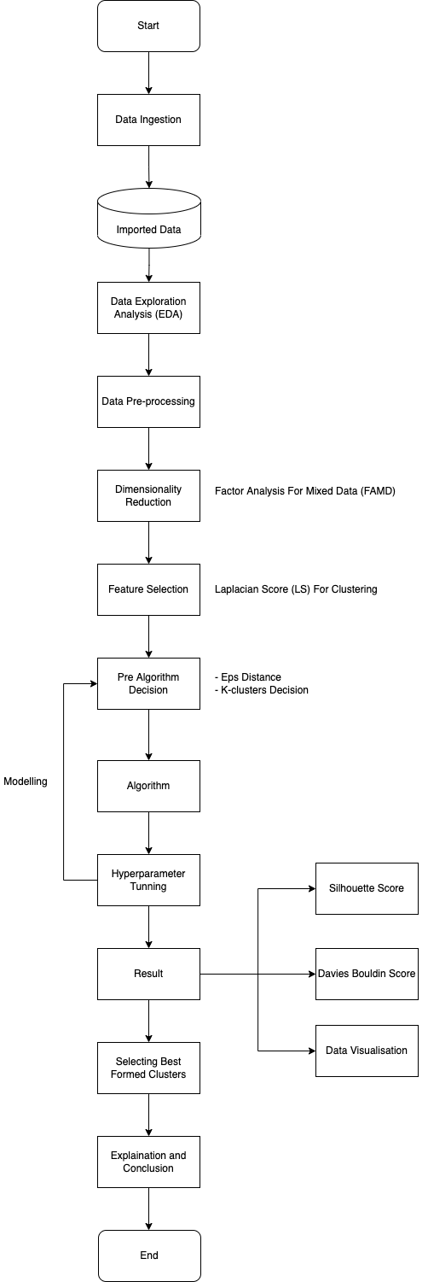
Workflow

Slide 10
Data Preprocessing
Dimensionality Reduction
The nature of our dataset is mixed-type data
In the experiment, we utilized the Factor Analysis for Mixed Data (FAMD) to carry out dimensionality reduction
FAMD combines the Multiple Correspond Analysis(MCA) and Principal Component Analysis(PCA) to be able process mixed data.
For selection of components ,we kept components which account for a total variance of at least 60%.
Feature Selection
We attempted to carry out feature selection using the Laplacian Score(LS) statistic.
It is then evaluated and plot against the silhouette score and Davies Bouldin score.
The result recommended us to select 2 features.
Scaling
In this paper, we used the standard scaler to scale the quantitative data.
The mean will be removed and scaled to unit variance

Slide 11
Optimization
Grid Search
In the experiment, grid search was used to search for the best hyper parameters for the models.
Elbow Plot Elbatta’s Eps Plot
Elbow plot and the Elbatta’s Eps plot was evaluated together with grid search to select number of cluster for partitional clustering
Cluster Visualization
We believe that the score may not be able to show everything especially for unsupervised learning.
Therefore, we utilized scatterplot and pair plot to evaluate more accurately.

Slide 12
Evaluation Methodology
In this paper, we experimented 5 models.
k-Medoids
k-Means++
Hierarchical Clustering (AGC)
Density-Based Spatial Clustering of Applications with Noise (DBSCAN)
Spectral Clustering (SC)
In the experiment, we select the silhouette score as our main scoring metric .
The Davies Bouldin score will serve as our sub metric which we will also take into considerations.

Slide 13
Results and Discussion
The table below shows the performance of all model used in experiment.
From the table, we observed that the Hierarchical Clustering has the highest overall performance.
It reach a relatively high silhouette score of 0.45 and a low Davies Bouldin score of 0.744.
However, despite the good paper score, we observed that the clustered formed by it was not as well as we expected.
The clustering were done badly as when we look at the scatter plot and pair plot.
After several evaluations and consideration , we choose the K-Mean ++ which possess the second-best performance.
Experiment Result
Name | Silhouette Score | Davies Bouldin Score
K-Medoids | 0.368147 | 0.883279
K-Means++ | 0.370927 | 0.875172
Hierarchical Clustering | 0.354730 | 0.902888
DBSCAN | 0.471174 | 2.528541
SC | 0.448073 | 0.744779

Slide 14
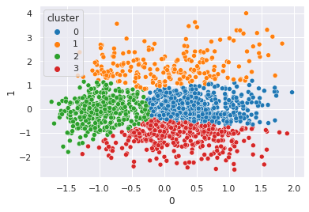
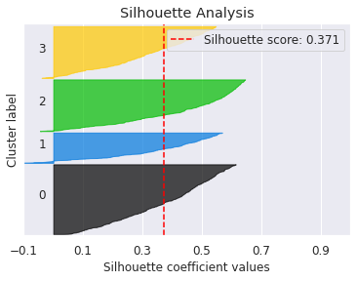
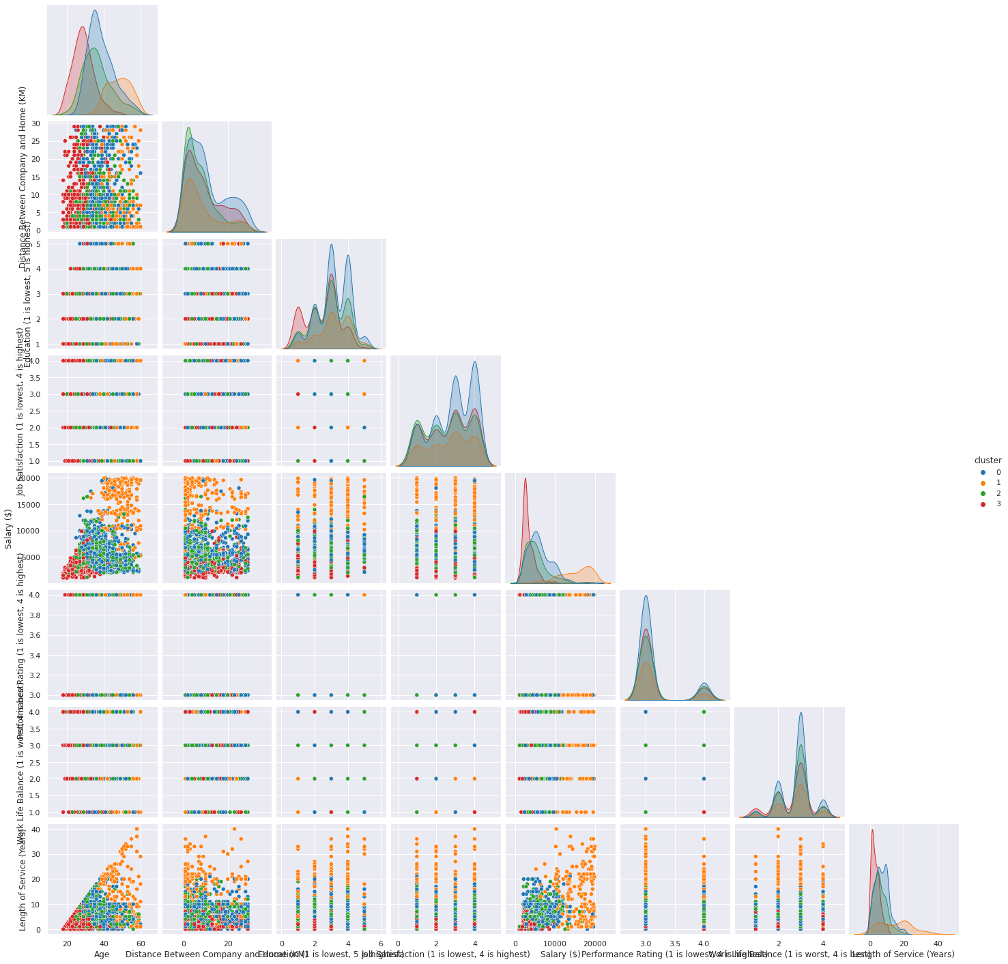
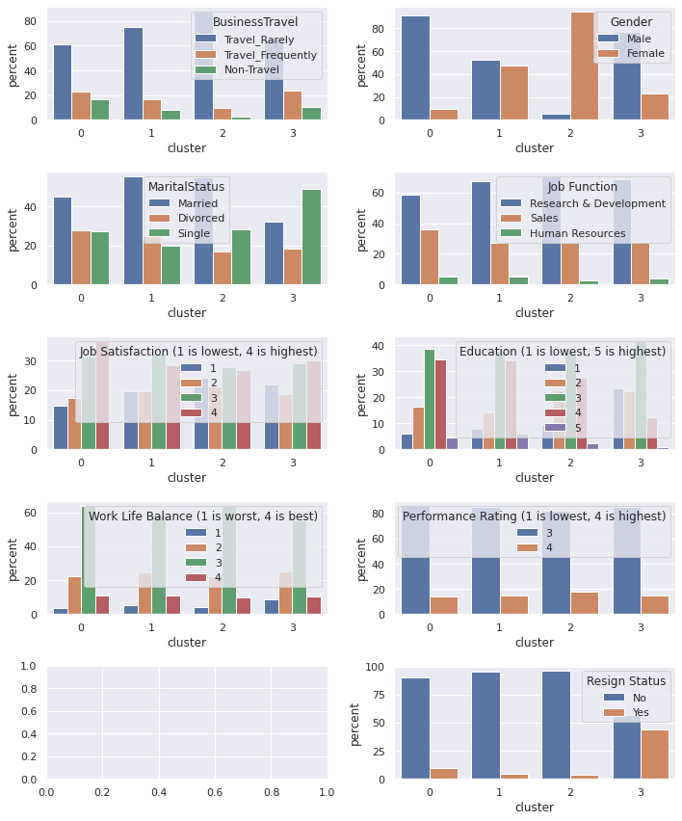
Final Evaluation
Here is the result of our final clustering.
Cluster Plot
As we observed in the figure below, the cluster seems to be done relatively well.
Silhouette Analysis
The silhouette analysis plot seems to look decent with a silhouette score of 0.37
Data Visualization
The pattern and the cluster was distinct.
Information could be recognized and interpret well

Slide 15
Interpretation – Characteristic of Cluster 1
For the first cluster ,they are a group of employee that are above the average age.
They have a relatively high education and have the highest satisfaction toward their job.
Their performance was average.
They have the best work life balance and have work relatively long in the company.
Most of the employee in this group do not travel often.
On average, this group of employee have above average salary

Slide 16
Interpretation – Characteristic of Cluster 2
For the second cluster , they are a group of employees that are mostly one of the oldest in company.
This group of employee have donated much of their life in the company ,most stayed the very long in the company.
They mostly have very high education (average highest) and have the highest salary in the company.
More than 80% of the employees from this group are married
Very less percentage of employee from this group resign.
This can be due to the fact that they are married and have a family to raise. Therefore, they seek for job stability and does not change job regular.

Slide 17
Interpretation – Characteristic of Cluster 3
For the third cluster, they are a group of employee that are of average age.
Most employees in this group are female.
This group of employee average have slightly higher than the average salary of employee.
Their average performance is the highest and have average work life balance.
Many employee in this group are married.
However, employee in this group average have below average job satisfaction.
Nevertheless, very less percentage of people in this group(average lowest) choose to resign.

Slide 18
Interpretation – Characteristic of Cluster 4
For the last cluster, they are a group of very young employees(average 28 years old).
Average employee in this group has education that is not high.(below average).
Their average work life balance is below average, but their job satisfaction is average.
Average employee in this group does not work long.
Their average salary is quite low.
Most of the employees in this group are single.
Many employees in this group tend to resign. This is not surprising as they are still young, mostly single and therefore still have the opportunity to switch their job.
This group of employees looks mainly like postgraduate students that have just entered the industry.

Slide 19
Interpretation – Suggestions and Improvement
After serious consideration , we thought that the management should try do something to retain the employees of the third cluster.
The employees from the third cluster has the highest average performance and a relatively high average work life balance.
Retaining them can help to ensure high work performance and good employee health at the same time which is beneficial for the overall growth of company.
Looking at the average job satisfaction, their satisfaction are the lowest. The company should try to improve their work experience and improve their salary to improve their satisfaction to avoid loss of these human resources.

Slide 20
Interpretation – Other Suggestions
Other general suggestions includes to give regular training to staff as we see that the average performance of long-staying staff (Long length of service) isn't very high.
In this case, training can be provided to them to upgrade and improve efficiency.
Other than that, the company should also try to retain employees of forth cluster by providing better job environment and experience. (such as discounted meals or free bus service for employees staying far) .
This is because that the employee in cluster 4 are mainly young employee.
Old employees will definitely retire one day.
To ensure consistent supply of man-power in the company, the company should make attempt to retain these young talents in the time.

Slide 21
Conclusion and Limitation
Conclusion
In this experiment, we carried out several data preprocessing and clustering methods and evaluated that the clusters formed by K-mean++ is the best. We successfully identified and differentiate each clusters. Several recommendation and suggestion for the company was also made. We recommend the company to focus more on the employees of the third cluster for the success of the company.
Limitation
The research of this experiment has to be seen in light of some limitations.
In the experiment , we have limited time while carrying out the experiment. Additionally, the number of sample of the dataset was relatively small which bought some constrict to the experiment.

Slide 22
Acknowledgement
The completion of this paper would not have been possible without the guidance and assistant of so many people. I sincerely appreciate their contribution and effort.
Particularly, I would like to thank my respected lecturer, Dr Wilson Qiu, for his continuous support and motivation. His guidance has helped me in the whole duration of the research. I could not have imagined a better lecturer for my machine learning study.

Slide 23
Thank You
Chen ZhuoFan (P2100746)
DAAA/FT/2A/04
30 July 2022

