Slide 1

Application of Machine Learning in Machine Failure Prediction
Chen ZhuoFan (P2100746)
DAAA/FT/2A/04
6 June 2022

Slide 2
Problem Background
Data Exploration
Methodology
Optimization
Conclusion and Limitation
Acknowledgement
Content

Slide 3


Problem Background
Globalization is the process of interaction and integration among people, companies and governments worldwide. It has accelerated since the 18th century and have enabled the trade of goods and services at a bigger scale.
The production of goods need to be done more effectively. In today's world, many goods are manufacturing by machines in a pipeline to ensure high efficiency and precision at the same time.
However, machines may malfunction with time. These malfunctioning machines may result in defects in goods which is not favorable. Manual checking can be time-consuming and cost-inefficient.
In this experiment ,we will make use of machine learning model to assist us in predicting malfunctioning machines so that repairs or replacements can be done in time to reduce disruption and loss.

Slide 4
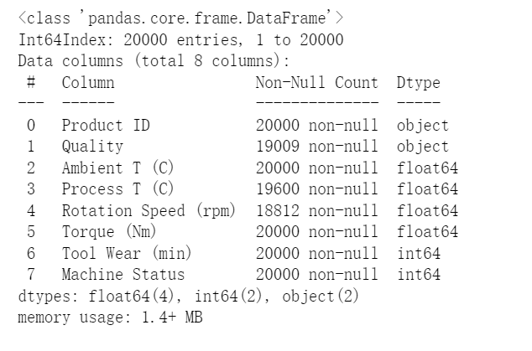
Dataset Information
The dataset used in the experiment was the “Factory Data Dataset” obtained from the Singapore Polytechnic.
The initial datasets consist of a label called ‘Machine Status’ and 8 independent features.
Information such as machine temperature, rotation speed, tear wear lifespan are collected.
The dataset attributes are shown in figure 1.
No. | Attributes | Value
1 | Product ID | String
2 | Quality | L- Low ; M- Medium H-High
3 | Surrounding Temperature(Ambient T( C)) | Float numbers
4 | Machine Temperature (Process T (C )) | Float numbers
5 | Rotation Speed (rpm) | Integer
6 | Torque (Nm) – Rotation force | Float number
7 | Tool Wear (min) | Integer
8 | Machine Status | 0-Normal 1-Abnormal

Slide 5
Uni-variate Analysis
Missing Data
In the dataset, we see that rotation speed has the greatest number of missing data(5.0%) ,followed by quality which is accounted for 4.9% and machine temperature(2.0%).
We carried out statistical tests and evaluate that the missing data mechanism for all 3 features that have missing data are Missing At Random (MAR)
Class Distribution
Highly imbalanced distribution.
The amount of data for which machine fails(3.39%) are much lesser than data for normal machines(96.61%).
Therefore , oversampling will be introduced later to counter this issue.
Low Variance
The Product ID has low variance, we see no interesting pattern etc.
Distribution
The torque and machine temperature are assumed to follow a normal distribution.
The rotation speed is positively skewed.
Most of the item are of low quality( 56.95%)
Outliers
There is much outliers in features like rotation speed and torque.

Slide 6

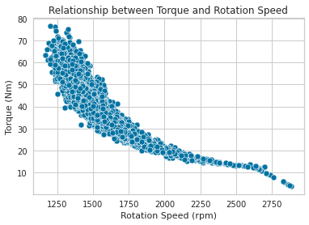
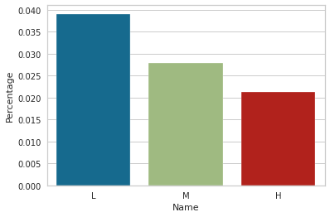
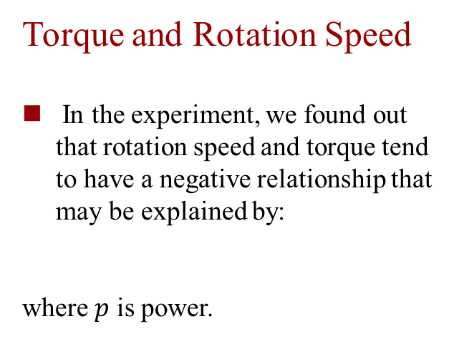
Bi-variate Analysis
Effect of Class on Distribution
The ambient temperature for abnormal machine tend to be higher as we see the distribution skew to the right.
Abnormal machine tend to have lower rotation speed.
The distribution of tool wear for abnormal machine is more negatively skewed compared to normal machine.
The estimated tool wear time for abnormal machine tend to be higher.
Torque and Rotation Speed
In the experiment, we found out that rotation speed and torque tend to have a negative relationship that may be explained by:
where $p$ is power.
Quality and Fault
In the experiment, we also observed that low quality machine seems to be higher chance of being abnormal

Slide 7
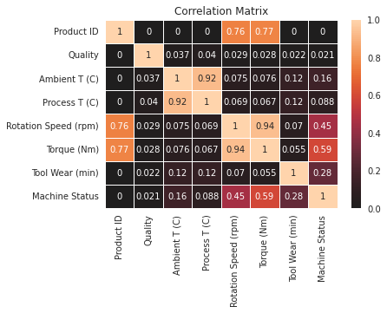
Bi-variate Analysis
Phik’s Correlation
From the correlation matrix ,we see that the features are not highly correlated with the target. The highest was 0.59 from Torque ,followed by rotation speed ,0.45 and tool wear,0.28.
However, between features, we realize that the rotation speed and torque are highly correlated: 0.94.
This is not surprising because we found out the inverse relationship between torque and rotation speed previously.
Hence, to reduce computing workload, we can remove one of them.
Since rotating speed has many missing values, we will remove rotation speed.

Slide 8
Methodology
Workflow in building a suitable model

Slide 9
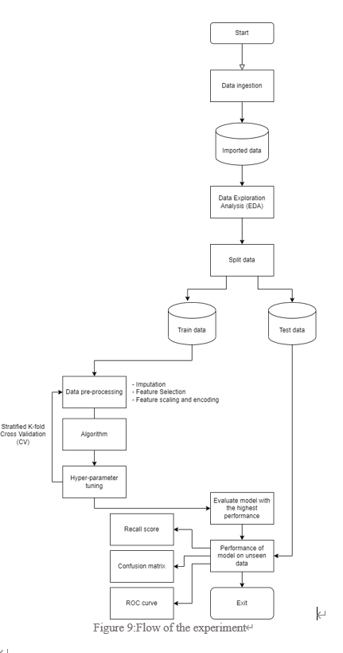
Workflow

Slide 10
Data Preprocessing
Split Data
In the experiment, we partition the dataset into a training set and a test set in the proportion of 8:2.
Models will be evaluated using 5 folds cross-validation with the recall as the main scoring metric.
The independent test data will be applied to the final evaluated model to evaluate the overall performance of the model on unseen data.
Scaling
In this paper, we will be using the Min-Max scaling to transform all the quantitative variables into the [0,1] range.
The minimum and maximum of the feature will be 0 and 1..
Remove Unnecessary Features.
As we discussed from the previous section, we will remove the Product ID and Rotation Speed.
Encoding
One-Hot Encoder will be used in this paper to counter this problem.
Since the cardinality of our quality feature is not high and our dataset is relatively big. There is no worry for curve of dimension.

Slide 11
Data Preprocessing
Imputation
In this paper, we will be using the Miss Forest imputator to compensate the missing values.
It has the capability of managing continuous and/or categorical data including complex interactions and nonlinear relations.
This imputator was also well-known for its high accuracy
Oversampling
To manage the imbalance in target classes will be using the Synthetic Minority Over-sampling Technique for Nominal and Continuous (SMOTE-NC) in this paper.
Feature Selection
We attempted to carry out feature selection using the chi-square test statistic.
However, the result recommended us to use all existed features.

Slide 12
Evaluation Methodology
In this paper, we experimented 8 models. A dummy baseline classifier was also added to facilitate comparison and evaluation.
Hist Gradient Boosting (HistGBM)
k-Nearest Neighbors (KNN)
Decision Tree (DT)
Random Forest (RF)
Support Vector Machine (SVM)
Gradient Boosting Tree (GBT)
eXtreme Gradient Boosting (XGBoost)
Adaptive Boosting (AdaBoost)
In the experiment, we select recall as our main scoring metric because it is the cost associated with false negative is very high. Reputation and schedule of factory may be affected.
Accuracy will serve as our sub metric where we will also take into considerations.
Stratified 5-fold cross validation was be used together with learning curve to further evaluate the model.

Slide 13
Optimization
Grid Search CV
In the experiment, grid search cv was used to search for the best hyper parameters for the models.
Learning Curve
Learning curve was also implemented to make sure that the model does not suffer from error due to variance and error due to bias

Slide 14
Results and Discussion
The table below shows the performance of all model used in experiment.
From the table, we observed that the Hist Gradient Boosting has the highest overall performance.
The test recall has reached a high score of 90.41%.with its test accuracy of 90.47%.
Experiment Result
Name | Training |  | CV
 | Recall | Acc | Recall | Acc
Baseline | 0.000000 | 0.966125 | 0.000000 | 0.966125
DT | 0.945583 | 0.877578 | 0.920676 | 0.874875
RF | 0.941876 | 0.935859 | 0.856099 | 0.926937
SVM | 0.905900 | 0.893750 | 0.856099 | 0.893563
AdaBoost | 0.876389 | 0.910078 | 0.861587 | 0.807687
XGBoost | 0.920203 | 0.929094 | 0.876300 | 0.923563
GBM | 0.931269 | 0.926266 | 0.893051 | 0.922875
HistGBM | 0.924812 | 0.907203 | 0.904145 | 0.904687
KNN | 0.940034 | 0.962531 | 0.785865 | 0.944785

Slide 15
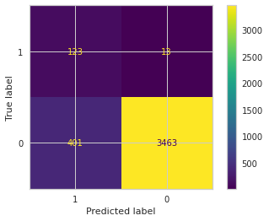
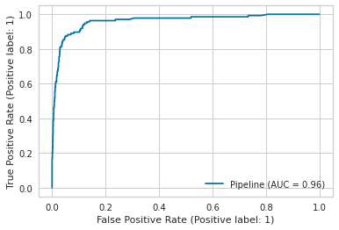
Final Evaluation
Now we will test our model on our unseen test data.
Recall
Upon testing our model with the unseen test data, it returns a recall score of 90.41%
Confusion Matrix
The confusion matrix shows that it predicted 13 false negatives and 401 false positives
ROC Curve
The ROC curve is considered close to the upper left corner, this implies that the model works well.

Slide 16
Conclusion and Limitation
Conclusion
Therefore, these results suggests that the model can generalize well with unseen data.
In this paper, we have explored the datasets, carried out several analysis and investigated the model has the highest performance in predicting machine failure. The final model we evaluated is the Hist Gradient Boosting Tree which ends up with a recall score of 90.4% and the accuracy score of 89.7% .
Limitation
The findings of this investigation have to be seen in light of some limitations.
In this investigation, we have limited time and limited information regarding the background of the dataset. This may affect our understanding and interpretation of the results.

Slide 17
Acknowledgement
The completion of this experiment would not have been possible without the guidance and participation of so many people. Their contributions are sincerely appreciated.
Particularly, I would like to express my appreciation to my respected lecturer, Dr. Wilson Qiu, for his continuous support and motivation. His sincerity and patience have truly inspired me.

Slide 18
Thank You
Chen ZhuoFan (P2100746)
DAAA/FT/2A/04
6 June 2022

