Slide 1
Motion Planning using Potential Fields for Robotic Image-Guided Intervention Systems
Mark Renfrew
Zhuofu Bai

Slide 2
The Problem
Inserting needle into tissue towards a target e.g., a tumor
How to steer the needle?
Target, obstacles may move
Global planning is not possible
Must use a local incremental planner

Slide 3
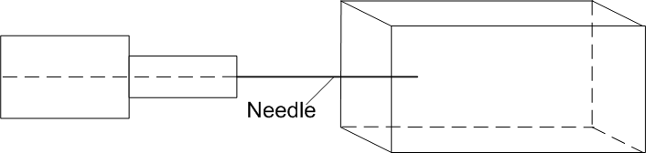

Needle Insertion
Target

Slide 4
Potential Field Model
Incremental local motion planner
Can be adapted for use with an uncertain environment
Holonomic system – no constraints on motion
Needs to be augmented to simulate needle motion

Slide 5
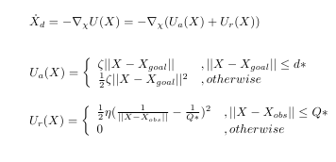
Potential Field Model

Slide 6
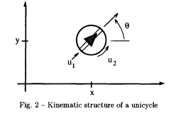
Non-holonomic constraints
Unicycle model

Slide 7



Non-holonomic constraints
Can be expressed as
Kinematic model:
Needletip velocities

Slide 8
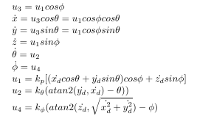
Non-holonomic constraints (3D case)

Slide 9
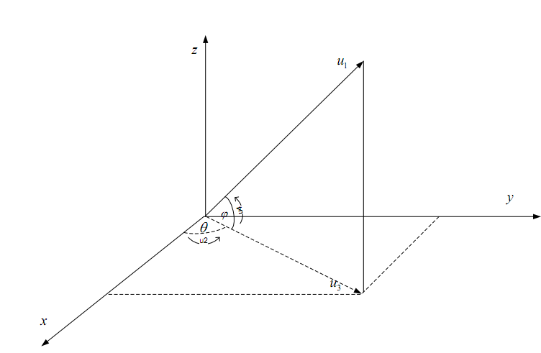
3D unicycle

Slide 10
Simulation
Holding all other parameters constant, is there a value of kθ which makes the unicycle behave like a needle?
Will it also be able to navigate past obstacles?

Slide 11
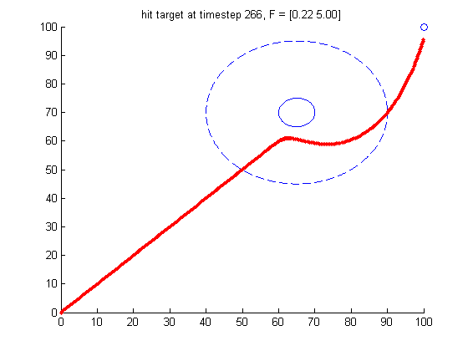
kθ = 1

Slide 12
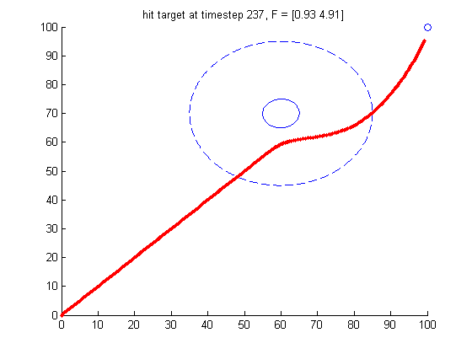
kθ = 0.1

Slide 13
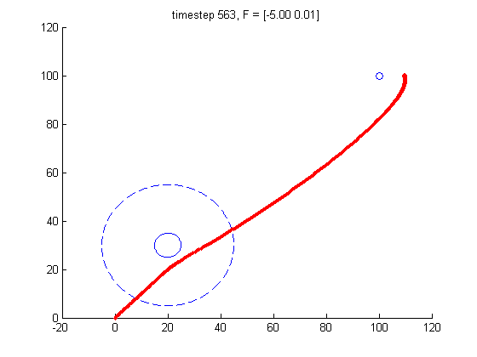
kθ = 0.01

Slide 14
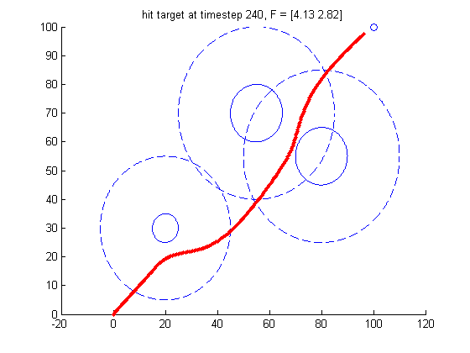
Multiple targets

Slide 15
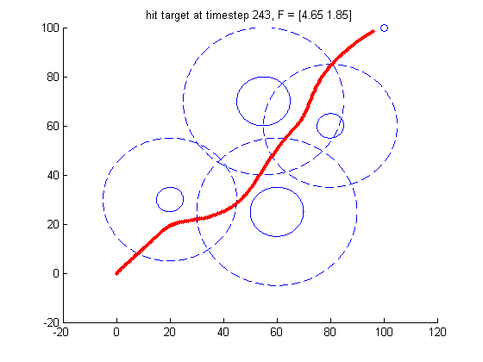
Multiple targets

Slide 16
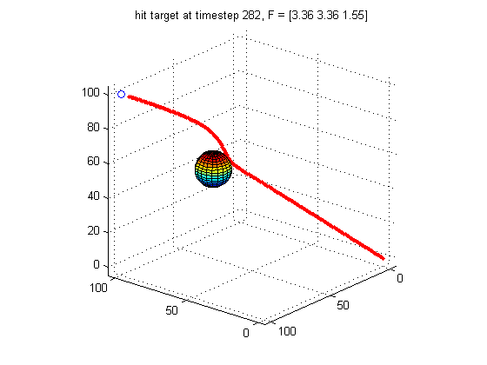
3D model

Slide 17
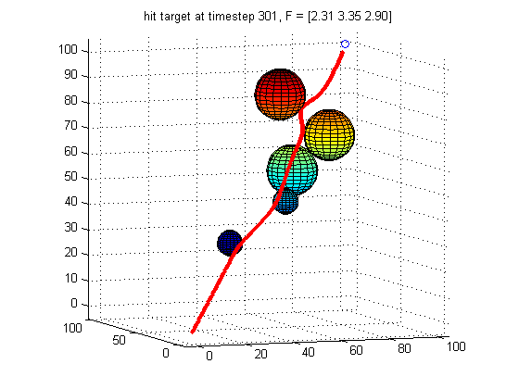
3D model

Slide 18
Conclusions
With proper parameter selection, the unicycle model can simulate a needle
If greater accuracy/realism is required, a more complicated model of the needle will be required

Slide 19
Future work
Constraints representing the needle body as well as the tip
Control model linking the needle base to the tip

Slide 20
Questions?

