Slide 1
Probablistic Localization of Target and Needle in Robotic Image-Guided Intervention Systems
Mark Renfrew
Zhuofu Bai

Slide 2
The Problem
Inserting needle into tissue towards a target e.g., a tumor
Needle may deform
Target may move unpredictably

Slide 3
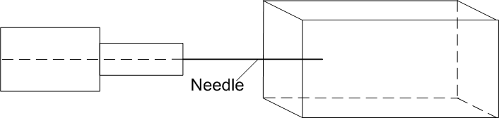

Diagram
Target

Slide 4
Models
Needle Motion Model
Target Motion Model
Needle Measurement Model
Target Measurement Model
Localization Model

Slide 5
Needle Motion Model
Needle is modeled as a set of N quadratic splines
N+1 control points
Image of equation from paper

Slide 6
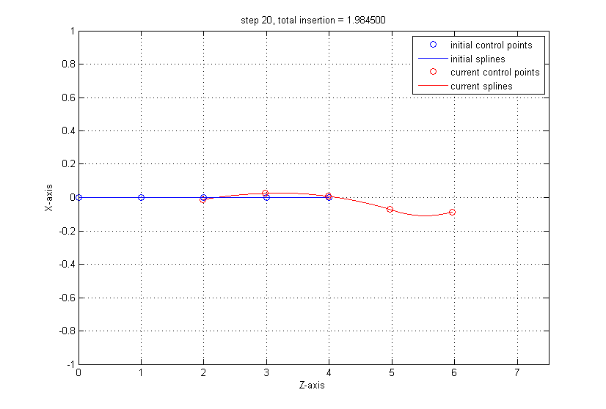
Needle Motion Model

Slide 7
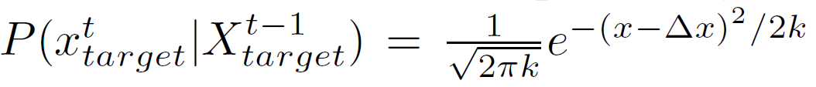

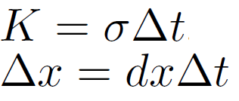
Target Motion Model
Target takes a random walk - Brownian Motion
is the timestep,

Slide 8
Imaging Model
We have a medical imaging device (e.g., CT scanner) oriented orthagonal to the needle base
It acquires images which represent a slice of the tissue at depth z
Subject to noise, false positives/negatives

Slide 9
Needle Measurement Model
Given an imaging depth z, returns measurement vector Mn = [INT, x, y]
INT=TRUE if needle intersects image plane
(x,y) give detected intersection coordinates
(x,y) may differ from (x’,y’), the real needle coordinates at depth z
If true detection, (x,y) are chosen from a normal dist
If false detection, (x,y) are chosen from a uniform distribution

Slide 10
Target Measurement Model
Assume spherical target
Detection probability is a saturating linear function of the target’s cross-sectional area on image
Measurement vector Mt = [INT,x,y]

Slide 11
Localization
Two particle filters
One tracks target; each particle represents (x,y,z) position of target
One tracks needle, each particle represents a needle shape
6N dimensions

Slide 12
Simulation
Needle with 5 control points, 5cm length inserted ~2cm over 20 timesteps
Needle tracking:
Configuration error 0.2651 +/- 0.0274
Needletip error 0.2614 +/- 0.0349
Target tracking:
Target error 0.0355 +/- 0.0155

Slide 13
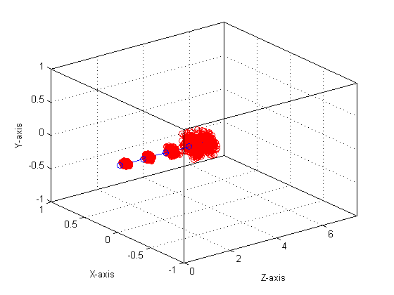
Needle tracking – 1 timestep

Slide 14
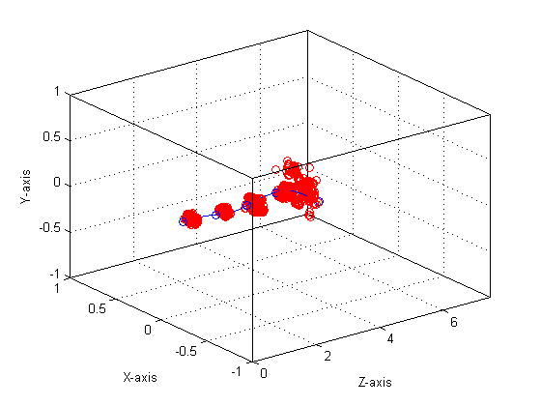
Needle tracking – 7 timesteps

Slide 15
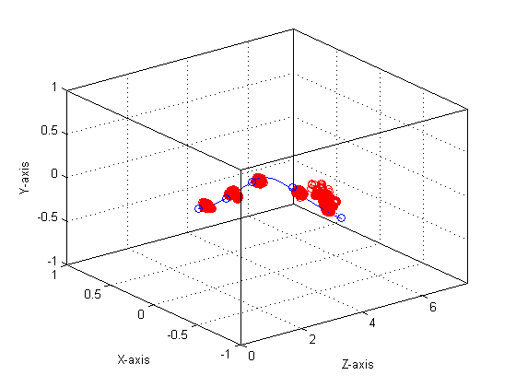
Needle tracking – 14 timesteps

Slide 16
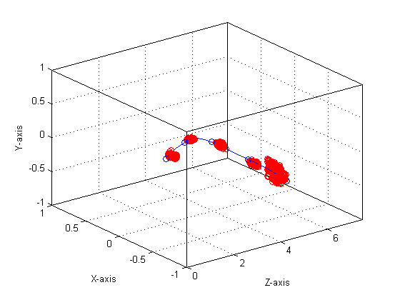
Needle tracking – 20 timesteps

Slide 17
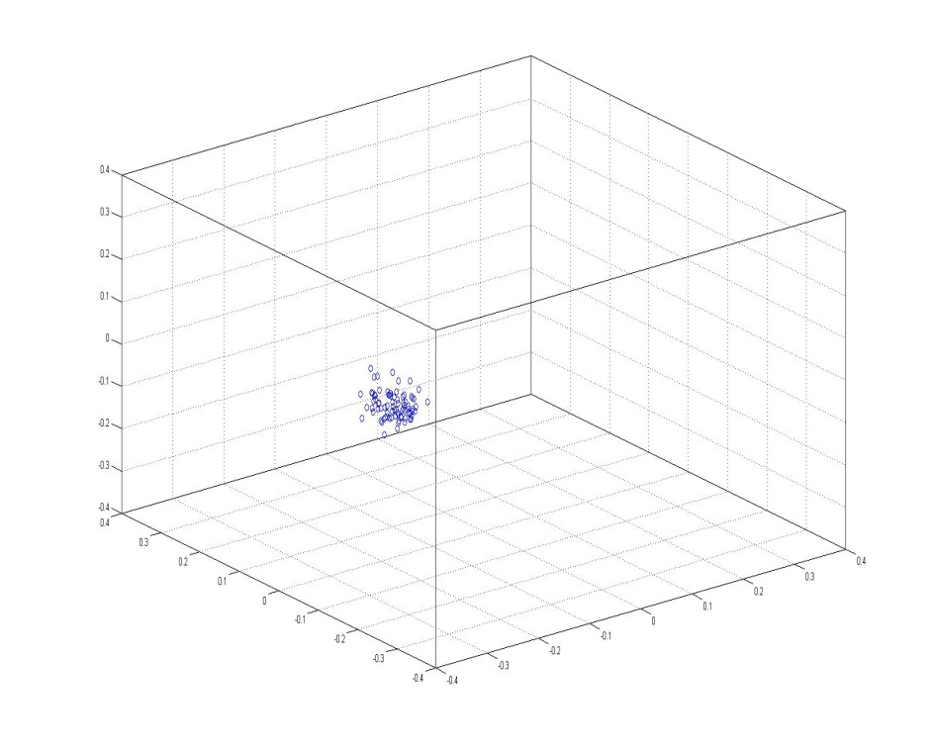
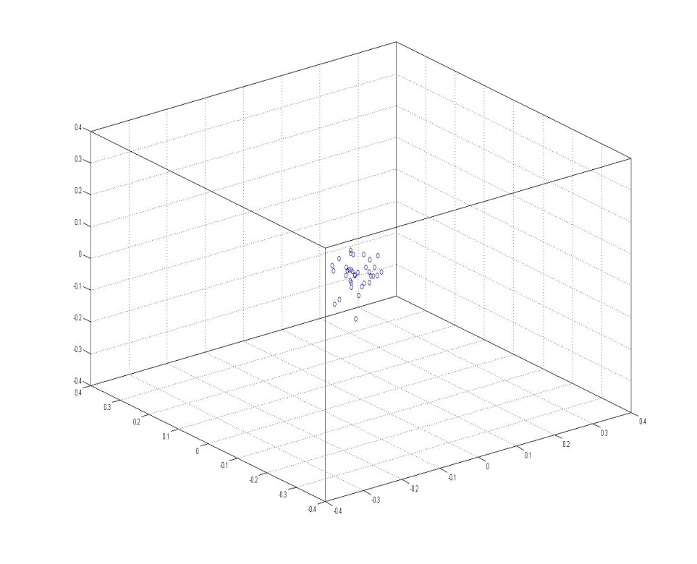
Target tracking
Time Step 1
Time Step 2

Slide 18
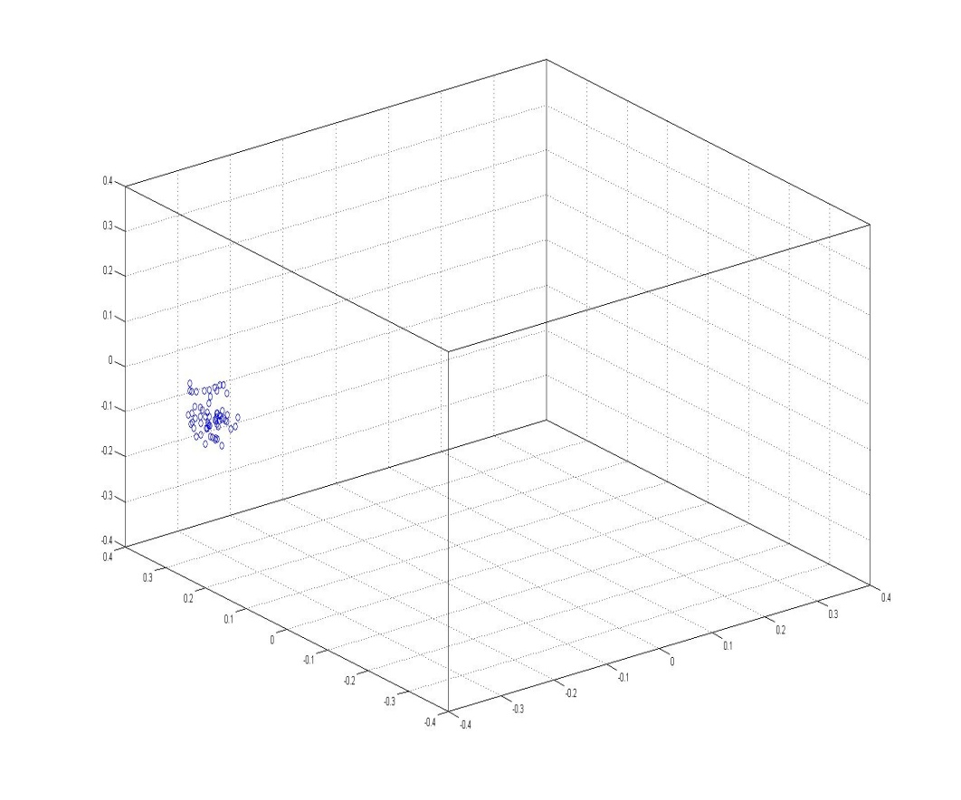
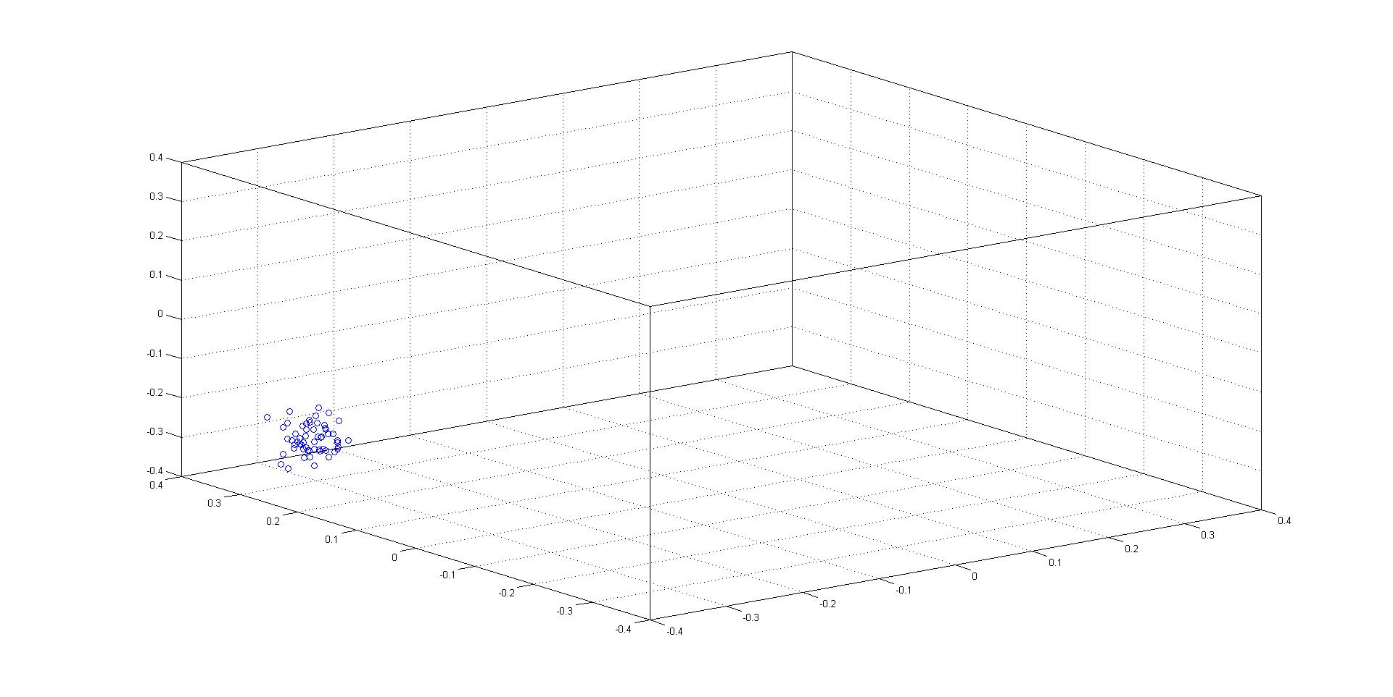
Time Step 5
Time Step 7

Slide 19
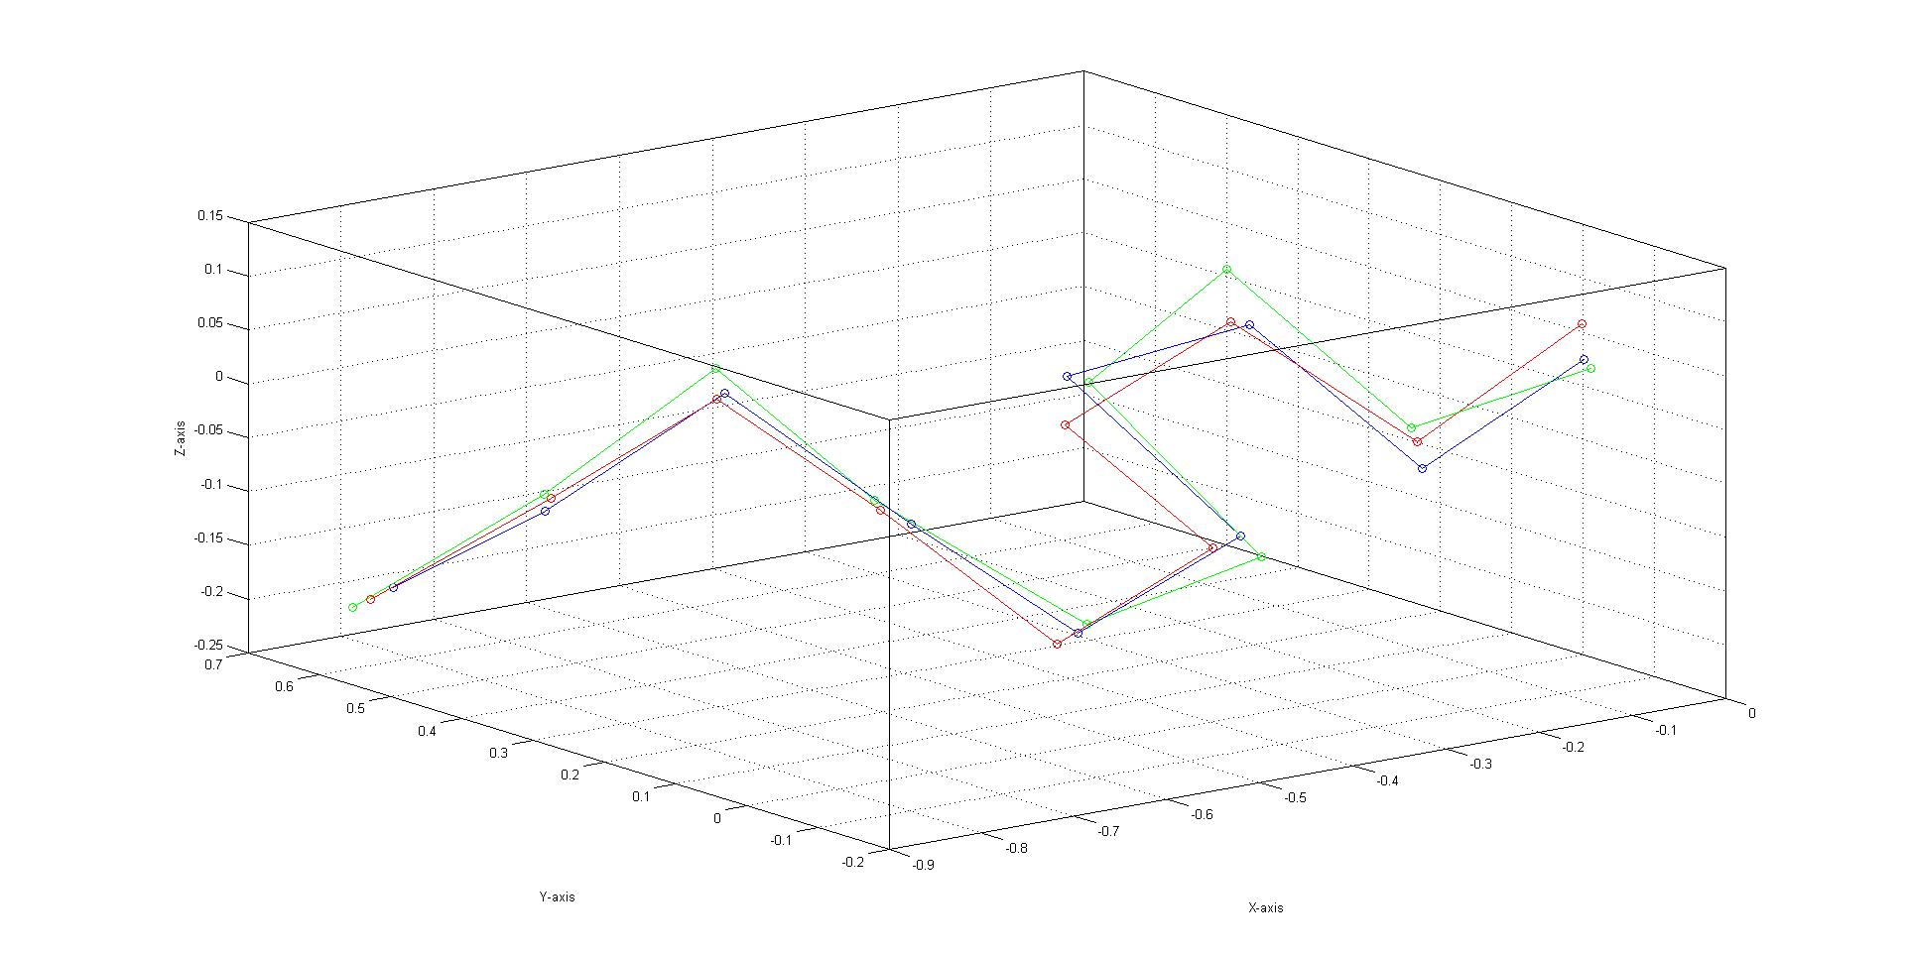
average error (kernel)=0.032628, average error(maximum weight)=0.038961

Slide 20
Questions?

