Slide 1
CS5222 Q&A (Chapter 1)

Slide 2
Which of this is not a network edge device? A) PC B) Smartphones C) Servers D) Router
Notes:
D) Router

Slide 3
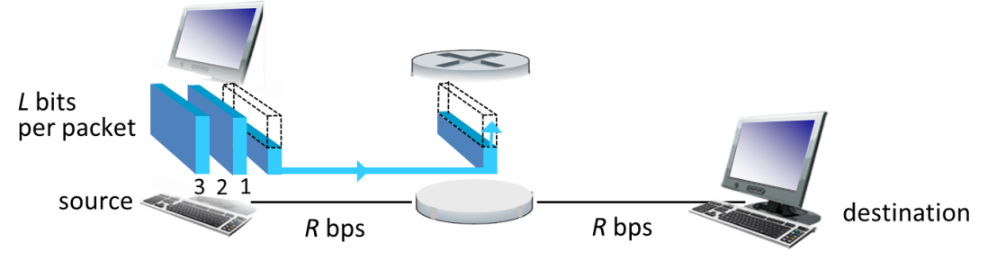
(Store-and-forward transmission) Ignore queuing, propagation delay, and processing delay. What will be the end-to-end delay for sending 3 packets each of length L across 2 links?
3L/R
4L/R
5L/R
6L/R
Notes:
B) 4L/R

Slide 4
Which of the following packet delay(s) is/are affected by network congestion?
A) nodal processing delay
B) queueing delay
C) transmission delay
D) propagation delay
Notes:
B) queueing delay

Slide 5
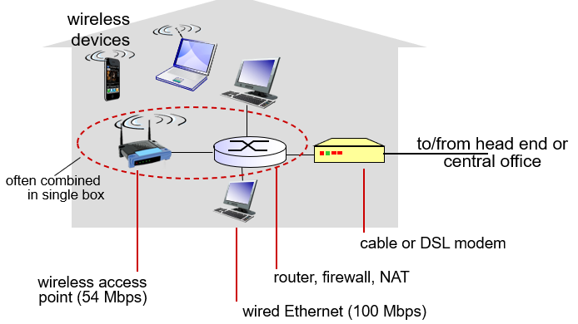
Suppose you are using a modem with speed 100 Mbps for your wireless router with speed 54 Mbps. They are connecting your smarthphone to the Internet. During contract renewal, PCCW offers to give you a new Wi-Fi router of 1 Gbps to replace the old one. What is the end-to-end throughput of your smartphone if you accept this offer?
A) 100 Mbps
B) 54 Mbps
C) 154 Mbps
D) 1 Gbps
Notes:
100 Mbps

Slide 6
What of the following statement(s) is/are true about the transport layer?
A) It is always providing a reliable process-process data transfer.
B) It is in Layer 4 of the Internet protocol stack.
C) It is providing services for the network layer below.
D) In the encapsulation, it adds a header to the segment and pass it to the application layer above.
Notes:
B

