Slide 1
CS5222 Q&A (Chapter 3)

Slide 2
Suppose a sender sends a packet to the receiver. Which of the following mechanism can a receiver use to determine whether the packet has been corrupted? (Choose one)
A) ACK
B) Checksum
C) Timeout
D) None of the above
Notes:
B) Checksum

Slide 3
Suppose a sender sends a packet to the receiver. Which of the following mechanism can a sender use to determine whether the packet has been corrupted? (Choose one)
A) ACK
B) Checksum
C) Timeout
D) None of the above
Notes:
A) ACK

Slide 4
Which of the following statement(s) about GBN is/are NOT true?
A) It is a pipelined protocol.
B) The sender needs one timer for its operation.
C) The receiver needs one buffer to hold some out-of-order packet.
D) When timeout, the sender just retransmits that unacked packet causing the timeout.
Notes:
C & D

Slide 5
Which of the following statement(s) about SR is/are NOT true?
A) It is a pipelined protocol.
B) The sender needs one timer for its operation.
C) The receiver needs one buffer to hold some out-of-order packet.
D) When timeout, the sender just retransmits that unacked packet causing the timeout.
Notes:
B

Slide 6
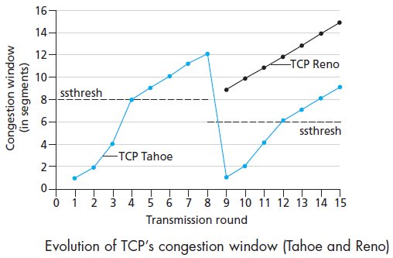
Consider TCP Reno. Suppose the sender observes three duplicated ACKs at around 15. What will be the congestion window size at around 16?
A) 1
B) 3
C) 7
D) 10
Notes:
D

Slide 7
Consider TCP Reno. Suppose the sender experiences a timeout at around 15. What will be the congestion window size at around 16?
A) 1
B) 3
C) 7
D) 10
Notes:
A

