Slide 1
CS5222 Q&A (Chapter 4 & 5)

Slide 2
Consider classful routing. Suppose a host in the organization has an IP address 219.100.8.32. What is the total number of host IP addresses that we can allocate?
A) 254
B) 256
C) 65534
D) 65536
Notes:
A

Slide 3
Which of the following statement(s) about DHCP is/are true?
A) Its transport layer is based on TCP
B) A newly arriving client obtains the IP address of the DHCP server through DNS.
C) When a client sends a “DHCP request” message, the destination IP address is a DHCP server’s IP address.
D) A newly arriving client can obtain an IP address and the network mask through DHCP.
Notes:
D

Slide 4
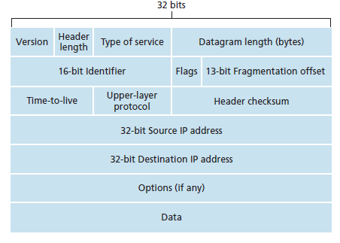
Which of the following statement(s) about IPv6 is/are true?
A) By choosing the IP protocol version number to be 6 in an IPv4 datagram, we will obtain an IPv6 datagram.
B) The checksum is enhanced for better security.
C) Fragmentation is not allowed for higher processing speed.
D) The adoption of IPv6 is close to 90% today.
Notes:
C

Slide 5
Which of the following statement(s) about the practical approach of Internet routing is/are true?
A) The forwarding table in a router is jointly determined by both the intra-AS and inter-AS routing algorithms.
B) Performance is always the key concern.
C) e-BGP can be used to propagate reachability information to all routers within an AS.
D) When choosing among gateway routers in hot potato routing, we only care about the intra-domain cost.
Notes:
A and D

