Slide 1
CMDL: A Large-Scale Chinese Multi-Defendant Legal Judgment Prediction Dataset
Presenter: Zhuo Han
Notes:
Hello, everyone. My name is Zhuo.
Today, I will report a work entitled CMDL: A Large-Scale Chinese Multi-Defendant Legal Judgment Prediction Dataset.
I will first summarize what the paper builds, then discuss why it can be useful, and finally point out some limitations and possible follow-ups.

Slide 2
Legal Judgment Prediction (LJP)
predicts the court’s outcome given the facts of a legal case
has been investigated in the context of different languages
Notes:
Legal judgment prediction, abbreviated as LJP, refers to the task of automatically predicting judicial results given case descriptions.
Since different regions of the world use different legal jurisdictions, LJP has been investigated in the context of different languages.

Slide 3
Chinese Legal Judgment Prediction
Three subtasks: (1) law article prediction, (2) charge prediction and (3) terms of penalty prediction
Input: a fact statement
Outputs: law article -> charge -> term of penalty
Notes:
This paper examines LJP in the context of Mandarin Chinese in the context of criminal law system of mainland China, which involves three subtasks: predicting (1) law articles, (2) charges, and (3) terms of penalty.

Slide 4
Drawback of Existing LJP Models
This paper argues that this leaves an important real-world scenario under-explored.
Multi-defendant cases are often removed because they are complex to annotate and evaluate.
Notes:
One weakness of existing LJP models is that they are mostly designed for single-defendant scenarios.
multi-defendant cases are messy, so earlier datasets often dropped them. But that also means we don’t really know how well our models work in real court scenarios.

Slide 5
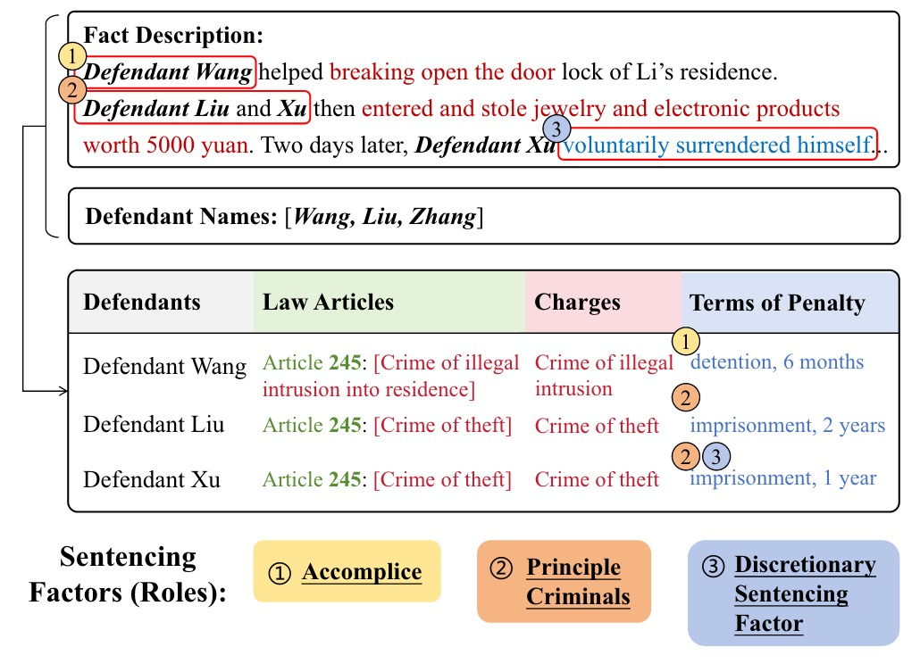
Multi-Defendant LJP
Given the fact description of a case, multi-defendant LJP aims to predict judgment outcomes for each defendant. An example is show in Figure 1.
In this example:
Defendant Wang: accomplice.
Defendant Liu: principal criminal.
Defendant Xu: principal criminal.
Figure 1: An illustration of multi-defendant LJP tasks.
Notes:
Compared to single-defendant LJP scenario, multi-defendant LJP indeed possesses higher complexity. For each case, the model have to make predictions for every defendant involved in the case.
An example is show in Figure 1, three defendants involved in the case receive different judgments as they face different sentencing factors based on judicial theory.
For instance, Defendant Wang involves in the case as the role of accomplice that does not directly participate in the theft activity. Whereas Defendant Liu and Xu are principal criminals for stealing.
Thus, Defendant Wang gets a lighter punishment compared to the others.

Slide 6
Challenges of Multi-Defendant LJP
Challenge 1: facts are typically presented in chronological order; details of each defendant are scattered across the fact description.
Challenge 2: different defendants are potentially involved in different circumstances; models should be able to apply relevant legal knowledge to each individual accordingly.
Notes:
There are two main challenges for models to distinguish sentencing factors among defendants.
First, facts are typically presented in chronological order; details of each defendant are scattered across the fact descriptions and the model has to find all the pieces about one defendant across the document.
Second, different defendants are potentially involved in different circumstances; models should be able to apply relevant legal knowledge to each individual accordingly.

Slide 7
Goal
A large-scale Chinese multi-defendant LJP dataset to facilitate multi-defendant LJP research.
Automatically annotated and easily extendable.
Detailed annotations.
A more comprehensive approach to evaluate model performance on multi-defendant cases.
To evaluate model performance from a holistic perspective of the case.
Notes:
This paper aims to propose a large-scale Chinese multi-defendant LJP dataset to facilitate LJP research.
The dataset provides detailed annotations, covering more fine-grained labels such as different types of fines, different types of penalties, and paragraph-level law articles, etc. It can be easily expanded and annotated with an automatic annotation process.
This paper also provides a more comprehensive approach to evaluate model performance on multi-defendant cases. Given the varying number of defendants in multi-defendant cases, it’s important to assess model performance not only at the individual defendant level, but also from a holistic perspective of the whole case.

Slide 8
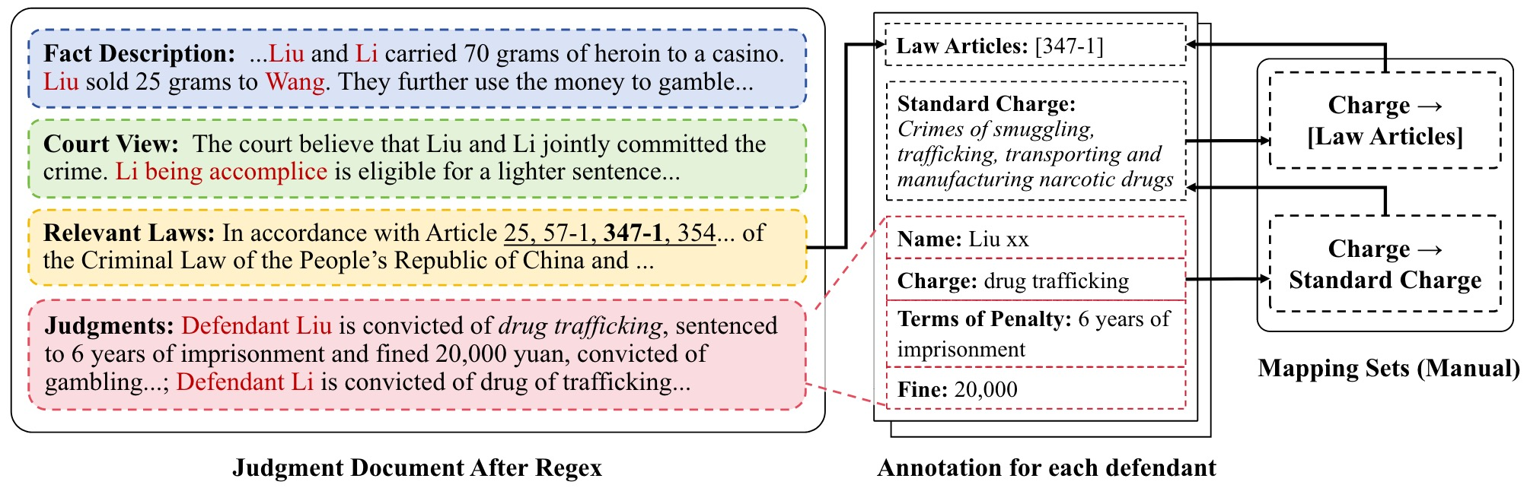
Corpus and Pre-Processing
Corpus: a total of 699,263 criminal documents involving two or more defendants from the past 20 years as our raw corpus from China Judgments Online. Only keep the judgment documents for LJP tasks requirements.
Pre-Processing: regular expressions are used to divide the documents into four parts:
fact description
court view
relevant laws
judgments
Figure 2: The data processing and annotation process of our dataset.
Notes:
For the construction of the CMDL dataset, first, raw corpus are collected from China Judgments Online the website.
Given the common structure of most legal documents, as illustrated in Figure 2, they first use regular expressions to divide the documents into four parts: fact description, court view, relevant laws and judgments.

Slide 9
Annotation- Charge
Labels: using a standardized mapping set of charges according to the latest 2023 version of The Criminal Law of China.
Charges extracted via regex are subsequently mapped to their respective standard.
Notes:
Since the criminal law of China has undergone multiple revisions, there are some criminal charges that have been deleted or renamed.
This paper uses the 2023 version of the criminal law as references, which is good for up-to-date studies, cases with deleted charges are filtered out and then establish a mapping set for renamed charges.
Besides, charges extracted through regex may not align precisely with the full standard charge names. Those charges are singled out and their mappings are added to the mapping set through manual checks.

Slide 10
Annotation- Law Article
Labels: by going through the Criminal Law, a mapping set from the standard charges to their relative legal provisions are constructed. This paper provides paragraph-level law article annotations rather than article-level annotations.
The specific label list for each defendant is constructed by mapping their charges to all possible relevant provisions through our mapping set and then including those that appear in the relevant laws section.
Notes:
The relevant laws section extracted previously corresponds to the citations for the entire case, which are difficult to separate and attribute to each defendant.
Also, the relationship between charges and law articles is not one—to-one. Therefore, a mapping set from the standard charges to their relative legal provisions are constructed by the definition in the Criminal Law.
Moreover, in legal documents, law articles are often cited down to the specific paragraph. Therefor this paper provides paragraph-level law article annotations to be more accurate and meet a wider range of real-world needs.

Slide 11
Annotation- Term of Penalty
Penalty type: death penalty, life imprisonment, fixed-term imprisonment, criminal detention, and public surveillance.
The annotations should be able to reflect both penalty type and length.
For a single defendant who commits several crimes, they typically receive a combined punishment, which is also annotated as the final penalty in addition to the penalty terms for each crime.
Notes:
As for the term of penalty, in practice, there are five main types of penalties: death penalty, life imprisonment, fixed-term imprisonment, criminal detention, and public surveillance.
All five types of penalties are considered during the annotation. Such annotations could well cover all possible term of penalty sentences of criminal cases. For example, when both life imprisonment and death penalty are labeled as False, and the length of the other three penalty types are labeled as 0, it indicates that the defendant is exempted from criminal punishment.

Slide 12
Annotation- Fines
Two types of annotations: specific amounts and being fined without a specified amount.
The fines imposed on defendants are extracted using regular expressions and standardized as integer types.
Instances where fines are mentioned but without specifying exact amounts are also annotated.
Notes:
Apart from the above three annotations, this paper also extracts the fines imposed on defendants using regular expressions and standardize them as integer values.
For those unable to be directly converted into integer, manual checks are conducted to annotate them.
Instances where fines are mentioned but without specifying exact amounts are also annotated.

Slide 13
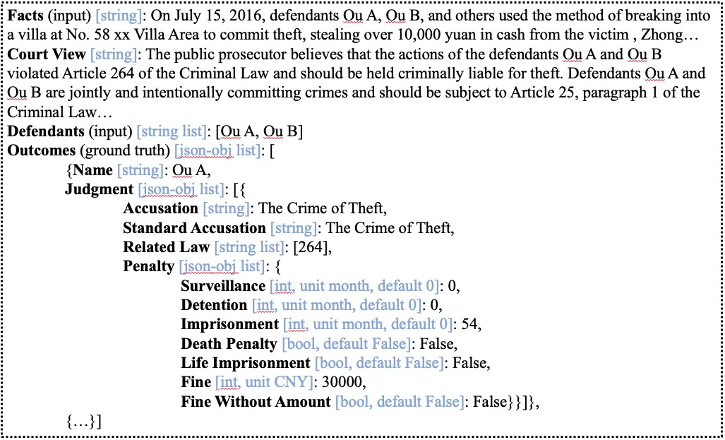
Anonymization
Finally, anonymize personal information (e.g. names and location) to protect privacy and avoid potential biases.
An example of a case in the dataset is shown in Figure 4 .
Figure 4: CMDL data example.
Facts (input) [string]: On July 15, 2016, defendants Ou A, Ou B, and others used the method of breaking into a villa at No. 58 xx Villa Area to commit theft, stealing over 10,000 yuan in cash from the victim , Zhong…
Court View [string]: The public prosecutor believes that the actions of the defendants Ou A and Ou B violated Article 264 of the Criminal Law and should be held criminally liable for theft. Defendants Ou A and Ou B are jointly and intentionally committing crimes and should be subject to Article 25, paragraph 1 of the Criminal Law…
Defendants (input) [string list]: [Ou A, Ou B]
Outcomes (ground truth) [json-obj list]: [
{Name [string]: Ou A,
Judgment [json-obj list]: [{
Accusation [string]: The Crime of Theft,
Standard Accusation [string]: The Crime of Theft,
Related Law [string list]: [264],
Penalty [json-obj list]: {
Surveillance [int, unit month, default 0]: 0,
Detention [int, unit month, default 0]: 0,
Imprisonment [int, unit month, default 0]: 54,
Death Penalty [bool, default False]: False,
Life Imprisonment [bool, default False]: False,
Fine [int, unit CNY]: 30000,
Fine Without Amount [bool, default False]: False}}]},
{…}]
Facts (input) [string]: On July 15, 2016, defendants Ou A, Ou B, and others used the method of breaking into a villa at No. 58 xx Villa Area to commit theft, stealing over 10,000 yuan in cash from the victim , Zhong…
Court View [string]: The public prosecutor believes that the actions of the defendants Ou A and Ou B violated Article 264 of the Criminal Law and should be held criminally liable for theft. Defendants Ou A and Ou B are jointly and intentionally committing crimes and should be subject to Article 25, paragraph 1 of the Criminal Law…
Defendants (input) [string list]: [Ou A, Ou B]
Outcomes (ground truth) [json-obj list]: [
{Name [string]: Ou A,
Judgment [json-obj list]: [{
Accusation [string]: The Crime of Theft,
Standard Accusation [string]: The Crime of Theft,
Related Law [string list]: [264],
Penalty [json-obj list]: {
Surveillance [int, unit month, default 0]: 0,
Detention [int, unit month, default 0]: 0,
Imprisonment [int, unit month, default 0]: 54,
Death Penalty [bool, default False]: False,
Life Imprisonment [bool, default False]: False,
Fine [int, unit CNY]: 30000,
Fine Without Amount [bool, default False]: False}}]},
{…}]
Facts (input) [string]: On July 15, 2016, defendants Ou A, Ou B, and others used the method of breaking into a villa at No. 58 xx Villa Area to commit theft, stealing over 10,000 yuan in cash from the victim , Zhong…
Court View [string]: The public prosecutor believes that the actions of the defendants Ou A and Ou B violated Article 264 of the Criminal Law and should be held criminally liable for theft. Defendants Ou A and Ou B are jointly and intentionally committing crimes and should be subject to Article 25, paragraph 1 of the Criminal Law…
Defendants (input) [string list]: [Ou A, Ou B]
Outcomes (ground truth) [json-obj list]: [
{Name [string]: Ou A,
Judgment [json-obj list]: [{
Accusation [string]: The Crime of Theft,
Standard Accusation [string]: The Crime of Theft,
Related Law [string list]: [264],
Penalty [json-obj list]: {
Surveillance [int, unit month, default 0]: 0,
Detention [int, unit month, default 0]: 0,
Imprisonment [int, unit month, default 0]: 54,
Death Penalty [bool, default False]: False,
Life Imprisonment [bool, default False]: False,
Fine [int, unit CNY]: 30000,
Fine Without Amount [bool, default False]: False}}]},
{…}]
Figure 2: Example of CMDL annotation.
Figure 2: Example of CMDL annotation.
Notes:
Finally, there’s the anonymization process where personal information is masked, such as names and locations, to protect privacy and avoid potential biases.
Noted that the above steps were all executed through code, saving significant human and time effort while making the dataset more extendable.
And an example of the resulted dataset is shown in Figure 4.

Slide 14
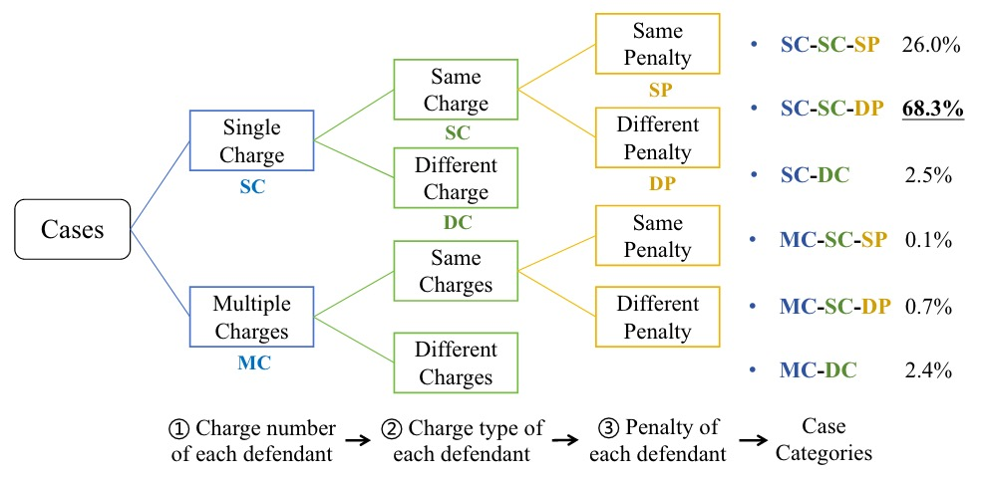
Hierarchical Case Categorization
Figure 4: Hierarchical case categorization.
Notes:
After the data preprocessing, this paper presented a case categorization based on the judgment results.
The hierarchical categorization and the percentage of cases in each category in demonstrated in Figure 4.
Most cases are: same charge, different penalties, and only a small portion has multiple different charges, and these are the hardest cases.

Slide 15
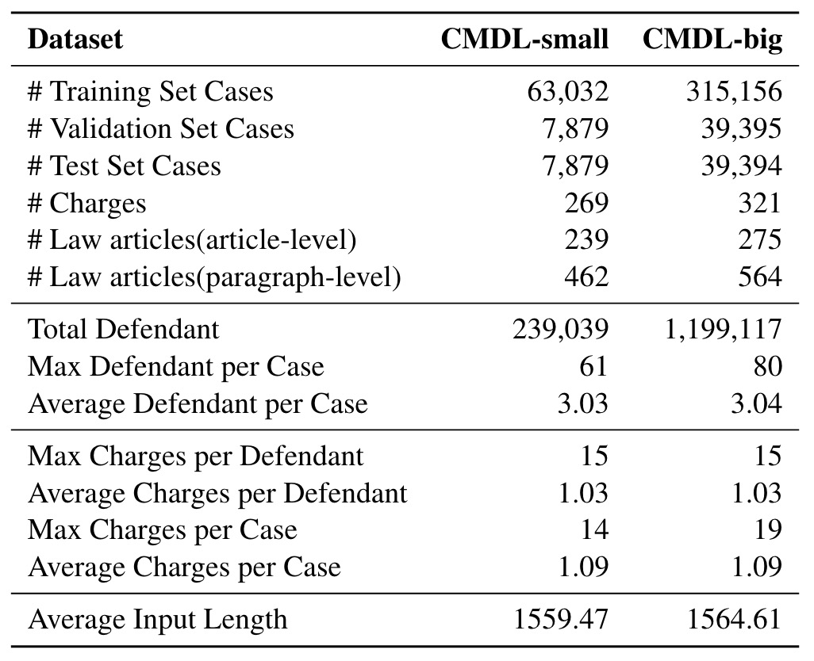
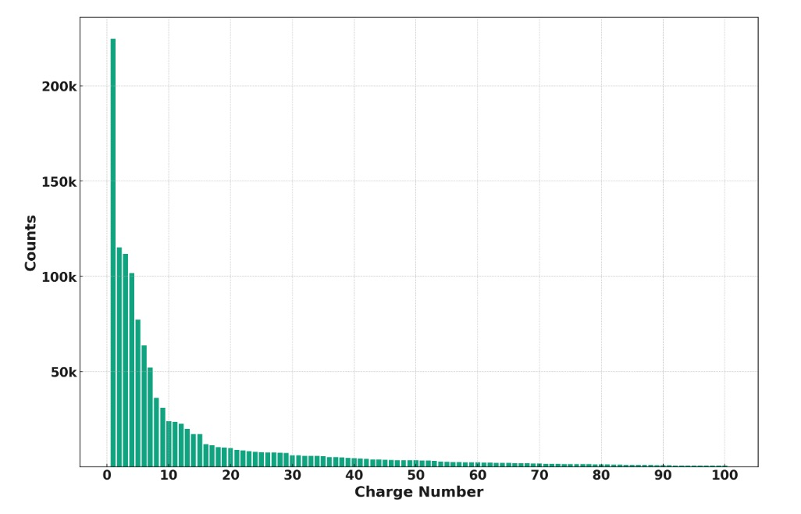
Dataset Statistics
The CMDL dataset consists of 393,945 criminal cases involving nearly 1.2 million defendants in total.
Figure 5: The distribution of top-100 frequent charges in our dataset.
Table 1: Statistics of CMDL.
Notes:
The CMDL dataset consists of 393,945 criminal cases involving nearly 1.2 million defendants in total.
The statistics of our dataset are listed in Table 1.
It is worth noting that there is a significant imbalance in the distribution of different categories within the dataset.
The low-frequency charge and law article categories are preserved to expose and demonstrate the challenges of long-tail issues.
Also they break the who dataset in two parts, the big and the small, for more adaptable use of the dataset.

Slide 16
Evaluation Setting
This paper evaluates LJP models’ ability for multi-defendant cases with two sets of metrics:
Defendant-level metrics: Accuracy, Macro-Precision, Macro-Recall, and Macro-F1.
Case-level metrics: Accuracy, Precision, Recall, and F1.
Final scores are weighted by the number of defendants in each case. And for individual cases, the score for each metric is determined by averaging the respective defendant-level metrics for all defendants involved.
Baselines: TopJudge, NeurJudge, BERT, LEGAL-BERT-SC, Lawformer, Dependant-T5, MAMD.
Experimental Settings
Defendant-level results on CMDL-small article-level law prediction and paragraph-level law prediction.
Case-level results on CMDL-small.
Notes:
This paper propose to evaluate LJP models’ ability for multi-defendant cases with two set of metrics: defendant-level metrics and case-level metrics.
Then the selected SOTA baselines to conduct the experiments. These are all re-used single-defendant models, no special architecture for cross-defendant reasoning is added.

Slide 17
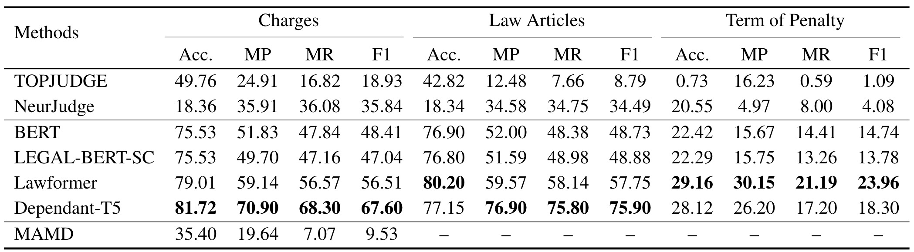
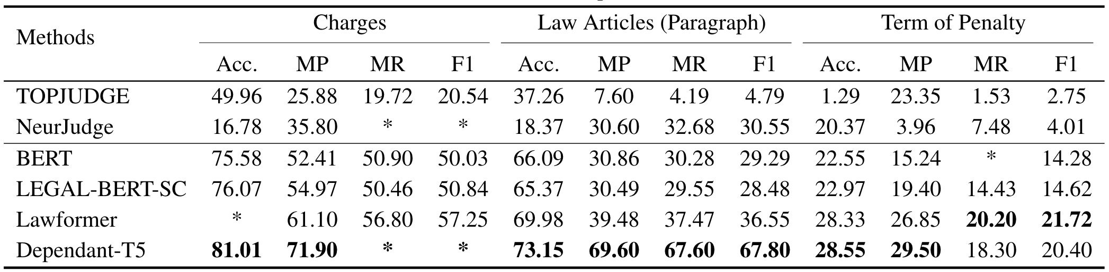
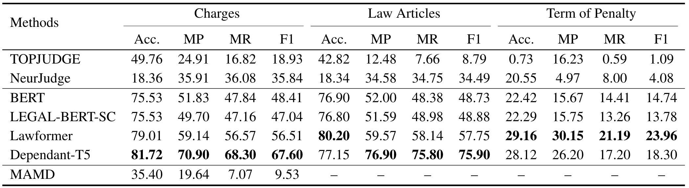
Experimental Results
Table 2: Defendant-level results on CMDL-small reporting article-level laws.
Table 3: Defendant-level results on CMDL-small reporting paragraph-level laws.
Notes:
Table 2 and 3 shows the defendant-level judgment prediction results on CMDL-small, reporting article-level law article results and paragraph-level law article results respectively.

Slide 18
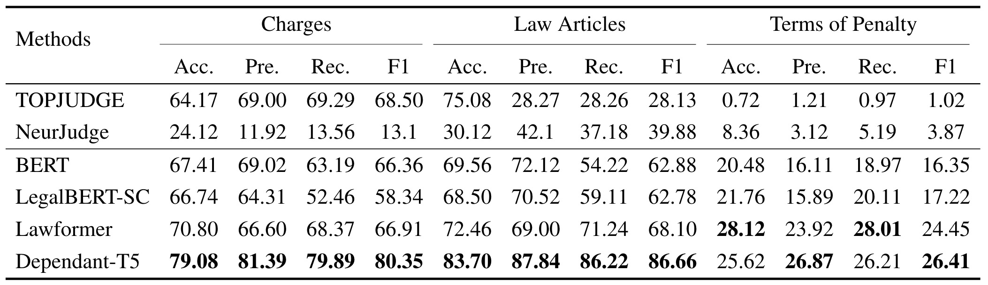
Experimental Results (cont.)
Table 4: Case-level results on CMDL-small reporting article-level laws.
Notes:
In this page, Table 4 shows the case-level results on CMDL-small with the article-level laws reported.

Slide 19
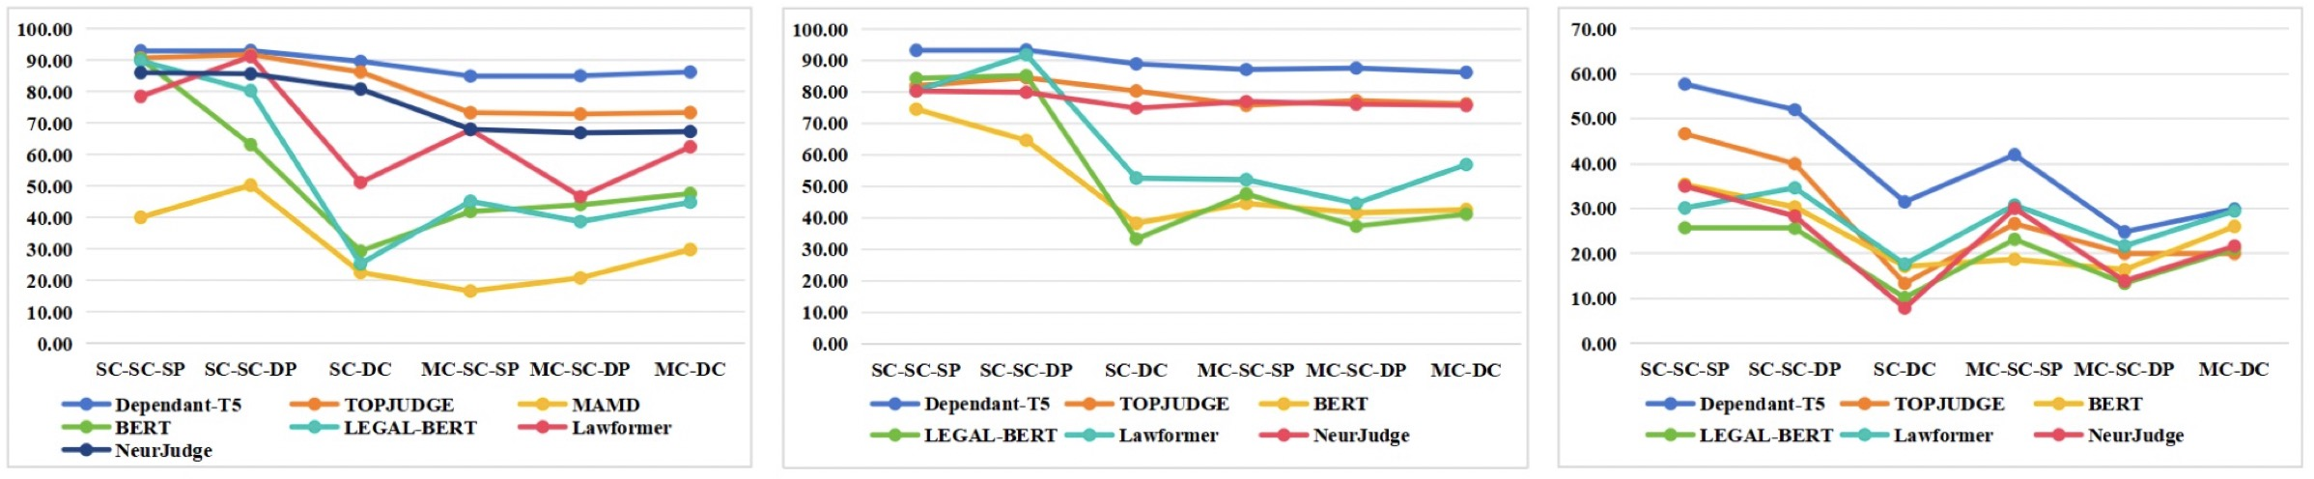
Experimental Results (cont.)
Figure 6: Reported F1 scores of judgment prediction results on different types of cases.
Notes:
We evaluate model performance on different types of cases. The results are shown in Figure 6.

Slide 20
Conclusions
Pre-trained models have a clear advantage in multi-defendant LJP.
Models struggle more with the prediction of finer-grained legal provision labels.
All models show unsatisfactory performance in terms of penalty predictions.
Predicting cases involving defendants with multiple charges is more challenging than those where all defendants only with a single charge (SC).
Predicting different penalties for defendants with the same charge is evidently more challenging.
Notes:
From the above experiments, the conclusions are:
Pretrained / legal-domain models (e.g., Lawformer, Dependant-T5) clearly outperform classical LJP models.
Paragraph-level law prediction is significantly harder than article-level and Models struggle more with the prediction of finer-grained legal provision labels
Penalty prediction remains weak across all models.

Slide 21
Strengths and Weaknesses
Strengths:
Large-scale
Rich, structured annotations
Case-level metrics that better reflect real multi-defendant difficulty
Automatic pipeline that make the dataset extendable
Weaknesses:
No end-to-end multi-defendant model is evaluated.
The evaluated baseline do not model legal interactions among defendants.

