Slide 1

Neural Machine Translation on IWSLT 2017:
A Systematic Study of Architectures, Tokenization, and Training Strategies
Group 98: Yilin Xu and Zhuo Han
Date: 2-Dec-2025
City University of Hong Kong
Notes:
“We built a unified NMT framework and ran a systematic study across architectures, tokenization, and training strategies. Our goal was not only to compare performance, but to understand why different choices matter.”

Slide 2
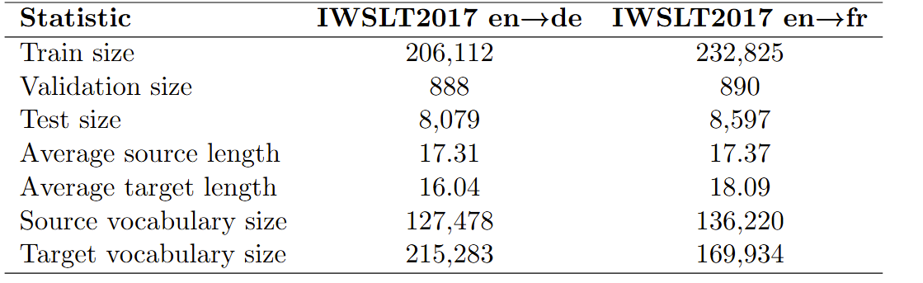
Task and Dataset
Main Task: English → German neural machine translation
Dataset: IWSLT 2017
Evaluation: BLEU + chrF, greedy & beam search
City University of Hong Kong
Notes:
“Our task is English→German translation on IWSLT17. The dataset is small enough to allow extensive controlled experiments. We evaluate with BLEU and chrF under both greedy and beam search.
As we all know, NMT performance depends not only on the model but also on tokenization, regularization, and training dynamics. So this is the most crucial start point for this project: We want to understand these effects systematically.”

Slide 3
Three Models plus Three Tokenizers
1
Three Models
GRU + Attention
LSTM + Attention
Transformer encoder–decoder
2
Three Tokenizers
White Space
character-level
sentencepiece (subword)
City University of Hong Kong
Notes:
“We implemented three encoder–decoder architectures in one framework:
GRU + attention
LSTM + attention
Transformer encoder–decoder
We also tested three fundamentally different tokenization strategies:
whitespace
character-level
sentencepiece
Altogether this gives us nine meaningful combinations, forming the core of our baseline study.”

Slide 4
Training Techniques
label smoothing: 0, 0.1, 0.2, 0.4
learning rate schedulers: Noam, ReduceLROnPlateau
warmup experiments: 1000, 1500, 2500
beam search vs greedy
random seeds (0, 42, 128, 512) & vocab variations (8K, 16K, 20K)
multilingual extension (En → De, En → Fr)
City University of Hong Kong
Notes:
“Beyond the base models, we explored several important training components:
label smoothing (0–0.4)
Noam learning rate schedule + warmup
greedy vs beam search
different size of vocabulary
different random seeds
and a simple multilingual extension with English→French
These are well-known MT techniques, but their impact at this scale is usually unclear. So we evaluate them carefully.”

Slide 5
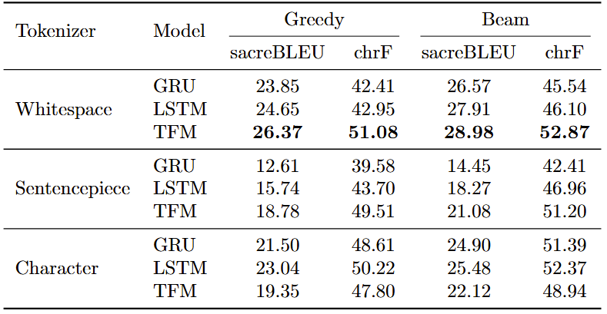
Key Results
Table I. Main results under different architectures and tokenization strategies
City University of Hong Kong
Notes:
First, tokenization affects performance more than the model architecture. Changing the tokenizer can shift BLEU by over 7 points, while GRU, LSTM, and Transformer differ by only around 1–2 points. Whitespace tends to be stable, sentencepiece sometimes performs well in chrF but not always in BLEU, and character-level suffers because sequences become extremely long.
Second, RNNs remain very strong on small datasets. On whitespace tokenization, Transformer achieves 28.98 BLEU with beam search, but LSTM reaches 27.91 and GRU 26.57. This reminds us that Transformers need larger datasets to fully outperform RNNs.

Slide 6
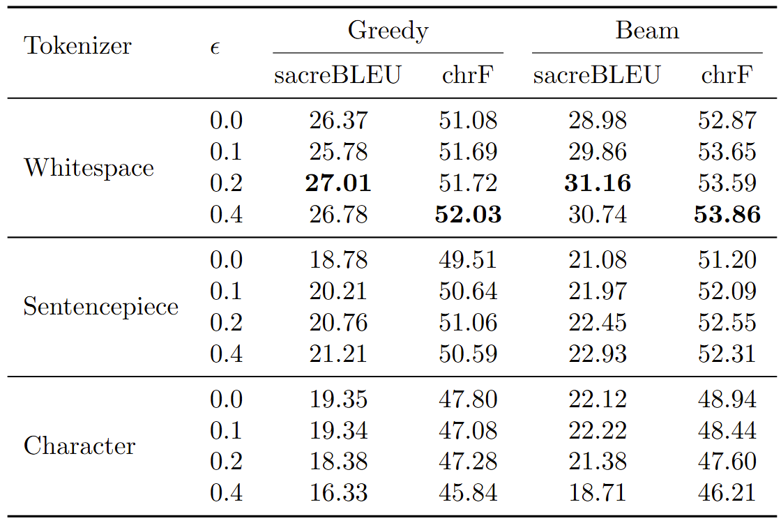
Key Results
Table 2. Effect of label smoothing
City University of Hong Kong
Notes:
Third, label smoothing has a clear sweet spot. For whitespace tokenization, 0.2 smoothing gives the best BLEU score of 31.16. But the effect depends heavily on tokenization: sentencepiece is less sensitive, and character-level models actually get worse with larger smoothing.

Slide 7
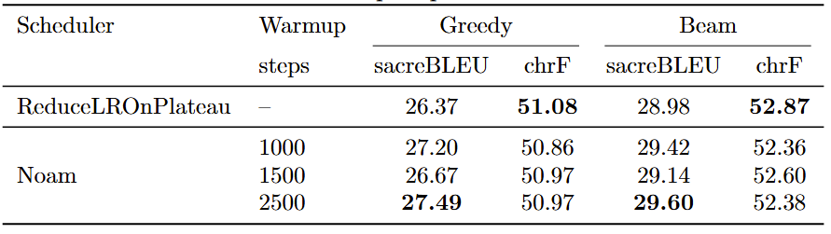
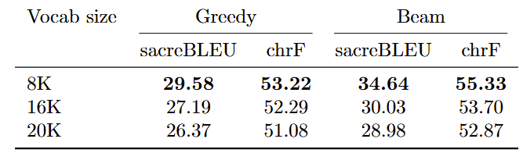
Key Results
Table 3. Effect of different learning rate scheduler
Table 4. Effect of vocabulary size
City University of Hong Kong
Notes:
Fourth, learning-rate scheduling is critical for Transformer training. Noam with the right warmup—around 2500 steps—outperforms ReduceLROnPlateau. If warmup is too small the model becomes unstable; if it’s too large learning slows down.
Fifth, vocabulary size matters a lot. Surprisingly, the smallest vocabulary (8K) performs best, achieving 34.64 BLEU, which is higher than 16K or 20K. Smaller vocabularies create more shared subwords and reduce sparsity, which is especially helpful in low-resource settings.

Slide 8
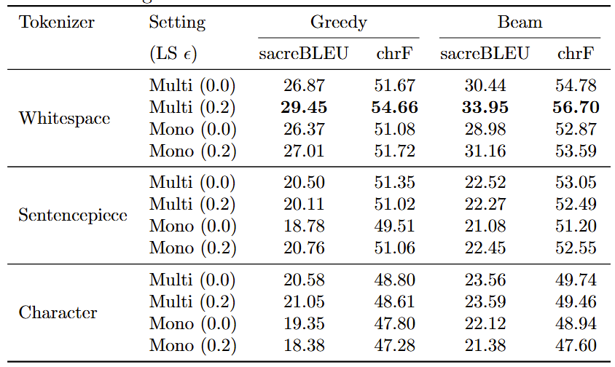
Key Results
Table 5. Multilingual training vs. Monolingual baselines
City University of Hong Kong
Notes:
Finally, multilingual training can provide positive transfer. Adding French–English data improves English→German performance, especially for whitespace tokenization. For example, BLEU goes from 31.16 in mono-lingual training to 33.95 in multilingual training. So even a small auxiliary language can help.”

Slide 9
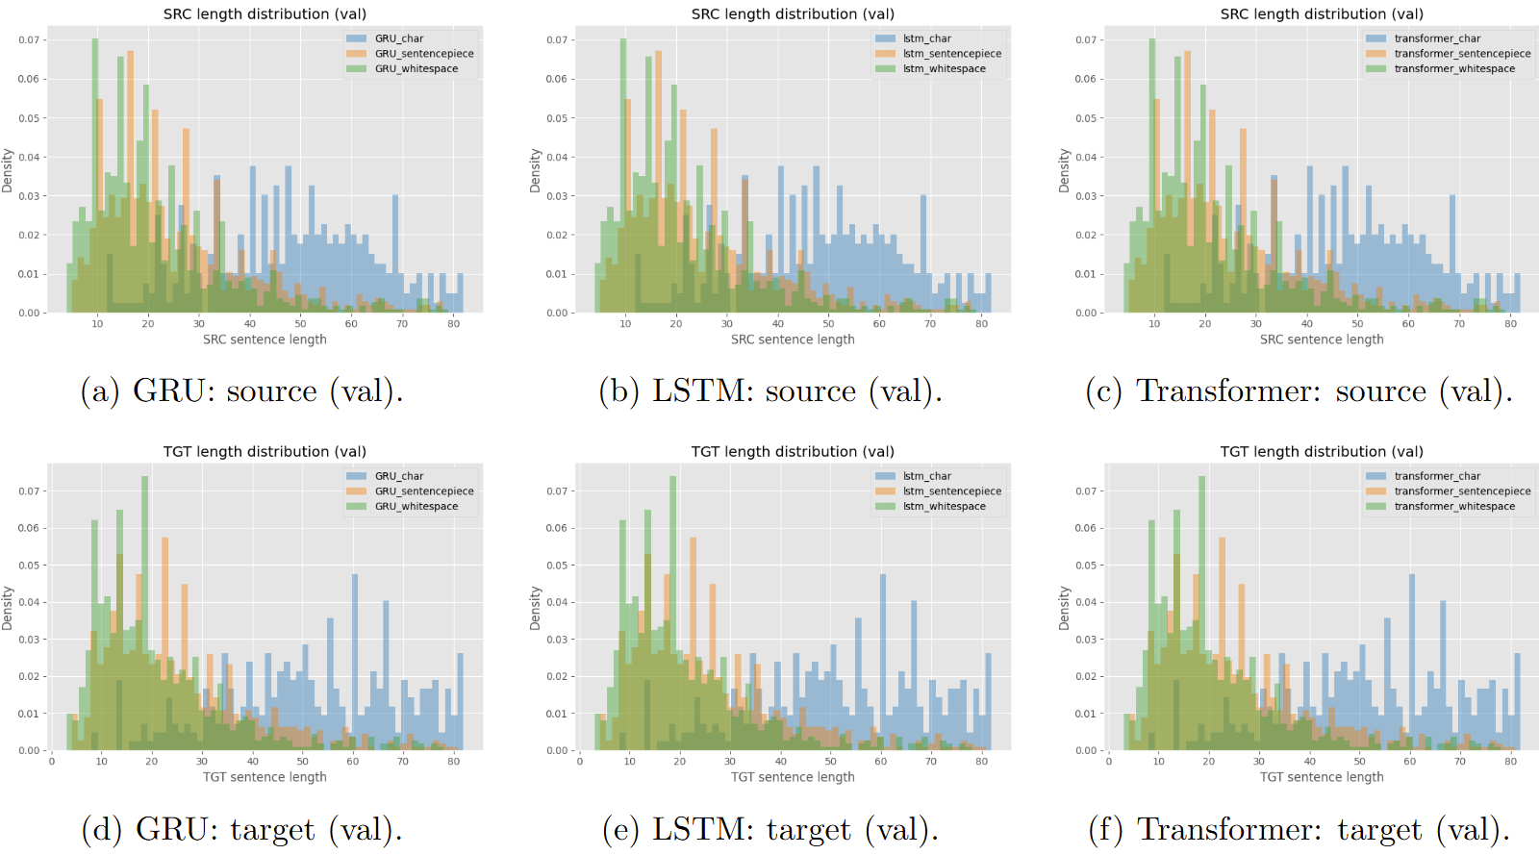
Visualization Insights
Figure 1. Sentence length distributions between different model structures.
City University of Hong Kong
Notes:
character-level tokenization consistently produces much longer sequences than whitespace or sentencepiece tokenization on both the source and target sides. In contrast, whitespace and sentencepiece concentrate on shorter lengths with similar overall shapes, while sentencepiece is typically slightly more compact than pure whitespace tokenization due to itsuse of reusable subword units.

Slide 10
Conclusion
Three key lessons:
Tokenization matters as much as the model architecture.
Training strategies like label smoothing and LR warmup have major impact.
Even simple RNN models can be strong at this scale.
Overall, our study shows that NMT performance depends on a combination of architecture, tokenization, and training dynamics—not just the model alone!
Thank you!
City University of Hong Kong
Notes:
“To conclude, our study shows that machine translation performance is shaped by many interacting components. In small datasets, tokenization, vocabulary size, label smoothing, and learning-rate schedules matter as much as the model itself.
The best overall performance comes from a well-tuned Transformer with an appropriate tokenizer and training strategy. But our results also highlight the surprising strength of RNNs and the value of multilingual training.
Overall, our study shows that NMT performance depends on a combination of architecture, tokenization, and training dynamics—not just the model alone!
Thank you.”

