Slide 1
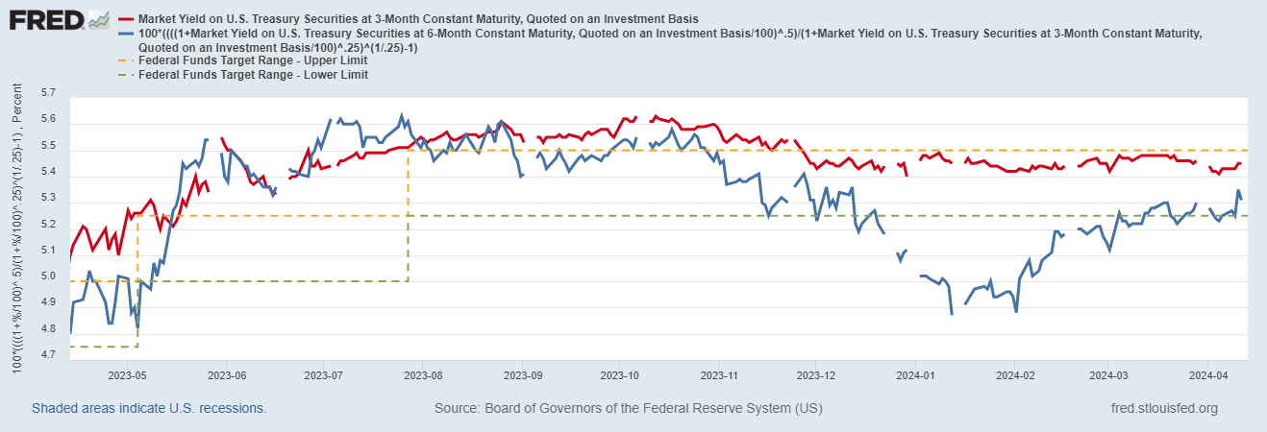
Fed Interest Rate: no-cut in 3M horizon

Slide 2
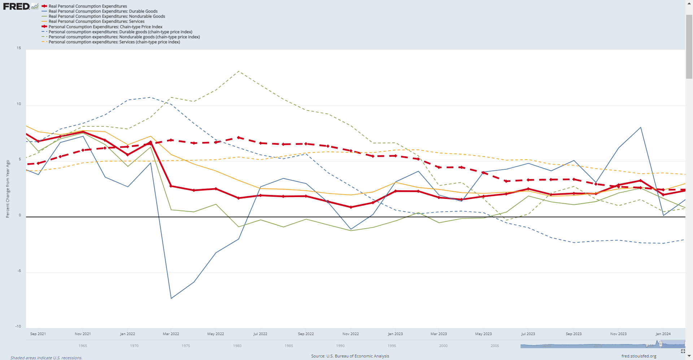
Consumer Spending: Real + Price
Real Spending: Durable:nonDur:Service:1:2:6.
PCE / PCE-service is growing at 2.4%. (what’s the health lvl?)
Wavering confidence as YoY durable-spending at or below non-durable-spending
durable spending is highly cyclical, but non-durable-spending is less cyclical
Price Index:
PCEPI / PCEPI-Service is decreasing steadily.
PCEPI-durable goods is deflating (like pre-pandemic)
PCEPI-non-durable goods can be fluctuate, driven mainly by O&G price

